Slide 1
Lesson 6
Rotaxanes, MIMs

Slide 2
[2]rotaxanes
Stoddart (switchable rotaxane) a Balzani/Stoddart (molecular elevator)

Slide 3
Il contributo dell’Italia
Science, 2004

Slide 4
Vincenzo Balzani ed Alberto Credi (Università di Bologna)
Biomotor molecules are extremely complex machines, the detailed structures and precise working mechanisms of which have been elucidated only in a very few cases (1, 2). Chemists are trying to construct much simpler molecular machines as a logical step toward mimicking the actions of biomotor molecules (3–5). In the past few years, several different kinds (6–14) of artificial molecular machines have been designed and constructed.
Here, we describe the incrementally staged design, bottom-up construction, characterization, and chemically driven operation of a two-component molecular machine that behaves like a nanometer-scale elevator.

Slide 5
The molecular elevator has its origin in the molecular shuttle, a degenerate two station [2]rotaxane.
The promise of this mechanically interlocked molecule (16) to act as the prototype for the construction of linear motors, based on highly controllable [2]rotaxanes, has been realized recently by redox (8, 11, 12), acid-base (8), and photochemical (11, 13) stimulations.

Slide 9
From pseudorotazane to rotaxane: introduction of the stopper

Slide 10
1-lo pseudorotaxano
The 'HNMR spectrum of 2-H.3PF6 at 20 "C shows signals corresponding to the formation of a [2]rotaxane.
The spectrum (Figure 1b) demonstrates that the DB24C8 ring binds selectively with the secondary dialkylammonium center, since the characteristic resonance at δ = 4.87-4.85 for the four CH, protons adjacent to the NH;group is observed. These protons experience a downfield shift of about A6 = 0.2 upon association with DB24C8:

Slide 11
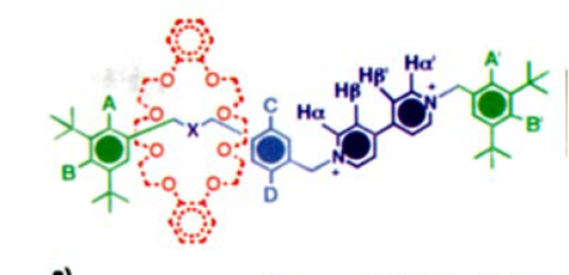
This selective binding was confirmed by one-dimensional 'H NMR NOE doubled-pulsed field-gradient spin-echo experimentsr"]-GOESY (gradient enhanced nuclear Overhauser effect spectroscopy)-carried out at 400 MHz at room temperature.
Selective irradiation of the protons (C) on the para-xylyl spacer closest to the NH2 center showed that, in addition to the expected intramolecular NOEs, intercomponent NOEs with some of the OCH, protons in the DB24C8 were observed

Slide 12

In order to establish that the [2]rotaxane 2-H. 3 PF, exists as a single translational isomer, a solution of 2-H.3PF6 in CD,COCD, was cooled down
to ~ 80 "C. Since no additional set of resonances could be detected, it may be concluded that the DB24C8 ring is bound to the NH: center with a selectivity of at least 98% in the temperature range between - 80 "C and + 31 "C.
VEDI LEZIONE 4 DOVE A BASSA T SI HA UNA DISTRIBUZIONE 80% SU BENZIDINE E 20% SU FENOLO

Slide 13
One reason for the synthesis of interlocked molecules, such as the [2]rotaxane 2-H. 3 PF, incorporating an NH: center and a bipyridinium unit, is to develop them as pH-sensitive or electrochemically driven molecular switches. Since we have established that the potentially mobile component of 2-H3+-that is the
DB24C8 ring-resides initially on the NH: station, it should be possible (Scheme 2) to deprotonate the NHZ center with base and "drive" the ring to the bipyridinium station.

