Slide 1
Lesson 7
MIMs

Slide 3
Synthesis by self-assembly

Slide 4
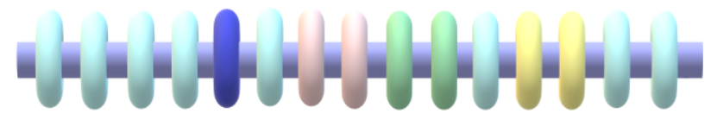
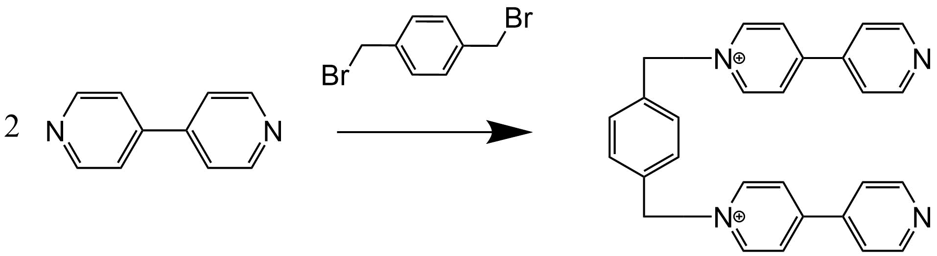
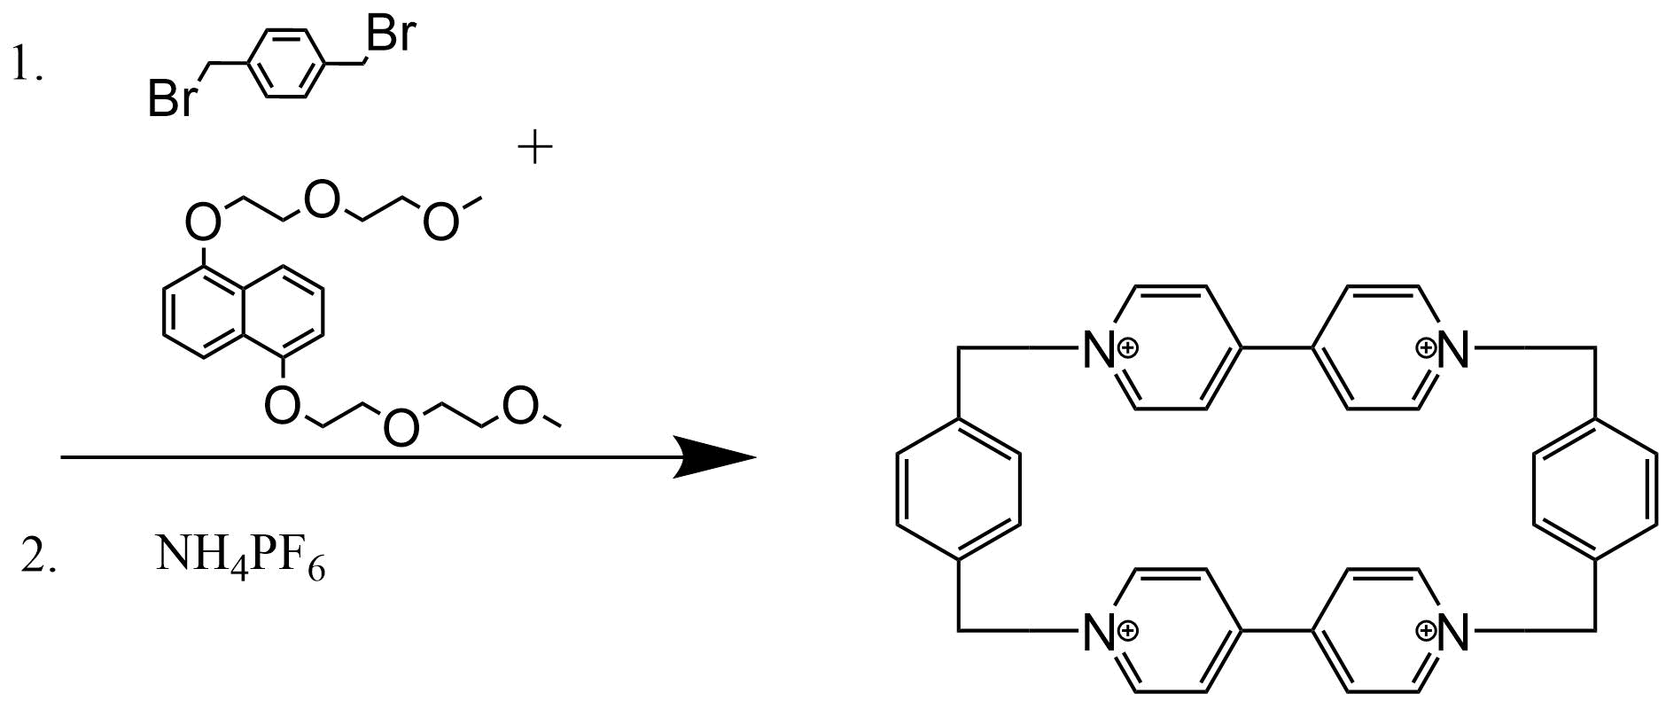
Il CBPQT⁴⁺
L’inventore del CBPQT⁴⁺ è J. Fraser Stoddart. È denominato anche «scatola blu di Stoddart» ed è un composto elettron-povero.
1,5-bis[2-(2metossietossi)etossi]naftfalene fa da templante per il secondo step della reazione.
L’anello tetra cationico viene poi complessato con 4 anioni esafluorofosfato ed il complesso è solubile in solventi organici (es. MeCN)

Slide 6
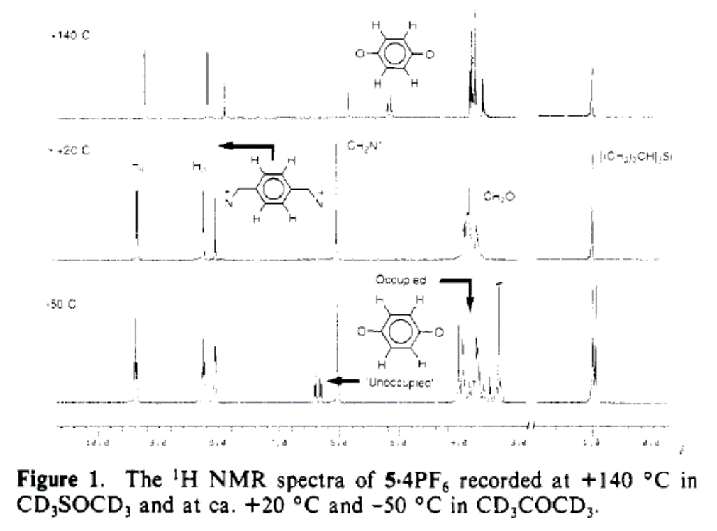

Slide 7
Nature, 1994

Slide 8
Introduction
The rotaxane structure resembles a bead trapped on a linear thread which is terminated by two bulky stopper groups. The bead can shuttle back and forth along the thread but cannot dissociate because of the presence of the terminal stoppers.
Recently, various methods have been developed that permit the template-directed synthesis of rotaxanes in yields much higher than those obtained from the former undirected, statistical methods.
In the rotaxane (Fig. 1A) that we describe here, the dumb-bell component contains two different π-electron donor stations, and the bead is a π-electron-accepting tetracationic cyclophane comprising two bipyridinium units bridged by two p-xylyl spacers. The dumb-bell component consists of biphenol and benzidine units (as π-electron donors) inserted within a polyether chain terminated by stoppers in the form of tri-isopropylsilyl groups.
The [2]-rotaxane 1·[PF6] 4 was obtained in 19% yield in the final assembly step, using a method similar to that already reported for the template-directed synthesis of rotaxanes.

Slide 9
The two positions at equilibrium!!

Slide 10
NMR at room temperature
At room temperature, the bead moves back and forth along the thread at a rate comparable to the NMR timescale.
This leads to the extreme broadening of many NMR signals for l·[PF 6]4 in CD3CN solution, and precludes the detailed assessment of preferred bead location in the [2]-rotaxane under these conditions.

Slide 11
NMR at low temperature
But on cooling this solution to 229 K, we were able to observe (Fig. 2A) distinct signals from two translational isomers, corresponding to the occupation by the macrocyclic bead of the benzidine and biphenol stations.

Slide 12
The relative proportions (Fig. 2A) of the two translational isomers were obtained from the integration of the respective 'H NMR resonances and correspond to 84'% occupation of the benzidine station and 16'% occupation of the biphenol station (at 229 K).
The preferential occupation of the benzidine station was anticipated from previous binding studies which demonstrated that the binding affinity of the cyclophanc for a model benzidine derivative is -10 times greater than that for the corresponding biphenol derivative.

Slide 13
The average position of the bead can be switched over to the biphenol domain of the thread either by protonation of the basic nitrogens of the benzidine residue or by electrochemical oxidation of this station (Fig. 1B). Both of these means of control over the shuttling process rely on the repulsive electrostatic interactions between the positively charged bead and the post-switching cationic nature of the benzidine station.

Slide 14
Addition of excess deuterated trifluoroacetic acid (TFA-d 1) to the solution of l·[PF 6]4 in CD3CN results in large changes in the NMR spectrum (Fig. 2B). First, only resonances from one translational isomer can be detected, which considerably simplifies the spectrum.

Slide 15
Neutralization of the added TFA-d, with pyridine-d5 essentially regenerates the spectrum (Fig. 2C) obtained before acid addition.

Slide 16
The conclusions obtained from the 'H NMR spectroscopic studies are supported by room-temperature ultraviolet/visible spectroscopy.
We have shown previously that a benzidine derivative forms a green charge-transfer complex with the cyclophane (λ-max = 690 nm), whereas the analogous biphenol species produces a red complex (λmax =480 nm).
At room temperature, the molecular shuttle investigated here exhibits both charge transfer bands (Fig. 3), indicating that the two stations are partially occupied, but on addition of excess TFA, the band centred at 690 nm disappears.

Slide 19
Previously, we have described (8, 18) the acid-base switching (Fig. 1B) of the [2]rotaxane [1H]3 composed of a dumbbell-shaped component containing two different stations, namely, a dialkylammonium (–NH2 –) center and a bipyridinium (BIPY2) unit, encircled by a dibenzo[24]crown-8 (DB24C8) ring component.
We demonstrated, with the use of a variety of techniques, that in both acetone and acetonitrile the DB24C8 ring resides almost exclusively around the –NH2 – center in one of the two possible translationally isomeric forms. X-ray crystallography has revealed (19) that this preference results from a combination of strong [N–H……O] hydrogen bonding and weak [C–H……O] interactions, augmented more often than not with some stabilizing [π−π] stacking forces.
On addition of a base (a tertiary amine) to a solution of [1H]3, deprotonation of the –NH2 – center occurs. The strong intercomponent hydrogen bonding is destroyed, and the DB24C8 ring moves to the BIPY2 unit, where it is stabilized by [C–H…O] and [π−π] stacking interactions. Subsequent addition of acid restores the –NH2– center, and the DB24C8 ring moves back to encircle this recognition site.

Slide 20
In pursuit of a better fundamental understanding of the nature of multivalency (20) in polytopic hosts and guests, we investigated (21) the acid-base–controlled (Fig. 1C) assembly and disassembly of a triply threaded two-component superbundle.
This 1:1 adduct consists of a tritopic host 2, in which three DB24C8 rings are fused together within a triphenylene core, and a trifurcated guest trication [3H3]3 wherein three dibenzylammonium ions are linked to a central benzenoid core.

Slide 21
Fluorescence titration experiments (including Job plots), as well as electrochemical and 1H NMR spectroscopic data, have established the remarkable strength of the superbundle encompassing the triply expressed binding motif revealed by x-ray crystallography in the solid state (V. Balzani et al., Chem. Eur. J. 9, 5348 (2003)).
In acetonitrile solution, the dethreading and rethreading of the 1:1 adduct can be controlled by addition of base and acid.

Slide 22
The synthesis (template-directed)
It was synthesized with the
use of a template-directed protocol (22) from
the trifurcated guest salt [4H3][PF6]6 and the
tritopic host 2, which form a 1:1 adduct
(superbundle) that can be converted into a
mechanically interlocked elevator [5H3]9
by functionalization of the ends of each
leg with bulky 3,5-di-tert-butylbenzyl feet

Slide 23
The NMR
The 1H NMR spectrum (Fig. 3A) of
[5H3][PF6]9 in CD3CN exhibits a complex
array of resonances corresponding to a triply threaded, mechanically interlocked
molecule with averaged C3v symmetry.
Characteristic (18) downfield shifts of the methylene proton resonances next to the –NH2 – centers indicate the preferred binding of the platform’s three crown ether loops with the three –NH2
– centers in the legs of the rig.

Slide 24
No additional proton resonances were obtained in the 1H NMR spectrum
when a CD3COCD3 solution of [5H3][PF6]9 was cooled down to – 80°C.
These observations confirm that [5H3]9 exists in the co-conformation shown in Fig. 3D.

Slide 25
Addition of a strong, nonnucleophilic
phosphazene base to a solution of the elevator in CD3CN caused dramatic changes
in the 1H NMR spectrum, particularly in
the chemical shifts of the BIPY2 and p-xylyl
methylene protons, demonstrating
that the three crown ether loops on the
platform are now associated with the three
BIPY2 recognition sites.
The original 1H NMR spectrum was regenerated
in every detail on addition of a slight excess
of trifluoroacetic acid to the NMR sample
treated with the base; i.e., the elevator goes
back completely to the upper level.

Slide 26
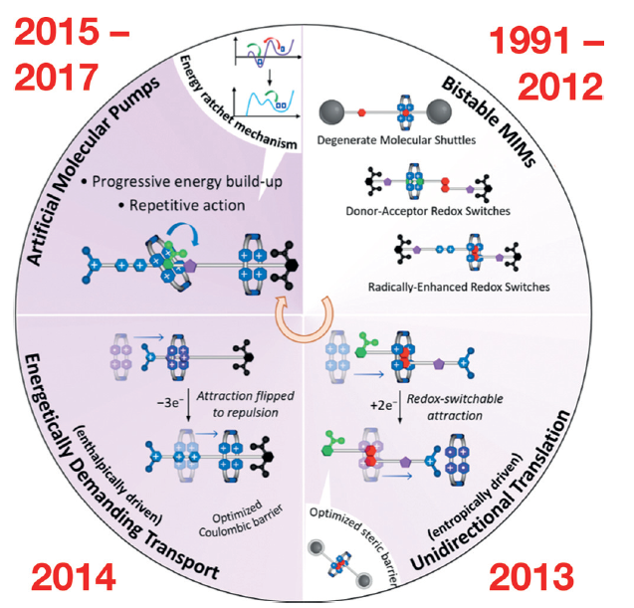
Mechanically Interlocked Machines (MIMs)
J. Faser Stoddart - Angew. Chem. Int. Ed. 2017, 56, 11094 – 11125

Slide 27
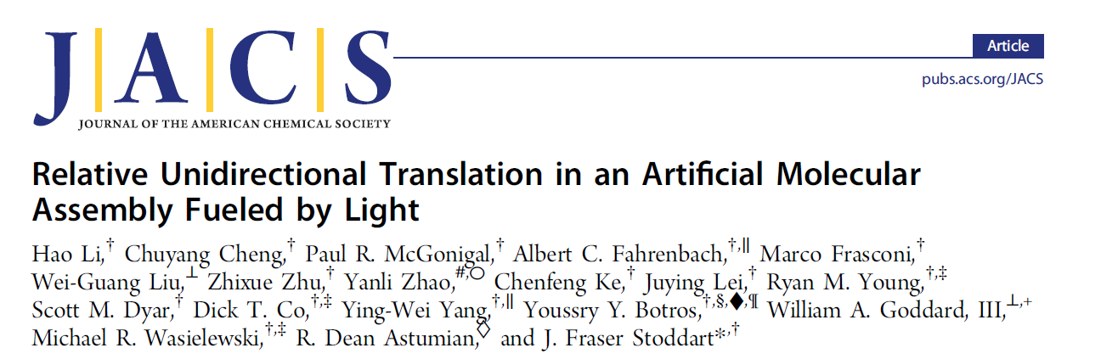
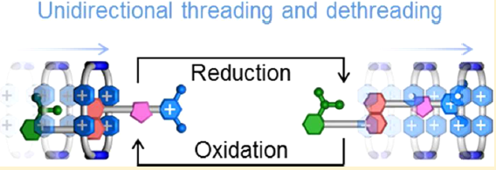
Presentazione di: Lorenzo Marradi
«Metodologie moderne di sintesi organica e organometallica»
CdL magistrale in «Scienze e tecnologie chimiche»
Università degli studi di Milano-Bicocca
2019/2020

Slide 28
Graphical representation of a [2]pseudorotaxane pump with structural formulas and simplified potential energy diagrams of a flashing ratchet.
(a) Structural formulas of the CBPQT4+ ring and asymmetric dumbbell D1+. Charges are balanced by hexafluorophosphate (PF6
−) counterions, which
are omitted for the sake of clarity. (b) Graphical representation of the operation of [2]pseudorotaxane D1+⊂CBPQT4+ in which the ring passes over a
sterically bulky group (green) to reach an electron-rich binding site (red) under oxidative conditions before dethreading by passing over the positively
charged end group (blue) when reduced. (c) A Brownian particle (blue sphere) under the influence of a potential energy surface moves to the lowest
energy state (red trough) by passing over the lowest kinetic energy barrier (green peak). Simultaneously raising the potential energy well (red trough) so
that it is no longer the minimum-energy state and reversing the relative heights of the energy barriers (green and blue peaks) causes the particle to
continue. Flip-flopping between the two oxidized and reduced states (b) of pseudorotaxane D1+⊂CBPQT4+, with potential energy surfaces that
qualitatively resemble those shown in panel c, creates directional and repetitive motion of the ring relative to the dumbbell.

Slide 29
Le macchine molecolari «naturali» devono operare in modo direzionale, contro il principio di reversibilità microscopica
motor molecules (MMs) are vital components that are required to drive biological systems away from thermal equilibrium and, in so doing, provide the impetus for all manner of important tasks, such as (i) ATP synthesis,2 (ii) the transport of cellular cargo,3 (iii) muscle contraction,4 (iv) cellular locomotion,5 and (v) the active transport of sugars,6 protons,7 or other ions8 acrossmembranes. All of these processes occur on the nanoscale and are dominated by nonstop Brownian motion9 caused by random collisions between molecules.
Rather than attempting to overcome this directionless energy, which is essentially thermal noise, nature’s MMs employ stochastic ratchet mechanisms to convert this noise into useful work.
Such “Brownian ratchets” create a net flux of particles in one direction by linking the oscillation between asymmetric potential energy surfaces raising and lowering activation barriers and energy wells (e.g., Figure 1) to the depletion of an external energy source.
In this manner, the consumption of fuel (e.g., the hydrolysis of ATP or the dissipation of absorbed photons of light as heat) provides the means necessary to overcome the limitations imposed by the principle of microscopic reversibility and maintains a nonequilibrium state in which useful work is performed

Slide 30
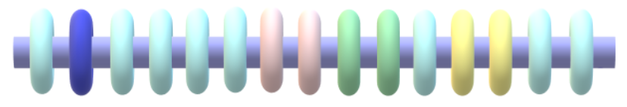
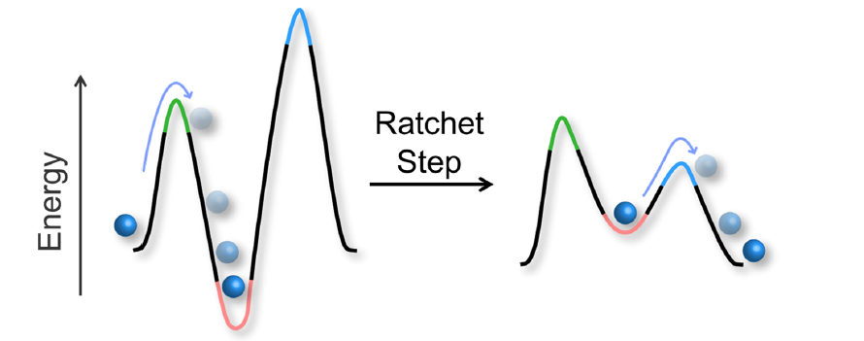
Principio di funzionamento
Il [2]pseudorotaxano in oggetto lavora come un «Brownian flashing ratchet»
Grazie all’energia di uno stimolo esterno versatile (luce o elettricità) è possibile alzare o abbassare due barriere cinetiche di attivazione così come un minimo di energia per spingere il sistema fuori dall’equilibrio e estrarne lavoro utile. In questo modo si supera il principio di microreversibilità.
Questo principio di meccanismo è alla base di molti processi biologici quali trasporto di ioni (es. pompa sodio-potassio), di H+ e di zuccheri.

Slide 31
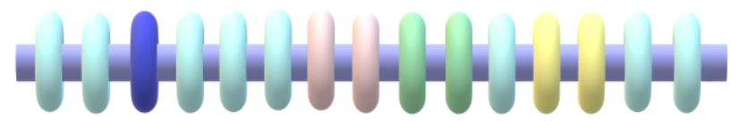
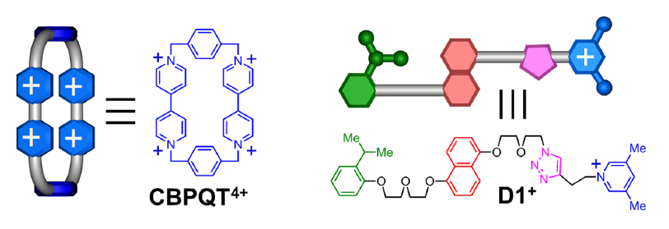
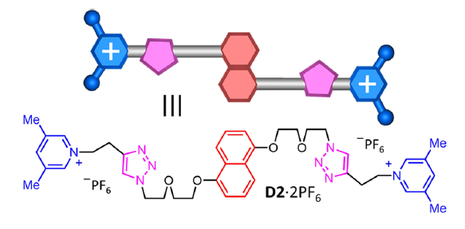
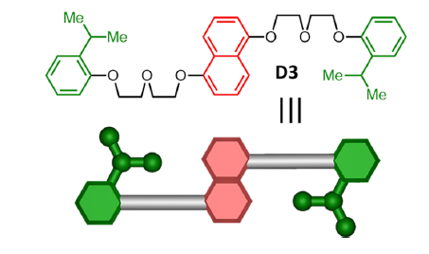
I protagonisti del [2]pseudorotaxano
CBPQT⁴⁺ : ciclobis(paraquat-p-fenilene)

Slide 32
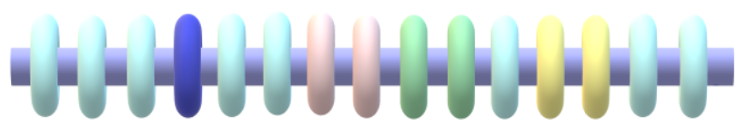
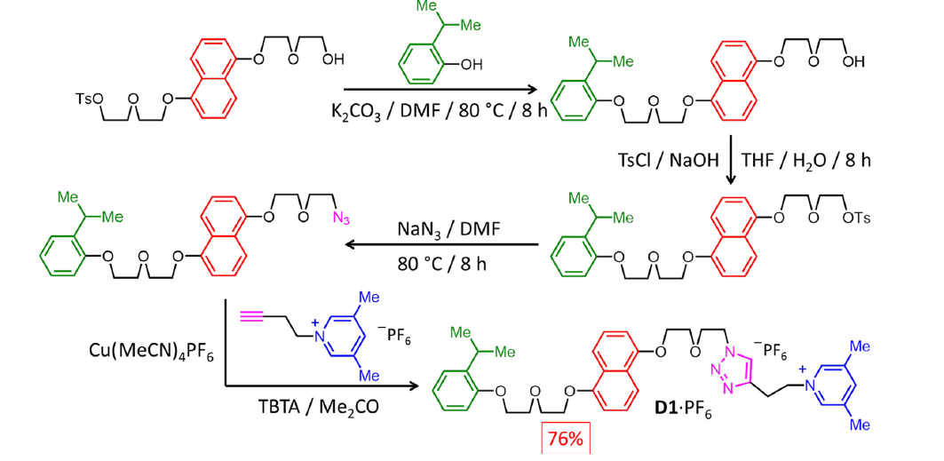
Sintesi (1) : D1·PF₆

Slide 33
Sintesi (2) : CBPQT⁴⁺
L’inventore del CBPQT⁴⁺ è J. Fraser Stoddart. È denominato anche «scatola blu di Stoddart» ed è un composto elettron-povero.
1,5-bis[2-(2metossietossi)etossi]naftfalene fa da templante per il secondo step della reazione.
L’anello tetra cationico viene poi complessato con 4 anioni esafluorofosfato ed il complesso è solubile in solventi organici (es. MeCN)

Slide 34
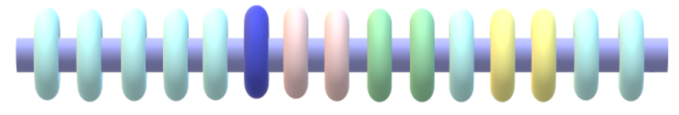
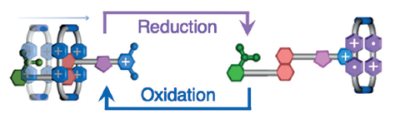
Strategia di analisi
La riduzione CBPQT⁴⁺ → CBPQT^{2(•+)} viene eseguita con un agente eterogeneo: polvere di Zn.
L’ossidazione CBPQT^{2(•+)} → CBPQT⁴⁺ viene eseguita all’aria grazie ad O₂
L’analisi è stata suddivisa in tre parti:
Analisi in condizioni ossidative
Analisi in condizioni riduttive
Analisi del processo stimolato dalla luce

Slide 35
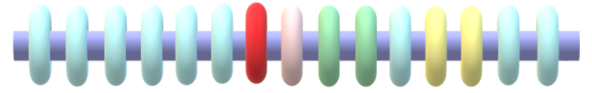
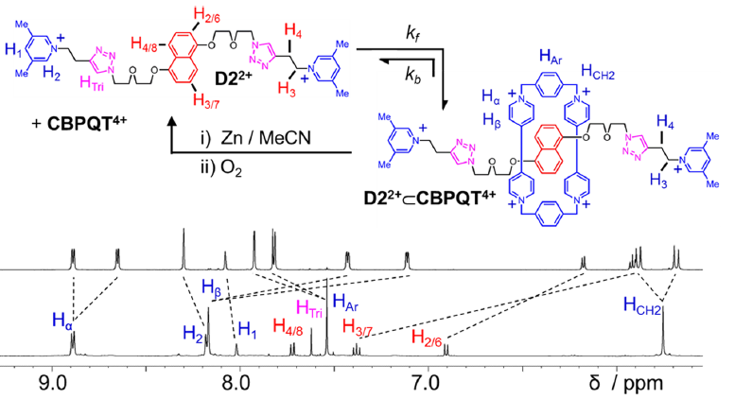
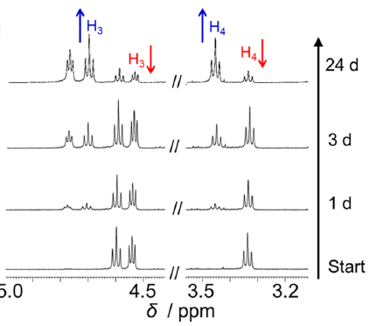

Analisi in condizioni ossidative (1): ¹H-NMR
Vengono investigate le barriere cinetiche di threading e dethreading del complesso simmetrico D2²⁺ ⊂ CBPQT⁴⁺
L’associazione e la dissociazione con l’anello ossidato avvengono molto lentamente (qualche settimana). A destra la cinetica di associazione del complesso registrata tramite integrazione dei picchi permette di ottenere il valore delle costanti di velocità e energie di attivazione dei due processi.
$$k_{threading}=1.0×{10}^{−4} L{mol}^{−1}s^{−1}$$
$$k_{dethreading}=1.0×{10}^{−4}L{mol}^{−1}s^{−1}$$
$$∆G_{threading}^{‡}=22.9 kcal mol^{−1}$$
$$∆G_{dethreading}^{‡}=25.9 kcal mol^{−1}$$

Slide 36
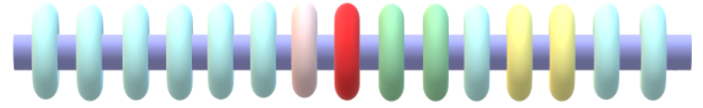
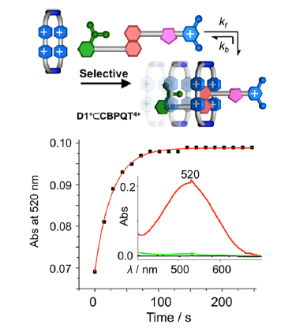
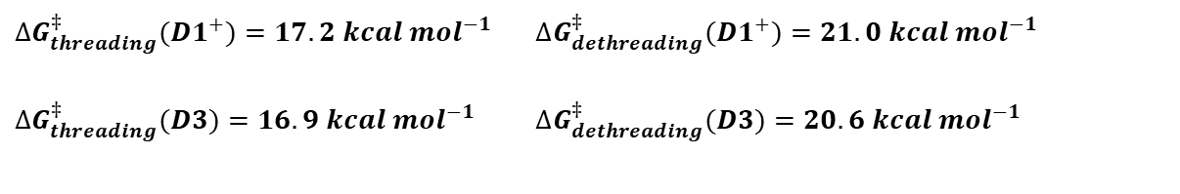
Analisi in condizioni ossidative (1): UV-Vis
Le barriere di attivazione dei complessi D3⊂ CBPQT⁴⁺ e D1⁺⊂ CBPQT⁴⁺ si deducono da studi con spettroscopia UV-Vis. Si registra il picco di assorbimento a 520 nm, legato ad una transizione a trasferimento di carica quando CBPQT⁴⁺ interagisce con DNP.
$∆G_{threading}^{‡}(D1^{+})=17.2 kcal mol^{−1}$ $∆G_{dethreading}^{‡}(D1^{+})=21.0 kcal mol^{−1}$
$∆G_{threading}^{‡}(D3)=16.9 kcal mol^{−1}$ $∆G_{dethreading}^{‡}(D3)=20.6 kcal mol^{−1}$
La velocità con cui l’anello si infila dalla parte del terminale 2-isopropilfenilico è almeno 4 ordini di grandezza maggiore rispetto al threading attraverso il terminale 2,5-dimetilpiridinio.
Si conclude che nel complesso D1⁺⊂ CBPQT⁴⁺ il threading avviene attraverso il isopropilfenile, stericamente ingombrato ma neutro.

Slide 37
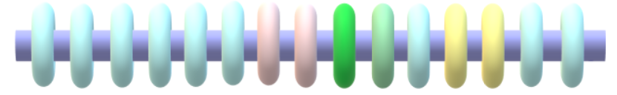
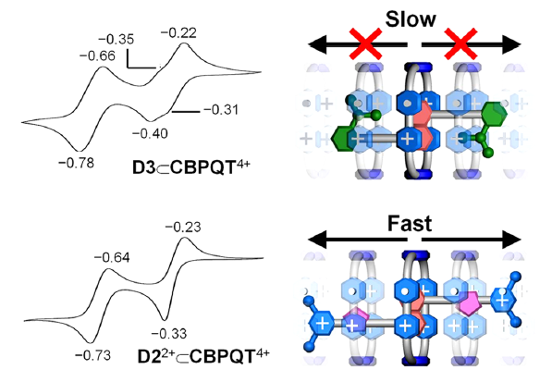
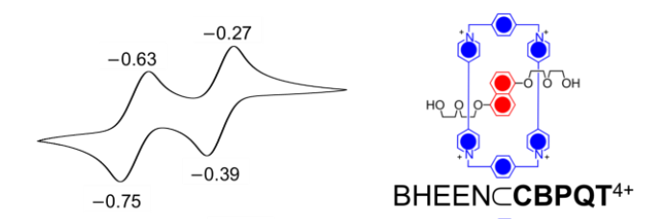
Analisi in condizioni riduttive (1): CV
Per valutare le velocità di dissociazione del complesso in condizioni riduttive è stata applicata la ciclovoltammetria con esperimenti eseguiti su tutti e tre i complessi e su un complesso senza terminali (BHEEN⊂CBPQT⁴⁺)
I due picchi a -0.40 V e -0.31 V sono assegnati alle due riduzioni ad un elettrone: CBPQT⁽⁴⁺⁾/CBPQT^{(2+)(•+)} e CBPQT^{(2+)(•+)}/ CBPQT^{2(•+)} . Dopo la prima riduzione il terminale isopropilfenilico rallenta la dissociazione e una delle due unità BIPY²⁺ continua ad interagire con l’unità DNP.
C’è solo un picco di riduzione bielettronico CBPQT⁽⁴⁺⁾/ CBPQT^{2(•+)}. Il terminale dimetilpiridinio permette all’anello dissocia immediatamente e la seconda riduzione avviene allo stesso voltaggio.
Per un asse senza gruppi terminali il comportamento è analogo al complesso D2²⁺ ⊂ CBPQT⁴⁺ .

Slide 38
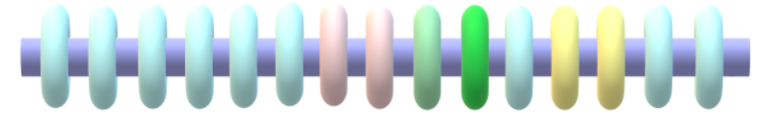
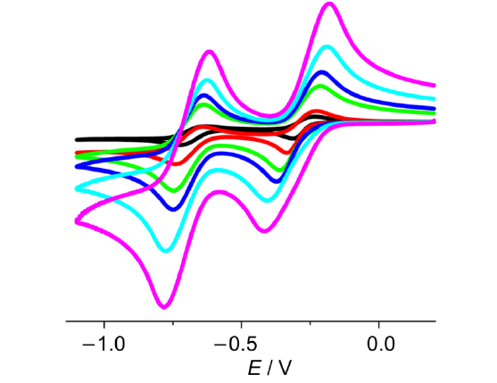
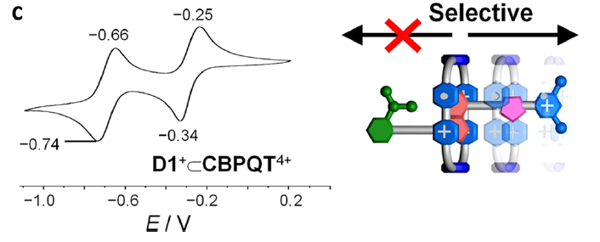
Analisi in condizioni riduttive (2): CV
Aumentando la velocità di scansione da 250 mV/s fino a 5000 mV/s per il complesso D2²⁺ ⊂ CBPQT⁴⁺ si mantiene la riduzione bielettronica indicando che la dissociazione avviene rapidamente in tempi di millisecondi.
Il voltagramma ciclico per il complesso D1⁺⊂ CBPQT⁴⁺ è analogo a quello del complesso D2²⁺ ⊂ CBPQT⁴⁺.
Si conclude che dopo riduzione di D1⁺⊂ CBPQT⁴⁺ il [2]pseudorotaxano va incontro ad una rapida dissociazione meccanostereoselettiva con l’anello che passa attraverso il terminale 3,5-dimetilpiridinio.

Slide 39
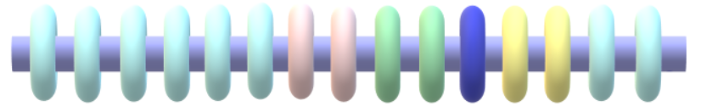
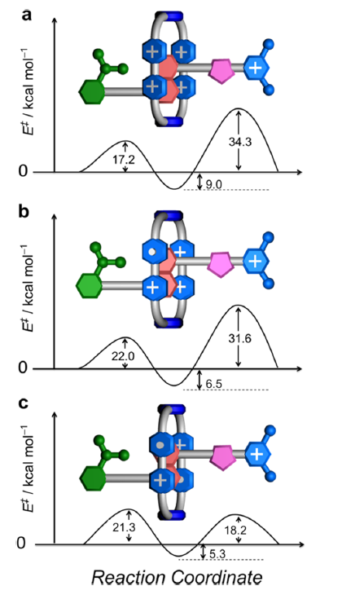
Calcoli computazionali DFT
I calcoli DFT dal punto di vista quantitativo non sono in pieno accordo con i dati sperimentali: sovrastimate le barriere energetiche del passaggio attraverso il gruppo carico perché non è considerata la presenza dei controioni PF₆⁻.
Permettono di dimostrare il trend qualitativo:
La barriera energetica del passaggio attraverso il gruppo isopropilfenile non dipende dallo stato di ossidazione dell’anello CBPQT
Le barriere energetiche del passaggio attraverso il gruppo 3,5-dimetilpiridinio diminuiscono significativamente al diminuire dello stato di ossidazione (riduzione).

Slide 40
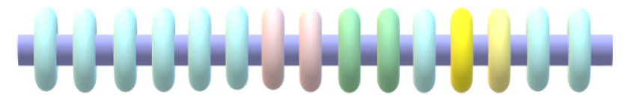
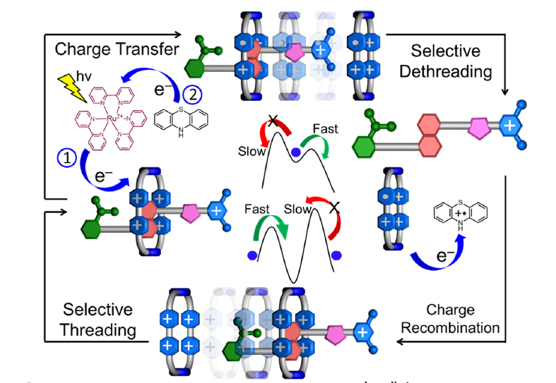
Switching stimolato da luce
Impulso di luce a 450 nm
Ru(bpy)₃²⁺ : fotosensibilizzatore
Riduzione monoelettronica dell’anello
Fenotiazina (ptz)
Ptz(•+) permette di riossidare l’anello una volta che si è sfilato

Slide 41
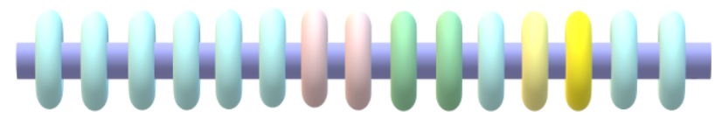
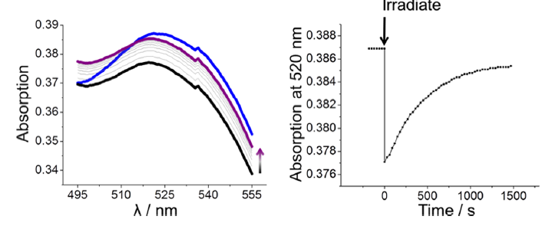
Switching stimolato da luce: analisi UV-Vis
Per il complesso D1⁺⊂ CBPQT⁴⁺ si misura l’assorbanza a 520 nm dovuta alla transizione a trasferimento di carica tra CBPQT⁴⁺ e DNP dopo irraggiamento con laser a 450 nm per 5 min.
Da misure di UV-Vis e ¹H-NMR si osserva che l’effetto di dissociazione e riassociazione si ha solo quando entrambe le specie Ru(bpy)₃²⁺ e ptz sono presenti in soluzione.
Dopo irraggaimento si ha netto calo dell’assorbanza che nell’arco di 30 min torna ai valori originali.
Si conclude che è possibile indurre un trasporto unidirezionale del complesso D1⁺⊂ CBPQT⁴⁺ stimolato da luce, che attiva un processo redox.

Slide 42
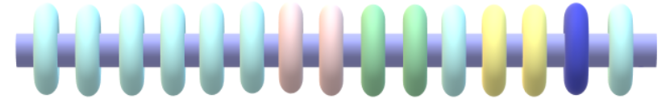
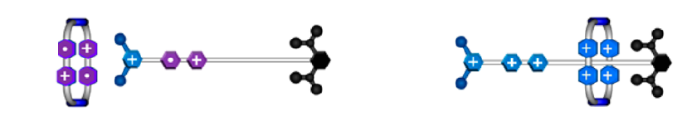
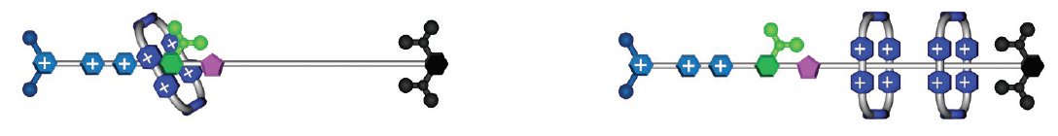
Passi successivi
2014
“Energetically Demanding Transport in a Supramolecular Assembly”
2017
“ An efficient artificial molecular pump “
(1): “Energetically demanding transport in a supramolecular assembly” . Cheng, P. R. McGonigal, W.-G. Liu, N. A. Vermeulen, C. Ke, M. Frasconi, C. L. Stern, W. A. Goddard III, J. F. Stoddart, J.Am. Chem. Soc. 2014, 136, 14702–14705. (2): “An efficient artificial molecular pump”: C. Pezzato, M. T. Nguyen, C. Cheng, M. T. Otley, D. J. Kim, J. F. Stoddart, Tetrahedron 2017, 73, 4849–4857

Slide 43
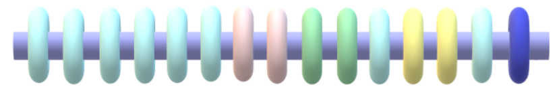
Conclusioni
Col sistema studiato si è dimostrato di poter operare una traslazione unidirezionale sotto stimolo esterno (redox, luce) portando il sistema fuori dall’equilibrio e capace di ripetere il meccanismo idealmente all’infinito.
Problema: Il sistema non opera lavoro!
I sistemi successivi sono in grado di operare come i sistemi di trasporto attivo in natura (carriers, trasporto di ioni..). Sono capaci sotto input energetico di operare lavoro, funzionano contro gradiente locale di concentrazione e isolano sistemi fuori dall’equilibrio a più alta energia. Tutto ciò operando cicli ripetitivamente.
Non ci sono ancora applicazioni reali
It is too early to speak in an authoritative and informed manner about what will be the killer applications of AMMs. We are at the very early stages of knowing how to build them let alone use them. [….]
As far as MIMs and AMMs are concerned, they await the engagement of the next generation of chemists eager to exploit the nature of the mechanical bond in chemistry, while taking up the task of designing and synthesizing MIMs and putting them to good use
J. Faser Stoddart

