Slide 1
Lesson 5
Rotaxanes, Mechanically Interlocked Molecules, molecular machines

Slide 2
I rotaxani e le macchine molecolari
The history of isomeric types of organic molecules has passed
through several important stages:
(1) Molecules that differ from each other with different numbers and types of atoms;
(2) constitutional isomers with typical sequence and nature of bonding between these atoms;
(3) stereoisomers that are distinguished by the spatial arrangement around an atom or center; and
(4) topological isomers with distinct topological geometries. It is the last form of isomerism that leads to Mechanically Interlocked Molecules (MIMs), such as catenanes, rotaxanes, and knots, which gain their inspiration from various natural objects and architectures

Slide 3
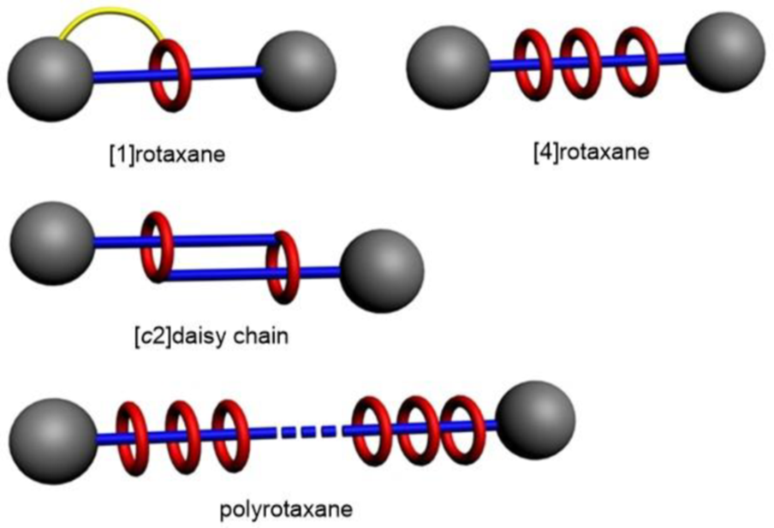
Mechanically Interlocked Molecules:the rotaxanes
[2]

Slide 4
Processi meccano-stereoselettivi

Slide 5
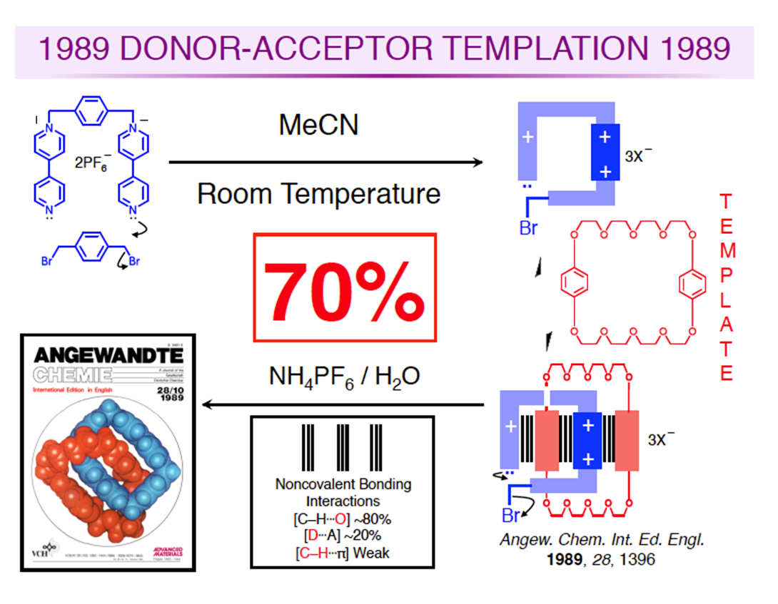
The synthesis: statistical threading and template methods
The statistical threading method (Scheme 1) was originally introduced by Harrison and co-workers in 1967. The formation of pseudorotaxanes and rotaxanes by this method is based on a purely statistical progress without any apparent attractive force between the linear species and the cyclic molecules. In the course of the past 30 years, rotaxanes have been easily accessed via template methods derived from π−π stacking interactions, hydrogen bonding, hydrophobic interactions, metal ion coordination, and anion templates

Slide 6
Different types of rotaxanes (and nomenclature)
Macchine molecolari

Slide 7
L’anello è un macrociclo HOST da crown ether a calixarene a CB

Slide 8
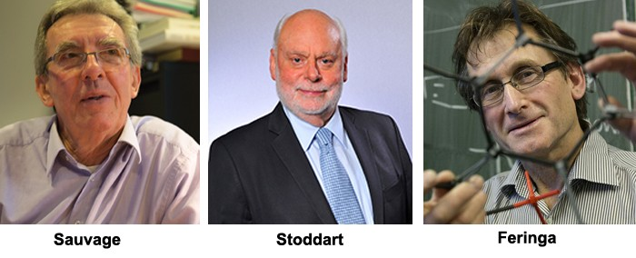
Sauvage Stoddart and Feringa (Nobel prize in 2016)
Interlocked molecules, Molecular machines, self-assembling systems

Slide 9
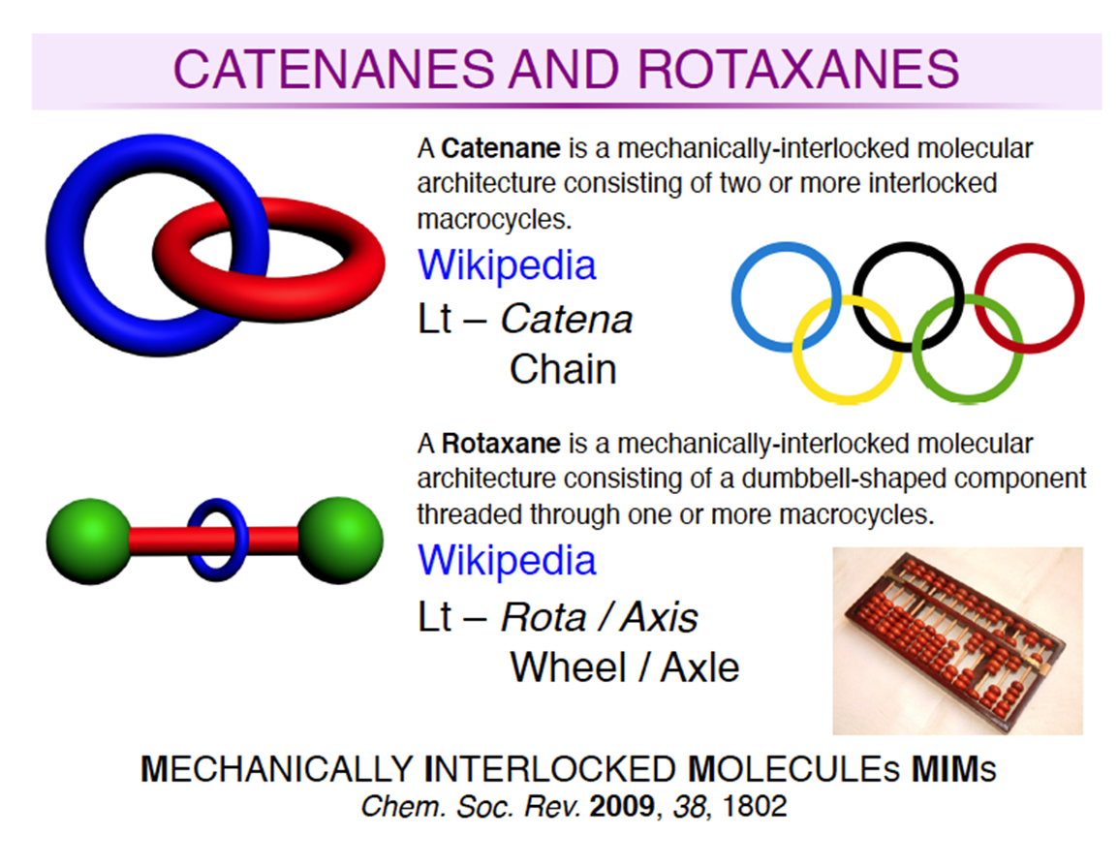
Molecole legate attraverso un «legame meccanico»
Stoddart
La molecola del catenano o del rotaxano è tenuta insieme non da legami covalenti ma da legami meccanici (le molecole sono letteralmente incastrate una nell’altra)

Slide 10
F. Stoddart, 1989

Slide 11
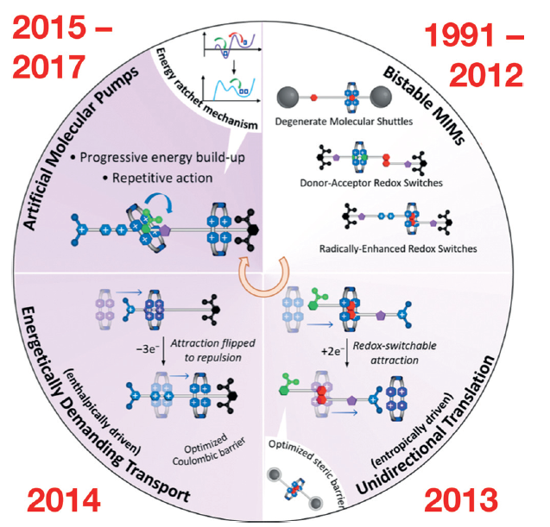
Mechanically Interlocked Machines (MIMs)
J. Faser Stoddart - Angew. Chem. Int. Ed. 2017, 56, 11094 – 11125

Slide 12
The complexation between paraquat and crown ethers
One particular interest in this research area came from the complexation between paraquat derivatives and bisarylene crown ethers reported by Stoddart and his co-workers in 1987, which have resulted in a variety of interlocked supramolecular assemblies, such as pseudorotaxanes, rotaxanes, and catenanes.
Consequently, paraquat derivatives have become some of the most common guests, and crown ethers, cryptands, cylindrical macrotricyclic polyethers, cucurbit[n ]uril, calix[6]arene derivatives, and other macrocycles have been utilized as the hosts for formation of the host− guest complexes with specific structures and properties.

Slide 13
cationi organici come guests
J. CHEM. SOC., CHEM. COMMUN., 1987
diquat
32-crown-10
paraquat

Slide 14
The experimental observation
When BMP32C10 is mixed in organic solvents, such as Me2C0, with equimolar amounts of either [Paraquat][PF6]2 or [Diquat][PF6]2, yellowish-orange solutions are formed immediately on account of the existence of charge transfer absorption bands with A, ca. 400 nm.

Slide 15
The NMR titration
Comparison (Table 1) of the 1H n.m.r. spectra of [Paraquat.BMP32C10] [ PF6I2 and [ Diquat .BMP32C10] [ PF6I2 in CD3COCD3 with those for the free salts and BMP32C10 reveals upfield shifts on complexation for most protons, particularly (i) both pyridinium ring protons (2-,6-H and 3-,5-H) in [Paraquat]2+, (ii) 3-,3'-H in [Diquat]*+, and (iii) H-a, H-b, and a-OCH2 in BMP32C10.
These observations can most easily be interpreted in terms of 1 : 1 complexes in which the bipyridinium unit in the substrates becomes sandwiched between the two resorcinol rings of BMP32C10, such that the anisotropic diamagnetic susceptibility of one aromatic ring reduces the local magnetic field experienced by 1H nuclei attached to neighbouring stacked aromatic rings.

Slide 17
X-ray structure
A combination of [C-H….O] hydrogen bonding, [N⁺…. O]
electrostatic interactions, and charge transfer between the
n-electron-rich resorcinol rings and the π-electron-deficient bipyridinium dication, clearly stabilise the 1 : 1 complex.

