Slide 1
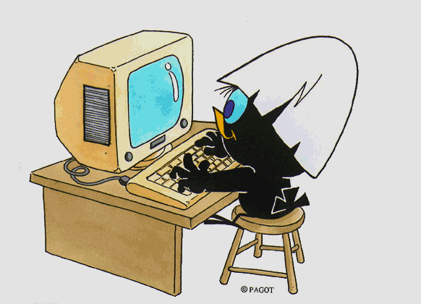
THE STUDY PLAN
MASTER'S DEGREE COURSE IN MATERIALS SCIENCE
Writing Guide

Slide 2


What is a study plan?
A study plan is a set of compulsory educational activities, activities provided as elective extras and educational activities chosen independently by the student in accordance with the Teaching Regulations of the Course of Study.
Typically two types of plan are offered, "da approvare" (to be approved) and "pre-approvato" (pre-approved).
The da approvare plan allows you to choose classes from other Courses at the University as free-choice exams in addition to those from your Course. This type of plan, which is "proposed" after confirmation, must be approved by the Teaching Coordination Council of your Course after the submission deadline; only then will it be included in your career plan.
The pre-approvato plan allows you to include activities recommended by your Course of Study as free-choice exams. The plan is therefore automatically approved, without it needing to be reviewed after submission deadline.

Slide 3
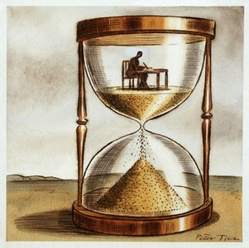
When is it completed?
When enrolling, you are automatically assigned a study plan called the statutory plan, which includes all compulsory educational activities. Subsequently, during the periods established by the University, usually November and March, you will be required to submit a study plan indicating your optional and free-choice activities in line with the number of credits to be acquired as well as any constraints and prerequisites set out by the Teaching Regulations of your Course.
A detailed and annually updated calendar is available online at https://www.unimib.it/servizi/segreterie-studenti/piani-degli-studi/area-scienze in the "AVVISO PRESENTAZIONE PIANI DI STUDIO" document (STUDY PLAN SUBMISSION NOTICE).
How is it submitted?
The plan must be submitted electronically through the Online Student Registry at https://s3w.si.unimib.it/Home.do
After submission, you must confirm the plan by clicking on the CONFERMA button.
Plans left in draft form (bozza) are not reviewed. You may complete it online as long as you are currently enrolled.
Students not currently enrolled must submit a paper form to the Careers Office, at the following address: segr.studenti.scienze@unimib.it.

Slide 4

Can I change my chosen plan?
You may change the plan, but only during set periods, usually in November and March.
Until the new study plan is implemented, you are obliged to follow the previous plan and cannot register for exams in classes you have requested to join.
You can only take exam assessments for an educational activity if it is in your most recent approved study plan.
Sitting exams (Art.13 Student Regulations)
Students may register for exams for activities included in their approved plan which refer to the year following the year of enrolment only if the classes have commenced and if they have acquired at least 50% of the credits of the year of enrolment, complying with any prerequisites.

Slide 5
Double Degrees and Study Plans
The Master's Degree course in Materials Science, taught entirely in English, is part of a European Union network project of double master's degrees called "SUMA - Master Programmes on sustainable materials", which aims to train a generation with an advanced scientific background and awareness on sustainable technological development. There are 5 partners participating in this graduate training network:
- University of Milano-Bicocca (Italy)
- KU Leuven (Belgium)
- Montanuniversität Leoben (Austria)
- University of Trento (Italy)
- Grenoble INP (France)
These universities offer 10 different double degree pathways, 2 of which involve the Master's Degree Course in Materials Science at the University of Milano-Bicocca. These two pathways are:
• UNIMIB – KU Leuven
• KU Leuven – UNIMIB
By studying for a full year in one of the partner Countries and doing the second year and thesis in a different country, students may obtain a double degree.
Students participating in one of these pathways must choose a DUAL DEGREE framework, rather than the da approvare framework.

Slide 6
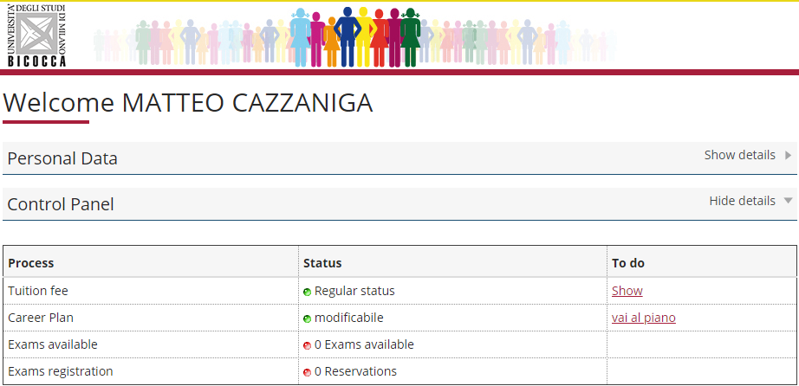


How do you fill it out?
To access it, log in at https://s3w.si.unimib.it/Home.do
This page shows the career(s) associated with your name. Select the active one to start.
While the plans are open, the study plan can be modified: click on "vai al piano", (go to plan) (fig.1).
Fig. 1

Slide 7
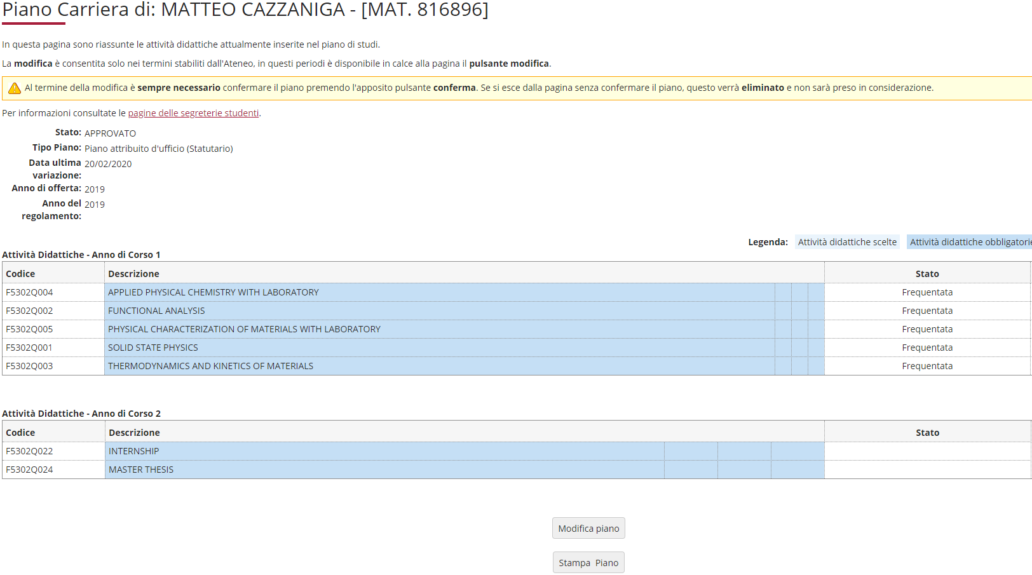

This screen shows the so-called statutory study plan (fig. 2) which includes activities and classes compulsory under the Teaching Regulations of the Course. First-year activities are marked "Frequentata" (Attended) as the plan is already associated with your career plan. Click "Modifica piano" (Edit Plan) to continue.
Fig. 2

Slide 8
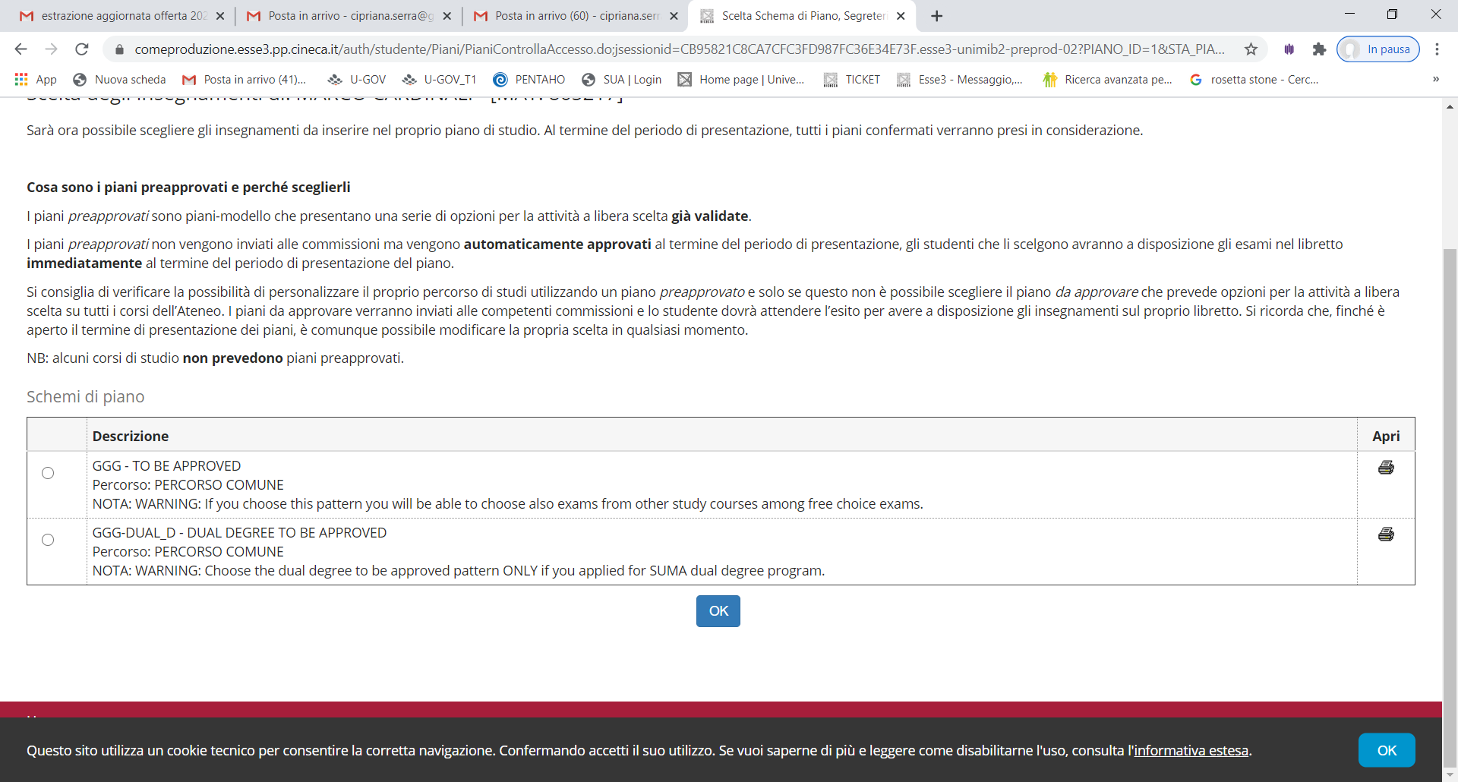
You are asked to choose between two types of frameworks, as previously mentioned: GGG- TO BE APPROVED or GGG-D-DUAL DEGREE TO BE APPROVED.
PLAN TO BE APPROVED:
Select GGG-DA APPROVARE and click OK (fig. 3).
Fig. 3

Slide 9
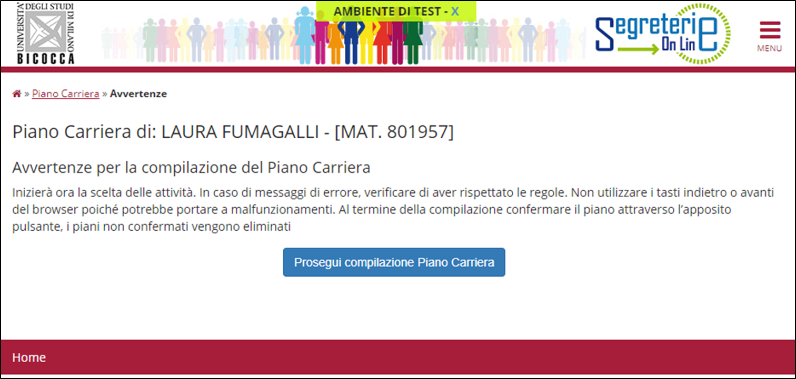


Click "Prosegui compilazione Piano Carriera" (Continue with Career Plan) to proceed (fig. 4).
Fig. 4

Slide 10

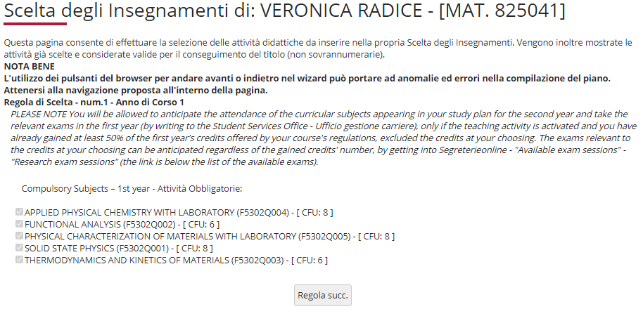


The following rule lists and ticks compulsory first-year classes and their credits (fig. 5). Click "Regola succ." to continue filling in the plan.
Fig. 5

Slide 11
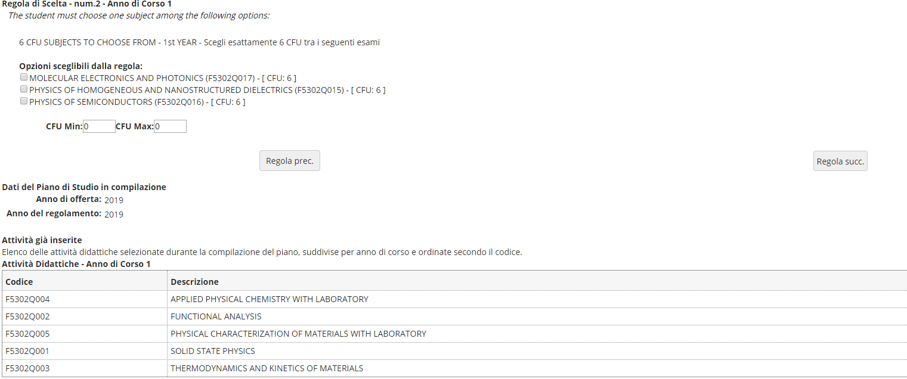


In the next section, you must select one core 6-credit first-year class in the Physical and Chemical Disciplines field, from three options (fig. 6). After choosing, click "Regola succ." to continue.
NOTE: All your selected and compulsory activities can be seen at the bottom of each page while you are filling in the plan (e.g. Fig. 6)
Fig. 6

Slide 12

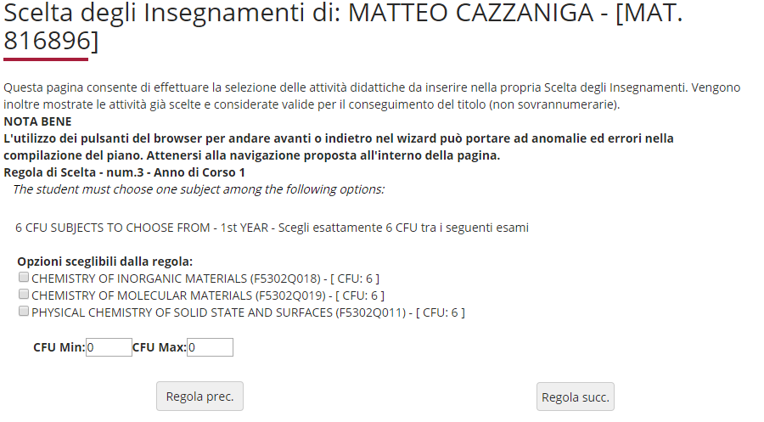


In this section, you must select one core 6-credit class in the Physical and Chemical Disciplines field in the first year of the course, choosing from three options (figure 7). Click "Regola succ." to continue filling in the plan.
Fig. 7

Slide 13
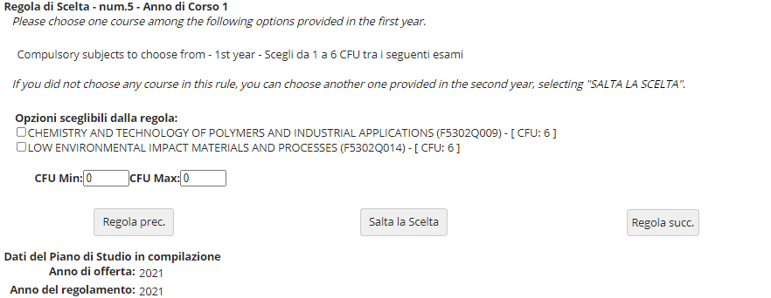

You must then select another core 6-credit class in the Physical and Chemical Disciplines field, choosing from three classes offered in the first year (figure 8) and second year (figure 9).
If you are using this section, click "Regola succ." to continue.
If you do not wish to select any activities, click "Salta la scelta" (skip choice) to move on.
.
Fig. 8

Slide 14

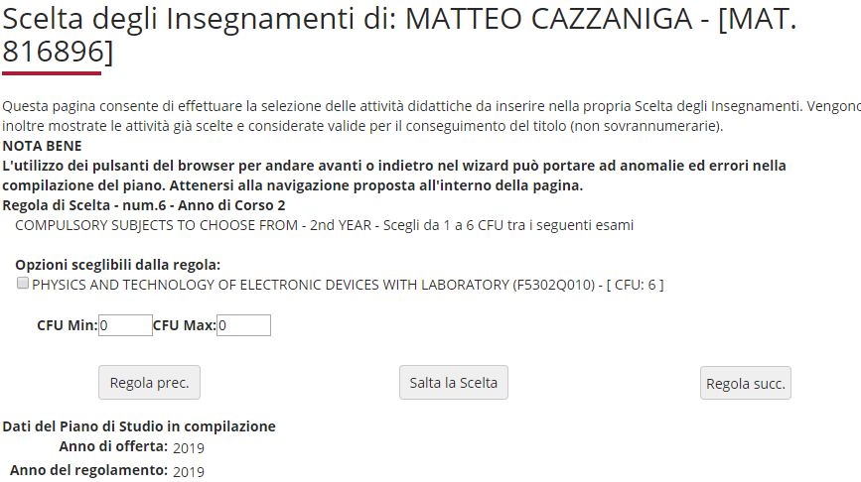

Complete this section if you did not choose any activities in the previous one.
If you are using this section, click "Regola succ." to continue.
If you do not wish to select any activities, click "Salta la scelta" (skip choice) to move on.
Fig. 9

Slide 15

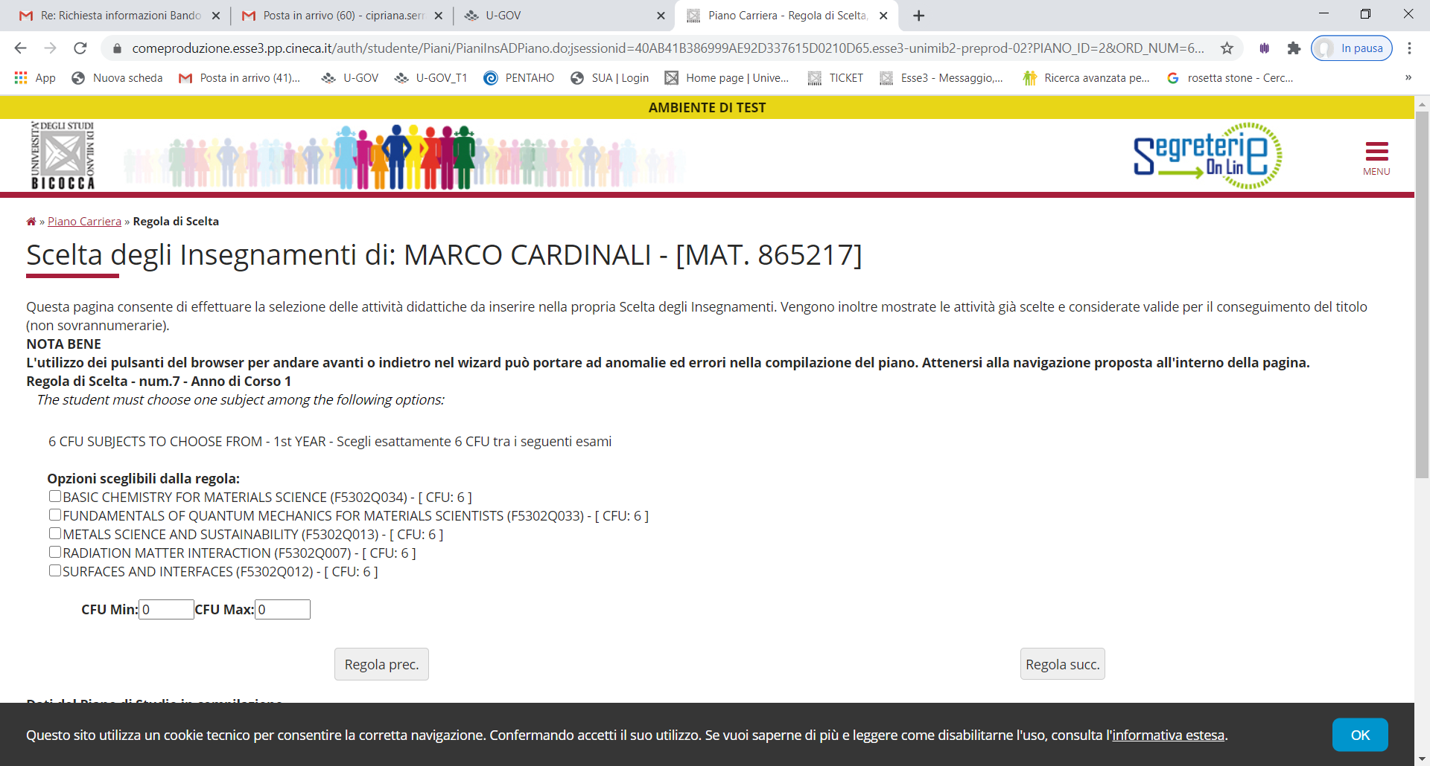
You must then add one similar or supplementary 6-credit class, choosing from those listed and offered in the first year of the course (figure 10). Click "Regola succ." to continue filling in the plan.
Fig. 10

Slide 16

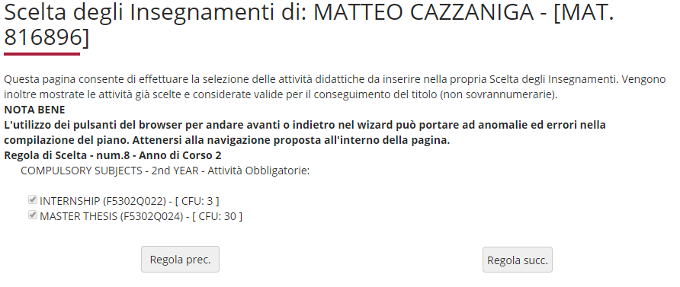

The next section lists and ticks the final assessment and internship, which are compulsory second year activities (figure 11). Click "Regola succ." to continue filling in the plan.
Fig. 11

Slide 17

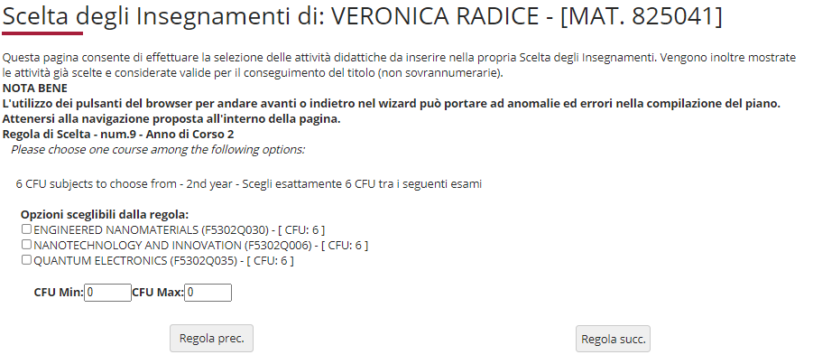
The Regulations provide for 6 core second-year credits in the field of Engineering Disciplines. Select one of the listed exams and click "Regola succ." to continue (fig. 12).
Fig. 12

Slide 18
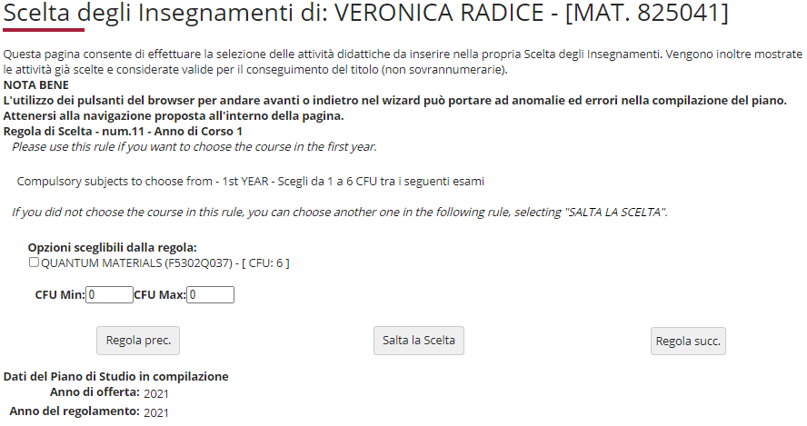

Add a similar or supplementary 6-credit class. In this section you may select a class offered in the first year (fig. 13).
If you are using this section, click "Regola succ." to continue.
If you do not wish to select any activities, click "Salta la scelta" (skip choice) to move on.
Fig. 13

Slide 19
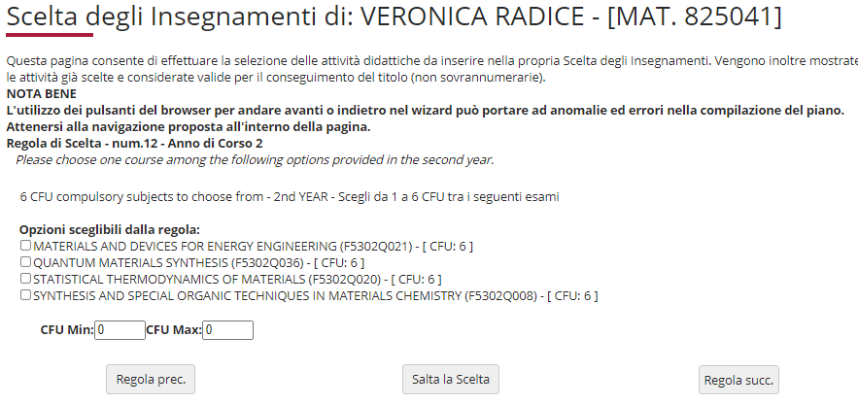
You may add a similar or supplementary 6-credit class by selecting one of the listed exams offered in the second year (fig. 13).
If you are using this section, click "Regola succ." to continue.
If you do not wish to select any activities, click "Salta la scelta" (skip choice) to move on.
Fig. 13

Slide 20
Additional Language Skills
3 "additional language skill" credits are acquired according to the procedures set out below.
Italian Students:
Passing a B2 level University foreign language assessment, in a language other than English, choosing from FRENCH, SPANISH or GERMAN
or
passing a C1 level University language assessment in ENGLISH
or
attending a Scientific English Workshop. Assessment results will be given as "approved/not approved"
or
- attending one or more of the University's cross-discipline activities recognised by the CCD for a total of at least 3 credits, aiming to acquire additional language skills, sign language (linguaggio dei segni) in particular.
Where Italian students already hold certificates issued by the University or by bodies accredited by the University attesting to language skills at a level equal to or higher than B2 for French, Spanish or German, or equal to or higher than C1 for English, will be exempt from the assessment and awarded the required credits
Foreign Students:
- passing an A2 level University language assessment in ITALIAN. Students who already hold certificates issued by the University or by bodies accredited by the University attesting to their language skills, with a level equal to or higher than level A2, will be exempt from the assessment and awarded the required credits.

Slide 21
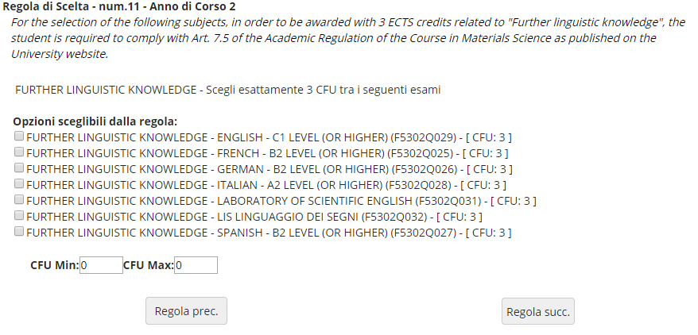
The following section allows you to include the 3-credit additional language skills activity to your study plan in the second year (figure 14).
Click "Regola succ." to continue.
Fig. 14

Slide 22
FREE-CHOICE ACTIVITIES
Over the next sections, starting with the exams taken during ERASMUS (fig. 12), you are asked to choose the modules offered by your Course and/or other University Master's Degree Courses to obtain free-choice credits, as provided for by the Teaching Regulations of the Course, for a total of 12 credits.
NOTE: if you select free-choice courses with a sum of 12 credits, e.g., two 6-credit exams, you cannot gain further credits. However, if you select exams with credits exceeding 12, for instance a 6-credit exam and an 8-credit one, you may "exceed" the 12-credit limit, up to 16 credits maximum.

Slide 23
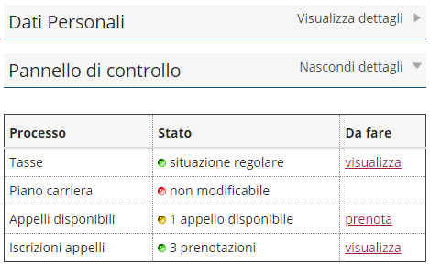
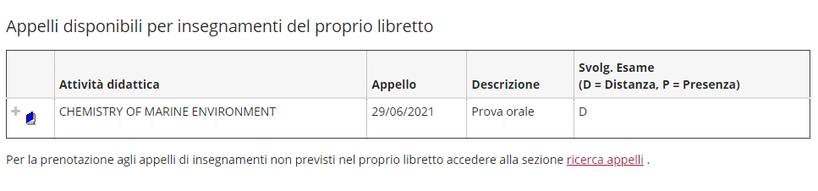

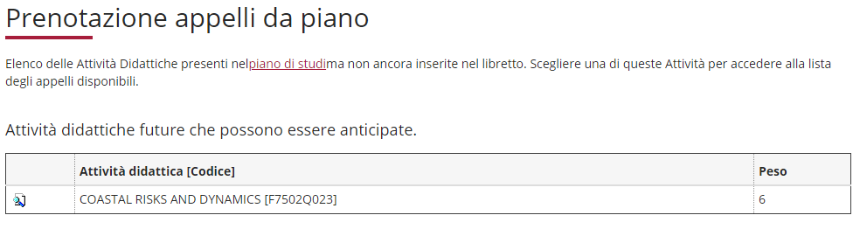
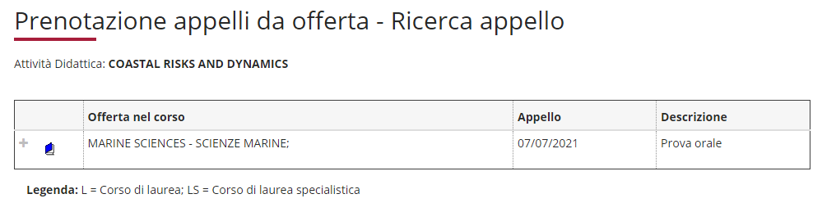
This figure illustrates the procedure for booking exams for free-choice activities.
To begin registering for the exam:
Click on the Prenota (Book) option in the Appelli Disponibili (Exams Available) section shown on your Online Student Registry homepage.
On the next screen listing available exams, select ricerca appelli (search for exams).
Select a free-choice activity
Proceed to registering for the exam.

Slide 24
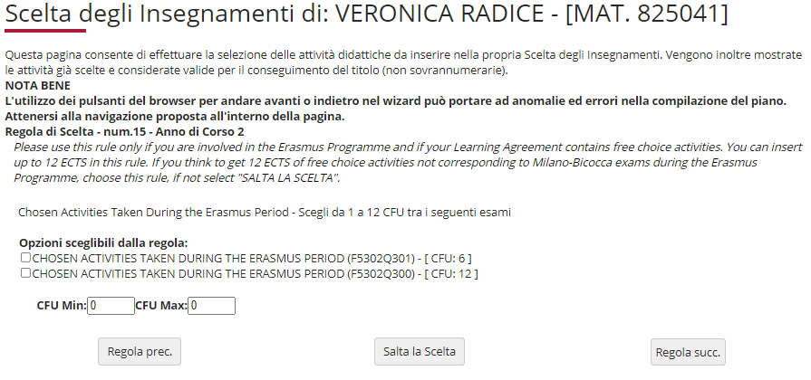

Use this section (fig . 15) if you are participating in the ERASMUS programme and if your Learning Agreement includes free-choice activities that do NOT correspond to exams offered by our University. You may choose up to 12 credits.
If you are using this section, click "Regola succ." to continue.
If you do not wish to select an activity, click "Salta la scelta" (skip choice) to move on.
Fig. 15

Slide 25
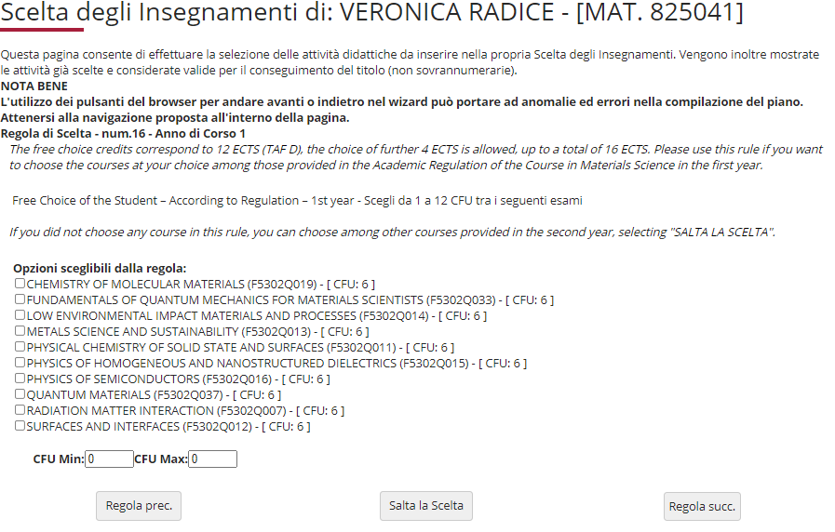
On this page (fig. 16), the optional classes offered by your Course Regulations in the first year which were not previously selected are listed and offered again as free-choice credits.
If you are using this section, click "Regola succ." to continue.
If you do not wish to select any activities, click "Salta la scelta" (skip choice) to move on.
Fig. 16

Slide 26
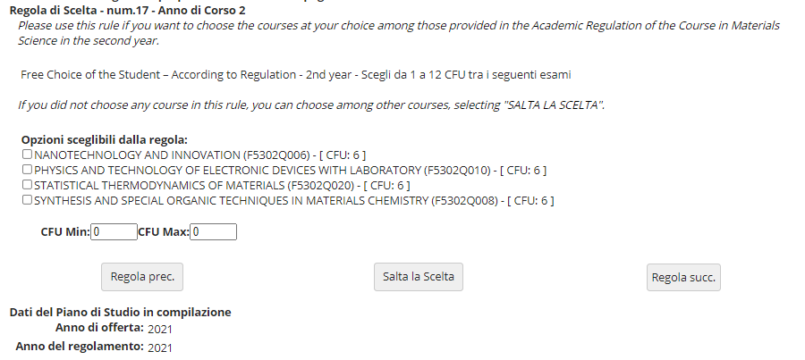
In this section (fig. 17), the optional classes offered by your Course Regulations in the second year which were not previously selected are listed and offered again as free-choice credits.
You may bring your attendance forward and sit exams from your first year.
If you are using this section, click "Regola succ." to continue.
If you do not wish to select any activities, click "Salta la scelta" (skip choice) to move on.
Fig. 17

Slide 27
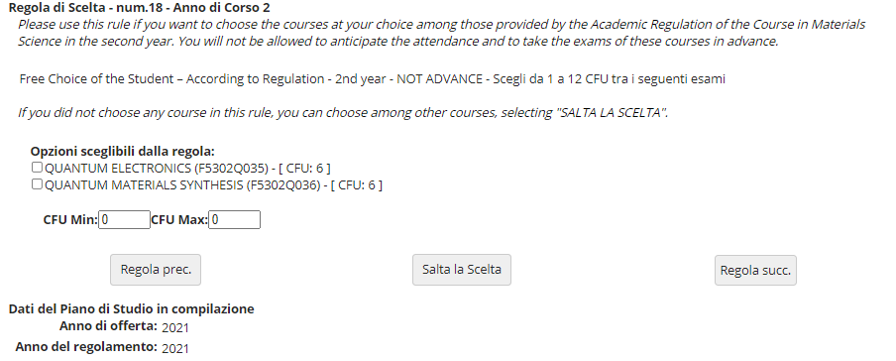
In this section (fig. 17), the optional classes offered by your Course Regulations in the second year which were not previously selected are listed and offered again as free-choice credits.
YOU MAY NOT ATTEND THESE CLASSES IN ADVANCE.
If you are using this section, click "Regola succ." to continue.
If you do not wish to select any activities, click "Salta la scelta" (skip choice) to move on.
Fig. 17

Slide 28

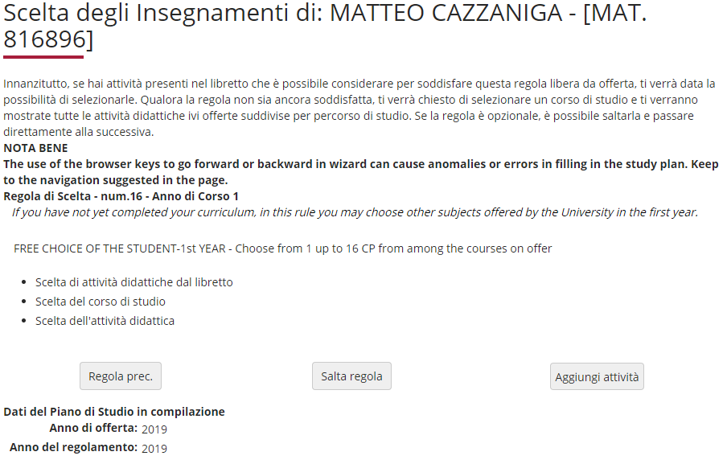


Using this and the next section allows you to gain free-choice credits by choosing from classes offered by other Course of Study at the University, in the first or second year.
Click "Aggiungi attività" (fig. 18) to access the list of University's Master's Degree classes (fig.19), and the classes available in your first year (fig. 20).
Click "Salta regola" if you would prefer to choose from the classes offered in your second year.
Fig. 18

Slide 29
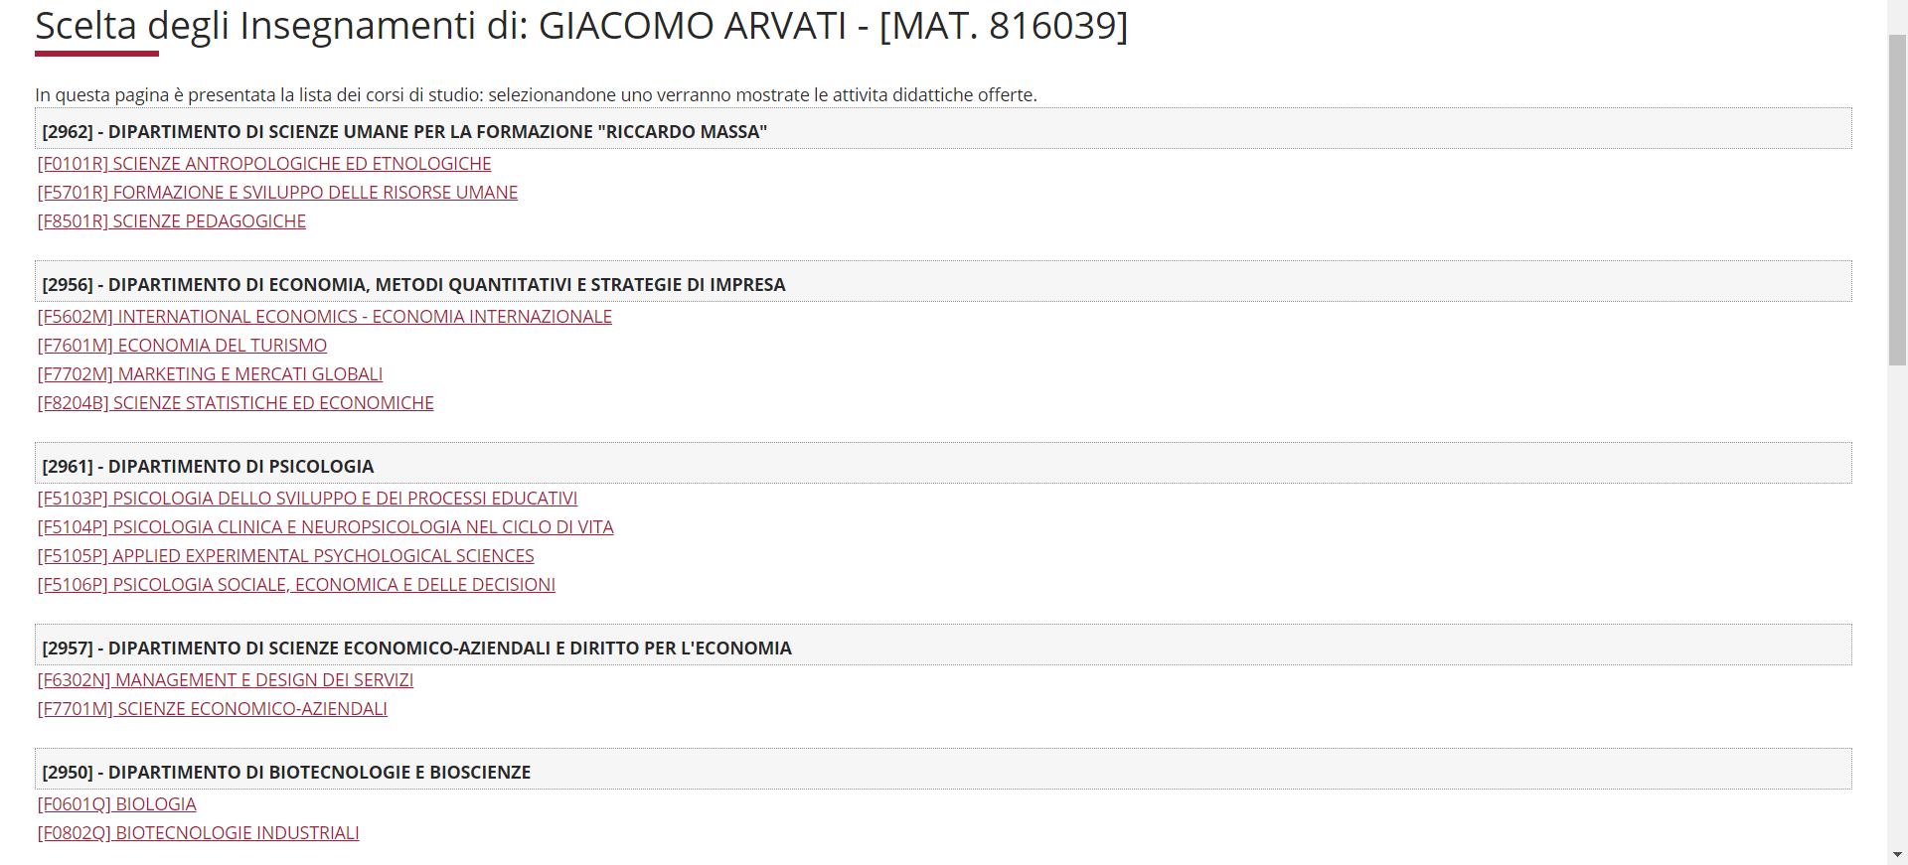
MARIO ROSSI
Fig. 19

Slide 30
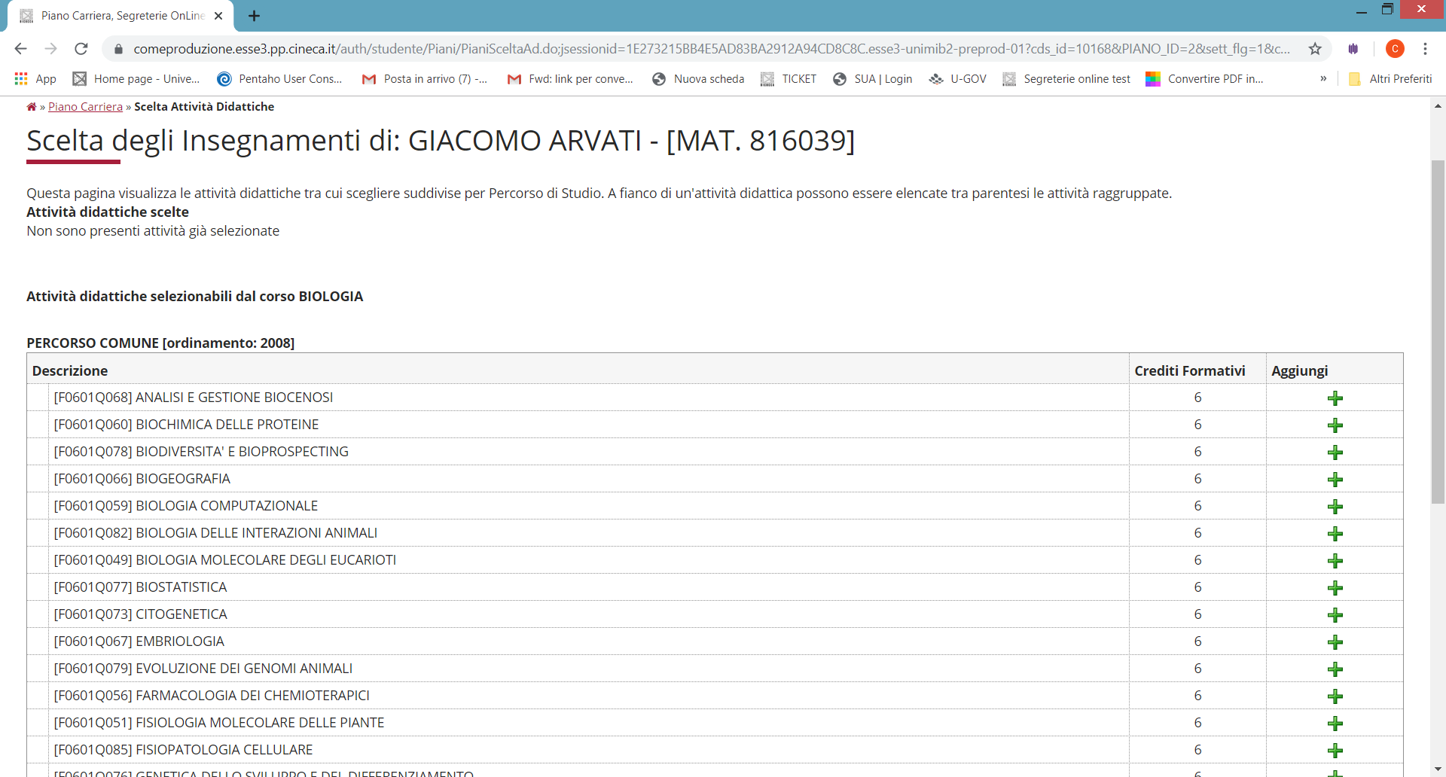
After selecting the Class you are interested in, click on the + (Aggiungi) symbol to add the activity (fig. 20) to your first year.
MARIO ROSSI
MARIO ROSSI
Fig. 20

Slide 31
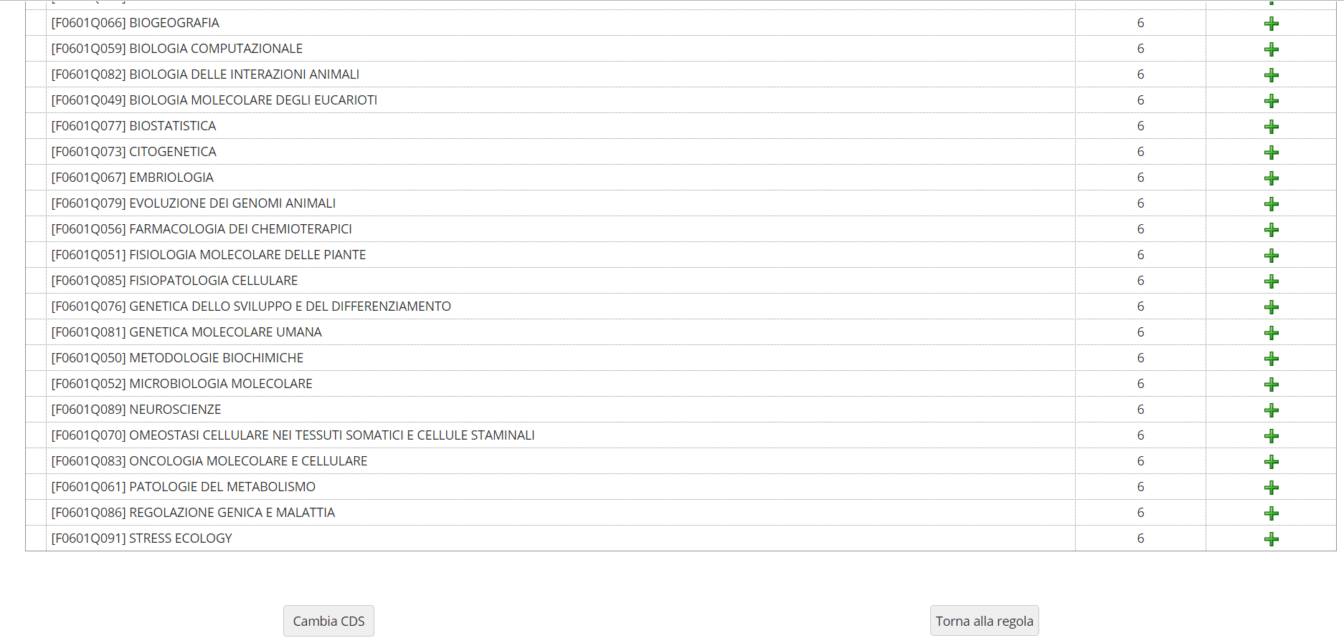
If you do not wish to add any activities, click "Torna alla regola" to return to the previous page.
If you would like to review the list of Master's Degree classes to choose from, click "Cambia CDS" (fig.21).
Fig. 21

Slide 32


If you do not wish to select classes for the first year and would like to see the classes offered by other courses at the University in your second year, click on "Salta regola" (fig. 22).
Fig. 22

Slide 33

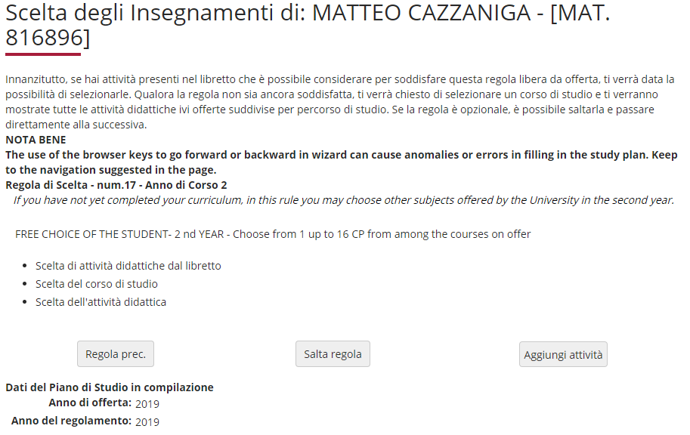

In this section (fig. 23), if you click on "Aggiungi attività", you will see a list of Master's Degree classes; once you have selected a Class, by clicking on + Aggiungi, you may add a free-choice class to your second year. However, if you have completed all your choices using the previous sections, click "Salta regola" to finish.
Fig.23

Slide 34
Extra Credits
You may include extra activities in your study plan for up to a maximum of 16 credits.
The purpose of adding extra credits is to include these already recognised credits in your career plan which have been gained by passing exams relevant to teaching (FIT* pathways) or cross-discipline activities offered by the University, which will be included in the Diploma Certificate.
Credits and marks obtained through additional classes are not counted toward your exam grade point average, but are recorded in your Master's Degree Course career plan.
You must send an acknowledged written request to the Careers Office during a study plan submission period to have your extra credits included in your study plan.
*FIT Pathways
For detailed information on pathways, visit the University's webpage at https://www.unimib.it/didattica/formazione-insegnanti-ed-educatori/percorso-24-cfu, or write to fit@unimib.it

Slide 35
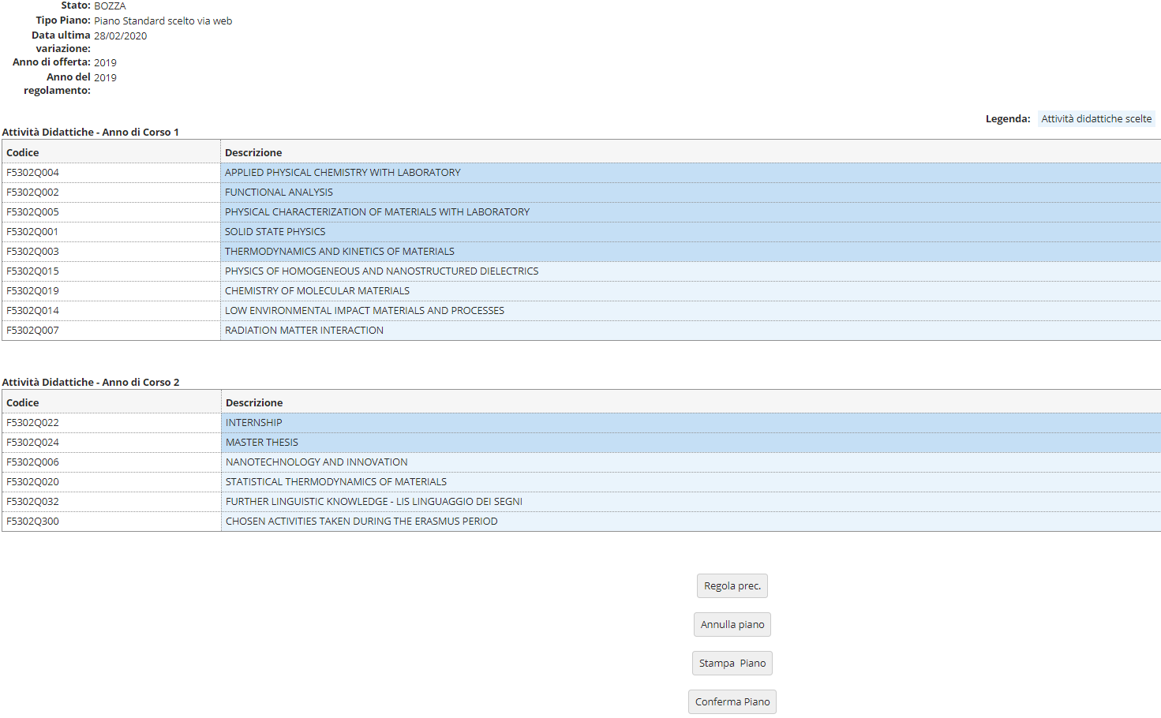


Once you have finished making your choices, click "Conferma Piano" (fig.24) to confirm and register your plan. The classes you have selected will appear on your transcript once they have been reviewed by your course's Teaching Coordination Council.
PLEASE NOTE: Plans left in draft form (bozza) are not reviewed.
Fig. 24

Slide 36
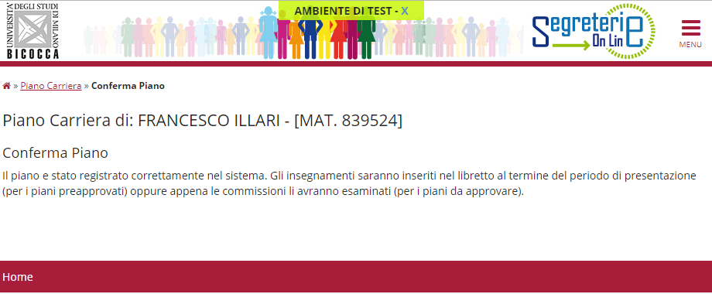
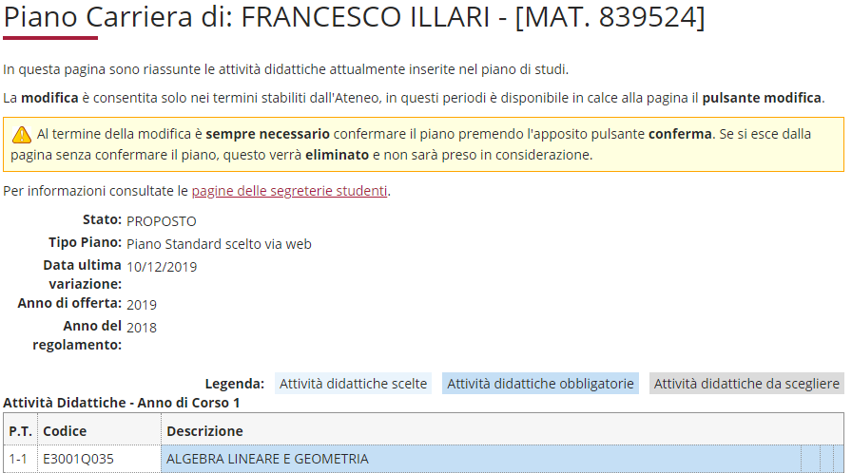
At this point your plan will be registered in the system and will appear as PROPOSTO (proposed) (figure 25).
You may still modify your selected classes throughout the entire open plan period.
Fig. 25

Slide 37
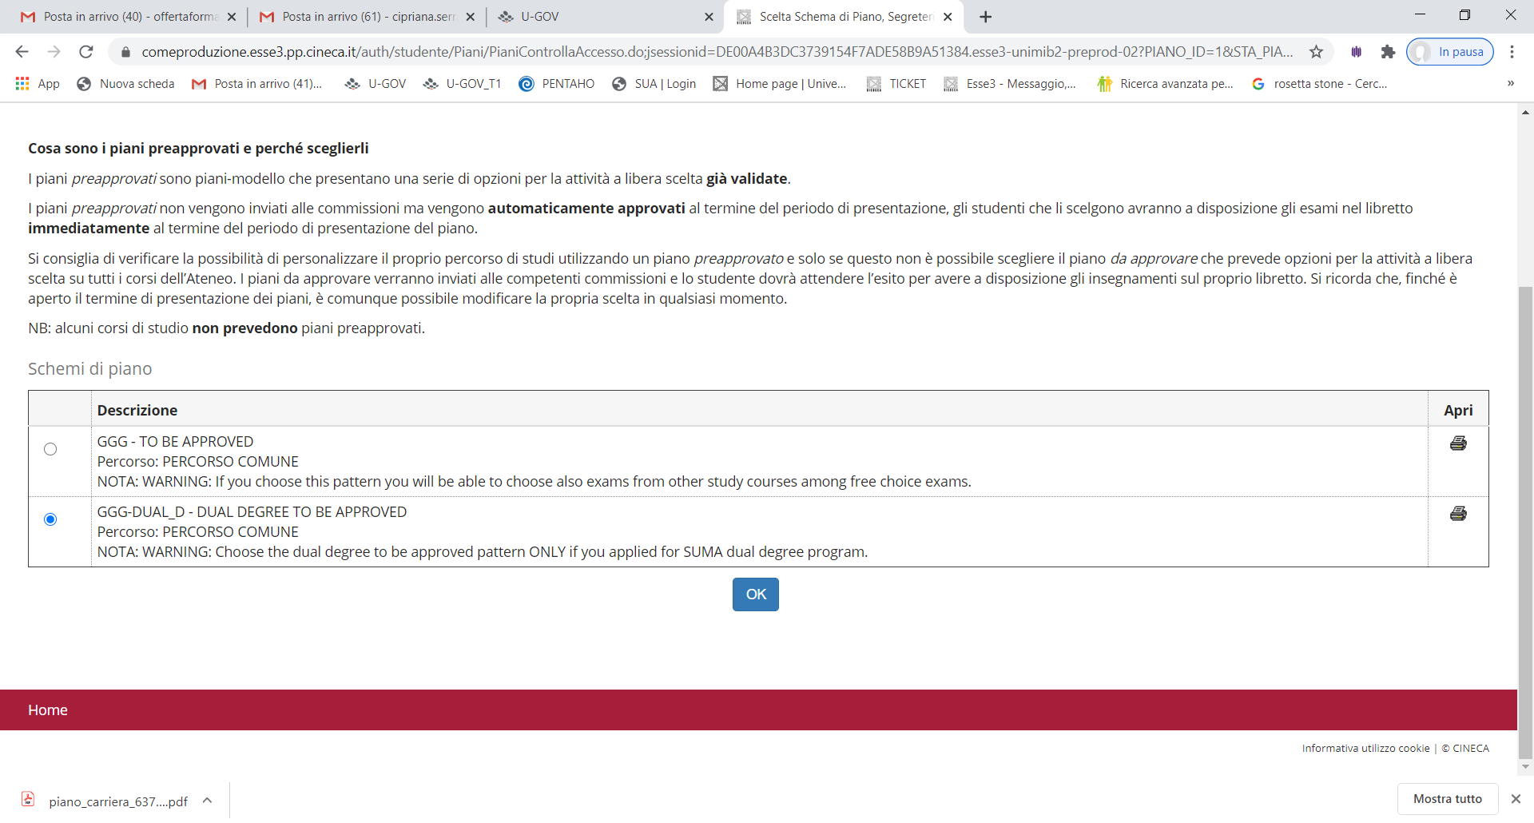
PLAN ASSOCIATED WITH THE DOUBLE DEGREE PROGRAMME:
If you are enrolled in one of the previously indicated double degree pathways, select GGG-DUAL DEGREE TO BE APPROVED from the initial screen (fig.26), click OK and then "Prosegui compilazione Piano Carriera" (Continue with Career Plan) (fig. 27).
Fig. 26

Slide 38
Fig. 27

Slide 39

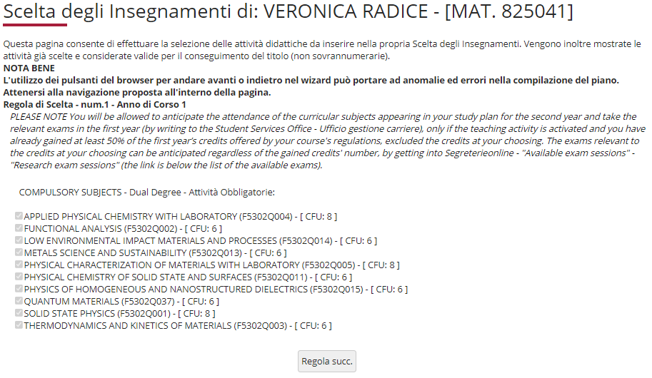
This plan includes a series of exams which must be sat in the first year at our University.
The following screen lists and ticks all the compulsory first-year classes in the double degree pathway (fig. 28). Click "Regola succ." to continue filling in the plan.
Fig. 28

Slide 40

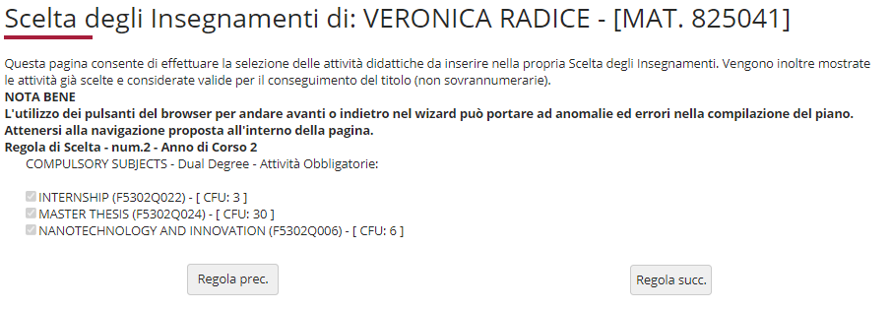
The following screen lists and ticks all the compulsory second year classes (fig. 33). Click "Regola succ." to continue filling in the plan.
Fig. 33

Slide 41

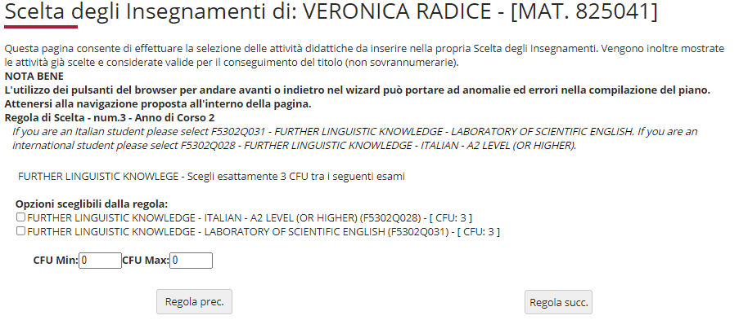
In the next section, you must select the 3-credit additional language skills activity (figure 34 ), scheduled for the second year.
Fig. 34

Slide 42
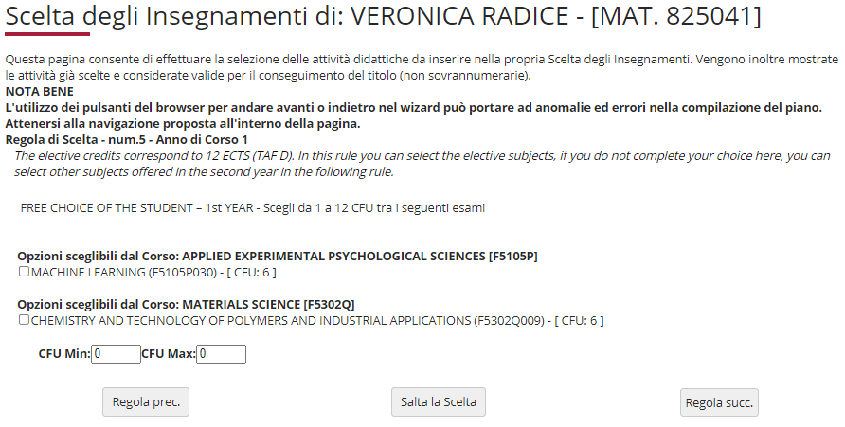
Over the next two sections, numbers 5 and 6, you must select the classes you wish to take in the first and second year in order to obtain your free-choice credits (fig. 35 and 36).
If you are using this section, click "Regola succ." to continue.
If you do not wish to select any activities, click "Salta la scelta" (skip choice) to move on.
Fig. 35

Slide 43
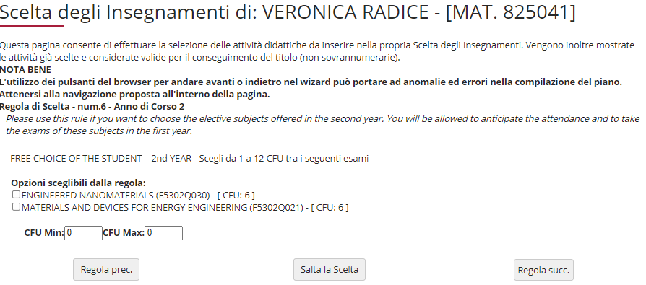
You may complete your free-choice credits by choosing activities scheduled in your second year.
If you are using this section, click "Regola succ.".
If you do not wish to select any activities, click "Salta la scelta" (skip choice) to finish.
Fig. 36

Slide 44
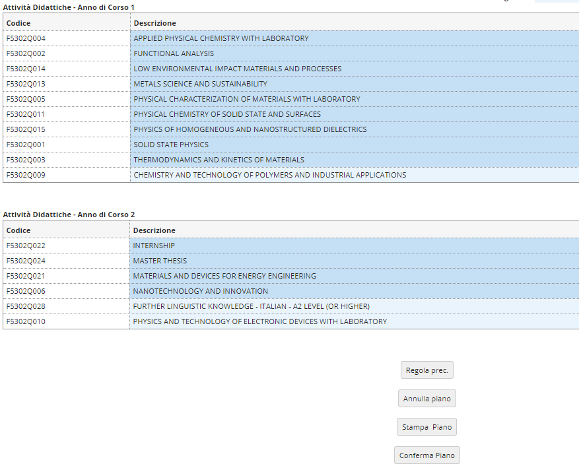


Once you have finished making your choices, click "Conferma Piano" (fig.37) to confirm and register your plan. The classes you have selected will appear on your transcript once they have been reviewed by your course's Teaching Coordination Council.
PLEASE NOTE: Plans left in draft form (bozza) are not reviewed.
Fig. 37
Fig. 36

Slide 45

PLEASE NOTE: Once you have finished filling out your plan, you may still make changes. Click on "Annulla piano", then "Modifica Piano" on the next page to return to the initial screen.
For further information or issues with the online procedure, contact the Science Department Careers Office at segr.studenti.scienze@unimib.it
Please refer to:
the Course Teaching Regulations at https://elearning.unimib.it/mod/folder/view.php?id=236488
the University of Milano - Bicocca Student Regulations (specifically art. 13 - Study Plan), at https://www.unimib.it/sites/default/files/allegati/regolamento_studenti_2019_con_decreto.pdf
Happy studying!

Slide 46

Who to contact for what
Teaching Administration
The Teaching Administration provide didactic support and information for students (class schedules, lecturer office hours, exam schedules, study plans, workshops).
Opening hours: Monday 14:00- 15:30; Wednesday 14:00 - 15:30; Friday 10:00 -12:00
U5 Building, 1st Floor, 55 Via Cozzi, Milan, 20126
Email: didattica.materiali@unimib.it
Telephone: 02 6448 5102
All information on teaching is available at https://elearning.unimib.it/course/index.php?categoryid=4578

Slide 47
Who to contact for what
Careers Office
The Careers Office manages administration for your entire student career, from admission to re-enrolment and to getting your degree. It also deals with issuing certificates and getting qualifications and exams from other universities, including foreign ones, recognised.
With regards to the study plan, the Careers Office is the department responsible for supporting students with the technical aspects of the plan submission system via the Online Student Registry.
For administrative information, visit https://www.unimib.it/servizi/segreterie-studenti
For more detailed information on study plans and submission deadlines for the academic year, please visit https://www.unimib.it/servizi/segreterie-studenti/piani-degli-studi/area-scienze
The Science Careers Office hours (desk 7 in the U17 Building - Piazzetta ribassata Difesa per le donne) are as follows:
Monday from 13:45 to 15:45
Wednesday and Friday from 09:00 to 12:00
Email: segr.studenti.scienze@unimib.it
There is no telephone service available.

