Slide 1
Ubiquitous computing and sustainability
The management of waste
di Elena Castellani - matr. 868076
Bryan Ivan Zhigui Guerrero - matr. 816335
Edoardo Sekules - matr. 861477

Slide 2
Index
Introduction
Management Waste
Technologies
Case study
Presentation Model
Technology
Videos
Future Developments
Conclusions

Slide 3
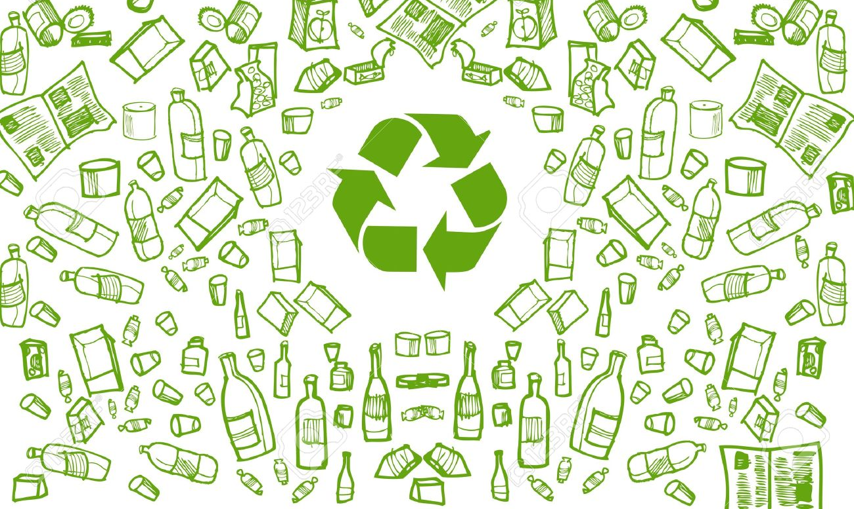
Introduction

Slide 4
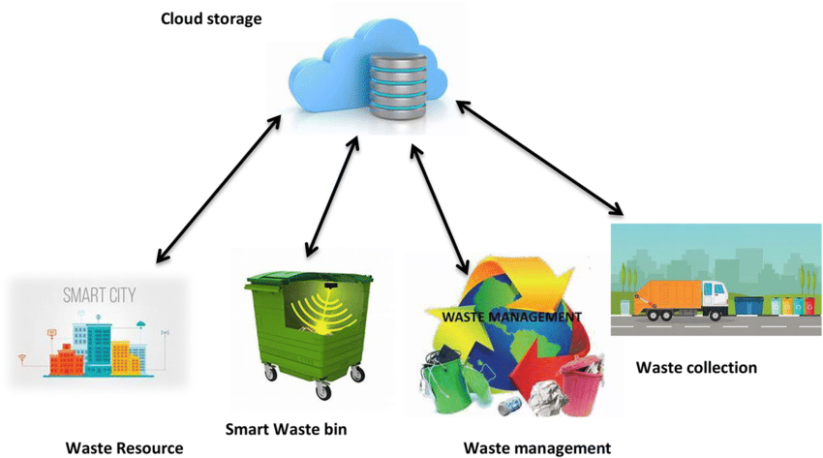
Introduction
Cities are becoming smarter and the technologies of ubiquitous computing are now spreading in various fields of everyday life.
Nowadays, the management of waste is one of the most difficult problem to resolve for many cities.

Slide 5
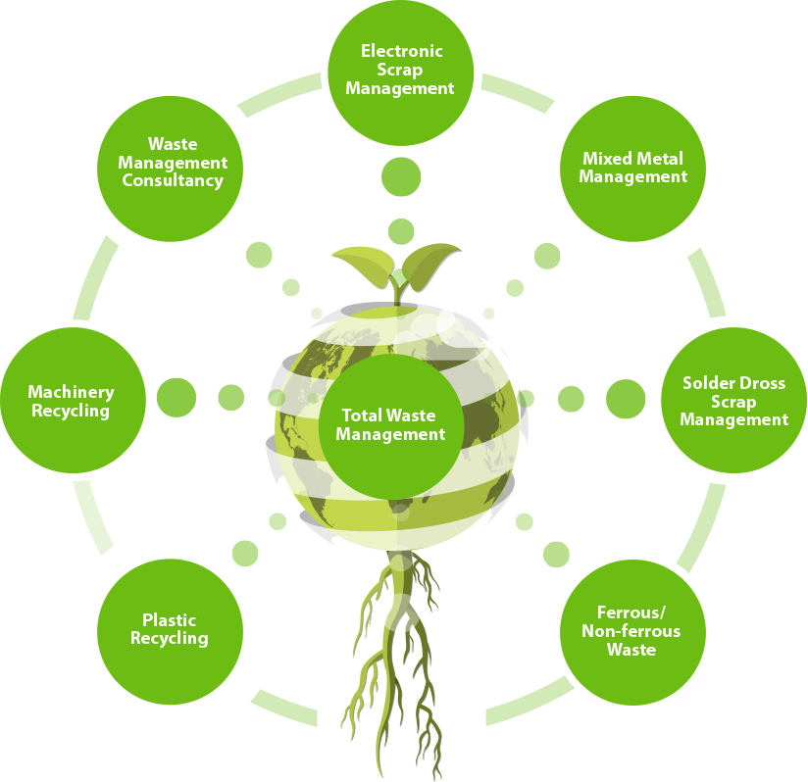
Management of waste
The management of waste is one of the most important and difficult problem which the majority of the city have to face because of:
trash removal service;
waste disposal service;
ecoisland limited capability.
Moreover:
the expected growth of urban population will increase of energy consumption;
the continuous emission of greenhouse will cause changes in the climate system.
Notes:
In addition to the problem of the management of waste, there are the ones (but not least) of:
the increase of population and the relative increase of energy consumption
and
the continuous emission of greenhouse that constantly causes changes in the climate system.

Slide 6
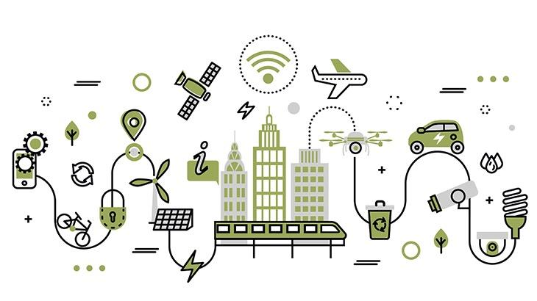
Technologies
There are new trends and goals pursued to make cities more efficient which concern:
wide use of IoT in finding solutions;
connection with Big Data: gathered by sensors can be sent to remote servers where it is stored, processed and used for making intelligent decisions for infrastructure and service management.
Notes:
In general the technologies used in smart cities involved iOT and connection with Big Data, which are used for process and making intelligent decisions for services and infrastructure management.

Slide 7
Case Study

Slide 8
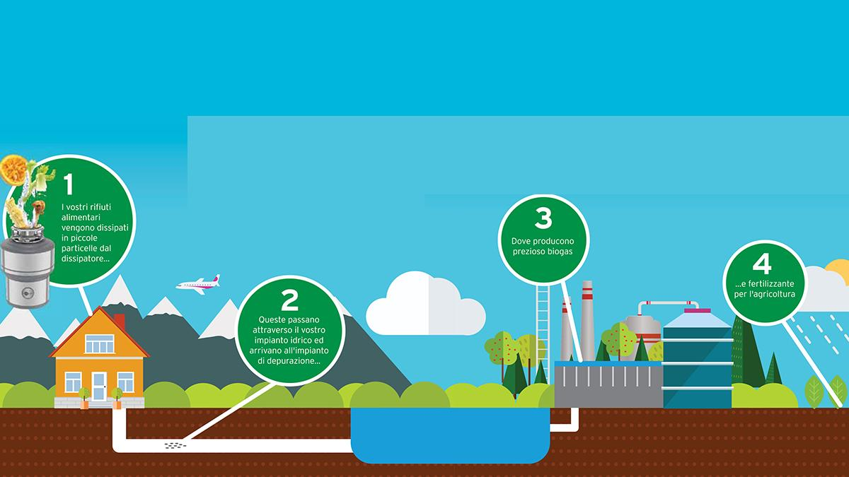
Case study / Re-Wise
Model presentation:
The model Re-Wise is an innovative model for the management of organic waste that exploits it as a source renewable energy using existing infrastructure:
sewerage
purification plant equipped with Anaerobic Digester
Released from november 2007 to April 2010
Notes:
The Re-Wise was released between november 2007 to April 2010 that is represented in figure.
"Spiga"
The food waste is first sorted (in the kictchen) and quantified through a dedicated system (DRA+SiQURo), it is sent to water purification plant through sewarage.
In the purification plant equipped the organic that still contains an energy content, through Anaerobic digestion, is transformed into biogas that use as renewable energy and natural fertilizer for cultivation.

Slide 9
Case study / Re-Wise with OWD
Model presentation:
OWD + SiQURo
2. Sewarage
3. Purification plant system
Notes:
The Re-Wise was released between november 2007 to April 2010 that is represented in figure.
"Spiga"
The food waste is first sorted (in the kitchen) and quantified through a dedicated system (DRA+SiQURo), it is sent to water purification plant through sewarage.
In the purification plant system,the organic that still contains an energy content, through Anaerobic digester, is transformed into biogas that use as renewable energy and natural fertilizer for cultivation.

Slide 10
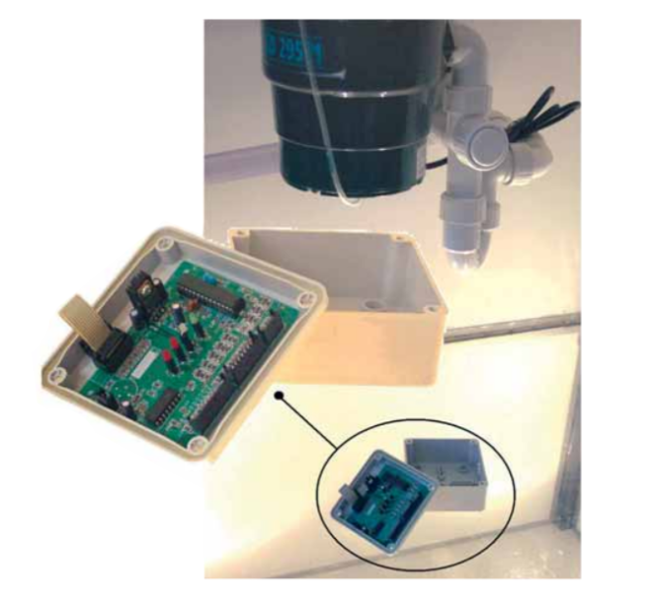
Case study / Organic Waste Disposer
Technologies
This instrument installed at home allows to manage the organic waste and separating from the others without any damage;
The organic waste is reduced in small particles thanks to an abrasive action;
System SiQURo: Together with OWD allows to quantifies the mass of food treated and send this data at the industries.
http://www.ecofast.eu/wp-content/uploads/2017/10/Re-Wise-project.webm
Notes:
The benefits generated from the proposed model are:
increase in the production of biogas controlled and managed through the monitoring system of the organic masses brought there
reduction in the emission of CO2 originating in the traditional collection of solid organic waste
reduction of costs of collection, transport, separation and other operations for treating waste
cost savings associated to collection, transportation, source separation and other waste management practices
establishment of a win-win opportunity for citizens, municipalities and service providers

Slide 11
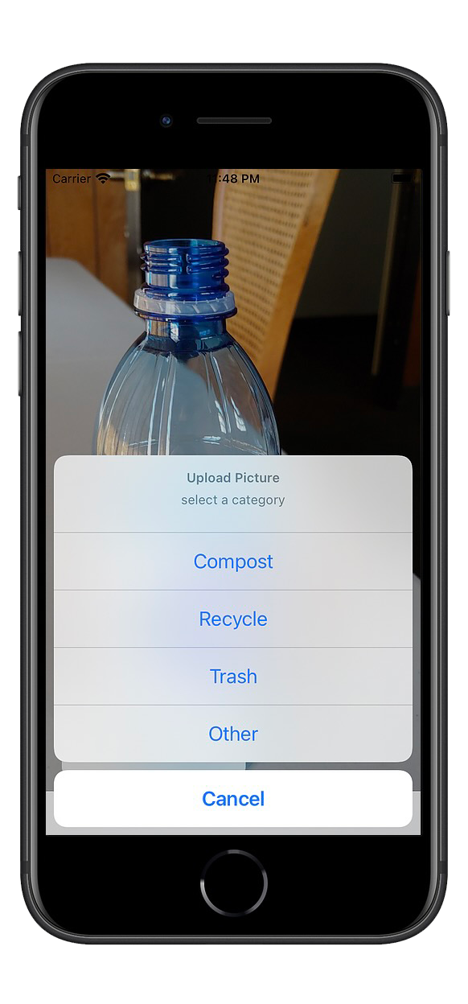
Case study / DeepWaste
Model presentation:
First mobile app targeted at the problem of erroneous waste disposal;
Enables users to be conscious; it also provides an instant and correct waste classification into trash, recycling or compost;
Currently available in Beta version for the testing phase.

Slide 12
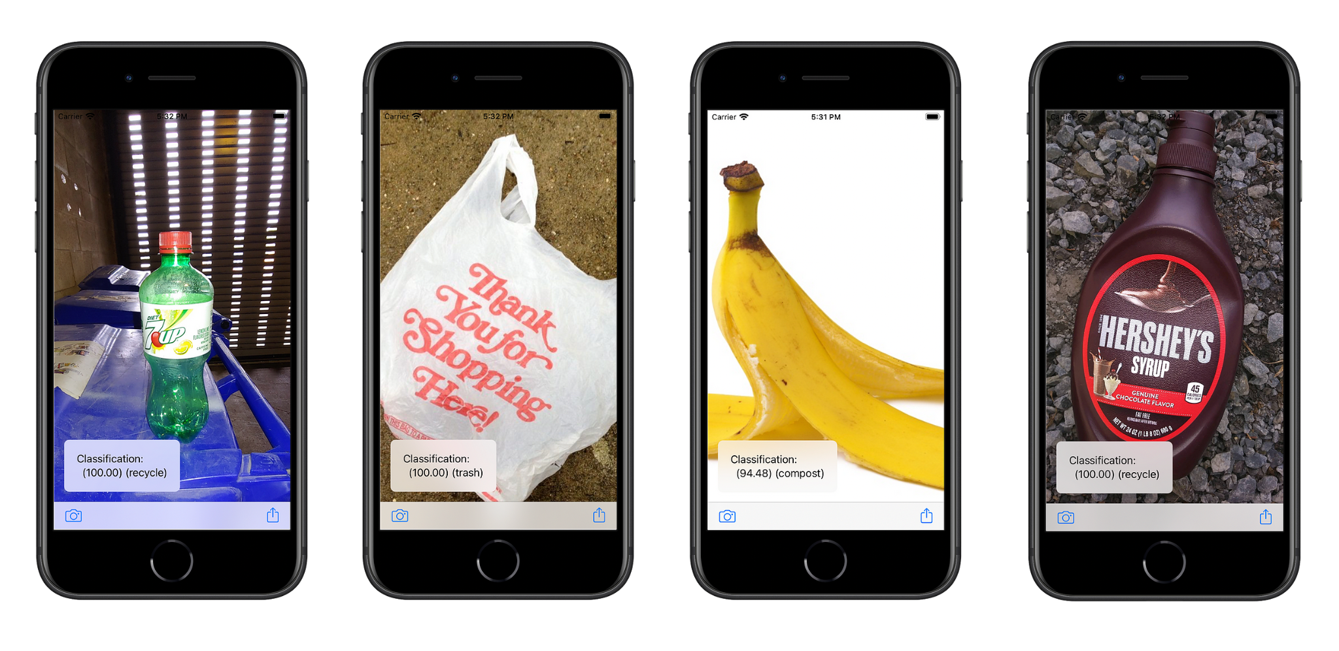
Case study / DeepWaste
Technologies
Use of deep learning technologies: simply pointing mobile camera to any piece of waste, the user gets an instantaneous feedback;
Combines the recent improvements of convolution neural networks (CNNs) and computational power of modern mobile phones;
Use of the D.L. technique Resnet50 implemented into a mobile app by using AppleCoreML by using the hardware of the mobile phone.

Slide 13
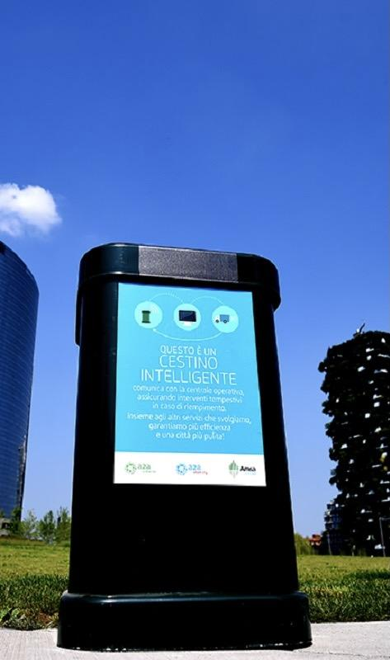
Case study / SmartBin (a2a)
Model presentation:
Manage waste collection in a sustainable way;
Avoid to place bins around the cities (SmartBin is currently used is Milano, Brescia, Bergamo and Cremona);
No need of power grid;
Long-life battery.
Notes:
The first model is SmartBin,

Slide 14
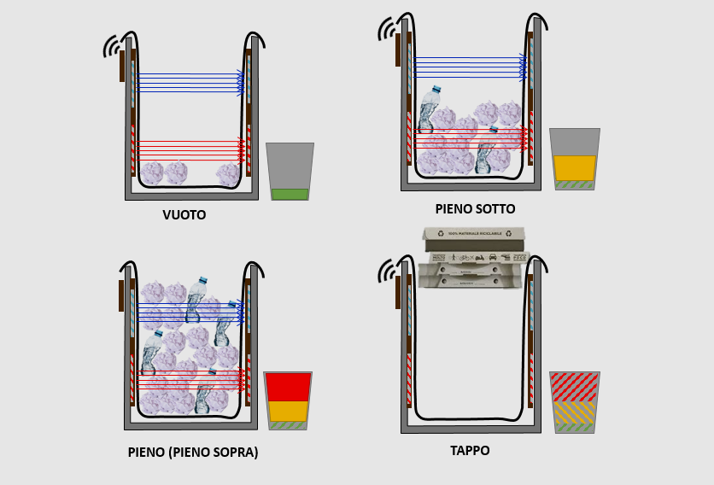
Case study / SmartBin (a2a)
Technologies
SmartBin sends measurements on his filling (empty, half-full or totally full) and blockage (occluded or not occluded);
Sensing Technology: two-level plates with electrical capability. Electricity energizes the plates which run measurements thanks to an algorithm.
The eventual presence of a stopper is detected by two optical sensors.

Slide 15
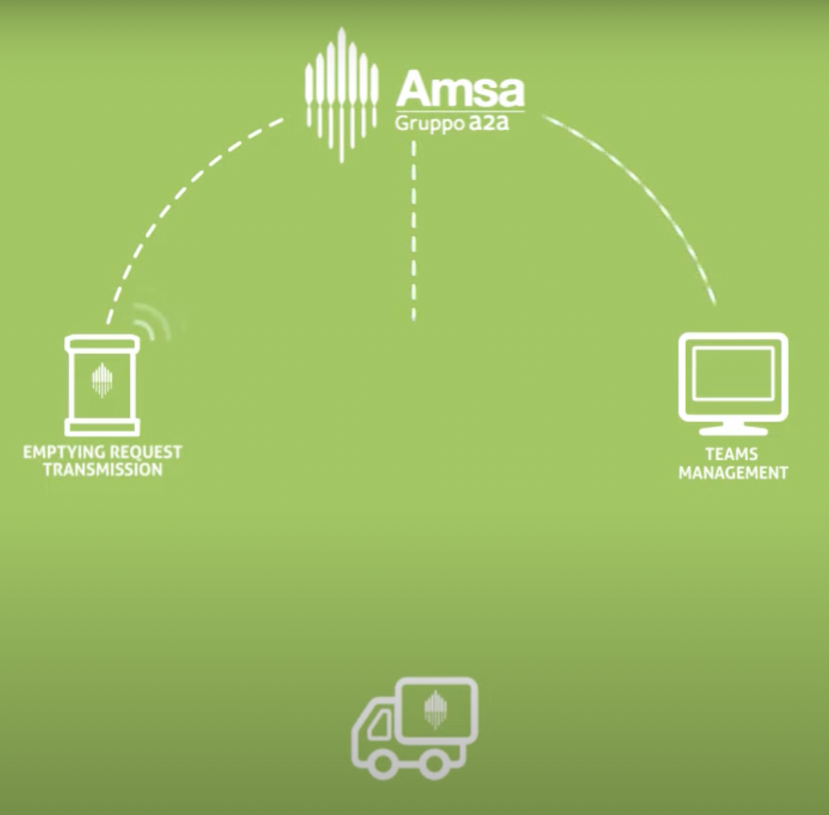
Case study / SmartBin (a2a)
Technologies
In each bin there’s a microchip that allows to send data in real time through a wireless network LoRa;
LoRa it is integrated into RN2483 Modem, and it covers a radius of 15km - no need of repeaters;
Data are collected and sent to a back-end software and managed by a specific team.

Slide 16
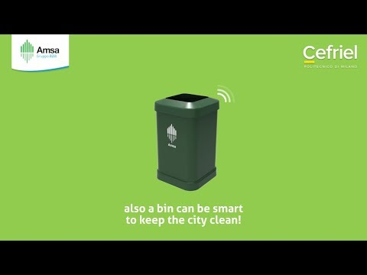
Case study / SmartBin (a2a)

Slide 17
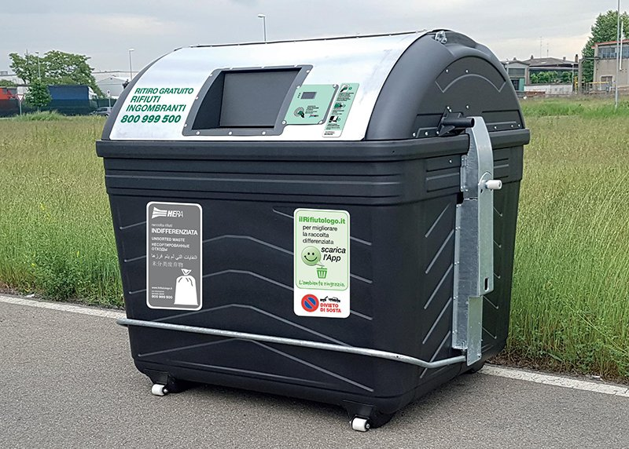
Case study / Smarty (Hera)
Model presentation:
The goal is to promote and stimulate recycling.
Punctual and efficient service: Smarty alerts Hera operators in case of fullness or breakdown;
More hygienic thanks to the absence of handles and levers.

Slide 18
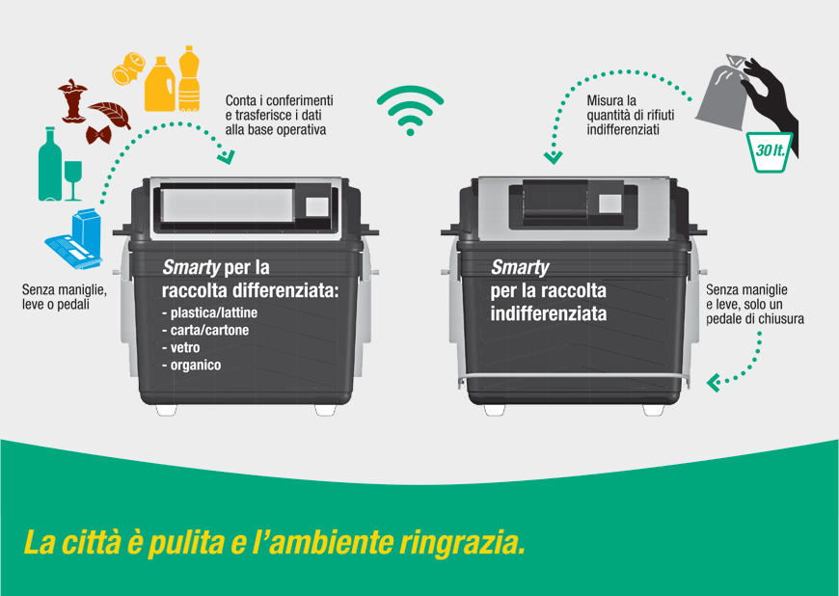
Case study / Smarty (Hera)
Technologies
Smarty recognises users thanks to a specific card or smartphone;
Data are safe and certifiable and are sent via wireless to the base operations

Slide 19
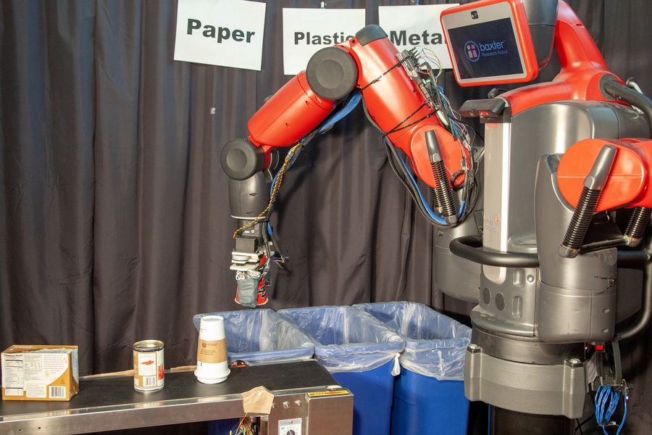
Case study / RoCycle (MIT)
Model presentation:
Robotic system which can detect if an object is paper, metal or plastic;
The goals are to reduce back-end cost of recycling and incentivize cities and countries to adopt specific recycling programs;
85% accurate at detecting materials;
35% accuracy at detecting the radius of an object and 78% accuracy to recognize soft or hard objects.

Slide 20
Case study / RoCycle (MIT)
Technologies
Tactile sensors on its fingertips to estimate an object’s size and stiffness;
Pressure sensors to measure the force needed to grasp the object;
Motor-driven hand made of a new material (auxetics) which doesn’t shrink when stressed;
Fluid-driven approach and dynamic movement.
Notes:
Questo nuovo materiale (a differenza degli altri che quando vengono tirati su si restringono - x, es la gomma quando si tira) l’auxetico diventa + ampio (quindi non si restringe quando è stressato). In questo modo il movimento è più fluido.

Slide 21
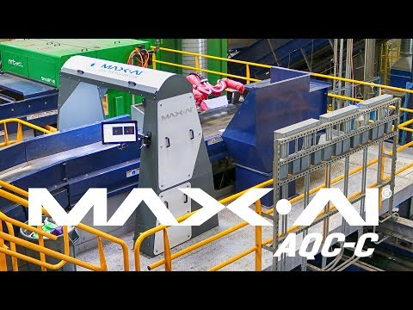
Case study / RoCycle (MIT)
Notes:
Rivedere caso d’uso per inserirlo meglio

Slide 22
Future Developments

Slide 23
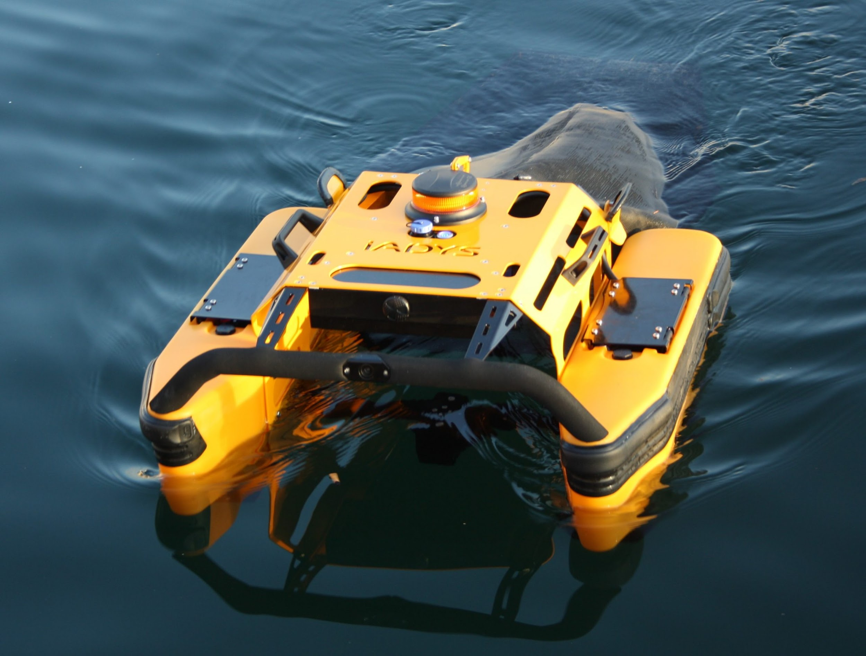
Case study / Jellyfishbot (IADYS - France)
Model presentation:
Jellyfishbot is a small marine drone whose mission is to collect floating waste and oil-spills from the water’s surface. Commissioned in June 2018 in Cassis (in the south of France), it has been adopted in several countries around the world.
The second version of the robot is now under development by IADYS. It is imaged to be totally autonomous and able to detect and capture floating waste - especially plastic – measuring between 5 mm and 25 cm in length, and hydrocarbons on the water with the help of environmental and environmental monitoring sensors.

Slide 24
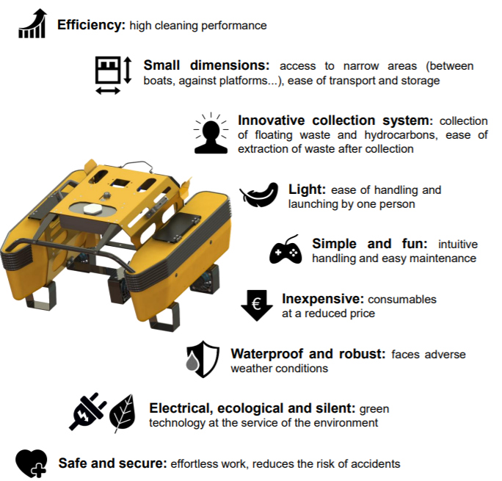
Case study / Jellyfishbot (IADYS - France)
Technologies
The first version of the small drone is remotely controlled with a joystick and it is battery-run.
Its small size (700 x700 x 500 mm) allows it to weave its way everywhere and to easily reach waste carried by the wind and currents into nooks and crannies and saturated zones.
To do this, the mini-catamaran made of aluminium and plastic floats is fitted with a net at the stern capable of collecting 80 litres of floating waste and 30 litres of hydrocarbons during each sortie.

Slide 25
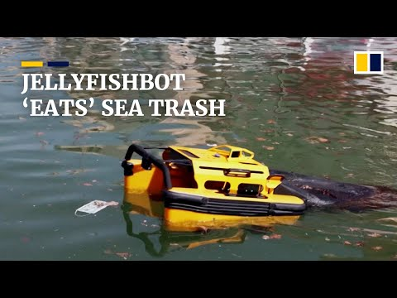
Case study / Jellyfishbot (IADYS - France)

Slide 26
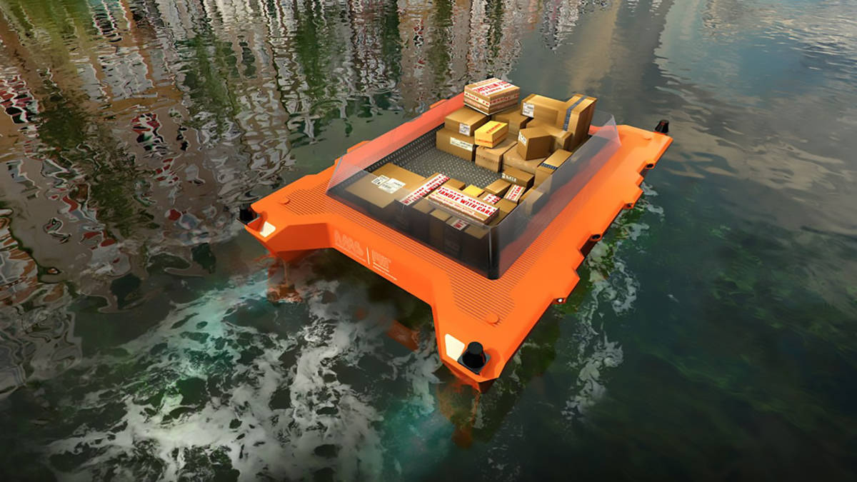
Case study / Roboat (MIT, City of Amsterdam)
Model presentation:
This project imagine a bunch of boats autonomous for the transport of goods and people.
The bunch can also cooperate to produce temporary floating infrastructure, like bridges or stages that can be assembled or disassembled in a few hours.

Slide 27
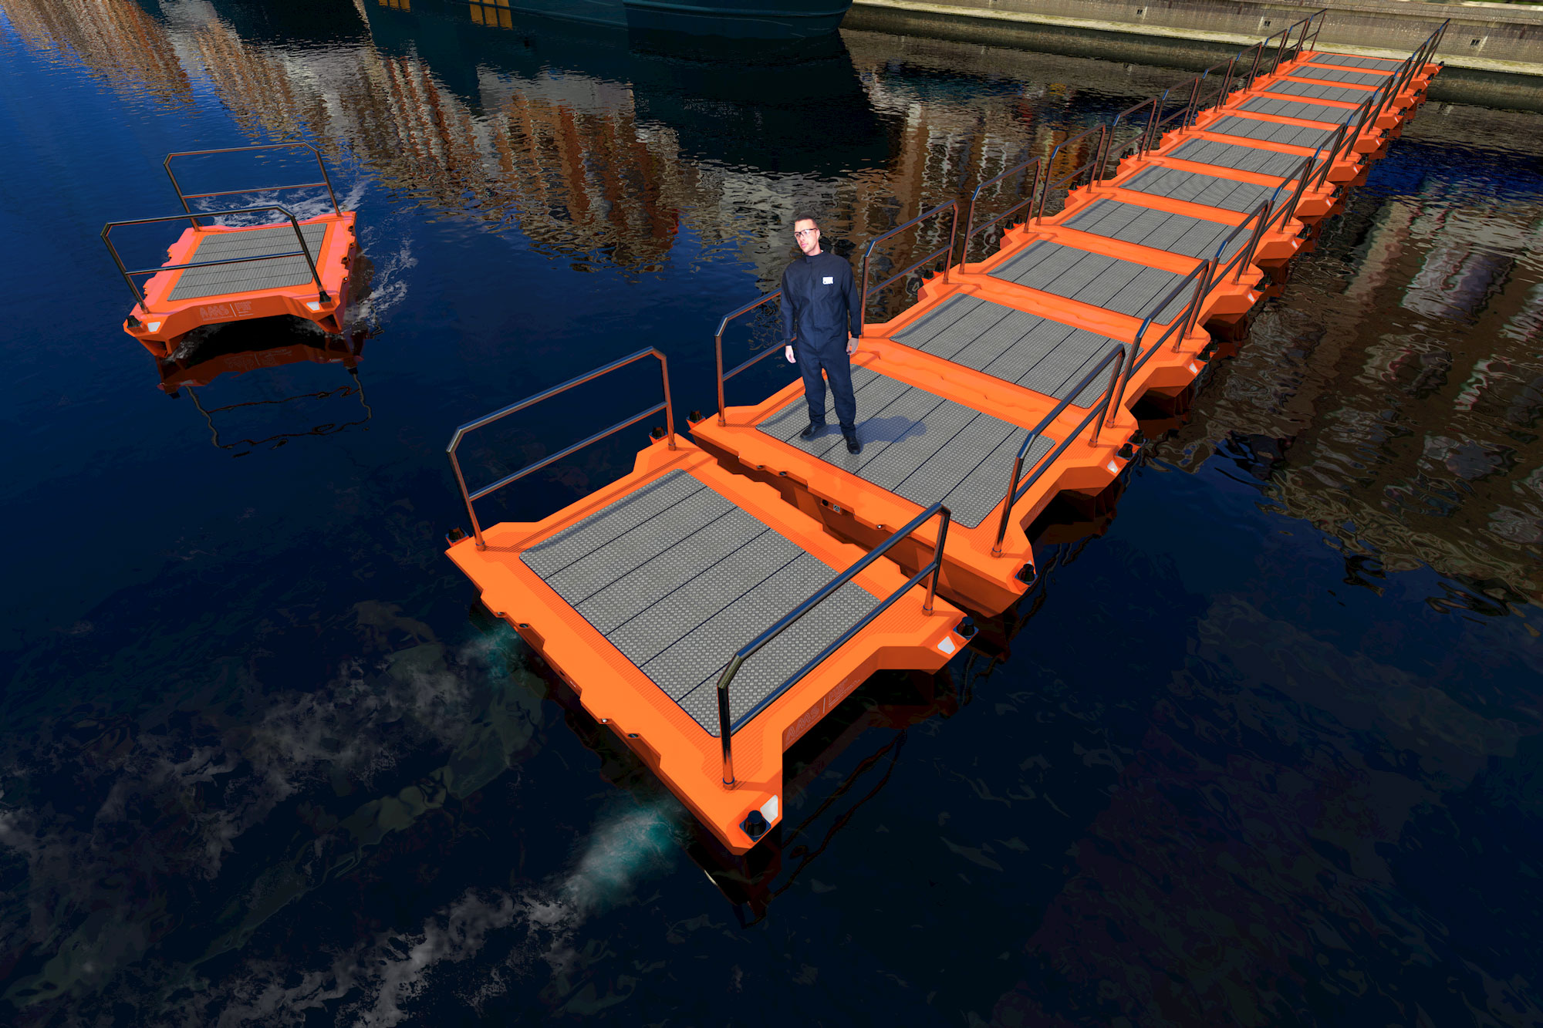
Case study / Roboat (MIT, City of Amsterdam)
Technologies
With the use of new environmental sensors in addition, the modular “robot boats” are able to carry out checks in the waters of cities and ensure their cleanliness and supply information on urban health and citizens themselves.
The first prototypes of autonomous boats are expected to be tested in Amsterdam in 2017. The project’s initial phase will last for five years.
The max speed that the self driving boat can reach is 12km/h and the range is about 75 km.

Slide 28
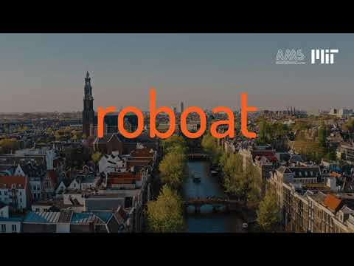
Case study / Roboat (MIT, City of Amsterdam)
Advantages:
This technology is innovative because makes boats
autonomous in the cleaning of the channels and in the
movement of people, goods, without
also forget the management skills
of dynamic infrastructures and sensors
environmental.

Slide 29
Conclusions

Slide 30
A reflection
The use of the internet of things, sensors and artificial intelligence (drones, robots etc.) represent the future of waste management.
The convergence between the aforementioned elements is the only possible solution to major contemporary problems such as overpopulation and climate change. But not only.
For companies, for example, the advantage would also be economic because they can increase operational efficiency, cut costs, and enhance customer satisfaction.

Slide 31
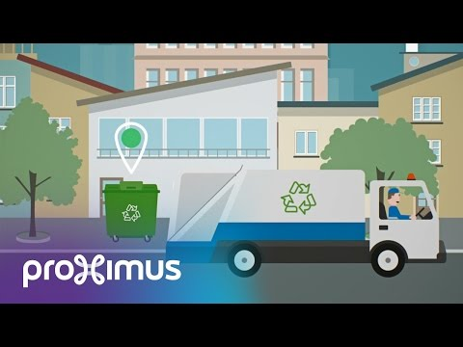
How can IoT help with waste management

Slide 32
Sources
‘Journal of land use, mobility and environment’ by TeMA Journal of Land Use, Mobility and Environment, 2015
‘Smart Waste Collection System based on Location Intelligence’ by Jose M. Gutierreza, Michael Jensenb, Morten Heniusa and Tahir Riazc, 2015
https://www.adambi.com/rmq.html
https://www.rfidglobal.it/
2 gestione rifiutic.indd
Re-Wise
TheJellyfishBoat
Roboat - AMS institute
MIT - Massachusetts Institute Of Technology
a2a - SmartBin
Gruppo Hera - Smarty
Ams Institute
Deepwaste
Solarimpulse

Slide 33
Thanks for your attention

