Slide 1
Marketing Strategy Master’s Course
Professor:
Ed Gilmore
egilmore100@gmail.com

Slide 2
Course objectives
Understanding the key areas of marketing and the practical application of ….Personal marketing, branding, principles of product creation, devising a strategic marketing plan, selling and distribution, retail strategies, advertising, media placement and monitoring, corporate communication, PR, customer care.
Problem solving, individually and in groups
Analysis, creative thinking: using marketing theory and
applying it to hypothetical cases
Learning to formally present your ideas
Listening/interacting/learning with me and from guest experts

Slide 3
Format and Approach
A practical understanding of marketing

Slide 4
Format and Approach
A practical understanding of marketing
- using marketing theory to solve real business problems.

Slide 5
Format and Approach
A practical understanding of marketing
- using marketing theory to solve real business problems.
Presentation of marketing theory

Slide 6
Format and Approach
A practical understanding of marketing
- using marketing theory to solve real business problems.
Presentation of marketing theory
The class is a workshop
- problem solving and exchange of ideas

Slide 7
Format and Approach
A practical understanding of marketing
- using marketing theory to solve real business problems.
Presentation of marketing theory
The class is a workshop
- problem solving and exchange of ideas
Individual & group creative thinking

Slide 8
Reference Material
• Marketing (5° edition)
- Baines, Fill
- Oxford press
• Like a Virgin
-Secrets they won't teach you at business school
by Richard Branson
** For every class you will receive all the slides presented. You are
responsible for all the material in the slides. The above Text Book
is a valuable reference, but not obligatory for the class.

Slide 9
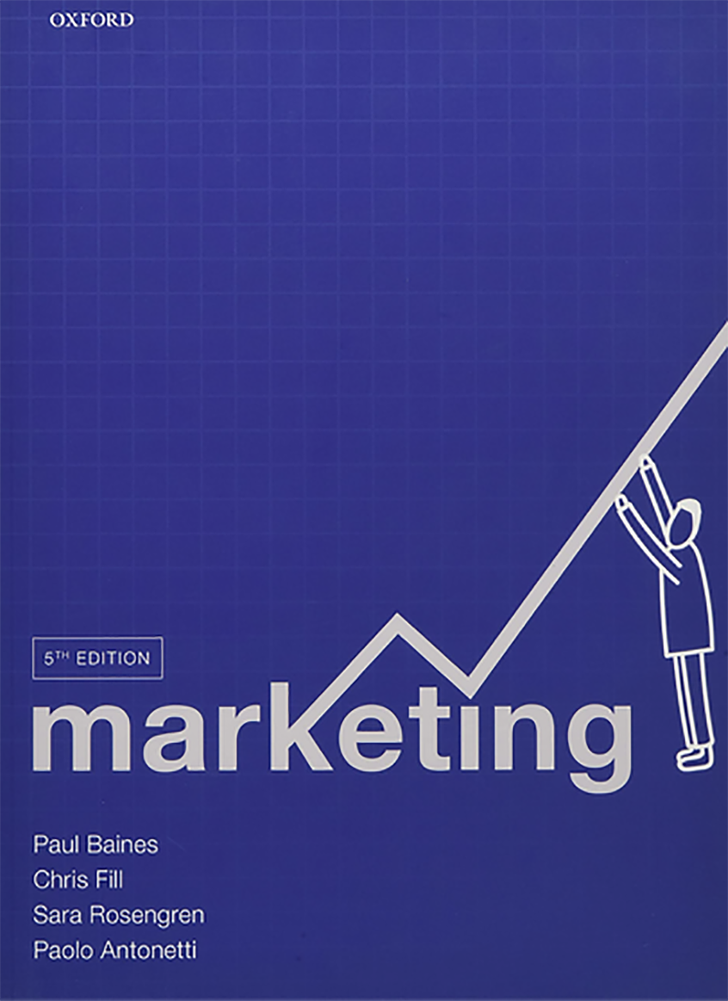

Slide 10
Richard Branson: Here's how to get anyone to listen to your idea
"The pitches that I remember, and resulted in support and investment, were the ones where the idea could have fitted on the back of an envelope"
"If you want to get your message across, be engaging, concise and to the point," he advises. "Then, when you are done saying what you have to say, stop saying it."

Slide 11
Course grading
Group Presentations............ 30%
Individual written report ... 15%
Class participation............... 15%
Final Exam .......................... 40%
Pay attention, learn and contribute !

Slide 12
Personal Marketing
If marketing involves selling, you should first
try to "sell yourself."

Slide 13
INTROS (The first lesson in effective marketing ………sell yourself !!
Who am I ?
Who are you ?

Slide 14
Elevator Pitch
Name
What company and where
Your position
The key point of your company
(all in 20 seconds !!)

Slide 15
What is marketing ??
It is many things to different people
Notes:
mar·ket·ing [mahr-ki-ting]
noun
1. the act of buying or selling in a market.
2. the total of activities involved in the transfer of goods from the producer or seller to the consumer or buyer, including advertising, shipping, storing, and selling.
3. Marketing is the process of communicating the value of a product or service to customers, for the purpose of selling that product or service.
4. (from the Chartered Institute of Marketing): “ The management process of
anticipating,identifying, and satisfying customer requirements profitably.”
5. (from the American Marketing Association): “Marketing is the activity, set of institutions, and processes for creating, communicating, delivering, and exchanging offerings that have value for customers, clients, partners, and society at large.”

Slide 16
History
The origins of the concept of marketing have their roots with the Italian economist Giancarlo Pallavicini in 1959 !!!
Giancarlo Pallavicini introduces the following definitions:
1) Marketing is defined as a social and managerial process designed to meet the needs and requirements of consumers through the processes of creating and exchanging products and values.
2) It is the art and science of identifying, creating and delivering value to meet the needs of a target market, making a profit : delivery of satisfaction at a price.

Slide 17
Definitions
mar·ket·ing [mahr-ki-ting]
1. the act of buying or selling in a market.
2. The total of activities involved in the transfer of goods from the producer or seller to the consumer or buyer, including advertising, shipping, storing, and selling.
3. (from the Chartered Institute of Marketing): “The management process of
anticipating,identifying, and satisfying customer requirements profitably.”
• 4. (from the American Marketing Association): “Marketing is the activity, set of institutions, and processes for creating, communicating, delivering, and exchanging offerings that have value for customers, clients, partners, and society at large.”
** 5. Marketing is the process of communicating the value of a product or service to potential customers, for the purpose of selling that product or service and creating brand loyalty.

Slide 18
Understanding a complex concept like Marketing
Why is it fundamental ?
Can you start a business without it ?
What is the most important part of marketing ?
What area of a business is really outside the
scope of marketing ?

Slide 19
Elements of Marketing management
Product idea and creation
Market research (trends, consumer taste, competition, pricing, etc)
Financial analysis for product viability
Strategic analysis (target market)
Product testing
Marketing plan
Pre-advertising/promotion
Training of sales force
Launch activity
Full advertising/promotion activity
Distribution-Product placement
Monitoring sales activity
Post launch analysis
Strategic planning revisions based on feedback/results
Customer service
Communication PR for product and brand management

Slide 20
Marketing minestrone
• Mass media used to build a brand
• Television, radio
• Sponsorship deals
• Display advertising (newspapers,magazines, on internet)
• Advertorials
• Brochures/Catalogues
• Yellow pages
• Billboard Advertising
• Price promotions and discounting
• Coupons
• Promotional events
• Packaging
• Competitions and prizes
• Refunds/rebates
• Loyalty incentives (supermarket cards)
• Point of sale displays
• Internet marketing/advertising
• Search marketing: to optimize positioning
• Email marketing: direct communication with permission
• Mobile marketing: phone and wireless world
• Online retailing: (B2C) shopping, click, order, have delivered
• Advergaming: Video & online games to advertise/brand
• Social media marketing: using social networks to produce content that users will share
• Virtual reality, AR, AI
• Viral marketing: using promotions, ideas, clips to “pass on”

Slide 21
Understand and choose
First have a fundamental understanding of what the elements are.
Choose the combination of elements to make a strategy to "market" your product or service.

Slide 22
Our focus
The understanding and application of marketing theory:
As a future (or current) executive you must
know the importance of employing the marketing philosophy” in nearly all aspects of your company.
Critical thinking yes, but more important, creative
thinking ..... connecting to the outside world, looking to the future.

Slide 23
MARKETING MIX The 4 P’s +1
POSITIONING
PRODUCT
PLACE
PRICE
PROMOTION

Slide 24
Product
The product is the physical product or service offered to the consumer. In the case of physical products, it also refers to any services or conveniences that are part of the offering. Product decisions include aspects such as function, appearance, packaging, service, warranty, etc.

Slide 25
Price
Pricing decisions should take into account profit margins and the probable pricing response of competitors. Pricing includes not only the list price, but also discounts, financing, and other options such as leasing.

Slide 26
Place
Place (or placement) decisions are those associated with channels of distribution that serve as the means for getting the product to the target customers. The distribution system performs transactional, logistical, and facilitating functions. Distribution decisions include market coverage, channel selection, logistics, and levels of service.

Slide 27
Promotion
Promotion decisions are those related to communicating and selling to potential consumers. It is useful to know the value of a customer in order to determine whether additional customers are worth the cost of acquiring them.
Promotion decisions involve analytical research, selection of targeted customer clusters, creative insights to make visual and written messages, media channel selection, managed advertising programs, continual monitoring and adjusting ADV campaigns, etc.

Slide 28
Positioning
Positioning refers to the place that a brand occupies in the mind of the customer and how it is distinguished from products from competitors. Primarily, it is about "the place a brand occupies in the mind of its target audience". Once that perceived image is fixed, it is difficult to re-position.
Some types: Value for the money, quality, service honesty, well-established, positive reputation (my friends like it ! )
Positioning is one of the most powerful marketing concepts.

Slide 29
Add People also ?
People decisions are those related to customer service. How do you want your workers to appear to your customers? The function of people is to present an appearance, an attitude which should reflect the values of the company & the brand.

Slide 30
Starting a Business
Where do I begin ?
What things must I decide before I spend any money ?
What are most important elements of planning ?

Slide 31
Marketing in 5 simple questions:
• Who are the customers and where are they ?
• What does the customer want ?
• Why does the customer make a purchase ?
• Why will a customer choose to buy my product ?
• How should my company sell to the customer ?

Slide 32
Customer is King
The 'Customer orientation' is perhaps the most common element used in contemporary marketing. It involves a firm essentially basing its marketing plans around the fundamental marketing concept, and thus supplying products to suit new consumer tastes.
The goal of reaching a customer and presenting your product well, used to be the number one goal.
Now, Customer Engagement is the buzzword of modern marketers.
Notes:
Customer engagement: Capture, continued dialogue, finding what they want, need, satisfying that need and cementing a relationship of them to
your brand.......... Virgin, Nordstrom

Slide 33
Marketing Marriage
Company
Product
Customer

Slide 34
First, have an identity
What is the identity of your company, your
uniqueness, your value ?
How can you sell a product or service if you can't communicate the value and quality to the public.
That identification, that perception of the company and product in the mind of the consumer (remember Positioning ! )

Slide 35
Make a positioning graph (price/quality)
La Rinascente
Zara
UPIM
Max Mara
Armani

Slide 37
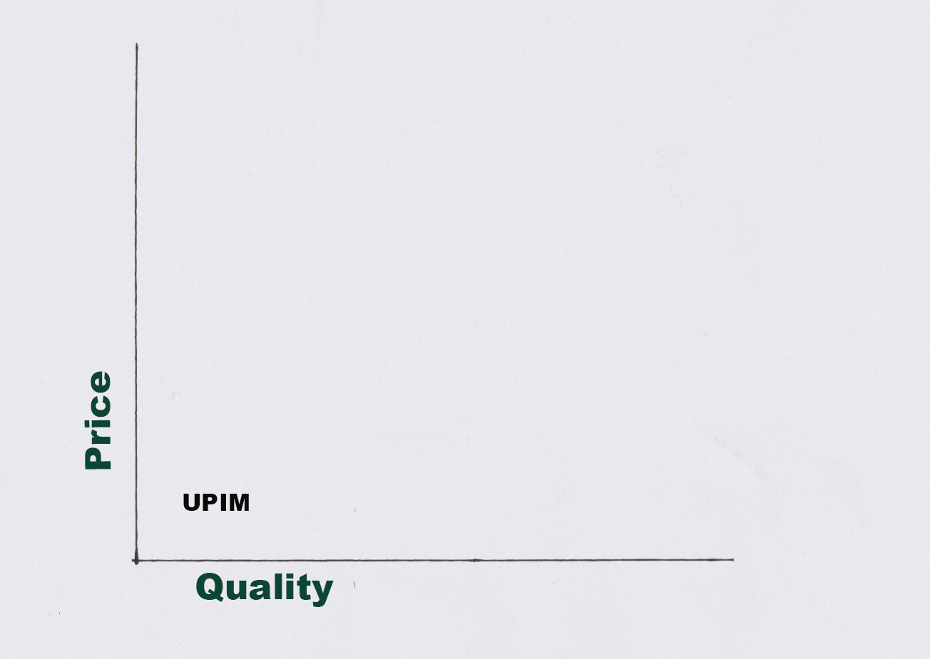

Slide 38
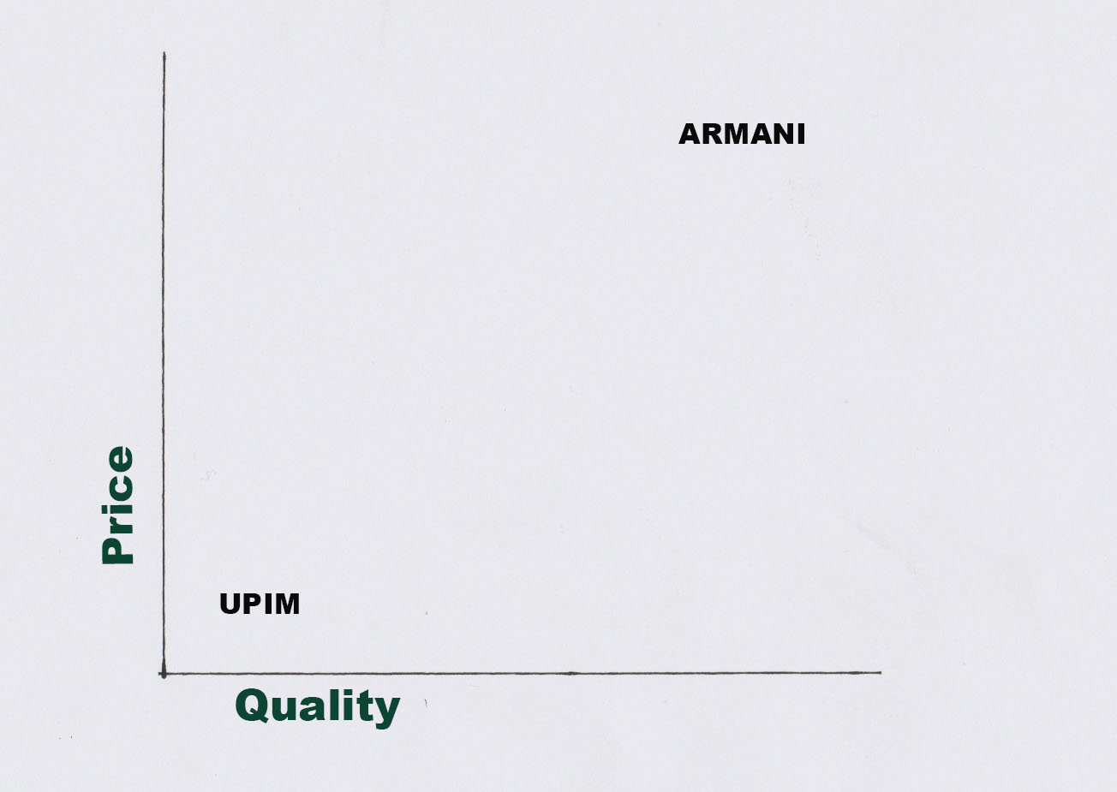

Slide 39
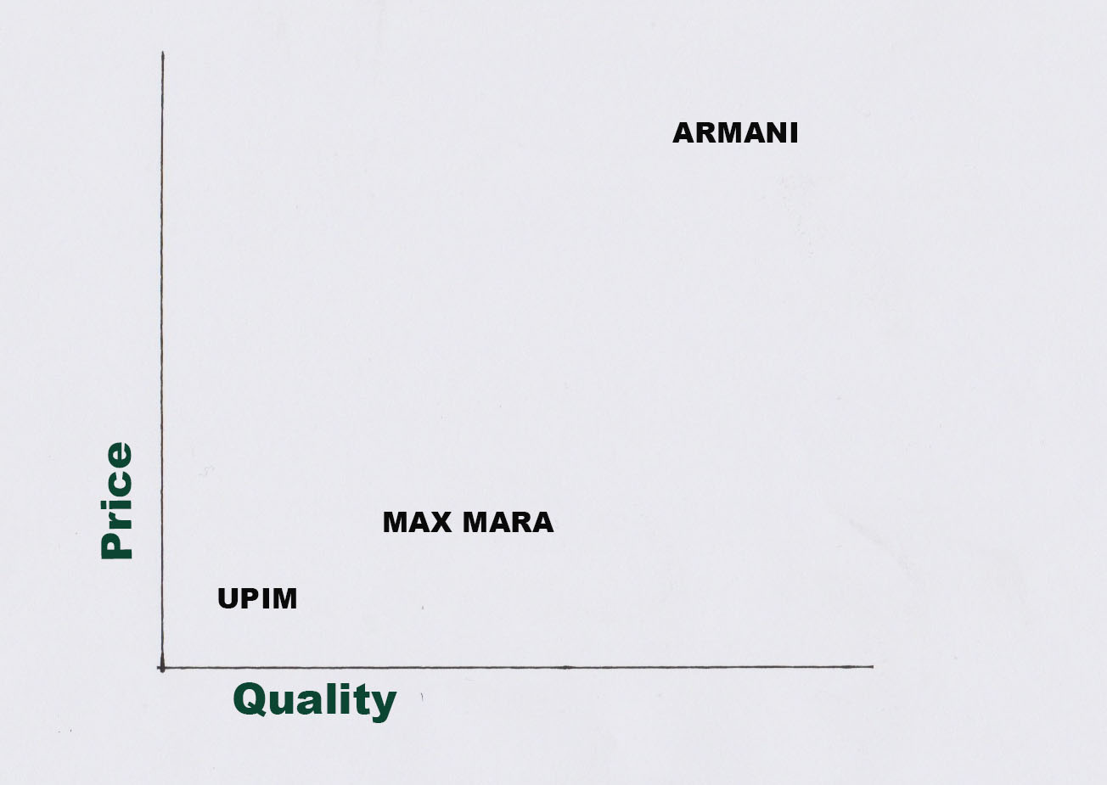

Slide 40
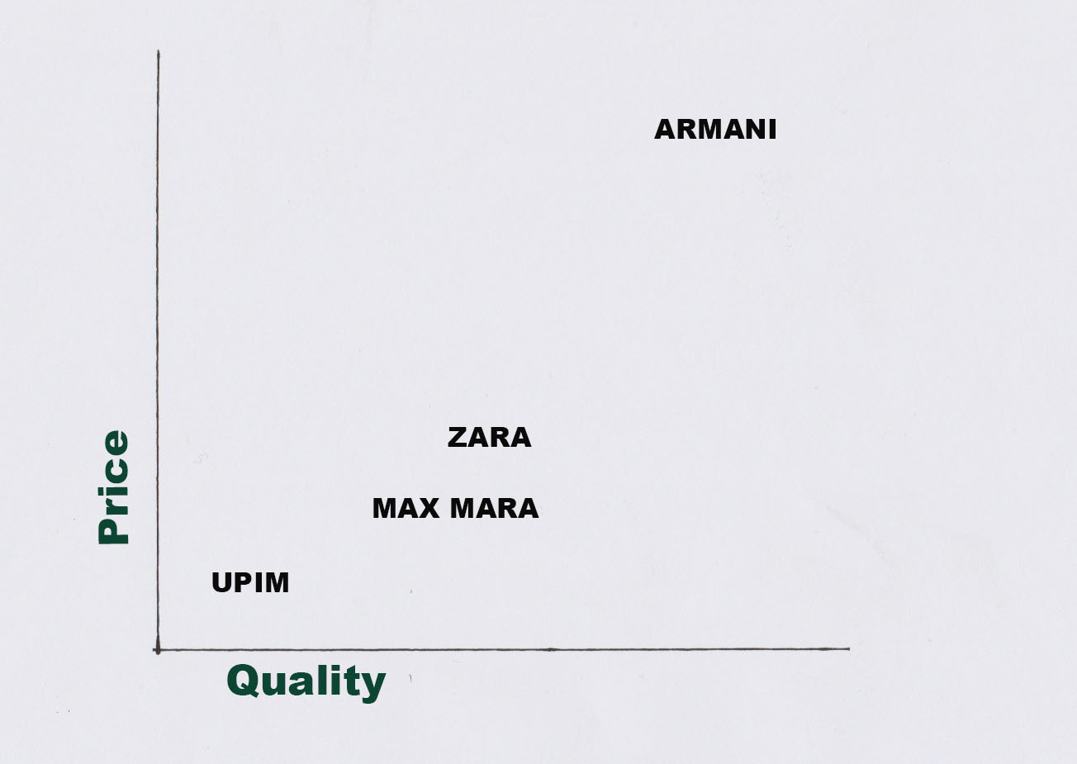

Slide 41
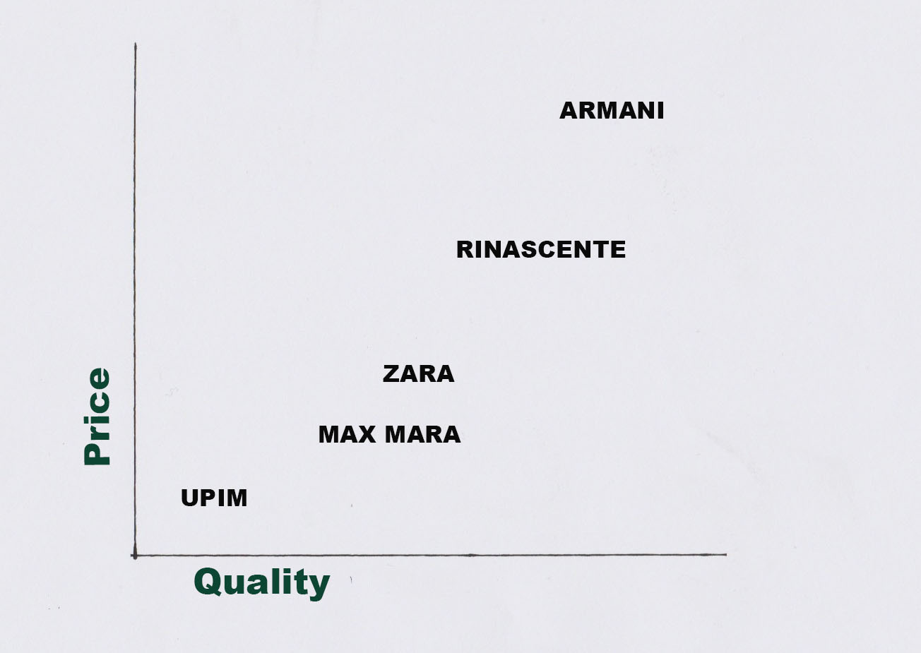

Slide 42
COMPETITIVE POSITION

Slide 43
S.W.O.T. Analysis
• To determine an organization’s strategic position
• A way to identify four Key elements that have an impact on strategy
• The matrix created forms a basis for discussion of strategic planning

Slide 44
S.W.O.T.
Strengths
Weaknesses
Opportunities
Threats

Slide 45
S.W.O.T. example
Strengths
Quick to respond to changes in the marketing environment
Flat management encourages fast decision making
Use of outside contractors enables flexibility
( Lowers employment costs/finance and improves customers’ perception of expertise)
Opportunities
Emerging markets such as Professional Services (e.g.dentists,lawyers,surveyors)
New distribution channels
Tax incentives to encourage purchasing
e-Commerce is a growing market
Weaknesses
Too much work from few clients and at non-premium prices
Few Project management skills
High office and finance costs
Small base of customers
Threats
Larger capitalized companies gaining market share
Speed of technological advances
Contractors have low levels of loyalty

Slide 46
Class Project
Write a S.W.O.T. analysis of your company, choosing the key elements of its product or services that you believe characterize it’s current situation and outlook for the future.
What are, in your opinion, some marketing options for your company to eliminate some weaknesses and increase market share ?

Slide 47
What, no job ?
Choose:
McDonald's
Alitalia
Prada
Vodafone

Slide 49
Homework
Next week the theme of the class is Branding.
Think about this question:
Is Branding important in Marketing ?
Inform yourself and have an opinion.

