Slide 1
Final Presentation Causal Networks
Counterfactual Explanations as Interventions in Latent Space
Alessandro Castelnovo, Anna Giabelli, Andrea Seveso

Slide 2
Introduction
We present CEILS (Counterfactual Explanations as Interventions in Latent Space): novel methodology to generate counterfactual explanations.
CEILS Goal: Capturing the underlying causal relations from the data and providing feasible recommendations to reach the proposed profile.

Slide 3
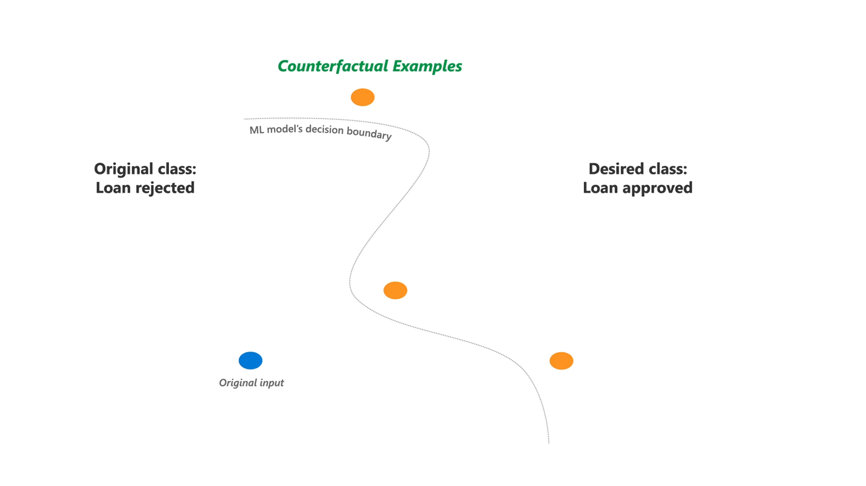
What is a Counterfactual Explanation
Counterfactual Explanations is a post-hoc explanations of machine learning models who generate a hypothetical (counterfactual) examples that show people how to obtain a different prediction.
Explainable AI provide an explanation on why the loan was rejected
Counterfactual Explanation
show decision outcomes from the algorithm with actionable alternative
person who applied for a loan and was rejected by the results of an ML algorithm
Counterfactual Explanations helps people to understand what they could have done to change their model decision

Slide 4
Desiderata of a Counterfactual Explanation
In the generation of the counterfactual examples, it is important to provide the following criteria:
Provide the nearest counterfactual (in the space of features, with respect to the observation to be explained) → Proximity
Low number of feature change → Sparsity
Producing more than one counterfactual explanation, as diverse as possible→ Diversity
Provide a counterfactual closer as possible to the distribution of the “observed dataset “ in the lower times as possible → Prototypes/ Computational Efficiency
Provide to the user recourse instead of explainability:
explanation: what prole would have led to receiving a different outcome?
recourse: what actions would have led me to reach such profile?
Provide plausible action: conditions on the feature space that pertain to have a realistic counterfactual explanation with respect to the training data distribution .
Provide feasible action: conditions on the actions needed to reach some point in feature space.

Slide 5
Desiderata of a Counterfactual Explanation
In the generation of the counterfactual examples, it is important to provide the following criteria:
Provide the nearest counterfactual (in the space of features, with respect to the observation to be explained) → Proximity
Low number of feature change → Sparsity
Producing more than one counterfactual explanation, as diverse as possible→ Diversity
Provide a counterfactual closer as possible to the distribution of the “observed dataset “ in the lower times as possible → Prototypes/ Computational Efficiency
Provide to the user recourse instead of explainability:
explanation: what prole would have led to receiving a different outcome?
recourse: what actions would have led me to reach such profile?
Provide plausible action: conditions on the feature space that pertain to have a realistic counterfactual explanation with respect to the training data distribution .
Provide feasible action: conditions on the actions needed to reach some point in feature space.
These criteria can be reached by capturing the underlying causal relations from the data

Slide 6
Feature Constraints
Regarding the feasibility, it is also useful to define (Karimi et al., Algorithmic recourse: from counterfactual explanations to interventions.):
Immutable features, as those that cannot change in any way, neither for direct intervention nor for indirect consequences of changes in other variables;
Mutable but non-actionable features, as those that can change due to the changes in other connected features, but cannot be directly intervened upon (such as rating in the example above);
Actionable features, as the ones that can vary both due to indirect and direct interventions.

Slide 7
CEILS contributions
Generate explanations and corresponding recommendations by searching for nearest counterfactuals in a latent space representing the residual degrees of freedom once the causal structure of the problem is considered.
In a nutshell, CEILS does the following:
Use the SCM to translate the problem from feature space to the space of exogenous and root variables (latent space);
Apply an arbitrary counterfactual explanation optimizer on latent space;
Translate counterfactuals back to the original feature space.

Slide 8
CEILS building blocks
Project the Causal Graph
Structural Equation
Generate Conterfactual
Recommended actions
Evaluate Counterfactual

Slide 9
Project the Causal Graph
Modeling causal knowledge is complex and challenging since it requires an actual understanding of the relations, beyond statistical evidence. In general, it is important that domain experts validate the relations detected by the causal discovery routine or include new ones when deemed necessary.
Learn Causal Network
Observational Data
Domain Expert Knowledge
Some Algorithm to learn causal network from observational data:
Constraint-based algorithms
The PC algorithm
Semi-parametric causal discovery
Additional topics
We assume Causal sufficiency (no hidden confounders)

Slide 10
independencies
Project the Causal Graph
PC ALGORITHM
The PC ALGORITHM (Spirtes & Glymour 1991, Spirtes et al. 2000) is probably the most known CONSTRAINT-BASED ALGORITHM for learning the structure of a causal network.
The MAIN STEPS OF THE PC ALGORITHM are:
Test for (conditional) independence between each pair of variables represented in 𝔇 = {$X_{1}$, $X_{2}$, $X_{3}\text{,} X_{4}$,$Y$} to derive MD, the set of conditional independence and dependence relations.
Identify the skeleton of the graph induced by 𝔇.
Identify colliders.
Identify derived directions
𝔇 = Observed Data
X1
Target variable
X2
X3
X3
Y
Y
X4
X4
Dependencies: {($X_{1}$, $X_{2}$), ($X_{1}$, $X_{3}$), ($X_{3}\text{,} X_{4}$), ($X_{3}\text{,} X_{2}$), ($X_{i}$, $Y$)} $i = 1,2,3,4$
Independences: ($X_{1}$, $X_{4}$), ($X_{2}\text{,} X_{4}$)
MD
We assume Causal sufficiency (no hidden confounders)

Slide 11
independencies
Project the Causal Graph
PC ALGORITHM
The PC ALGORITHM (Spirtes & Glymour 1991, Spirtes et al. 2000) is probably the most known CONSTRAINT-BASED ALGORITHM for learning the structure of a causal network.
The MAIN STEPS OF THE PC ALGORITHM are:
Test for (conditional) independence between each pair of variables represented in 𝔇 = {X1,X2,X3,Y} to derive MD, the set of conditional independence and dependence relations.
Identify the skeleton of the graph induced by 𝔇.
Identify colliders.
Identify derived directions
𝔇 = Observed Data
X1
Target variable
X2
X3
Y
X4
Dependencies: {($X_{1}$, $X_{2}$), ($X_{1}$, $X_{3}$), ($X_{3}\text{,} X_{4}$), ($X_{3}\text{,} X_{2}$), ($X_{i}$, $Y$)} $i = 1,2,3,4$
Independences: ($X_{1}$, $X_{4}$), ($X_{2}\text{,} X_{4}$)
MD
THE PC ALGORITHM produced PDAG
We assume Causal sufficiency (no hidden confounders)

Slide 12
independencies
Project the Causal Graph
PC ALGORITHM
The PC ALGORITHM (Spirtes & Glymour 1991, Spirtes et al. 2000) is probably the most known CONSTRAINT-BASED ALGORITHM for learning the structure of a causal network.
The MAIN STEPS OF THE PC ALGORITHM are:
Test for (conditional) independence between each pair of variables represented in 𝔇 = {X1,X2,X3,Y} to derive MD, the set of conditional independence and dependence relations.
Identify the skeleton of the graph induced by 𝔇.
Identify colliders.
Identify derived directions
𝔇 = Observed Data
X1
Target variable
X2
X3
Y
Based on the skeleton, we search for subset of variables $\{X,Y,Z\}$such that $X$ e $Y$ are neighbors, $Z$ and $Y$ are neighbors, while $X$ and $Z$ are not neighbors
X4
We assume Causal sufficiency (no hidden confounders)

Slide 13
independencies
Project the Causal Graph
PC ALGORITHM
The PC ALGORITHM (Spirtes & Glymour 1991, Spirtes et al. 2000) is probably the most known CONSTRAINT-BASED ALGORITHM for learning the structure of a causal network.
The MAIN STEPS OF THE PC ALGORITHM are:
Test for (conditional) independence between each pair of variables represented in 𝔇 = {X1,X2,X3,Y} to derive MD, the set of conditional independence and dependence relations.
Identify the skeleton of the graph induced by 𝔇.
Identify colliders.
Identify derived directions
𝔇 = Observed Data
X1
Target variable
X2
X3
Y
The direction of an edge is said to be derived when it is a logical consequence of previous actions
When a unique DAG can not be obtained from the database of cases, we can ask help to the domain expert.
X4
We assume Causal sufficiency (no hidden confounders)

Slide 14
Structural Equations
The Structural Causal Model encodes a more detailed description of causal relationships. This is defined by a triplet (X,U,F). F represent a set of functions called Structural Equations, F : U → X mapping the exogenous (unobserved) variables to the endogenous (observed) X = F(U).
U = Latent Space
𝔇 = Observed Data
Infer the structural equations: Given the DAG we assume an Additive Noise Model:
$X_{j}=$ $f_{j}(pa(X_{j}$))+ $U_{j}, ∀j=1,…,d$
X1
U1
Target variable
U2
X2
X3
Y
U3
X4
U4

Slide 15
Structural Equations
The Structural Causal Model encodes a more detailed description of causal relationships. This is defined by a triplet (X,U,F). F represent a set of functions called Structural Equations, F : U → X mapping the exogenous (unobserved) variables to the endogenous (observed) X = F(U).
U = Latent Space
𝔇 = Observed Data
Calculate the latent variable U: A regressor model M is trained to estimate each function $f_{j}$, predicting $X_{j}$ from its parent nodes. A node without parents is called root node.
$$\left\{\begin{aligned}\hat{U_{j}}=X_{j}, for all roots j \\ \hat{U_{j}}=X_{j}−ℳ_{j}(pa(X_{j}\text{)}, for all non−roots j\end{aligned}\right.$$
X1
U1
Target variable
U2
X2
X3
Y
U3
X4
U4

Slide 16
Structural Equations
The Structural Causal Model encodes a more detailed description of causal relationships. This is defined by a triplet (X,U,F). F represent a set of functions called Structural Equations, F : U → X mapping the exogenous (unobserved) variables to the endogenous (observed) X = F(U).
U = Latent Space
𝔇 = Observed Data
Model in the latent space: starting from root nodes is possible to construct the full relation F : U → X. Once the relation X = F(U) is available, is possible to build the model:
$$\hat{C}\left(u\right)=\left(C∘F(U)\right)$$
X1
U1
Target variable
U2
X2
X3
Y
U3
X4
U4
$\hat{C }$ = Model in the latent space

Slide 17
Generate Conterfactual (1/2)
In a static world, the action “$δ$” could correspond to $x^{cf}−x$. In general, this is not true, and a more general formulation is:
$$\left\{\begin{aligned}δ^{∗}=\arg{\min_{δ∈Ϝ_{δ}}cost(δ,x)} \\ x^{cf}=S(x,δ)∈Ρ_{χ} \\ C\left(x^{cf}\right)≠C\left(x\right)\end{aligned}\right.$$
𝛿 is the “cheapest” action in the space of the feasible action
Subset of feature space X containing plausible counterfactuals
In CEILS, given a model:
$$\hat{Y}=C\left(x\right)=1_{\{R\left(x\right)>t\}}=1_{\{P\left(Y=1|X=x\right)>t\}}$$
and structural equations $X=F(U)$ we can build their composition:
$$\hat{C}\left(u\right)=\left(C∘F\right)\left(u\right)=1_{\{R\left(F(u)\right)>t\}}{=1}_{\{P(Y=1|U=u)>t\}}$$
$\hat{C}$ is a model that takes in input $u$ in the latent space, converts it in the original space thanks to the structural equations $F(u)$, and then predicts its corresponding $Y$.
Thanks to $\hat{C}$ we can search the counterfactuals in the latent space $u$ instead of the feature space $x$

Slide 18
Generate Conterfactual (2/2)
Now 3 steps are needed to obtain the causal counterfactual explanation:
Abduction: events are restricted by the observation of the actual state, computing $U|\{X=x\}$
Action: is the process of acting upon some variables and fixing them to some specific values. The actual intervention $δ$ is computed as the minimal shift in latent space needed to reach a different outcome with respect to $\hat{C}$, namely $u^{cf} = u + δ$
Prediction: we compute the values of the observed variables $X$ given the latent $U = u$and given the intervention: $x^{cf} =F(u + δ)$

Slide 19
Recommended actions (1/2)
Notice that the action:
$${δ= u}^{cf} − u$$
differs for root nodes and non-root nodes. For root nodes there is no difference between the latent variable $U$ and the feature $X$. For non-root nodes:
$${ x}^{cf}− x={F( u}^{cf}) −F(u)=f(pa({ x}^{cf}))−f(pa(x))+δ$$
This is called a soft intervenction, while a hard intervenction is ${ x}^{cf}− x=δ$.

Slide 20
Recommended actions (2/2)
CEILS implements by default soft interventions:
The latent space action $δ$ is an example of soft intervention since it is performed on top of other changes in the variable due to changes in its parents.
It is important to point out that the main advantage of CEILS is that it provides not only the counterfactual explanation, but also the action needed to reach it. Recommending actions as shifts in the latent space, CEILS takes into account the underlying causal flow.

Slide 21
Evaluation metrics (1/3)
Validity: the fraction of generated explanations that are valid counterfactuals, i.e. that are given a different outcome $y$ with respect to the factual instance.
Proximity: the distance between the original instance and the counterfactual explanation.
$${proximity}_{cont}\left(x^{cf},x\right)=\frac{1}{n_{cont}}\sum_{p=1}^{n_{cont}}{\frac{|x_{p}^{cf}−x_{p}|}{{MAD}_{p}}}$$
$${proximity}_{cat}\left(x^{cf},x\right)=\frac{1}{n_{cat}}\sum_{p=1}^{n_{cat}}{I(x_{p}^{cf}≠x_{p})}$$

Slide 22
Evaluation metrics (2/3)
Sparsity: the number of features that need to change with respect to the original input.
$$sparsity\left(x^{cf},x\right)=\sum_{p=1}^{d}{1_{\{\left|x_{p}^{cf}−x_{p}\right|>t_{p}\}}}$$
Distance: L1 distance between counterfactual and factual observations.
$$distance\left(x^{cf},x\right)={∥x^{cf}−x∥}_{1}$$
All the above metrics refer directly to the counterfactual explanations, thus are metrics on feature space. The following metrics are focused on the evaluation of actions, thus on latent space quantities.

Slide 23
Evaluation metrics (3/3)
Cost: L1 norm of the action that must be done in order to reach a counterfactual explanation.
$$cost\left(x^{cf},x\right)={∥{F^{−1}(x}^{cf})−F^{−1}(x)∥}_{1}$$
Feasibility: it corresponds to the percentage of explanations whose actions are all feasible. Requirements upon actions:
$${{F^{−1}(x}^{cf})}_{v}={F^{−1}(x)}_{v}⟺δ_{v}=0 ∀v non−actionable$$
$${{F^{−1}(x}^{cf})}_{v}≥\left(≤\right){F^{−1}\left(x\right)}_{v}⟺δ_{v}≥\left(≤\right)0 ∀v increasing \left(decreasing\right) only$$

Slide 24
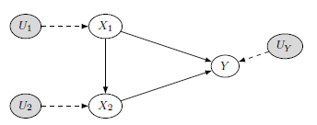
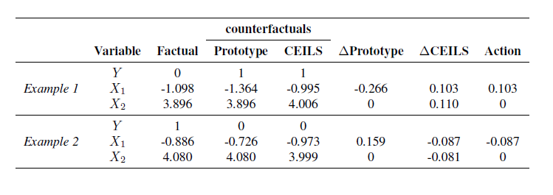
Experiment – Syntetic Dataset
We generate a toy dataset of 100,000 samples with two features (X1 and X2) and a binary outcome (Y ) with the following Structural Equations:
$$X_{1}=U_{1},{ U}_{1}\sim 𝒩\left(−1,1\right)$$
$$X_{2}=X_{1}+U_{2},{ U}_{2}\sim 𝒩(5,1)$$
Y$=1_{\left({3X}_{2}−X_{1}+U_{Y}\right)>t},{ U}_{Y}\sim 𝒩(0,1)$
Generate counterfactual explanations with:
Alibi Prototype (correlation keeping)
CEILS built up on Alibi Prototype
$X_{1}$ – actionable (e.g. Income)
$X_{2}$ – mutable but non-actionable (e.g. Rating)
Alibi Prototype ignores the impact of $X_{1}$ on $X_{2}$

Slide 25
Conclusion
Main novelty: it is possible to embed CEILS in any existing counterfactual generator;
Leveraging causal relationships enables to provide feasible recommendations and reduce overall effort;
A practical evaluation on a real-world use case and dataset has been provided.

Slide 26
ANNEX

Slide 27
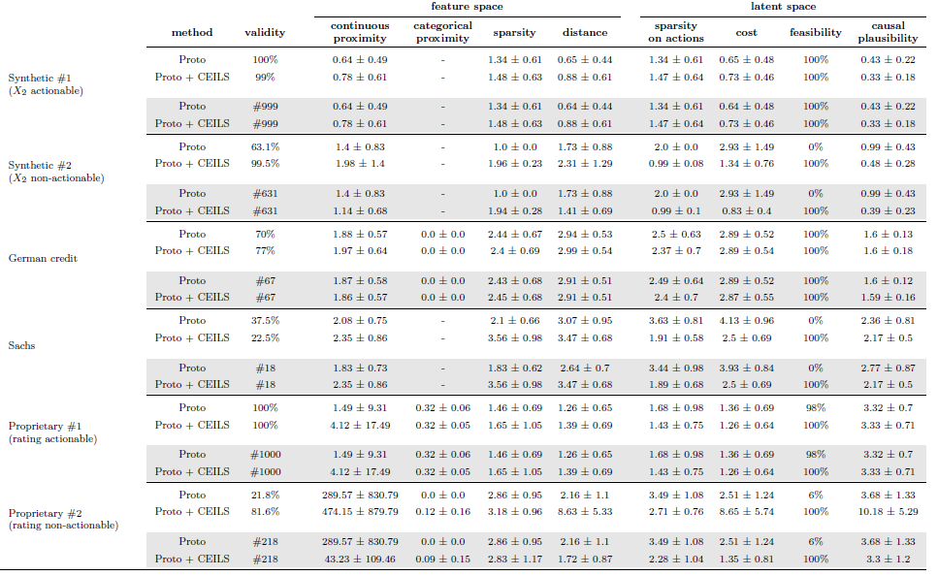
Experiments – Results

Slide 28
Other SOTA Techniques
Some works have put forward proposals to embed causality aspects into the counterfactual generation process.
For example, Mahajan et al. (2019) introduce a “causal proximity” loss term by which the counterfactual explanation is “pushed” towards regions in which the underlying causality among features is preserved.
Karimi et al. (2020c) build on the optimization framework described in Karimi et al. (2020a) and introduce causality by computing counterfactuals through abduction- action-prediction steps as prescribed by Pearl et al. (2016).

Slide 29
Future Works
Possibility to relax the assumption of having a complete/reliable causal graph and work with incomplete causal relations;
Extend the evaluation by employing other conterfactual generators as baselines;
Compare the result of CEILS to other baselines;
Involve end-users to obtain feedback that will guide towards better explanations.

Slide 30
THANK YOU

