Slide 1
Branding
What is it and why is it important ?
Notes:
What is your definition ?

Slide 2
Brand Definition
Unique design, sign, symbol, words, or a combination of these, employed in creating an image that identifies a product and differentiates it from its competitors. Over time, this image becomes associated with a level of credibility, quality, and satisfaction in the consumer's mind.
It stands for certain benefits and value.
Legal name for a brand is trademark and, when it identifies or represents a firm, it is called a brand name.

Slide 4
What is it ?
A symbol, an identity
Perception of quality, stability, service
A way for a company to communicate a product’s value, and the value of the company that makes it.

Slide 6
So.....Why Brand?
Helps people identify an offering quickly and
with a certain degree of trust.
• Develops a positive emotional link to the consumer so they are reassured with their purchase.

Slide 9
So a brand becomes an established identity
This identity needs to be protected and managed because it has a value.
What happens if something goes wrong ?

Slide 10
One of the most recognized brands in the world
This is the 36th anniversary of one of the biggest brand
mistakes in history.
What happened in 1985 ?

Slide 11
Introduction of New Coke

Slide 12
Volkswagen
The brand
Before ……………….. and after Sept 2015

Slide 13
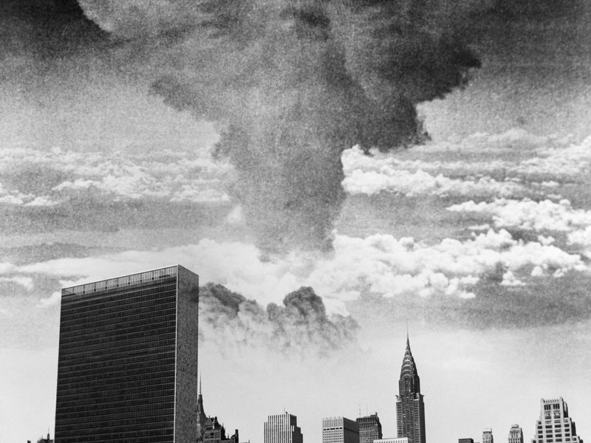
VW: Brand Disaster

Slide 14
Damage control
Public Relations:
How did VW handle the problem with the public ?
What has happened to their image,their
sales, market share ?
3) What did they do to repair their brand?
4) Did they recover from this damage ?

Slide 15
Brand symbolic meanings
conveys certain attributes
has benefits: (actual/psychological)
values: the product represents the producer
culture
personality

Slide 16
What does the name Mercedes communicate ?

Slide 17
High quality

Slide 18
High quality
Luxury – upper class

Slide 19
High quality
Luxury – upper class
German engineering

Slide 20
High quality
Luxury – upper class
German engineering
Solid, dependable, high performance

Slide 21
High quality
Luxury – upper class
German engineering
Solid, dependable, high performance
Prestige ….status symbol for the owner

Slide 22
Brand Name
Easily spelled, remembered, spoken
Indicative of the product’s major benefits
Distinctive, unique
Capable of registration protection
Notes:
Examples: Lego, Sure (deodorant)
Foreign language problems must be checked out:
Clairol “Mist Stick” ..... in German, mist means manure (letame)

Slide 23
Strong Brand Names- Why ?

Slide 24
Why "Amazon" ?

Slide 25
Bezos looked for a brand name that would align with his vision: the earth’s biggest bookstore. Bezos picked up a dictionary and scanned word after word, page after page. In 1995, he discovered the word “Amazon” (lets hope he started alphabetically), as in earth’s largest river. He liked the homonym for two primary reasons. In the past, websites were listed alphabetically, which meant Amazon would always be higher on the page, giving a slight competitive advantage. And secondly, he picked the largest river in the world to communicate Amazon’s vast selection of books.

Slide 26
Nestlé
largest food & beverage brand in the world
They own and control over 2000 products
Is the perception of their brand positive, negative or neutral ?
How does the company manage their brand image ?

Slide 27
What's in a name ?
Lego
Sure

Slide 28
Before choosing a name:
Think globally – check the registry of names already used
Think of cultural misunderstandings
Check with the major languages for any
possible embarrassing translations

Slide 29
Branding Gaffe
Clairol company:
Product: Electric hair curler with steam vapore
Name: The Mist Stick

Slide 30
Choosing a name -Where do you start ?

Slide 31
Brand Personality Psychosocial meanings
Sincerity: Honest, transparent, wholesome, cheerful
Excitement: Spirited, imaginative, daring, energetic
Competance: Reliable, prepared, intelligent, successful
Sophistication: Charming, chic, upper class
Ruggedness: Outdoors, tough, durable

Slide 32
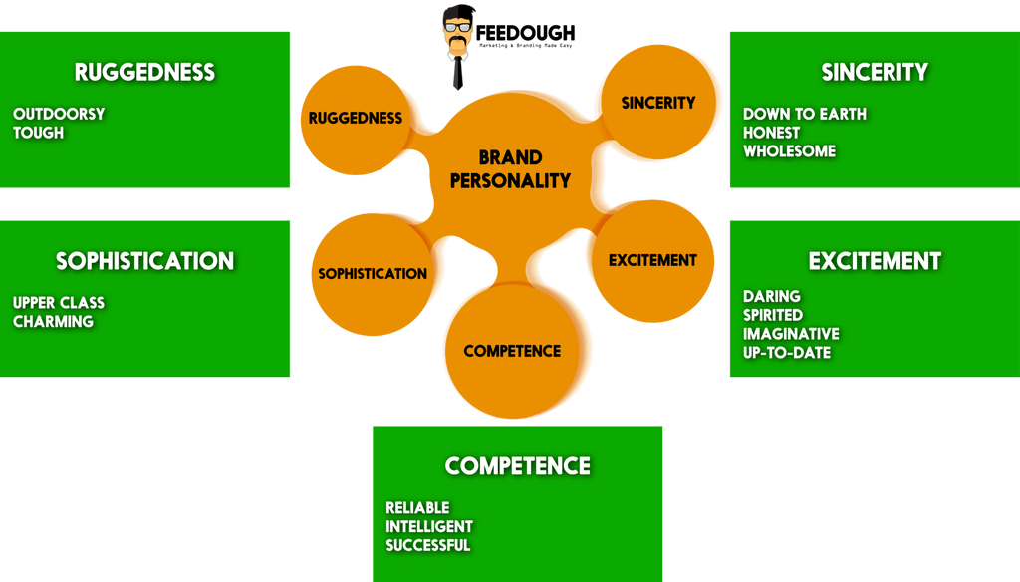

Slide 33
The power of a group
Shared thinking... brain power is multiplied
Division of tasks
Productivity increase
Learning to cooperate with people you don't like !

Slide 34
Class Groups
Agency 1: M. Brocca, L. Muhsen, O. Salem, M. Cattaneo, F. Sansone
Agency 2: N. Balyan, O. Bagdanova, K. Jain, H. Kamal, M. Corti
Agency 3: D. Lobuono, A. Petakovic, Z. Kiziltunc, F. Vriale, C. Masi
Agency 4: R. Plaia, N. Rinaldo, D. Rebeccato, A. Rodigari, M. Serra
* The first person named in the group is designated as the group leader, who will
coordinate the group activity and lead the presentation.

Slide 35
Group Think
Analyze the Brand Personalities of these Brands:
Timberland Johnson & Johnson
Nike Apple
Easy Jet Pampers
Why was the name chosen ?
Why is the product consistent with their brand name?

Slide 37
Hey, give me a break !!

Slide 38
Brand experience
Your brand is the experience customers have when doing business with your company. It includes:
The benefits the customer receives from the brand. These are things like more time or money, recognition, acceptance, security or pleasure. Does your product or service deliver any of these benefits?
The promises you make and keep. Do you meet the deadline or delivery date? Do you include extras, or go above and beyond the ordinary? Do you find ways to add value?
How you follow up after you’ve delivered. After sale care: your keeping in touch, how you deal with problems that arise and how you nurture your business relationships over time.

Slide 39
Customer Journey
Related closely to the Brand Experience
Every "touch point" in the way a customer
experiences a company, product or service
..... from discovery, engagement, buying, use
and after sales service.

Slide 40
Brand elements
Brand Name
Brand Identity
Brand awareness
Brand Image
Brand extension
Off-brand
Brand equity
Brand Positioning
Re-branding
Brand Management
Co-Branding

Slide 41
Create a Name
Brainstorm:
Versace is creating a line of fashion sunglasses
linked to the sporting life.... strong, bold,
durable, stylish, chic
What should this sunglass line be called ??

Slide 42
Organize your thoughts
First: Understand the client. Versace: Who are they ? Brand values ?
Create key elements:
Product Type Feeling
sunglasses sporty Fashion statement
optics activewear strong style
eyewear performance power look
"shades" champion sexy strong
Mix the concepts, use free association with other adjectives and make a list of possible names

Slide 44
First step of IDENTITY
Mission statement
- In few words it indicates the reason for operating your business. Your philosophy, goal.
Do you know the Nike mission statement ?

Slide 45
“To bring inspiration and innovation to every athlete in the world.”
This mission statement is a promise to their customers. Who are their customers? Athletes. What do they aim to do with every product and customer interaction? Inspire and innovate.
This has brought continuity to the marketing strategies for the life of their company.
Think of their tagline: Just Do It
(inspiring, call to action)

Slide 46
Johnson & Johnson Credo
"Johnson & Johnson creates a healthy environment where everyone feels their contributions are valuable and contributory to the wellness of humanity. We spark solutions that create a better, healthier world.”

Slide 47
Brand E x t e n t i o n
Notes:
Mars chocolate bars... introduced Mars ice cream bars (strategic to avoid seasonality sales slumps)
Harley Davidson ( rugged, tough, masculine, wild)... Used HR brand on line of borse frigo, baby clothes, fragrances... was a disaster and
they pulled out of this marketing direction as it could damage the core brand image.

Slide 48
Extentions
Coppertone Sunglasses, Harley Davidson Apparel, Starbucks Frappuccino, Snickers Ice Cream Bars, Cindy Crawford Jewelry, etc.
Google: from search and extended into a hosted email service, web analytic tools, etc.
Apple: from personal computers into MP3
players, phones, pads, etc.

Slide 49
Brand Equity
In accounting, a brand defined as an intangible asset is often the most valuable asset on a corporation’s balance sheet. Brand owners manage their brands carefully to create shareholder value, and brand valuation is an important management technique that ascribes a money value to a brand.

Slide 50
Positioning The Battle for your mind

Slide 52
Re-branding (logos) (a corporate facelift)
Notes:
Logo change is easy
Has direction, company philosophy changed ? It must be communicated
Apple Computer ... to Apple (not just a one product company)
Just happened: Wall Street Institute changed to Wall Street English

Slide 53
Co-Branding
The marketing of a product or service under 2 or more brand names
Advantages: cost sharing, risk sharing, greater visibility and customer trust
Examples: Dell or HP computers + Intel
BMW & Louis Vuitton
Starbucks & Spotify

Slide 54
Cross-Branding
A marketing strategy which combines two offerings from separate companies. The technique is usually used to sell complementary products or services. Also called cross promotion or cross merchandising.

Slide 55
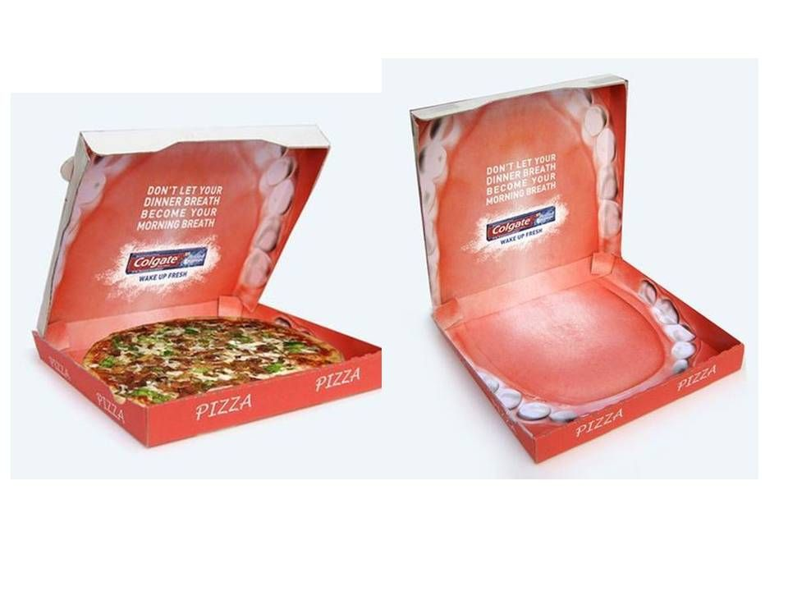
Cross Branding........... Cross Promotion

Slide 56
Review of Definitions
Brand Name.... unique, remembered, gives the essence of its qualities
Brand identity … what a company wants people to think about a brand
Brand image……… what people actually think about the brand
Brand awareness ……….. how much people are aware of the brand
Brand extension… when a new product or service is added and is associated with the existing brand
Branding… when a product or service is associated with a brand
Off-brand…… when a product does not have a particular brand name... usually less expensive, sometimes of less quality...... "a store brand"
Brand equity… the value that a brand adds to a product or service, a company
Brand positioning...identifying and trying to occupy a market niche; creating a distinct impression in the customer’s mind
Co-branding... Brand partnering in selling a common product
Cross branding... Brands partnering in doing promotions

Slide 57
Building a brand
Prominent- in the minds of potential buyers
Performance – how well does it work
Imagery- the “look” (color/packaging)
Judgements- their opinions & evaluations of the product
Feelings- emotional connections when using the product
Resonance- the loyal relationship of the customer has been established.

Slide 58
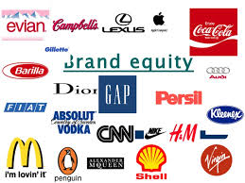
Image-quality-feeling-performance
Explains how brands work through psychological associations and personalities.
Notes:
Apple & Virgin: how are company philosophies different ? how does their approach to the market differ ?

Slide 59
Class Think
Virgin Group
Ralph Lauren
Barilla
Apple
Psychological image and the core brand values that you feel gives it a certain "brand image".
2) What does the company do to promote and reinforce their brand image ?

Slide 60
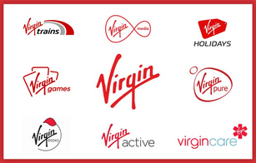
– the House of Brands model
To understand how a huge global company with over a hundred sub-brands can be consistent with their brand identity, read this:
https://fabrikbrands.com/virgin-brand-architecture/

Slide 61
Remember the question ?
So, is Branding that important in Marketing ?

Slide 62
Brand Value threats
Threats to Traditional Brands:
Mobile shopping apps
price-quality comparison apps
consumer recommendations
word of mouth social power

Slide 63
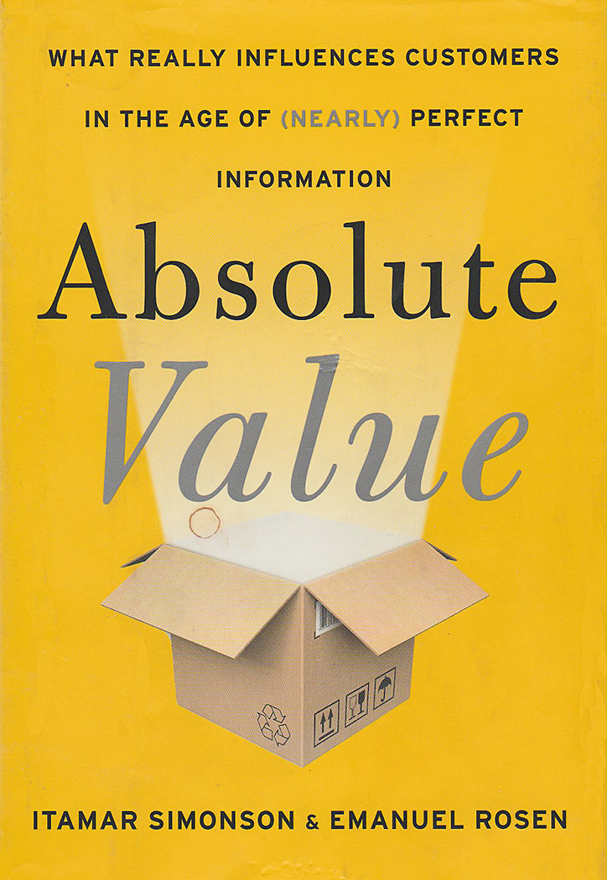
The end to traditional Marketing ?
Do we say goodbye to:
Brand value
Positioning
Mass advertising
Customer loyalty
?

Slide 65
Creating a Brand

Slide 66
FIRST PRESENTATION ADVISING A START-UP
How to organize the beginning steps of marketing for a company with an interesting product idea. However, it doesn’t have an identity, a developed brand or solid marketing direction.
The company is in the fashion sector and wants your advice regarding:
-Their name,
-their approach to have a successful marketing strategy,
-to be recognized even though they have a limited budget.... how can they "stand out" in the crowded fashion market ?

Slide 67
Client brief (Groups 1 & 2)
- The company started 3 months ago with 4 partners (with design and manufacturing experience)
- They have prototypes of 15 items already made
- The tentative name for the company is "Look Good Fashion" but they don't like it. They don't have a
clear idea about how to start and promote their business. How can their concept help them to find customers ?
Key Facts:
Made in Italy design and manufacture
All 100% certified organic and Fairtrade materials
Comfortable, practical clothing for women
From socks, sleepwear, pants, dresses and jackets
A fair price (all items from 70 to 400 euros)
They have an advertising budget of 200,000 euros
Their philosophy:
We make beautiful garments that reflect our values: people and the planet are central to everything we do. Our garments are made with organic cotton and sustainable materials, using traditional skills.
We follow the principles of Fair Trade in every aspect of our business. We also work hard to ensure that we pioneer sustainable methods of production to minimise environmental impact. Not only is the majority of our cotton certified organic and Fairtrade, all our clothes are dyed using safe and azo-free dyes.

Slide 68
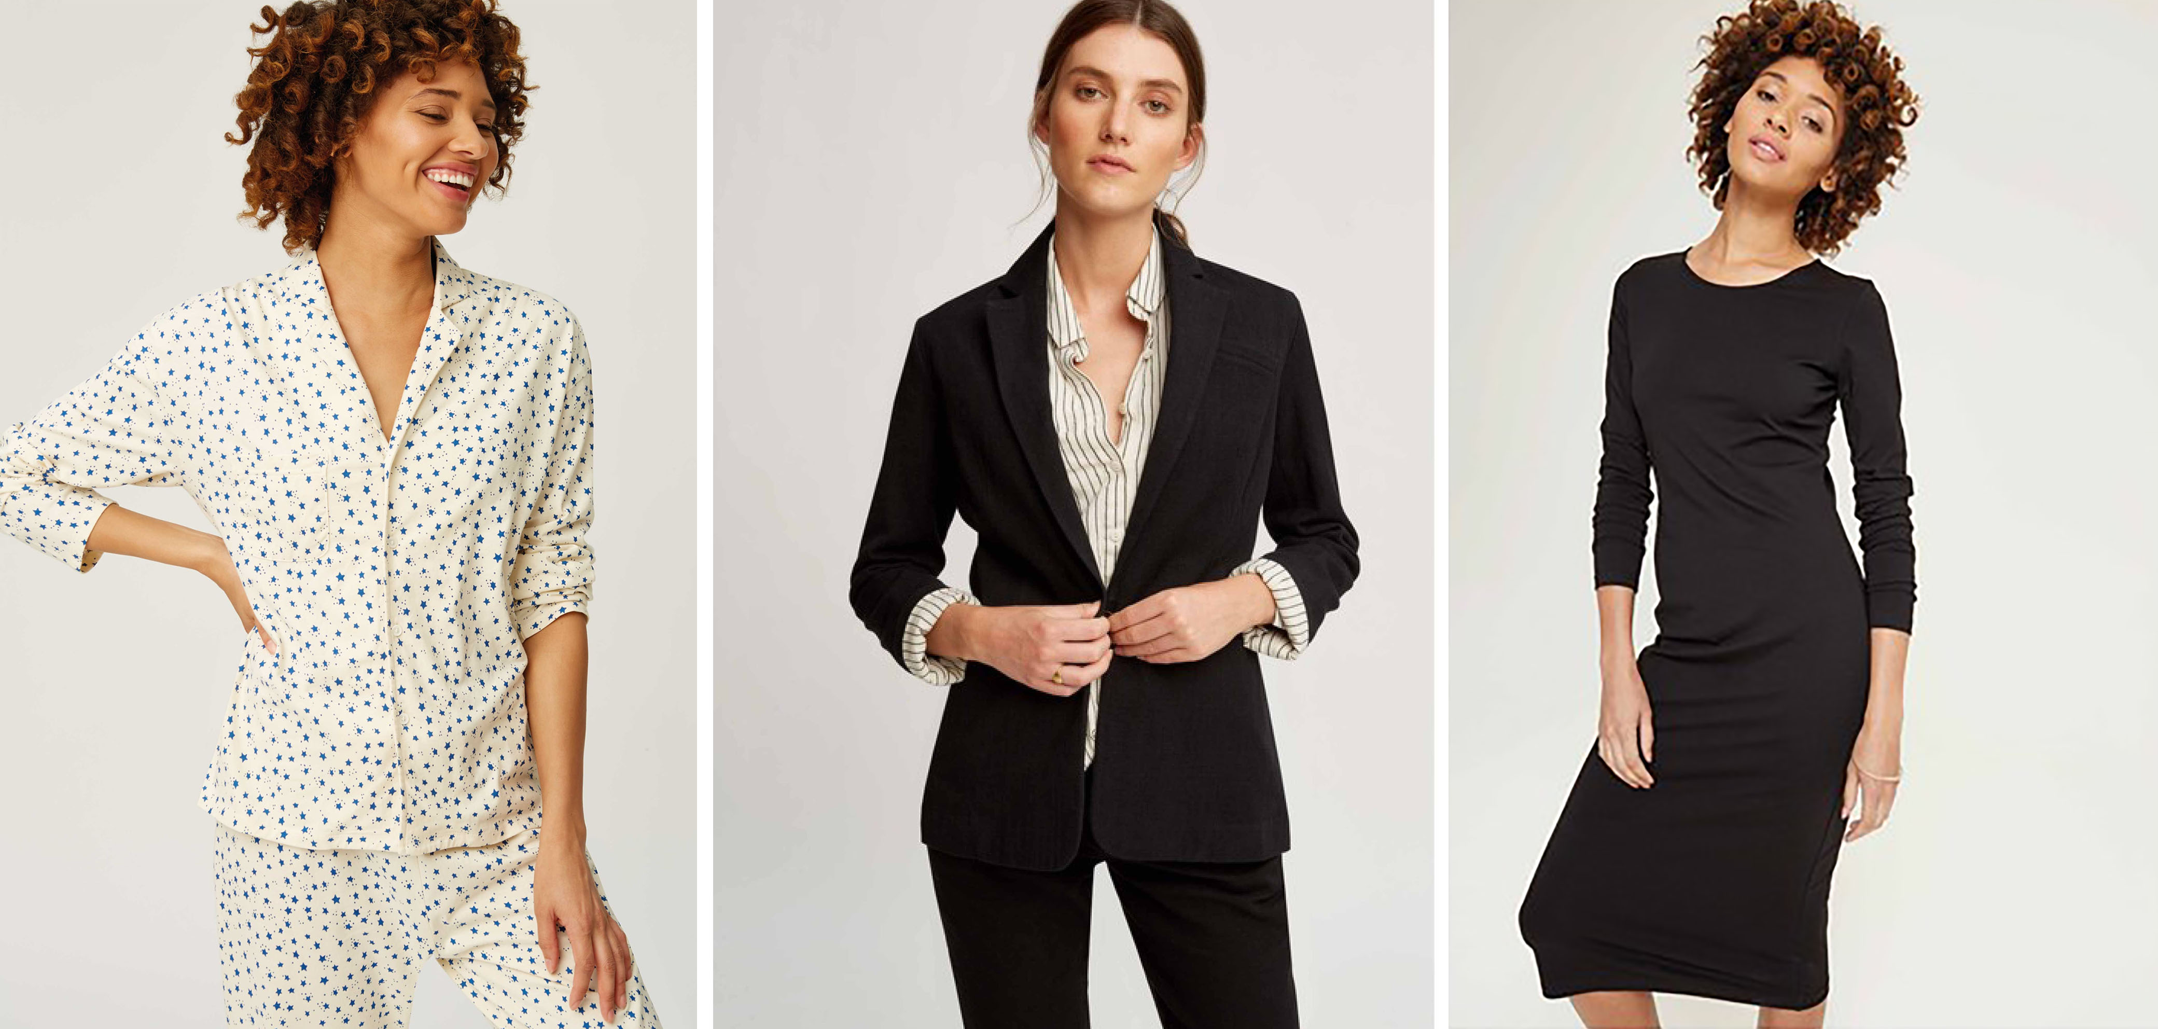
LOOK GOOD FASHION

Slide 69
Client Brief (Groups 3 & 4)
Client: 27 year old woman, Italian born but half her life lived in Monte Carlo; she is an intelligent, sophisticated woman and very determined. Starting her own company with custom designed purses and accessories, which is now called Giulia Bags.
Studied art and design and has a passion for designing womens accessories, particularly purses.
Started last year with a family loan of 75.000 euros
Insists on the best materials, strictly handmade in Italy; It is critical for her collections.
Likes the idea to be linked to “made in Italy” but has a very strong emotional and business connection to Monte Carlo.
Has a line of 6 purses designed and currently in 7 stores (6 in Italy and 1 in Monte Carlo). Another 6 purses are designed and ready for production for her Spring collection.
She sees her bags high quality, chic, natural, practical, classic yet with modern and fresh designs, appealing to women of success and style… expensive but not in the high luxury level.
Is doing all the marketing herself but has 1 assistant in training. The purses are made in Varese (production limit 25 per day but could be increased to 100 if necessary).
Material and labor average cost per bag is 70-100 euro); selling price is from 420-500 euro.
Wants to expand the selling locations in Italy and France initially; advertising money €100.000
**Needs marketing advice ( new brand name, marketing model to promote & sell and what you think is good advice for her company to start to grow)

Slide 70
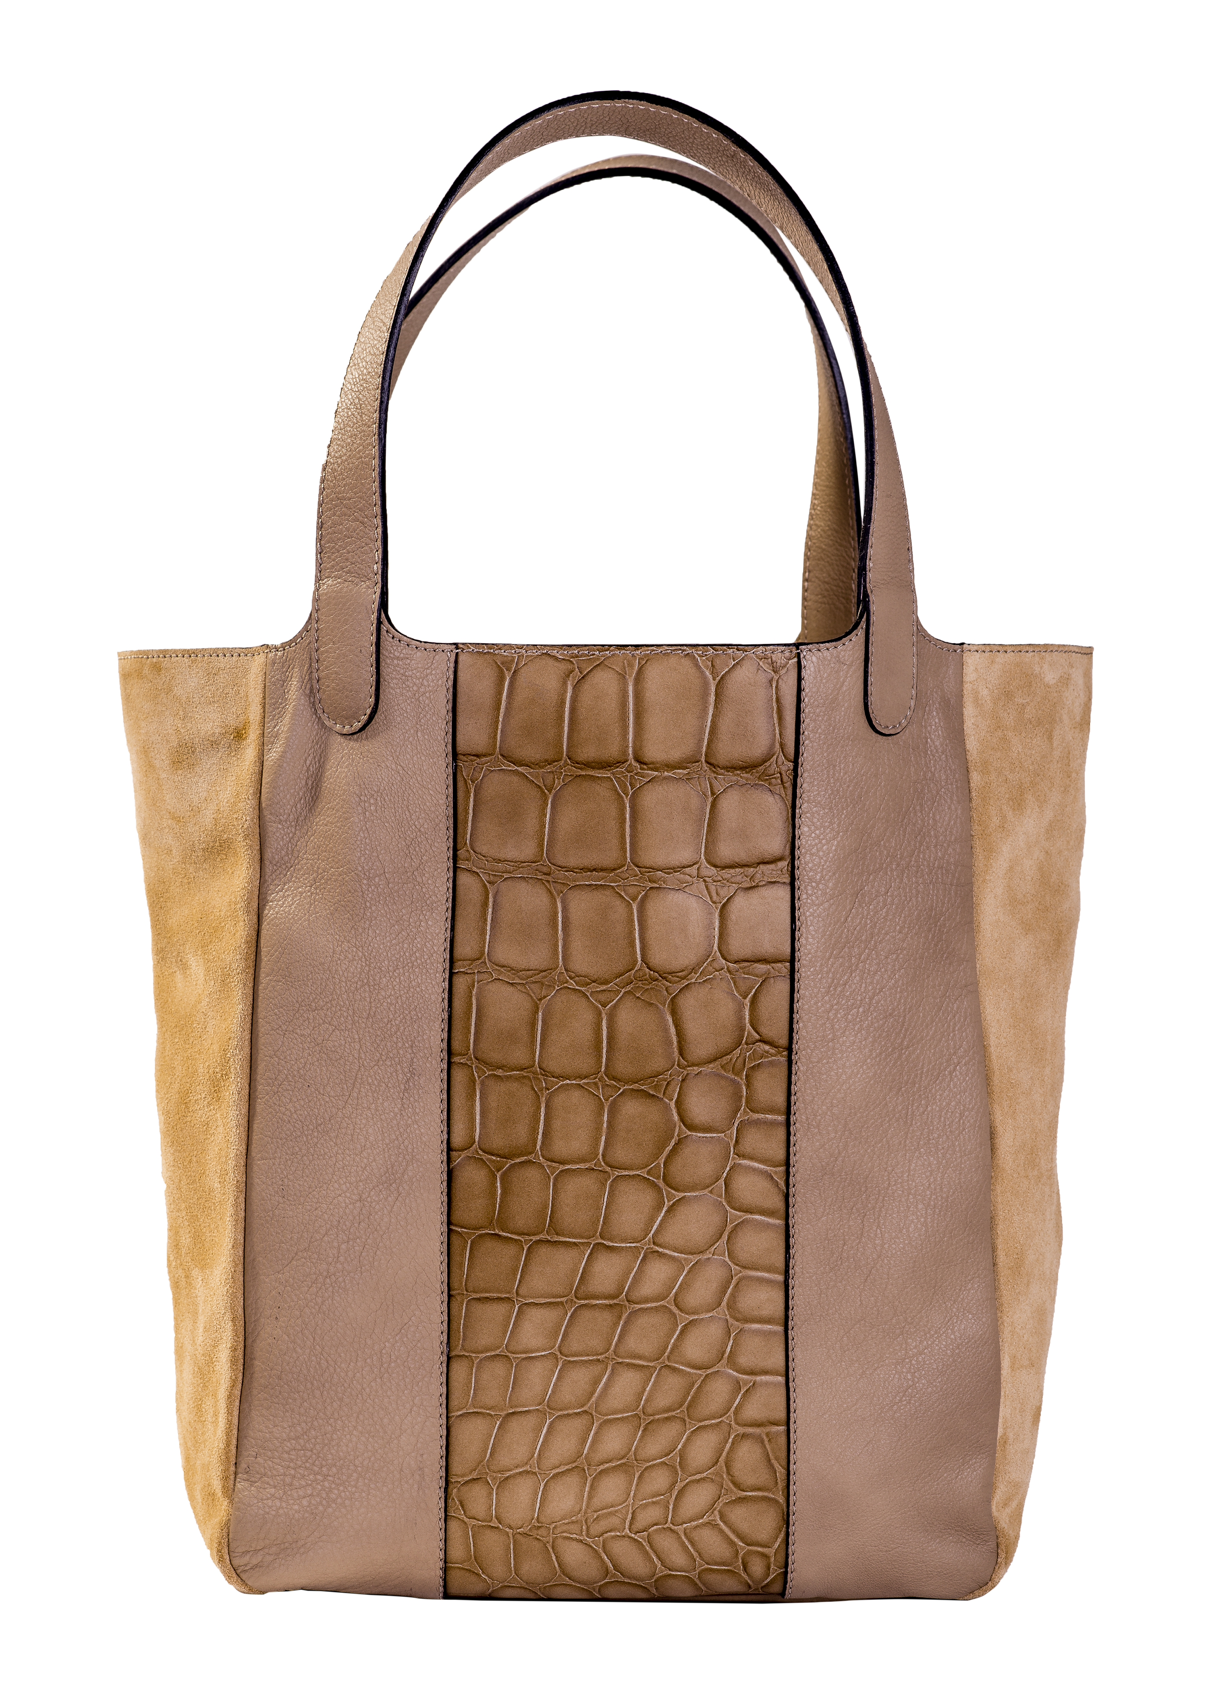
Giulia Bags

Slide 71
What is needed
Analyze and advise a start-up:
** Needs: 1) a brand name, an image,
2) a direction and positioning advice (what exactly is the market, who is the customer for their fashion line ?)
3) the best way to sell the product
4) some promotion and advertising advice for a low budget/high budget
5) A Power point presentation that explains your suggestions to the Client. Don't give specific detail ( precise budget numbers, etc.) but an overall approach.
Suggestions:
Think about the competition; what is the niche for this product?
Use psychological elements of brands to match a name with the brand identity you want.
Use the 5 P’s to organize a general outline of a marketing approach.
What are some logical steps they must follow to change the image and grow the company ?

Slide 72
Agency tasks
Research – what is the market ? Who is the target customer ?
Creative – brand name and the use of that name to create a product & marketing identity. How to be known in crowded fashion world ?
Selling strategy - where to sell, how to distribute
Promotion & advertising - advice and direction
** The group leader will moderate the presentation,
does the introduction and gives the conclusion.
Format: Powerpoint presentation with each person in the agency presenting their specialty.
Time: no more than 20 total minutes for each agency !!

