Slide 1
Sales and Distribution

Slide 2
Marketing vs. Sales
What are the differences ?

Slide 3
Key points
• Marketing focuses on creating demand, or
“product pull”
• Sales focuses on “pushing out” the product
through distribution channels.
• Marketing activity communicates, informs, persuades the potential client as to the value of the offering.
• Sales are concerned with the delivery part of the value equation and are short-term focused.
• Marketing tends toward longer term customer satisfaction.

Slide 4
Classic Distribution
Producer
Distributor
(delivery)
Wholesaler
Retailer
Customer

Slide 5
Classic Channel Strategy
Intensive distribution:
Wide distribution- high volumes- fast turnover of goods
Selective Distribution
Limited outlets based on price and geographic considerations
Exclusive Distribution
Distributor handles only one manufacturer’s products

Slide 6
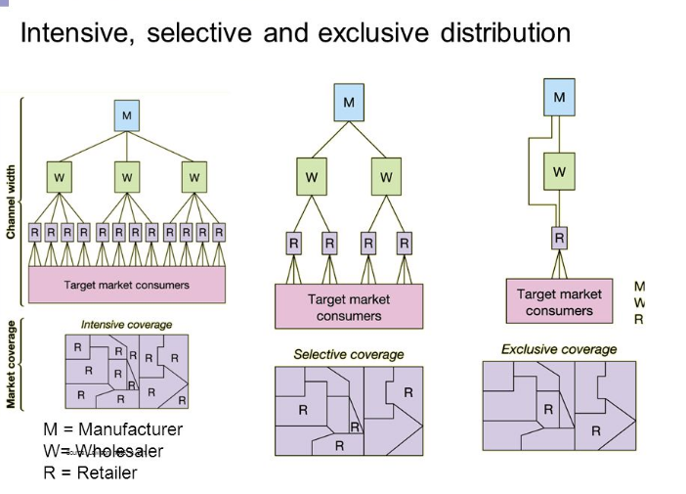

Slide 7
Intensive

Slide 8
Selective

Slide 9
Exclusive
Because Rolex does not want to dilute the brand equity, it will not enter in the region directly and won’t hire too many distributors so that it has “premium” and “exclusive” positioning of the brand.

Slide 10
Direct Channel Structure
Manufacturer has control of everything from him to consumer:
Examples ?
Notes:
Adobe systems and others: digital content, software delivered electronically directly to end buyer
Dell Computer- all phases controlled by Dell (JIT manufacturing and delivery)
Zara

Slide 11
Total control model
Example: Inditex- Zara
- a marketing miracle –
- a design, production and delivery
monster machine.
Notes:
48 hour turnaround : design,produce and deliver a new garment to 5900 stores in 85 countries
All work done in one place in Spain at their headquarters; centralized decision making and control
complicated products made in house, simple ones outsourced

Slide 12
Multichannel Structure
One product has multiple ways of finding and making the sale with the customer.
Example: Airlines sell tickets directly to customers via internet (their site or travel sites) and also through travel agencies.
• Other examples ?
• Potential problems with managing multchannel ?
Notes:
mobile phones of Samsung: direct from them on internet; from service providers (TIM, Wind, etc), at stores, even a supermarket
Music labels: via stores, directly, from catalogs, independent retailers, music services (Apple music, google, spotify etc.)

Slide 13
Brand problems: Economics, Coverage, Control
Releasing a product in multichannels risks lose of control over pricing and presentation.
Possible damage to brand if sellers do not adhere to correct pricing and presentation of the product.
Notes:
Google, Amazon, Discount retailers........ liberal pricing policies given by manufacturer ?
Cost analysis: liberal policies equal higher unit sales, or does this damage some elements of distribution chain ? Need a balance.
Apple has specific pricing guidelines to protect brand and give consistency to marketing model, and to avoid confusion.

Slide 14
Sell-in.....Sell-out
Sell-in: how many units of a product is a manufacturer selling into the retailer.
Sell-out: how many units of a product is selling out to the customer (from the retailer)

Slide 15
Selling Keeping the personal touch
Retail stores (warm, human, hands-on)
- lighting, attractive layout, trained sales staff
- pleasant customer experience
- selection, service, price build loyalty
On-line shopping (cold, fast, convenient, efficient)
- easy to navigate design, items displayed well
- customer help line or chat line
- fast shipping and a no-problem return policy

Slide 16
Marketing Mix: The 5 P’s
Product (appearance, packaging, quality,performance, service, list price)
Positioning (where are you in the competitive landscape ? The image of product in the mind of the target customer)
Price (profit margin,break-even point,going rate, recommended retail price, overhead)
Placement (location niche, distribution channels, logistics. managing on-line sales)
Promotion (media, advertising, discounting, rebates, public relations)
Notes:
This is a tease to an argument that we will discuss more in the next class.
You need to know these now for the projects we’ll work on today.

Slide 17
Supply Chain Management
(remember that about 15% of the average product's price is in shipping and transport costs)
SCM is concerned with the value creation chain of all the activities associated with physical distribution.
It embraces the chain of suppliers that provide raw materials (upstream), through assembly & manufacturing to distribution and end-user customers (downstream).
SCM supersedes the previous terms logistics and physical distribution.

Slide 18
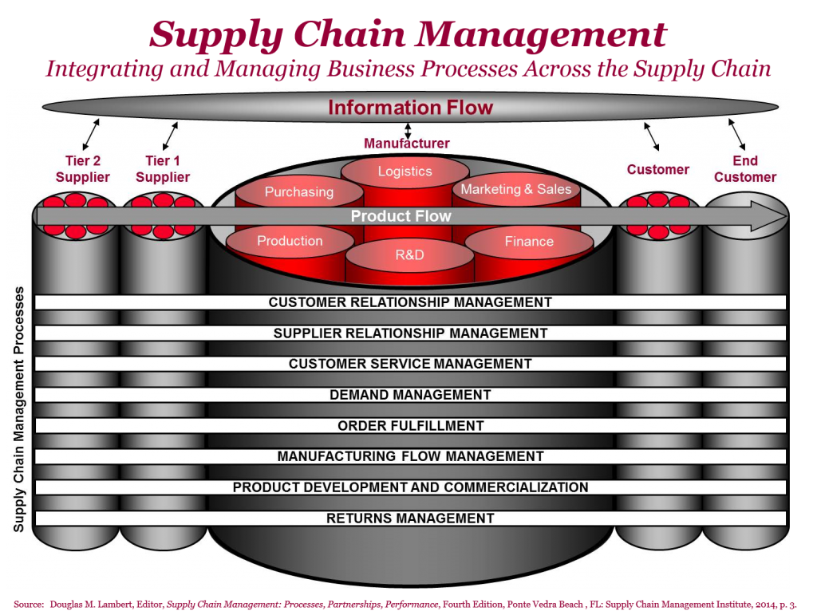

Slide 20
Amazon Fulfillment Center
Giant automated storage and product movement system
Product coded based
People doing final order checking, packaging.
In Italy, there are currently 6 operating, and
they link to other smaller warehouses and
distribution hubs that supply major cities.

Slide 21
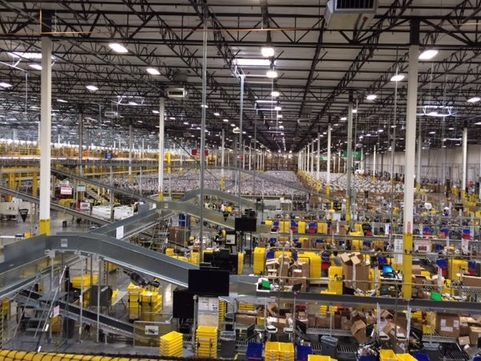

Slide 22
SCM goals
Waste reduction: reducing excess stock
Time compression: Reducing order to delivery time
Flexible response: efficiency in handling orders and effecting deliveries.
Unit cost reduction: Understanding the needs of the end customer, a company can construct an efficient
system to deliver the product to meet that standard,
and reduce operating costs.

Slide 23
Global supply/waste nightmare
Returned merchandise:
from in-store purchases/ on-line purchases
Where does it go ???

Slide 24
Read this: https://www.cnbc.com/2019/12/14/how-amazon-and-google-use-ai-to-destroy-less-excess-inventory.html?&qsearchterm=returned%20clothing%20waste

Slide 25
The philosophy of JIT is simple: the storage of unused inventory is a waste of resources
• Warehousing depots: stocking extra inventory is
costly
Manufacturing just in time: Goods made only upon receipt of an order.
Just in time delivery: using multiple options of making a delivery according to needs of customer.
Notes:
Japan innovated this concept in the 50’s: Toyota cars were supplied with parts when they were needed

Slide 26
Benetton
Uses JIT manufacturing: some garments are manufactured in neutral colours and dyed to order.
Their distribution center in Italy is run mainly
by robots..... delivering goods to 120 countries
within 12 days.

Slide 27
Order fulfilment
retrieving, packing and shipping orders
Computerized tracking, robotic systems
Speed, efficiency, cost effectiveness, to create
a better customer experience.
* Restaurants using wireless telecom
is another way to have faster and more
efficient communication of customer order.

Slide 28
“If you can’t beat them, join them”
Set up a web site to sell certain items from your inventory on-line, at a different price from the prices at your store. Direct sell & delivery to customer.
Is there a risk of having different prices (on line vs. in store) ?
Or...........................

Slide 29
Merge real with digital
Sell in parallel: in store and on your web site at the same price. Delivery of goods is optional, either direct by courier or for pick-up at the store.
The battle is to keep the customer loyalty (to your store brand), and to do this you must offer
choice, service and price.

Slide 31
Project for Groups 1 &2
The Aladdin Company invented a new line of stylish,elegant, functional and rather expensive faucets (rubinetti) called The Aladdin Faucet.
• They use a unique technology, patented, of electronic voice activated control to adjust the water temperature. Flow of water is the touchless system of infrared control.
- Voice commands are in 5 languages (but could be expanded). Uses instant hot water system; default temp is warm; 4 year manufacturers service guarantee.
- High quality materials, Made in Italy, available in three different styles that
can be either in Chrome, Black or Gold finish.
Suggested retail price 700 euros (manufacturing cost 115 euros) .... in comparison, the retail price of a standard, but good quality faucet is approximately 250 euros.
The Aladdin Co (your client) has a 750.000 euro advertising budget
Global product launch date in 5 months !

Slide 32
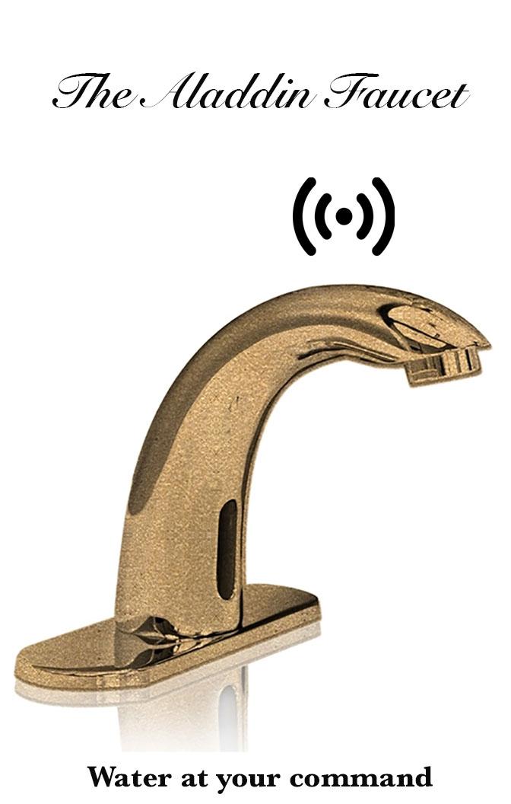

Slide 33
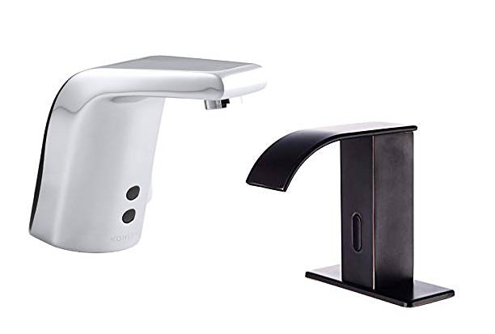

Slide 34
Agency Pitch tasks
• How would you market these ? Independently, with your registered brand and sell on-line ? Advertise in trade magazines, TV, Social ? Have an exclusive distributor or selected distribution ? Partner with an established brand ? Exclusive contract with certain stores ?
Group division:
1) Market Research: with sector overview to show typical sales and distribution
methods in particular for luxury bathroom accessories.
2) Brand and Positioning analysis: target customer and how to reach him
3) Selling Strategy: Pricing. sales and distribution system
4) Advertising and promotion ... how to get brand awareness, promoting the
product for launch.
5) Group leader to Introduce, do transitions and conclusion
(15 minute total limit for each group to present)
**Consider : The 5 P's of marketing, all the possible sales and distribution options, the fastest and most effective way for the public to know about your brand.

Slide 35
Project for Groups 3 & 4
"The ultimate office chair" by Rossini
A new Italian designed ergonomic desk chair. It is unique in the field because it has incorporated a fully remote-controlled programmable back massage.
Independent neck, upper back and lumbar massage units that use Artificial Intelligence robotic technology to simulate a hand massage according to the technique you prefer.
Leather (black or brown) and high quality steel construction.
Fully adjustable, even recline mode, for maximum work comfort
Suggested sales price € 950 .... with 5 year full service warranty
** The Rossini Company wants to enter a crowded office chair market with a different way to sell and distribute.
They believe that the home office market has potential.

Slide 36
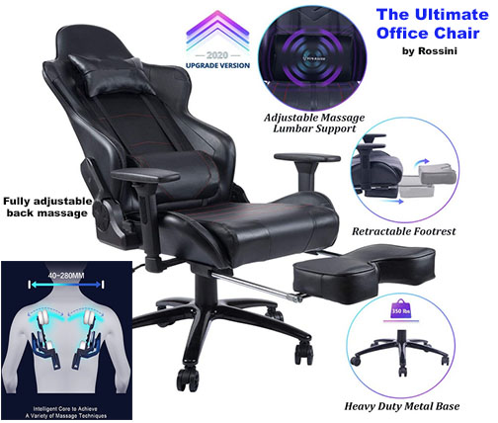

Slide 37
Agency Pitch Tasks
• The Rossini Company does not want to sell on Amazon with the other chairs. They want to show their unique product and made in Italy quality. The manufacturing cost
is € 325. The want to launch their product in Spring 2022.
• How would you market these ? Independently, with your registered brand and sell on-line ? Advertise in trade magazines, TV, Social ? Have an exclusive distributor or selected distribution ? Partner with an established brand ? Exclusive contract with certain stores ?
Group division:
1) Market Research: with sector overview to show the typical sales and distribution
methods for office furniture.
2) Brand and Positioning analysis: target customer and how to reach him
3) Selling Strategy: Pricing. sales and distribution system
4) Advertising and promotion ... how to get brand awareness, promoting the
product for launch.
5) Group leader to Introduce, do transitions and conclusion
(20 minute total limit for each group to present)
**Consider : The 5 P's of marketing, all the possible sales and distribution options, the fastest and most effective way for the public to know about your brand.

