Slide 1
Advertising
and the fundamentals of
Research

Slide 2
Be a winner
Presenting is successful if it is personalized
It is a formal method to make a personal conversation
To have a conversation, understand who you are speaking to
From your experience and research, show that you understand the uniqueness of that product and have the right approach to deliver that message to the target audience to produce sales.
Use should and must, not could
Brief is better. Graphics are simple, not complicated lines of text
Deliver a key message, have a unified theme (all team members coordinate). A marketing agency is paid for INSIGHT.
Be positive, and repeat the key points at the conclusion
Don’t:
Read the contents of a slide
Use a SWOT analysis as research
Promise improvement but not specific sales results for your strategy.

Slide 3
New Class Groups
Agency 1: Petakovic, Kamal, Rebeccato, Jain, Muhsen
Agency 2: Rodigari, Corti, Vriale, Plaia, Balyan
Agency 3: Bagdanova, Brocca, Sansone, Serra, Kiziltunc
Agency 4: Cattaneo, Masi, Lobuono, Salem
* The first person named in the group is designated as the group leader, who will coordinate the group activity and lead the presentation.

Slide 4
Coronavirus effect
Disrupting marketing strategies
Communication / Public Relations
- China export trade
- Supply chain.... fashion, tech, auto
- Demand side collapse
- Travel and tourism

Slide 5
Retailer Capri Holdings takes a hit
Michael Kors owner Capri Holdings said it has taken a $100 million hit to revenue because of the coronavirus. Capri closed 150 of its 225 stores in mainland China and has seen a significantly drop in foot traffic. The company warned that travel restrictions on visitors from China could also put pressure on sales in other regions. “This is going to be a very tough period for luxury brands,” said Ben Cavender, managing director at China Market Research Group in Shanghai. “There is going to be a negative long-term effect as well, as many corporate offices are shut down or barely functioning and this is a key time period for planning future seasons.”

Slide 6
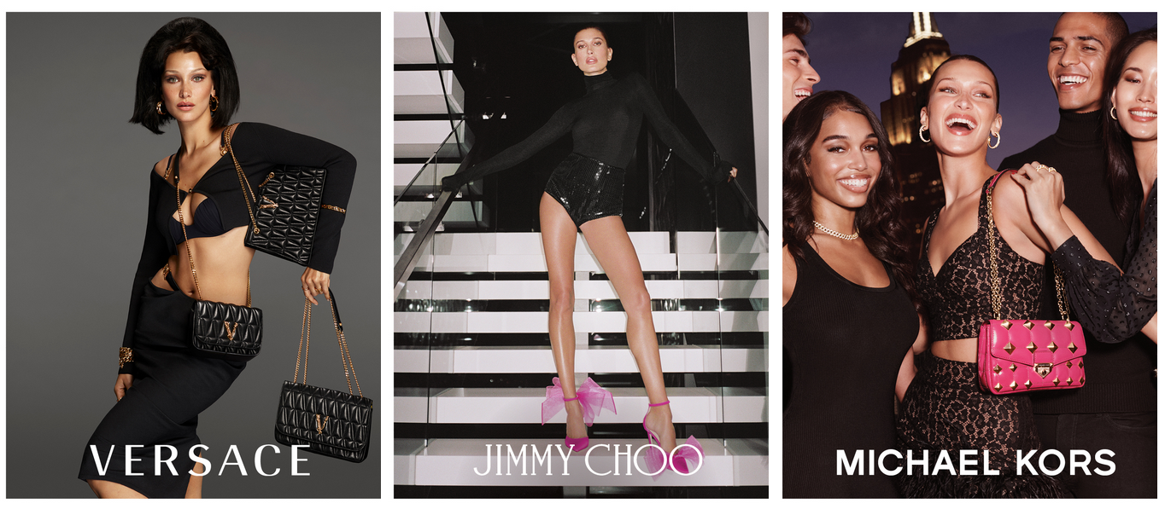
Capri Holdings
2020 ------- 2021 ------- 2022 ?

Slide 7
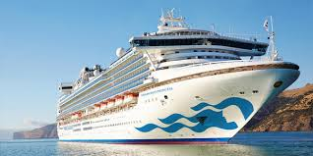
PR: Crisis Management
Diamond Princess

Slide 8
Tools of Marketing
Advertising
Sales Promotion
Public Relations
Direct Marketing
Personal Selling
Notes:
Advertising: High, Low, Medium
Sales Promotion: Medium, Medium, High
Public Relations: Low, High, Low
Direct Marketing: Med, Med, High
Personal selling: High, Med, Med>

Slide 9
Traditional “above the line advertising”
What most people think of as advertising:
• Mass media used to build a brand
• Television, radio
• Sponsorship deals
• Display advertising (magazines-billboards)
• Digital (banners, pop up ads)
• Brochures/catalogues
Notes:
Siemens-Disney sponsorship deal –synergy but why:
Siemens (also Coca-Cola, hewlett Packard, General Motors are “corporate alliance partners)

Slide 10
TV/Radio
“Shotgun advertising”- typical broadcast TV
With cable, digital channels very precise segmenting of the audience reach is possible.
- Sophisticated techniques to identify audience
characteristics gives a greater range of possibilities for commercial placement (media mix)

Slide 11
Corporate Sponsorship
Physically present corporate symbols endorsing the activity of another brand.
Sponsorship deals: a great marriage when the synergy is right.
What corporate names fit with Disney ?
Notes:
Is this simply Public Relations ?
First: What is Disney? Films,TV, books, theme parks
“Corporate alliance partners” : General Motors, Siemens, Coca Cola, Lego, Boudin Bakeries, and many more
A lot of money, but they receive:
Brand promotion, association with a quality company (sponge off the brand goodwill of the partner)
Product placement
Priority in purchasing agreements (Disney spends about $15 bn/yr on goods and services

Slide 12
Digital activities
Internet marketing/advertising
Search marketing: SEO to optimize search positioning
Email marketing: direct communication with permission
Mobile marketing: phone and wireless world
Online retailing: (B2C) shopping, click, order, have delivered
Advergaming: Video & online games to advertise/brand
Social media marketing: using social networks to produce content that users will share; for customer reach and brand exposure. "Controlling the conversation"
Viral marketing: using promotions, ideas, clips to “pass on”
Notes:
Search marketing: Search Engine Optimization (SEO) tactics, key word magic, paid placement

Slide 13
“Below the line” advertising (some call it “direct advertising”)
Price promotions and discounting
Coupons
Gift with purchase
Competitions and prizes
Refunds/rebates
Loyalty incentives (supermarket cards)
Point of sale displays

Slide 14
Social Media globally
Top 10 Social Networking Sites by Market Share Statistics [2021]
Facebook – 2.74 Billion Active Users.
YouTube – 2.291 Billion Active Users.
WhatsApp – 2.0 Billion Active Users.
Facebook Messenger – 1.3 Billion Active Users.
Instagram – 1.221 Billion Active Users.
Weixin/WeChat – 1.213 Billion Active Users.

Slide 15
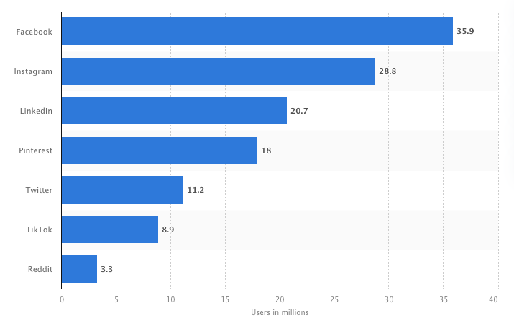
Users of leading social networks in Italy in March 2021

Slide 17
TV still king of Italian market
According to the study results, a traditional channel such as television still held the biggest market share (51 percent). However, online advertising was ranked second with a market share of 33 percent. The remaining channels, press and radio, made up 12 and four percent of the total advertising market, respectively.

Slide 18
Digital Data Analysis
Tracking and gathering data regarding individual use of the internet to understand interests and behaviors (consumer, psycho-social, political, etc).
In marketing today, data collection and analysis is the most used method of understanding who, where why and how people choose to buy.
Data analytical tools form the major source for marketers to create strategies to target the correct customer for their products and services.

Slide 19
Big Data
What is it?
Big data comes from myriad sources -- some examples are transaction processing systems, customer databases, documents, emails, medical records, internet clickstream logs, mobile apps and social networks.
How Big is Big ?
Read this article: https://findstack.com/big-data-statistics/
Extremely large data sets that may be analysed computationally to reveal patterns, trends, and associations, especially relating to human behaviour and interactions.

Slide 20
Remember one Byte ?
Most people are familiar with megabytes (1,000,000 bytes), gigabytes (1,000 megabytes) and even terabytes (1,000 gigabytes). ... For context, there are 1,000 terabytes in a petabyte, 1,000 petabytes in an exabyte, 1,000 exabytes in a zettabyte and 1,000 zettabytes in a yottabyte.

Slide 21
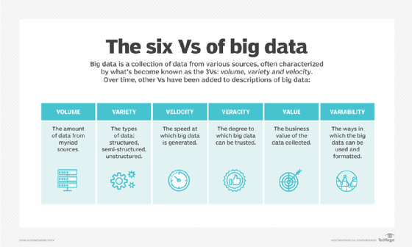

Slide 22
Big Data Use in Marketing
Customer engagement, specifically how your customers view and interact with your brand, is a key factor in your marketing efforts. Big data analytics provides the business intelligence you need to bring about positive change, like improving existing products or increasing revenue per customer.
The 360-degree view from big data allows marketers to present customer-specific content when and where it is most effective to improve online and in-store brand recognition and recall.
Big data can help marketers leverage real-time data in cloud computing environments. The ability of big data to acquire, process, and analyze real-time data quickly and accurately enough to take immediate and effective action cannot be matched by any other technology. This is critical when analyzing data from GPS, IoT sensors, clicks on a webpage, or other real-time data.

Slide 23
Analytics and Intuition
Using the data collected from both types of research, a good marketing manager uses his analytical judgement combined with an intuitive sense of the consumer behavior to formulate his marketing and advertising strategy.

Slide 24
Triggers and Barriers
Understanding consumer behavior means to
to know what are the barriers (negative
reasons) preventing a purchase.
- and to discover what facts would trigger
(cause) a purchase decision.

Slide 25
Developing a Communication Strategy
The A-I-D-A model
Awareness : bring attention and knowledge of product
Interest: create a high level of interest in that product
Desire: Converts interest into desire to buy
Action: makes the purchase or changes their purchasing
behavior.
Notes:
What is the L’Oreal slogan ? Logical or emotional ? May cost more, but a superior product and after all I’m worth it !

Slide 26
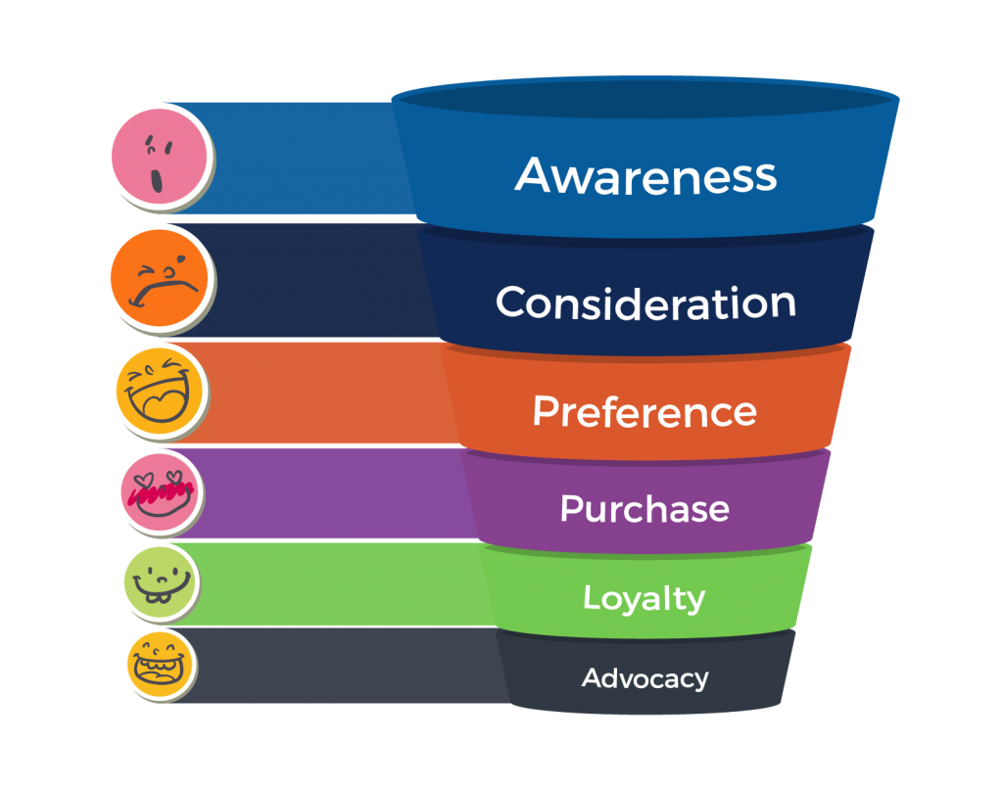
Customer Journey Funnel

Slide 27
Using the funnel
Identify what part of that customer journey needs the most attention.
Each product, each market, requires a careful assessment of where your strategy must be focused.
Promotion (one of the 5 P's) is a fundamental tool of the marketing plan to target areas of the customer journey funnel.

Slide 28
Every strategy session asks:
Where are we? (positioning)
Who are we? (our brand)
Who is our competition?
What does the public think of us? (brand image)
Why does someone want to buy our product ?
Where do we want to go? (future positioning)
How can we change the image of our company?
How do we advertising this to the public? (media mix)

Slide 29
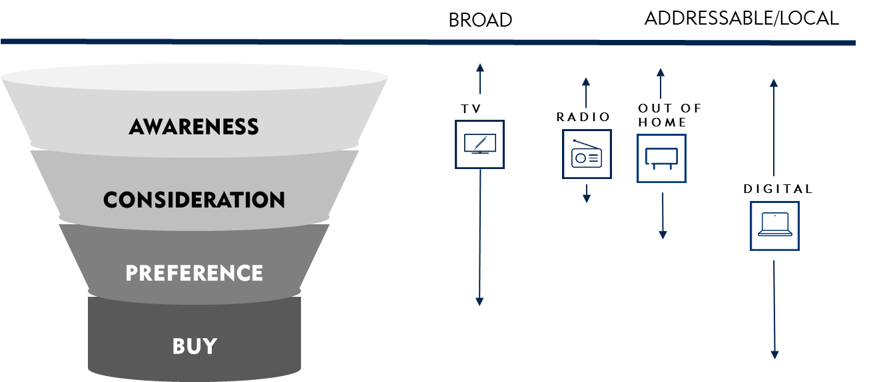
EACH MEDIA WORKS ON DIFFERENT STEPS AND ON DIFFERENT KIND OF TARGET

Slide 30
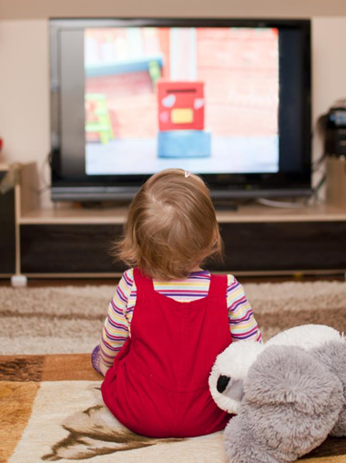
80% OF LEARNING IN HUMAN BEING TAKES PLACE THROUGH SIGHT
The receiving subject remembers on average 10% of what they read, 20% of what they hear, 30% of what they see and
** 50% OF WHAT THEY SEE AND HEAR SIMULTANEOUSLY
Source: “Communication graphics”, Research. Matthew P. Murgio, 1969.

Slide 31
TO BUILD AWARENESS video is by far the main driver
β
IMPACT ON
AWARENESS

Slide 32
Choosing the media mix
Media Mix is the combination of advertising channels that is used in the promotion of a particular good or service.
The idea is to choose the right combination to communicate with the audience and make an impact as estimated in the media planning strategy.
For the media mix to be effective, it’s imperative that the demographics of the target segment are considered. The closer a media mix reflects its target segment, the more successful it is.
Key elements in the decision:
Type of product
Budget
Profile and habits of typical customer
Timing and Product seasonality
Knowledge of competitors media strategy

Slide 33
Following the campaign
Statistically monitor the results / performance of the product or service.
KPI - Key performance indicator
"a measurable value that demonstrates
how effectively a company is achieving
key business objectives "

Slide 35
Importance of Research
This is the pillar that supports the base of marketing decisions
The market is complex with competition, life style changes, and hard to predict consumer interests.
Smart sophisticated research tools can extract the current consumer sentiment and focus that information to make the right strategic decisions.
"Doing the necessary groundwork"

Slide 36
Research ➔ Customer Insight
The key sub-discipline to planning, designing
product or service.
• Identifying customers’ changing needs
First have a Strategic goal- a Marketing Strategy
Then, the market research determines the impact of that strategy. One can modify selling tactics based on good market data collection and analysis. Keep constantly tuned into customer behavior.

Slide 37
DEEP UNDERSTANDING OF THE EVOLVING BACKGROUND & SCENARIO
DEEP UNDERSTANDING OF THE CONSUMER JOURNEY AND NEEDS
BRAND & COMPETITOR ASSESSMENT: TRIGGERS AND BARRIERS, SWOT ANALYSIS
STRONG KNOWLEDGE ON EACH SINGLE MEDIA IMPACT & INTERACTION BETWEEN MEDIA IN EACH FUNNEL STEP
STRONG TECH CAPABILITIES
FROM DATA
TO INSIGHTS
TO ACTIONS
BRAIN (info.) Vs. MUSCLE ($$$)
(Remember David Vs. Goliath?)

Slide 38
Qualitative Research
Personal gathering of data from the public. Beliefs, attitudes, opinions and intentions are studied.
• Analysis of data: subjective observation of responses. The key factors are the quality of the questions asked, and the skill of the interviewer, the way the data is interpreted.
• Results: - not really statistically valid, but the findings can be very useful and be made part of a quantitative survey later.

Slide 39
Types of Qualitative Research
Surveys
- in person - Phone - Mail
** CAWI- Computer Assisted Web Interviewing
Focus Groups
Good information, intensive in depth information gathering
Personal Interviews
Good way to find customer attitudes
Observation
At store, work or home …. Observe and tape their behavior
Field Trials
- Product placement for a trial period with observation
Syndicated Market Research
A research study which is conducted and funded by a market research firm but not for any specific client is called a syndicated research. The result of such research is often provided in the
form of reports, presentations, raw data, etc. and is made available in the open market for anyone to purchase.
Notes:
90 % response rate in person, good info but costly
Phone 50% response rate and declining
Mail 3 to 15% response rate
Focus groups 2 hrs average, should have 3 groups to balance results
Personal interviews 1 hour

Slide 40
Quantitative Survey Research
How:
- questionaires
- Larger, statistically valid samples of people
Sources: telephone, postal, face to face, on-line
The answers to questions about: what, how many, how often, where ? Often on a scale of 1 to 5.
Results: generate a numerical answer (often as a percentage)
Depending on the sample size there is always a margin of error in every quantitative result. The statistical results of good quantitative surveys are fundamental in giving a scientific, objective benchmark in the marketing decision making process.

Slide 41
Which is best ? qualitative or quantitative

Slide 42
Answer: BOTH
Numerical data based on statistics + subjective (qualitative) data to understand customer sentiment
When used together they form a more complete and accurate sense of product preferences and consumer attitude.

Slide 43
Class Groups
Agency 1: Petakovic, Kamal, Rebeccato, Jain, Muhsen
Agency 2: Rodigari, Corti, Vriale, Plaia, Balyan
Agency 3: Bagdanova, Brocca, Sansone, Serra, Kiziltunc
Agency 4: Cattaneo, Masi, Lobuono, Salem
* The first person named in the group is designated as the group leader, who will coordinate the group activity and lead the presentation.

Slide 44
RESEARCH: CASE STUDY
Client: San Carlo snack products
Overview
San Carlo wants to know:
- Brand awareness of their product
- effect of their use of a celebrity spokesperson on sales
- understanding if they should renew or change Carlo Cracco.
Before they decide this, they requested a deep research survey
to understand the effect of Cracco for the brand.

Slide 45
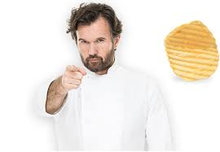

Slide 46
Specific questions to answer
1) Is he good for the brand image ?
2) If the company changes the spokesman will it have a negative impact for the brand image?
3) Does the company have better sales results that are directly related to having this person ?
4) Can the company use the public perception of this person to change their products and increase market share in the future ?
5) Is it worth paying him 2 million euros a year ?

Slide 47
Research parameters
500 interviews
ITALIANS 18-54
SNACK FOODS (AT LEAST ONCE A MONTH)
47

Slide 48
Knowledge of the Personality (the actual spokesman for the brand)
D. Conosci il personaggio [XXX] ?
100%
18-54
those consuming snacks
at least once a month
BASE: Tot. Campione – Pop. 18-54 Users Snack (almeno una volta al mese)
n=552 individui – Valori percentuali

Slide 49
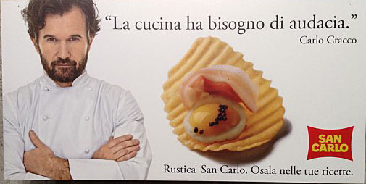

Slide 50
Awareness TOP OF MIND brand snack
Q? Speaking of snacks, what is the first brand that comes to your mind ?
One person out of two
knew the BRAND
BASE: Tot. Campione – Pop. 18-54 Users Snack (almeno una volta al mese)
n=552 individui – Valori percentuali – Citazioni spontanee – Una sola citazione per intervistato – TOT % = 100

Slide 51
Awareness TOP OF MIND brand Potato chips – In more detail
D. Speaking of the brand name, what is the first name that comes to your mind ?
 | TOTAL |  | Sex |  |  | Age |  |  |  |  | AREA DI RESIDENCE
 |  |  | Maschio | Femmina |  | 18-24 | 25-34 | 35-44 | 45-54 |  | NORTH WEST | NO EAST | CENT | SOUTH
San Carlo | 51,1% |  | 50,0% | 52,2% |  | 53,8% | 51,2% | 54,4% | 46,6% |  | 49,0% | 44,2% | 56,0% | 53,6%
Pai | 19,4% |  | 20,1% | 18,7% |  | 14,1% | 12,4% | 16,6% | 29,5% |  | 19,6% | 20,2% | 16,5% | 20,4%
Amica Chips | 7,1% |  | 6,2% | 7,9% |  | 7,7% | 10,9% | 6,5% | 4,5% |  | 8,4% | 14,4% | 5,5% | 3,1%
Pata | 5,8% |  | 6,6% | 5,0% |  | 1,3% | 7,8% | 5,9% | 6,3% |  | 7,7% | 9,6% | 4,6% | 3,1%
Lay's | 4,3% |  | 2,2% | 6,5% |  | 7,7% | 8,5% | 1,8% | 2,3% |  | 4,2% | 3,8% | 1,8% | 6,1%
Pringles | 4,0% |  | 5,1% | 2,9% |  | 7,7% | 1,6% | 4,1% | 4,0% |  | 5,6% | 2,9% | 3,7% | 3,6%
Cipster | 3,3% |  | 4,7% | 1,8% |  | 0,0% | 1,6% | 5,9% | 3,4% |  | 3,5% | 2,9% | 2,8% | 3,6%
Crik Crok | 2,7% |  | 2,9% | 2,5% |  | 5,1% | 1,6% | 3,0% | 2,3% |  | 0,0% | 0,0% | 6,4% | 4,1%
Altro | 1,4% |  | 1,5% | 1,4% |  | 2,6% | 2,3% | 1,2% | 0,6% |  | 1,4% | 0,0% | 1,8% | 2,0%
BASE: Tot. Campione – Pop. 18-54 Users Patatine (almeno una volta al mese)
n=552 individui – Valori percentuali – Citazioni spontanee

Slide 52
Actual recognition of the BRAND spokesman (Open question with no prompting)
53,2%
* Citazioni riconducibili al personaggio, senza riferimento diretto al nome o cognome
BASE: Tot. Campione – Pop. 18-54 Users Snack (almeno una volta al mese)
n=552 individui – Valori percentuali – Citazioni spontanee

Slide 53
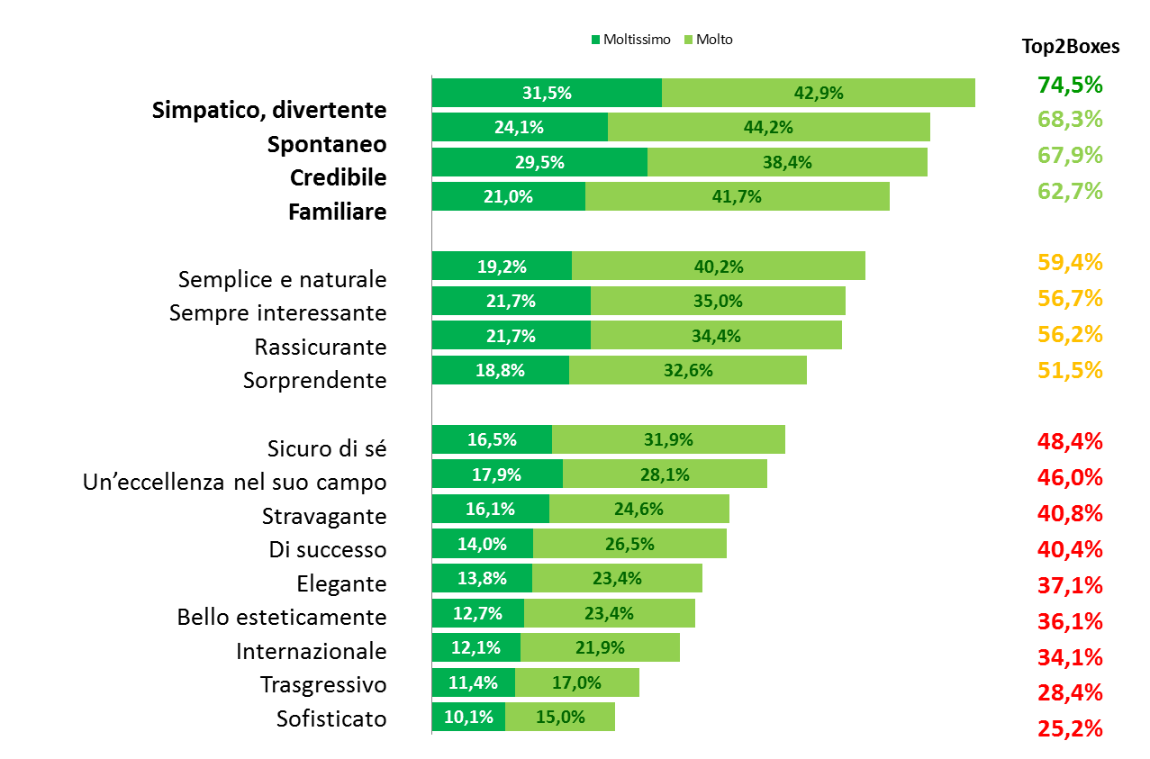
Graphic of an Ideal spokesperson
D. Here below are some characteristics that people have indicated are important for a spokesman for a snack brand. How important are these characteristics to you ?
BASE: Tot. Campione – Pop. 18-54 Users Snack (almeno una volta al mese)
n=552 individui – Valori percentuali – Top2Boxes: %Moltissimo + %Molto

Slide 54
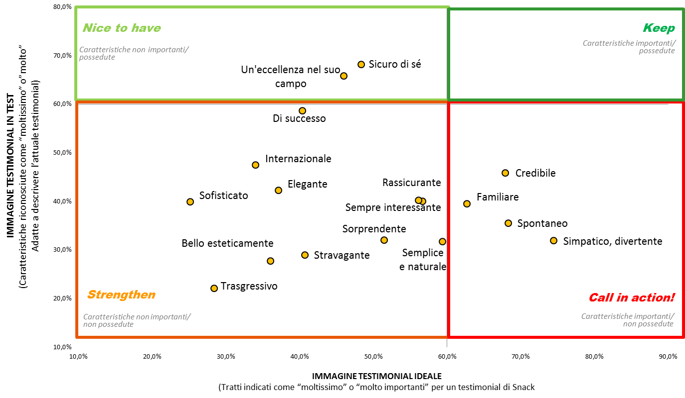
Chart of the Ideal Spokesperson
D Here below are some characteristics that people have indicated are important for a spokesman for a snack brand. How important are these characteristics to you ?.
BASE: Tot. Campione – Pop. 18-54 Users Snack (almeno una volta al mese)
n=552 individui – Valori percentuali – Top2Boxes: %Moltissimo + %Molto

Slide 55
The ability of Carlo Cracco to bring attention to the brand
[D. If Carlo Cracco were to talk about the quality of San Carlo products,
would you be more interested ?
+ RELEVANCE
EFFECT
(% Moltissimo + % Molto + % Abbastanza)
74,5%
TOP2 BOXES
(% Moltissimo + % Molto)
41,7%
BASE: Tot. Campione – Pop. 18-54 Users Patatine (almeno una volta al mese)
n=552 individui – Valori percentuali – Top2Boxes: %Moltissimo + %Molto

Slide 56
CAPACITY of Carlo Cracco to transfer the quality image of the product
D. If Carlo Cracco were to talk about the quality of the product, would
you find him believable ?
+ QUALITA’
EFFETTO
(% Moltissimo + % Molto + % Abbastanza)
75,5%
TOP2 BOXES
(% Moltissimo + % Molto)
42,8%
BASE: Tot. Campione – Pop. 18-54 Users Patatine (almeno una volta al mese)
n=552 individui – Valori percentuali – Top2Boxes: %Moltissimo + %Molto

Slide 57
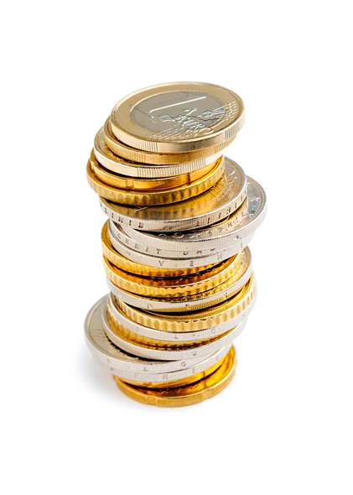
Added value attributed to a product that has recipes signed by the actual spokesperson
D.Would you be willing to pay for a product that had personal recipes by the actual spokesperson ?.
67,0%
BASE: Tot. Campione – Pop. 18-54 Users Snack (almeno una volta al mese)
n=552 individui – Valori percentuali

Slide 58
Reciprocal exchange of value between brand and the Personality
D. How much value would you say that the brand has given to the spokesperson ?
D.How much value would you say that the spokesperson has given to the brand ?
More popular (+39%)
35%
Closer to the Italians
(+37%)
more friendly
(+30%)
38%
More up to date
and modern
(+41%)
More interesting
(+40%)
A desireable brand (+39%)
BASE: Tot. Campione – Pop. 18-54 Users Snack (almeno una volta al mese)
n=552 individui – Valori percentuali – Top2Boxes: %Moltissimo + %Molto

Slide 59
What does the reseach tell us ?
1) Is he good for the brand image ?
2) If the company changes the spokesman will it have a negative impact for the brand image?
3) Does the company have better sales results that are directly related to having this person ?
4) Can the company use the public perception of this person to change their products and increase market share in the future ?
5) Is it worth paying him 2 million euros a year ?

Slide 60
Individual study & Group conclusions
Each student must look at the research survey data. Based on the data, answer the five questions on the previous slide. Discuss your opinions with those inside your group.

Slide 62
Groups 1 & 2 Project
You are the marketing/media agency that has the Prada account. The product development director of Prada has a meeting with you to tell you about a new line they are developing, and the project is secret .
Facts:
1) They are making a new ready to wear line focusing on business wear that is "stylish casual". Retail cost should be about 800 euros (in comparison, their custom line costs €3500 +; their Prada ready to wear is in the € 1200 to 1700 range)
2) A tentative name for the new line: "Prada Business"
3) Prada now believes in personal customer care in a prestige store experience
4) They want to have the main launch at the Milano autumn Fashion Week starting on October 1st. This is a global launch. Budget for marketing & media is unlimited.
Prada needs answers:
-How do we sell this line.... in the current stores, in different stores, on-line ?
-Will this line damage sales of existing high end & RTW line ? Hurt the brand image ?
-Should they use Prada in the name, or something completely different ? Why ?
-What is your plan to promote this and create a great positive buzz before launch day?
- Promotion and ADV to launch and after.

Slide 63
Groups 1 & 2 tasks
Research: Prada selling model ; Competition & their methods
Brand: The new name; Discuss effect on brand image; positioning target
Selling strategy: in store? on-line?
Advertising strategy:
-promotion, teaser before launch?
-after launch advertising strategy
** note: big budget, money is not a problem; choose the media that work best.

Slide 64
Groups 3 & 4 Project
: Perfume with real gold
1) Perfume that contains real gold
2) The famous House of Chanel wants to introduce a new product with a new brand name. There is no current name for the brand or the product.
3) Will be probably the most expensive perfume on the market. The client wants a high profit margin! Their idea for the price is $1000/bottle
4) Goal: Create brand name, idea for bottle packaging, identify target customer; maximize product awareness and make a plan to promote and place on the market.
5) Production costs: Research and development costs to date: 100,000 euros;
1 oz quantity of perfume costs 150 euros to produce, which includes the gold.
6) Because it is not a mass market product, Chanel wants to keep the adv budget under € 1 million, but find a unique way to promote this perfume globally. What is it ?

Slide 65
Groups 3 & 4 tasks
Research: Who is Chanel?; Any other super luxury perfumes? Who and what size is the potential target ?
Brand: The new name and what kind of bottle or product presentation?
Selling strategy: How to find and attract the right customer for this unique product ? Showing and distributing ?
Advertising/promotion strategy: Are standard methods used or is something unusual needed ? Give ideas to announce, promote and introduce this perfume. Remember that the budget is limited, but so is the target.

