Slide 1
Digital Marketing
Creative concepts
Media Strategies

Slide 2
What is Digital Marketing ?

Slide 3
Definitions
Definition of digital marketing. The marketing of products or services using digital channels to reach consumers. The key objective is to promote brands through various forms of digital media. Digital marketing extends beyond internet marketing to include channels that do not require the use of the internet.
Some types of Digital Media:
Include software, digital images, digital video, video games, web pages and websites, , including social media, email and SMS, data and databases, digital audio, such as MP3 and electronic books.

Slide 4
Instant Data has changed marketing
Understanding buying behavior
Customer profiling
Targeting messages- cost effective, efficient

Slide 5
"QUANTITY" LOSES ITS VALUE
BEFORE
TODAY
MASS
MEDIA
MASS
MEDIA
ADDRESSABLE
MEDIA
ADDRESSABLE
MEDIA

Slide 6
CHANGE IN THE VALUE CHAIN
TECH
DATA
MEDIA
MESSAGE
BEFORE
TECH
DATA
MEDIA
MESSAGE
TODAY

Slide 7
TODAY, DATA GUIDES THE WHOLE PROCESS
STRATEGY
PLANNING
BUYING
MEASURING
D
D
D
D
Cookie
Cookie
Cookie
Cookie
Notes:
BIG means LARGE & DEEP

Slide 8
BIG = BROAD & DEEP
BROAD
Impressions
Cookies
Clicks
Unique visitors
Analytics
DEEP
People
Profiles
Attitudes
Values
Consuming
Opinions

Slide 9
Search Engine Optimization
SEO is the art and science of persuading search engines such as Google, Bing, and Yahoo, to recommend your content to their users as the best solution to their problem.
These engines want to provide the best, most helpful and credible answer or solution. They use complex formulas to determine this.
The engine wants to direct the search to the most relevant,
reliable site. That site must have the format and the content in
which the person can engage with.

Slide 10
INCREASE YOUR SEARCH VISIBILITY
Moving your position on Google search to the first page is everyone's idea of paradise.
It is misson impossible for an amateur to fool the Google algorhythms and have your website be in the top ten.
Sophisticated professional assistance is needed to optimise your website and improve your visibility. It is the first thing any new business should do !!

Slide 11
Good link to learn more about SEO:
https://www.semrush.com/blog/what-is-seo/?kw=&cmp=IT_SRCH_DSA_Blog_Core_BU_EN&label=dsa_pagefeed&Network=g&Device=c&utm_content=484898487299&kwid=dsa-1057183190635&cmpid=11799892942&agpid=113510715006&BU=Core&extid=150728475512&adpos=&gclid=CjwKCAiAp4KCBhB6EiwAxRxbpBwiRnlogG24IfTZOLh0NJbOykBzT30X2BxHal_S0qzQvqx3HOZCXBoCR5AQAvD_BwE

Slide 12
Digital Marketing Advantages ?
d

Slide 13
Digital Marketing Advantages ?
Trackability of consumer movement

Slide 14
Digital Marketing Advantages ?
Trackability of consumer movement
Statistically relevant information/ real time

Slide 15
Digital Marketing Advantages ?
Trackability of consumer journey
Statistically relevant information/ real time
Reliable methods of profiling target clusters

Slide 16
Case study: Calzedonia
Over 2300 physical stores worldwide
Vertically integrated, controls all steps of the supply chain (manufacture to final sale)
Calzedonia Group also owns Intimissimi, Tezenis, Falconeri, Atelier Emé
Low to mid-priced products
Strong discounting and promotion strategies
Pre-covid advertising: pushed customers to the stores
with media balanced 60% pushing store traffic and
40% encouraging on-line shopping.

Slide 17
Marketing decision
During the quarantine:
- virtually all stores were closed in lock down
- on-line sales (womens stockings and casual sportswear) increased 400+% !! New customers discovered e-commerce.
- media budget shifted to nearly 100% digital directed to on-line sales

Slide 18
Post lockdown
In mid-lockdown:
Calzedonia considered changes in their business model regarding physical stores and the advertising mix .
What would you do as marketing manager ?

Slide 19
Management Brainstorm
Is the experience in this Covid crisis telling us to change our business model ?
Are physical stores totally essential to the customer experience? If yes, how many, and where to cut ?
Advertising direction: More investment in e-commerce? Is this the new future ?
From a marketing perspective, what do you recommend to senior management ?

Slide 20
Answer ?

Slide 22
Marketing in a crisis/transition mode
How are these marketing activities effected by the coronavirus pandemic ?
- Advertising
(TV, radio, outdoor, web ??)
- Media placement
- Events
- Public Relations / Corporate Communications

Slide 23
What sectors are doing well ?

Slide 24
What sectors are doing well ?
1. Remote working tools and software

Slide 25
What sectors are doing well ?
1. Remote working tools and software
2. E-learning

Slide 26
What sectors are doing well ?
1. Remote working tools and software
2. E-learning
3. Entertainment (digital/streaming)

Slide 27
What sectors are doing well ?
1. Remote working tools and software
2. E-learning
3. Entertainment (digital/streaming)
4. Virtual reality (VR)

Slide 28
What sectors are doing well ?
1. Remote working tools and software
2. E-learning
3. Entertainment (digital/streaming)
4. Virtual reality (VR)
5. Pharmaceutical and medical devices

Slide 29
What sectors are doing well ?
1. Remote working tools and software
2. E-learning
3. Entertainment (digital/streaming)
4. Virtual reality (VR)
5. Pharmaceutical and medical devices
6. Logistics

Slide 30
What sectors are doing well ?
1. Remote working tools and software
2. E-learning
3. Entertainment (digital/streaming)
4. Virtual reality (VR)
5. Pharmaceutical and medical devices
6. Logistics
7. Virtual healthcare

Slide 31
What sectors are doing well ?
1. Remote working tools and software
2. E-learning
3. Entertainment (digital/streaming)
4. Virtual reality (VR)
5. Pharmaceutical and medical devices
6. Logistics
7. Virtual healthcare
8. Contactless technology (robotics, drones, no contact shopping)

Slide 32
What sectors are doing well ?
1. Remote working tools and software
2. E-learning
3. Entertainment (digital/streaming)
4. Virtual reality (VR)
5. Pharmaceutical and medical devices
6. Logistics
7. Virtual healthcare
8. Contactless technology (robotics, drones, no contact shopping)
9. Freelancing/gig economy (with corporate downsizing)

Slide 33
What sectors are doing well ?
1. Remote working tools and software
2. E-learning
3. Entertainment (digital/streaming)
4. Virtual reality (VR)
5. Pharmaceutical and medical devices
6. Logistics
7. Virtual healthcare
8. Contactless technology (robotics, drones, no contact shopping)
9. Freelancing/gig economy (with corporate downsizing)
10. Electronic transfers (digital payment, cashless economy)

Slide 35
DISRUPTION

Slide 36
Disruptive Innovation
the computer, the smartphone, digital photography,internet e-commerce, digital content delivery, crypto currency, the electric car are all examples of disruptive products. The actual term “disruptive innovation” however, was only established by Clayton Christensen, a Harvard Professor, in 1997.

Slide 37
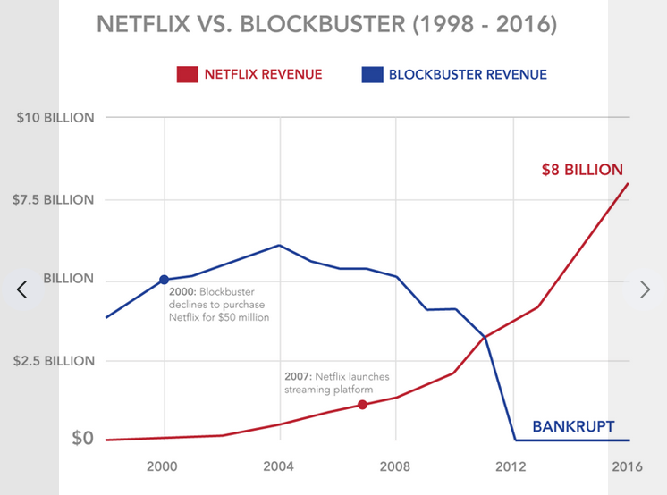

Slide 38
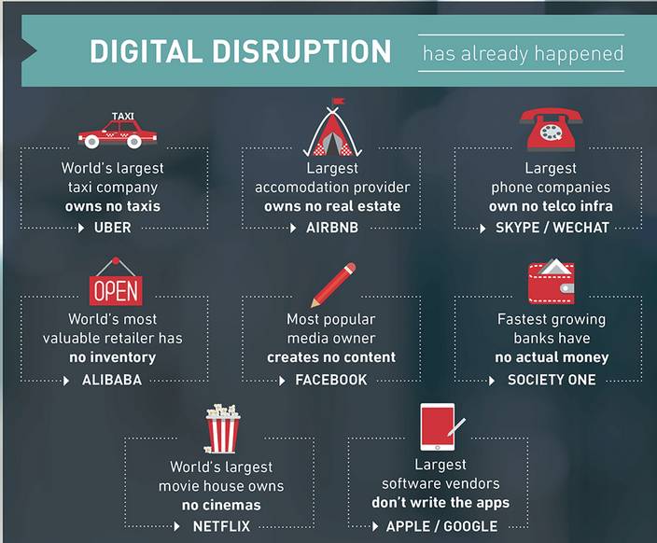

Slide 39
Disruptive Marketing
Sometimes, the traditional way of doing things is boring, banal, tired, and simply doesn't work.
Sometimes rules really need to be broken in order to be seen in a crowded market.
Disruptive marketing techniques allow brands to tap into the desire for change and implement it into their vision for long-term success.

Slide 40
Disruptive Advertising
The ad "1984” by Apple, changed advertising
-why was it different ?
-how did it change advertising ?
https://www.youtube.com/watch?v=X6BTTi63XeM

Slide 41
Why was it disruptive ?

Slide 42
Why was it disruptive ?
No product shown, no features mentioned

Slide 43
Why was it disruptive ?
No product shown, no features mentioned
Images and text shock you to attention

Slide 44
Why was it disruptive ?
No product shown, no features mentioned
Disturbing images and text shock you to attention
A revolutionary message as a call to action

Slide 45
Why was it disruptive ?
No product shown, no features mentioned
Images and text shock you to attention
A revolutionary message is a call to action
The Apple ad, shown only once as an event, but was so strong it became viral

Slide 46
Why was it disruptive ?
No product shown, no features mentioned
Images and text shock you to attention
A revolutionary message is a call to action
The Apple ad, shown once as an event, but was so strong it became viral
The ad resonates and becomes a PR product that generates word of mouth

Slide 47
Pirelli Tire
Established, traditional company that used a classic advertising and promotion model.
Their motto: "Power is nothing without control"
In 1995, they agreed to shake up their image,
build new awareness. The campaign made
advertising history.

Slide 48
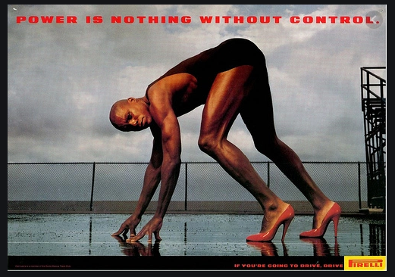
Advertising Flashback

Slide 49
What is the concept ?

Slide 50
Pirelli update for the covid crisis

Slide 51
COVID 19
LOCKDOWN
IN
NEW YORK

Slide 52
New Pirelli ad
what does it communicate ?

Slide 54
Video spot
A full video spot created for the Pirelli anniversary:
(this is in Italian, but you can find an English version on YouTube)
https://youtu.be/3xrmS8M065I

Slide 55
How to make a disruptive ad
Understanding a traditional concept, then turning it on its head.
creativity, changing a viewers expectation (shock value)
Suburra example

Slide 56
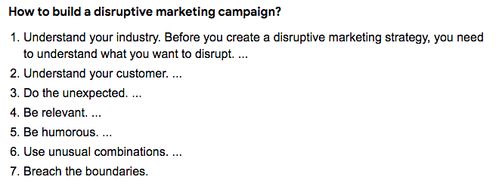

Slide 57
WHY BE DIFFERENT ??

Slide 58
Many reasons
To survive in a jungle of competition, you must be noticed and quickly .
The average attention span for consumers is 8.25 seconds. That is three quarters of a second shorter than the attention span of a goldfish.
Send a message that your brand is clever, creative, cool, modern and in tune with the audience.

Slide 60
Media Categories
Paid – Paid for when used
Owned – a company's own web properties
Earned – Publicity gained through promotion
efforts other than paid advertising

Slide 61
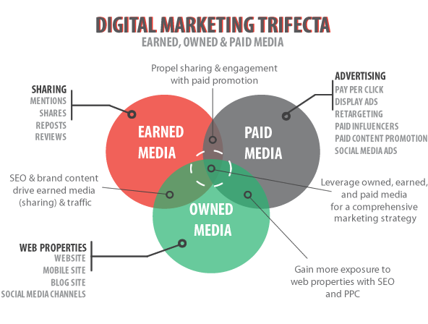

Slide 62
Did you know?
97% of people visiting a e-commerce site for the first time, leave without buying anything.
Are they lost forever ?
No, not with re-targeting: using tracking pixels
which follow you to other sites and remind you
of products you have seen before.
- Google ads
- Amazon trackers
- Facebook retargeting
- Linkedin ads, etc, etc.

Slide 63
DATA COLLECTION
MARKET AND CUSTOMER INSIGHT
MEDIA STRATEGY

Slide 64
How is the Marketing Media Mix Changing?
About two-thirds or more marketers are planning to increase their budgets for:
Social advertising (71%);
Online video (71%);
Social media (non-ad campaigns; 69%);
Retargeting (67%); and
Search engine marketing (66%).

Slide 65
Biggest areas of cutbacks
Print newspapers (39% decreasing spend to some extent);
Print magazines (36%);
TV (24%);
Radio (23%); and
Outdoor/billboard (21%)

Slide 66
Marketing tools for B2B
Are they different than B2C ?
Do you consider the consumer funnel ?
Is off-line or on-line better

Slide 67
Different approach
B2B and B2C marketing differ primarily in terms of their audiences and how they communicate to them. While B2C marketing focuses on quick solutions and enjoyable content, B2B marketing is more concerned with building relationships and proving a product's return on investment for a business customer.
What both types have in common is P2P (Person to person marketing)

Slide 68
B2B
ROI matters in B2B marketing.
- B2B purchase process tends to be driven more by logic and financial incentive.
The B2B buying cycle is often much longer than the B2C decision process.
- Have patience when marketing to other businesses, and create content for them that addresses the various stages of their buying cycle.

Slide 69
B2C
B2C purchases are more emotionally driven
- shorter term considerations in buying
- marketing communication should be more direct & informal
- Yes, brand loyalty can be an goal, but a marketer must communicate product quality & price as first consideration.

Slide 70
Current Trends in Digital

Slide 71
Internet of Things (I.O.T.)
The Internet of Things is the network of devices such as vehicles, and home appliances that contain electronics, software, actuators, and connectivity which allows these things to connect, interact and exchange data.
refers to the billions of physical devices around the world that are now connected to the internet, collecting and sharing data.

Slide 72
"Anything that can be connected, will be connected."
If it has an on and off switch then chances are it can be a part of the IoT.
Your alarm clock wakes up you at 6 a.m. and then notifies your coffee maker to start brewing coffee for you.
you are on your way to a meeting; your car could have access to your calendar and already know the best route to take.

Slide 73
I LOVE THIS AD: https://www.youtube.com/watch?v=v2kV6pgJxuo

Slide 74
Smart connected living
Advantages:
- easier, more efficiency for the user
- marketing has data sources for tracking behavior
Disadvantages:
- privacy and security threat from hacking
- need for stabile internet connections
Is Alexa spying on your private life ??

Slide 75
Interactive digital Making a creative connection to the customer
Encouraging and developing ways to have customers co-market (participate) with your product.
- Games, contests, to promote idea exchange
- Radio links to digital in brand promotions
Notes:
Canon EOS photo chain campaign

Slide 76
Virtual Reality
Virtual reality is an artificial environment that is created with software and presented to the user in such a way that the user suspends belief and accepts it as a real environment., usually by way of a headset with special lenses . Ideally, VR allows people to simulate the experience in 360 degrees.

Slide 77
Augumented Reality
Augmented reality is the blending of interactive digital elements – like dazzling visual overlays, or other sensory projections – into our real-world environments.
Imagine delivering a marketing strategy in real time. Customers and clients get to experience your product or service as it is meant to be used.
(Some popular examples of AR apps include AcrossAir, Google Sky Map, Layar, Lookator, SpotCrime, PokemonGo etc.)
https://www.youtube.com/watch?v=NOKJDCqvvMk

Slide 78
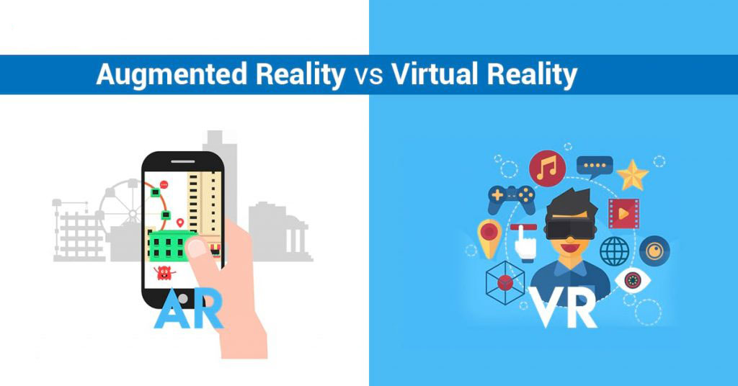
Learn the difference: https://www.youtube.com/watch?v=NOKJDCqvvMk

Slide 79
Amazon AR shopping mirror

Slide 80
Ikea AR "Place app" Access to 3200 items in their inventory

Slide 81
Artificial Intelligence
- "the ability of a computer program or machine to
think and learn. By definition, machine learning is any technology that uses algorythms to try to create repeatable results."
- this "learning"creates new algorythms to measure past habits which can even predict future behavior.
- Chat bots, "smart" voicemail systems
- Robotic surveys
- Home/office assistants (ie. Alexa)
** Used extensively by Media Agencies to assist in
programmable inserts of advertising into media channels

Slide 82
Another view of A.I.
The Atlas of AI: Power, Politics, and the Planetary Costs of Artificial Intelligence

Slide 85
For next Class: look at Pirelli
Each person must look at the Pirell.com website. Observe, study and analyze how it works as a communication, marketing platform.
1) Tell me what you think are the corporate objectives of the Pirelli website. Are they only promoting their brand values (people, innovation, technology) or something else?
2) Investigate their presence on social media. Does it seem to work to bring a positive benefit to Pirelli? How?
3 ) Are the conversations regarding Pirelli on social sites actually relevant to the commercial interests of the Pirelli company, that is to increase the sale of their tires ?
4) read this article: https://www.ferpi.it/news/comunicare-come-media-company-una-sfida-aziendale
........ We will talk about these things in the next class.

Slide 86
Groups 1 & 2 Project
Your agency has been selected by GlobalCom to prepare and execute an advertising campaign to sell a particular smartphone model in the Italian market.
Facts:
1) Global is one of the top five brands in the world. Known for good quality/reasonable price, they follow the innovations of Apple and Samsung and offer a lower-priced alternative with similar features the public wants.
2) For two years, their Model 8 was a good seller at a price point of about 300 euros. They want to introduce a new larger,more powerful model 9 that will cost more. At the same time they have ready another model called Model 8 Lite, that will be almost the same as the present Model 8, but with a better camera; it is water resistant, and comes in 3 new "fun" colors (Candy Red, Mirror Blue, and Shocking pink). The suggested retail price: 140 euros.
3) Your agency must promote the Model 8 Lite for the Italian market.
4) You have the data which shows the characteristics that customers liked best about the previous Model 7: The quality of the materials give it a robust feeling; the camera was appreciated for its quality images; the position of the control buttons made it easy to operate.

Slide 87
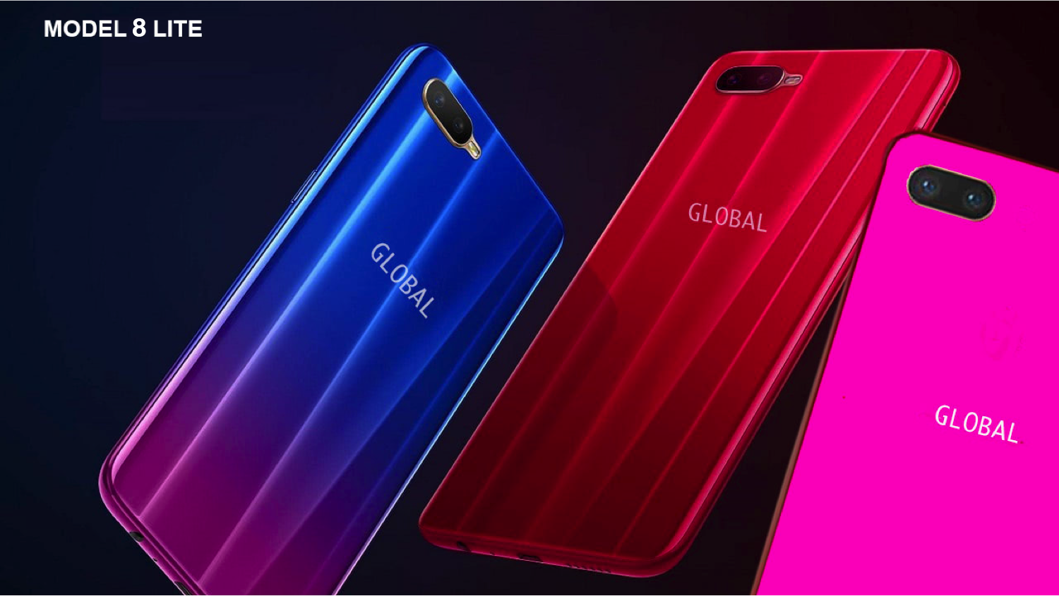

Slide 88
- Global thinks the target customer is under 25 years old. Do you agree ?
The overall objective of GlobalCom is to gain significant market share in the teen & young adult market. They want to do this even if this model is not a profit maker for them.
As an agency you have to:
(1) Use research and give an overview of the cell phone market
(2) create a slogan for this new model
(3 present a selling strategy that finds a niche for this phone in a crowded market and aggressively works to gain market share.
(4) make an advertising program that reaches the target customer, that informs them of the key features and creates excitement and interest. In this task you must choose the combination of media channels (TV, radio, outdoor, social media, the company website, contests, events, etc.,etc. ) that you think are appropriate.
- The product will be launched on July 1°, 2021. The budget: 2 million euros
- Present your plan to the marketing director of GlobalCom.

Slide 89
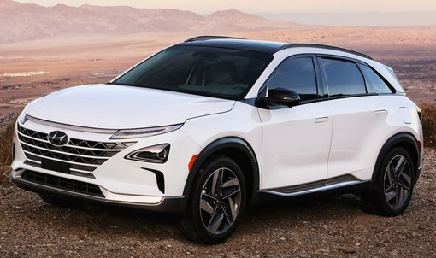
Groups 3 & 4 Project
Promoting the first Ultimate Green SUV, the hydrogen-fueled 2022 Hyundai Nexo

Slide 90
Car facts
List Price € 60.000 (with government tax incentives of 6k, effective price is € 54.000 + €13.000 in free fuel !!
400 km range; 0-100km/hr in 8.4 sec./ emissions..only water
5 year warranty with free service.
Includes all the latest electronic features for safety and navigation.
Problem is limited fuel stations: over 150 in Europe and 6 in
Italy (with more planned in 2022)

Slide 91
Agency tasks
- Research: What is the car market for SUVs overall and for environmentally
friendly models (Electric, hybrids); Who is the target customer
for this hydrogen powered SUV ?
-Selling strategy: with the car features and innovative technology, how can
you convince potential customers to buy, considering the
problem with limited fueling stations. Is your approach short or
long term?
- Advertising and media choice: With the 2021 budget of €3 million euros, how would you creatively promote this unique automobile ? What media channels would you emphasize considering the potential target customer ?

