Slide 1
Corporate Communications and Social Media

Slide 2
Corporate Communication
Corporate communication is a set of activities involved in managing and orchestrating all internal and external communications aimed at creating favourable point of view among stakeholders on which the company depends.
• Formally called “public relations” or “public affairs”
• The head communications officer reports directly to the CEO
in many top global organizations due to its critical importance
to the company.

Slide 3
C.C.Responsibilities
Oversees:
Communication strategy
Media relations
Crisis communications
Internal communications
Corporate responsibility
Investor relations
Government affairs

Slide 4
What is corporate identity ?
Corporate identity is the reality and uniqueness of an organization, which is integrally related to its external and internal image and reputation through corporate communication.

Slide 5
Corporate Image in the Digital World
Developing and maintaining your brand awareness using all digital marketing options.
Monitoring the public perception of your
company and its brand (brand image)
• Customer feedback through the use of content delivery and
interacting with social media sites.
• Using CRM philosophy and methods to build
brand loyalty.

Slide 6
A merger is happening !!
Corporate
Communications
Social Data
Collection
Corporate
Marketing

Slide 7
Web communication:
A psychological Journey

Slide 8
What is "Storytelling" ?

Slide 9
Content Marketing
Storytelling is the key component, one of the
most powerful ways to give life to your brand.
By giving your products and services an identity by capturing and sharing the stories , you can take your target audience on a journey they want to experience. In order for consumers to form a personal connection with your brand, company stories must be authentic, creative and inspirational.

Slide 10
Web communication:
A psychological Journey
From storytelling to converted sales
1) Stories create curiosity, interest to read

Slide 11
Web communication:
A psychological Journey
From storytelling to converted sales
1) Stories create curiosity, interest to read
2) Stories become associated with the sponsor, content source

Slide 12
Web communication:
A psychological Journey
From storytelling to converted sales
1) Stories create curiosity, interest to read
2) Stories become associated with the sponsor, content source
3) Content is engaging, causing repeat visits

Slide 13
Web communication:
A psychological Journey
From storytelling to converted sales
1) Stories create curiosity, interest to read
2) Stories become associated with the sponsor, content source
3) Content is engaging, causing repeat visits
4) Engagement leads to sharing on social media

Slide 14
Web communication:
A psychological Journey
From storytelling to converted sales
1) Stories create curiosity, interest to read
2) Stories become associated with the sponsor, content source
3) Content is engaging, causing repeat visits
4) Engagement leads to sharing on social media
5) Stories form brand sympathy, reinforcing brand image

Slide 15
Web communication:
A psychological Journey
From storytelling to converted sales
1) Stories create curiosity, interest to read
2) Stories become associated with the sponsor, content source
3) Content is engaging, causing repeat visits
4) Engagement leads to sharing on social media
5) Stories form brand sympathy, reinforcing brand image
6) Stories can subtly or overtly push those seeking commercial
info about the brand products to go to the commercial site.

Slide 16
Emotional Branding
Emotional branding is a progressive marketing strategy that has the potential to drive revenue and increase customer retention. How a person feels about your brand typically determines whether they buy your product. A brand is a matter of perception.
When you tell a story that embodies human challenges, you create an experience that resonates with your customers.

Slide 17
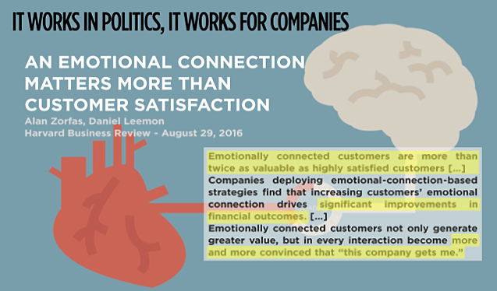

Slide 18
Outside the web
The psychological brand "liking" created by the
web stories or by other forms of communication
(events, sponsorships, etc) forms an inclination
that is favorable to buy the brand product.

Slide 19
A look at Pirelli
1) Tell me what you think are the corporate objectives of the Pirelli website. Are they only promoting their brand values (people, innovation, technology) or something else?
2) Investigate their presence on social media. Does it seem to work to bring a positive benefit to Pirelli? How?
3 ) Are the conversations regarding Pirelli on social sites actually relevant to the commercial interests of the Pirelli company, that is to increase the sale of their tires ?

Slide 20
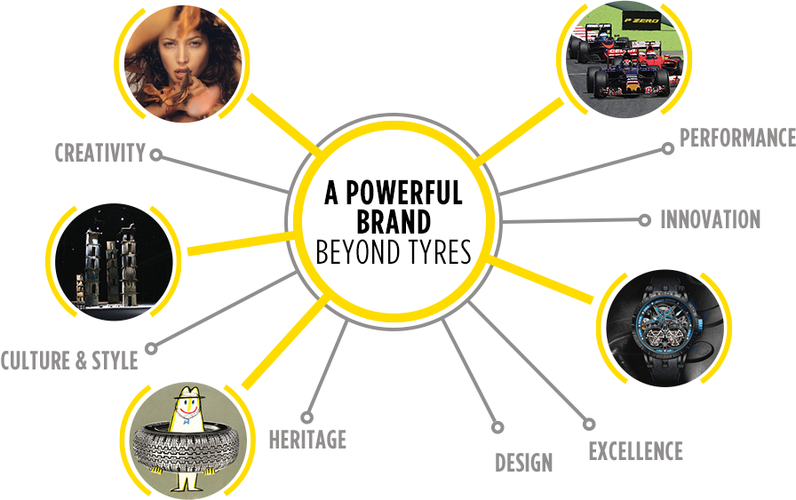

Slide 21
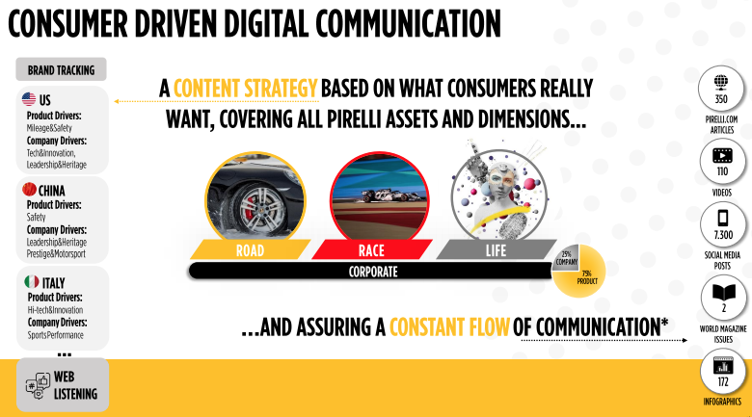

Slide 22

PIRELLI COMMUNICATION MODEL
REACH
ENGAGEMENT
CONVERSION
Online: towards Pirelli.com and product sites
KPIs
REPUTATION
Offline: conversion to propensity to buy,
say something positive and recommendation
CONTENT DISTRIBUTION
OWNED CHANNELS
EARNED CHANNELS
REACHED THROUGH DIGITAL AND TRADITIONAL PRESS AND THROUGH PAID
WEB SITES
SOCIAL MEDIA
CONTENT DISTRIBUTION
Budget: xx
CONTENT PRODUCTION
STORIES PRODUCTION
VIDEOS AND PICTURES
PRESS CONFERENCE
PRESS RELEASE
INFOGRAPHICS
CONTENT PRODUCTION
Budget: xx
ADV
EVENTS
USING BIG DATA AND ANALYTICS TO GET INSIGHTS ON CONSUMERS’ INTERESTS IN ORDER TO PRODUCE STORIES RELEVANT TO THE TARGET.
UTILIZZO DI BIG DATA E ANALYTICS PER INSIGHT SU GUSTI E INTERESSI DEL CONSUMATORE AL FINE DI REALIZZARE STORIE RILEVANTI PER IL TARGET.
PROJECT NAME
INIZIATIVA
2

Slide 24
Pirelli's
Vision, Purpose & Mission

Slide 25
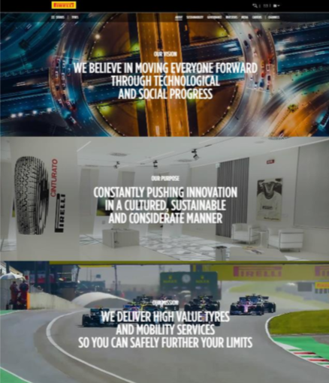

Slide 26
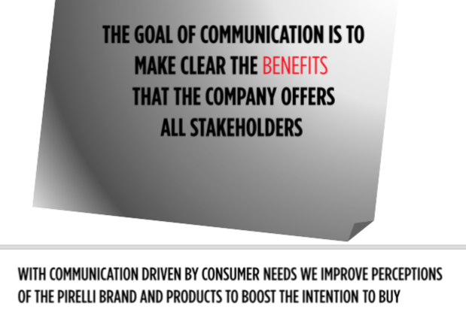

Slide 27
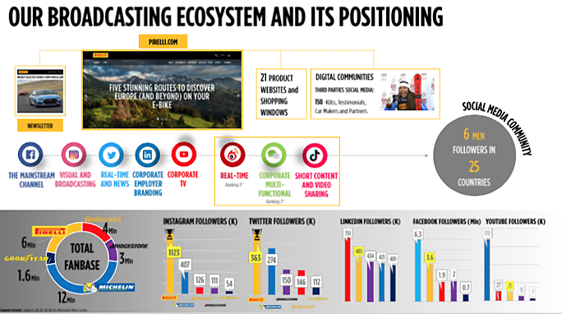

Slide 28
Public Relations
Perception is Everything
In brand building perception is the single most crucial ingredient for success.
Buyers and investors perceive value
Value is created through perception, which informs us and drives decision making.
Value is created through public relations and enhanced through communications.
What is the role of PR in this time of crisis ?
What is the role of "traditional" PR departments in companies
today ?

Slide 29
SOCIAL MEDIA

Slide 30
Social Marketing Compass
The Social Compass serves as our value system when defining our program activities. It points a brand in a physical and experiential direction to genuinely and effectively connect with customers, peers, and influencers, where they interact and seek guidance online.
Brian Solis – a marketing, branding and social media teacher with many good books.

Slide 31
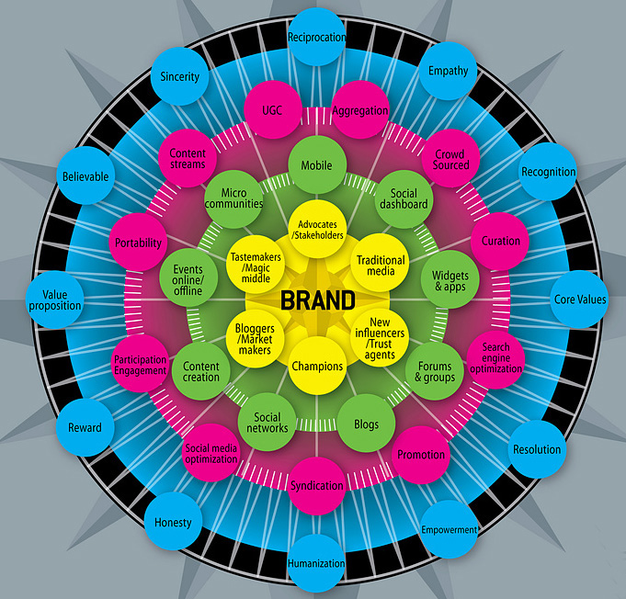

Emotions/Sentiment Channels Platform Players

Slide 32
Recap of Media Categories
Paid – Paid for when used
Owned – a company's own web properties
Earned – Publicity gained through promotion
efforts other than paid advertising

Slide 33
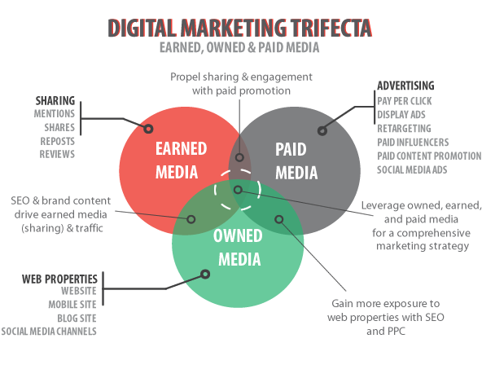

Slide 34
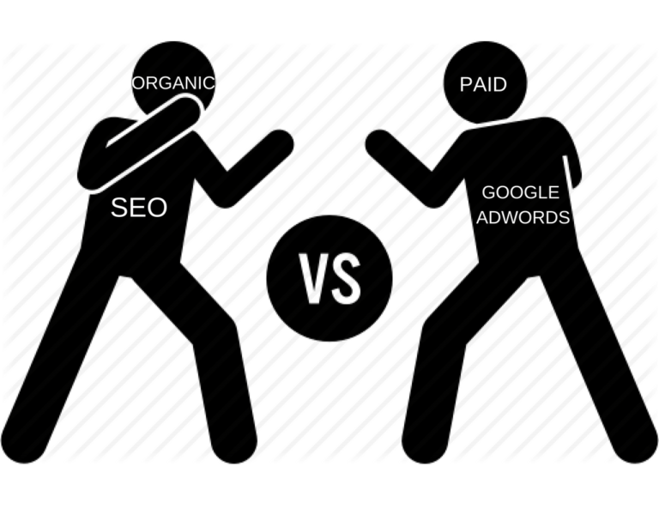
Organic vs. Paid

Slide 35
Organic Advantages
Organic search traffic brings in highly qualified prospects
Natural search traffic is a sustainable approach
Organic search is cost-effective in the long run
Natural traffic brings in regular and more engaged visitors
Organic traffic gives you higher credibility
Natural traffic is an excellent method of brand building
Notes:
Organic traffic refers to traffic that comes in through search engines, whereas Natural traffic would also include people directly entering a URL, coming in through social referrals, and through links on other sites

Slide 36
Paid Advantages
Small Initial Investment
Defining Budget
High ROI
Target Traffic
Test Marketing Campaigns
Instant traffic
Tracking success

Slide 37
Good article to explain on-line options
https://rafikidigi.com/organic-traffic-vs-paid-traffic/

Slide 39
New Class Groups
Agency 1: Salem, Rodigari, Kamal, Bagdanova, Kiziltunc
Agency 2: Masi, Cattaneo, Corti, Muhsen
Agency 3: Rebeccato, Balyan, Lobuono, Petakovic, Sansone
Agency 4: Vriale, Serra, Jain, Brocca, Plaia
* The first person named in the group is designated as the group leader, who will coordinate the group activity and lead the presentation.

Slide 40
Groups 1,and 2 Project
Ferrero wants to have a meeting with you, their agency, on March 12 to discuss your preliminary ideas to launch and promote their new snack line Nutti Frutti, for July 1st, 2022, as a trial in the Italian market only.
Prepare the talking points of your idea that will combine Off-line advertising with Social media. The product is ultimately targeted to be consumed by children.
Tasks: Analysis of market and typical adv methods used
Creative idea to capture attention and engage target
Timeline of pre-launch marketing to product rollout
Budget: 4 million euros

Slide 41
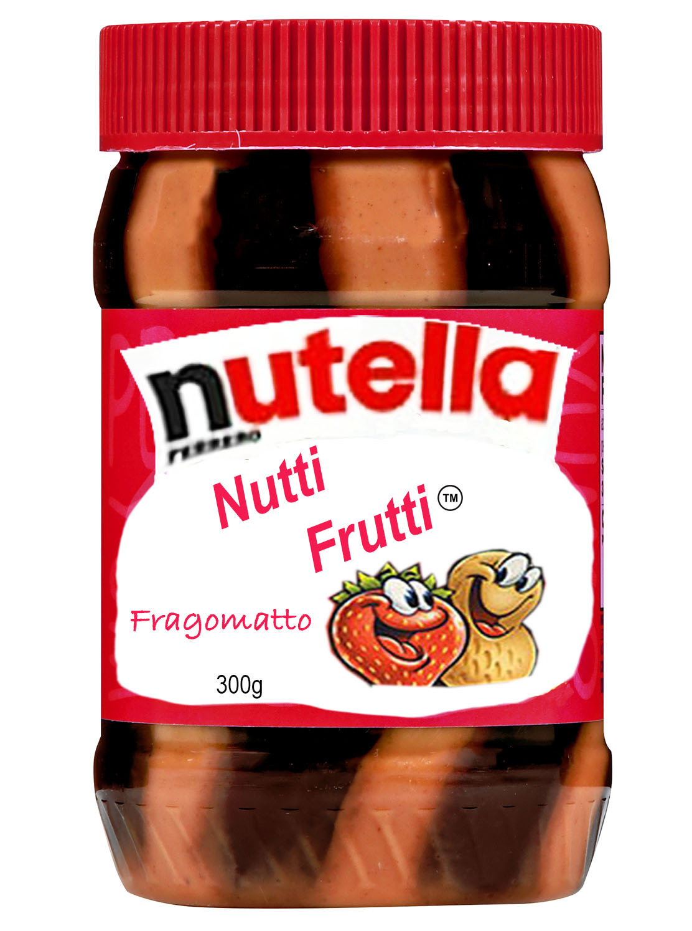
Introducing:
- Stripes of Nutella and fruit flavored jam
- Three flavors of jam: Strawberry, Grape and Orange

Slide 42
Agency tasks
Research the snack and children food sector
Creative idea to make people remember that
Nutti Frutti is different and even better.
Media choice & strategy
Promotion & selling strategy

Slide 43
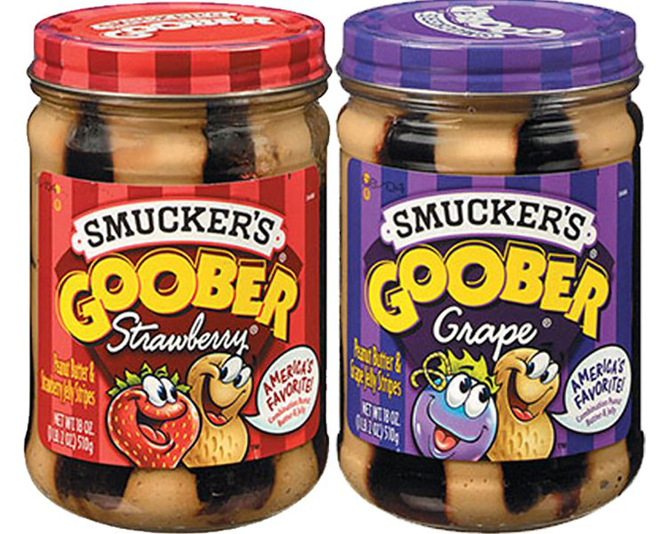
(The Americans were first)

Slide 44
Acqua Ferrarelle Problem
Their brand position has dropped by 20% in the last 5 years.
Their sales have steadily dropped 5-7% annually for the last 5 years.
Increased competition; people choose bottled water
principally on the price
They are losing sell-in space in markets
What can they do to regain profits & position ?
** attack the problem: who, what, where, how ?

Slide 45
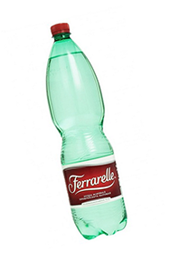
Groups 3 & 4
HOW DO YOU SELL A
BOTTLE OF WATER ?

Slide 46
Ferrarelle facts
slogan: A miracle of nature
Healthy water for the family
naturally sparkling
high concentration of essential minerals
Promotes sustainability
Premium price for a premium product

Slide 47
Group Tasks
What can they do to regain profits & position ?
- The company wants a creative ad campaign for June 1° launch, mixing off-line with digital, social emphasis.
Their budget is 5 million euros.
Research
Creative idea to make people remember that
Ferrarelle acqua is different and better.
Media choice & strategy
Promotion & selling strategy

Slide 50
In class project:
A feasibility study
- to indicate to the client the marketing and sales potential of his product.
- a marketing opinion based on research, logic and intuition
-tell the client if the idea is worth pursuing, and indicate the potential returns or explain exactly why it is too risky ?
- If it is a positive conclusion, give client a mini-road map on
how to market his product.

Slide 51
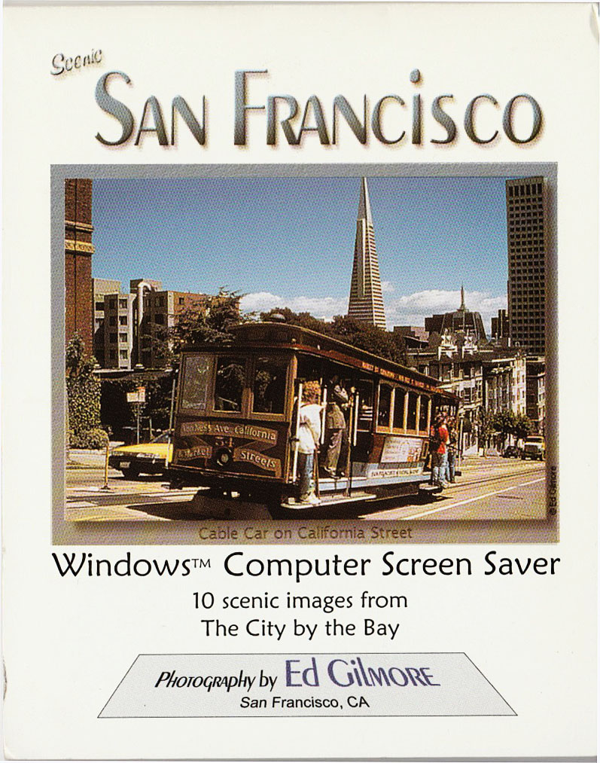
Tourism Screen Saver

Slide 52
Analysis & Feasibility Study
Tourism Screen Savers
Make a market analysis:
Client wants to know of the market potential for product in a tourist area like San Francisco.
What is the marketplace for this product.. size and potential ?
Current situation (This is a unique product for the tourist market)
* Product has no patent protection... does it matter ?
Product presentation, the look, the appeal ?
Who buys, where, what price is optimum ?
Short term-Long term outlook ?
Financial feasibility: Production costs, royalties & distribution costs
Overall opinion: Is it advisable to proceed? Risk/ rewards ? Defend your idea.

Slide 53
Screen saver facts
Tourism market is the target audience, but very competitive.
Recently the product was introduced for one month as a test in Seattle with good results and positive feedback. Test market retail cost 12 euros, the stores pay 7 euros wholesale.
A Windows operating system, 10 photos change automatically on screen every 30 seconds.
Costs: 1 euro manufacturing and packaging + 1 euro per package for a photo royalty; current production capacity 100 per day; with outsourcing the potential capacity is 1500/day at a unit cost of 50 cents each.
Research: Approximate size of California tourist market, principal areas with maximum tourist flows, number of stores selling souvenirs ?? ( answer: 200 to 300 )
Distribution method & costs: wholesale distributors serve major cities; storage, shipping ? Advertising ?
No patent, the screen saver technology already exists but the company is using the concept to create a small tourist souvenir item for many cities or destinations.
First comments from sellers: - The public likes the idea thinks it is a novel way to see photos
of the place, instead of the usual postcards.
  - The retail price is a little bit too high
- The bigger stores would like to have a monitor that shows how the screen saver works

Slide 55
Tourism Screensavers
Survey results: Good concept, packaging, POP display
Price point high, recommend $9.95
Some suggest TV monitor to display product
Overall positive and ready to put in store immediately
Initial market: 75 outlets (shops, hotels, airports) with additional 50 in
all of SF Bay Area
Expanding market: Napa Valley, Monterey/Carmel, Yosemite & Sequoia
Nat’l parks, Death Valley, Las Vegas, Grand Canyon
Negatives:
No design protection; risk of copying is very high
Limited sales life in an exclusive condition (estimate 3 to 5 months )

Slide 56
Costs
Unit costs:
Manufacturing 0.50
Shipping .20
Photo royalty .80
Regional distributor 1.00
Project coordination .50
$ 3.00
With the recommended new retail price of $9.95, the wholesale cost to the seller should be $5.00.

Slide 57
Projected Revenues
Only in SF Bay Area:
Assuming 50 locations only, at 12 units sold daily
@ $9.95 selling price; 18,000 units monthly =net profit to OtterScreens of $36,000 per month
optional Expanded Market:
Additional 75 locations in California and Nevada/Arizona brings additional projected sales of 27,000 units/month or $54,000 in additional net profit to OtterScreens.
Total monthly net to OtterScreens: $90,000

Slide 58
Market Strategy
Assume exclusive product life of 3-5 months before clones arrive.
Simultaneous launch at all sites recommended
Pull out of the the market all existing products from Seattle until the
launch date to keep the product secrecy.
• CMA handles all project coordination from photo procurement to contracts to distribution.
• OtterScreens must prepare for production increase of 800-1000 units/day. A JIT system will match sales & orders; OtterScreens is responsible for all after sale technical assistance and customer service.
• Launch date April 15 (3 months from now); this will allow time to get photos, sign distribution deals and contracts with shops
• Payment to CMA $5000 for expenses of SF sales network setup only;
or $15,000 for SF + expanded market. All additional payments to
CMA are by sales commission of 50 cents per each unit sold.

Slide 59
What happened ?
Went into 40 stores in SF Bay area
20 stores in LA,10 stores in Monterey/Carmel, 10 in National Parks,20 in Las Vegas
100 stores total with average sales of 10/day for 2 months
First product clone arrived in SF in 70 days, in 90 days LA & Vegas
After 90 days lost contracts in 60 stores
After 120 days CD screensavers arrived with 100 images for same price and
our products were pulled everywhere, except Las Vegas Hotels.
The company decided not to compete and closed operations.
Total units sold in 4 months: 95,000
in 1 year: 105,000

