Slide 1


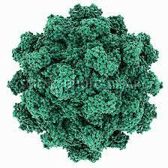
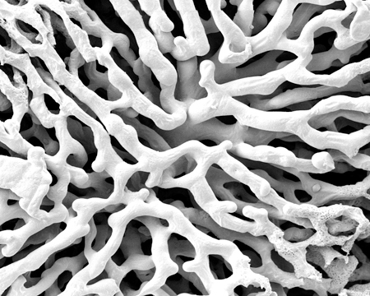
Introduzione alle Epatiti Virali
Antonio Ciaccio
UOC Gastroenterologia
Ospedale San Gerardo
Direttore: Prof P Invernizzi

Slide 2

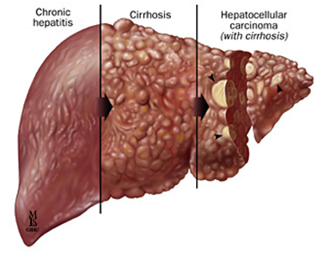

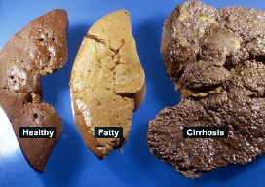

Keyword search: End Stage Liver Disease

Slide 3
Definition
Q: What is hepatitis?
A: Hepatitis is an inflammation of the liver. The condition can be self-limiting or can progress to fibrosis (scarring), cirrhosis or liver cancer. Hepatitis viruses are the most common cause of hepatitis in the world but other infections, toxic substances (e.g. alcohol, certain drugs), and autoimmune diseases can also cause hepatitis.
Source: WHO website

Slide 4
Chronic Hepatitis, Definition
Ongoing, long-lasting Inflammation of the liver
Duration: over six months
Severity is variable
Histopathology: few patterns and features
Potential for progression
No or few symptoms
No specific radiologic findings
LAB: usually raised ALT and/or GGT
Many causes

Slide 5
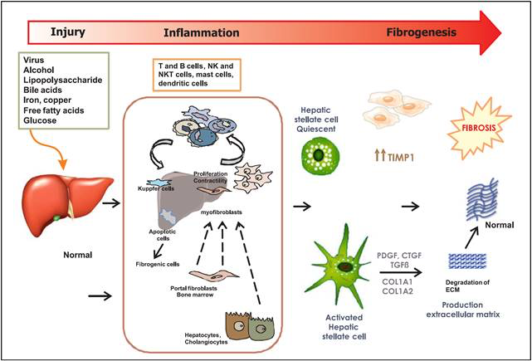
From inflammation to fibrosis
Notes:
Fibrosis in many organs is produced by a pathological excess in the deposit of extracellular matrix, including collagen types 1 and 2, along with chronic inflammation. In the liver, it is associated with the consumption of alcohol, NAFLD, viral or autoimmune hepatitis, and systemic diseases (Figure 1).5
The response of hepatocytes to inflammation plays a decisive role in the physiopathology of hepatic fibrosis, which involves the recruitment of both pro- and anti-inflammatory cells such as monocytes and macrophages. These amplify the response throughout the production of other cytokines and chemokines, which increase the stimulus of hepatic stellate cells by activating proinflammatory cells. Fibrogenic cytokines, such as transforming growth factor beta (TGF-β), activated by macrophages facilitate the transdifferentiation of stellate cells to myofibroblasts, which are the main source of production of extracellular matrix.6,7 Understanding these mechanisms has several clinical implications, including the development of therapeutic options that allow us to prevent, stop, or revert the progression of hepatic fibrosis and improve liver function (Figure 2).8 Unfortunately, there is no effective antifibrotic treatment approved for human use, and the point at which fibrosis becomes irreversible is not yet recognizable. The formation of regenerative nodules, the development of portal hypertension, and data indicating early hepatic failure are considered irreversible changes. However, it has been proved that in the early stages of fibrosis when the cause has been treated (e.g., hepatitis B or C), regression occurs in at least 70% of patients with the right antiviral management.9,10

Slide 6
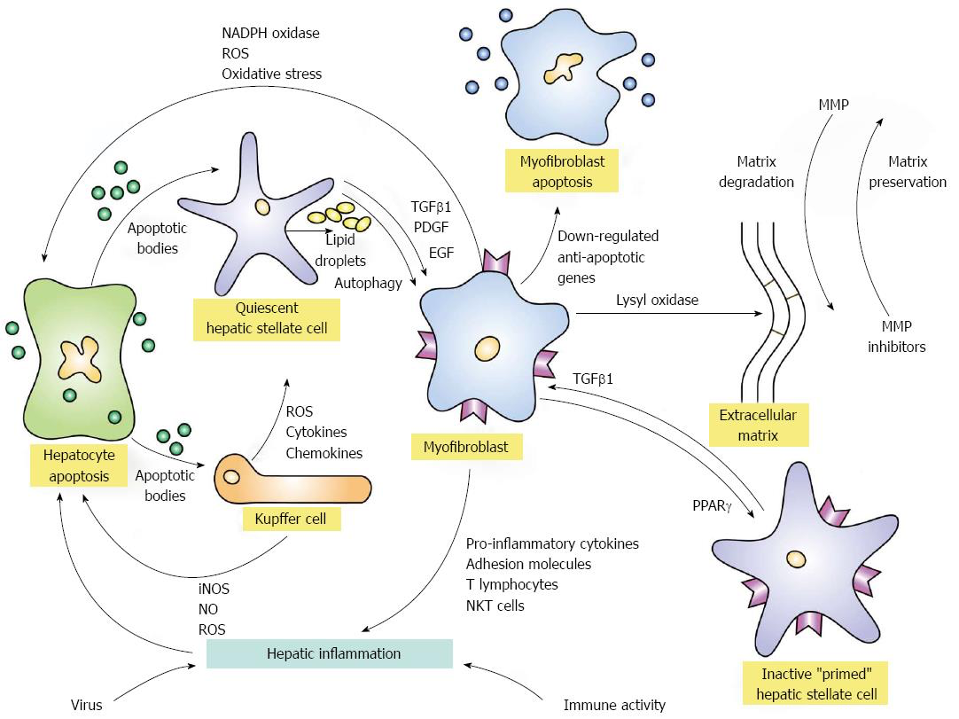



From inflammation to fibrosis
2
1
Czaja AJ. Hepatic inflammation and progressive liver fibrosis in chronic liver disease. World J Gastroenterol 2014
Notes:
Figure 1 Activation and de-activation pathways of hepatic fibrosis. Hepatic inflammation triggered by virus infection or immune-mediated mechanisms can initiate fibrogenesis by inducing apoptosis of hepatocytes.
The released apoptotic bodies can activate quiescent hepatic stellate cells and transform them into myofibroblasts under the mediation of transforming growth factor beta 1 (TGFβ1), platelet-derived growth factor (PDGF), and endothelial growth factor (EGF).
The activation process is fueled by the release of lipid droplets (autophagy).
The apoptotic bodies from the damaged hepatocytes can also stimulate Kupffer cells to generate reactive oxygen species (ROS) and nitric oxide (NO) by inducible nitric oxide synthase (iNOS).
The ROS in turn can enhance hepatocyte apoptosis and continue the activation of hepatic stellate cells.
Kupffer cells can also release ROS, cytokines and chemokines that contribute to the transformation of quiescent hepatic stellate cells to myofibroblasts.
The myofibroblasts can also generate ROS and increase oxidative stress on hepatocytes by the nicotinamide adenine dinucleotide phosphate (NADPH) oxidase pathway and promote hepatic inflammation by enhancing the expression of pro-inflammatory cytokines, adhesion molecules, activated T lymphocytes, and natural killer T (NKT) cells.
The myofibroblasts generate the extracellular matrix which can be cross-linked by lysyl oxidases and rendered resistant to degradation by metalloproteinases (MMP).
The reversibility of the extracellular matrix depends in part on the cross-linkage of collagen fibrils and the counterbalance of activities between MMP and MMP inhibitors.
Myofibroblast activity can be attenuated by the down-regulation of anti-apoptotic genes which then favor myofibroblast apoptosis and the expression of the peroxisome proliferator-activated receptor-gamma (PPARγ) gene which may contribute to hepatic stellate cell inactivation.
Inactivated stellate cells are different from quiescent hepatic stellate cells in that they are “primed” to have a low threshold for reactivation by TGFβ1.
Citation: Czaja AJ. Hepatic inflammation and progressive liver fibrosis in chronic liver disease. World J Gastroenterol 2014; 20(10): 2515-2532

Slide 7
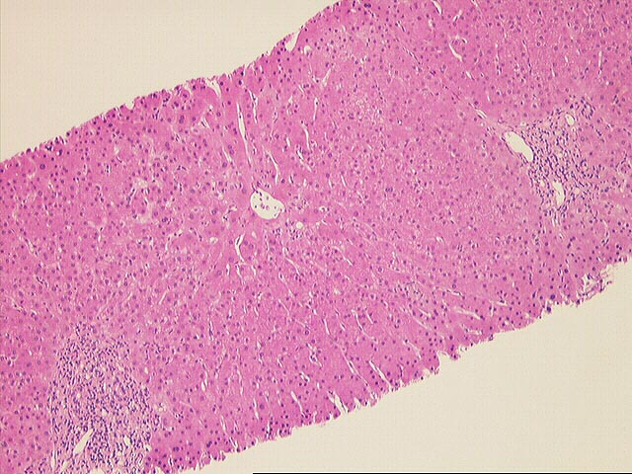
From inflammation to fibrosis

Slide 8
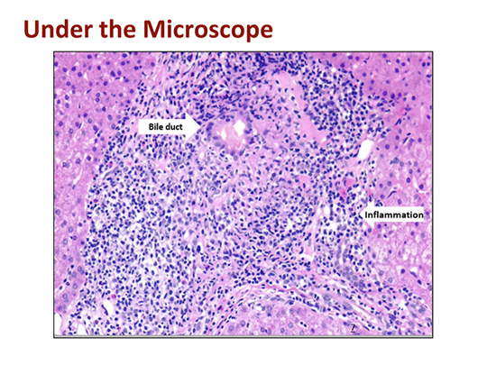
Cholangitis

Slide 9
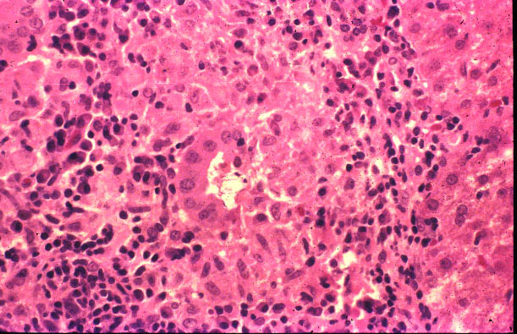
Cholangitis

Slide 10
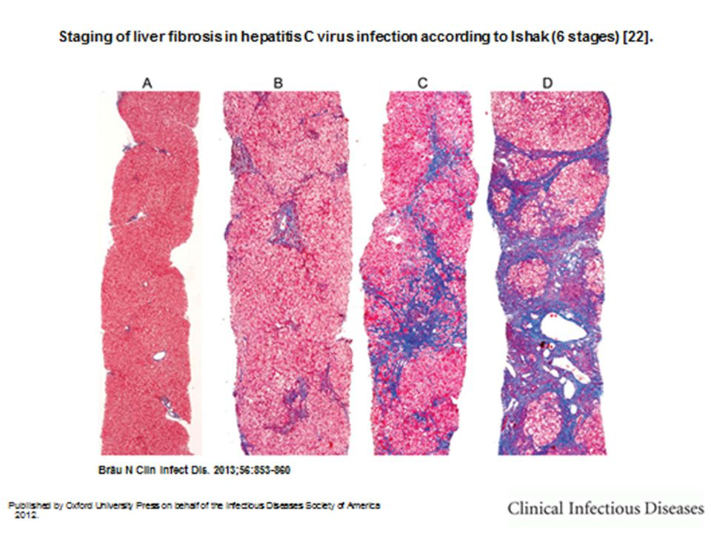
Fibrosis progression through stages
Notes:
Tricromica. Collagene in blu.

Slide 11
Fibrosis progression through stages

Slide 12
Fibrosis progression through stages

Slide 13
Fibrosis progression through stages

Slide 14
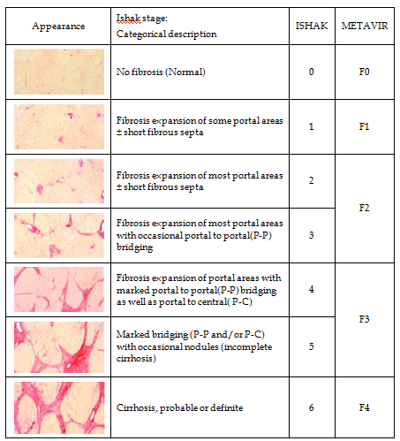
Fibrosis

Slide 15
  Natural History

Slide 16
Keyword search: End Stage Liver Disease

Slide 17
HCC
Chronic Hepatitis Natural History
Death
Progressive functional impairment, portal hypertension
Infection
Fibrosis progression
Transition to cirrhosis
decompensation
LTx
Portal hypertension
Liver function, protein syntesys

Slide 18
  Etiology

Slide 19
Causes of chronic hepatitis
Viral
  HCV
  HBV (+/- delta)
Toxic
  Alcohol
  Drug-induced
Metabolic
  Non-alcoholic steatohepatitis (NASH)
  Inherited Metabolic Disorders of the Liver
    Hereditary Hemochromatosis
    Wilson Disease
    Other
Autoimmune
  Autoimmune hepatitis
  Primary biliary cholangitis
  Primary sclerosing cholangitis
  Overlap syndromes

Slide 20
HAV
HBV
HCV
HDV
HEV
Trasmissione fecale-orale
Trasmissione parenterale
Trasmissione parenterale
Trasmissione parenterale – virus difettivo
Trasmissione fecale-orale

Slide 21
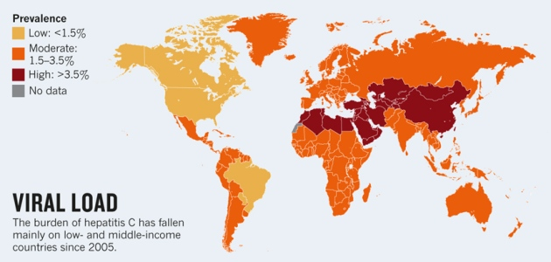
Hepatitis C

Slide 22
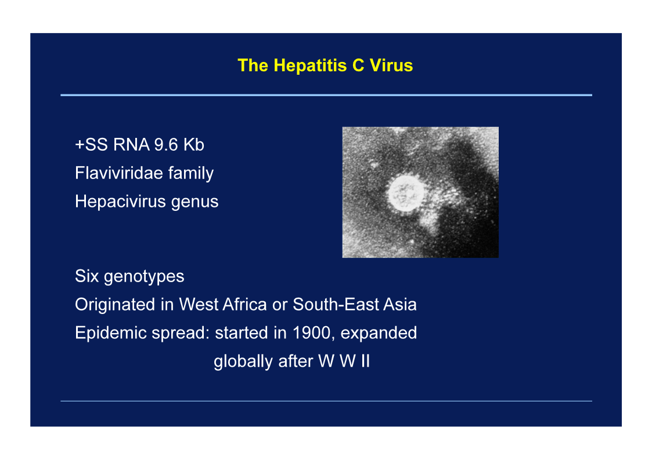

Slide 23
HCV
RNA-dependant RNA polymerases lacking a proof-reading system.
High rate of random mutations.
HCV can be classified into genotypes which are differed from each other by ~25–35% at nucleotide level.
Genotypes were further subdivided into subtypes which are different from each other by ~15–25% at the nucleotide level (Virus Taxonomy, the International Committee on Taxonomy of Viruses).
More closely-related mutant spectra are termed viral quasispecies, such as escape mutants from immune response in one patient.

Slide 24
HCV
Translation of the HCV RNA starts from the 5′-UTR internal ribosomal entry site and generates a single polyprotein.
That polyprotein is processed by cellular proteases to produce the structural proteins that form the viral particles (core and envelope glycoproteins E1 and E2), or is processed by viral proteases to generate non-structural (NS) proteins (p7, NS2, NS3, NS4A, NS4B, NS5A, and NS5B)
Notes:
Figure 1. HCV genome and viral particle structure. (A) The HCV structural proteins constitute the viral
particle. The positions of HVR-1 and -2 in the E2 protein and ISDR in the NS5A protein are indicated;
(B) alignment of the HVR-1 and HVR-2 amino acid sequences of HCV genotypes 1b and 2a [13];
and (C) alignment of the ISDR sequence of the NS5A proteins (R6 [14], 1b (GenBank BAA88704.1),
1a [15]; N [16], JF [17], and G4 (GenBank BAM95359.1). HCV, hepatitis C virus; HVR, hypervariable
region; ISDR, interferon (IFN)-sensitivity-determining region; NS, nonstructural. Amino acids with red
indicate mutated residues and blue indicate insertion.
HVR-1 appears to be the dominant epitope [11,12] and its mutation can facilitate escape from host immune responses. Variations in HVR-1 and HVR-2 are
generated quickly and can confer adaptive advantages in viral tropism, host range, virulence, and drug
resistance. In HCV patients, a higher rate of amino acid substitutions per site was observed in the
acute phase than in the chronic phase [13]. One patient lost reactivity to their own HVR-1 amino
acid sequence during chronic infection (HCV genotype 1b), whereas another patient had reactivity to
HVR-1 (HCV genotype 2a). Therefore, HVR-1 may not always display neutralizing epitopes in HCV
infection. The sequence variations in HVR-1 may reflect the existence of various clones in the acute
phase, the adaptation of which could cause persistent, chronic infection.

Slide 26
Hepatitis C
Screening
Lo screening dell’infezione attiva dell’HCV è effettuato con l’intento di rilevare le infezioni da virus dell’epatite C ancora non diagnosticate, migliorare la possibilità di una diagnosi precoce, avviare i pazienti al trattamento onde evitare le complicanze di una malattia epatica avanzata e delle manifestazioni extraepatiche, nonché interrompere la circolazione del virus impendendo nuove infezioni.
Lo screening è rivolto, in via sperimentale, una tantum per il biennio 2020 -2021, per un unico test, a
- tutta la popolazione iscritta all’anagrafe sanitaria e nata dal 1969 al 1989;
- ai soggetti seguiti dai servizi pubblici per le Dipendenze (SerD), indipendentemente dalla coorte di nascita e dalla nazionalità;
- ai soggetti detenuti in carcere, indipendentemente dalla coorte di nascita e dalla nazionalità.
Le operazioni di screening saranno organizzate dalle Regioni e prevedono:
a) per la coorte di nascita dal 1969 e al 1989 lo screening avverrà, con chiamata attiva attraverso i Medici di Medicina Generale e/o il Servizio di prevenzione territoriale.
Ogni occasione di incontro con una struttura sanitaria sarà, per la coorte indicata, un’opportunità per effettuare lo screening per HCV.

Slide 27
Lab tests
Anti-HCV: for screening or surveillance
HCV RNA: to confirm active infection
  Qualitative
  Quantitative
  Detection limit usually 10-25 IU/mL in Real Time PCR
Western blot: not used in clinical practice
Genotype: II level test, prior to treatment decision

Slide 28
Genotipi virali
6 genotipi virali numerati da 1 a 6
Genotipo 1 (sottotipi 1a - 1b):più diffuso in tutto il mondo
Genotipo 1a : più diffuso negli US
Genotipo 1b : maggior prevalenza in Europa
Genotipi 2 : area mediterranea
Genotipo 3a : in Europa > prevalenza in TD
Genotipi 5 – 6 : rari

Slide 29
HCC
Hepatitis C Natural History
Death
Progressive functional impairment, portal hypertension
Infection
Fibrosis progression
Transition to cirrhosis
decompensation
LTx

Slide 30
Infection
Acute Hepatitis C
<0.1%?
55-85%
Fulminant hepatitis
Chronic hepatitis
Recovery
≈20%
Cirrhosis
Recovery
Hepatocellular carcinoma
Death

Slide 31
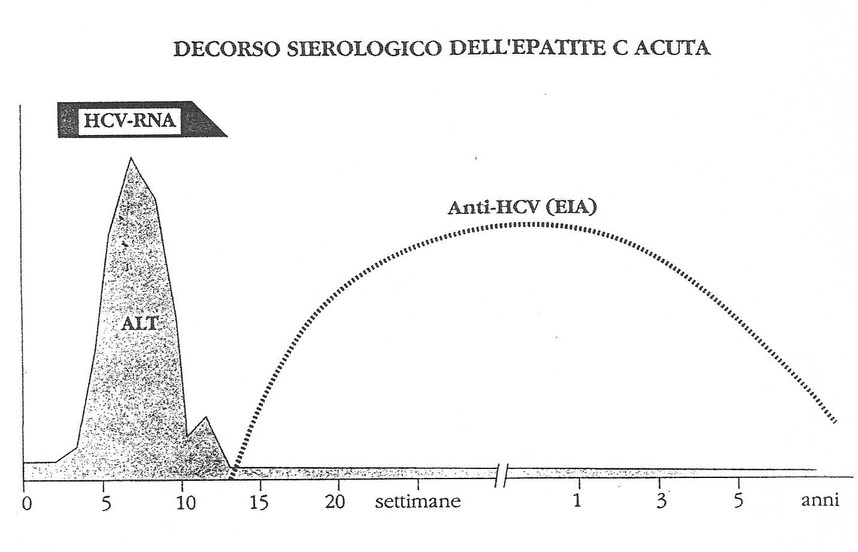
Acute hepatitis C
Self-limited infection without hepatitis
HCV RNA
ALT
Periodo di incubazione: mediamente 6-8 settimane
Periodo «finestra»: anche superiore alle 8 settimane

Slide 32
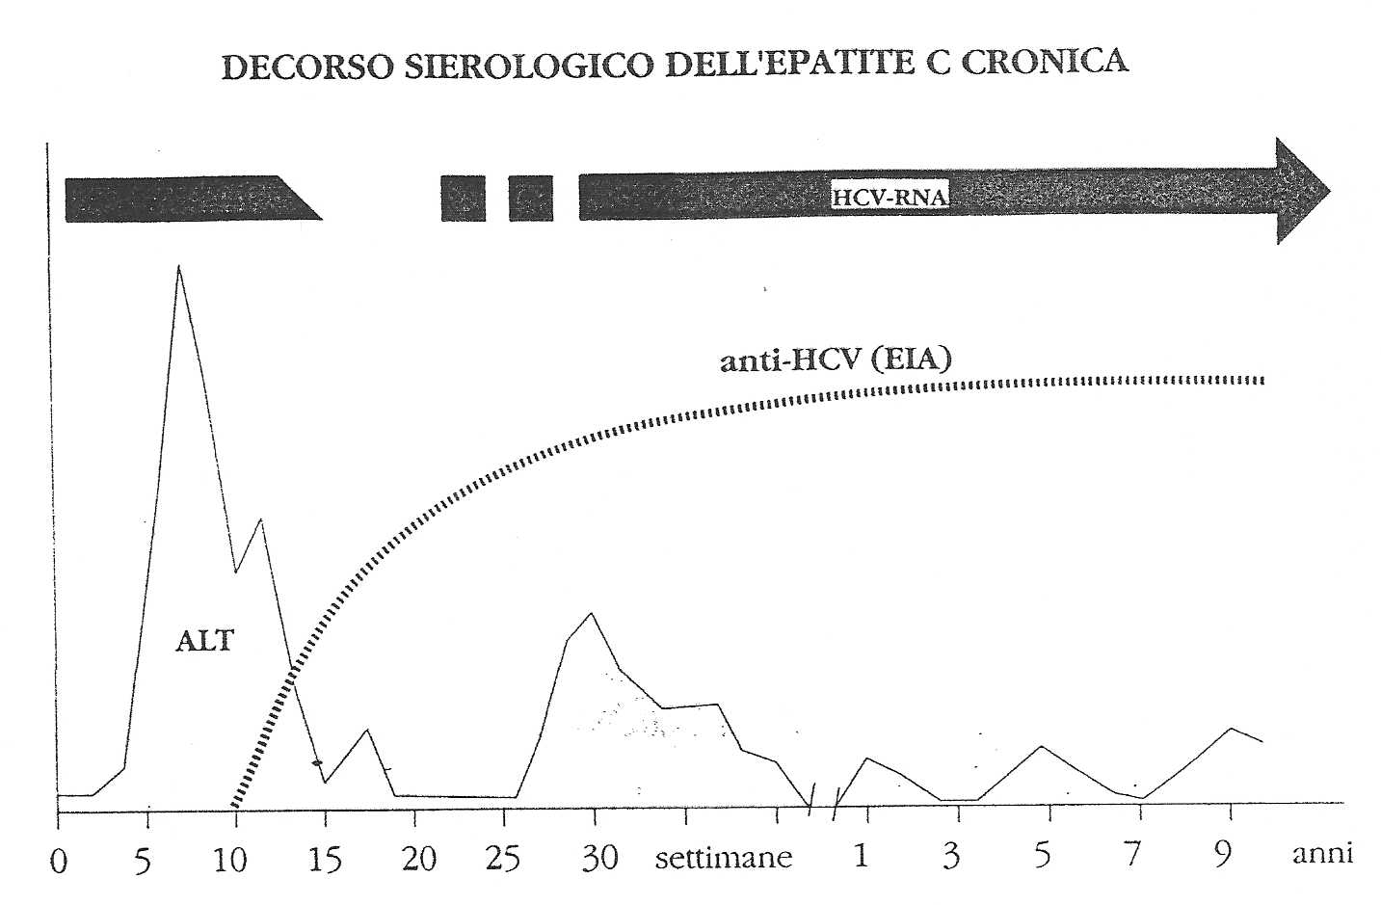
HCV RNA

Slide 33
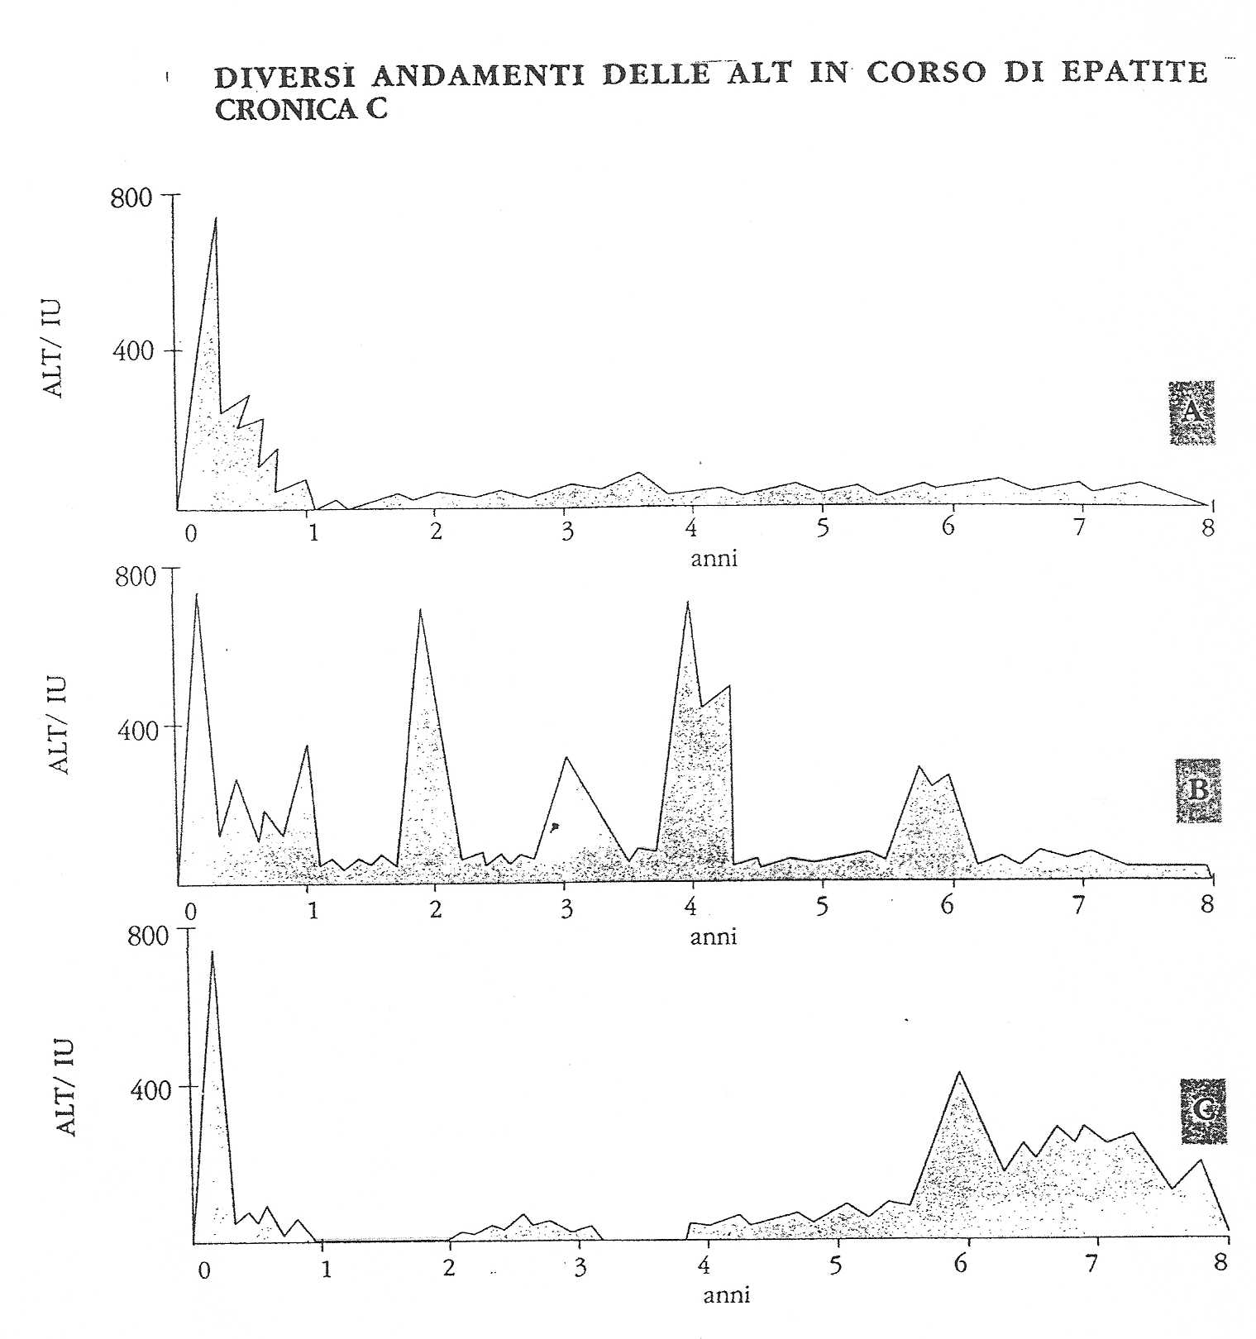

Slide 34
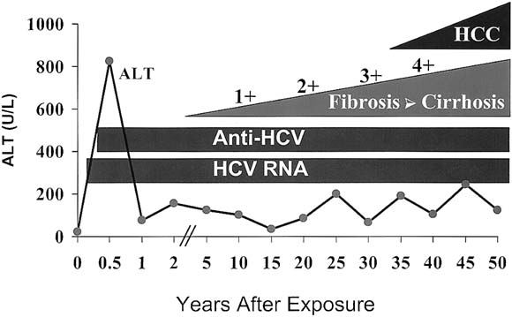
THE NATURAL HISTORY OF CHRONIC HEPATITIS C
OVER 50 YEARS
Hoofnagle et al. Hepatology 2002.
Notes:
During chronic infection, a progressive worsening of fibrosis to cirrhosis (from none to 4+) can occur. Hepatocellular carcinoma typically appears after decades of infection and usually in a patient with an underlying cirrhosis

Slide 35
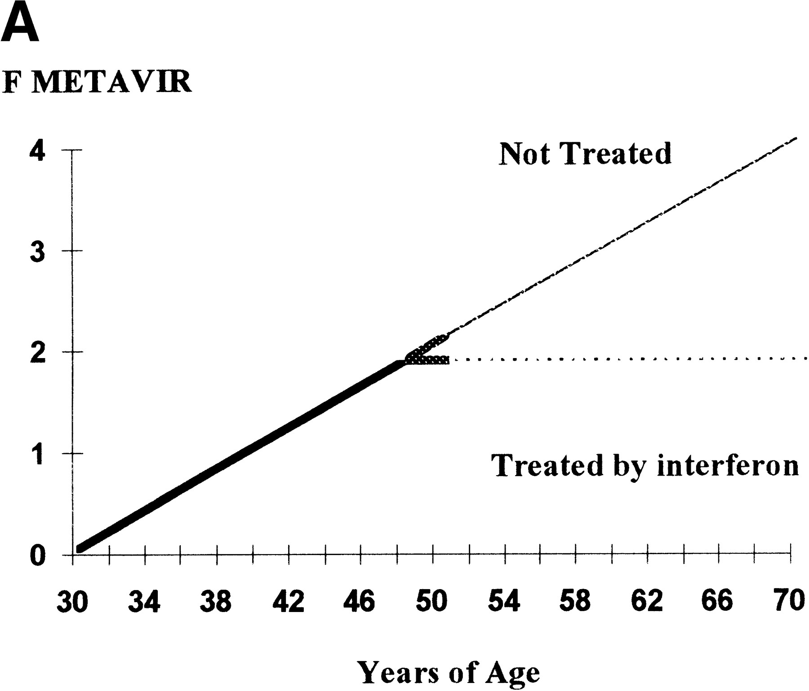
Fibrosis Progression in Hepatitis C
N= 2,235
RAPID FIBROSERS
FIBROSIS STAGE
SLOW FIBROSERS
1
1
2
2
2
3
3
4
Poynard et al. Lancet 1997.

Slide 36
RISK OF CIRRHOSIS BY LIFETIME DAILY ALCOHOL INTAKE IN PATIENTS WITH AND WITHOUT HCV INFECTION
Odds Ratio
0
25/50
75/100
125/150
>175
Lifetime daily alcohol intake (g/day)
Corrao and Arico. Hepatology 1998.

Slide 37
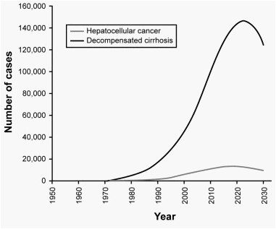
Future disease burden related to HCV
Davis G, Gastroenterology 2010
Notes:
After the disease has been established for approximately 20 years, much higher levels of morbidity and mortality become apparent as the disease progresses. The patient will experience more persistent elevation of liver enzymes, persistent viremia, and a more rapid progression to cirrhosis, decompensation, hepatocellular carcinoma, and possibly even the need for liver transplantation. Because of this insidious nature, the incidence of advanced liver disease is expected to increase significantly, making early diagnosis and treatment of chronic hepatitis critical.
Reference
Davis GL, Albright JE, Cook S, et al. Projecting the future healthcare burden from hepatitis C in the United States. Hepatology. 1998;28(4 pt 2):390A.

Slide 38
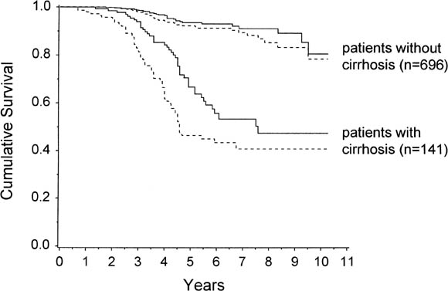
Prognosis of chronic hepatitis C: results of a prospective cohort study
No cirrhosis
Cirrhosis
Cumulative survival, combining the numbers of deaths and LTXs as events (solid lines), and cumulative survival without complications (broken lines) in patients with cirrhosis at study entry (upper part;
n = 141) and in patients without cirrhosis at study entry (lower part; n = 696), respectively.
Niederau et al. Hepatology 1998, 28:1687-1695
Notes:
FIG. 2. Cumulative survival,
combining the numbers of deaths
and LTXs as events (solid lines), and
cumulative survival without complications
(broken lines) in patients with
cirrhosis at study entry (upper part;
n 5 141) and in patients without
cirrhosis at study entry (lower part;
n 5 696), respectively. For definitions
of clinical complications, see
Patients and Methods. By proportional
hazards model, survival and
complication-free survival were significantly
better in patients without
cirrhosis at study entry as compared
with patients who already had cirrhosis
at study entry (for risk ratios and
confidence intervals, see Results)

Slide 39
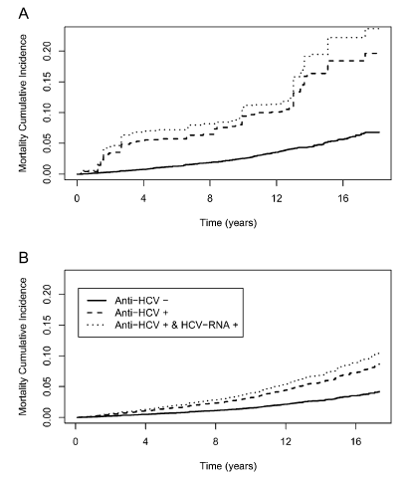
All-Cause, Liver-Related, and Non–Liver-Related
Mortality Among HCV-Infected Individuals in the General US Population
Adjusted for co-factors and liver-related causes.
El Kamary et al., Clin Infect Dis 2011
Notes:
Unadjusted
Covariate-adjusted
Background. Liver-related mortality among those infected with hepatitis C virus (HCV) has been described,
but little is known about non–liver-related mortality. Our objective was to determine HCV-associated all-cause,
liver–, and non–liver-related mortality in the general US population.
Methods. A prospective cohort study of 9378 nationally representative adults aged 17–59 years was performed
utilizing the Third National Health and Nutrition Examination Survey (NHANES III) Linked Mortality File that
was made publicly available in 2010. HCV status was assessed from 1988 to 1994, with mortality follow-up of the
same individuals through 2006.
Results. There were 614 deaths over a median follow-up of 14.8 years. After adjusting for all covariate
risk factors, HCV chronic infection had a 2.37 times higher all-cause mortality rate ratio [MRR] (95% CI: 1.28–4.38;
P 5 .008), a 26.46 times higher liver-related MRR (95% CI: 8.00–87.48; P , .001), and 1.79 times higher non–liverrelated
MRR (95% CI: .77–4.19; P 5 .18), compared with being HCV-negative. This represents an estimated 2.46
million US adults aged 17–59 years with chronic HCV infection who had an estimated 31,163 deaths from all causes
per year, of which 57.8% (95% CI: 21.9%–77.2%) were attributable to HCV. Among those, there was an estimated
9569 liver-related deaths per year, of which 96.2% (95% CI: 87.5–98.9%) were attributable to HCV. Non–
liver-related deaths were not significantly associated with HCV status.
Conclusions. Chronic HCV all-cause mortality is more than twice that of HCV-negative individuals. This
suggests that those with chronic HCV infection are at a higher risk of death even after accounting for liver-related
morbidity and should be closely monitored.

Slide 40
Manifestazioni extraepatiche da HCV

Slide 41
Manifestazioni extraepatiche associate a infezione da HCV
A: Associazione definita sulla base di
Alta prevalenza
Patogenesi
Crioglobulinemia mista
Glomerulonefrite membrano-proliferativa
Neuropatia periferica
B: Associazione definita sulla base di maggiore prevalenza rispetto ai controlli
Linfoma non-Hodgkin a cellule B
Gammapatie monoclonali
Porfiria cutanea tarda
Lichen planus
C: Associazione in attesa di conferma/caratterizzazione
Tiroidite autoimmune
Carcinoma della tiroide
Sindrome sicca
Alveolite-fibrosi polmonare
Diabete mellito
Nefropatie non-crioglobulinemiche
D: Osservazioni aneddotiche
Psoriasi
Neuropatie non-crioglobulinemiche
Poliartrite cronica
Artrite reumatoide
Poliarterite nodosa
M. di Bechet
Poli/dermatomiosite
Fibromialgia
Orticaria cronica
Prurito cronico
Pseudo-sarcoma di Kaposi
Eritema necrotico migrante
Vitiligo
Cardiopatie e miocarditi
Ulcere corneali di Mooren
Disfunzioni erettili
A.I.S.F. (2003) Manifestazioni extraepatiche dell’HCV

Slide 42
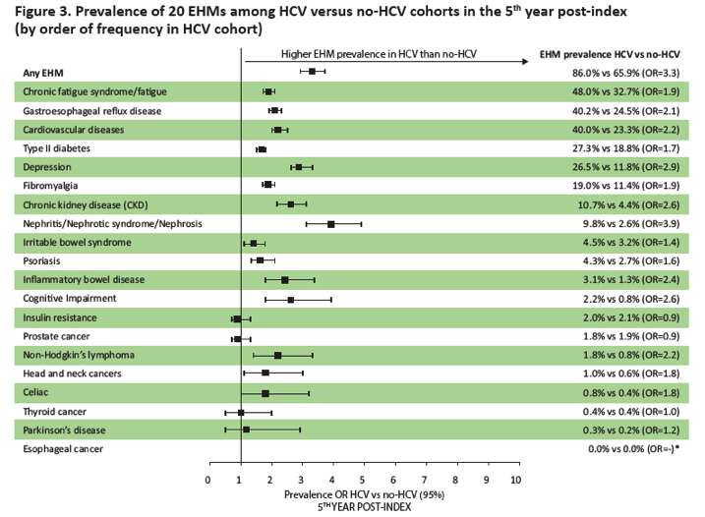

Slide 43
Classification of HCV Extrahepatic Manifestations
Immune-related extrahepatic manifestations
Mixed cryoglobulinemia
Cryoglobulinemic vasculitis
B-cell NHL
Sicca syndrome
Arthralgia/myalgia
Autoantibody production (i.e. cryoglobulins, rheumatoid factor, and antinuclear, anticardiolipin, antithyroid and anti-smooth muscle antibodies)
Polyarteritis nodosa
Monoclonal gammopathies
Immune thrombocytopenia
Inflammatory-related extrahepatic manifestations
Type 2 diabetes mellitus type 2
Insulin resistance
Glomerulonephritis
Renal insufficiency
Fatigue
Cognitive impairment
Depression
Impaired quality of life
Polyarthritis/fibromyalgia
Cardiovascular disorders (i.e. stroke, ischemic heart disease)

Slide 44
Mixed Cryoglobulinemia
Cryoglobulins are cold-insoluble immune complexes containing rheumatoid factor, polyclonal IgG (and HCV RNA) that precipitate and deposit on vascular endothelium, effecting a vasculitis in organs such as the skin, kidneys, and peripheral nerves.
Cryoglobulins are classified as:
  type I (monoclonal Ig only),
  type II (mixture of monoclonal Ig which is usually IgM RF, and polyclonal IgG)
  type III (mixture of polyclonal Ig that is usually IgM, and polyclonal IgG)
Since the identification of HCV in 1989, it has been recognized as the cause of >90% of MC, and <5% of cases are now considered “essential”(3-5). HCV is primarily associated with type II MC (which typically has an IgMκ RF with anti-idiotypic activity(6)), and to a lesser extent, with type III MC
In 1966, Meltzer described MC as the clinical triad of palpable purpura, arthralgia, and asthenia accompanied by organ involvement (e.g. nephropathy and neuropathy) and elevated serum RF, defined as Ig capable of binding IgG(1). It is now known that this triad is rare; many MC patients are asymptomatic.
Adapted from Charles ED, Kidney Int 2009

Slide 45
Manifestations
HCV MC vasculitis primarily affects the small and medium-sized vessels of the skin, kidneys, and peripheral nerves. Histology typically reveals a leukocytoclastic vasculitis, with deposition of IgM RF, IgG, C3, and neutrophils in the vessel wall. A necrotizing vasculitis, with fibrinoid necrosis of the intima and the inflammation of the entire vessel wall and perivascular space, may also occur.
Palpable purpura, primarily of the lower legs, occurs in more than 90% of patients with symptomatic HCV MC, is frequently intermittent, and is often the initial manifestation of HCV MC. Purpuric lesions may occasionally progress to chronic ulcers and frank gangrene.
HCV-MC renal involvement is usually Type I membranoproliferative glomerulonephritis (MPGN), with severe features. Manifestations range from isolated proteinuria to nephritic syndrome with variable progression towards chronic renal insufficiency.
The MPGN is characterized by endocapillary mesangial cell proliferation, monocytic infiltration, double contour membranes, glomerular IgM, IgG and C3 deposition, eosinophilic PAS-positive intraluminal deposits, and vasculitis of the small and medium sized renal arteries.
The incidence of neurological involvement is variable. Sensorimotor neuropathy arises from cryoglobulin deposition in the vasa vasorum. Painful paresthesias and concomitant weakness, particularly in the lower limbs may occur, as may isolated mononeuritis, manifested by foot or wrist drop.
Adapted from Charles ED, Kidney Int 2009

Slide 46
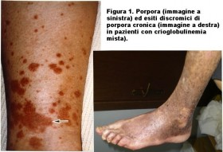
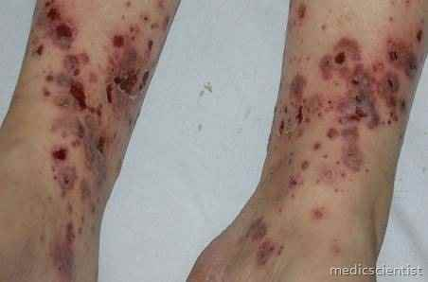
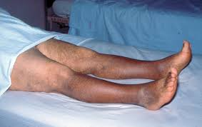
Porpora da vasculite cutanea crioglobulinemica

Slide 47
SINDROME CRIOGLOBULINEMICA
STANCHEZZA
ARTRALGIE
PORPORA
COMPROMISSIONE RENALE
NEUROPATIA PERIFERICA E/O CENTRALE

Slide 48
NEFROPATIE E HCV
NEFROPATIA CRIOGLOBULINEMICA
GLOMERULONEFRITE MEMBRANOPROLIFERATIVA (GNMP)
NEFROPATIA MEMBRANOSA

Slide 49
NEFROPATIA CRIOGLOBULINEMICA
35-60% dei casi di CM Tipo II
Ematuria
Proteinuria (anche > 3g 24/h)
Edemi declivi
IR di grado variabile: indice prognostico negativo

Slide 50
NEFROPATIA CRIOGLOBULINEMICA
Ispessimento della membrana basale dei glomeruli – proliferazione cellulare e infiltrazione di macrofagi circolanti
HCV presente nei glomeruli, anse capillari e mesangio

Slide 51
NEFROPATIA CRIOGLOBULINEMICA
Trombi intraluminari formati da crioglobuline precipitate
Depositi diffusi di IgM nelle anse capillari
Depositi subendoteliali (rari)

Slide 52
GNMP
Può essere diagnosticata in corso di infezione cronica da HCV anche in assenza di crioglobuline (rara)
Manifestazioni istologiche simili a quelle della nefropatia crioglobulinemica

Slide 53
NEFROPATIA MEMBRANOSA
Malattia glomerulare
Ispessimento delle menbrane basali glomerulari senza aspetti proliferativi
S. nefrosica
Assente ipocomplementemia e fattore reumatoide

Slide 54
Acute viral hepatitis
Defined by Lab findings with or without clinical manifestations.
ALT elevation > 10xULN, usually > 20xULN
May be accompanied by jaundice
Nausea, anorexia, abdominal pain, malaise, fever as possible symptoms in a minority of cases.
Histologic findings encompass acute necrosis, inflammation and collapse of architectural organization of the hepatic lobule.

Slide 55
Hepatitis E
Hepeviridae (infect mammals, birds and fishes)
  Orthohepaevirus: also infect human
  Species from A to D
  Species A is responsible of human infection
    Eight genotypes
    Only GT 1 and 2 infect humans.

Slide 56
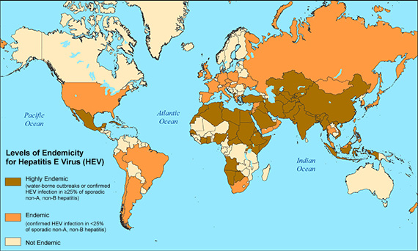
HEV World distribution
Source: CDC 2018

Slide 57
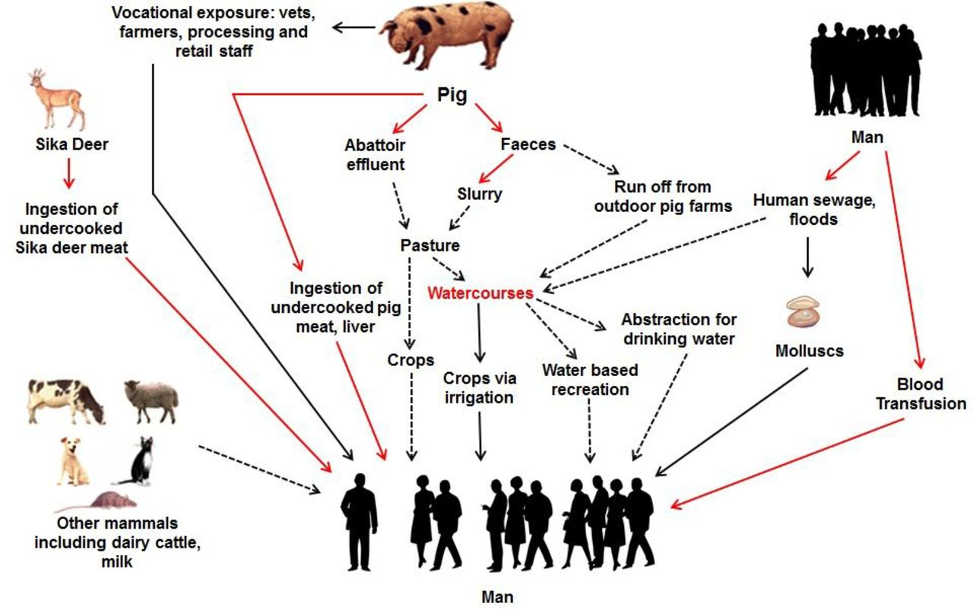

Zoonotic hepatitis E virus (HEV): sources and routes of infection.
R₀ in a pig population up to 8
Red = proven routes
Black = probable
Dotted = possible
Brendan N Mclean et al. Pract Neurol 2017;17:282-288
©2017 by BMJ Publishing Group Ltd
Notes:
Zoonotic hepatitis E virus (HEV): sources and routes of infection. The red lines are proven routes of infection. The black lines are probable routes of infection. The black dotted lines are possible routes of infection. The pig is considered to be the primary reservoir and is very commonly asymptomatically infected with HEV worldwide.

Slide 58
HEV Infection and Hepatitis E
10 things you should know about
Very harmful in pregnancy!
(True for Gt 1 & 2) Risk for acute liver failure.
In the UK, donor HEV viraemia rates approach 1 in 1000
One important route of transmission is via contaminated pork meat
HEV is associated with extrahepatic manifestations, mainly neurologic
It takes cooking temperatures of 71° C for 20 min to inactivate HEV completely.
HEV
increasing number of patients are being recognised with primarily a neurological illness
The symptoms of hepatitis E infection are indistinguishable from other forms of acute viral hepatitis
Chronically infected patients have no symptoms, but develop rapidly progressive cirrhosis
The diagnosis is confirmed by a combination of serology (anti-HEV IgM and IgG) together with HEV PCR
result in a chronic infection in immunocompromised patients, including solid organ transplant recipients, patients with haematological malignancy and people with HIV

Slide 59
Extrahepatic manifestations of HEV infection
Neurological
" Guillain-Barr􏰀e syndrome
" Neuralgic amyotrophy (brachial neuritis)
" Meningoencephalitis
" Mononeuritis multiplex
" Bell’s palsy
" Vestibular neuritis
" Peripheral neuropathy
" Myositis
Haematological
" Thrombocytopenia
" Monoclonal immunoglobulin " Cryoglobulinaemia
Nephrological
" Glomerulonephritis
Miscellaneous
" Acute pancreatitis
" Arthritis
" Autoimmune thyroiditis " Myocarditis

Slide 60
Therapy?
Severe hepatitis: ribavirin
Chronic hepatitis in immunosuppressed subjects: reduce immunosuppression usually associated with 30% virus clearance.
If this does not work or not feasible: ribavirin.
In the vast majority of cases the course of infection is so short that therapy is just not an option.

Slide 61
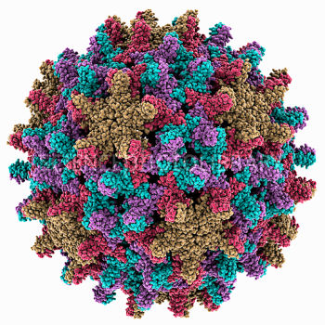
Epatite B: Epidemiologia e Storia Naturale
Antonio Ciaccio
Università Milano-Bicocca
UOC Gastroenterologia
Ospedale San Gerardo
Direttore: Prof M Strazzabosco

Slide 62
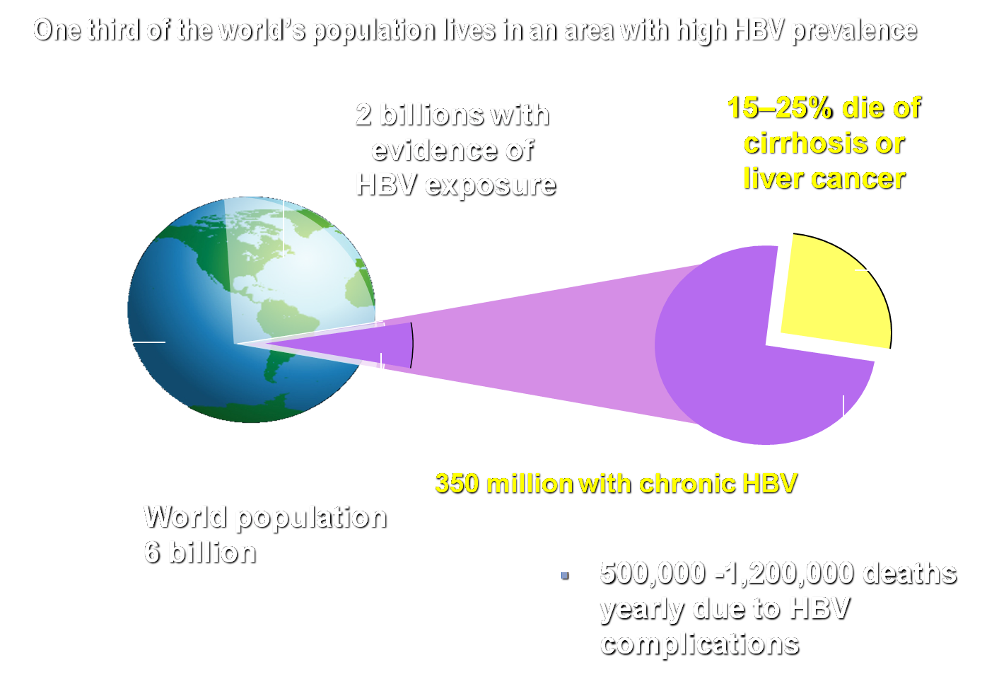
2 Billions Exposed to HBV Worldwide
Lavanchy D. J Viral Hepatitis 2004; 11: 97-107

Slide 63
Global Patterns of
Chronic HBV Infection
High (>8%): 45% of global population
  lifetime risk of infection >60%
  early childhood infections common
Intermediate (2%-7%): 43% of global population
  lifetime risk of infection 20%-60%
  infections occur in all age groups
Low (<2%): 12% of global population
  lifetime risk of infection <20%
  most infections occur in adult risk groups
Notes:
35

Slide 64
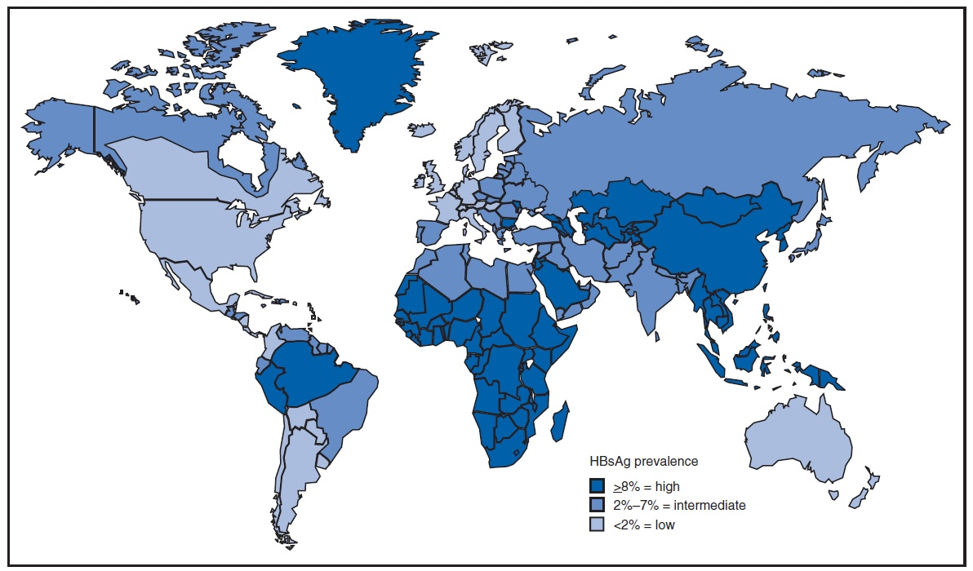
Global Distribution of Chronic HBV Infection
350 million chronic carriers worldwide
Ninth leading cause of death
Nearly 75% of HBV chronic carriers are Asian
Notes:
Key messages
Hepatitis B is one of the most common infectious diseases in the world.
There are 350 million chronic carriers of the hepatitis B virus worldwide.
Hepatitis B is the ninth leading cause of death worldwide.
Geographical prevalence varies widely throughout the world.
Nearly 75% of HBV chronic carriers are Asian.
Points of explanation
The geographical prevalence of hepatitis B varies from a highly endemic disease in Asia and Africa to a disease of low prevalence in North America and Western Europe.
Additional information
More than 2 billion people worldwide have been infected with HBV though not all of these have become chronically infected.
The majority of hepatocellular carcinoma in Asia results from hepatitis B virus infection
References
Margolis HS, Alter JH, Habler SC. Hepatitis B: evolving epidemiology and implications for control. Sem Liver Dis 1991;11:84-92
Mast EE, Alter JH. Epidemology of viral hepatitis: an overview. Sem Viral 1993;4:273-283
World Health Organisation Data

Slide 65
Current Epidemiology of HBV infection
in Italy
Low endemicity (HBsAg prevalence < 2%)
No geographical difference in prevalence of HBsAg
Sexual contact is the major route of transmission
Low HBsAg prevalence (12%) in chronic hepatitis

Slide 66
Prevalenza di HBsAg tra le gestanti in Italia per area di provenienza, 2001
(Stroffolini et al. Vaccine 2003)
Area di provenienza N° positive/N° testate Prevalenza (%) Italiana 139/9929 (1,4)
Extracomunitaria 35/597 (5,9)
Sconosciuta 8/355 (2,3)

Slide 67
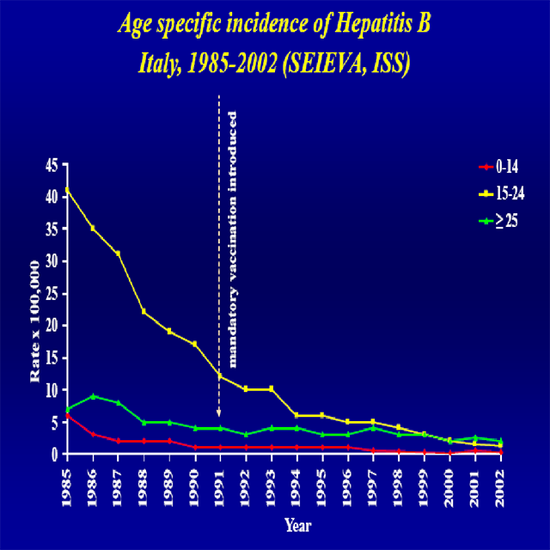

Slide 68
Hepatitis B Perinatal Transmission*
If mother positive for HBsAg and HBeAg
  70%-90% of infants infected
  90% of infected infants become chronically infected
If positive for HBsAg only
  5%-20% of infants infected
  Chance to be infected largely depends on HBV viremia.
  90% of infected infants become chronically infected
*in the absence of postexposure prophylaxis

Slide 69
Risk Factors for Hepatitis B
MMWR 2006;55(RR-16):6-7
Notes:
This graphic shows the distribution of risk factors in 2001. Persons with multiple sexual contacts, men who have sex with men, and sexual contact with a person known to have HBV infection account for 54 percent of cases with a known risk factor. Injection drug use accounts for 20 percent of cases. About 3 percent of cases are in people who have household contact with a person with acute or chronic hepatitis B. Fifteen years ago, health care workers accounted for 2 percent of HBV infections- 2 or 3 thousand new infections each year. Since that time, the rate of infection among health care workers has declined by 95 percent, and is now lower than the rate for the general population. Hepatitis B vaccine has made occupational HBV infection a thing of the past.

Slide 70
Hepatitis B Virus Infection by Duration of High-Risk Behavior
IV drug user
HCWs
Homosexual men
Heterosexual
100
80
60
Percent infected
40
20
0
0
3
6
9
12
15
Years at Risk
Notes:
HCWs healthcare workers

Slide 71
Adults at Risk for HBV Infection
Sexual exposure
  sex partners of HBsAg-positive persons
  sexually active persons not in a long-term, mutually monogamous relationship*
  persons seeking evaluation or treatment for a sexually transmitted disease
  men who have sex with men
*persons with more than one sex partner
during the previous 6 months

Slide 72
Adults at Risk for HBV Infection
Percutaneous or mucosal exposure to blood
  current or recent IDU
  household contacts of HBsAg-positive persons
  residents and staff of facilities for developmentally disabled persons
  healthcare and public safety workers with risk for exposure to blood or blood-contaminated body fluids
  persons with end-stage renal disease

Slide 73
Adults at Risk for HBV Infection
Other groups
  international travelers to regions with high or intermediate levels (HBsAg prevalence of 2% or higher) of endemic HBV infection
  persons with HIV infection

Slide 74
Prevaccination Serologic Testing
Not indicated before routine vaccination of infants or children
Recommended for
  all persons born in Africa, Asia, the Pacific Islands, and other regions with HBsAg prevalence of 8% or higher
  household, sex, and needle-sharing contacts of HBsAg-positive persons
  HIV-infected persons
Consider for
  Groups with high risk of HBV infection (MSM, IDU, incarcerated persons)

Slide 75
Prevention of Perinatal Hepatitis B Virus Infection
Begin treatment within 12 hours of birth
Hepatitis B vaccine (first dose) and HBIG at different sites
Complete vaccination series at 6 months of age
Test for response after completion of at least 3 doses of the HepB series at 9 through 18 months of age (generally at the next well-child visit)

Slide 76
Replication cycle of HBV
Infectious HBV virion
Infectious HBV virion
Hepatocyte
NTCP
HBsAg envelopes
DNA pol
Partially double-stranded DNA
RT
(-)-DNA
Encapsidated pregenomic mRNA
A(n)
cccDNA
mRNA
NTCP = sodium taurocholate cotransporting polypeptide

Slide 77
HBe
replication
Liver chemistry
Liver histology

Slide 78
Risk of Chronic HBV Persistence by Age of Infection
Notes:
Cronicizzazione

Slide 79
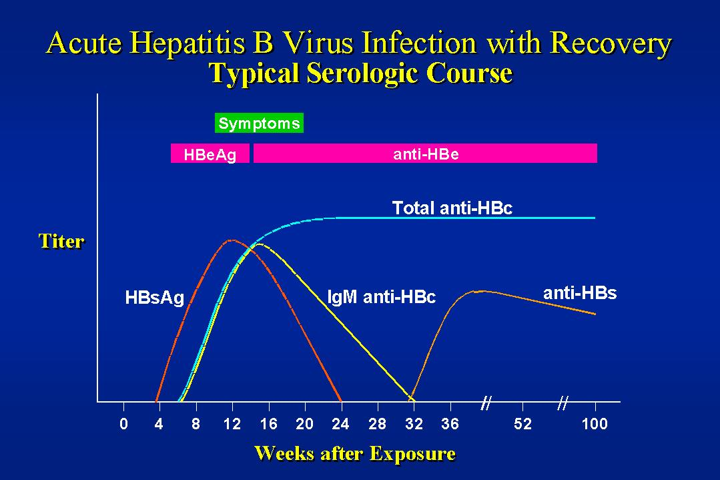

Slide 80
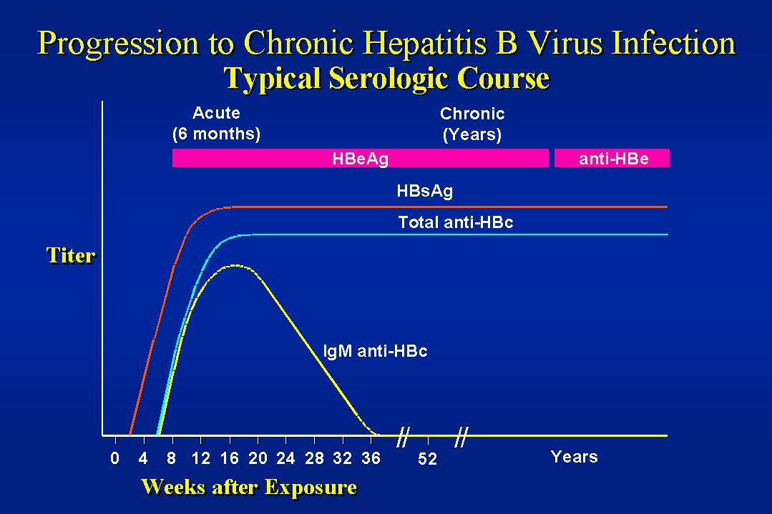

Slide 81
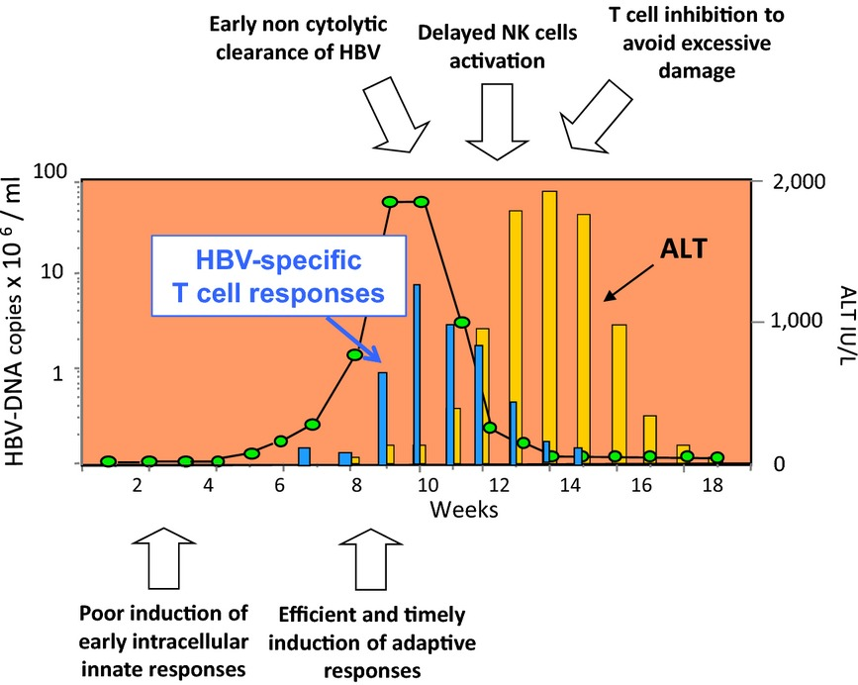
HBV and Immune System
Poor innate response at early phase of infection.
T lymphocyte response efficient at early stages, but progressively less protective later on.
Chronic virus persistence is characterized by a lack of protective T‐cell memory maturation and by an exhaustion of HBV‐specific T‐cell responses.
Persistent exposure of T cells to high antigen loads is a key determinant of functional T‐cell impairment but also other mechanisms can contribute to T‐cell inhibition, including the tolerogenic effect of the liver environment.
Ferrari C. HBV and the immune response, Liv Int 2015
Notes:
Sequence of immunological events taking place from the time of infection in self‐limited acute infections acquired in the adult life. Despite a poor induction of innate intracellular responses by HBV, HBV‐specific T cells are efficiently and timely activated immediately after the start of the active virus replication, which generally follows by some weeks the time of infection. These responses are essential for the early non‐cytolytic clearance of HBV. In contrast to the timely induction of T‐cell responses, NK cell activation seems to be delayed because the peak of NK cell frequency and function has been reported to follow the peak of viraemia. HBV‐specific T cells appear to be highly activated but almost totally unable to secrete antiviral cytokines and to perform cytolytic activity at the time of the ALT peak. This T‐cell inhibition is believed to be a protective mechanism to avoid excessive immune pathology and it is mostly sustained by soluble factors such as arginase released by necrotic liver cells

Slide 82
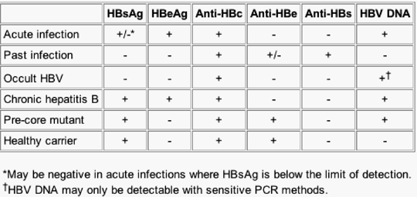
Serologic tests for HBV Infection

Slide 83
Course of Chronic Hepatitis B across years
Loss of HBsAg = no further progression
HBsAg inactive carrier = no further progression
HCC
HCC
Decesso
Chronic Hepatitis B
Progressione della fibrosi
Infezione
Sviluppo cirrosi
Scompenso
LTx

Slide 84
HBsAg+, and now?
ALT | PLT | HBV DNA | Diagnosis
Normal | Normal | Absent or Low | Inactive carrier
Raised | Normal | Positive | Chronic Hepatitis
Raised | Low (<150.000) | Positive | Chronic Hepatitis with cirrhosis
Normal | Low | Undetectable | Cirrhosis, but inactive virus

Slide 85
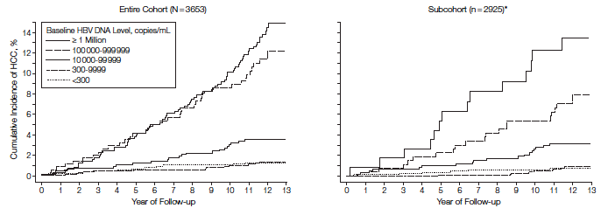
Cumulative Incidence of Hepatocellular Carcinoma by Serum HBV DNA Level at Study Entry
HBe-
ALT N
F<4
All participants were seropositive for the hepatitis B surface antigen (HBsAg) and seronegative for antibodies against the hepatitis C virus. Asterisk indicates these participants were seronegative for the hepatitis B e antigen and had a normal level of serum alanine aminotransferase and did not have liver cirrhosis at study entry.
HBV indicates hepatitis B virus; HCC, hepatocellular carcinoma.
Chen C-J et al., JAMA 2006

Slide 86
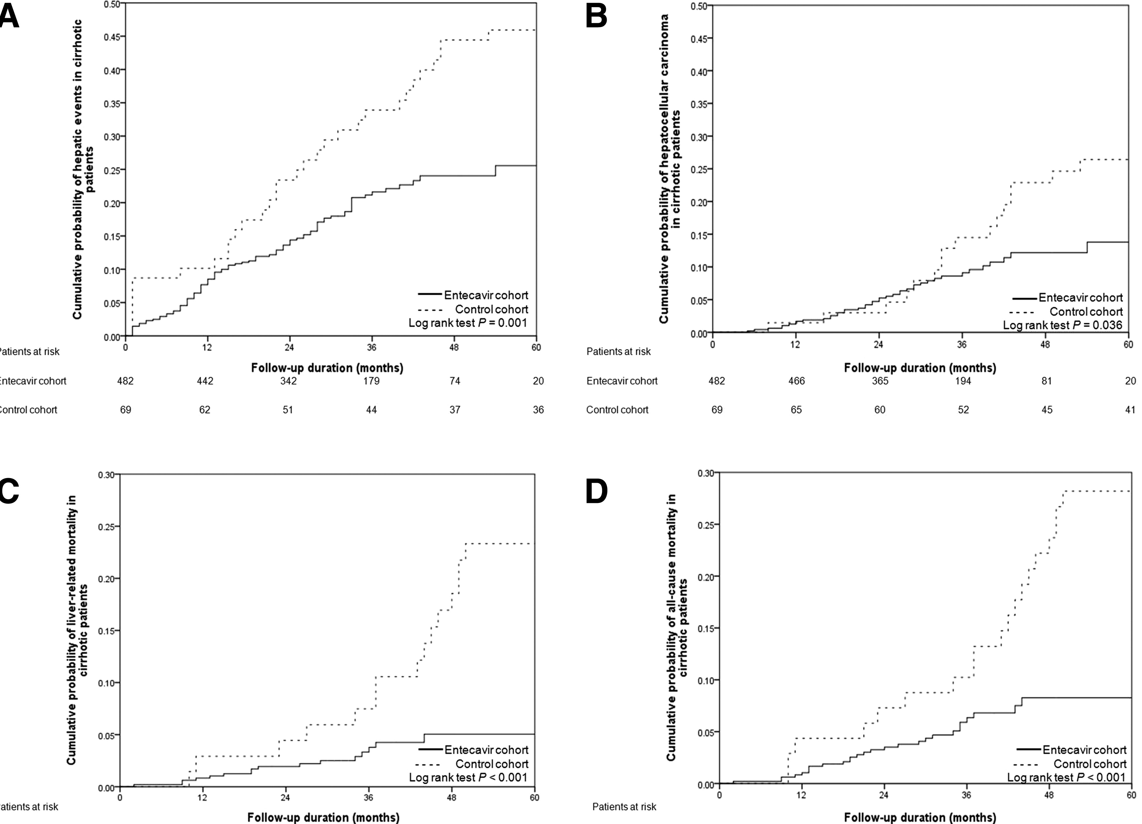
Outcomes of Chronic Hepatitis B
liver-related events
HCC
liver-related mortality
all-cause mortality

