Slide 1
Statistical Methods
for the territorial and social environment
IBM SPSS Statistics
17/03/2022

Slide 2
TODAY
BOXPLOT
COMPARING MEANS
ASSOCIATION
LIKERT SCALE
SEMANTIC DIFFERENTIAL SCALE

Slide 3
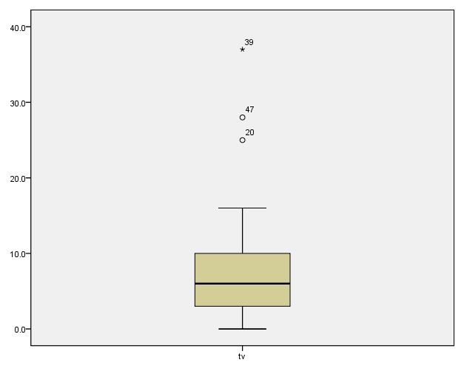
BOXPLOT
Box plots have box from LQ to UQ, with median marked. They portray a five-number summary of the data:
Minimum,
LQ,
Median,
UQ,
Maximum
except for outliers identified separately
Outlier = observation falling
below LQ – 1.5(IQR)
or above UQ + 1.5(IQR)
Outliers

Slide 4
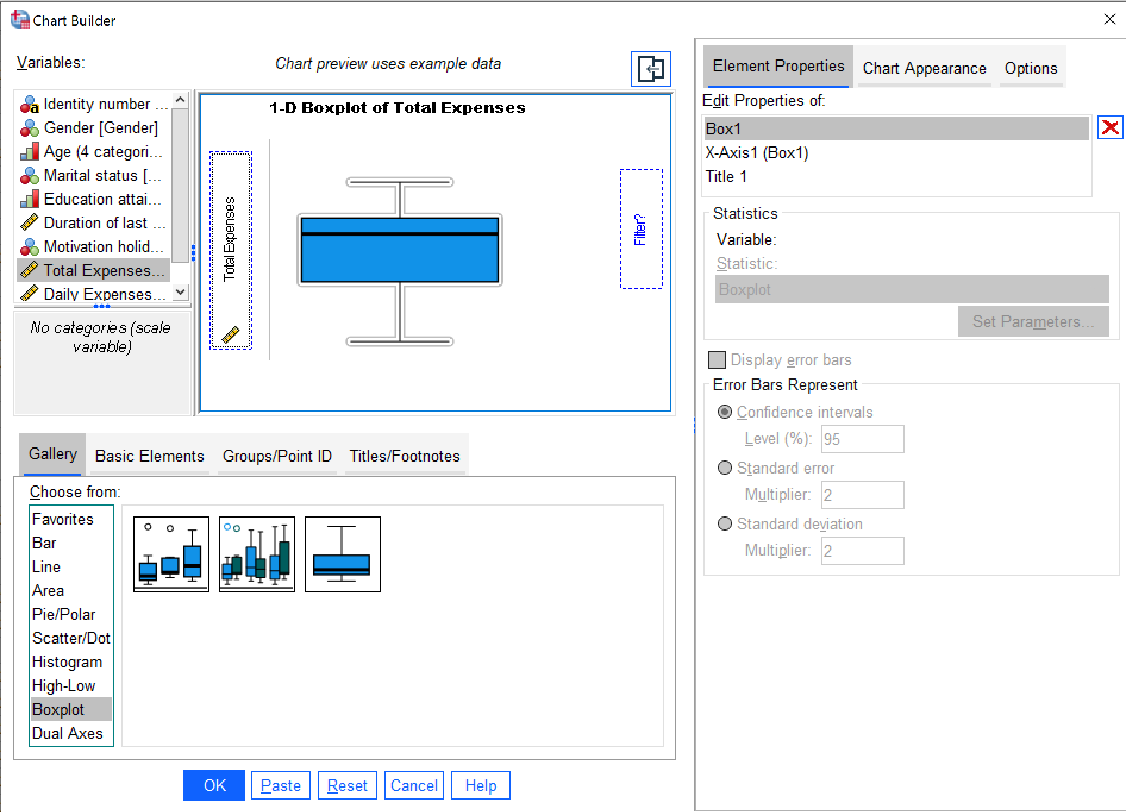
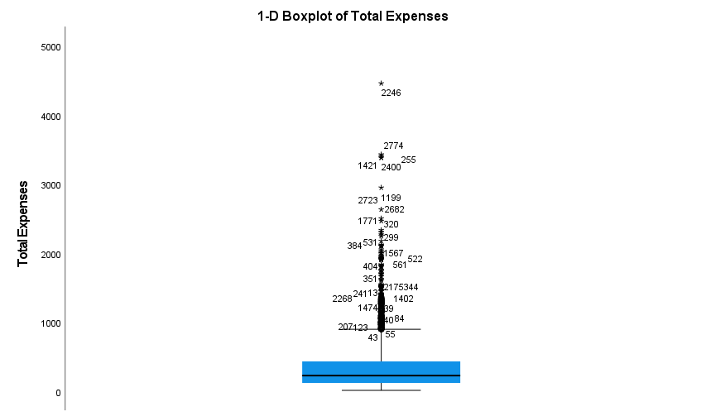
BOXPLOT

Slide 5
Comparing means Association

Slide 6
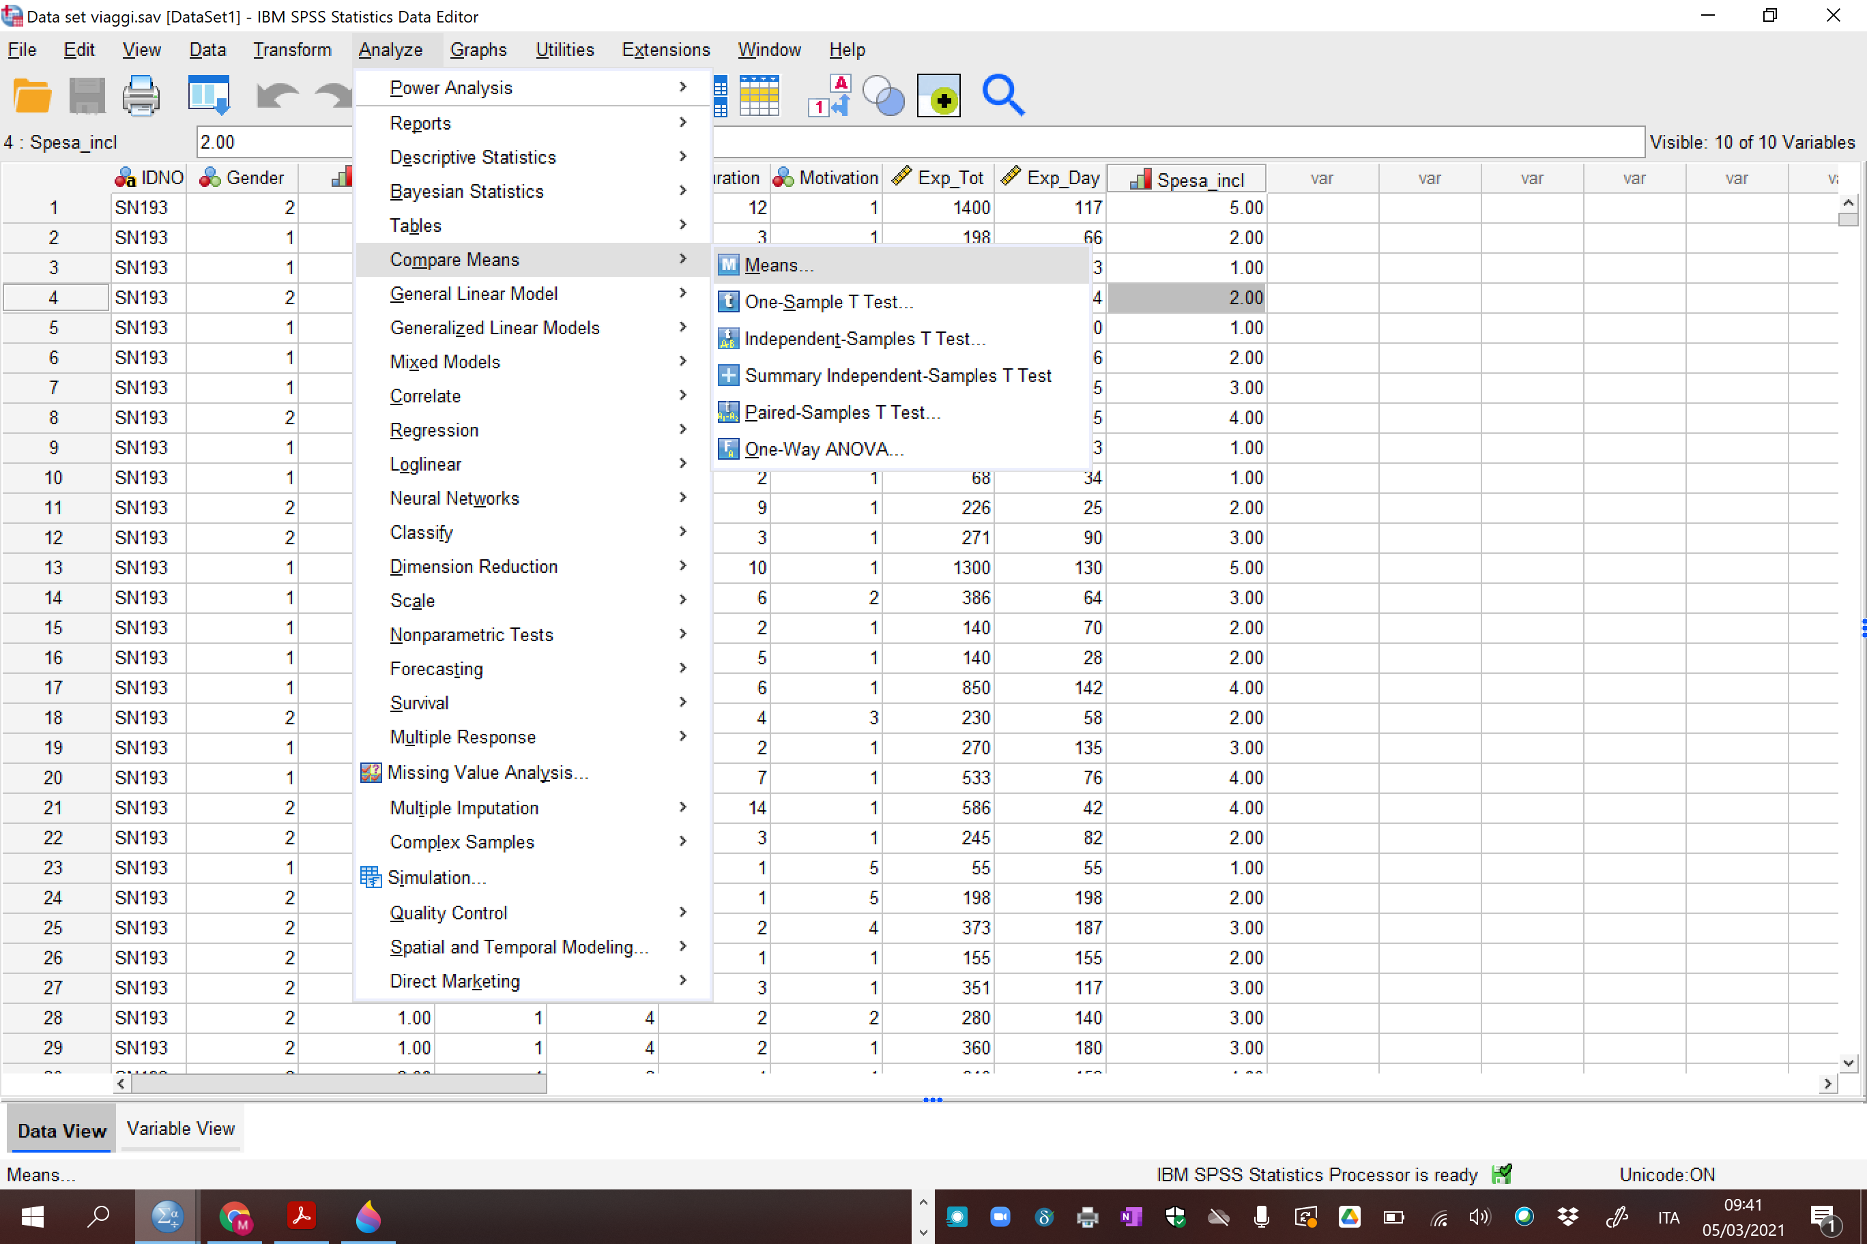
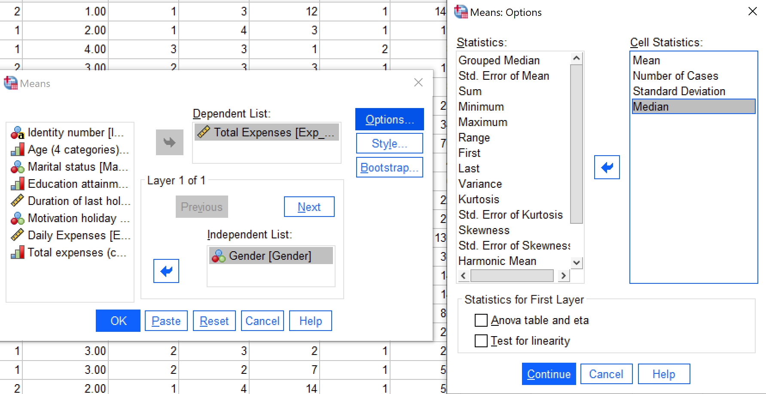
COMPARING MEANS

Slide 7
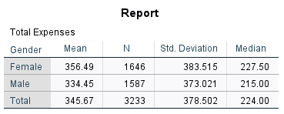
COMPARING MEANS

Slide 8
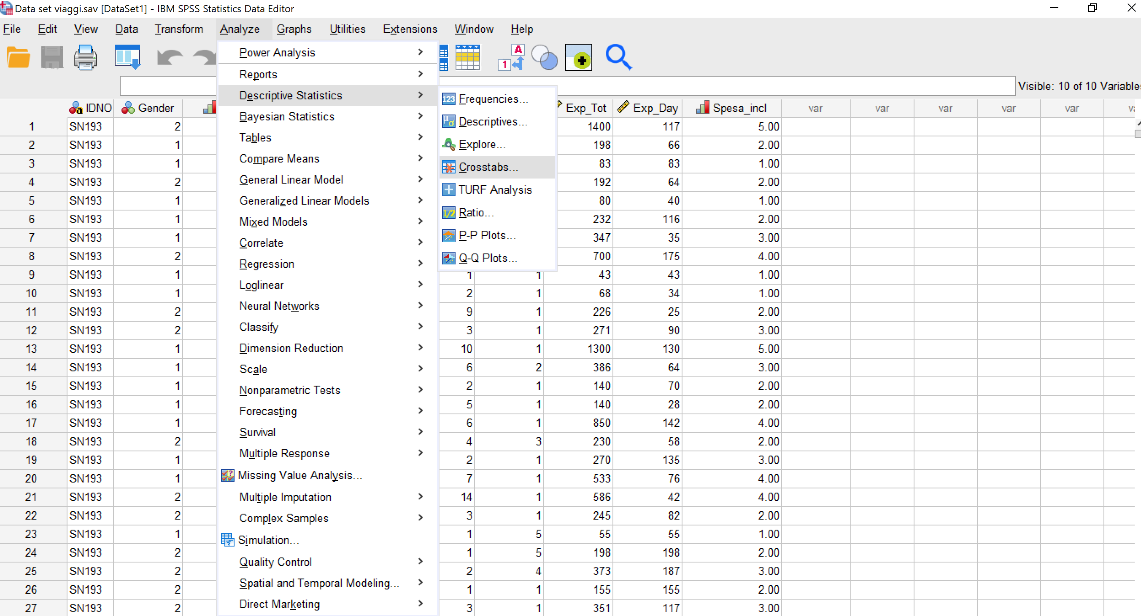
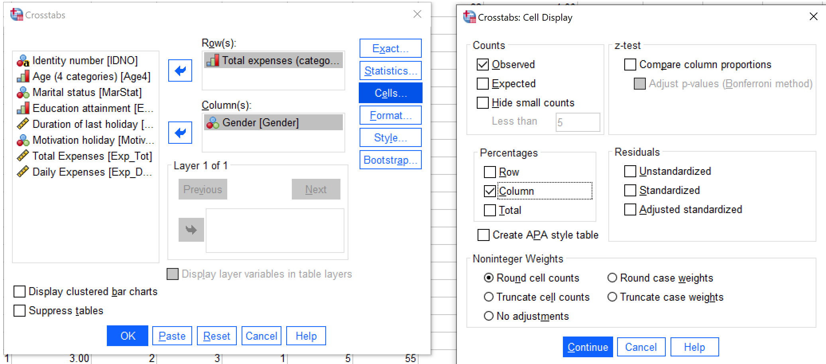
ASSOCIATION

Slide 9
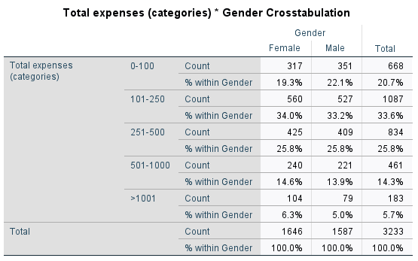
ASSOCIATION

Slide 10
Likert scale

Slide 11
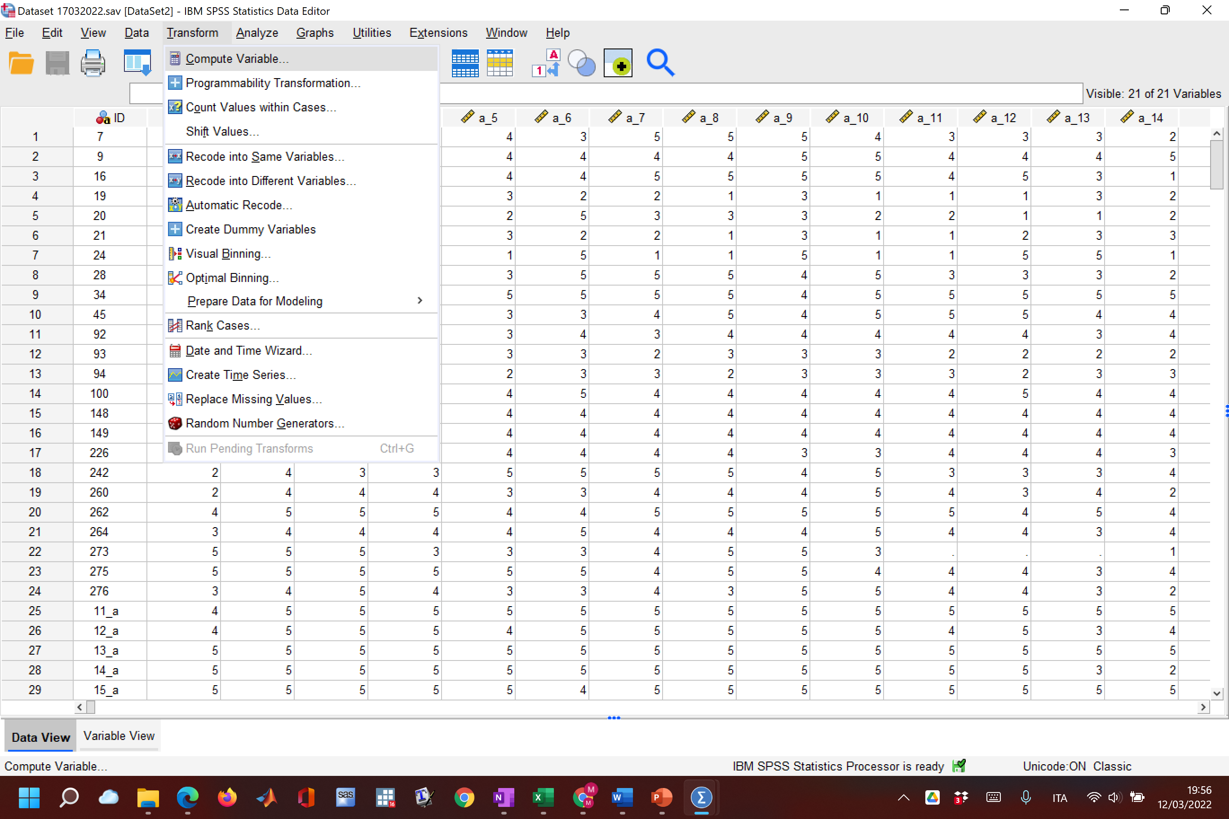
CREATE A LIKERT SCALE
CREATE A LIKERT SCALE
Dataset 17032022

Slide 12
