Slide 1
Corporate positioning and Strategic Market Planning

Slide 2
Who is Ferrarelle ?
Ferrarelle SpA is the owner of the brands Ferrarelle, Natia, Santagata, Roccafina, Vitasnella, Boario and Fonte Essenziale. Plus, they are the exclusive distributor of the French brand Evian.
Fatturato 2019: 192 Million
Fatturato 2020: 204 Million
Diversification gives the company exposure to different pricing segments and target markets, spreads the risk.

Slide 3
Ferrarelle products

Slide 4
Ferrarelle
With water, do quality and ingredients matter ?
Water sales are low profit margin, high volume. The top
two bottled water companies (San Pellegrino & San Benedetto sold about 2.8 billion liters annually.
You need a strong innovative campaign about purity and natural ingredients to differentiate the brand. To hit a selected target, highlight
the mineral that benefits that group (ie.calcium for women over 50)
Heavy promos of discounts..... yes, but for limited time
Sponsored events (sports), sample giveaways in key areas of Italy
Testimonial (in sport or a nutritionist)
TV spots showing family health and vitality, always with the tagline: "Ferrarelle, the miracle of nature"

Slide 5
Market share mineral water in Italia

Slide 6
Competitor slogans
Perrier: "The champagne of bottled water"
Acquafina: "The purest part of you"
Boario: "Our daily source of calcium"
Evian: "Live young"
Acqua Vitasnella: "The water that eliminates water"
Acqua Rochetta: "Clean inside, beautiful outside"
Uliveto: "Acqua della Salute" .. una fonte di calcio.

Slide 7
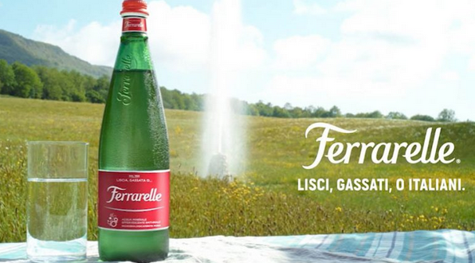
What did Ferrarelle do ?
TV spots with new campaign slogans:
- Family, health, sustainability
- the campaign to recycle plastic spots (ie. with Gabriele Corsi)
with separate slogan "Impatto - 1"
- the '“Alleluia!” spot

Slide 8
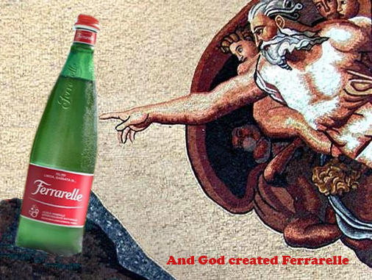

Slide 9
Ferrero pitch
Ferrero wants to have a meeting with you TODAY to discuss your preliminary ideas to launch and promote their new snack line Nutti Frutti, for July 1st, 2022, as a trial in the Italian market only.
Give the talking points of your idea that will combine Off-line advertising with Social media. The product is ultimately targeted to be consumed by children.
Tasks: Analysis of market and typical adv methods used
Creative idea to capture attention and engage target
Timeline of pre-launch to product rollout

Slide 10
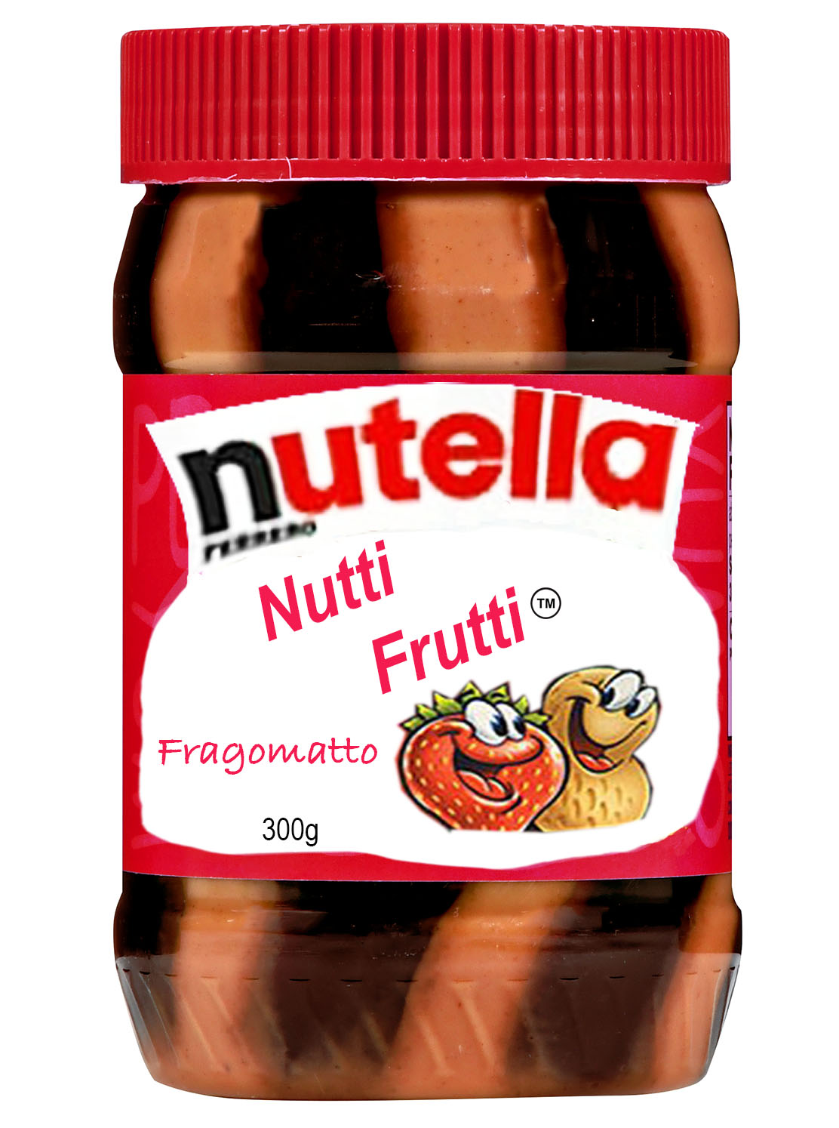
Introducing:
- Stripes of Nutella and fruit flavored jam
- Three flavors of jam: Strawberry, Grape and Orange

Slide 11
What about the Brand ?
Awareness
Brand Image / Brand Positioning
Brand Extention

Slide 12
Product selling points
Unique features
-appearance
-quality and ease of use
- good taste combination
- nutritional, natural ingredients
- snack food that kids like

Slide 13
Target
children 4 to 15....... but even adults
*mothers- principal target
A lunch time food (sandwiches)
Snacks (on crackers)

Slide 14
Same product as U.S. brand
J.M.Smucker is an old family based company founded in 1897 in the jam and marmelade sector.
Slogan: "With a name like Smuckers it has to be good"
Over the years they have diversified into other food items, among which is peanut butter ( Jif brand, #1 in market)
In 1968 introduced Goober product, combining peanut butter and jam in the same bottle. Slogan: "The sandwich in a jar"

Slide 15
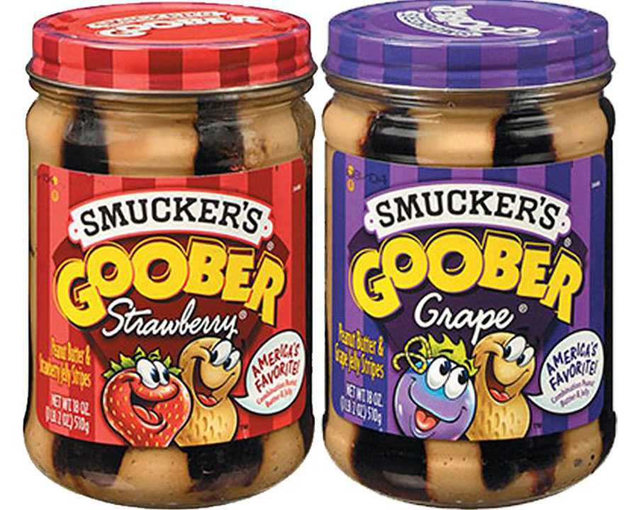
The Americans were first

Slide 16
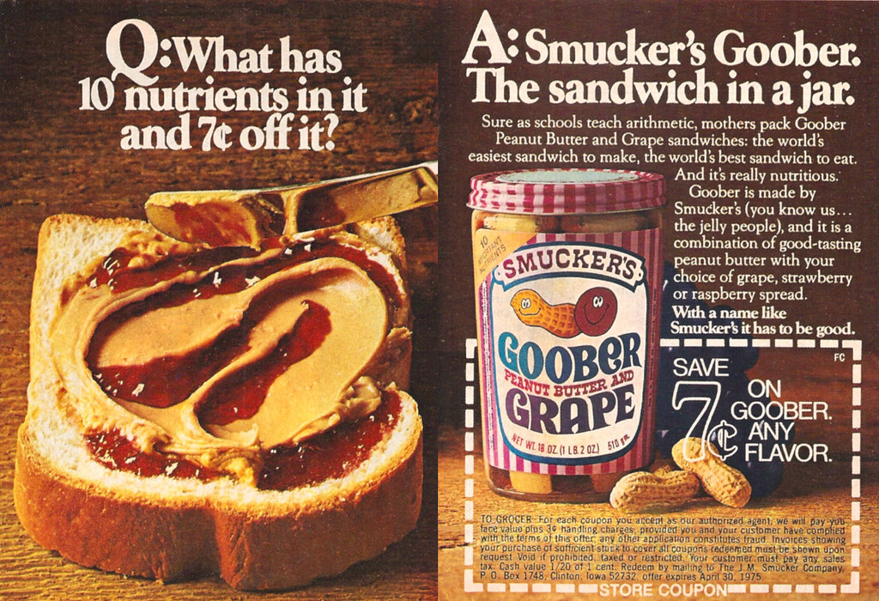

Slide 17
Smuckers Corporate Impact Report
To see how involved they are in the area
of social responsibility:
https://s3.us-east-2.amazonaws.com/jms-s3-com-jms-p-pmc6/assets/news-stories/corporate-publications/2021-corporate-impact-report.pdf

Slide 18
J.M. Smucker Revamps Marketing Strategy to Keep Up With Changes, Push Growth
Smucker’s brands enjoy broad awareness, but they aren’t always resonating with today’s consumers, who want their brands to “stand for something,”
Smucker, along with other food makers, adapts to changing shopping habits, with consumers seeking fresh and natural options over processed foods.
“We have to make sure each and every one of our core brands and emerging brands are engaging with consumers in the right way.”
“The way to go to market today is to try to inject data and media into the heart of creativity and have those work seamlessly together.”
Investment has emphasized online coupons, and other forms of digital advertising, which tend to focus more on functional messaging around protein, and emphasizing how many peanuts go into the making of a jar.

Slide 19
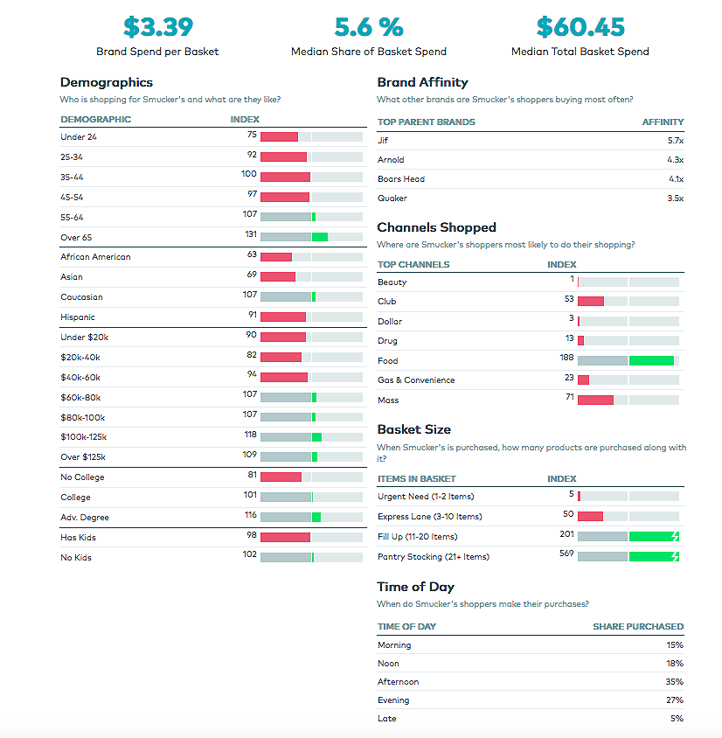
TARGET
ANALYSIS

Slide 20
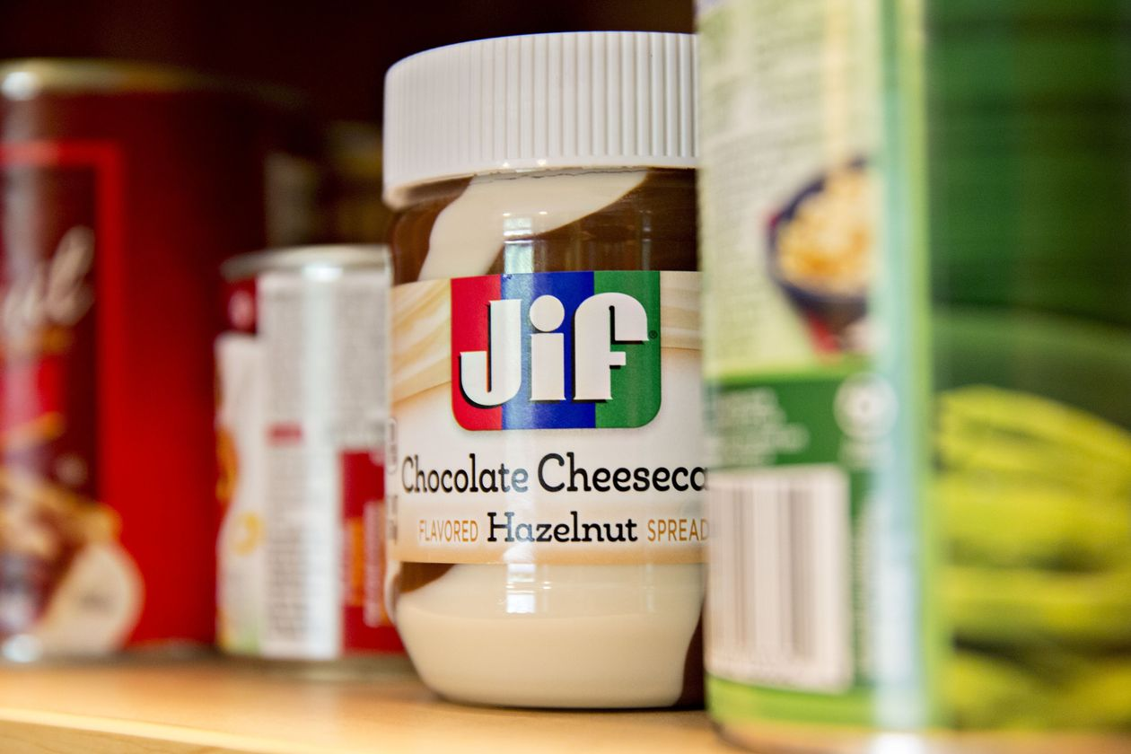

Slide 21
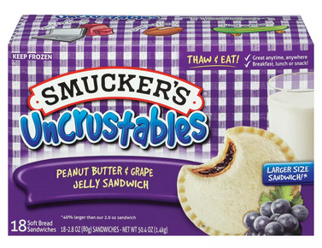

Slide 22
KEY SELLING POINTS
Healthy, natural ingredients, the basis of sound nutrition for the family
Quick to prepare, kids and adults love the taste
Convenience: for people with no time, packaged ready to eat products.
Leveraging the Smuckers name (“with a name like Smuckers, it has to be good”)

Slide 23
Marketing focus
Traditional approach for years: TV to introduce a product, then coupons and in-store promotions to push sales.
New approach emphasizes digital communication to engage customers, with a faster more flexible approach to adapt to new tastes.... introducing products to expand choice.
TV spots, short video clips for social media, digital coupons, product sample giveaways to introduce new items

Slide 25
Forward Vision: A Strategic Marketing Plan

Slide 26
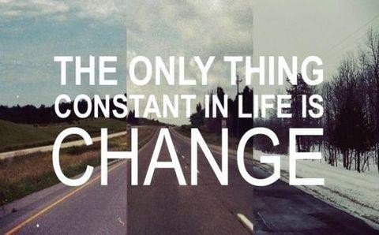

Slide 27
Definition
Strategic marketing planning is the process that the operational and managerial staff of a company goes through to create and implement effective marketing strategies.
Key aspects:
identifying promotional opportunities and evaluating the marketing opportunities;
researching, analyzing and identifying the target markets;
developing a strategic position for the company to pursue and how to implement the strategy
preparation and implementation of the operational marketing plan
measuring and evaluating the results of the marketing efforts of the company.

Slide 28
Time frame
Think longer term: 3 to 5 years (or beyond) then every year update based on conditions.
** Consider national and global trends, strategies of competitors,changing customer tastes, new technologies, lifestyle changes, etc.

Slide 29
If your company is in the tech sector, what are global trends??

Slide 30
Tech trends
• Big Data
Next year, companies such as Intel and IBM will turn all that data into powerful decision-making tools. IBM in particular will further expand the supercomputer Watson and introduce cognitive computing to every industry that has data to share.
• Artificial intelligence
Microsoft, for example, is using machine learning to analyze speech and conversation so its new Skype Translator can not only perform real-time, bidirectional translation, but can even mimic the tone of speech so it makes sense in another language.
• Robots
Industrial applications, personal robots for the home, thinking robots ?
• Nanotech and material sciences
- Could deliver cancer-killing medicine at a molecular-level
- Operations performed inside arteries with nano instruments
- Material sciences, everything from waterproofing phones to smarter fabrics.
• VR, AR, IOT, Cyber Security, Blockchain

Slide 31
First step-Think Big Strategic analysis & evaluation
Should provide insight into the markets, competitors, and the organization’s resources.
How will these factors shape the direction of the company in the marketplace.

Slide 32
Then go small (Operational marketing plans)
• A detailed operating plan to use annually
• This plan adapts to the actual conditions of the market, and should be consistent with the longer term vision as expressed in the strategic marketing plan.

Slide 33
Getting started
Strategic market planning starts at the corporate executive level.
Set your overall mission, purpose & values
• Look at the broad picture and use the concept of S.W.O.T.,but utilize many research tools to have a close analysis of consumer and competitive trends, national and global economic conditions, etc.

Slide 34
From a Strategy Vision to a more detailed Analysis
Test your vision with careful research
For a new product, consider all factors that will be positive or negative (feasibility) to launch it;
- costs
- production difficulties
- supply chain issues
- infrastructure
- customer resistance
- competitive pressures
- potential revenue, brand advantages, positioning
• Research, discuss, brainstorm,write preliminary proposal

Slide 35
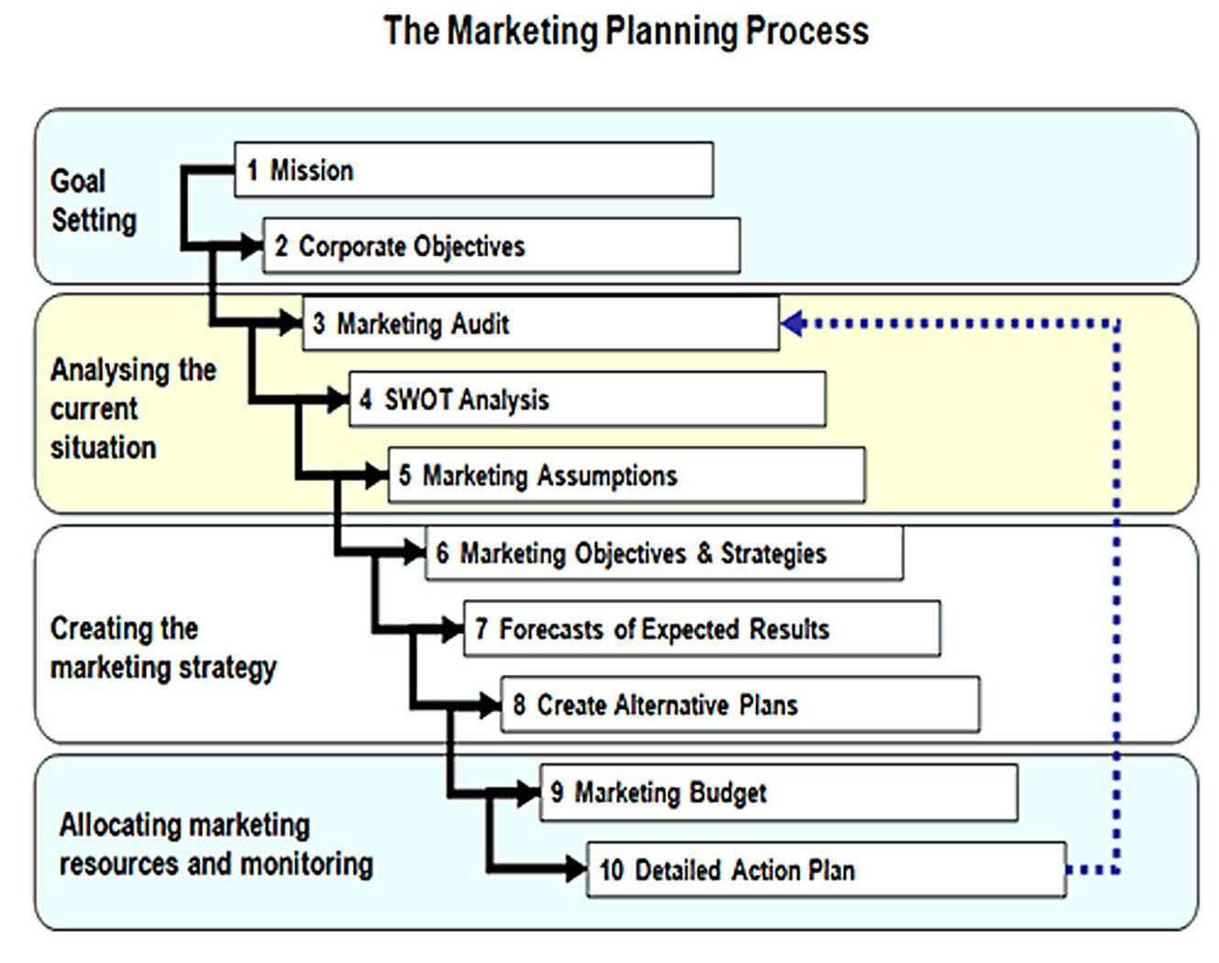

Slide 37
Is it mission impossible ?
No, but it is a serious job that requires research, planning meetings to reach consensus.
Making calculated decisions for your company
to face the future with success. Weighing the
benefits of change with the financial realities
of making that change happen.
It requires cold logic and intuitive vision

Slide 38
From Ideals, you make Goals
Convert those ideals (mission, purpose and values) into:
1) Measurable goals
2) Then allocate the resources to support the goals.

Slide 39
Some critical areas
The future always includes potential risks...
so a serious risk assessment of the market is
mandatory.
Detailed financial modeling is necessary to
have an idea of the resources needed to reach
your goals.

Slide 40
Analyze the competition- but not a brief S.W.O.T. analysis
Who are they?
Their strengths and weaknesses
Their strategic goals
Which strategies are they following now ?
How are they likely to respond to the market?
What are realistic strategies to confront them and win?

Slide 41
The best way to win ? Having a competitive advantage
An unique innovative product
Being better known, or having the best brand
Having patent protection
The customer perceives the difference between your product and the rest of the market and prefers it.
This advantage must last for a reasonable period of time ........... until it’s imitated.

Slide 42
Growth prospects
Intensive: Increasing the market share of products you already produce, or introducing new selling strategies to an established market to boost growth.
Integrative: growth strategy that emphasizes blending businesses together through acquisitions and mergers...buying other element of their value chain.
Diversification: Developing projects outside the current normal activities; other markets, other products.
Notes:
Benetton moved from designing and manufacturing their clothing products into retailing

Slide 43
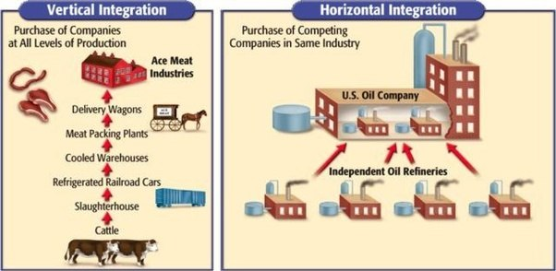
Integration models

Slide 44
Review of Key points in the Report
Executive Summary – who are we, what is our overall mission and plan
Future vision and objective – what are the key elements of our business that make us unique
Defining target markets/ end users –profiles of customers and critical markets to reach
Product needs and requirements – How must products be to fit the brand and succeed
Distribution channels
Analysis of Competition – Include your pricing and positioning strategy to combat them
Advertising and Promotion
Budgeting for production/marketing
Sales and KPI forecasting/ monitoring
*Sample:
https://www.mplans.com/coffee_bar_marketing_plan/executive_summary_fc.php
Notes:
Show sample plan

Slide 46
They're coming !!

Slide 47
What are cobotics ?
Human-robotic cooperation in manufacturing often using machine learning to improve and enhance performance.
see: https://www.youtube.com/watch?v=Qjz44XxyGbM

Slide 48
PR challenge
Robots
-from a marketing-advertising perspective how do you communicate to the public, in order to convince them to change their perception of robotic technology and to welcome it as a positive element of commerce and into their personal lives.
A. Manufacturing sector: convince a union that it's a good idea to replace a human for some jobs.
B. Inside homes: doing cleaning, cooking, being a butler ?
C. Piloting a commercial jet

Slide 51
Individual Project
Write a Vision Statement
- It is a short written report, not a Power point presentation (no more than 3 pages- no slides or graphs) on a suggested strategic marketing move. It is an analysis prepared by you, the Marketing manager, that supports your idea about how the company should position itself in the future. This vision has a 5 year horizon. The logic must support your argument and you must convince the company president (me). It is not necessary to have a precise financial analysis, just approximate. You are selling an idea to improve the company, to be more competitive and to enter into a new stage of growth for the future.

Slide 52
Two choices for report
Write a report to your own company president to give your analysis, as the marketing director, to improve operations, changing marketing approach to adapt to competition and changing consumer trends.
or Use the case study on the next slide

Slide 53
Sector:High quality furniture
You are the marketing manager of the Empire Furniture Company, makers of handmade high quality home and office wood furniture. The family owned company is over 75 years old with a good reputation for high quality. They are based in Chicago and have showrooms and sales representatives in Chicago, New York, Los Angeles, Seattle and Dallas.
With the rising costs of materials and increasing competition in the sector, they are
slowly losing market share( almost 20% in 5 years) You believe that the company needs
to move with the new technology and to adapt cobotics into the manufacturing methods. How can a company, making excellent but highly labor intensive furniture, use cobotic technology to be more competitive ? A separate furniture line ? The same customer target or a new one? More or fewer locations ? Sell by e-commerce ? Change distribution method ? Make a big capital investment to meet the challenge of the future ? What is your idea, your vision that will transform the company ? Convince the president !!
A research note:
After a complete research you have discovered that with an investment of
$35,000 per robot, (In total, 8 are needed) that will work with some human craftsman to do
the tedious and repetitive tasks of the production process and thus speed up
the process of current manufacturing by 40%, saving time and the cost of labor.

Slide 54
Vision statement format
To cover a 5 year horizon, write a structured report (almost like a letter),from you, the new marketing director, to myself, the president of Empire Furniture.
How to present this Vision statement Suggested topics are: 1) an Executive Summary, 2) Positioning and Competitive analysis, 3) Transition strategy, 4) Marketing/promotion,5) Cost analysis and profit projection, 6) Conclusion. All this is done in a way to explain logically your idea and convince the president.
Facts: Company has a turnover of $28 million per year with one large manufacturing plant outside of Chicago with 350 employees. They currently sell throughout the USA & Canada with exclusive distributors and showrooms in 5 major cities. Currently no e-commerce.
Possible risks: problems with unions, brand de-valuation
$35 thousand per robot; if you make a new manufacturing factory it would cost
$8 million, but could operate with only 80 workers.
Due date: send to me (egilmore100@gmail.com) by 28 March and no later

Slide 55
Style and approach
You are a marketer... it is the heart of the report
Use the terminology and theory of marketing
to explain your proposed action:
Brand value, market share, positioning, market
trends, competive advantage, pricing strategy, identifying
the target customer and having a strategy to
sell to them. It is not a dream, but a practical reality.
* This letter is to me, the president of the company. Therefore do not tell me something that I already know !!!

Slide 56
What and Why
** Be innovative, logical and passionate.... but...
It's not enough to say what the idea is.
- Support the idea to show why it is good
- Explain the positive future consequences of the
idea for the brand, future revenue and
positioning.

Slide 57
Good Luck

