Slide 1
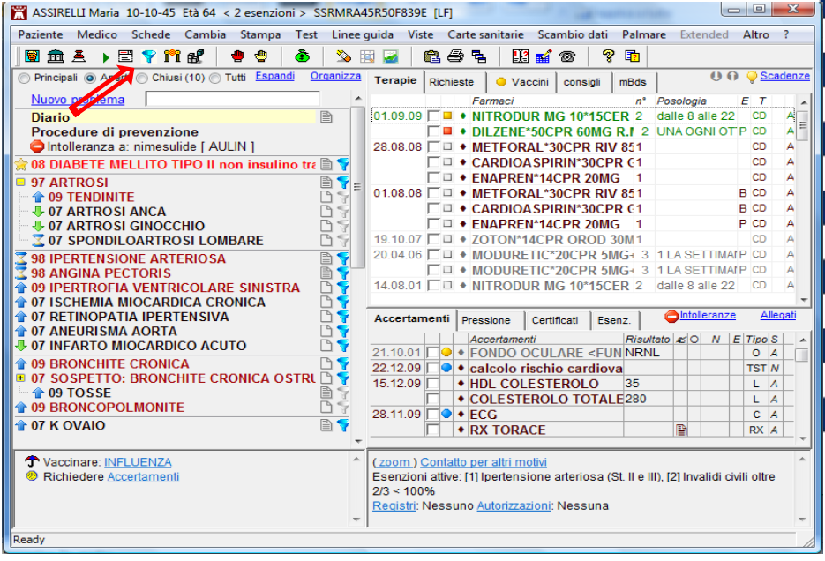
Medical records
Giuseppe Parisi
Case based learning and general clinical practice
School of Medicine and Surgery
Milano Bicocca

Slide 2
What do you think is important to record in the new patient's file?

Slide 3
Functions of medical records

Slide 4
Chronological criterium
15-1-97 144/80
4-4-97 Samyr (col 208 tri 118)
11-2-98 attacchi di panico……… Tavor 1mg + ½
*fumo 20 die
26-2-98 Samyr (gli 117 col 208-----
Gli 132
Col 216
reflusso diarrea
Difficult to follow different chronic illness (anxiety disorder, suspected diabetes, drugs)
The doctor tries to mark differently different problems

Slide 5
Problem oriented medical record: a chronological criterium for each problem
PROBLEM 1
Note 1
S
O
A
P
Note 2
S
O
A
P
Note 3
S
O
A
P
Note 4
S
O
A
P
Note 5
S
O
A
P
PROBLEM 2
Note 1
S
O
A
P
Note 2
S
O
A
P
Note 3
S
O
A
P
Note 4
S
O
A
P
Note 5
S
O
A
P

Slide 6
Problem 1: low back pain
Note 1: april 6 2019
S low back pain
O no red flags
A non specific lbp
P sicknote

Slide 7
Problem oriented medical record

Slide 8
problem everything that the patient (or the doctor) experiences as a problem, according with Engel’s biopsychosocial model
Patient’s agenda
Doctor’s agenda
Clinical problems
Clinical symptoms
Clinical problems
Risk behaviour
Non-clinical problems
Psychological
Social
Existential

Slide 9
Active Chronic problem
everything that the patient experiences as a problem,
lasting more than six months
i.e. marital tension, teenager daughter….

Slide 10
POMR
ACTIVE PROBLEMS
INACTIVE PROBLEMS
1982 CIGARETTE SMOKER
2014 MOVES FROM SICILY
2015 HYPERTENSION
2019 CHILD CARE
2019 LOW BACK PAIN
………..

Slide 11
POMR
ACTIVE PROBLEMS
INACTIVE PROBLEMS
1982 CIGARETTE SMOKER
2014 MOVES FROM SICILY
2015 HYPERTENSION
………..
2019 CHILD CARE
2019 LOW BACK PAIN

Slide 12
Patent file 1
Phone number and E-mail
Health code
Personal data
Informed consent, not sharing info

Slide 13
Patient file 2
Family, risk factors, main problems, habits…

Slide 14
Patient file 3
Problems
Treatment
medical reports, test results

