Slide 1
Retail Marketing

Slide 2
Vision statement Review
To cover a 5 year horizon write a structured report (almost like a letter),from you, the new marketing director, to myself, the president of Empire Furniture.
How to present this Vision statement Suggested topics are: First an Executive Summary, then Positioning and Competitive analysis, Transition strategy, Marketing/promotion, Cost analysis and profit projection, Conclusion. All this is done in a way to explain logically your idea and convince the president.
Facts: Company has a turnover of $28 million per year with one large manufacturing plant outside of Chicago with 350 employees. They currently sell throughout the USA & Canada with exclusive distributors and showrooms in 5 major cities. Currently no e-commerce.
Possible risks: problems with unions, brand de-valuation
$35 thousand per robot; if you make a new manufacturing factory it would cost
$8 million, but could operate with only 80 workers.

Slide 3
Style and approach
You are a marketer... it is the heart of the report
Use the terminology and theory of marketing
to explain your proposed action:
Brand value, market share, positioning, market
trends, competive advantage, pricing strategy, identifying
the target customer and having a strategy to
sell to them. It is not a dream, but a practical reality.
* This letter is to me, the president of the company. Not only
describe what is the problem and why you need to change,
but how you actually suggest to make this change possible.

Slide 4
What and Why
** Be innovative, logical and passionate.... but...
It's not enough to say what the idea is.
- Support the idea to show why it is good
- Explain the positive future consequences of the
idea for the brand, future revenue and
positioning.

Slide 5
Retailing
Definition: Providing consumers with access to
products in an ambiance that meets their needs.
Look again at 2 of the 5 P’s in the Marketing Mix.
Which have a significant effect with retail ?

Slide 6
Price and Place

Slide 7
Price
What is the value of the product or service to the buyer?
Are there established price points for products or services in this area, compared to competitors ?
Is the product price sensitive? Will a small decrease in price gain you extra market share? Will a small increase be indiscernible, therefore gain you extra profit margin?
What discounts should be offered to customers; when should they be offered and why

Slide 8
Determining price
Remember the Screen savers story?
- profit margins should be carefully studied, studying all factors of the market and your fiscal situation.
• Research the market competition and what the tendencies of a typical consumer are regarding products of your type.
• Are you selling a product that has a very “flexible” and high list price that can be discounted by the retailer and still allow him to make a profit ?

Slide 9
Something to think about
Operational considerations:
How can you access the right distribution channels?
Do I need a physical store ? or a showroom ?
Should I lease space in an existing store ?
Do you need to use a sales force?
Marketing considerations:
Traditional advertising ? Attend trade fairs?
Design a web site?
Or send samples to catalogue companies?
What do your competitors do, and how can you learn from that and differentiate?

Slide 10
Place
Where do buyers look for your product or service?
If they look in a store, what kind? A specialist boutique or in a supermarket, or both? Or online? by direct mail catalog?

Slide 11
Amazon..new marketing model
Why would the worldwide giant of on-line
selling open physical retail stores ??
.... for what strategic marketing reasons
(Think the world is all digital ? Did you know that
70% of all retail spending is still in physical stores ?)
Notes:
Has already 8 bookstores and also sell gadgets
About 20 campus bookstores that don't sell books
Whole foods grocery chain
a convenience store without cashiers
Reasons: 1) to change the retail model with automation and data mining techniques (like they use online)... renting this technology to other retailers as a revenue
source; note: 10 % of Amazon's revenue came from their Cloud computing service)
2) to showcase gadgets (like Kindle) for people to feel and test
3) to appeal to the customer who needs time to look, explore and make impulse purchases
4) the locations are also pick-up points (groceries and products... thus reducing delivery costs for Amazon)
5) Building brand loyalty; at student campus locations, students get Amazon Prime at a 50% discount which creates customers for life.

Slide 12
Aggressive marketing strategies
Has already 8 bookstores and also sells gadgets
Over 20 University campus bookstores
Whole foods grocery chain
Now a store without cashiers
Massive entrance into Cloud computing

Slide 13
Why change?
1) to change the retail model with automation and data mining techniques (like they use online)... renting this technology to other retailers as a revenue source; note: 14 % of Amazon's revenue came from their Cloud computing service)
2) to showcase gadgets (like Kindle) for people to feel and test
3) to appeal to the customer who needs time to look, explore and make impulse purchases
4) the locations are also pick-up points (groceries and products... thus reducing delivery costs for Amazon)
5) Building brand loyalty; at student campus locations, students get Amazon Prime at a 50% discount which creates customers for life.

Slide 14
Types of Retailers
Department
Discount
Convenience
Specialty
Category Killer
Supermarket
Superstores
Notes:
Department: grandi magazini (Rinascente, Harrods, Macys).... deep assortment of goods, usually good customer service, trained staff, value added services like home delivery, bridal registries, alterations, gift wrapping, etc
Discount: broad but shallow goods assortment, low prices, few customer services
Specialty: sell certain product categories (shoes, books, jewelers
Cat Killer: like Ikea, Staples .... one category of merchandise (home furnishings) broad assortment, low prices, few to moderate service
Supermarkets: Large, wide assortment, convenience, self-service, limited customer service,
Superstores: “ Big Box”stores; similar to supermarkets with different products, low prices, limited service (Walmart, Carrefour, etc.)

Slide 15
As a retailer, what is the most important thing you must focus on ??

Slide 16
The Customer !!!
Making the customer experience pleasant, convenient, fast and successful is goal #1.
So what is important to the consumer when going to a physical store ? What points of “convenience” are most important ??

Slide 17
Retail convenience points
Access
Search
Possession
Transaction

Slide 18
Access convenience
Location
Availability
Hours of operation
Parking... or access to public transportation
Ease and speed of finding products
Notes:
Global trend: Rise of convenience stores, for speed, essential products, easy to reach (often by car)

Slide 19
Search convenience
Ease in identifying and selecting products
Intelligent and clear store layout
Displays, signage, interactive systems
Information available when needed, either minimal (in the case of discount retailers) or
maximum personalized attention (for high- end or luxury merchandise)
Notes:
Info kiosks;
Knowledgable trained staff, ready to help but not intrusive

Slide 20
Possession Convenience
Product availability
Obviously, for retail channels with highly customized products, having items in inventory is not always possible.
Notes:
the Internet is great for “search convenience” but scores low in “possession convenience”

Slide 21
Transaction Convenience
The speed and ease in which a customer can
make a transaction.... or amend a transaction before and after purchase.
• Design and use of good queuing systems to avoid service and checkout delays. (multiple registers, numbered tickets for service)
Notes:
Some innovations happening: self scanning of merchandise (Carrefour, Tesco, Metro); self check out and payment at some markets
Pay systems: chip cards or cell phone scanning technology

Slide 22
Retail considerations
Packaging –color, shape, text, clarity
Store shelf placement... visibility, correct category location.
Signage, POP, video ads, in store promos.
Store layout, lighting (intensity, direct-indirect)
Ease of movement for the customer
Staff assistance or self-service
Notes:
Ikea layout for customer capture- must follow the path and arrows to see the whole store before exiting; self-service but department order has a logic; wide corridors, disponiblity of staff to help; custom design a possibility

Slide 23
Store Product Placement

Slide 24
Placement strategies
Block placement- items related to each other are placed together
Vertical placement- items displayed on more than one shelf
Commercial placement- items with a higher perceived value are given more desireable shelf space
Margin Product placement- the more profit the retailer gets from that product, the better position it receives.

Slide 25
Shelf Management
Most retailers position items grouped by brand to make categories easy to shop. This strategy allows consumers to more easily compare similar items.
Category management: Its mission is simply to reduce out-of-stocks,maximize inventory efficiency, and increase the profitability of a brand. Category management has now evolved to fully understanding consumer buying habits and helping brands meet consumers' needs.

Slide 26
Category Management
Category management provides strategies to better connect with consumers, develop brands, manage spending, optimize product placement and grow sales. Combining business intelligence, logistics data, syndicated and Point of sale (POS) data and consumer data, true category management maximizes business results.

Slide 27
Look at Pharmacies
Store layout
Positioning of products
Colors, lighting
Category management
Staff training to maximize perception of individual service, and revenue per visit.

Slide 28
Colors
Color's influence on consumer behavior isn't confined to just merchandise. The colors surrounding customers while they're shopping also can influence whether they make a purchase.
"Blue is associated with water, green with grass, red is fire." Humans are hard-wired with connections to color.
Comfort and calm customers. Warm colors like oranges and browns are inviting and reassuring to shoppers, while cooling colors like green and blue can have a calming effect.

Slide 29
Using color intelligently
Alert your shoppers to certain products: Bright colors like yellow and red grab customers' attention. Be careful, too much red can be disturbing and agitating.
Build brand recognition. Colors can increase brand recognition by 80 percent !!
Highlight rather than overpower your product. Be careful not to drown out what you're selling by immersing it in too much color.
- subtle highlighting and carefully blending complimentary colors is a skilled art.

Slide 30
Physical Stores vs Internet
When is an actual store better than selling on the internet ?
Customer experience ?
Benefits – disadvantages:
Are stores becoming a showroom for customers to see, try merchandise, ask questions ..... then buy on the internet ?
Shopping apps.... do they damage the store ?
Notes:
Customer experience
Price vs. convenience
Are stores becoming a showroom for customers to see, try..... then buy somewhere else !! ??
Shopping apps

Slide 32
Performance Marketing
Performance Marketing is a comprehensive term that refers to online marketing and advertising programs in which advertisers (a.k.a., “retailers” or “merchants”) pay marketing companies (a.k.a, “affiliates” or “publishers”) when a specific action is completed... such as a sale, lead or click.

Slide 33
What Makes It Unique?
In most traditional forms of advertising, the advertiser pays a fee up front for ad space independent of performance. That could mean hundreds to thousands of dollars spent without ever seeing a conversion.
With performance marketing, advertisers only pay for successful transactions.

Slide 34
Benefits of Performance Marketing
There are many benefits to running performance marketing campaigns, including:
Easy-to-track performance
Low risk
ROI-focused
The main benefit to performance marketing is that it’s 100% measurable. Thanks to new technology and advanced ad platforms, all your campaign metrics are tracked and reported for your convenience.
In addition to better tracking, performance marketing is ROI-focused, which means less risk for the advertiser. With less risk, quicker launch times are possible. No more pushing for approvals.

Slide 35
ROI measurement
Performance marketing has successfully reversed the traditional value proposition of advertising and also allows for real-time measurement of ROI.
Performance marketing is trackable and measurable down to the click. Advertisers can measure everything from the cost of acquisition to incrementality (e.g. average order value).
Incremental Sales – “a sale or action that resulted from a particular marketing activity, campaign, link or channel, that the advertisers/merchant would not have realized without the particular partner, channel, campaign or activity taking place”.

Slide 36
Loyalty Programs
Using points, tiers, social media, & paid programs.
Does it work ??
As many as 84% of consumers say they’re more likely to stick with a brand that offers a loyalty program. And 66% of customers say the ability to earn rewards actually changes their spending behavior.
Many examples (Esselunga, Starbucks, Amazon Prime ) but here
is one to see:

Slide 37
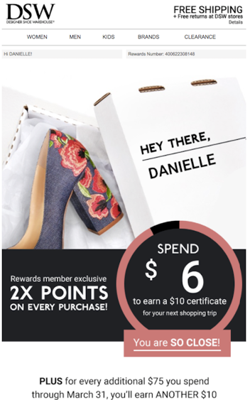

Slide 38
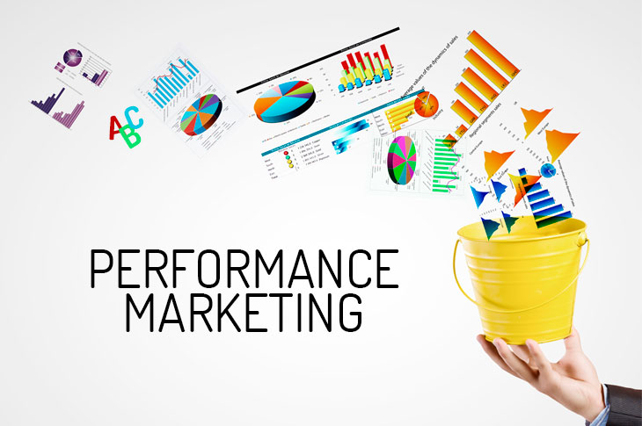

Slide 39
What is Push-Pull marketing ?

Slide 41
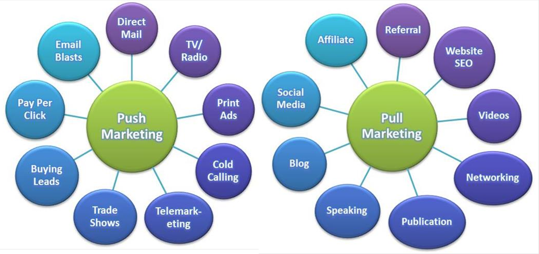

Slide 42
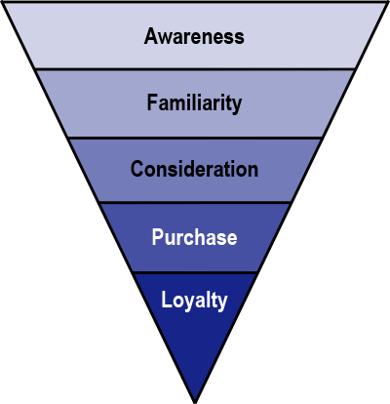

Slide 44
THANK YOU
Let’s keep in touch.
www.linkedin.com/in/wsasha

Slide 45
Does conventional marketing theory work during the Coronavirus crisis ?

Slide 46
Reinventing a damaged sector
The Physical Retail Store is in trouble
What happened to:
"Let's go shopping !! "

Slide 47
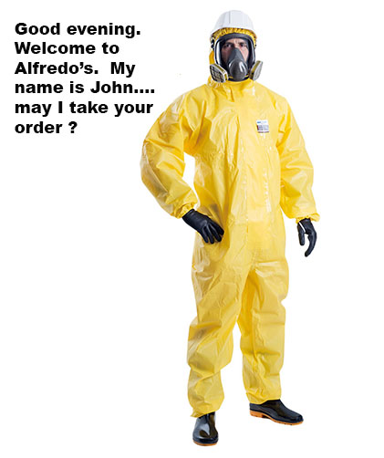
This was the nightmare 2 years ago !!

Slide 48
Crisis in Retail
Case: Office Chair World
Current business model
60 physical stores with large showrooms in major cities of Europe
They have an e-commerce website (online catalog, click and buy)
Sell at a discount over 70 different kinds of office chairs from many manufacturers
A typical customer likes to see and try a chair before buying.
Current advertising (digital & direct mail) drives store traffic. (for 80% of sales)
Problem:
Covid Crisis forced closure of stores for over one year.
E commerce sales were up but still the company lost 60% of revenue.
Company believes that past customers will fear coming even with all
correct Covid protocol procedures.
Request: Company president is asking your agency for a radical change in their business model to have a new selling model for the future.

Slide 49
Outline your Idea and Approach
What
Why
How

