Slide 1
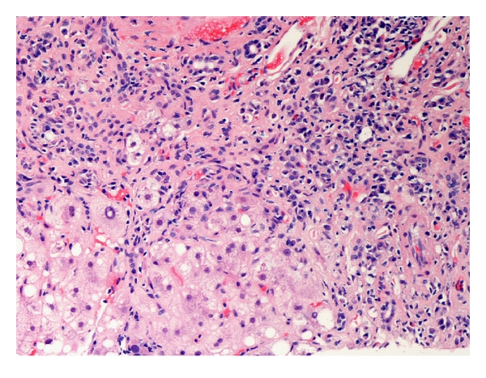

CLINICAL CASE SESSION
Autoimmune Liver Disease
April 4, 2022
School of Medicine Bergamo
Dr. Miki Scaravaglio
Notes:
universit-degli-studi-di-milano-bicocca-logo-png-transparent.png

Slide 2
SUMMARY
Clinical case 1
Clinical case 2
Clinical Case 3

Slide 3
SUMMARY
Clinical case 1
Clinical case 2
Clinical Case 3

Slide 4
CLINICAL CASE 1
P.F. 49 yo male
Mother with arterial hypertension and T2DM
Father died of CRC at 51 yo
1 sister in good health
No cigarettes or alcohol abuse. No IVDU.
No recent travels abroad.
No previous blood transfusion

Slide 5
COMORBIDITIES
Crohn’s disease (CD)
BMI 26 – Overweight
Keratoconus
Medications: none
Notes:
Keratoconus a disorder of the eyes causing a progressive thinning of the cornea resulting in double vision,

Slide 6
DISEASE PRESENTATION
December 2016
Access to the local emergency department (ED) for acute chest pain
Clinical examination: no jaundice, no spider naevi, liver and spleen not enlarged (i.e. no signs of chronic liver disease). Weight 85 kg, Height 180 cm
First investigations:
  AST 150<50, ALT 350<50, GGT 150<70, ALP 100<110, gammaglobulins not available
  HCV-Ab negative; HbsAg/HbcAb/HBsAb negative; HAV IgM negative; HEV IgM/IgG negative
  CMV&EBV IgM negative
  abdominal US: steatosis
Spontaneous normalisation of transaminases until May 2018
Notes:
moderate elevation of transaminases
No other investigations

Slide 7
HEPATITIC FLARE
May 2018
Severe ashtenia
Blood exam: ALT 3000, AST 1500, GGT 400, ALP 100, bilirubin t/d 1.5/0.8, INR 1.02, PLT 200000, Gamma globulins 24<18%, IgG 2000<1600
Further investigations:
  Ceruloplasmin (normal), a1AT (normal), %sat transferrin 30, mutation of HFE gene negative.
  ANA 1:320 homogeneous pattern (ASMA, LKM, AMA, ANCA negative);
  No alterations on the abdominal US
  Abdominal MRI: no signs of chronic hepatitis, no signs of portal hypertension, normal gallbladder and biliary ducts
Notes:
Because the patientt was symptomatic, He underwent blood examination resulting in a severe alteration of serum liver exams

Slide 8

WHAT’S NEXT?
Liver biopsy?
Wait & see?
Start treatment?

Slide 9
REVISED DIAGNOSTIC CRITERIA
14 – Probable AIH
prior to liver biopsy

Slide 10
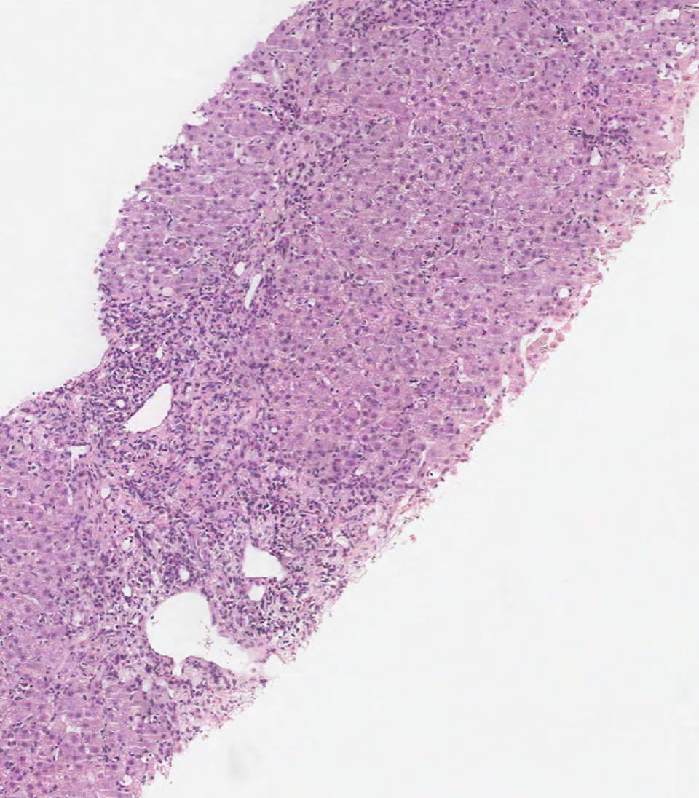
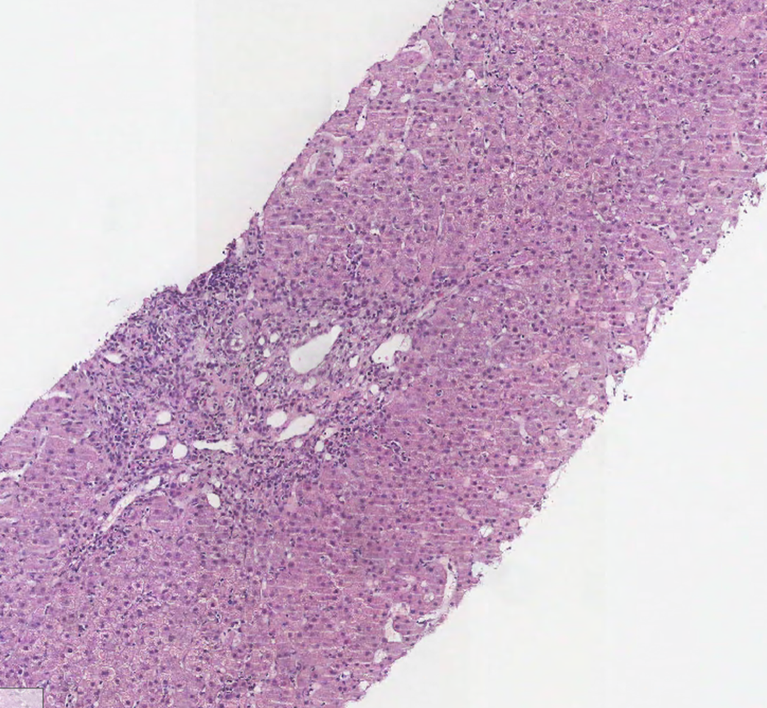
LIVER BIOPSY
The tests were highly suggestive for AIH.
He underwent liver biopsy to confirm the AIH diagnosis.
Biopsy (May 2018)
One specimen of 2cm, 18 portal tracts overall
Moderate portal infiltrate with lymphocytes and plasma cells
Marked interface hepatitis
Spotty hepatocyte apoptosis and necrosis
No steatosis, no iron overload
Porto-portal and porto-central septa (Fibrosis F3 METAVIR)
Diagnosis: MODERATE CHRONIC HEPATITIS WITH BRIDGING FIBROSIS COMPATIBLE WITH AIH

Slide 11
MANAGEMENT
May 2018: Start Prednisolone 50 mg/day
July 2018: AST 43<34, ALT 81<49, GGT 37<40, gamma globulins 18<18%, IgG 1340<1600 -- Start Azatioprine 150mg/day
October 2018: AST 32<51, ALT 37<51, GGT 24<55, gamma globulins 15<18% -- BIOCHEMICAL REMISSION
Transient elastography september 2019: 7.7 kPa IQR/med 15%
Transient elastography may 2020: 3.5 kPa IQR/med 11%
Notes:
Liver stiffness sharply decrease in patients with biochemical remission (-7.5%/year)

Slide 12
MANAGEMENT
Maintenaince regimen: steroid progressively reduced till prednisolone 5 mg/day keeping azathioprine at the dosage of 150mg/day
No flare occured during the maintenaince regimen.
October 2021: we proposed P.F. to perform liver biopsy and assess histological remission to discontinue prednisolone.
Notes:
After 3 years of persistent biochemical remission

Slide 13
DRUG-RELATED AE
STEROID
MOC june 2018: osteopenia -- start integration of calcium and vit D
Regular monitoring of arterial pressure: development of arterial hypertension – start ACEi
Regular monitoring of FPG or DTX for the risk of steroid-induced diabete
AZA
Regular monitoring cell blood count for the risk of cytopenia
Tumor surveillance
Notes:
Liver stiffness sharply decrease in patients with biochemical remission (-7.5%/year)

Slide 14
LEARNING POINTS
  Histological demonstration of AIH is required for the diagnosis of AIH and, therefore, liver biopsy is mandatory in the diagnostic work-up of AIH, before treatment.
  Assessment of drug-related long term adverse events is crucial. Patients must undergo:
      MOC at steroid start and periodically
      Arterial pressure monitoring
      FPG or DTX
      CBC monitoring
      Annual dermatological examination to monitor non-melenocytic skin lesions
  After 2y of steroid and 3-5y years of AZA, AIH therapy can be discontinued if biochemical remission is achieved. Current Guidelines reccomend also liver biopsy to assess histological remission. .

Slide 15
SUMMARY
Clinical case 1
Clinical case 2
Clinical Case 3

Slide 16
CLINICAL CASE 2
M.M. 55 yo female
Mother with giant-cell arteritis (Horton disease)
Grandmother died of cirrhosis of unknown etiology
Sister with Hashimoto thyroiditis and her daughter with celiac disease
No cigarettes or alcohol abuse. No IVDU.
No recent travels abroad.
No previous blood transfusion
Menopause

Slide 17
COMORBIDITIES
T1DM
Celiac disease
dyslipidemia
Medications: gluten free diet, basal bolus insulin regimen
Notes:
Keratoconus a disorder of the eyes causing a progressive thinning of the cornea resulting in double vision,

Slide 18
DISEASE PRESENTATION
September 2018
Access to the local emergency department (ED) for severe ashtenia, weight loss (7 kg in 2 months)
Clinical examination: no jaundice, no spider naevi, liver and spleen not enlarged (i.e. no signs of chronic liver disease). Weight 50 kg, Height 160 cm. BMI 19.5
Notes:
moderate elevation of transaminases
No other investigations

Slide 19

WHAT’S NEXT?

Slide 20
FIRST INVESTIGATIONS
AST 350<50, ALT 420<50, GGT 110<70, ALP 100<110, gammaglobulins 27.2<18%
HCV-Ab negative; HbsAg/HbcAb/HBsAb negative; HAV IgM negative; HEV IgM/IgG negative
CMV&EBV IgM negative
Normal a1AT, ceruloplasmin, %sat transferrin
ANA 1:160 granular pattern, LC1 positive (AMA, ASMA, LKM, SLA/LP, ANCA neg), Ab anti tireoglobulin positive with normal TSH, fT4, fT3.
No alterations on the abdominal US
Notes:
moderate elevation of transaminases
No other investigations

Slide 21
REVISED DIAGNOSTIC CRITERIA
17 – Definite AIH
prior to liver biopsy

Slide 22
WHAT’S NEXT?

Slide 23
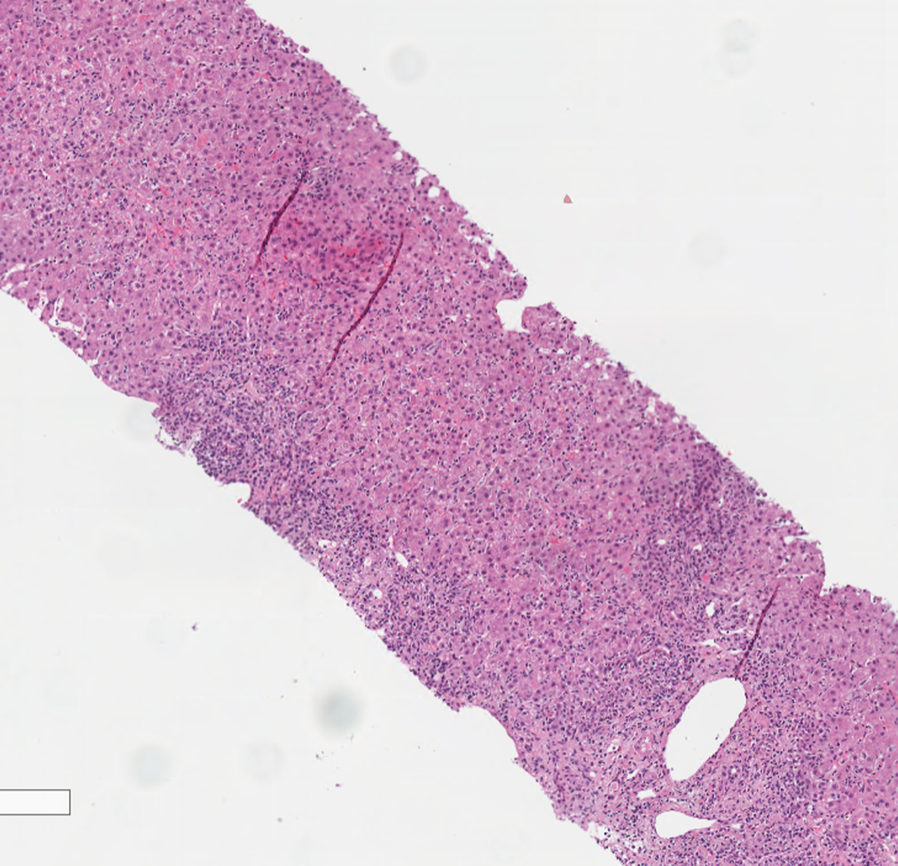
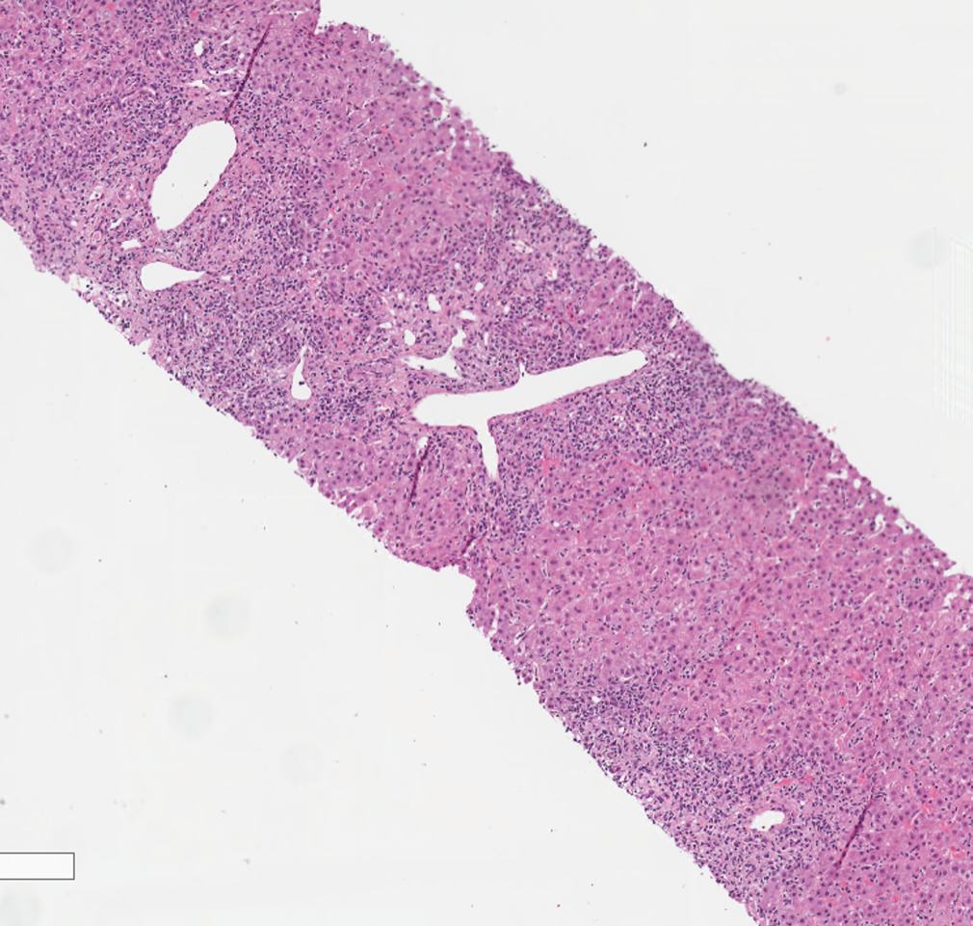
LIVER BIOPSY
Biopsy (Jan 2019)
Two specimens of 2 cm, 22 portal tracts overall
Moderate portal infiltrate with lymphocytes and plasma cells MUM1+
Moderate to severe interface hepatitis
Spotty hepatocyte apoptosis and necrosis
Hepatocyte balooning
Rosetting of liver cells
Mild steatosis
Mild portal fibrosis without septa (Fibrosis F1 METAVIR)
Diagnosis: MODERATE ACUTE HEPATITIS COMPATIBLE WITH AIH

Slide 24
MANAGEMENT
Feb 2019: Start Prednisone 50 mg/day
Mar 2019: AST 17<39, ALT 42<34, GGT 42<40, gamma globulins 21<18%, suboptimal control of blood glucose
Apr 2019: AST 221, ALT 300 – RELAPSE DUE TO RAPID REDUCTION OF STEROID – back to prednisone 50mg/day
May 2019: AST 50, ALT 100 – start AZA 100mg/day
Jan 2020: AST 20, LAT 17, GGT 20, ALP 59, gammaglobulins 15%
Notes:
Liver stiffness sharply decrease in patients with biochemical remission (-7.5%/year)

Slide 25
MANAGEMENT
Maintenaince regimen: steroid progressively reduced till prednisolone 5 mg/day keeping azathioprine at the dosage of 75 mg/day
One flare occured during the steroid deescalation.
Notes:
After 3 years of persistent biochemical remission

Slide 26
DRUG-RELATED AE
What should we monitor during AIH treatment?
Notes:
Liver stiffness sharply decrease in patients with biochemical remission (-7.5%/year)

Slide 27
DRUG-RELATED AE
STEROID
MOC mar 2019: osteoporosis -- start integration of calcium and vit D
Regular monitoring of arterial pressure
Regular monitoring of FPG or DTX
AZA
Regular monitoring cell blood count for the risk of cytopenia
Tumor surveillance (dermatologic, ginecologic, breast cancer)
Notes:
Liver stiffness sharply decrease in patients with biochemical remission (-7.5%/year)

Slide 28
LEARNING POINTS
  Concomitant extra-hepatic autoimmune diseases (CEHAID) can occur in AIH patients being autoimmune thyroid disease the most frequent. Thyroid function should be include in the baseline assessment of patients with newly diagnosed AIH.
  CEHAID can significantly impact on QoL and possibly complicating the disease management (i.e. worsen of blood glucose levels in T1DM)

Slide 29
SUMMARY
Clinical case 1
Clinical case 2
Clinical Case 3

Slide 30
CLINICAL CASE 3
C.S. 45yo male
Sister with celiac disease
Works as whitewasher.
No cigarette or alcohol consumption. No IVDU.
No recent travels abroad.
Comorbidities: Herniated disc
Medications: none; occasionally NSAIDs for back pain

Slide 31
DISEASE PRESENTATION
January 2016
Presenting symptoms: Severe astenia, weight loss (10 kg in 12 months), mild itching.
Clinical examination: no signs of chronic liver disease. Weight: 58 kg. Height 175 cm. BMI 19.
Biochemistry & Serology
  AST 250<50, ALT 380<50, GGT 2030<55, ALP 600<150, Bil t/d 2.78/1.6.
  HCV-Ab negative; HbsAg/HbcAb/HBsAb negative; HAV IgM negative; HEV IgM/IgG negative
  CMV&EBV IgM negative
  AMA positive 1:1320; ANA positive 1:640, LKM negative
Abdominal US: Normal structure of the liver, bile ducts not dilated, no indirect signs of portal hypertension.
Notes:
HE HAD THE DIAGNOSTIC CRITERIA OF PBC WITH ASSOCIATED MODERATE ELEVATION OF TRANSAMINASES

Slide 32
WHAT’S NEXT?
Liver biopsy?
Wait & see?
Steroid trial?
Start UDCA?

Slide 33
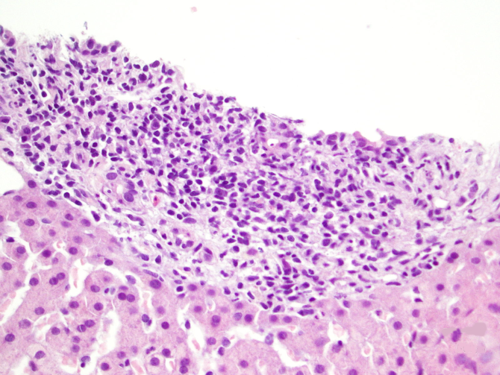
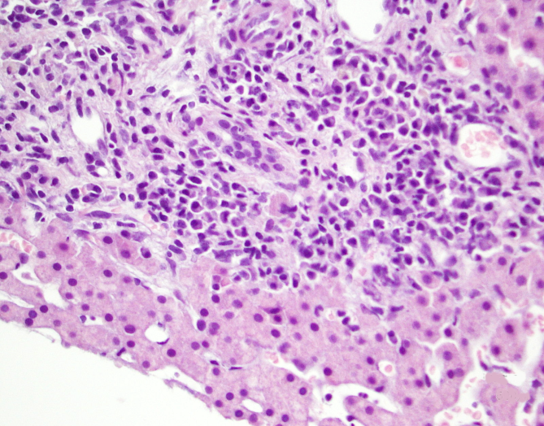
FURTHER INVESTIGATIONS
The tests were diagnostic for PBC.
However, considering the hepatitic activity he underwent liver biopsy.
Biopsy (March 2016)
Two specimens, 20 portal tracts overall
Lobular structure preserved
Moderate portal infiltrate with lymphocytes and rare plasma cells
Erosion of the limiting plate of many portal tracts. Severe biliary duct loss with BD injury of the remaining BDs
No steatosis, no iron overload
Initial septa (Fibrosis F2 METAVIR)
Diagnosis: SEVERE BILIARY DAMAGE COMPATIBLE WITH PBC (LUDWIG II) AND OVERLAP AIH

Slide 34
INITIAL MANAGEMENT
March 2016: AST 290<40, ALT 400<40, GGT 1600<50, ALP 600<150, gamma globulins 18<18% -- Start UDCA 900 mg/day
May 2016: AST 180, ALT 250, GGT 800, ALP 300 -- Start Prednisone 50mg/die
June 2016: AST 200, ALT 500, GGT 1700, gamma globulins 15<18%, IgG 800<1600, IgM 800<600 – Steroid progressively reduced
December 2016: AST 130 ALT 270, GGT 1400, ALP 200

Slide 35
WHAT IS THE
MOST LIKELY DIAGNOSIS?
PBC–AIH overlap
PBC-NASH overlap
PSC-NASH overlap
PSC

Slide 36
FURTHER INVESTIGATIONS AT OUR CENTRE
From December 2016 at our centre
LIVER AUTOIMMUNITY
WILSON DISEASE
AMA positive
ANA positive 1:160 nuclear lamine
Anti gp210 positive
ASMA negative
AntiTG negative
AntiSLA/LP negative
Anti sp100 negative
Alfa1antitripsine: 174<88
Ceruloplasmina: 45<22
Urinary copper 24h 110<70

Slide 37
ANY ADDITIONAL INVESTIGATION?
MRCP?
Colonoscopy with retrograde ileoscopy and random biopsies?
Notes:
**** chiedere a Marco che cosa è?

Slide 38
FURTHER INVESTIGATIONS AT OUR CENTRE
MRCP: no bile duct dilatation nor stricturing
Colonoscopy: normal macroscopic and microscopic features
Wilson’s disease genetic test (exon 1-21 gene ATP7B) negative
Liver biopsy review:
  1 BD intact
  Diffuse ductular reaction and massive biliary metaplasia
  Moderate interface hepatitis
  C: Severe PBC (Ludwig II, Nakanuma III)

Slide 39
FURTHER MANAGEMENT
March 2017: Stop prednisone
May 2017: AST 150, ALT 250, GGT 800, ALP 300
September 2017: start bezafibrate 400 mg/day
January 2018: stable transaminases, only mild improvement of GGT&ALP
February 2018: start obeticholic acid 5 mg/day
February 2019: AST 80, ALT 130, GGT 500, ALP 130 -- obeticholic acid up-titrated to 10mg/day with slowly but progressive normalisation of SLTs.

Slide 40
CASE SUMMARY
The patient was initially managed at a secondary centre.
His liver disease was (wrongly) labelled as PBC-AIH overlap and over-treated with immunosuppression. The biliary disease was undertreated (no licensed secondary therapies available at that time).
After evaluation in a tertiary centre.
  The immunosuppression was withdrawn.
  The biliary treatment was optimised with Bezafibrate (off-label) with no efficacy on LTs; after OCALIVA at a starting dose of 5 mg daily and titrated up to 10 mg the patient achieved a good biochemical response and no complication of his liver disease.

Slide 41
LEARNING POINTS
  ALT is often elevated as PBC is an inflammatory disease. Hepatitis can be secondary to severe PBC. Treating PBC correctly without immunosuppression can improve hepatitis.
  Overlap with AIH is rare (8-10%). Correctly diagnosing PBC–AIH overlap is crucial. Incorrect diagnosis can lead to unnecessary immunosuppression, delayed treatment, and possibly disease progression - Biopsy is mandatory to confirm diagnosis
In some cases to be certain of AIH overlap a trial of steroids can be necessary. The trial should be stopped if no response is achieved.
High-risk patients (very elevated LFTs, suspicion of overlap and/or advanced fibrosis at diagnosis) should be referred to tertiary centre.

Slide 42
INTERFACE HEPATITIS
IS CHARACHTERISTIC
BUT NOT
PATOGNOMONIC OF AIH!

Slide 43
THANKS FOR THE ATTENTION

