Slide 1
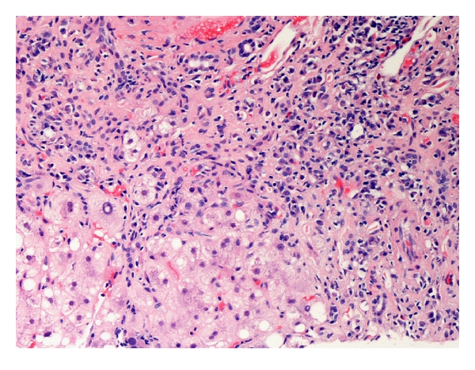
AUTOIMMUNE HEPATITIS
Elective Course “AUTOIMMUNE LIVER DISEASE”
APRIL 4, 2022
An heterogenous and challenging disease
Dr. Alessio Gerussi
alessio.gerussi@unimib.it

Slide 2
Summary
History
Definition
Epidemiology
Clinical presentation
Diagnosis
Prognosis and treatment
Pathogenesis, unmet needs and future perspectives

Slide 3
Summary
History
Definition
Epidemiology
Clinical presentation
Diagnosis
Prognosis and treatment
Pathogenesis, unmet needs and future perspectives

Slide 4
Historical notes
Top: Jan G̈osta Waldenstrom (right) with Dr. Goran Bauer, President of the Swedish College of Physicians, Stockholm, c.1989 (courtesy of Dr. Frank Wollheim).
Bottom left: Henry George Kunkel, Paris 1979, being informed of his naming for the Lita Annenberg Hazen Award (courtesy of Dr. Eng M. Tan).
Bottom right: Ian Reay Mackay, on the occasion of his Retirement Symposium in 1987 organized by the Walter and Eliza Hall Institute (courtesy of the subject).
Reuben A. Hepatology. 2003
Notes:
﻿Real- ization that there existed a distinct form ofchronic hepa- titis characterized by hyperglobulinemia dawned with reports from two physicians who were destined to be gi- ants of immunology in the 20th century, by name the Swede, Jan Go¨sta Waldenstro¨m,22from Malmo and theAmerican, Henry George Kunkel,23 from New York
﻿young, predominantly fe- male patients with chronic liver disease of mostly insidi- ous onset, associated with hypergammaglobulinemia. The inclusion of many extrahepatic systemic manifesta- tions, including arthralgias, rashes, fever, amenorrhea, hirsutism, etc., formed a recognizable albeit complex clin- ical syndrome
﻿finding oflupus erythema- tosus (LE) cells ( neutrophil or macrophage that has phagocytized (engulfed) the denatured nuclear material of another cell.^{[1]} The denatured material is an absorbed hematoxylin body (also called an LE body).^{[2]} They are a characteristic of lupus erythematosus) in the blood of2 patients with hypergam- maglobulinemic (then, presumed viral) active chronic hepatitis,
﻿Mackay et al. in Pathology and Chem-ical Pathology were able to add 5 additional hypergam- maglobulinemic chronic hepatitis patients from the same unit to the 2 reported earlier by Joske and King.42Theyprovisionally designated the liver disorder in these 7 pa- tients as lupoid hepatitis since they reasoned
﻿The dilemma was resolved, how-ever, as Hoborow et al.52 and even Mackay et al.32showedthat antinuclear antibodies (ANA) were positive in pa- tients with the classic lupoid hepatitis syndrome, whether or not LE cells were detected, making ANA detection and not LE cell positivity a determining criterion

Slide 5
Summary
History
Definition
Epidemiology
Clinical presentation
Diagnosis
Prognosis and treatment
Pathogenesis, unmet needs and future perspectives

Slide 6
Definition
Rare and multifactorial liver disease
Persistent and relapsing immune-mediate liver injury
Characterised by chronic hepatitis
Trivedi P et al Grand Rounds Autoimmune Hepatitis J Hepatol 2019

Slide 7
Summary
History
Definition
Epidemiology
Clinical presentation
Diagnosis
Prognosis and treatment
Pathogenesis, unmet needs and future perspectives

Slide 8
AIH is a rare disease mostly affecting females
AIH can be diagnosed
  At all ages
  In both sexes
    BUT female to male ratio is 4:1 (10:1 in Type 2)
  All over the world
Rare disease
  Incidence: 1.07 x 100,000/year -1.9 x 100,000/year
  Prevalence: 16.9 x 100,000
  Increasing?
Age- and sex-standardized incidence rates (SIR) of AIH in Denmark
Grønbæk L et al, Journal of Hepatology 2014
Notes:
the largest population-based cohort study of AIH

Slide 9
AIH is still a dangerous liver disease
Especially in the first year since diagnosis
Long-term mortality is also higher than general population
Most of deaths are liver-related
Grønbæk L et al, Journal of Hepatology 2014
Notes:
the largest population-based cohort study of AIH

Slide 10
Familiarity: low risk and only in first-degree relatives
Only first-degree relatives of index patients with AIH are at increased risk of AIH from the time of the index patient’s diagnosis
The absolute risk is very low (10- year cumulative risk 0.1%)
Grønbæk L et al, Journal of Hepatology 2018
Notes:
﻿In first-degree relatives, there were six incident autoimmune hepatitis diagnoses during 64,020 years of follow-up: the standardized incidence ratio was 4.9 (95% CI 1.8–10.7), and the 10- year cumulative risk was 0.10% (95% CI 0.04–0.23)
﻿The probandwise concordance rate, a measure of heritability, was higher in monozygotic than in dizygotic twins (8.7% [95% CI 1.1–28.0] vs. 0%).
﻿the first nationwide cohort study of family occurrence of AIH, it includes a large cohort of twins, covers a long time-period with complete follow-up, and compares with the general population

Slide 11
AIH often clusters with other autoimmune conditions
Wong et al Liver International 2016

Slide 12
Autoimmune thyroiditis and connective tissue disorders are the most frequent CEHAID
Wong et al Liver International 2016

Slide 13
Patients’ relatives are not at risk of CEHAID
patients with AIH do have an increased risk for other autoimmune diseases﻿ (prevalence ratio at age 20 = 9.92 CI 95% ﻿6.21–15.83)
but their relatives do not (prevalence ratio at age 20 = 1.11 CI 95% 0.72 -1.70)
Grønbæk L et al, Liver International 2019
Notes:
﻿the largest study of patients with AIH and their relatives

Slide 14
Summary
History
Definition
Epidemiology
Clinical presentation
Diagnosis
Prognosis and treatment
Pathogenesis, unmet needs and future perspectives

Slide 15
Different clinical scenarios
Hyperacute onset - acute liver failure
Acute onset - acute jaundiced hepatitis
Acute on chronic onset - flare on a unknown cirrhotic liver
Chronic onset - a asymptomatic or mildly symptomatic patient with incidentally found raised liver function tests ± presence of cirrhosis

Slide 16
Identification of AIH as cause of ALF
Different histology -> involvement of centrilobular zone dominates
No consensus guidelines
Early identification might allow early starting of steroids, potentially deferring/avoiding liver transplant (?)
Stravitz et al Hepatology 2011

Slide 17
Variant syndromes
2,1-19% of PBC patients
7,4-14% of PSC patients
Boberg et al J Hepatol 2011

Slide 18
Summary
History
Definition
Epidemiology
Clinical presentation
Diagnosis
Prognosis and treatment
Pathogenesis, unmet needs and future perspectives

Slide 19
Signs and symptoms are not specific
Symptoms: anorexia, fatigue, abdominal pain, arthralgias
Signs: present only when liver failure occurs
Concomitant extrahepatic autoimmune diseases can be helpful when evaluating a patient with raised transaminases or acute hepatitis

Slide 20
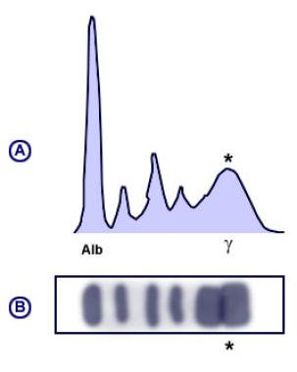
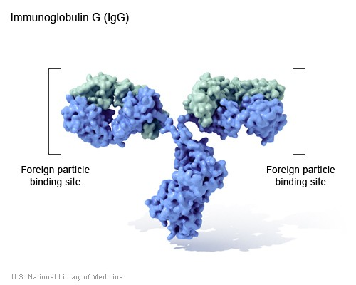
Laboratory
KEY ELEMENTS:
  Raised serum ALT and AST (ALT>AST)
  Raised serum gamma globulins (polyclonal) and immunoglobulins G
OTHER FEATURES:
  Alkaline phosphatase is normal or only midly raised
  Bilirubin and GGT are variably raised

Slide 21
Autoantibodies identify two subtypes of AIH
Type 1 AIH Antibodies to nuclei (ANAs) and/or to smooth muscle (SMAs)
Type 2 AIH Antibodies to a liver kidney microsomal constituent (anti-LKMs))

Slide 22
“Other” serum autoantibodies in AIH
anti-SLA
AIH type 1
anti-LC1
AIH type 2
ANCA
AIH type 1

Slide 23
Type 1 and Type 2 AIH show different clinical pictures
Gleeson D, Heneghan MA Gut 2011

Slide 24
Main causes of hepatitis

Slide 25
Drugs as triggers of AIH
A significant proportion of patients with AIH (9.7%) have drug-induced AIH,
  mainly due to nitrofurantoin and minocycline
  these two groups have similar clinical and histological patterns
DI-AIH patients do not seem to require long-term immunosuppressive therapy
Björnsson E et al Hepatology 2010

Slide 26
Histology is essential for diagnosis
Liver biopsy is essential for:
  Diagnosis
  Discriminating between acute vs chronic AIH
  Staging
23% of biopsy-proven non-alcoholic steatohepatitis have AIH-like autoantibodies
Prior to liver biopsy, 88% of patients with positive autoantibodies fulfill diagnostic criteria for AIH
Adams LA et al Am. J. Gastroenterol 2004

Slide 27
Histological features are different according to presentation
Interface hepatitis
Lobular hepatitis
Hepatocyte ballooning
Lobular disarray
Spotty hepatocyte apoptosis/necrosis
Extensive hepatocyte necrosis
Chronic AIH
Acute AIH
Acute liver failure
Trivedi P et al Grand Rounds Autoimmune Hepatitis J Hepatol 2019

Slide 28
Revised Diagnostic Criteria 1999
International Autoimmune Hepatitis Group Report: J. Hepatol. 31 (1999)
Notes:
Rapporto F M?

Slide 29
Simplified Diagnostic Criteria 2008
Hennes et al Hepatology 2008

Slide 30
Diagnosis of AIH needs a combination of diagnostic aspects
The heterogeneity of its features requires clinical judgement
Often some aspects of the “classical” presentation are missing
A combination of clinical, laboratory, histological and also demographic and epidemiological aspects help to reach a final diagnosis
Some diagnosis are made after evaluating response to treatment

Slide 31
Summary
History
Definition
Epidemiology
Clinical presentation
Diagnosis
Prognosis and treatment
Pathogenesis, unmet needs and future perspectives

Slide 32
Predictors of worse outcome at presentation
Cirrhosis
Black ethnicity
Type 2 AIH
Younger age
SLA/LP positivity
De Boer Y & Gerussi A & van den Brand F Clin Gastro Hep 2019

Slide 33
Is treatment for AIH always indicated?
Overt hepatic decompensation: treatment guided only by expert hands, close to a transplant unit
Inactive (“burned out”) cirrhosis: side effects are probable, impact on overall outcome is likely to be negligible
Acute severe AIH / fulminant disease: treatment regimens should be offered only by transplant units
Trivedi P et al Grand Rounds Autoimmune Hepatitis J Hepatol 2019

Slide 34
Controversies in induction of AIH
  Prednisolone up to 1 mg/kg/day, reduced gradually to 10 mg/day over 2-3 months while transaminases fall
    More steroid-related side effects?
    More rapid normalisation of serum transaminases (77% at 6 months compared to 39% with standard dose)
  Azathioprine started a few weeks after the prednisolone
    Not evidence-based
    Reasonable -> especially if diagnostic doubt exists
    Transaminases should be lower than 2 x ULN – bilirubin less than 5
Schramm C, et al Hepatology 2010
Trivedi P et al Grand Rounds Autoimmune Hepatitis J Hepatol 2019
Heneghan M et al, The Lancet 2013
Notes:
Failure of transaminases to normalise and absence of an early fall are both associated with worse outcomes

Slide 35
Controversies in maintenaince of AIH: the choice of the long-term drug
Biochemical remission can be maintained with Prednisolone (7,5-12,5 mg/day) + azathioprine (1-2 mg/kg/day)
If azathioprine is chosen for monotherapy, doses of 2 mg/kg/day are appropriate but this should be tailored to individual response
Prednisolone monotherapy is typically an exception, reserved to very elderly patients (2,5/5 mg per day) or patients concerned to azathioprine side effects
Trivedi P et al Grand Rounds Autoimmune Hepatitis J Hepatol 2019

Slide 36
Controversies in maintenaince of AIH: how to monitor disease progression
Biochemical remission is a valid surrogate of histological remission
Transient Elastography is an useful tool to monitor disease progression
Hartl et al J Hepatol 2018
Notes:
Supporting data:
Only 18% of those on biochemical remission have HAI 4 or 5, none had HAI > 5 or showed progression of fibrosis
None of the patients with severe fibrosis at study entry who achieved biochemical remission reached a major endpoint during 11.8 years of f up
Biochemical remission is an independent predictor of fibrosis regression
Liver stiffness sharply decrease in patients with biochemical remission (-7.5%/year)

Slide 37
Controversies in maintenaince of AIH: length of treatment
There is no consensus on the appropriate length of treatment
Guidelines suggest that corticosteroids should be given for 18-24 months and azathioprine for 3-5 years before considering withdrawal
Withdrawal should be tried only if transaminases and IgG have remained normal over this time
Trivedi P et al Grand Rounds Autoimmune Hepatitis J Hepatol 2019

Slide 38
Relapse (Flare)
Relapse is defined as an increase in serum ALT >= 3 x ULN ± an increase in serum IgG > 20 g/L
  Relapses are associated with progression of the disease and worse outcome
  Relapses occur at a rate of 31% after 5 years, 41% after 10 years and 51% after 20 years since diagnosis
  Relapses almost always occur when therapies are stopped (59% at 1 year, 81% and 88% at 3 and 5 year), even in patients in biochemical remission for more than 2 years
Trivedi P et al Grand Rounds Autoimmune Hepatitis J Hepatol 2019
Hoeroldt B et al, Gastroenterology 2011
Van Gerven et al J Hepatol 2012

Slide 39
Controversies in maintenaince of AIH: need for biopsy before withdrawal
There is evidence that 45% of patients on biochemical remission have HAI 4-6 and this is associated with worse transplant-free survival.
Despite within the range of normality, they typically have higher ALT and AST (24 vs 18 and 27 vs 23 respectively)
Dhaliwal HK et al Am. J. Gastroenterol. 2015
Relapse is more likely when persistent histological inflammation (HAI) is present (>3)
Therefore biopsy should be performed for all patients planning to stop treatment
EASL Guidelines 2015
Trivedi P et al Grand Rounds Autoimmune Hepatitis J Hepatol 2019

Slide 40
Summary
History
Definition
Epidemiology
Clinical presentation
Diagnosis
Prognosis and treatment
Pathogenesis, unmet needs and future perspectives

Slide 41
AIH is a complex disease
Multifactorial polygenic disorder
Interaction of a trigger and environmental factors in a genetically susceptible individual
Autoreactivity / Molecular mimicry
  cytochrome P450IID6 in type 2
  soluble liver antigen in type 1
Heneghan M et al, The Lancet 2013

Slide 42
Genetics of AIH
HLA variants:
  Disproportionate frequencies of certain HLA-D alleles in AIH
  Geographical variations
Non-HLA variants:
  Data from 2014 unique GWAS study enlighted the association with:
    SH2B3 (Lnk): associated also with PBC, PSC and other autoimmune conditions
    Two HLA alleles
Webb et al, Annu Rev Path 2018

Slide 43
Loss of tolerance
Impairment of regulatory T cells (number and function)
Effector T cells poor responsive to their control
This breakdown leads to loss of tolerance to liver autoantigens
Heneghan M et al, The Lancet 2013

Slide 44
Dyson J.K. et al. J. Hepatol. 62 (2015)
Notes:
storia

Slide 45
THANKS FOR
YOUR ATTENTION

