Slide 1

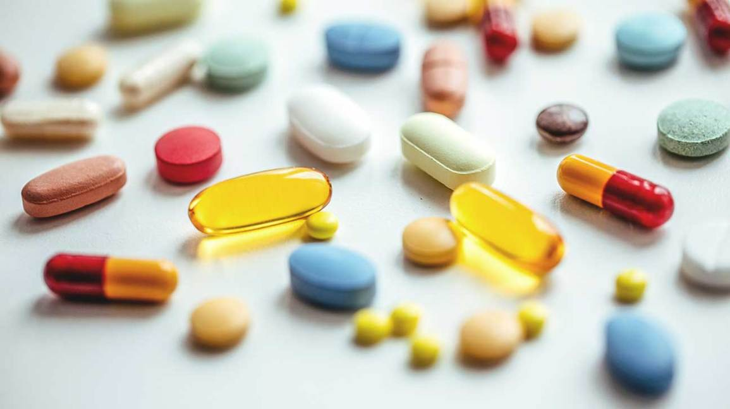
DRUG-INDUCED LIVER INJURY
Dr. Alessio Gerussi

Slide 2
Definition
Drug-liver injury (DILI) is classified into two categories:
Intrinsic/direct DILI
  Dose-related
  Predictable
  Short onset (hours to days)
Idiosyncratic DILI
  Not dose-related
  Unpredictable
  Variable latency (days to weeks)
EASL guidelines J Hepatol 2019

Slide 3

Epidemiology
Determining the true incidence of DILI is difficult
Most of data derive from retrospective studies of databases from pharmacovigilance centres/pharma companies

Slide 4
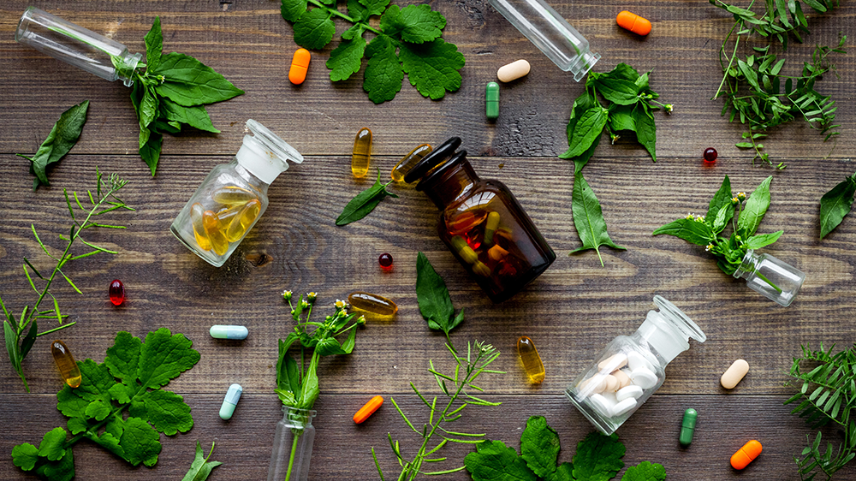
Epidemiology
The awareness of potential hepatotoxicity associated with alternative medicine such as herbal preparations and dietary supplements is increasing
More than 100 medicinal preparations have been reported to be toxic to the liver

Slide 5
Outcomes
The vast majority of patients fully recover
However, 15% of cases of acute liver failure involve drugs and drugs are the most common cause of acute liver failure in Western countries
Transplant-free survival in DILI-ALF is worse
EASL guidelines J Hepatol 2019

Slide 6
Risk factors
Age
  The incidence of serious adverse drug reactions increase with age
  It is likely that age is not a risk factors per se but the elderly often take more medications
  Older patients have a more cholestatic phenotype
Sex
  Females have
    Higher rates of DILI due to immunogenic drugs (minocycline, nitrofurantoine)
    Higher risk of progressing to ALF
EASL guidelines J Hepatol 2019

Slide 7
Thresholds and patterns
ALT >5 x ULN
ALP >2 x ULN (+ elevation of GGT)
ALT >3 x ULN & total bilirubin >2 x ULN
EASL guidelines J Hepatol 2019

Slide 8
R value
ALTxULN ÷ Alkaline phosphatase (AP) x ULN
Used to defined hepatotoxicity injury patterns:
  hepatocellular (R>5),
  mixed (R=2–5), and
  cholestatic (R<2)
EASL guidelines J Hepatol 2019

Slide 9
Histology of hepatocellular DILI
More marked inflammation, necrosis and apoptosis
Plasma cells and eosinophils are more often present in portal inflammation
When severe, zone 3 is involved by confluent necrosis
EASL guidelines J Hepatol 2019

Slide 10
Drug-induced autoimmune hepatitis
2-9% of all AIH are drug-induced
In cases where even liver histological features cannot establish drug aetiology it is reasonable to institute steroid treatment in patients who do not show recovery despite drug cessation
Once remission has been achieved, withdrawal of immunuosuppression is advisable since relapse is less likely than in idiopathic AIH
EASL guidelines J Hepatol 2019

Slide 11
Drug-induced fatty liver disease
Amiodarone (1-3%)
  Hepatitis occurs after hours if intravenously administered
  Hepatitis occurs after 3 months and takes weeks to months to reverse on withdrawal if oral route
Methotrexate (>10%)
Tamoxifen (2%)
  Reported only in overweight/obese women with metabolic syndrome
EASL guidelines J Hepatol 2019

Slide 12
Immunotherapy
ICI-related acute grade 3 or 4 hepatitis is rare, biliary toxicity is exceptional
DILI is an exclusion diagnosis which requires an extensive work-up
Immune-related hepatitis, not autoimmune-like hepatitis
Discuss the case with your hepatologist and have a low treshold for liver biopsy

