Slide 1
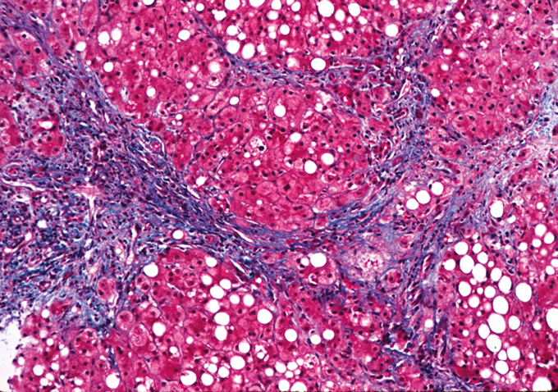

ALCOHOL-RELATED
LIVER DISEASE
Dr. Alessio Gerussi

Slide 2
Definitions
Alcohol use disorder (AUD):
  a problematic pattern of alcohol use leading to clinically significant impairment or distress (DSM-V criteria)
Alcohol-related liver disease (ALD):
  Regular alcohol consumption of >20 g/d in females and >30 g/d in males
  AND
  Presence of clinical and/or biological abnormalities suggestive of liver injury
EASL guidelines J Hepatol 2018

Slide 3




Unità alcolica
1 UA = 12-13 g di etanolo puro
mL bevanda x gradazione alcolica x 0,79 = grammi di etanolo
100
330 ml, 4.5°
125 ml, 12°
40 ml, 36°
80 ml, 18°

Slide 4
Individuals at risk - Screening
ALD should be considered in:
  Those in alcohol rehab clinics
  Harmful drinkers identified by GP
  Patients presenting with extrahepatic manifestations of AUD
    Symmetric peripheral neuropathy
    Pancreatitis
    Cardiomyopathy
EASL guidelines J Hepatol 2018

Slide 5
How to screen?
GGT, ALT, AST
Transient elastography
Ultrasound
Exclude other etiologies: HBV, HCV, autoimmune markers, transferrin and transferrin saturation, alpha1-antitrypsin
EASL guidelines J Hepatol 2018

Slide 6
Tests for alcohol consumption
Indirect markers
  Raised levels of GGT, AST
  AST usually is <300, AST/ALT > 1
Direct markers
  Ethyl glucuronide (EtG) in urine or hair
EASL guidelines J Hepatol 2018

Slide 7
Who should be biopsied?
In patients recruited in clinical trials
In case of inconclusive non-invasive tests
In case of suspicion of a competing liver disease
EASL guidelines J Hepatol 2018

Slide 8
Histological features
Four groups of elementary lesions
Macrovesicular steatosis
Hepatocellular injury with ballooning, potentially necrosis
Lobular inflammation
Fibrosis/cirrhosis
EASL guidelines J Hepatol 2018

Slide 9
The spectrum of histological diagnoses
Alcoholic steatosis
Alcoholic steatohepatitis (ASH)
Fibrosis/cirrhosis
HCC
EASL guidelines J Hepatol 2018

Slide 10
Alcoholic steatosis
90% of heavy drinkers have steatosis
Unknown whether alcoholic steatosis is a benign condition or can progress to cirrhosis
There are studies suggesting cirrhosis may occur after a median of 10 years in 10% of patients with simple steatosis without ASH or fibrosis
EASL guidelines J Hepatol 2018

Slide 11
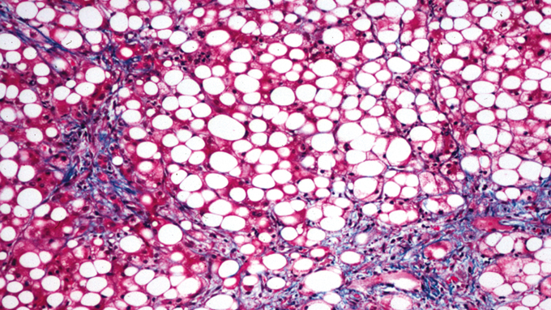
Alcoholic steatosis

Slide 12
Alcoholic steatohepatitis
Increases the risk of cirrhosis and HCC
Morphological features:
  Steatosis
  Hepatocellular ballooning
  Necrosis
  Lobular inflammation (neutrophils)
EASL guidelines J Hepatol 2018

Slide 13
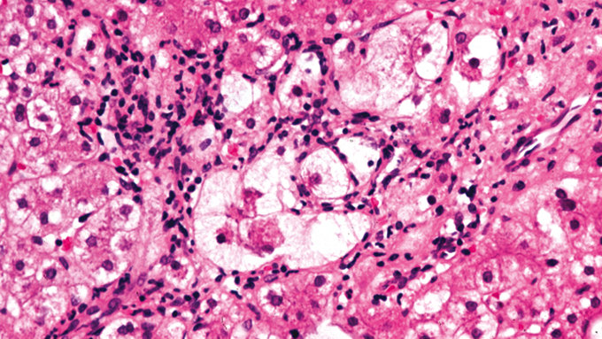
Alcoholic steatohepatitis
Notes:
inflammation and necrosis, which are most prominent in the centrilobular region of the hepatic acinus

Slide 14
Alcoholic steatohepatitis
Steatosis may be present in less than 5% of the parenchyma, or even absent in cases of:
  Severe ASH
  After periods of abstinence
  Cirrhosis
Ballooning refers to swelling, rounding and pale staining of the cytoplasm
Ballooned cells often contain large Mallory-Denk bodies
EASL guidelines J Hepatol 2018

Slide 15
ASH vs NASH
Broad overlap in histological features; however:
Hepatocellular injury and fibrosis are often more severe in ALD
Sclerosing hyaline necrosis, alcoholic foamy degeneration, fibro-obliterative changes in hepatic veins, portal acute inflammation, cholestasis are very rare in pure NAFLD
EASL guidelines J Hepatol 2018

Slide 16
Alcoholic hepatitis (AH)
A distinct clinical syndrome characterised by:
  Recent onset of jaundice
  with/without other signs of liver decompensation (ascites/encephalopathy)
  In patients with ongoing (<60 days of abstinence) alcohol abuse (typically >80g/d for decades)
  Hepatitis
Histologically defined by steatohepatitis features
EASL guidelines J Hepatol 2018

Slide 17
Alcoholic hepatitis (AH)
The cardinal sign of AH is progressive jaundice
Labs:
  Neutrophilia
  Hyperbilirubinemiea (>50 microMol/L)
  AST > 2 x ULN (<300)
  AST/ALT > 1.5
  If severe high INR, hypoalbuminemia, reduced PLT
EASL guidelines J Hepatol 2018

Slide 18
Diagnosis in AH
Clinical findings + typical laboratory findings
Tranjugular liver biopsy is recommended especially when diagnosis is uncertain
  Up to 30% of patients clinically diagnosed with AH have an alternative diagnosis
EASL guidelines J Hepatol 2018

Slide 19
Differential diagnosis
Sepsis
Upper GI haemorrhage
Shock/ischemic hepatitis
Drug-induced liver injury
Singal et al J Hepatol 2018

Slide 20
Algorithm for diagnosis of AH
Clinical criteria:
Heavy alcohol use (>2 drinks in females and >3 drinks in males) for >5 years;
Active alcohol use until at least 8 weeks prior to presentation;
Recent (<1 month) onset or worsening of jaundice;
Exclude other liver diseases, biliary obstruction, HCC.
Biochemical criteria:
Serum bilirubin >3 mg/dl,
AST >50 and <500,
AST >ALT by 1.5:1
Singal et al J Hepatol 2018
Notes:
**Transjugular route preferred for obtaining the liver tissue. **Characteristic histological findings: Cell balooning, neutrophil infiltration, cholestasis, varying degree of steatosis and fibrosis. ***Needed for inclusion in clinical trials and before starting specific pharmacologic therapy. AH, alcoholic hepatitis; ALT, alanine aminotrans- ferase; AST, aspartate aminotransferase; HCC, hepatocellular carcinoma

Slide 21
Prognostic scores
Aim: to identify patients at high risk of early death
Severe AH: Maddrey ≥ 32 or MELD ≥ 20
EASL guidelines J Hepatol 2018

Slide 22
Treatment
Alcohol abstinence
Treatment of complications (encephalopathy, ascites, infections)
Nutrition
For severe cases, Corticosteroids
EASL guidelines J Hepatol 2018

Slide 25
Prognosis
Severe AH (MELD-defined): 20% mortality within 90 days
Severe AH (Maddrey-defined) 50% mortality within 90 days
Steroid responders (~60%) and abstinent do well
Non responders and abstinent have an intermediate prognosis and may be considered for LT
Singal et al J Hepatol 2018

Slide 26
LT for severe unresponsive AH
An increasing trend
Im et al J Hepatol 2019

Slide 27
LT for severe unresponsive AH
A debated indication
ARGUMENTS IN FAVOUR:
6-MONTH RULE prevents unnecessary LT
6-MONTH RULE allows a patient to demonstrate a commitment to abstinence and to avoid future relapse
Public perception is negative and will reduce organ donation
AH patients do not deserve LT which is a limited resource
ARGUMENTS AGAINST:
Many patients with severe AH without response will die during this interval
6-MONTH RULE is imprecise and discriminates against those with favourable psychosocial profiles and low risk of relapse
Evidence behind this is scarce
AUD is a complex disease and also HCV, HBV, NAFLD are influenced by personal behaviour
Im et al J Hepatol 2019

Slide 28
LT for severe unresponsive AH
Good outcomes
Im et al J Hepatol 2019

Slide 29
Alcoholic cirrhosis
The clinical course is influenced by the pattern of alcohol intake:
Periods of excessive alcohol intake can lead to superimposed ASH, possibly leading to Acute-on-chronic liver failure
Prolonged abstinence can compensate previously complicated cirrhosis
EASL guidelines J Hepatol 2018

Slide 30
Screening for extrahepatic complications
Alcoholic cardiomyopathy
IgA-induced nephropathy
Central and peripheral nervous system involvement
Chronic pancreatitis
EASL guidelines J Hepatol 2018

