Slide 1
Relational Marketing and Communications
Managing relationships and Customer Experiences

Slide 2
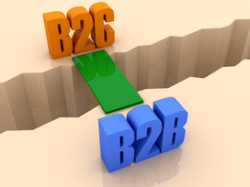

Slide 3
B to C versus B to B
B2B effective messages will focus on how your product or service saves time, money, and resources. What kind of return on investment can buyers expect with their purchase?
in B2B marketing, a few sales can make a quarter. “Because B2B companies typically have higher budgets, and B2B products tend to cost more. Trust and relationship building are key to marketing success.
a B2B purchase is based more on product logic and features. A consumer's purchase instead is often based more on emotion.
B2C marketing focuses on the results and benefits a product
brings to the life of the customer: Price, quality, features

Slide 4
Elements of Service
After branding, product creation and launch, this is the next phase.
1) A service encounter: the period of time during which a customer interacts directly with a service.
The quality of this encounter impacts perceived service value,
which influences customer satisfaction.

Slide 5
Service Levels
Levels: High contact – person to person encounter from beginning to end of the service
Medium contact- some personal contact but limited
Low contact- little or no personal contact (an ATM, internet search, TV entertainment

Slide 6
Performance Measurement
By surveys (SERVPERF) to rate their feeling about the service received:
Reliability......... dependability of repeat performances
Responsiveness.... willingness of staff to provide prompt service
Assurance....... courtesy, confidence and competence of staff
Empathy........ consideration and care given to customers
Tangibles....... appearance of employees, facilities,
communication materials, etc.

Slide 7
Loyalty and Retention Customer Care
Incentivized loyalty- ie. collecting reward points
Price loyalty
Emotional loyalty.... personal identification with the supplier with real or perceived benefits

Slide 8
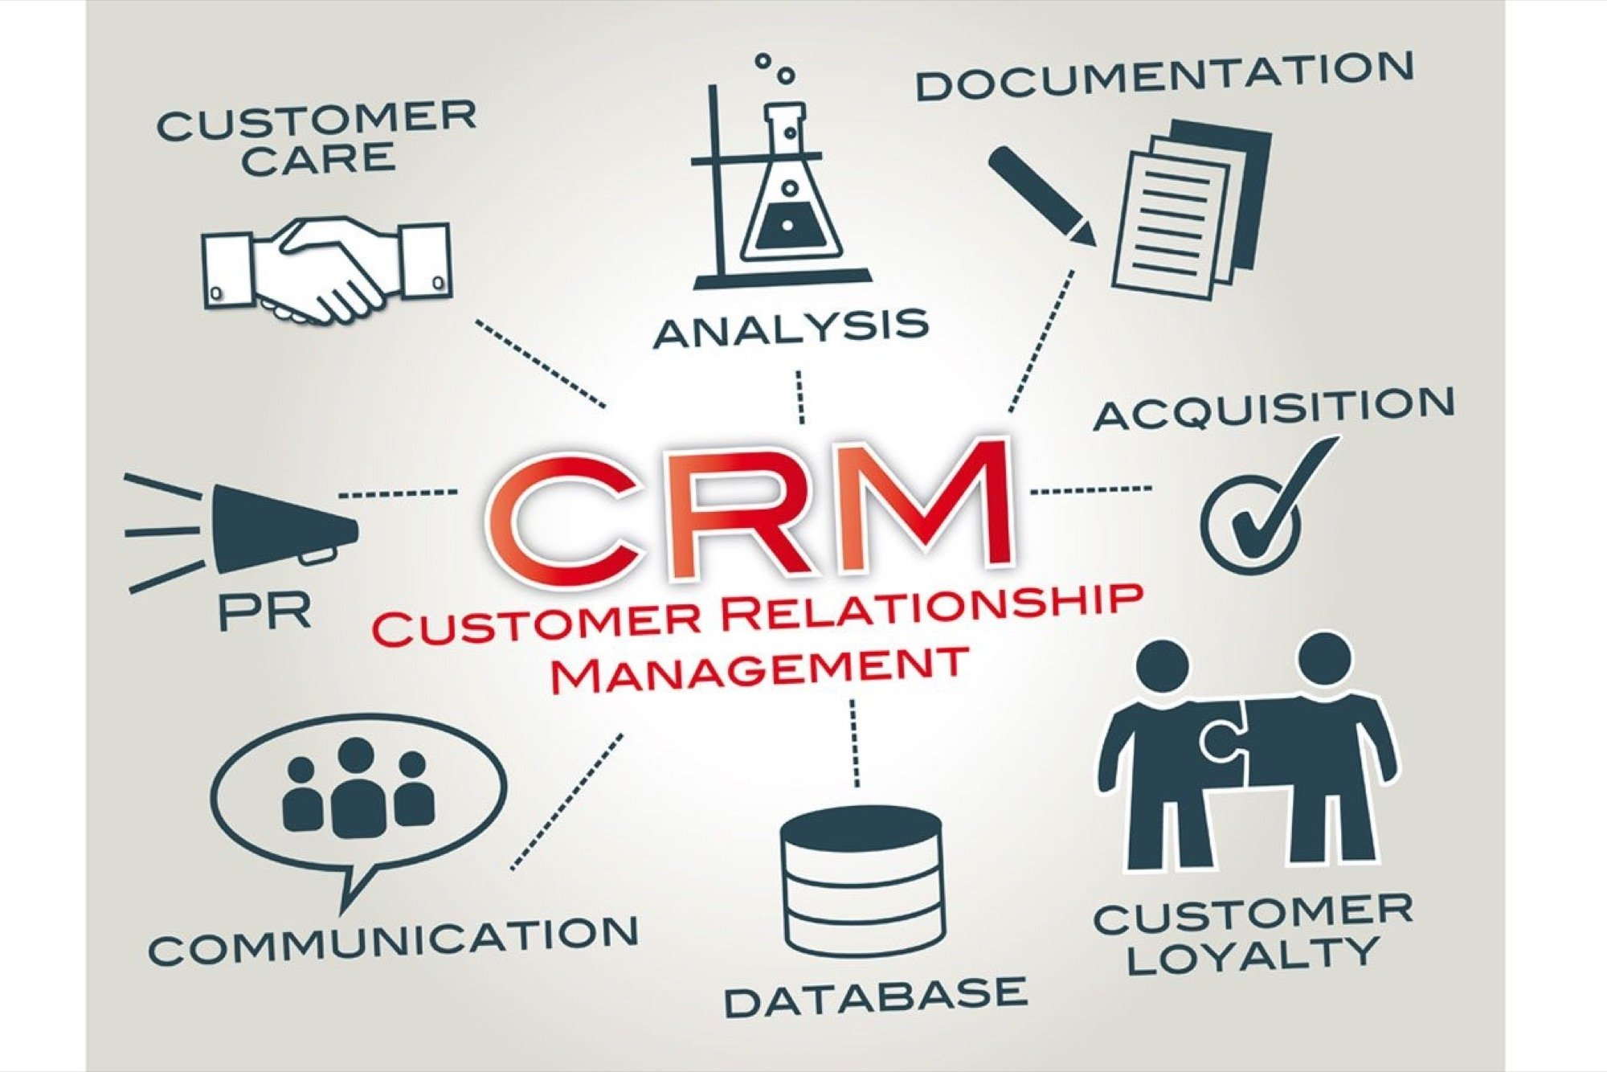

Slide 9
CRM Customer relationship management
A system for managing a company’s interactions with current and future customers
Uses technology to organize, automate and synchronize sales,
marketing, customer service and technical support.
• Complex software to record data on all transactions and interactions with customers and business partners.
- puts customer needs and solutions together
- Sales force automation: lead generation, tracking analysis
- Data generation from transaction info to provide KPI's
- Opportunity management: to forecast growth trends

Slide 10
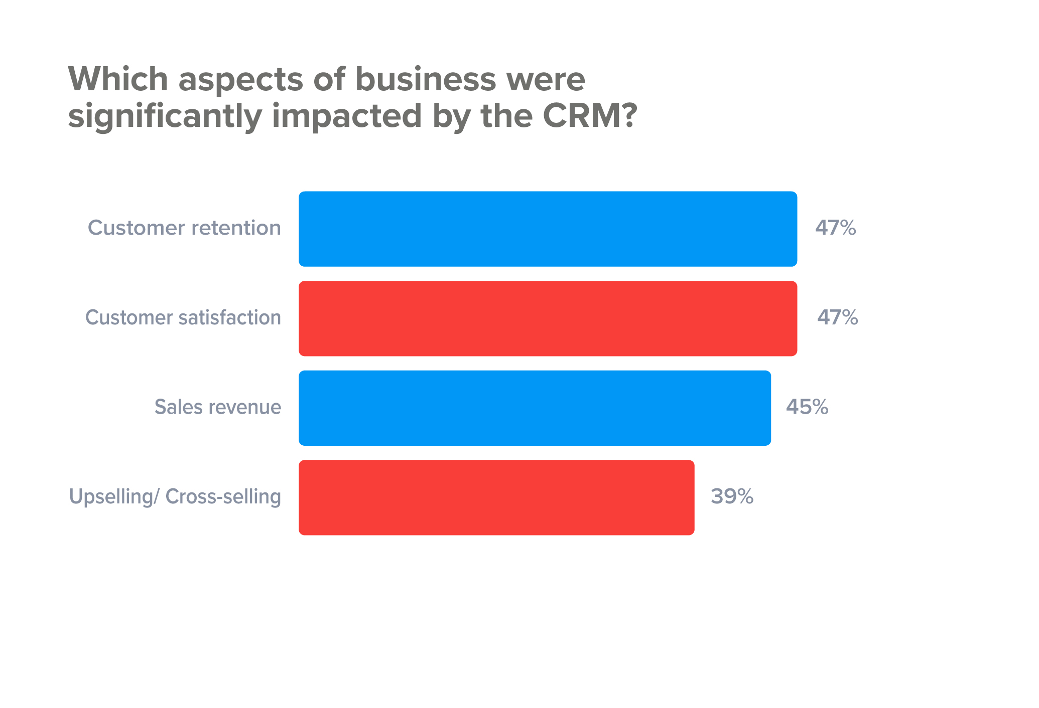

Slide 11
Which Software?
Best rated:
Best known:

Slide 12
Customer service options
Not just the classic"passive" phone call center
New technologies are required to meet the
requests for product & brand support:
-live chat, community forums, social media,
AI, pro-active customer outreach/follow-up

Slide 13
Customer Experience (their “journey”)
The total customer reaction to his contact with the service. The emotions provoked, sensations felt, knowledge gained and skills acquired through active involvement with the company pre-, during and post-consumption.
rational, emotional, sensorial, physical, spiritual
• All factors contribute to a high value experience:
ambiance, color, packaging, ease of use, customer support,
product performance, personal validation of your choice
of the product and brand.

Slide 14
The Nordstrom Experience
Their employees: the philosophy is “hire the smile, train the skill.”
Feeling that you are part of something meaningful. (“Selling clothes isn’t what we do. It’s filling people’s needs and making them feel better emotionally.”)
Feeling valued. (“The more people are valued, the more connected they become. It perpetuates itself.”)
The Customer: They expect excellent quality clothing and will pay a premium
price for that plus the store sales service, product guarantee, and for the feeling of being part of a special experience. The Nordstrom customer is solidly connected to the brand and that loyalty is reinforced over the years.
•New Mobile CRM app:

Slide 15
Nordstrom CRM app
allows consumers to buy products, develop looks, create a wish list, venture in-store for events and call customer service.
Nordstrom’s branded rich app is a critical component of a successful cross-channel mobile strategy as it empowers Nordstrom to build a closer, more personal relationship with their most loyal customers
Nordstrom can engage and transform customers from occasional visitors to loyal customers by having them download the app for faster, more frequent and higher value experiences

Slide 16
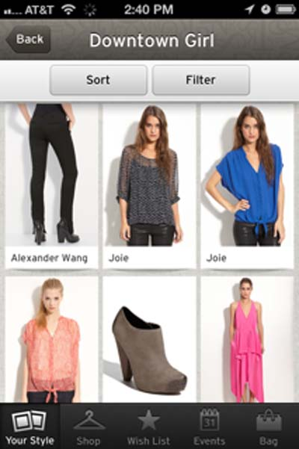
Nordstrom mobile app
Users can click on the style that most represents the way they dress and are given choices of handbags, tops, bottoms and other accessories.
Selecting a product will bring up its individual page with a description and an option to share via email, Facebook or Twitter.
Nordstrom can engage and transform customers from occasional visitors to loyal customers by having them download the app for faster, more frequent and higher value experiences

Slide 17
When service goes bad: key elements to correct
1. Set standards of behavior
- answer phone in less than 4 rings
- have professional phone greetings
- answer emails within 1 hour

Slide 18
-
2. Start using the right language
- "you owe us €50" ....... "our records show a balance of €50"
- "Please hold"....."May I briefly place you on hold"

Slide 19
-
3. Train employees about what extraordinary
customer service looks like.
- Apple
- Starbucks
- Ritz-Carlton hotel

Slide 20
-
4. You need an adequate CS budget
- fast effective service requires enough staff
- do you have an after-hours capability ?
- use FAQ to avoid unnecessary calls

Slide 21
-
5. Have reliable internal CS communication
- follow every inquiry or complaint from start
to resolution:
- have a tracking system to know where each
inquiry is, who is responsible and the status.

Slide 22
Communications
Website
content marketing
The new world of AI... finding customers, improving efficiency, using to communicate.
Linking content offered to final sales
Research: Brand Tracking
adjusting content delivery
linking ADV to social content
CRM to confirm results

Slide 24
Final Exam Review
You are responsible to know all the content of the lectures that are on the lesson slides plus any relevant key information given by the guest that spoke to the class.
Pay attention to how to market a new product or service and also how to devise a marketing plan to solve a company problem.
During the final you cannot use notes or activate a cell phone or tablet
device. The final exam will be on 22/05 and starts at 9 and you have
until 12.00 to finish. Be prepared and please be ready on time !!

Slide 25
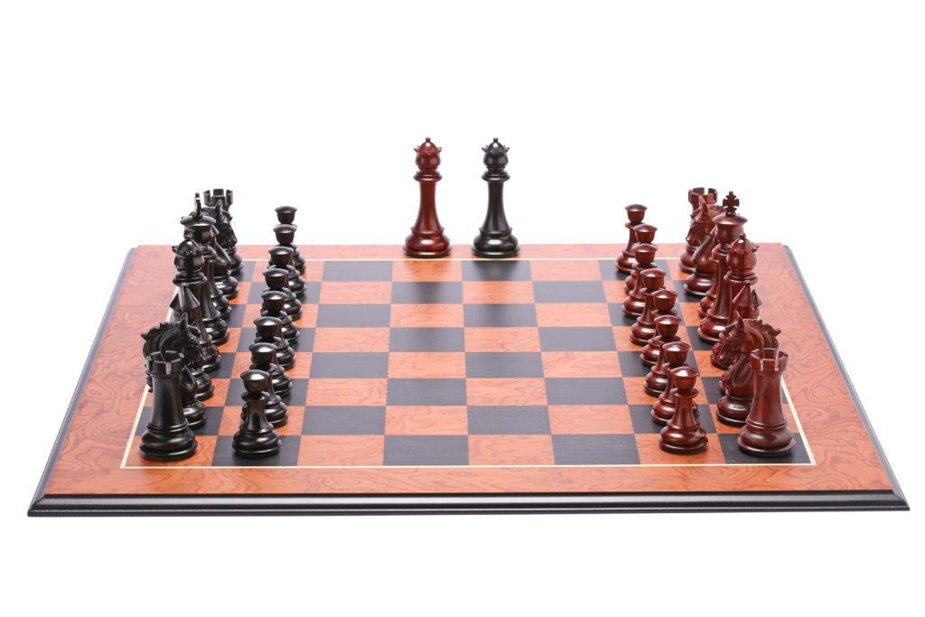
Marketing is Chess

Slide 26
Know the power of each piece
Price
competition
sector location
product qualities
economic trends
consumer profile
creative message
media channels
=
Insight
Market
Strategy

Slide 27
Remember: Analytical & Intuitive ?
“Logic will get you from A to B. Imagination will take you everywhere.”
“If you can't explain it to a six year old, you don't understand it yourself.”
- Albert Einstein

Slide 28
S.W.O.T. Analysis
• To determine an organization’s strategic position
• A way to identify four Key elements that have an impact on strategy
• The matrix created forms a basis for discussion of strategic planning

Slide 29
S.W.O.T.
Strengths
Weaknesses
Opportunities
Threats

Slide 30
MARKETING MIX The 4 P’s +1
POSITIONING
PRODUCT
PLACE
PRICE
PROMOTION

Slide 31
Elements of Marketing management
Product idea and creation
Market research (trends, consumer taste, competition, pricing, etc)
Financial analysis for product viability
Strategic analysis (target market)
Product testing
Marketing plan
Pre-advertising/promotion
Training of sales force
Launch activity
Full advertising/promotion activity
Distribution-Product placement
Monitoring sales activity
Post launch analysis
Strategic planning revisions based on feedback/results
Customer service
Communication PR for product and brand management

Slide 32
Research ➔ Customer Insight
Fundamental research is the key to planning, designing a product or service.
• Identifying and monitoring customers’ changing needs
First have a Strategic goal- a Marketing Strategy
Then, the market research determines the impact of that strategy. One can modify selling tactics based on good market data collection and analysis. Keep constantly tuned into customer behavior.

Slide 33
Brand Name
Easily spelled, remembered, spoken
Indicative of the product’s major benefits
Distinctive, unique
Capable of registration protection
Notes:
Examples: Lego, Sure (deodorant)
Foreign language problems must be checked out:
Clairol “Mist Stick” ..... in German, mist means manure (letame)

Slide 34
Brand Quiz
Brand Identity

Slide 35
Brand Quiz
Brand Identity....... is the collection of all elements that a company creates to portray the right image to its consumer.

Slide 36
x
Brand image

Slide 37
x
Brand image……… what people actually think about the brand

Slide 38
x
Brand awareness

Slide 39
x
Brand awareness ……….. how much people are aware of the brand

Slide 40
x
Brand extension

Slide 41
x
Brand extension… when a new product or service is added and is associated with the existing brand

Slide 42
x
Off-brand

Slide 43
x
Off-brand…… when a product does not have a particular brand name... usually inferior, less expensive. Sometimes also referred to as a
"store brand".

Slide 44
x
Brand equity

Slide 45
x
Brand equity…… the value that a brand adds to a product or service

Slide 46
x
Brand positioning

Slide 47
x
Brand positioning...identifying and trying to occupy a market niche; creating a distinct impression in the customer’s mind. It is their perception of your company in relation to your competitors.

Slide 48
x
Derived brand

Slide 49
x
Derived brand… when a component of a product becomes a brand on its own.
(sometimes called a “spin off” )

Slide 50
Definitions
Brand identity … what a company wants people to think about a brand
Brand image……… what people actually think about the brand
Brand awareness ……….. how much people are aware of the brand
Brand extension… when a new product or service is added and is associated with the existing brand
Off-brand…… when a product does not have a particular brand name... usually inferior, less expensive
Brand equity…… the value that a brand adds to a product or service
Brand positioning...identifying and trying to occupy a market niche; creating a distinct impression in the customer’s mind
Derived brand… when a component of a product becomes a brand on its own
(sometimes called a “spin off” )

Slide 51
Classic Distribution
Producer
Distributor
(delivery)
Wholesaler
Retailer
Customer

Slide 52
Classic Channel Strategy
Intensive distribution:
Wide distribution- high volumes- fast turnover of goods
Selective Distribution
Limited outlets based to price and geographic considerations
Exclusive Distribution
Distributor handles only one manufacturer’s products

Slide 53
Direct Channel Structure
Manufacturer has control of everything from him to consumer:
Examples ?
Notes:
Adobe systems and others: digital content, software delivered electronically directly to end buyer
Dell Computer- all phases controlled by Dell (JIT manufacturing and delivery)

Slide 54
Digital activities
Internet marketing/advertising
Search marketing: to optimize positioning
Email marketing: direct communication with permission
Mobile marketing: phone and wireless world
Online retailing: (B2C) shopping, click, order, have delivered
Advergaming: Video & online games to advertise/brand
Social media marketing: using social networks to produce content that users will share; for customer reach and brand exposure.
Viral marketing: using promotions, ideas, clips to “pass on”
Notes:
Search marketing: Search Engine Optimization (SEO) tactics, key word magic, paid placement

Slide 55
Price
What is the value of the product or service to the buyer?
Are there established price points for products or services in this area?
Is the product price sensitive? Will a small decrease in price gain you extra market share? Will a small increase be indiscernible, therefore gain you extra profit margin?
What discounts should be offered to customers; when should they be offered and why
How will your price compare with your competitors?

Slide 56
Place
Where do buyers look for your product or service?
If they look in a store, what kind? A specialist boutique or in a supermarket, or both? Or online? Or direct, via a catalogue?
How can you access the right distribution channels?
Do you need to use a sales force? Or attend trade fairs? Or make online submissions? Or send samples to catalogue companies?
What do your competitors do, and how can you learn from that and differentiate?

Slide 57
Tools of Marketing
Advertising
Sales Promotion
Public Relations
Direct Marketing
Personal Selling
How do they compare regarding:
Cost
Credibility
Level of control
Notes:
Advertising: High, Low, Medium
Sales Promotion: Medium, Medium, High
Public Relations: Low, High, Low
Direct Marketing: Med, Med, High
Personal selling: High, Med, Med>

Slide 58
Traditional “above the line advertising”
What most people think of as advertising:
• Mass media used to build a brand
• Television, radio
• Sponsorship deals
• Display advertising (newspapers,magazines, and on internet)
• Advertorials
• Brochures/catalogues
• Yellow pages
Notes:
Siemens-Disney sponsorship deal –synergy but why:
Siemens (also Coca-Cola, hewlett Packard, General Motors ar “corporate alliance partners

Slide 59
"Below the line" marketing
Products are promoted in media other than mainstream radio or television
A more targeted communication
- direct mail (coupons, offers, promotions)
- trade shows and events
- SEO marketing
- Social media targeted campaigns
- most poster/billboard advertising

Slide 60
Developing a Communication Strategy
The A-I-D-A model
Awareness : bring attention and knowledge of product
Interest: create a high level of interest in that product
Desire: Converts interest into desire to buy
Action: makes the purchase or changes their purchasing
behavior.
Notes:
What is the L’Oreal slogan ? Logical or emotional ? May cost more, but a superior product and after all I’m worth it !

Slide 61
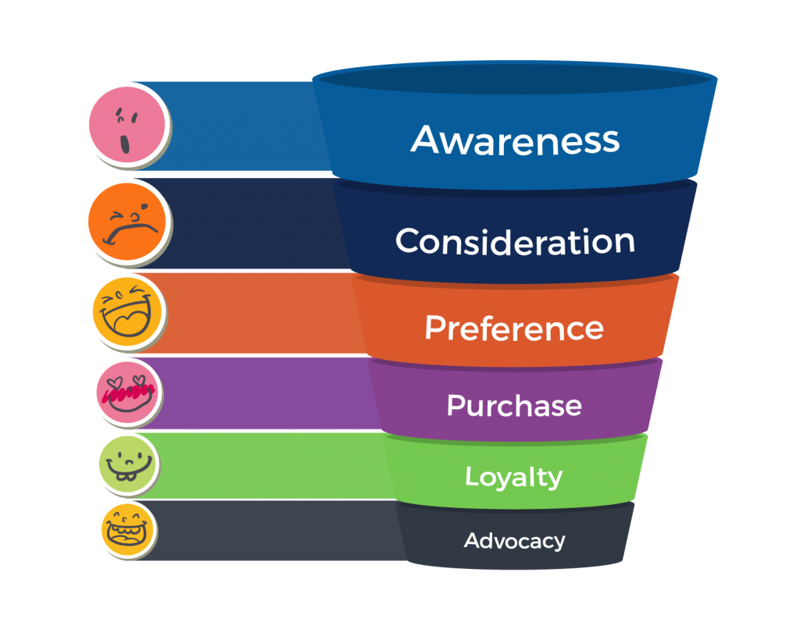
Customer Journey Funnel

Slide 62
Every strategy session asks:
Where are we? (positioning)
Who are we? (our brand)
What does the public think of us? (brand image)
Where do we want to go? (future positioning)
How can we change the image of our company?
How do we advertising this to the public? (media mix)

Slide 63
Positioning
Positioning is the single greatest influence on a customer’s buying decision
Each customer evaluates products in the market according to their mental map of the market
Positioning exists in customers’ minds, not in positioning statements
People do not easily or willingly change their minds about a product’s positioning
Making the product easier to buy through effective positioning makes the product easier to sell.

Slide 64
Remember Acqua Ferrarelle ?
Their brand position dropped by 20% in the last 5 years.
Their sales have steadily dropped 5-7% annually for the last 5 years.
Increased competition; people choose water
principally on the price
They are losing shelf space in markets

Slide 65
Ferrarelle Positioning
slogan: "A miracle of nature"
Healthy water for the family
naturally sparkling.. nothing added
high concentration of essential minerals
Higher price for a better product

Slide 66
What did Ferrarelle add to their advertising ?
What qualities are now promoted to differentiate them from other waters ?

Slide 67
What did Ferrarelle add to their advertising ?
What qualities are now promoted to differentiate them from other waters ?
Sustainability : Recycling program of their
bottles. Using testimonials in
their TV spots.

Slide 68
What did Ferrarelle add to their advertising ?
What qualities are now promoted to differentiate them from other waters ?
Sustainability : Recycling program of their
bottles. Using testimonials in
their TV spots.
Family Health : Using children in "alleluia"ads;
(Thank God my parents buy Ferrarelle)

Slide 69
Choosing the media mix
Media Mix is the combination of advertising channels that is used in the promotion of a particular good or service.
The idea is to choose the right combination to communicate with the audience and make an impact as estimated in the media planning strategy.
For the media mix to be effective, it’s imperative that the demographics of the target segment are considered. The closer a media mix reflects its target segment, the more successful it is.
Key elements in the decision:
Type of product
Budget
Profile and habits of typical customer
Timing and Product seasonality
Knowledge of competitors media strategy

Slide 70
Customer Insight
Fusing knowledge from many sources, such as industry reports, surveys, sales force data, CRM data, focus groups, employee feedback, social media data analysis, managerial intuition.

Slide 71
Product Creation
From concept to marketing strategy

Slide 72
Can a great idea be a successful product ?

Slide 73
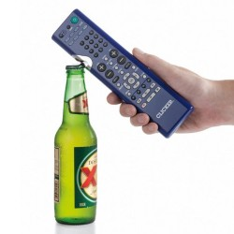
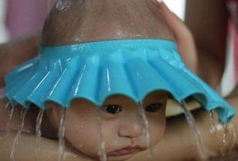
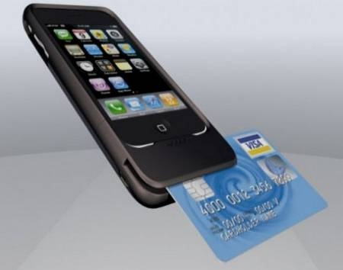
Gadget or visionary ?
Notes:
Hundreds (maybe thousands) of new products are invented daily. Some novelties, gadgets, limited value.
Some address a need that is part of a long term trend that could open a huge market........ the card reader telephone.
** What is that market ?: ( “mobile payment systems” )... now a huge competitive battleground for positioning
R&D departments: focus on trends, changing needs, trying to find a solution with a product/service/system
,What are examples of breakthrough products/services ? Electric light/electric network/ automobile, phone, radio, television, nuclear, transistor, silicon chip,personal computer,internet, GPS, smart phone/ pads
We are in the communication age begun in 1982; currently what is hot? (alternate energy)

Slide 74
Developing a New Product
• Analyze data, trends.. brainstorm
Considerations(reality check):
-valid concept
-feasibility of cost and
manufacture
-market demand (who,where,why)

Slide 75
Product Qualities
Uniqueness
Quality
Essential
Stylish
Ground breaking / “game changer”
Short-life gimmick
Reliable
Easy to use
Luxurious
Economical
Practical
Value for the money
Innovative

Slide 76
Ask first:
sector & competition
identity of brand- qualities
awareness level
mass or niche product
target identification
costs
pricing
promotion & PR
• launch & distribution method

Slide 77
Marketing challenges today
1: restarting business activity in this health and energy crisis
2. declining organic reach (as platforms shift more free exposure to paid adv)
3. building a brand name (with steady trust building-on & offline)
4. keeping content relevant and effective (linking to SEO performance)
5. understanding and interpreting data to make valid decisions
6. use of AI (in sentiment and predictive analysis)by the big media players
7. privacy laws (GDPR) are closing off access to personal data
8. personalising customer communications (conversational language)
9. combatting the Amazon effect
10. making full use of data (smaller players at a disadvantage)

Slide 78
Strategies post-coronavirus
While shoppers moved online during the pandemic, it has actually become cheaper for businesses to buy digital advertising, as demand has fallen.
Brands are likely to benefit from free ads on Google, which made product listings on its Google Shopping platform free last month, in a move designed to win e-commerce advertising business from Amazon.
(The coronavirus) is accelerating the catalyst for people to move from wholesale businesses to direct to consumer businesses and move from businesses that traditionally used a physical store model to adapting a multi-channel selling approach.
Direct-to-consumer (DTC) brands, those that sell to people through their own channels rather than via third-party retailers, have especially taken advantage of cheaper online media buys.

Slide 80
Product Development Puzzle
1 Develop the actual product, create logo, packaging or style
2 Analyzing market test and calculating market potential for the product
3 Determine marketing distribution strategy 4 Final adjusted business model
5 Set a customer service strategy 6 Launch product
7 Determine media mix for advertising and promotion 8 Careful real market testing
9 Research and develop the product concept 10 Product launch strategy
11 Marketing cost calculation and anticipated ROI
12 Preliminary business model 13 Analyze data, trends.. brainstorm..idea creation
14 Deposit profits in an offshore in Panama 15 Determine the pricing
16 Seeking investment partners 17 Test final concept with colleagues and potential consumers
18 Developing a model for tracking marketing and sales activity
19 Getting initial development financing 20 Cost analysis before doing the prototype stage

Slide 81
New Product Development
•13 Analyze data, trends.. brainstorm... idea creation
•9 Research and develop the product concept
•17Test final concept with colleagues and potential consumers
•20 Cost analysis before doing the prototype stage
•12 Preliminary business model
•19 Getting initial development financing
•1 Develop the actual product, create logo, packaging or style
•15 Determine the pricing
•11 Marketing cost projection and anticipated ROI
•8 Careful real market testing
•2 Analyzing market test and calculating market potential for the product
•4 Final adjusted business model
•16 Seeking investment partners
•3 Determine marketing distribution strategy
•7 Determine media mix for advertising and promotion
•18 Developing a model for tracking marketing and sales activity
•10 Finalize launch strategy
•5 Set a customer service strategy
•6 Launch product
•14 Deposit profits in an offshore account in Panama

