Slide 1

Acute Liver Failure
&
Acute-on-Chronic Liver Failure
Alessio Gerussi MD, PhD

Slide 2
Summary
Acute liver failure
  Definition
  Epidemiology
  Presentation and Diagnosis
Acute-on-chronic liver failure
  Definition
  Epidemiology
  Presentation and Diagnosis

Slide 3
Summary
Acute liver failure
  Definition
  Epidemiology
  Presentation and Diagnosis
Acute-on-chronic liver failure
  Definition
  Epidemiology
  Presentation and Diagnosis

Slide 4
Definition of Acute Liver Failure
International normalized ratio (INR) ≥ 1.5
Neurologic dysfunction with any degree of hepatic encephalopathy
No prior evidence of liver disease
Disease course of ≤ 26 weeks

Slide 5
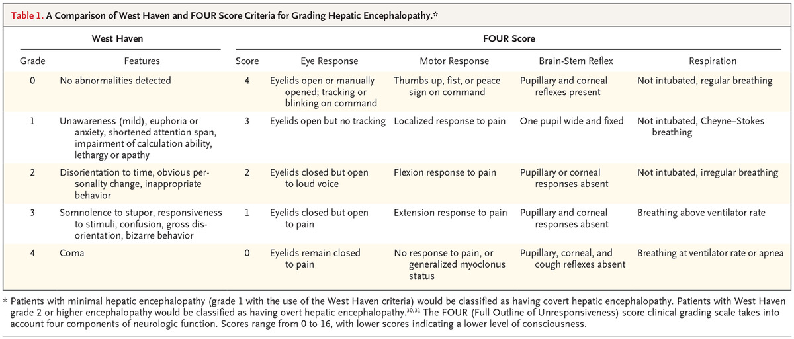

Slide 6
Notes:
﻿The original term “fulminant hepatic failure,” defined as “a severe liver injury, po- tentially reversible in nature and with onset of hepatic encephalopathy within 8 weeks of the first symptoms in the absence of pre-existing liver disease,”6 remains relevant today. More modern definitions recognize distinct disease phenotypes and quantify the interval between the onset of symptoms and the development of en- cephalopathy7
﻿In hyperacute cases, this interval is a week or less, and the cause is usually acetaminophen toxic- ity or a viral infection. More slowly evolving, or subacute, cases may be confused with chronic liver disease and often result from idiosyncratic drug-induced liver injury or are indeterminate in cause. Patients with subacute causes, despite having less marked coagulopathy and encephalopathy, have a consistently worse outcome with medical care alone than those in whom the illness has a more rapid onset

Slide 7
Notes:
﻿Acute liver failure is much less common in the developed world than in the develop- ing world, where viral infections (hepatitis A, B, and E) are the predominant causes. Public health measures (e.g., vaccination and improved sanitation) are among the factors resulting in the reduced incidence of these infections in the United States and much of Western Europe, where drug-induced liver injury is the most common cause of acute liver failure
﻿Although acute liver failure after acetaminophen ingestion can occur after consumption of a single large dose, the risk of death is greatest with substantial drug ingestion staggered over hours or days rather than at a single time point. Acute liver failure is more common with late presentation to medical attention because of un- intentional rather than deliberate self-poisoning.18 Malnourished patients and patients with alco- holism are at increased risk.19 Acetaminophen is also a potential cofactor for hepatic injury in patients taking the drug for the relief of symp- toms from hepatic illness of other causes.20,21 Idiosyncratic drug-induced liver injury is rare,
even among patients who are exposed to poten- tially hepatotoxic medication, and few patients with drug-induced liver injury have progression to encephalopathy and acute liver failure.22 Fac- tors such as an older age, increased elevations in blood aminotransferase and bilirubin levels, and coagulopathy are associated with an increased risk of death

Slide 8
Notes:
﻿The clinical presentation usually includes hepatic dysfunction, abnormal liver biochemical values, and coagulopathy; encephalopathy may develop, with mul- tiorgan failure and death occurring in up to half the cases (Fig.

Slide 9
Notes:
A detailed history, including a careful review of possible exposure to viruses, drugs, or toxins, may help uncover a possible cause of liver failure. Clinicians must inquire about over the counter medica- tions, alternative therapies, herbs, and supplements. If the patient is encephalopathic, a collateral history from friends or family is impor- tant, as identifying a cause can be paramount in the management of ALF as specific therapies may be applicable such as NAC, steroids for autoimmune hepatitis, and early antiviral therapy for fulminant hepatitis B, herpes simplex virus, cytomegalovirus, or varicella zos- ter virus. In our center NAC is used in non-APAP ALF, however, the data supporting NAC has been tested with mixed results in ALF of non-APAP etiology. In the ALFSG trial, 173 patients with non- APAP ALF were randomized to receive a 72-h infusion of NAC or placebo. Although the secondary end point of the trial, transplant- free survival, was more common in NAC-treated than placebo- treated patients, the primary end point of overall survival was no significantly different between groups (6). Non-acetaminophen drug or toxin-induced liver injury accounts for 13% of cases (Table 2). Toxins may include Amanita phalloides (mushrooms), sea anem- one sting, or carbon tetrachloride. Acute hepatitis A and B account for 4 and 7% of ALF cases, respectively. The remainder of cases may be due to other viruses (herpes simplex virus, Epstein-Barr virus, cytomegalovirus), Wilson disease, Budd–Chiari syndrome, sinu- soidal obstruction syndrome, acute fatty liver of pregnancy, auto- immune hepatitis, malignant infiltration, or ischemia (4).

Slide 10
Notes:
When ordering laboratory testing for patients admitted with ALF, a standard protocol can facilitate a thorough evaluation (Table 3), since the initial lab survey is often extensive. Even if a diagnosis seems clear, evaluating for concomitant diseases such as viral hep- atitis or human immunodeficiency virus is important in a patient who may require a liver transplant. Serial measurements of liver enzymes, coagulation parameters (INR and factor V levels), arte- rial pH, and arterial lactate will help to prognosticate the extent of liver damage. Serial assessments of serum ammonia levels and mental status evaluation can guide neurological evaluation, assess for progression of HE and direct further intervention (e.g., head computed tomography, management of intracranial hyperten- sion). On presentation, very high transaminase levels (AST and ALT levels >1,000 U/l) may limit the differential diagnosis to a few possible etiologies: acute viral infection, acetaminophen-induced injury, shock liver, or autoimmune hepatitis. AST and ALT lev- els exceeding 3,500 U/l are highly correlated with acetaminophen poisoning. Whereas transaminase levels may be helpful initially, they may not add much information once the diagnosis of ALF is established. Transaminase levels that appear to be normaliz- ing in the face of a rising INR may indicate massive hepatocyte loss. Alternatively, normalizing liver enzymes may also indicate improving hepatic injury facilitated by removal of a toxic expo- sure, natural history of a virus, or a treatment response (e.g., auto- immune hepatitis, herpes simplex, and hepatitis B). A bilirubin level on presentation may bear prognostic significance in the context of drug-induced liver injury. Initial INR and creatinine also provide prognostic information

Slide 15
Summary
Acute liver failure
  Definition
  Epidemiology
  Presentation and Diagnosis
Acute-on-chronic liver failure
  Definition
  Epidemiology
  Presentation and Diagnosis

Slide 16
Definition of ACLF – CANONIC study
  acute decompensation of cirrhosis
  organ failure/s, defined by the chronic liver failure (CLIF)-SOFA score
  high 28-day mortality (>15%)
R. Moreau et al. Gastroenterology 2013 ; 144 : 1426-1437

Slide 17
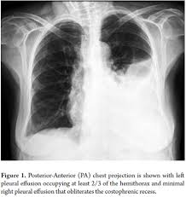

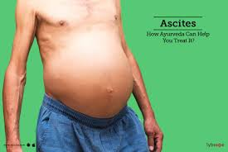


Decompensation of cirrhosis
HEPATIC HYDROTORAX
ACUTE KIDNEY INJURY
ASCITES
HEPATIC ENCEPHALOPATHY
SPONTANEOUS BACTERIAL PERITONITIS
GASTROINTESTINAL BLEEDING
HYPONATREMIA

Slide 18
Precipitating events of ACLF
 | No ACLF | ACLF All grade | ACLF grade 1 | ACLF grade 2 | ACLF grade 3
Precipitating event | 41.1 % | 56.4 % | 48.6 % | 60.0 % | 72.7 %
Potential precipitating event
Bacterial infections | 21.8 % | 32.6 %* | 29.9 % | 30.8 % | 44.7 %#
Active alcoholism within the last 3 months | 14.9 % | 24.5%* | 16.1 % | 28.6% | 40.4%#
Gastrointestinal bleeding | 17.3% | 13.2% | 10.1% | 13.0% | 23.4%
Others | 3.5% | 8.6%* | 8.5% | 9.6% | 6.7%#
More than 1 precipitating event | 5.7% | 13.5%* | 12.0% | 14.0% | 17.0%#
Legend: * = < 0.001 versus no ACLF ; # = p < 0.001 across ACLF grades
R. Moreau et al. Gastroenterology 2013 ; 144 : 1426-1437

Slide 19
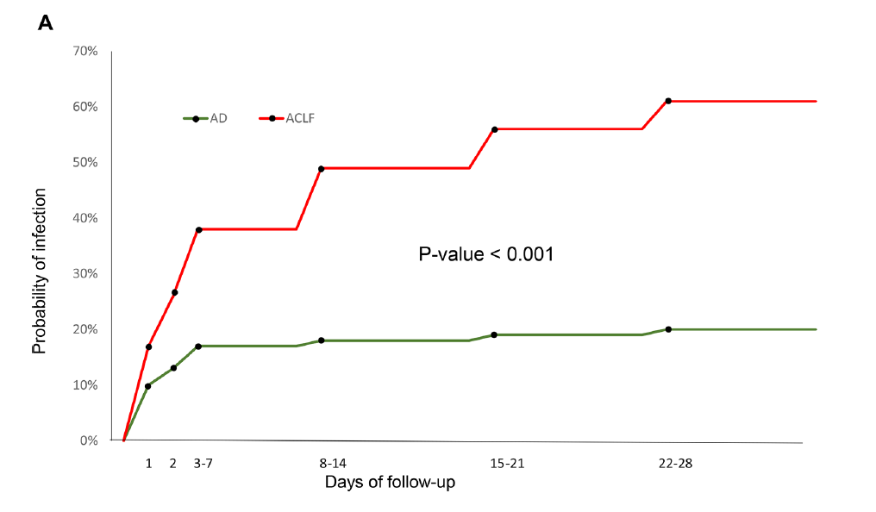
Incidence of bacterial infections within follow-up in patients with acute decompensation (AD) and with ACLF
J. Fernandez et al. Gut 2018 ; 67 : 1870-1880

Slide 20
Notes:
Sommando gli score ottieni il CLIF ORGAN FAILURE SCORE (CLIF OF SCORE) e ti fornisce il GRADE DI ACLF

Slide 21
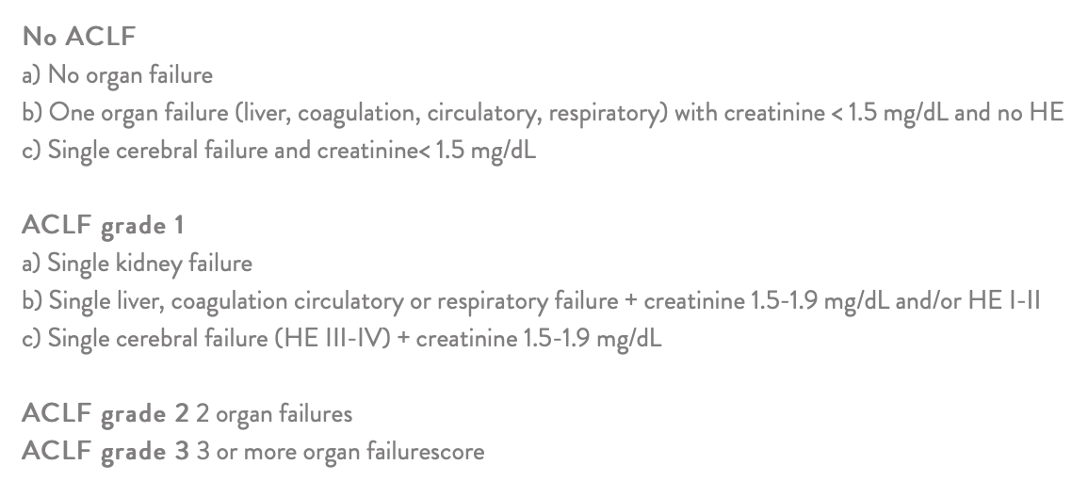

Slide 23
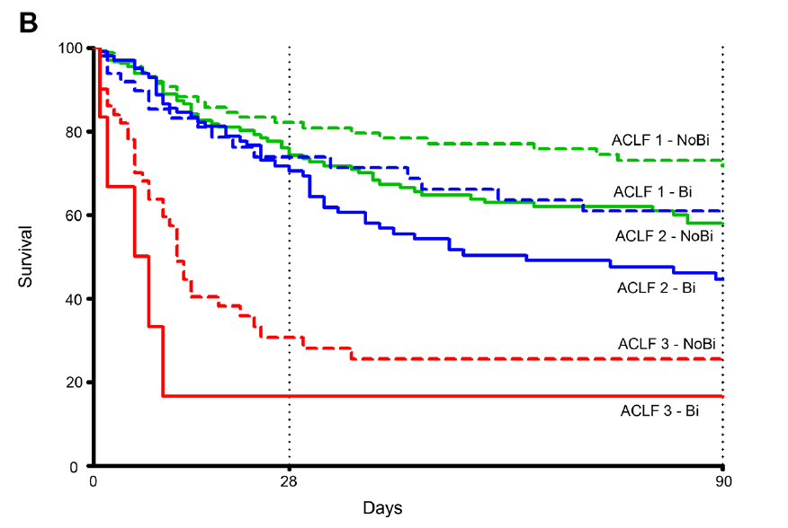
Acute on chronic liver failure
UIMH
2019
Survival in patients with ACLF with (Bi) and without (NoBi) bacterial infections
J. Fernandez et al. Gut 2018 ; 67 : 1870-1880

Slide 24
Acute on chronic liver failure
UIMH
2019
The Clif-C-ACLF score
Clif-C-ACLF score = 10 x [0.33 x Clif-Ofs + 0.04 x Age + 0.63 x Ln (WBC count) – 2]
The cumulative probability of death at time “t” can be estimate by the equation:
P = 1 – e ^{-Cl(t) x} ^{exp [β(t) x Clif-C-ACLF score]}
R. Jalan et al. J. Hepatol. 2014; 61 : 1038-1047

Slide 25
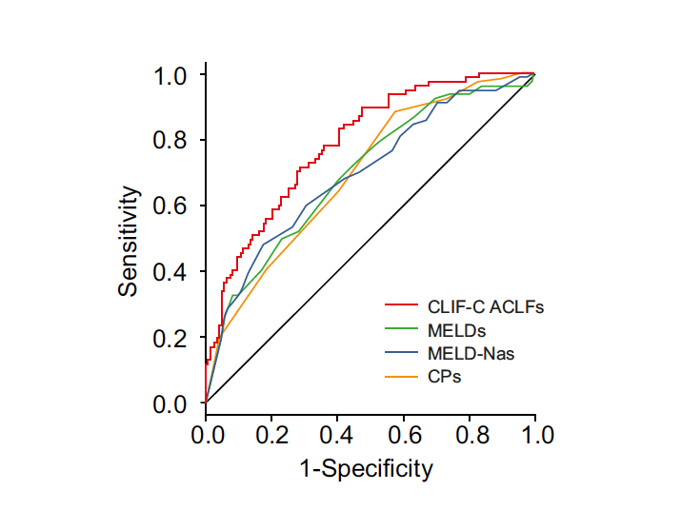
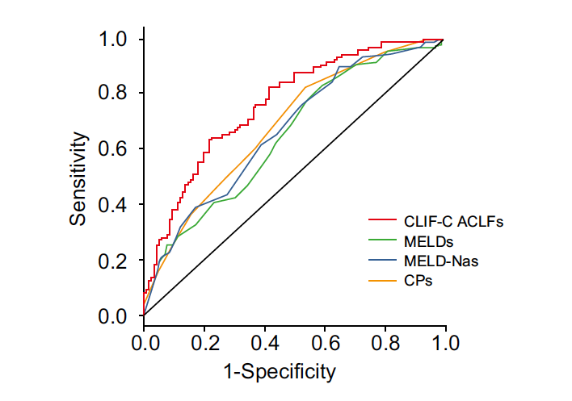
Acute on chronic liver failure
UIMH
2019
The accuracy of the Clif-C-ACLF score in predicting 28 day (left panel) or 90 day (right panel) mortality
R. Jalan et al. J. Hepatol. 2014; 61 : 1038-1047

Slide 26
Acute on chronic liver failure
UIMH
2019
Clinical course of patients with ACLF
Initial Grade | Final grade
 | No ACLF | ACLF-1 | ACLF-2 | ACLF 3
ACLF-1 (202) | 55% | 24% | 9% | 12%
ACLF-2 (136) | 34% | 14% | 25% | 25%
ACLF-3 (50) | 16% | 4% | 12% | 68%
T. Gustot et al. Hepatology 2015; 62 : 243-252

Slide 27
Notes:
CLIF-C AD (Acute Decompensation) score and expected mortality rates

Slide 29
Notes:
Acute‐on‐chronic liver failure (ACLF) can develop at any stage from compensated to decompensated cirrhosis, and can involve hepatic or extrahepatic precipNitaattuirnegReevveinetws.sA| DcoisnesaidserParbimleers proportion of patients have no identifiable triggering event. In this figure, paracentesis means ‘large volume paracentesis’ (>5 litres). Acute decompensation of cirrhosis defines the acute development of clinically evident ascites, hepatic encephalopathy, gastrointestinal haemorrhage or any combination of these in patients with or without prior history of these complications. Although bacterial infections are not specific complications of cirrhosis, they are considered as such in patients with prior history of ascites, haemorrhage or encephalopathy because of their high prevalence and their association with abnormalities related to cirrhosis, including bacterial translocation and impaired leukocyte function1–8. DILI, drug‐induced liver injury; TIPS, transjugular intrahepatic portosystemic shunt. Figure is adapted from an image provided courtesy of Jordi Bozzo, Avinguda de la Generalitat, Barcelona, Spain.

Slide 30


ACLF AND LIVER TRANSPLANT: FRIENDS OR FOES?

Slide 31
ACLF AND LIVER TRANSPLANT: FRIENDS OR FOES?
The «delisting dilemma»
Linecker, Journal of Hepatology , 2018

