Slide 1

NON-ALCOHOLIC
FATTY LIVER DISEASE
Dr. Alessio Gerussi

Slide 2
Definitions
NAFLD = non-alcoholic fatty liver disease
  NAFL = non-alcoholic fatty liver
    Steatosis alone
    Steatosis with inflammation without ballooning
    Steatosis with ballooning without inflammation
  NASH = non-alcoholic steatohepatitis
    Steatosis + Inflammation + Ballooning
EASL guidelines J Hepatol 2016

Slide 3
Epidemiology
NAFLD is the most common liver disorder in Western countries (25% of adults), and its prevalence is rising in Middle East and Asia
NAFLD is also present in 7% of normal-weight persons
The prevalence of NAFLD in children is 3-10%, up to 70% in those with obesity
NASH, the most severe form of NAFLD, has been estimated to be between 3 and 5% of adults
Mantovani et al Metabolism 2020

Slide 4
Diehl et al NEJM 2017

Slide 5
Epidemiology
>80% of patients with NASH and 51% with NAFLD are overweight or obese
72% of patients with NASH and 69% with NAFLD have dyslipidemia
44% of patients with NASH and 23% with NAFLD have type 2 diabetes mellitus
68% of patients with NASH and 39% with NAFLD have hypertension
NASH is the hepatic correlate of the Metabolic Syndrome
Diehl et al NEJM 2017

Slide 6
NAFLD – Metabolic syndrome
NAFLD is tightly associated with metabolic risk factors/components of Metabolic Syndrome:
Waist circumference ≥94/≥80 cm for Europeans men/women
Arterial pressure ≥130/85 mmHg or treated for hypertension
Fasting glucose ≥100 mg/dl (5.6 mmol/l) or treated for T2DM
Serum triacylglycerols > 150 mg/dl (> 1.7 mmol/L)
HDL cholesterol <40/50 mg/dl for men/women (<1.0/1.3 mmol/l)
EASL guidelines J Hepatol 2016

Slide 7
The prevalence of MetS in patients with NAFLD/NASH
MetS
42%
71%
NAFLD
NASH
Younoussi et al Hepatology 2016

Slide 8
Look for metabolic risk factors in patients with NAFLD
NAFLD
MET S
Look for NAFLD in patients with metabolic syndrome

Slide 9
A public health perspective
Obesity increases the risk of NAFLD
The prevalence of NAFLD is proportional to the increase in BMI
Worldwide overweight and obesity rates have nearly tripled since 1975
It is estimated that 13% of the world’s adult population is obese and 39% is overweight
The WHO has identified obesity as 1 of the 9 global non-communicable diseases that must be addressed
Younoussi J Hepatol 2019

Slide 10
A public health perspective
The prevalence of NAFLD in South America seems to be higher than that reported for the US
The prevalence of NAFLD in China has doubled in the past 20 years and it is increasing in Japan
In Europe the prevalence of NAFLD is around 24%
Similar rates have been reported in Australia and Middle East
Data from Africa are scarce
Younoussi J Hepatol 2019
Notes:
Australia (one of the country with the highest burden of obese individuals globally)

Slide 11
Age and sex
The prevalence of NAFLD increases in older individuals, probably due to a higher burden of metabolic conditions
Discrepancy regarding sex
  Some studies report a female predominance (Thailand, Sri Lanka)
  Others report a higher prevalence in men (US, China, Spain)
Younoussi J Hepatol 2019

Slide 12
Type 2 Diabetes and NAFLD
The WHO has estimated that world-wide deaths from diabetes will double by 2030
The presence of T2DM in patients with NAFLD:
  accelerates disease progression
  predicts advanced fibrosis and mortality
US-defined NAFLD is associated with a 2/5-fold risk of developing T2DM after adjustment for metabolic confounders
EASL guidelines J Hepatol 2016
Younoussi J Hepatol 2019

Slide 13
The prevalence of NAFLD in patients with T2DM is over 60%
NAFLD
TYPE 2 DIABETES
EASL guidelines J Hepatol 2016

Slide 14
The prevalence of T2DM in patients with NAFLD is around 23%
TYPE 2 DIABETES
NAFLD

Slide 15
Lean NAFLD
Patients with NAFLD and BMI in the «normal» range
Prevalence in the US: 7%
While in the past lean NAFLD was considered a less severe form of NAFLD, there is a growing evidence that these patients have metabolic abnormalities compared to people not obese or without NAFLD

Slide 16
Metabolic abnormalities in lean NAFLD/NASH
All components of metabolic syndrome correlate with liver fat independently of BMI
  -> The presence of metabolic syndrome should lead to screen for NAFLD
Storage of hepatic tryglycerides is associated with impaired insulin-mediated suppression of hepatic glucose production
In non-diabetic individuals HOMA-IR index can serve as surrogate for insuline resistance
HOMA-IR:
Fasting glucose (mmol/L) + insulin (mU/ml)
22.5
EASL guidelines J Hepatol 2016

Slide 17
Lean NAFLD
Patients with NAFLD and BMI in the «normal» range
  Prevalence in the US: 7%
While in the past lean NAFLD was considered a less severe form of NAFLD, there is a growing evidence that these patients have metabolic abnormalities compared to people not obese or without NAFLD
Moreover, in the group «lean NAFLD» there is high heterogeneity

Slide 18
Lean NAFLD – possible etiologies
Congenital lipodystrophy
Acquired lipodystrophy (HIV treatment)
Congenital defects of metabolism (lysosomal acid lipase deficiency)
Endocrine disorders
  Polycystic ovarian syndrome
  Hypothyroidism
  GH deficiency
Drug use (amiodarone, methotrexate, tamoxifen)
Jejunoileal bypass
Starvation
Total parental nutrition
Notes:
Congenital lipodystrophy: rare autosomal recessive disorder which manifests with insulin resistance, absence of subcutaneous fat and muscular hypertrophy

Slide 19
Who should be screened for NAFLD?
OBESITY
METABOLIC SYNDROME
TYPE 2 DIABETES
SCREENING
Bugianesi et al J Hepatol 2016

Slide 20
Screening
Preferentially by ultrasound
  Limited sensitivity (only for liver fat >5-25%)
  Accuracy is reduced in obese patients
  Nevertheless, endorsed as the first-choice imaging in adults at risk for NAFLD
Abnormal liver enzymes are poor indicators since most patients (80%) have normal ALT values according to the current range
Bugianesi et al J Hepatol 2016
EASL guidelines J Hepatol 2016

Slide 21
Diagnosis
The diagnosis of NAFLD requires the exclusion of:
  Daily alcohol consumption ﻿﻿≥ 30 gr for men and ≥20 gr for women
  Secondary causes:
EASL guidelines J Hepatol 2016

Slide 22
Comprehensive evaluation of suspected NAFLD patients
Alcohol intake
Personal and family history of diabetes, hypertension, CVD
BMI, waist circumference, change in body weight
Hepatitis B/Hepatitis C virus infection
History of steatosis-associated drugs
AST, ALT, GGT, ALP
Fasting blood glucose, HbA1c, OGTT (fasting insuling -> HOMA-IR)
Complete blood count
Serum total and HDL cholesterol, tryglicerydes, uric acid
Ultrasonography
EASL guidelines J Hepatol 2016

Slide 23
Extended evaluation (based on clinical judgement)
Ferritin and transferrin saturation
Tests for coeliac and thyroid diseases, polycystic ovary syndrome
Tests for rare liver diseases
  Wilson
  Autoimmune liver diseases
  Alpha1-antitrypsin deficiency
EASL guidelines J Hepatol 2016
Notes:
Persistently high serum ferritin, increased iron saturation, in the context of homozygote or heterozygote C282y HFE mutation consider iron overload
Autoimmune liver disease if high serum titers of autoab plus high globulins

Slide 24
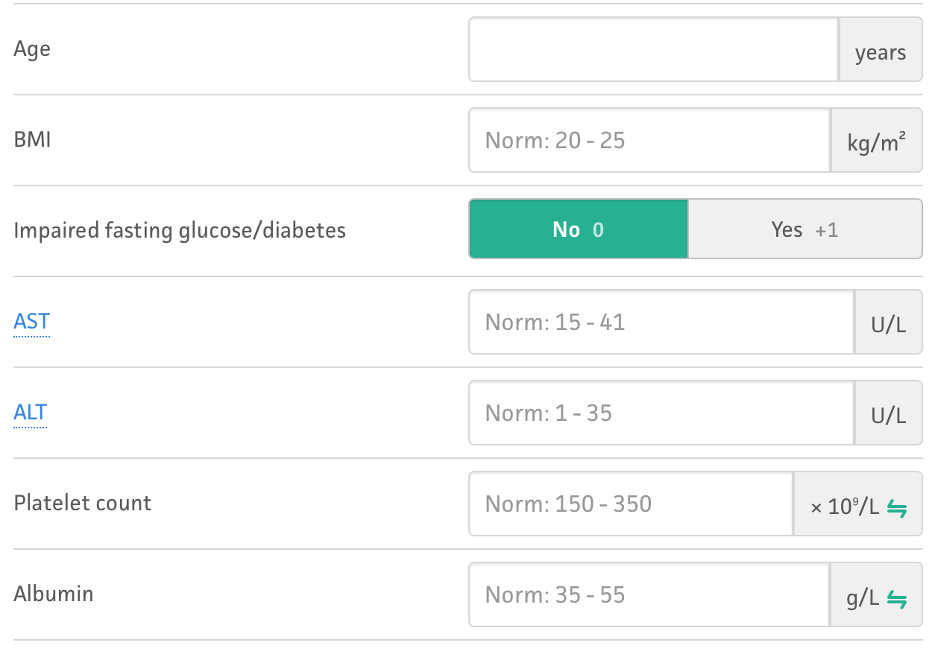
Screening for liver fibrosis
Fibrosis is the major risk factor for progression to advanced disease
Available tools:
  Simple:
    NAFLD fibrosis score (NFS)
    FIB-4
  Complex:
    ELF, Fibrotest, Fibrometer
  Fibroscan
Bugianesi et al J Hepatol 2016

Slide 25
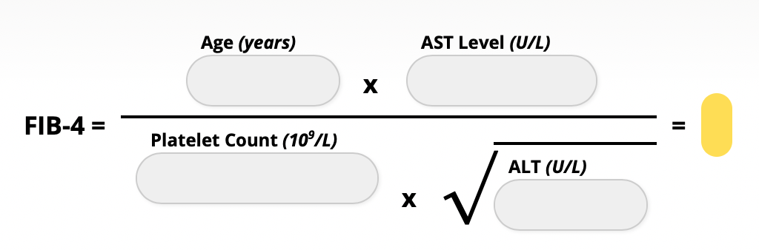
Screening for liver fibrosis
Fibrosis is the major risk factor for progression to advanced disease
Available tools:
  Simple:
    NAFLD fibrosis score (NFS)
    FIB-4
  Complex:
    ELF, Fibrotest, Fibrometer
  Fibroscan
Bugianesi et al J Hepatol 2016

Slide 26
Liver biopsy
Specialist referral and liver biopsy are required in case of suspect of severe fibrosis from non-invasive biomarkers
Liver biopsy is strongly advisable in the setting of clinical trials and when non-invasive evaluation brings contradictory information
Goal: to diagnose NASH and advance fibrosis
Bugianesi et al J Hepatol 2016

Slide 27
Histological features - grading
The NAFLD Activity Score (NAS) includes:
Severity of steatosis (0-3)
Hepatocellular ballooning (0-2)
Lobular inflammation (0-3)
NAS score is the unweighted sum of these three numbers (0-8)
Younoussi et al Hepatology 2017

Slide 28
Histological features - staging
Fibrosis is not part of the NAS score because fibrosis is a sign of the stage of disease rather than a grade of injury
4 stages:
Notes:
Stages of fibrosis in NAFLD according to the NASH CRN staging system (Masson trichrome stains). Collagen is blue with this method.
Stage 1 (left): centrilobular perisinusoidal fibrosis. Blue stained collagen fibers outline the sinusoids surrounding the cen- tral vein in the center of the field.
Stage 2 (left middle): centrilobular perisinusoidal fibrosis and periportal fibrosis. Delicate collagen fibers are deposited around the sinusoids in the upper part of the field while denser collagen expands the portal tract in the lower part of the field.
Stage 3 (right middle): bridging fibrosis. A vascularized septum of fibrous tissue transects the hepatic parenchyma.
Stage 4 (right): cirrhosis. Nodules of hepatocytes are surrounded by variable-size fibrous septa.

Slide 29
Metabolic risk factors present
Ultrasound and Liver enzymes
Steatosis present
Steatosis absent
Normal liver enzymes
Abnormal liver enzymes
Normal liver enzymes
Serum fibrosis markers
Low risk
High risk
Follow up 2 years with
liver enzymes/fibrosis biomarkers
Specialist referral
Follow up 3-5 years with
liver enzymes/ultrasound
EASL guidelines J Hepatol 2016

Slide 30
LOW RISK
Vs
HIGH RISK
Castera L et al Gastro 2019

Slide 31
Natural history
NAFLD is a slowly progressive disease, while 40% of patients with NASH will progress to advanced stages of fibrosis
Fibrosis increases of 1 stage every
  14 years in NAFLD
  7 years in NASH
NASH is associated with increased standardized mortality ratio compared to general population, while NAFLD is not.
Causes of death:
  Cardiovascular disease
  Cancer
  Liver disease
EASL guidelines J Hepatol 2016

Slide 32
Cardiovascular disease
Cardiovascular disease is more frequent in terms of incidence and prevalence in NAFLD than in matched controls
  A recent paper (Alexander et al BMJ 2019) seems to challenge this concept
This association is driven by MetS components
Cardiovascular disease should be identified in NAFLD
NAFLD screening should be performed in patients at high CVD risk
EASL guidelines J Hepatol 2016

Slide 33
Hepatocellular carcinoma
Area of research
There is evidence that HCC can arise also in non-cirrhotic NAFLD liver
However, due to the large number of NAFLD cases at risk for HCC systematic surveillance is impracticable
EASL guidelines J Hepatol 2016

Slide 34
Treatment
To target the root cause of energy surplus and excess adiposity
To target specific anti-inflammatory and antifibrotic therapies

Slide 35
Treatment: diet and lifestyle changes
Healthy diet and physical activity are mandatory in all patients
Patients without NASH or fibrosis should receive counselling for healthy diet and physical activity but no pharmacotherapy
In overweight/obese NAFLD, a 7–10% weight loss is the target of most lifestyle interventions, and results in improvement of liver enzymes and histology
EASL guidelines J Hepatol 2016
Notes:
IR, insulin resistance; NASH, non-alcoholic steatohepatitis

Slide 36
Dietary recommendations
  Weight loss can be achieved by dietary energy (caloric) restriction
    500 kcal/d below
  Exclusion of NAFLD-promoting components
    processed food
    food and beverages high in added fructose
  The macronutrient composition should be adjusted according to the Mediterranean diet
EASL guidelines J Hepatol 2016
Notes:
IR, insulin resistance; NASH, non-alcoholic steatohepatitis

Slide 37
Exercise
Both aerobic exercise and resistance training effectively reduce liver fat
30 min/d for at least 5 days in a week
The choice of training should be tailored based on patients’ preferences to be maintained in the long-term
EASL guidelines J Hepatol 2016
Notes:
IR, insulin resistance; NASH, non-alcoholic steatohepatitis

Slide 38
Outcomes
Even when patients do achieve weight loss most return to their baseline weight within 3/5 years
A holistic lifestyle intervention plan is recommended
EASL guidelines J Hepatol 2016
Notes:
IR, insulin resistance; NASH, non-alcoholic steatohepatitis

Slide 39
Components of a lifestyle approach to NAFLD
Energy restriction
Calorie restriction (500−1,000/day)
7−10% weight loss target
Long-term maintenance approach
Fructose intake
Avoid fructose-containing
food and drink
Daily alcohol intake
Strictly below 30 g men
and 20 g women
Coffee consumption
No liver-related limitations
Comprehensive
lifestyle approach
Macronutrient composition
Low-to-moderate fat
Moderate-to-high carbohydrate
Low-carbohydrate ketogenic diets or high protein
Physical activity
150−200 min/week moderate intensity
in 3−5 sessions
Resistance training to promote
musculoskeletal fitness and improve
metabolic factors
EASL guidelines J Hepatol 2016

Slide 40
Pharmacotherapy: who should be considered?
  Progressive NASH
  Early-stage NASH with risk of fibrosis progression:
    Age > 50 years
    diabetes
    MetS,
    increased ALT
  Active NASH with high necroinflammatory activity
No drugs are approved for NASH
No specific therapy can be recommended
Any drug treatment is off label
EASL guidelines J Hepatol 2016
Notes:
IR, insulin resistance; NASH, non-alcoholic steatohepatitis

Slide 41
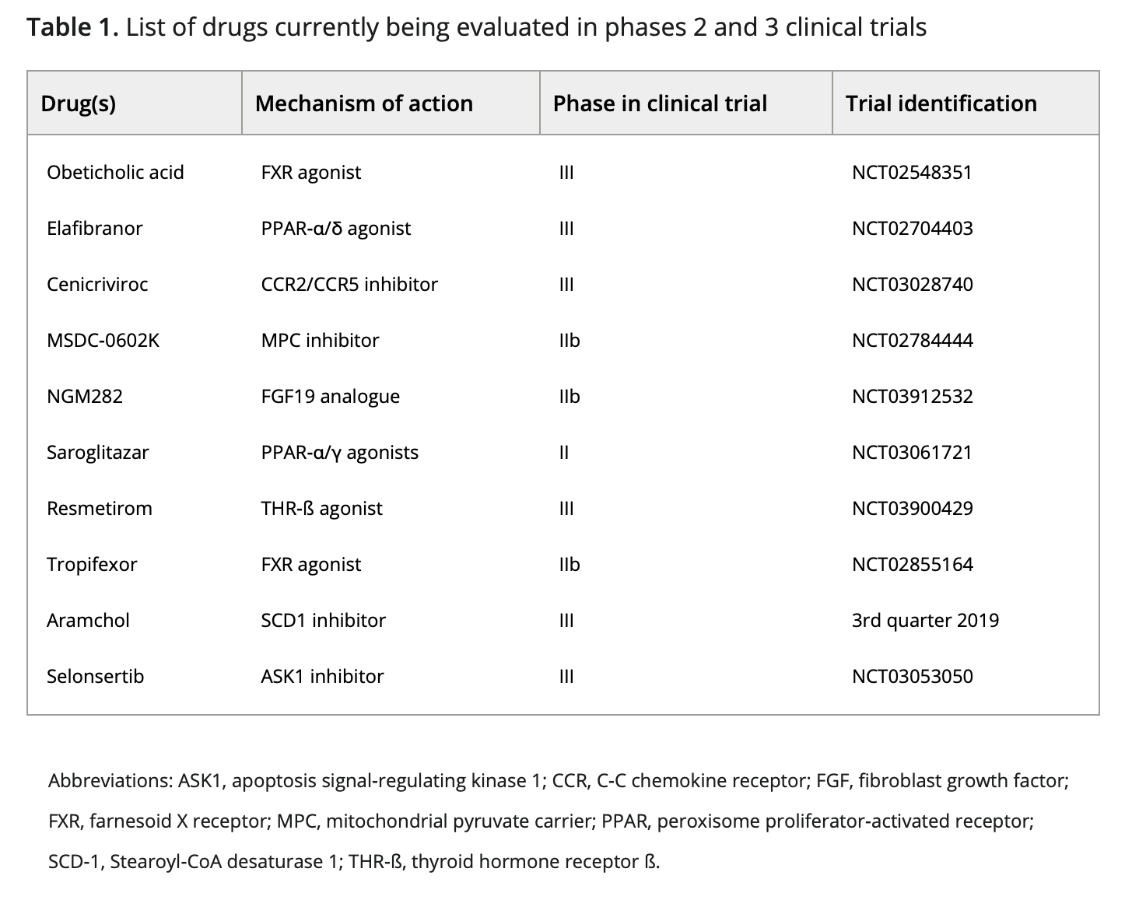
Drugs
Cardoso et al Liver Int 2020

