Slide 1
Diagnostic test tutorial

Slide 2
Exercise 1:
If a person is infected with SARS-CoV-2, the probability that the molecular test (nasopharyngeal swab) gives a positive result is 98%, if it is not infected the same probability drops to about 1%. In quarantine persons, the percentage of infected (e.g. 10 days after diagnosis for SARS-Cov-2) is 50%.
a) What is the probability of not being infected having a negative swab result?
b) If the first swab is negative, what is the probability of not being infected with a second negative swab?
Notes:
Raz matematico/stat di quella che era la richiesta di avere due tamponi negativi per uscire dalla quarantena dopo infezione con Sars-Cov-2, che non è più in vigore

Slide 3
Exercise 1:
If a person is infected with SARS-CoV-2, the probability that the molecular test (nasopharyngeal swab) gives a positive result is 98%, if it is not infected the same probability drops to about 1%. In quarantine persons, the percentage of infected (e.g. 10 days after diagnosis for SARS-Cov-2) is 50%.
a) What is the probability of not being infected having a negative swab result?
b) If the first swab is negative, what is the probability of not being infected with a second negative swab?
$$Sensitivity=P\left(T+\right|M+)=0.98$$

Slide 4
Exercise 1:
If a person is infected with SARS-CoV-2, the probability that the molecular test (nasopharyngeal swab) gives a positive result is 98%, if it is not infected the same probability drops to about 1%. In quarantine persons, the percentage of infected (e.g. 10 days after diagnosis for SARS-Cov-2) is 50%.
a) What is the probability of not being infected having a negative swab result?
b) If the first swab is negative, what is the probability of not being infected with a second negative swab?
$$Sensitivity=P\left(T+\right|M+)=0.98$$
$$Specificity=P\left(T−\right|M−)=1−0.01=0.99$$

Slide 5
Exercise 1:
If a person is infected with SARS-CoV-2, the probability that the molecular test (nasopharyngeal swab) gives a positive result is 98%, if it is not infected the same probability drops to about 1%. In quarantine persons, the percentage of infected (e.g. 10 days after diagnosis for SARS-Cov-2) is 50%.
a) What is the probability of not being infected having a negative swab result?
b) If the first swab is negative, what is the probability of not being infected with a second negative swab?
$$Sensitivity=P\left(T+\right|M+)=0.98$$
$$Specificity=P\left(T−\right|M−)=1−0.01=0.99$$
$Prevalence=P(M+)=0.$5

Slide 6
Exercise 1:
a) What is the probability of not being infected having a negative swab result?
P${(M}^{−}|T^{−}$)=$\frac{P(M^{−}∩T^{−})}{P\left(M^{−}∩T^{−}\right)+P(M^{+}∩T^{−})}=$
=$\frac{P\left(M^{−}\right)P(T^{−}|M^{−})}{P\left(M^{−}\right)P(T^{−}|M^{−})+P\left(M^{+}\right)P(T^{−}|M^{+})}=$
$$Sensitivity=P\left(T+\right|M+)=0.98$$
$$Specificity=P\left(T−\right|M−)=1−0.01=0.99$$
$Prevalence=P(M+)=0.$5
$$=\frac{0.5∙0.99}{0.5∙0.99+0.5∙0.02}=0.98$$

Slide 7
Exercise 1:
a) What is the probability of not being infected having a negative swab result?
$$Sensitivity=P\left(T+\right|M+)=0.98$$
$$Specificity=P\left(T−\right|M−)=1−0.01=0.99$$
$Prevalence=P(M+)=0.$5
 | M⁺ | M⁻ | Totale
T⁺ | 490 | 5 | 495
T⁻ | 10 | 495 | 505
Total | 500 | 500 | 1000
P${(M}^{−}|T^{−}$)=495/505=0.98
2% SARS-CoV-2 +!
Notes:
What if prevance would rise?

Slide 8
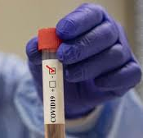
Exercise 1: double negative swab
b) If the first swab is negative, what is the probability of not being infected with a second negative swab?
$$Sensitivity=P\left(T+\right|M+)=0.98$$
$$Specificity=P\left(T−\right|M−)=0.99$$
$Prevalence=P(M+)=0.$5
P${(M}^{+}|T_{1}^{−}$)=0.02
 | M⁺ | M⁻ | Totale
T⁺ | 19.8 | 10 | 39.8
T⁻ | 0.2 | 970 | 970.2
Total | 20 | 980 | 1000
$P\left(M^{−} | T_{1}^{−},T_{2}^{−}\right)$=970/970.2=0.9999~1

Slide 9
Exercise 1: double negative swab
b) If the first swab is negative, what is the probability of not being infected with a second negative swab?
$$Sensitivity=P\left(T+\right|M+)=0.98$$
$$Specificity=P\left(T−\right|M−)=0.99$$
$Prevalence=P(M+)=0.$5
P${(M}^{+}|T_{1}^{−}$)=0.02
$$P\left(M^{−} | T_{1}^{−},T_{2}^{−}\right)=\frac{P\left(M^{−}\right)P\left(T^{−} | M^{−}\right)}{P\left(M^{−}\right)P\left(T^{−} | M^{−}\right)+P\left(M^{+}\right)P\left(T^{−} | M^{+}\right)}=$$
=$\frac{0.98∙0.99}{0.98∙0.99+0.02∙0.02}=0.999$

Slide 11
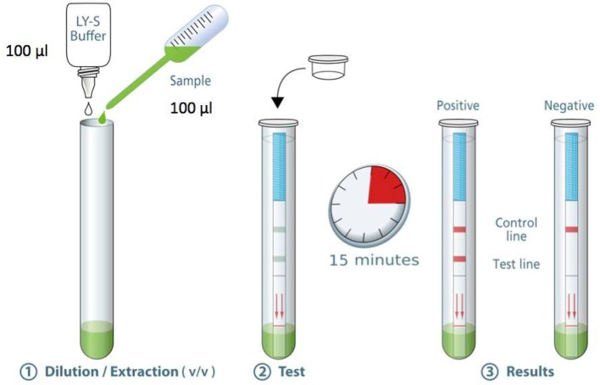

Slide 12
Out of 100 patients with a positive test result, how many will actually NOT be infected with Sars-CoV-2?
100*(1-0.987)=~1.3
Out of 100 patients with a negative test result, how many will actually be infected with Sars-CoV-2?
100*(1-0.777)=~22.3
Notes:
Threshold cycle

Slide 13
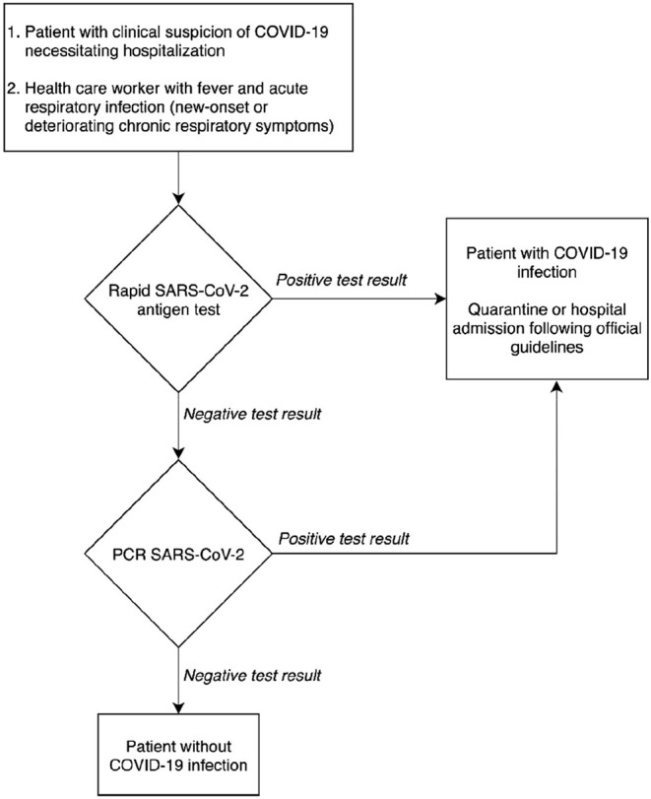
Figure 2 : Proposal for a diagnostic decision algorithm.

