Slide 1
Secondary Metabolites from Plant Sources

Slide 2
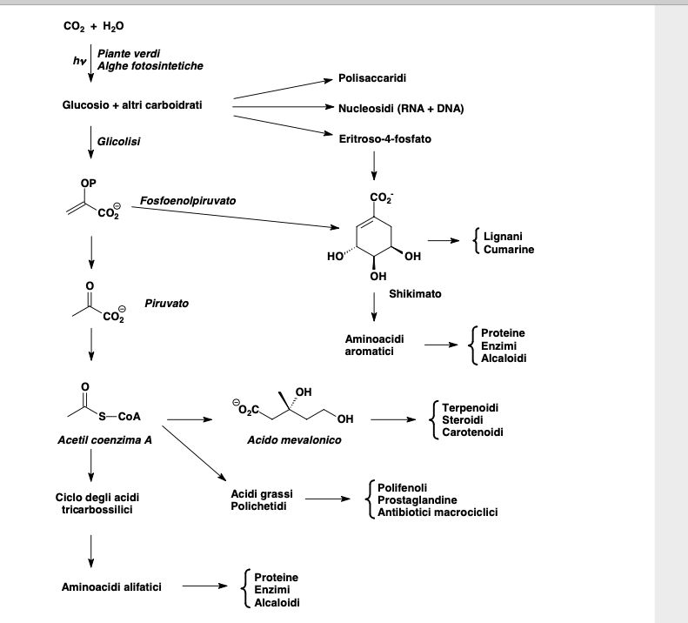

Slide 3
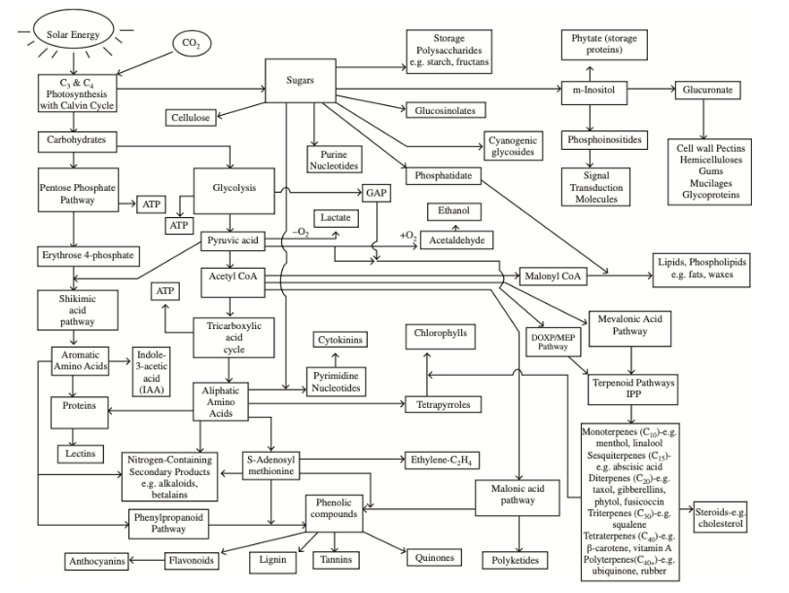

Slide 4
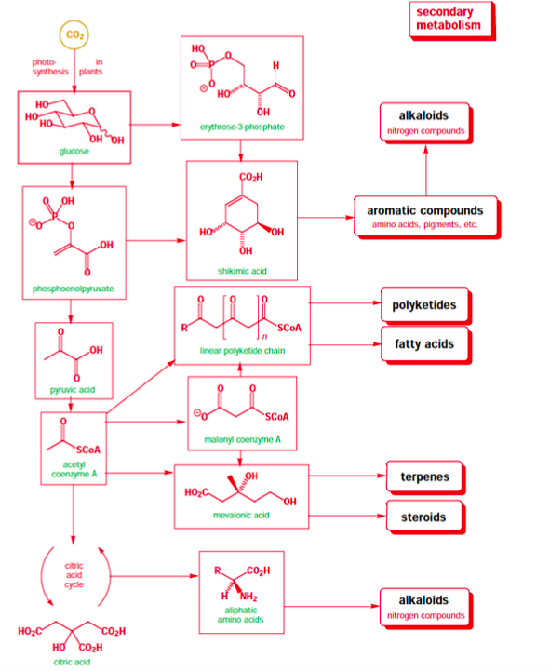
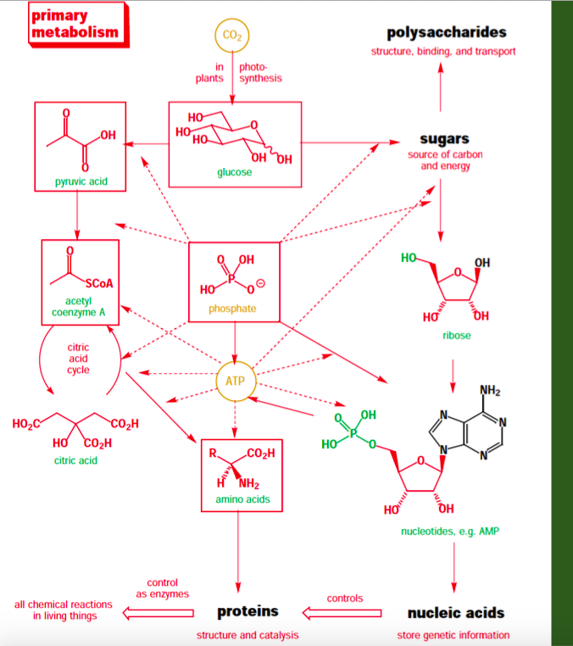
erytrose 4-phosphate

Slide 5
Solar energy
CO₂
CELLULOSE
C3-C4 photosynthesis with Calvin Cycle
SUGARS
GLUCOSINOLATES
Carbohydrates
GLYCOLYSIS
MALONYL-CoA
LIPIDS, PHOSPHOLIPIDS, FATS, WAXES
PENTOSE PHOSPHATE P.
ERYTROSE 4-PHOSPHATE
PHOSPHOENOLPYRUVATE
ACETYL-CoA
MEVALONIC ACID P.
SHIKIMIC ACID P.
TCA
DOXP/MEP
PATHWAY
TERPENOID
PATHWAY
IPP
AROMTIC AA
ALIPHATIC AA
MO-SESQUI-DI-TRI-TETRA-POLY
TERPENES
NITROGEN-CONTAINING SECONDARY PRODUCTS (e.g. ALKALOIDS)
ANTHOCYANINS
FLAVONOIDS
LIGNIN
TANNINS
QUINONES
PHENYLPROPANOID P.
PHENOLIC COMPOUNDS

Slide 6
Common to plants, microbes, and mammals are the pentose phosphate pathway, glycolysis, and the tricarboxylic acid (TCA) cycle that are concerned with aerobic respiration and adenosine triphosphate (ATP) biosynthesis — the key energy molecule of the cell.
In plants: the carbon reduction cycle in photosynthesis and the shikimic acid pathway.
The majority of all essential products are made from sugars, acetyl CoA (coenzyme A), or amino acids.
Secondary metabolites: terpenoids, nitrogen-containing compounds, and phenolic compounds have not any impact on the growth and development of the plant.

Slide 7
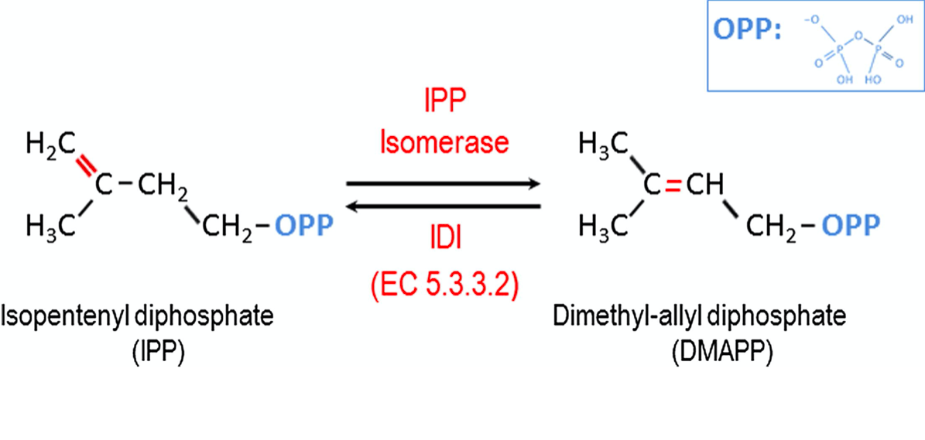
The main precursor molecule that leads to synthesis of terpenoids is IPP, isopentenyl diphosphate
There are two pathways that lead to the synthesis of IPP: (1) in the cytosol, IPP is formed from pyruvic acid via acetyl-CoA and mevalonic acid; (2) in plastids, it is synthesized from pyruvic acid and glyceraldehyde-3-phosphate (GAP) via 1-deoxy-D-xylulose-5-phosphate (DOXP) and 2-C-methyl-D-erythritol-4-phosphate (MEP).
IDI, isopentenyl diphosphate isomerase

Slide 8
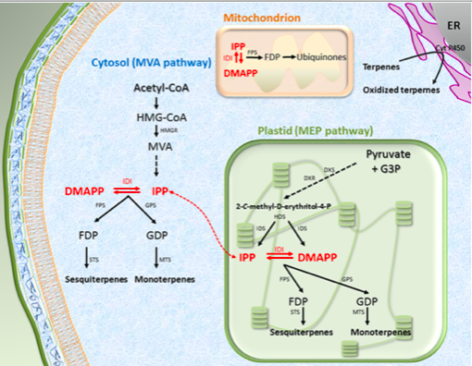
Biosynthesis of IPP
The mevalonic acid (MVA) pathway
The non-mevalonate pathway also called methyl-erythritol-phosphate (MEP) pathway
MVA pathway: 3 acetyl-CoA are converted to IPP, via HMG-CoA (hydroxymethylglutaryl-CoA) and mevalonic acid intermediates
MEP pathway (plastids): condensation of pyruvate and G3P, production of 1-deoxy-D-xylulose-5-phosphate, which is reduced to 2-C-methyl-D-erythritol-4-phosphate before to be converted simultaneously to both IPP and DMAPP.
doi:10.1016/j.biochi.2012.03.021

Slide 9
Biosynthesis of IPP
The last enzyme of the pathway is an hydroxymethylbutenyl diphosphate reductase also called iso-pentenyl diphosphate:dimethylallyl diphosphate synthase (IDS)
IDS produces IPP/DMAPP
doi:10.1016/j.biochi.2012.03.021

Slide 10
Terpenes can be classified according to their basic structure and function
These polymers are of different sizes, ranging from the C5 basic units (hemiterpenes) to high molar mass polymers such as natural rubber made of thousands C5 units
The enzyme controlling the availability and isomerization of both universal units IPP and DMAPP is the iso- pentenyl diphosphate isomerase, also called IDI
IPP isomerase (EC 5.3.3.2) catalyzes the crucial conversion of IPP into DMAPP, in an Mg-dependent and reversible isomerization process
doi:10.1016/j.biochi.2012.03.021

Slide 11
More than 65,000 terpenes are produced by Nature.
These molecules represent the oldest and the largest class of small biomolecules, constituting the so-called “terpenome”.
They perform a large variety of functions and properties in all living organisms, making them an incredible resource of natural products.
They are widely represented in plants, where they act as insecticides, pesticides, pollinator attractors, hormones, flavors, pigments, etc.
Their features make isoprenoids very attractive for applications in food, and cosmetics (for example as essential oils), and chemical, pharmaceutical and rubber industries.
Terpenes produced in the terpenoid pathway serve a huge variety of functions in photosynthesis, hormone-controlled development (gibberellin and abscisic acid), and flower coloration and scent to name a few. For humans, they are a source for rubber, essential oils (perfumes), and medicinal drugs such as Taxol® (an anticancer drug).

Slide 13
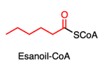
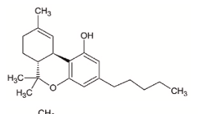
Fatty acids, polifunctional molecules
Unità C₆ di esanoato: unità starter nella formazione dei cannabinoidi
Cannabinoidi un gruppo di terpeni fenolici isolati dalla Canapa indiana (Cannabis sativa).
Il principale componente psicoattivo è il Tetraidrocannabinolo (THC)
Tetraidrocannabinolo (THC)

Slide 14
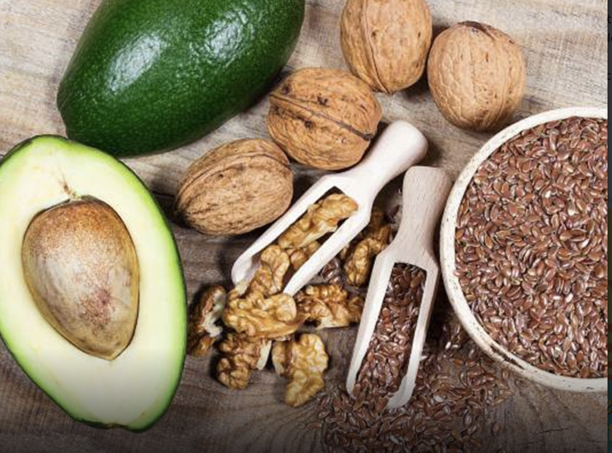
Fatty acids, polifunctional molecules

Slide 15
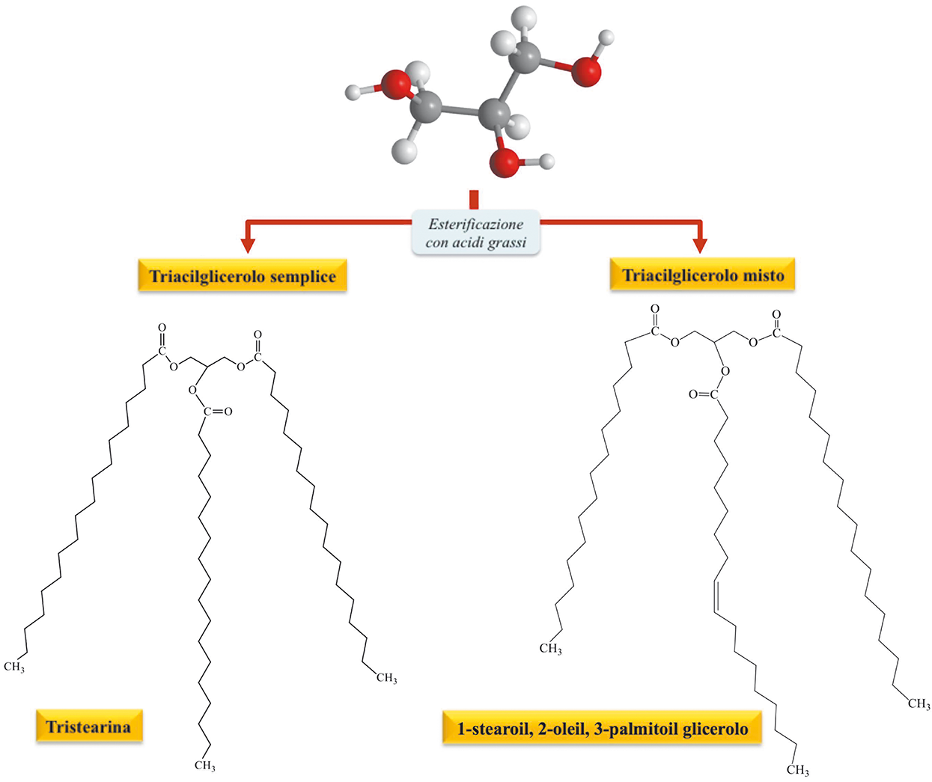
Lipds are classified in simple and complex lipids:
Simple lipids: triacilglycerols, steroids and waxes;
Complex lipids: phospholipids and glycolipids
Triacilglycerol are more than 90% of total lipids

Slide 16
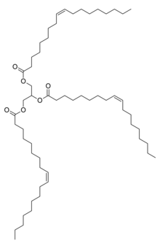
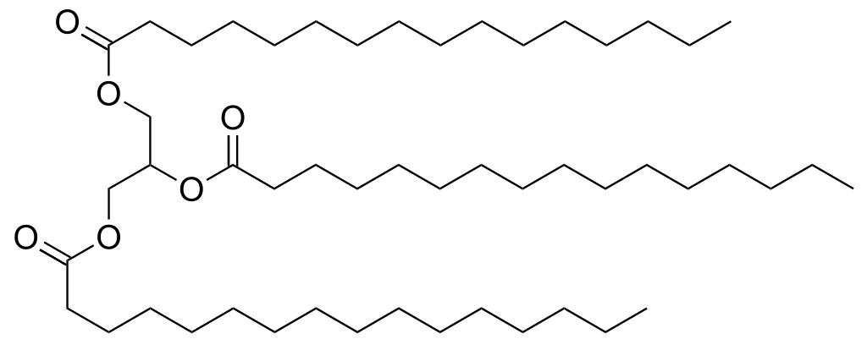
Triglycerides are the main natural fats. Triglycerides are called simple if the three alcoholic groups of glycerol are esterified by the same fatty acid, mixed if the fatty acids are different.
glicerolo
Lipide
Example of a triglyceride with 3 double cis bonds, triolein (up 80% olive oil). The molecule has an irregular shape and packs with difficulty, remaining fluid at room temperature

Slide 17
Fatty Acids
Fatty acids are the simplest lipids. They are characterized by a polar hydrophilic head region connected to a long hydrophobic tail.
There are well over one hundred different types of fatty acids, though the most common in plants are oleic acid and palmitic acid.
The hydrocarbon chain may be saturated, as in palmitic acid, or unsaturated, as in oleic acid.
Fatty acids differ from each other primarily in chain length and the locations of multiple bonds. Thus, palmitic acid (16 carbons, saturated) is symbolized 16:0; oleic acid, which has 18 carbons with one cis double bond at carbon 9, may be symbolized 18:1. (Double bonds cis unless otherwise indicated).

Slide 18
Fatty Acids
In higher plants, the most abundant fatty acids have an number of carbons ranging from C14 to C22.
In higher plants and animals, the predominant fatty acid residues are those of the C16 and C18 species of palmitic, oleic, linoleic, and stearic acids.
Unsaturated fatty acids predominate in higher plants, with oleic acid (C18) being one of the most common.
Unsaturated fatty acids have lower melting points than saturated fatty acids of the same chain lengths.
Plants produce very important storage forms of lipids (fats and oils) as energy reserves in fruits and seeds, such as the fats and oils found in avocados, olives, soybeans, sunflower seeds and peanuts.

Slide 19
These stored lipids are often found in the cytoplasm of either cotyledon or endosperm cells in organelles known as spherosomes (also called lipid bodies), which, like vesicles, bud off of the ER.
In addition to the typical lipid cell components, plants have different metabolic pathways that produce waxes that make up the protective cuticle of epidermal cells. Waxes containing polymeric esters formed by the linking of several Ω-hydroxyacids are especially prominent in the waxy coatings of conifer needles.

Slide 20
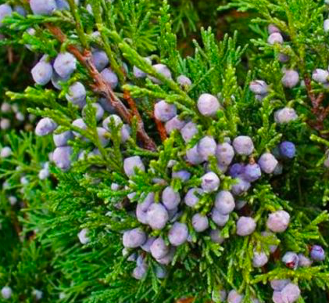
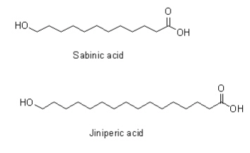
Juniperus sabina, Ginepro sabina
The two most common acids in such waxes are sabinic acid, and juniperic acid

Slide 21
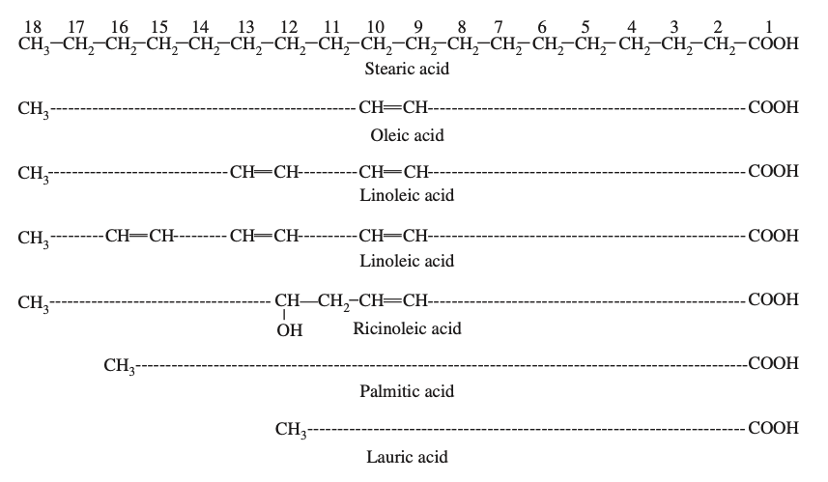
Fatty acids

Slide 22
Fatty Acids

Slide 23
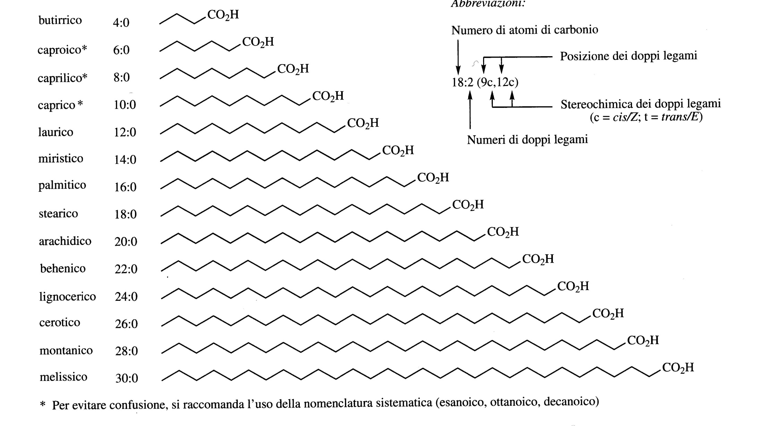
Saturated fatty acids

Slide 24
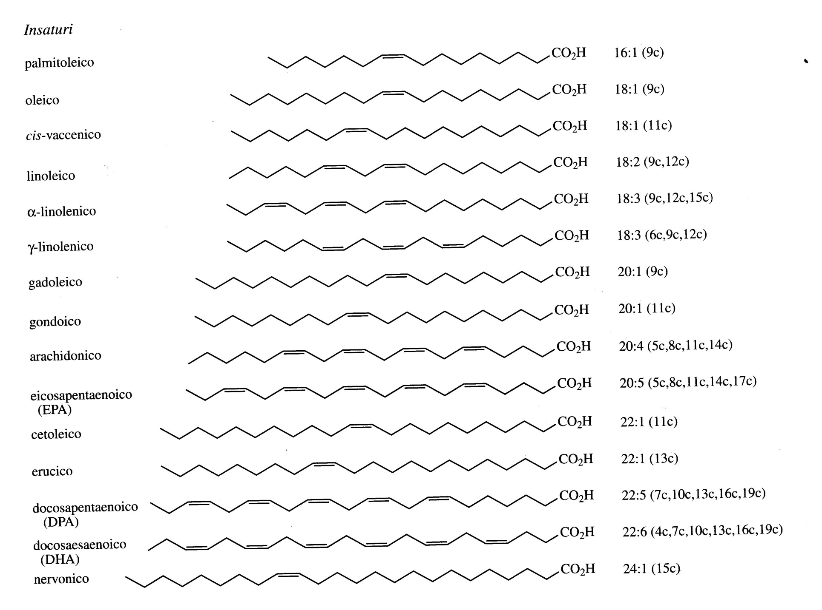
Unsaturated fatty acids

Slide 26
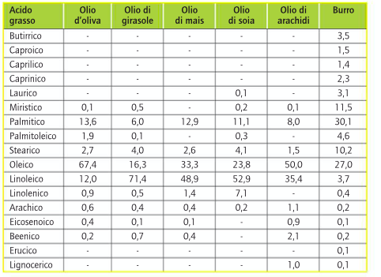

Slide 27
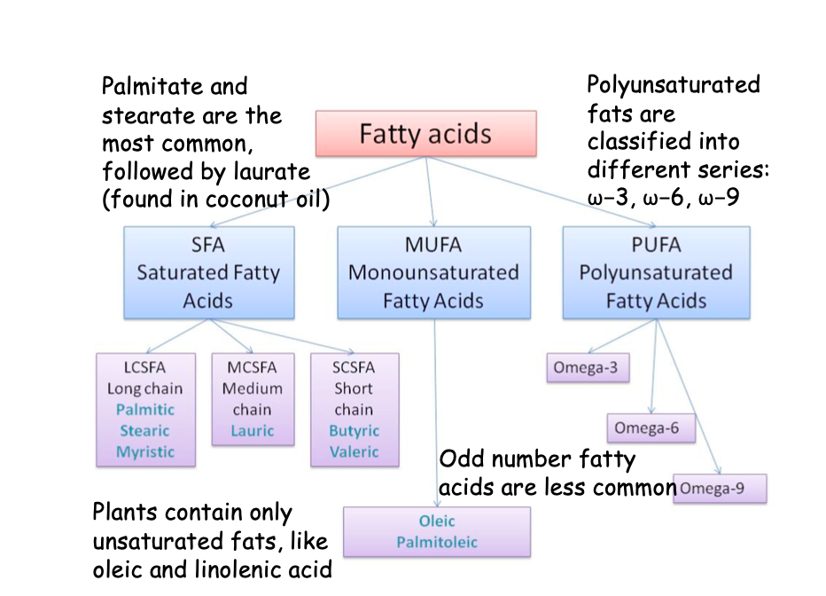

Slide 28
PUFA (Polyunsaturated Fatty Acids)
ω-6 ( linoleic acid) series and ω-3 ( linolenic cid) series fatty acids are essential for diet
Arachidonic acid is synthetized from linoleic acid and it is the precursor of eicosanoids

Slide 30
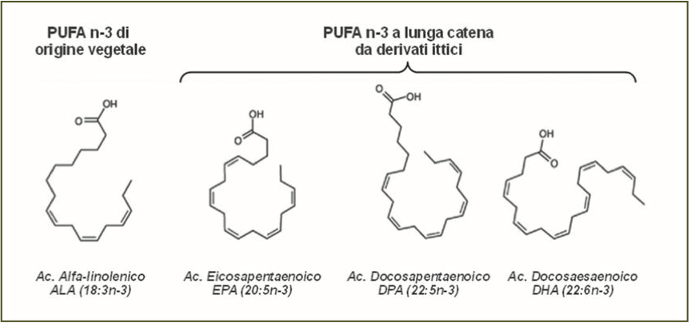
Fatty acids in fish oil are long-chain with many unsaturations such as eicosapentaenoic acid (EPA) and docosahexaenoic acid (DHA) and docosapentaeonic acid (DPA)
Fatty acids are called "essential fatty acids" (EFA) and having a double bond 3 carbons from the methyl terminus they are grouped together under the name of ω-3 fatty acids.

Slide 31
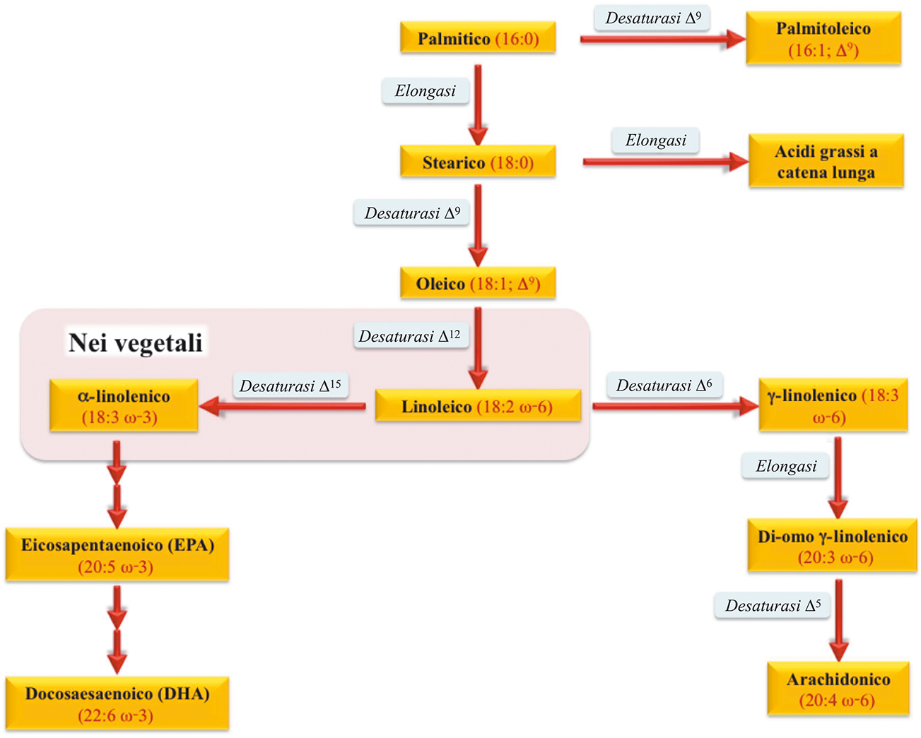

Slide 32
Unsaturated fatty acids are synthesized through various biogenetic pathways but in most cases they are formed by dehydrogenation of the corresponding saturates with the enzyme Δ⁹ desaturase.
The double bonds that are formed in subsequent desaturations depend on the organisms: in non-mammals the additional double bonds are formed towards the terminal methyl, in mammals towards the carboxyl group.

Slide 33
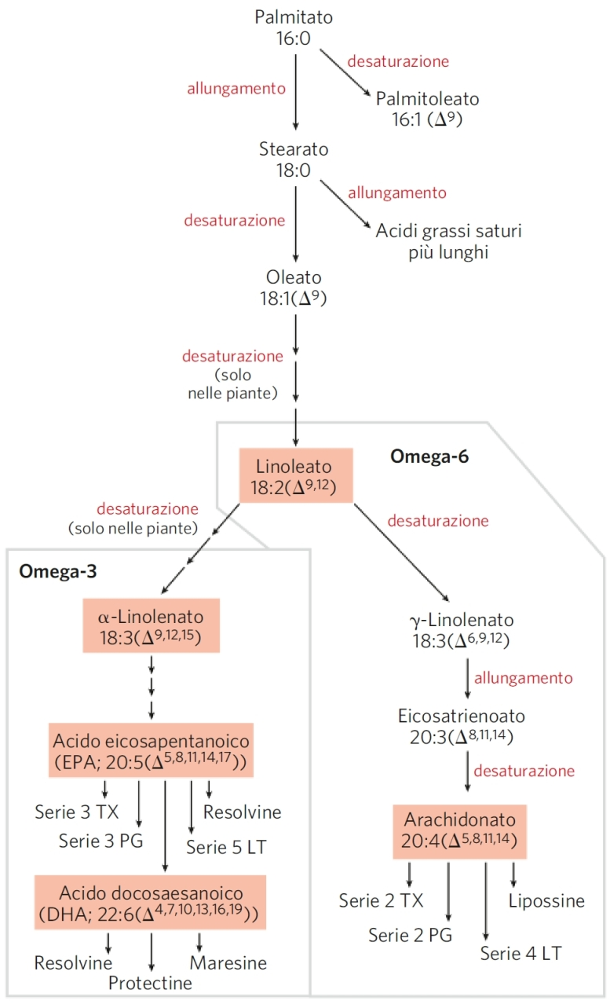

Slide 34
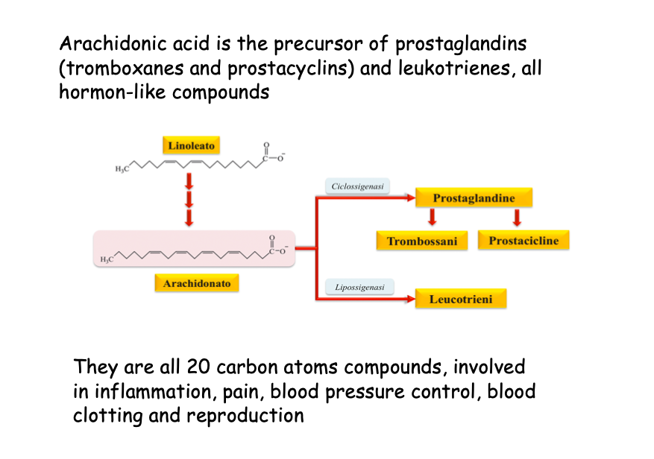

Slide 37
Triglycerides are the main natural fats. Triglycerides are called simple if the three alcoholic groups of glycerol are esterified by the same fatty acid, mixed if the fatty acids are different.
glicerolo
Lipide
Example of a triglyceride with 3 double cis bonds, triolein (up to 80% olive oil). The molecule has an irregular shape and packs with difficulty, remaining fluid at room temperature

Slide 38
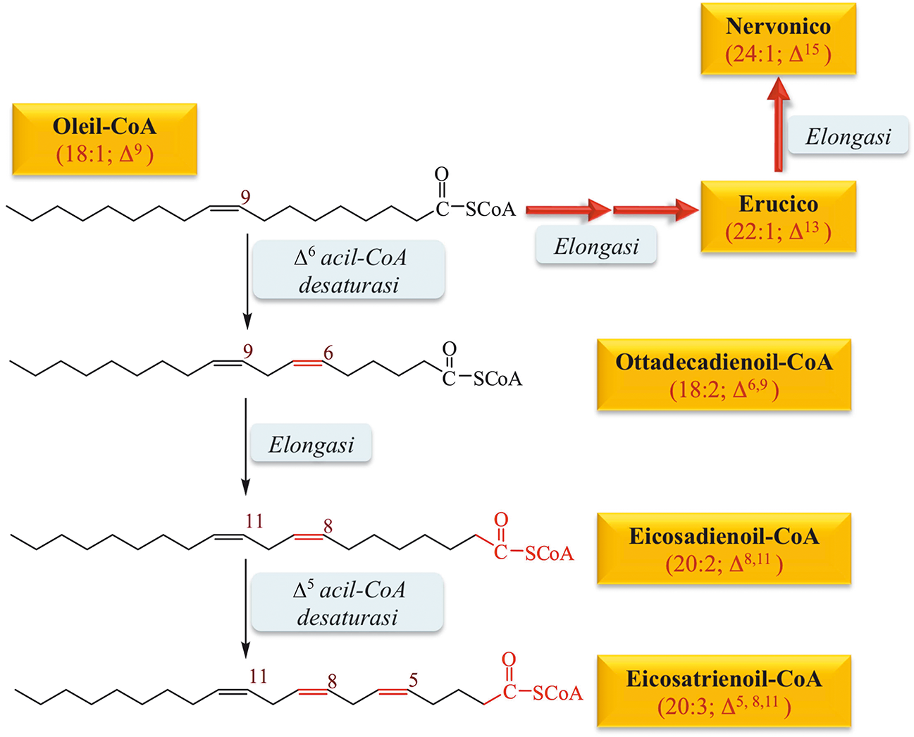
Nervoic acid is synthetised
during fetal nervous system development
Erucic acid is cardiotoxic

Slide 39
Fatty Acids and diet
Diets high in saturated fats have been implicated in an increased risk of coronary heart disease, cancers, and diabetes, and replacement of sources of saturated fats with unsaturated fats was suggested.
Some fats have protective properties. α-Linolenic acid is apparently a major cardioprotective nutrient. It was suggested that a diet with an optimum balance of ω-6 and ω-3 polyunsaturated fatty acids may delay the onset of neurodegenerative disorders, such as Parkinson’s disease and Alzheimer’s disease.
The ω-6 and ω-3 polyunsaturated fatty acids, including linoleic acid (ω-6 fatty acid) and α-linolenic acid (ω-3 fatty acid), are essential to human nutrition.

Slide 40
Fatty Acids and diet
Saturated fatty acids (e.g., palmitic and stearic acids) as well as the monounsaturated fatty acids (oleic and palmitoleic acids) are generally classified as non-essential.
The essential fatty acids — linoleic acid and α-linolenic acid — cannot be synthesized de novo by humans. These fatty acids serve as biosynthetic precursors to long-chain polyunsaturated fatty acids (e.g., arachidonic acid, eicosapentaenoic acid, and docosahexaenoic acid) and are necessary for the formation of healthy cell membranes, the proper development and functioning of the brain and nervous system, and the production of eicosanoids (thromboxanes, leukotrienes, and prostaglandins).

Slide 41
Fatty Acids and diet
The primary sources of linoleic acid are seeds, nuts, grains, and legumes.
α-Linolenic acid is found in the green leaves of plants, including phytoplankton and algae, and in flax (Linum usitatissimum) seeds, canola (Brassica napus) seeds, walnuts (Juglans spp.), and soybeans (Glycine max).
In most natural fatty acids the double bond configuration is Z / cis. A partial Z-E isomerization can intervene in the hydrogenation processes to produce semi-solid fats. The presence of trans double bonds could be related to the onset of coronary heart disease and atherosclerosis.
Trans-fatty acids are found in partially hydrogenated vegetable oil, in meats, and in dairy products. There is evidence that the intake of trans-fatty acids should be reduced, because they are associated with an increased risk of coronary heart disease.

Slide 43
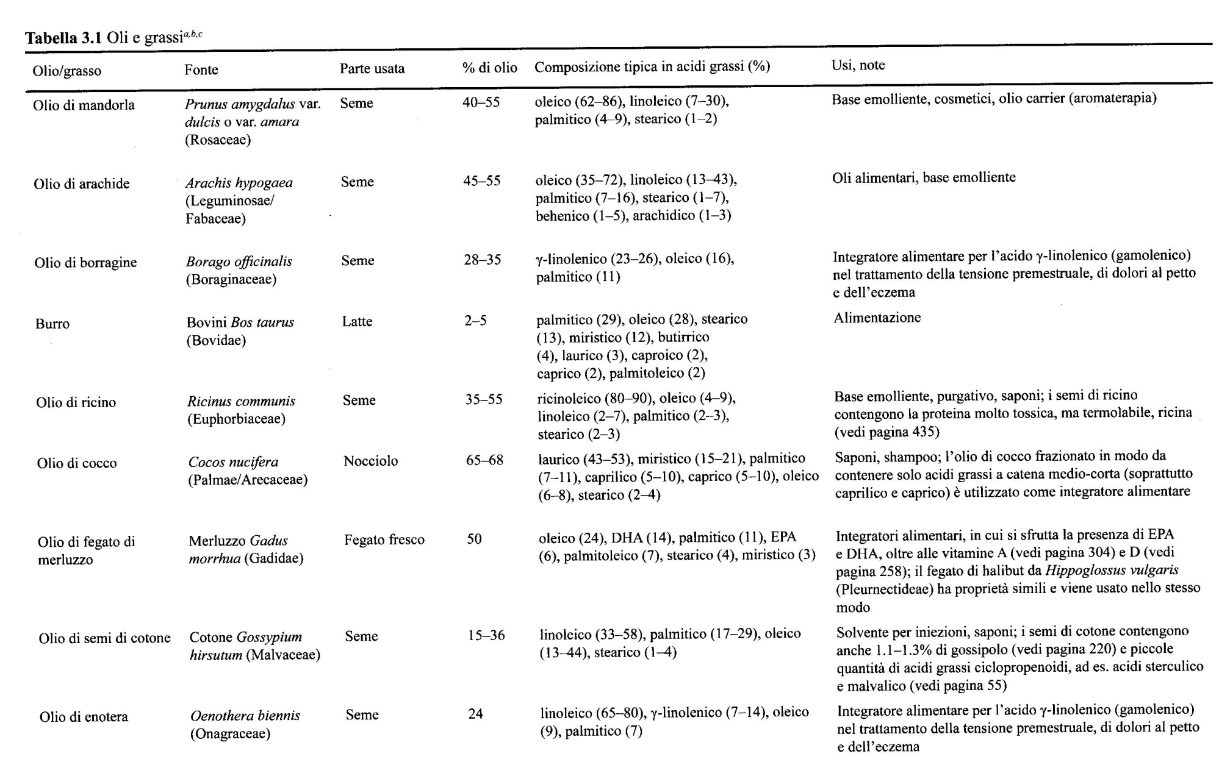

Slide 44
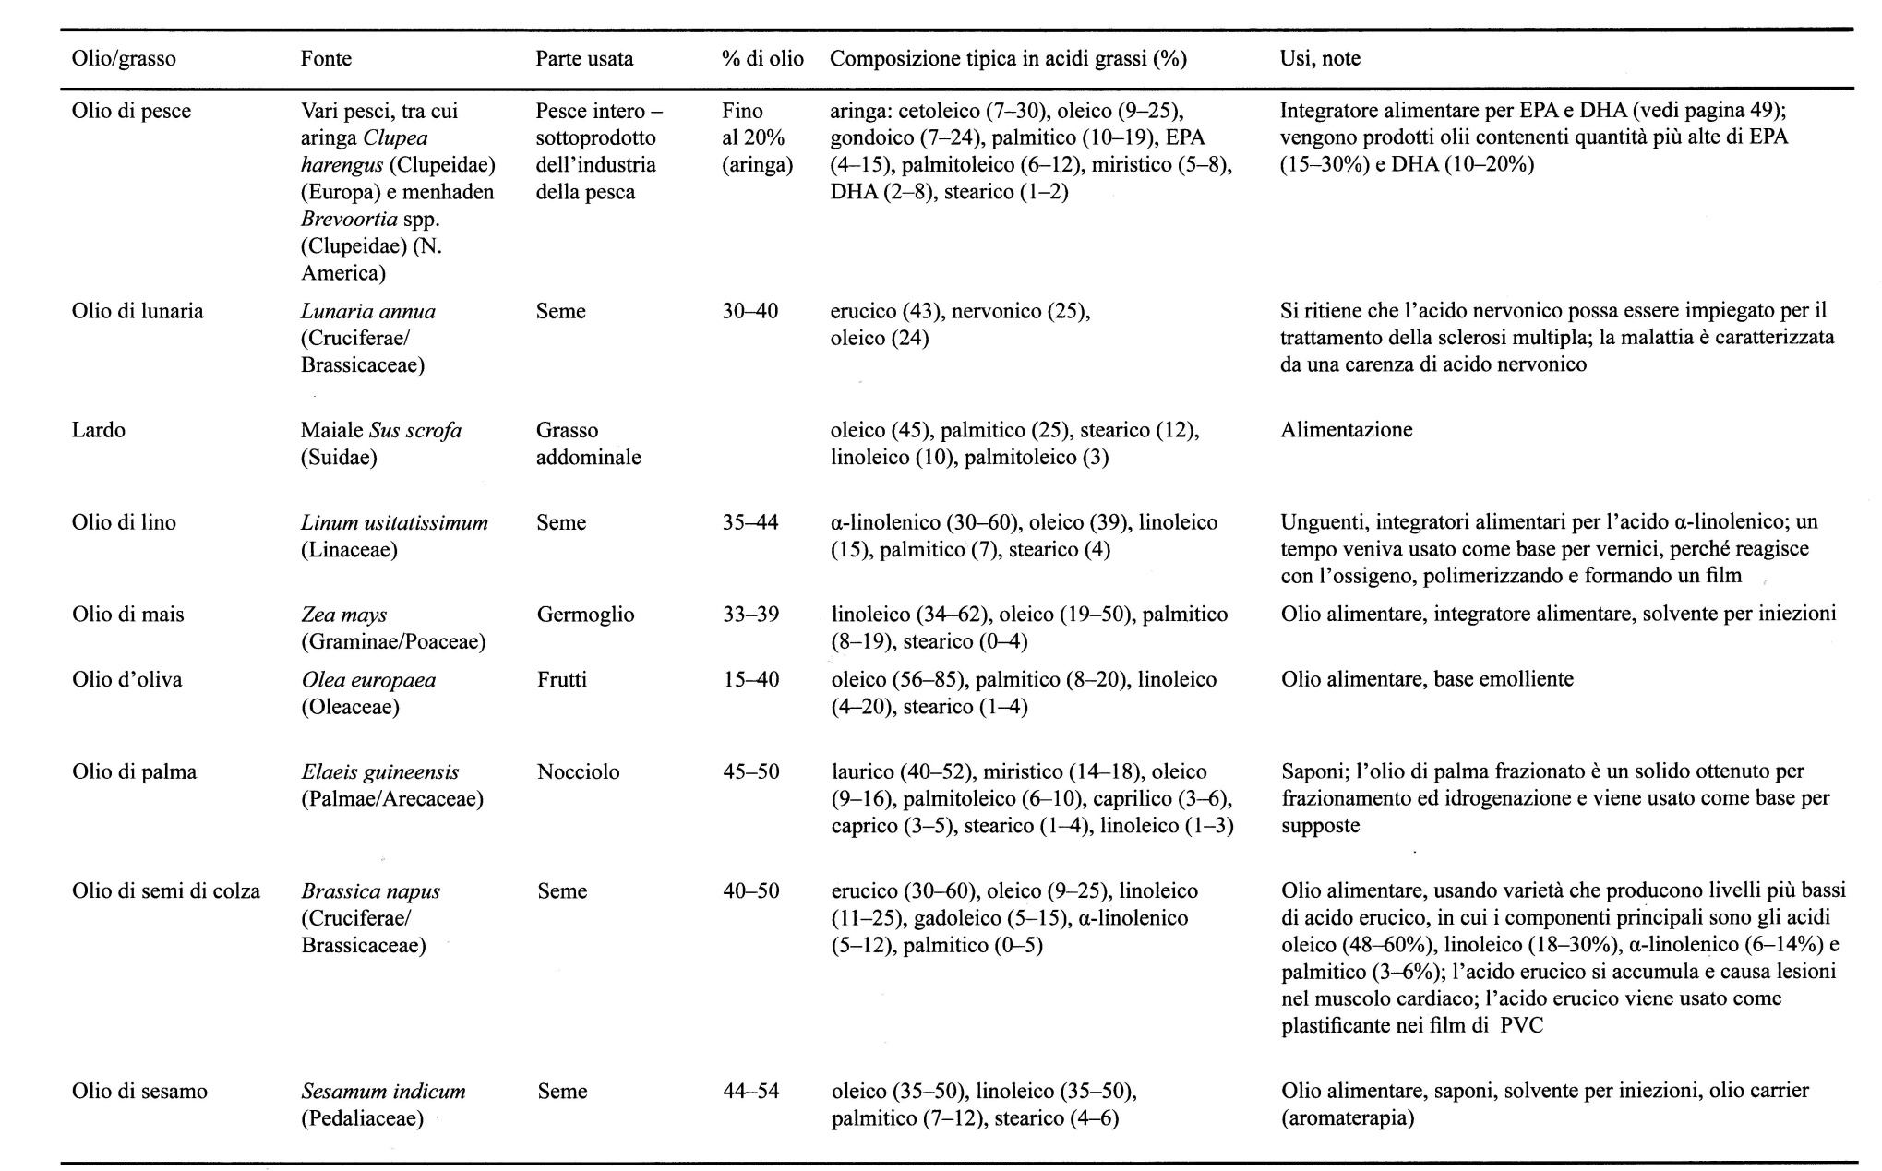

Slide 45
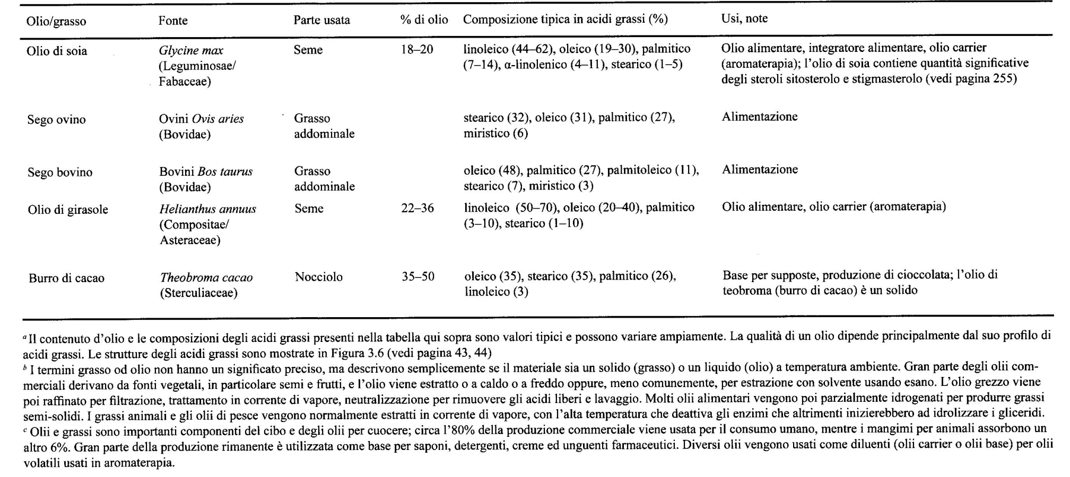

Slide 47
In all organisms, fatty acids are synthesized by a sequence of four repeated enzymatic reactions, catalyzed by the multienzymatic system of fatty acid synthase:
Condensation (with CO₂ loss)
Reduction (NADPH-dependent)
Dehydration
Reduction (NADPH-dependent)
In each passage through this anabolic pathway, the fatty acid chain is lengthened by two carbon atoms, donated by the activated malonate

Slide 48
The synthesis of fatty acids involves a series of reactions that follow a different strategy from the corresponding degradation process:
The intermediates of fatty acid synthesis are covalently linked to sulfhydryl groups of acyl carrier proteins (acyl carrier protein, ACP)
The enzymes of fatty acid synthesis are components of a long peptide chain FAS, FAS II in plants
The coenzyme for redox reactions of fatty acid synthesis is NADP⁺ / NADPH

Slide 49
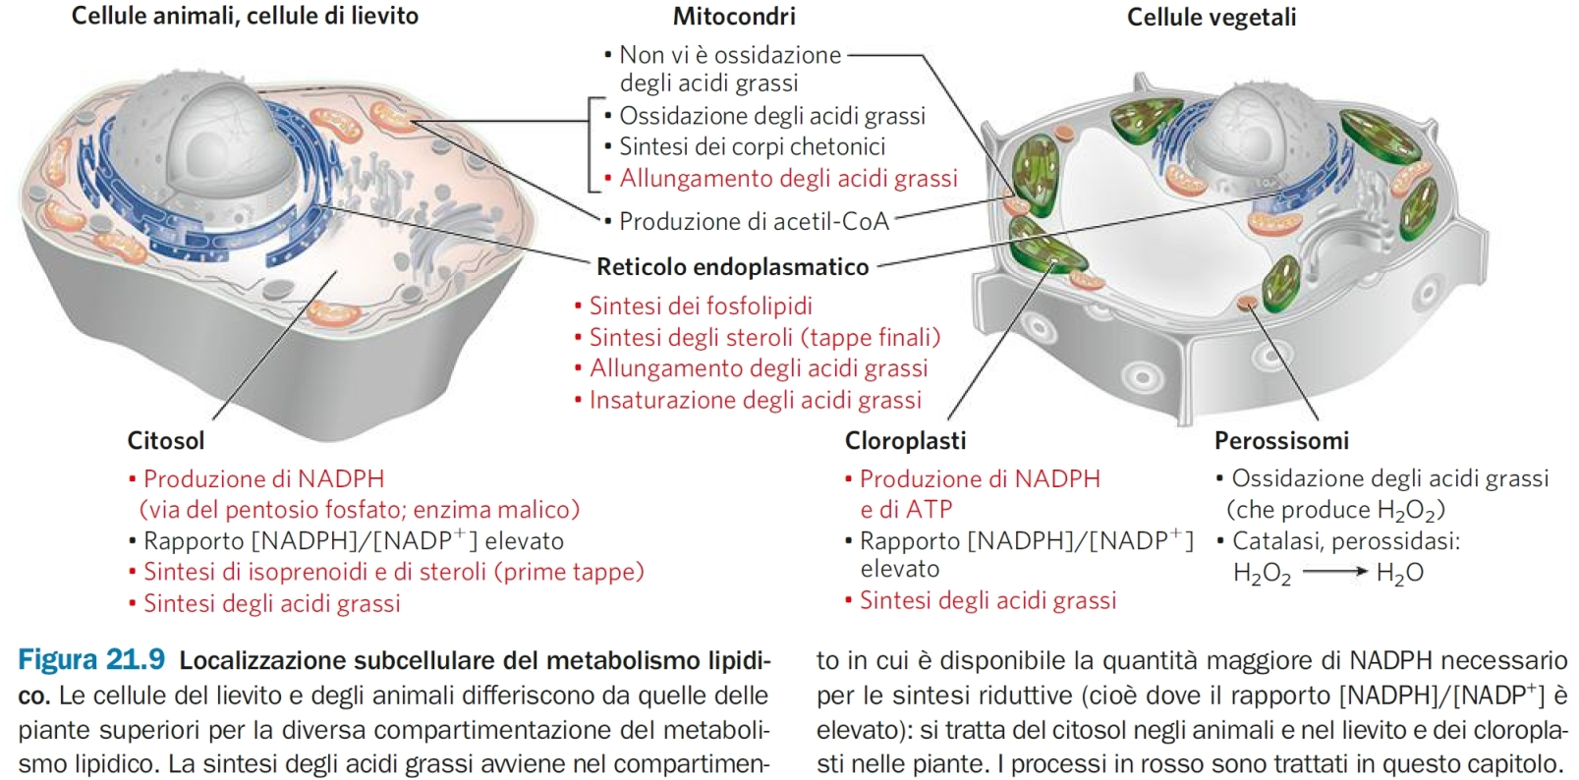
NADPH produced in chloroplasts during photosynthesis

Slide 50
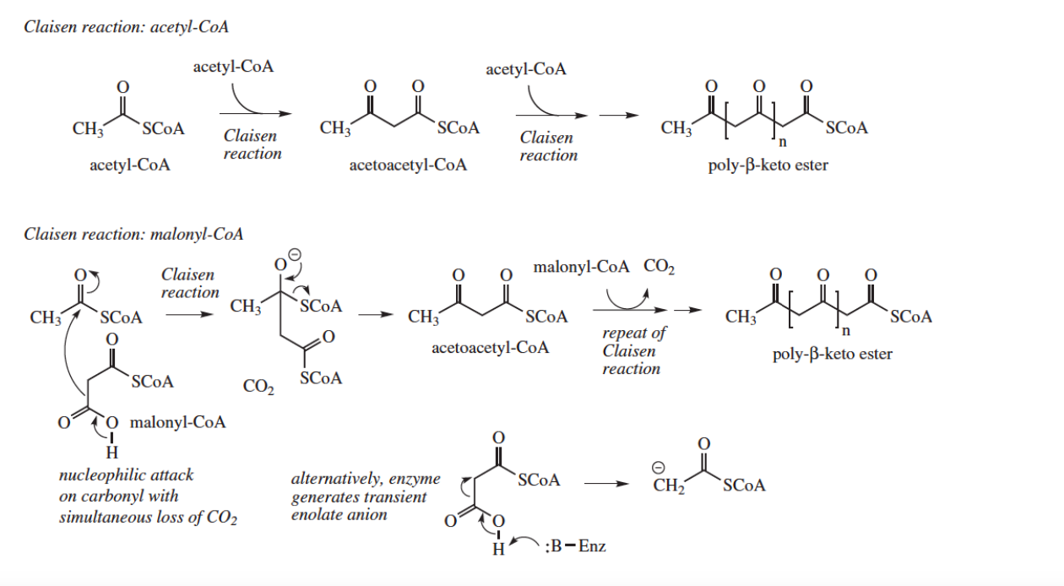
Acetate pathway: Fatty acids and Polyketides
Polyketides are an important class of natural products grouped by their common biogenesis
They all derive from β-polyketones obtained by condensation of acetic acid molecules.
Polyketides: Fatty Acids / Polyacetylene Compounds / Prostaglandins / Macrolide Antibiotics / Aromatic Compounds (Anthraquinones, Tetracyclines)

Slide 51
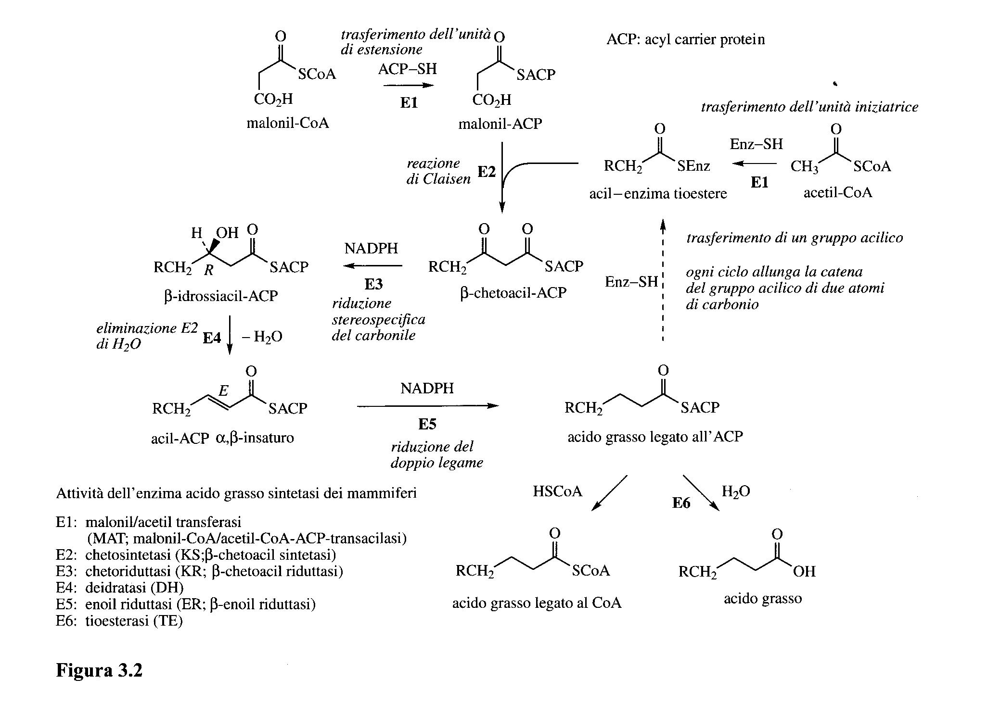
Acetyl-CoA and Malonyl-CoA are involved in the condensation stage as thioesters of an acyl-carrying enzyme (ACP)

Slide 52
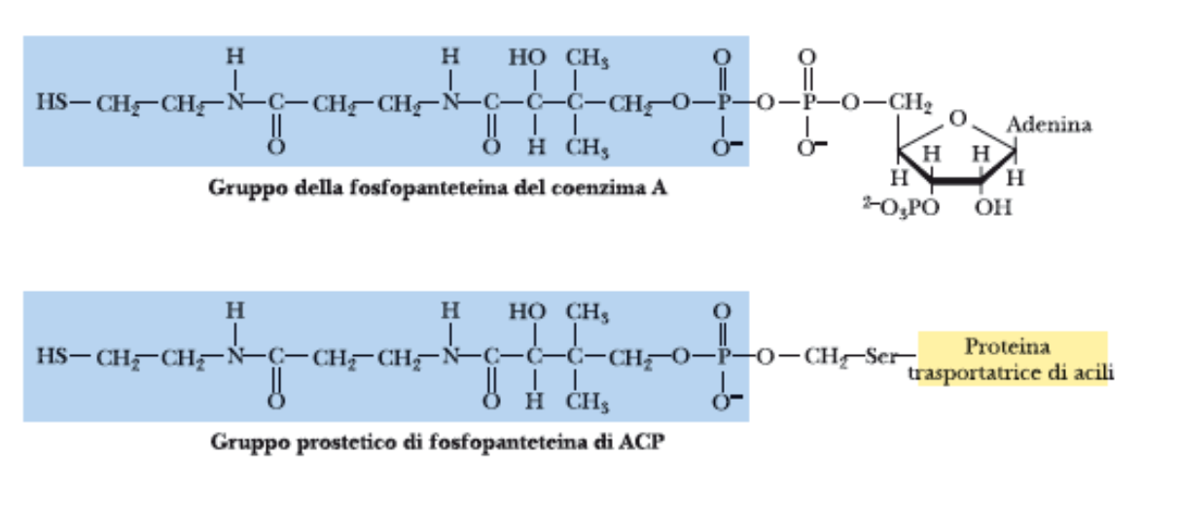
The acyl carrier protein (ACP) has 4-phosphopantetheine as a prosthetic group

Slide 53
Vertebrate FAS I is a single multifunctional polypeptide chain, which in mammals has 7 different domains, each with its own active site:
KS, β-ketoacyl-CoA synthase MAT, malonyl / acetyl-CoA-ACP transferase ACP acyl transporter protein
KR, β-ketoacyl-ACP reductase
DH, β-hydroxyacyl-ACP dehydratase
ER, enoyl-ACP reductase
TE, thioesterase
In plants: FAS II is made up of separate proteins with the diffent functions
FAS II synthetizes also unsaturated, branched and hydroxylated fatty acids (found in the mitochondria of vertebrates)

Slide 54
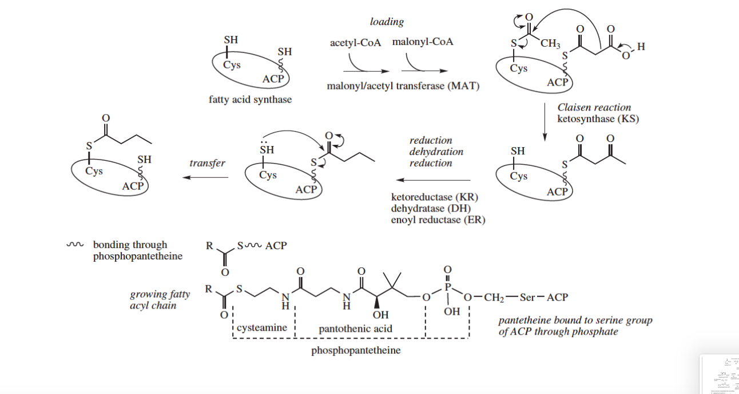

Slide 55
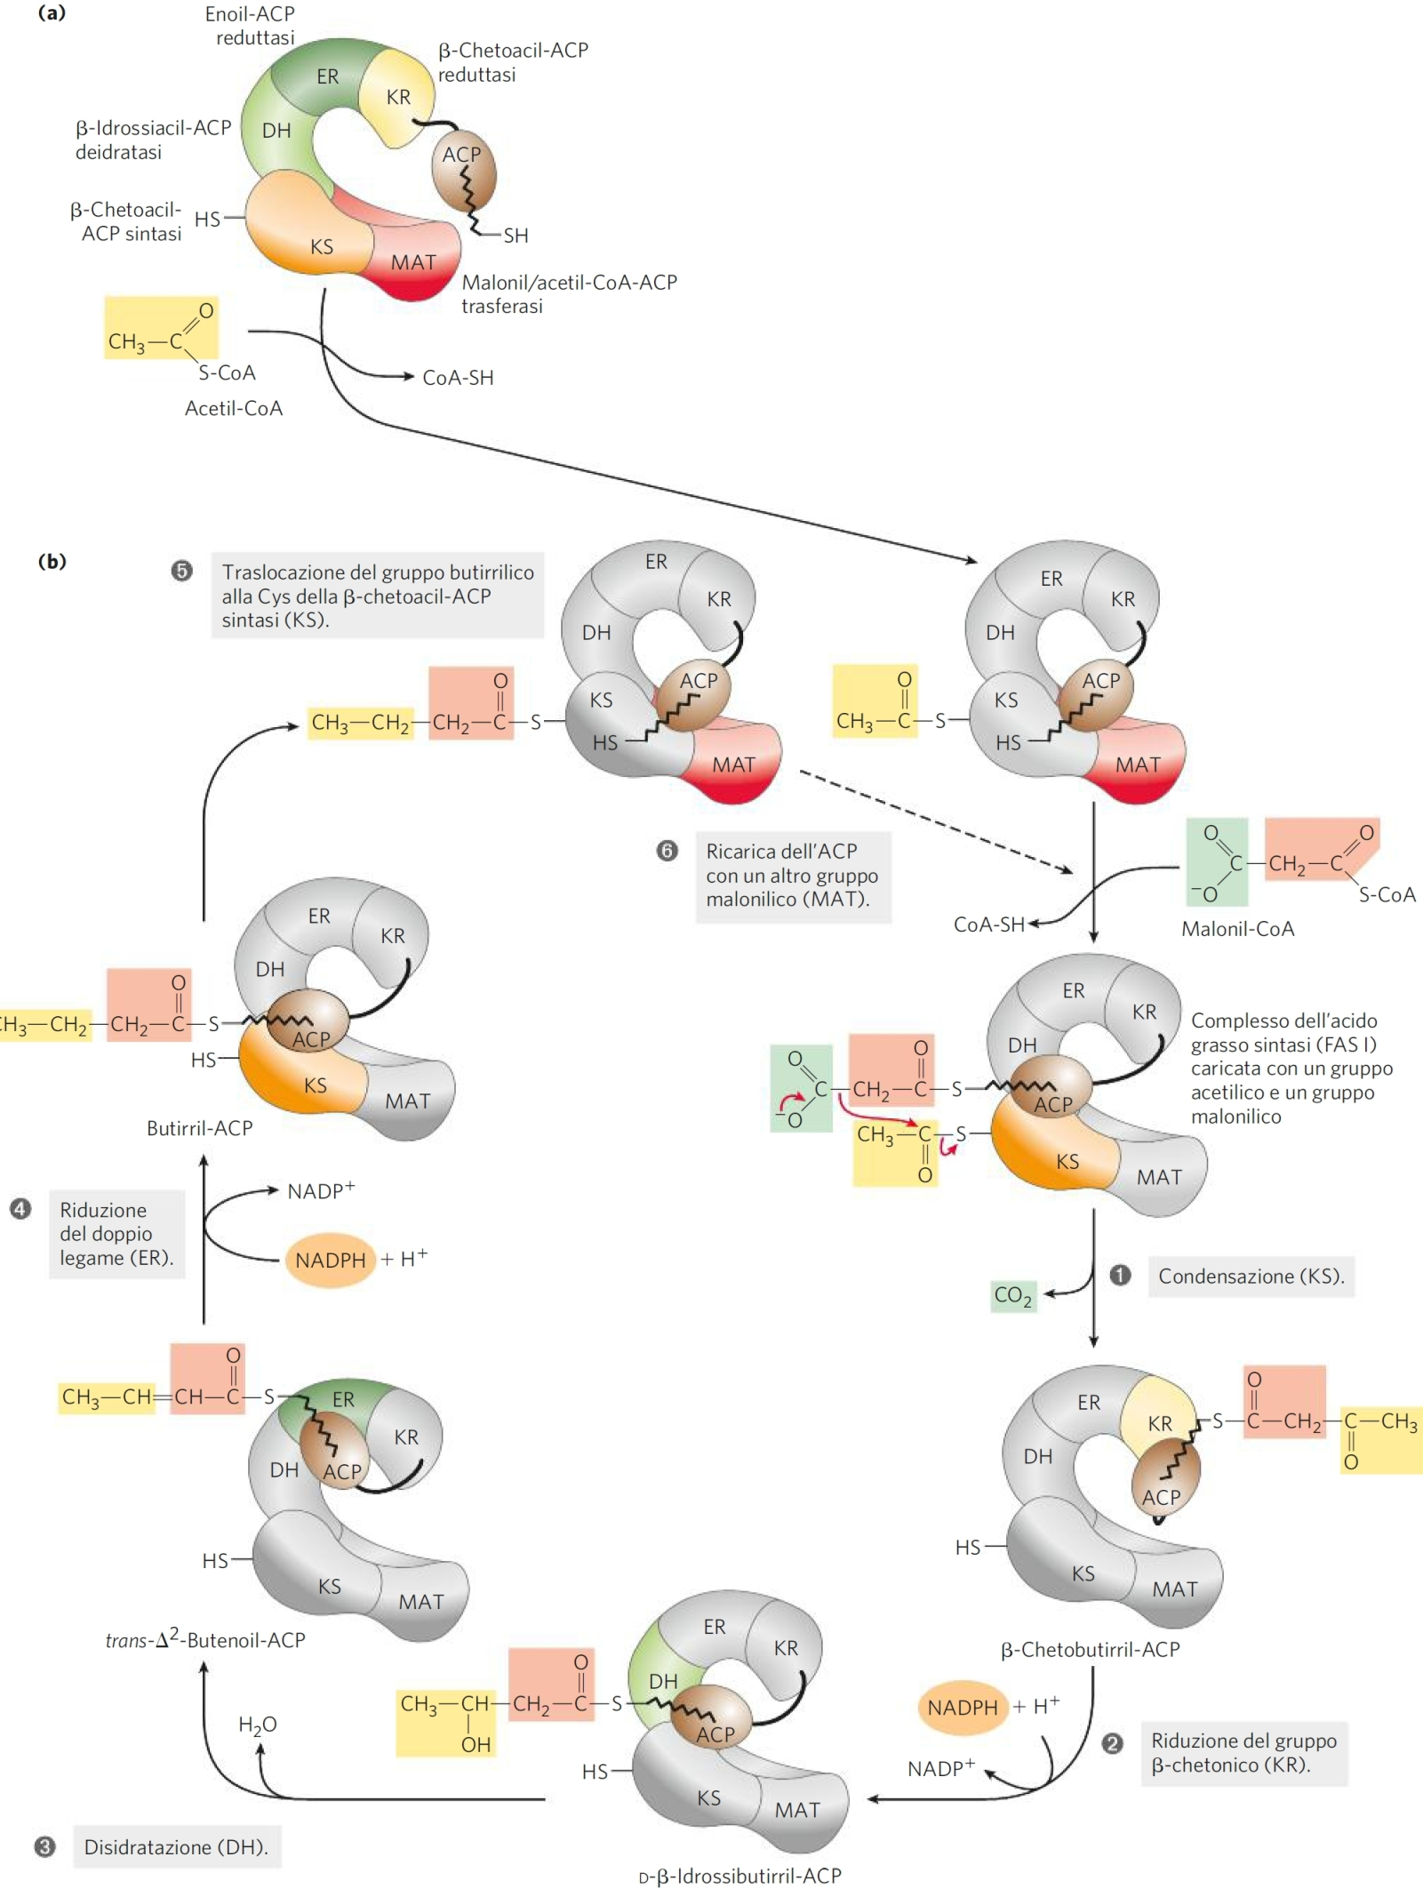
FAS binds activated acetyl and malonyl groups, catalyzing the following reactions up to the synthesis of palmitic acid (C16: 0):
Condensation (Claisen) of acetyl and malonyl, conformation of acetyl-ACP, catalyzed by β-ketoacyl-CoA synthase (KS)
Reduction of the carbonyl group on C-3, catalyzed by β-ketoacyl-ACPreductase (KR) (NADPH-dependent)
Dehydration of carbon dioxide C-2 and C-3 and synthesis of trans- Δ²-butenoyl-ACP, catalyzed by β-hydroxyacyl-ACP dehydratase (DH)
Reduction of the double bond with formation of butyryl-ACP by enoyl-ACP reductase (ER) (NADPH-dependent)

Slide 56
Acetyl-CoA and Malonyl-CoA are involved in the condensation stage as thioesters of an acyl-carrying enzyme (ACP)

Slide 57
Malonyl / acetyl-CoA-ACP transferase (MAT) protein and acyl transporter protein (ACP) allow enzymes to receive the necessary substrates
For reasons still unclear, the elongation of the chain generally ends after 7 cycles of condensation and reduction reactions, with the release of palmitic acid by thioesterase (TE).

Slide 58
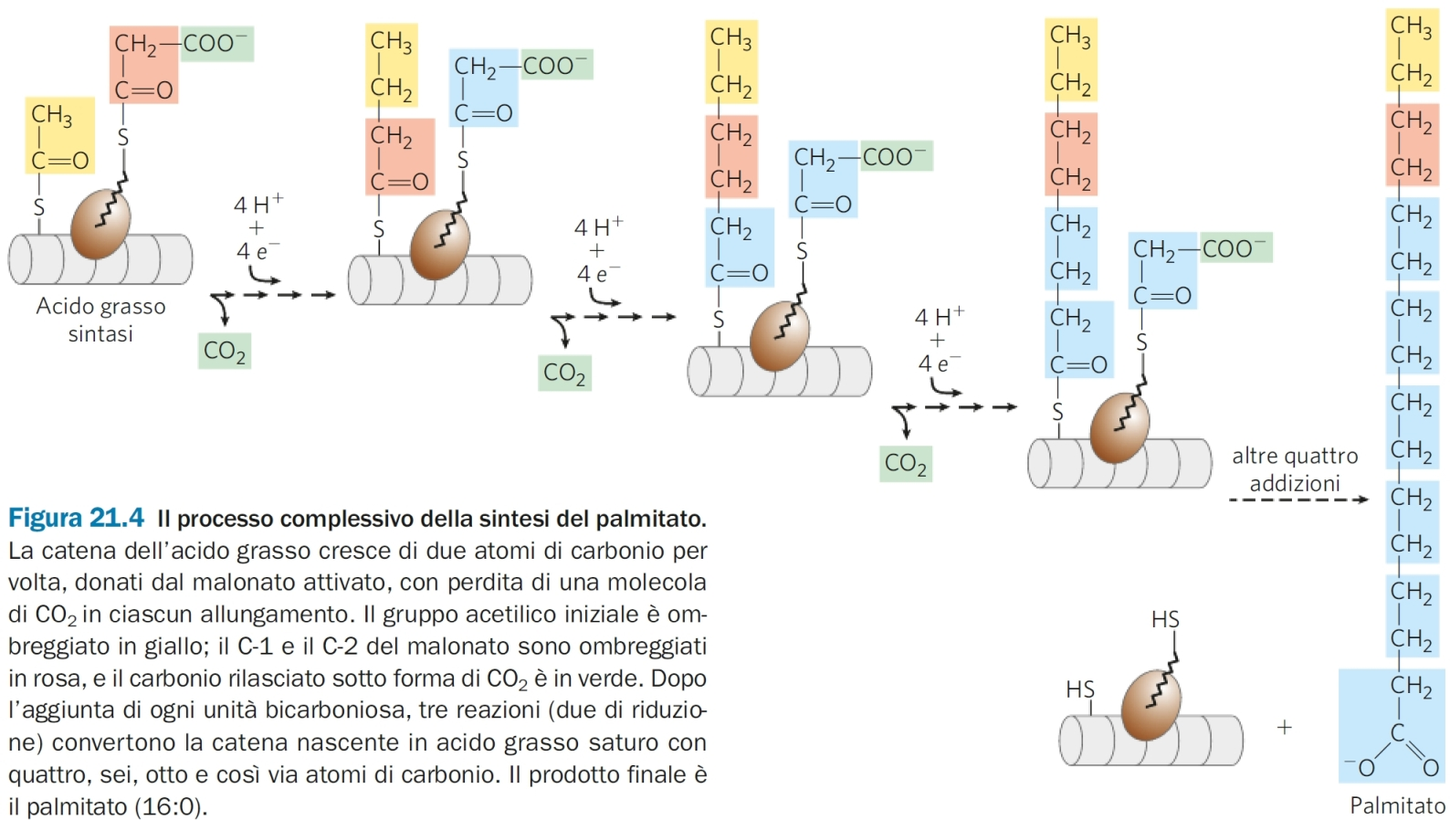

Slide 59
