Slide 1
Cdks (cyclin-dependent kinases)
Based on the sequence of the kinase domain, CDKs belong to the CMGC group of kinases (named for the initials of some members), along with mitogen-activated protein kinases (MAPKs), glycogen synthase kinase-3 beta (Gsk3β), members of the dual-specificity tyrosine-regulated kinase (DYRK) family and CDK-like kinases (CLKs).
In related kinases such as MAPKs, substrate specificity is conferred by docking sites separated from the catalytic site, whereas CDKs are characterized by dependency on separate protein subunits, cyclins, that provide additional sequences required for enzymatic activity.
Kinase activity (phosphorylation) is turned on by association with cyclins.
Activities cyclically vary during cell cycle and phosphorylate proteins involved in cell-cycle regulation.
CDKs were first discovered by genetic and biochemical studies in model organisms such as yeasts and frogs in the 1980s.
Proteins belonging to CDK family have been named as Cdk1 through to Cdk20.

Slide 2
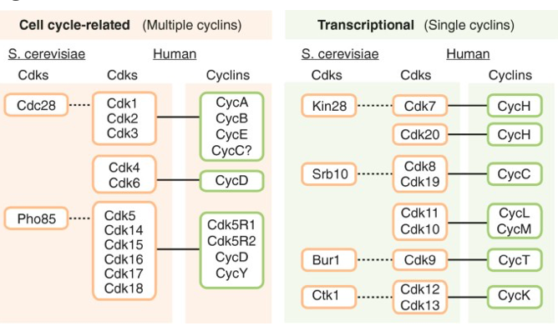
Comparison of yeast and mammalian CDKs
Cells of the budding yeast S. cerevisiae contain two CDKs that are activated by multiple cyclins: Cdc28 and Pho85 which is not essential and it is required for viability in some stress conditions.
Cdk1 is the mammalian ortholog of Cdc28, whereas Cdk5 is considered to be the Pho85 ortholog.
The Cdk4/Cdk6 subfamily is not present in yeast.
Malumbres Genome Biology 2014, 15:122 http://genomebiology.com/2014/15/6/122
CDKs are grouped as CDKs that bind multiple cyclins and can regulate the cell cycle and CDKs that are activated by a single cyclin and are involved in the regulation of transcription.

Slide 3
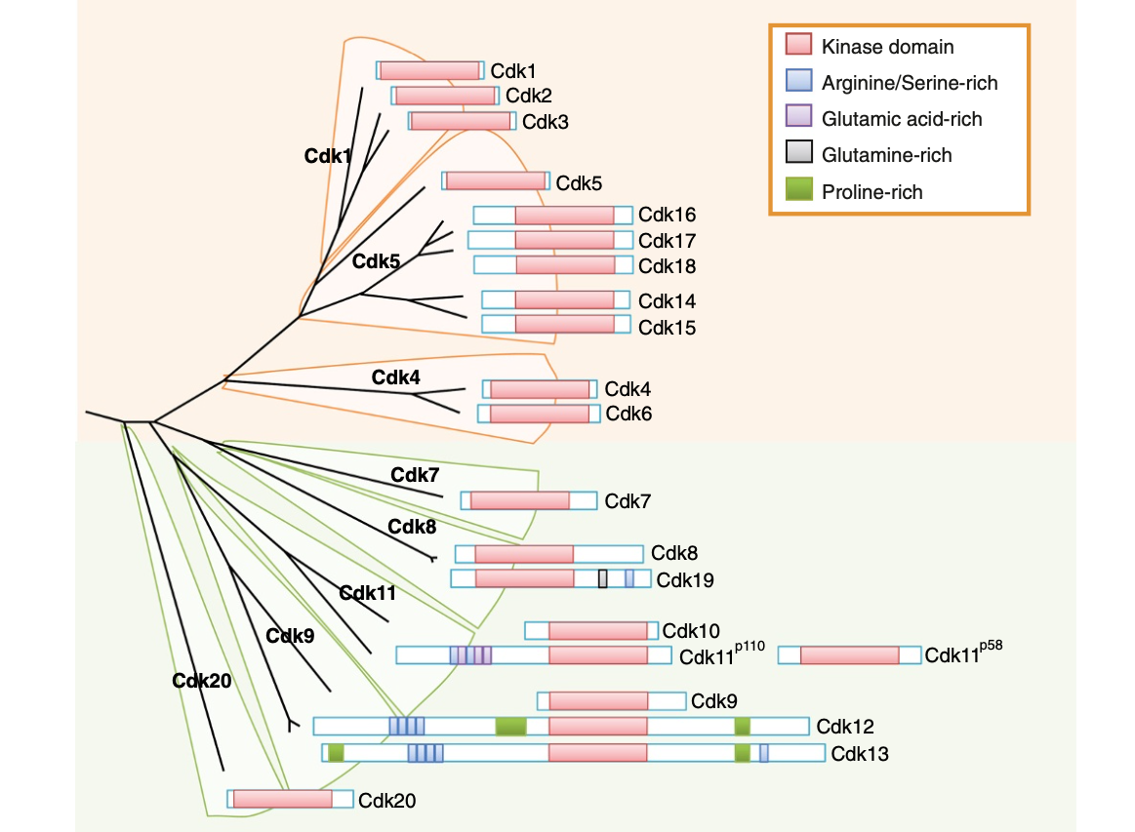
Evolutionary relationships among the mammalian CDK subfamilies
The phylogenetic tree is based on the comparison of the human kinase domains.
The conserved protein kinase domain (red) and some additional domains are indicated for each CDK.
Proteins belonging to CDK family have been named as Cdk1 through to Cdk20.
Evolutionary studies suggest that CDKs fall into eight subfamilies represented by Cdk1, Cdk4 and Cdk5 (from the yeast cell-cycle-related CDKs), and Cdk7, Cdk8, Cdk9, Cdk11 and Cdk20 (functioning as transcriptional CDKs).
Like its yeast ortholog, Cdk1 is the only CDK essential for the cell cycle in mammals, whereas both Cdk2 and Cdk3 are dispensable.
Malumbres Genome Biology 2014, 15:122 http://genomebiology.com/2014/15/6/122

Slide 4
Multiple Cdks and Cyclins Regulate Passage of
Mammalian Cells through the Cell Cycle
In mammalian cells the principal Cdks, associated with cell cycle control are Cdk1, Cdk2, Cdk4 and Cdk6
The first human Cdk to be discovered was identified by the ability of a cDNA clone encoding it to complement S. pombe cdc2Δ mutants. Initially was called human Cdc2, now is called Cdk1.
A cDNA encoding mammalian Cdk2 was isolated by its ability to complement S. cerevisiae cdc28Δ
Cdk4 and Cdk6 were isolated based on their homology to other Cdks.
Like S. cerevisiae, mammalian cells express multiple cyclins: Cyclin A and Cyclin B were initially detected as proteins whose concentration oscillates in experiments with synchronously cycling early sea urchin and clam embryos.
Homologous Cyclin A and Cyclin B proteins have been found in all higher eukaryotes examined.
cDNA encoding three related human D-type cyclins and cyclin E were isolated based on their ability to complement S.cerevisiae cells mutant in all three CLN genes encoding G1 cyclins.

Slide 5
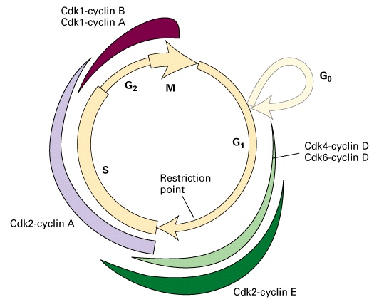
Cdk1 is the founding member, it has been typically associated with Cyclin A and Cyclin B (Mitosis). It phosphorylates a wide spectrum of proteins (more than 70) and controls critical processes required for mitosis such as nuclear envelope breakdown, disassembly of the Golgi apparatus, chromosome cohesion and condensation, formation of the spindle and attachment of chromosomes to the spindle.
Lack of genetic models considering the essentiality of this kinase. In fact, genetic ablation of Cdk1 in the mouse embryos causes early letality.
Cdk4 and Cdk6 are activated by D-type cyclins (D1, D2, D3), which are the major cell cycle sensors for mitogenic signals in the cell cycle (G1/S progression).
D-type cyclins are transcriptionally induced by all mitogenic signals including the Ras/mitogen-activated protein kinase (MAPK) pathway.
Cdk2 is activated by cyclin E (G1/S progression)

Slide 6
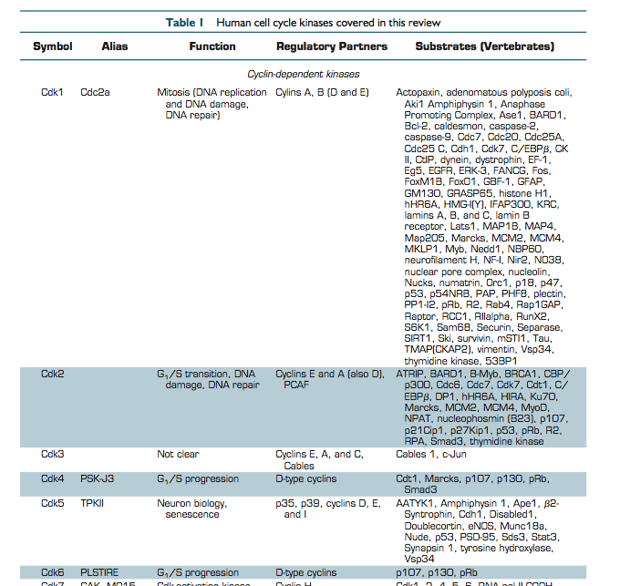
Cell cycle kinases

Slide 7
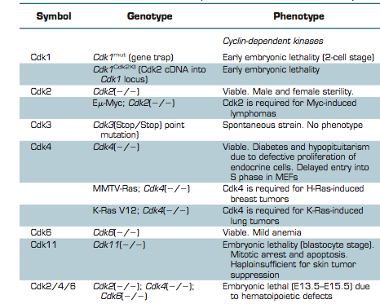
Representative mouse models of cell cycle kinases

Slide 8
Fungi contain 6 to 8 CDKs and 9 to 15 cyclins.
Flies and echinodermata contain 11 CDKs and 14 cyclins.
Human cells have 20 CDKs and 29 cyclins.

Slide 10
PSTAIRE α-helix is present in all CDKs and is essential for binding of cyclins (EGVPSTAIREISLLKE).

Slide 11
The cyclin family
Cyclins are a large family of approximately 30 proteins varying in mass from 35 to 90 kDa.
These proteins are structurally defined by the presence of the so-called cyclin box, a domain of approximately 100 amino acid residues that forms a stack of five α-helices.
Many cyclins have two cyclin boxes, one amino- terminal box for binding to CDKs, and a carboxy-terminal box that is usually required for the proper folding of the cyclin molecule.
The cyclin box is also present in other molecules (the retinoblastoma protein Rb, the transcription factor TFIIB)
In general, cyclins show less sequence similarity than the CDKs.
The cyclin family contains approximately 29 protein in humans, clustered in 16 subfamilies and three major groups: group I (cyclins A, B, D, E, F, G, J, I and O); group II (cyclin Y group - a partner of the Cdk5 subfamily); and group III (cyclin C group: C, H, K, L and T, major partners of transcriptional CDKs).

Slide 12
Cdk kinase activity is determined by:
Regulated periodic synthesis of cyclins
Activating phosphorylation (by other protein kinases)
Inhibitory phosphorylation (by other protein kinases)
Binding of inhibitory proteins (CKIs)
Regulated proteolysis of the cyclins and inhibitors
Cellular localization of kinase and substrate
CDKs are proline-directed serine/threonine-protein kinases:
S/T-P-X-K/R consesus sequence

Slide 13
Controlling Cdk activity
 | Cyclin-dependent kinase | Activating phosphorylation | Inhibitory phosphorylation
Homo sapiens | Cdk2 | Thr 160 | Thr 14, Tyr 15 (myt1,wee1)
Saccharomyces cerevisiae | Cdc28 | Thr 169 (Cak1) | Thr 19
Schizosaccharomyces pombe | Cdc2 | Thr 167 | Tyr 15

Slide 14
Controlling Cdk activity
Cyclin availability
Phosphorylations
Cdk inhibitors
Y15
T160
Cdk2
T14
Activation
Cyclin binding (translation)
Phosphorylation Thr 161 (T-loop)
Dephosphorylation of Tyr 15 (cdc25)
No binding with inhibitor
Inhibition
Cyclin degradation
Dephosphorylation of Thr 161
Phosphorylation of Thr 14 and Tyr 15
Binding with inhibitor

Slide 15
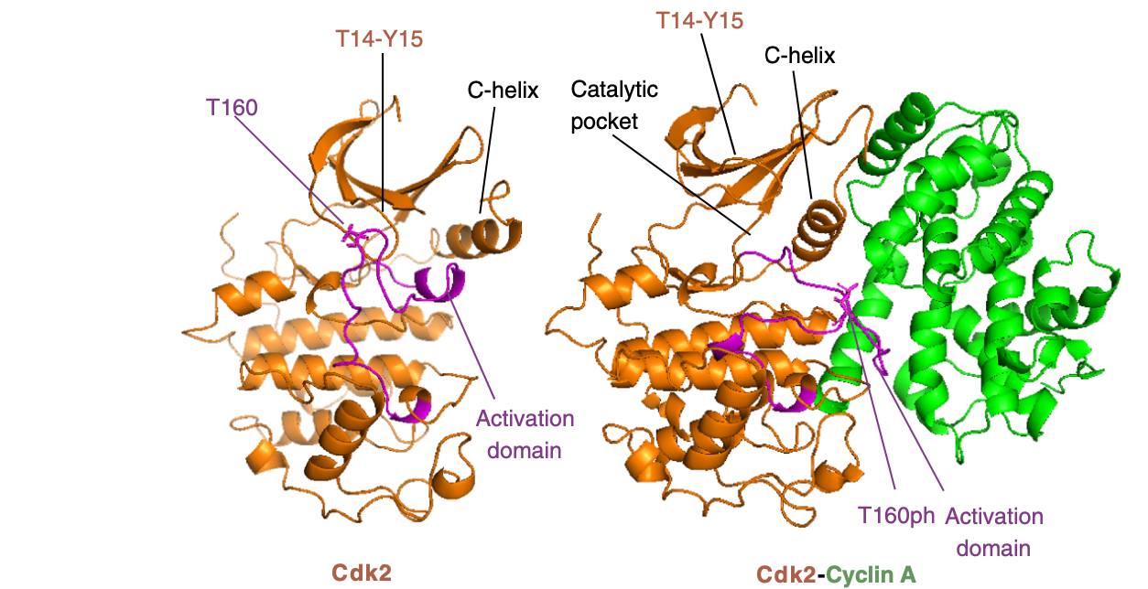
In monomeric Cdk2 (unbound with cyclins) the activation domain, in which is included the phosphorylation- sensitive (T160 in Cdk2) residue (in the so-called T-loop) is close, ensuring that the catalytic pocket is inaccessible.

Slide 16
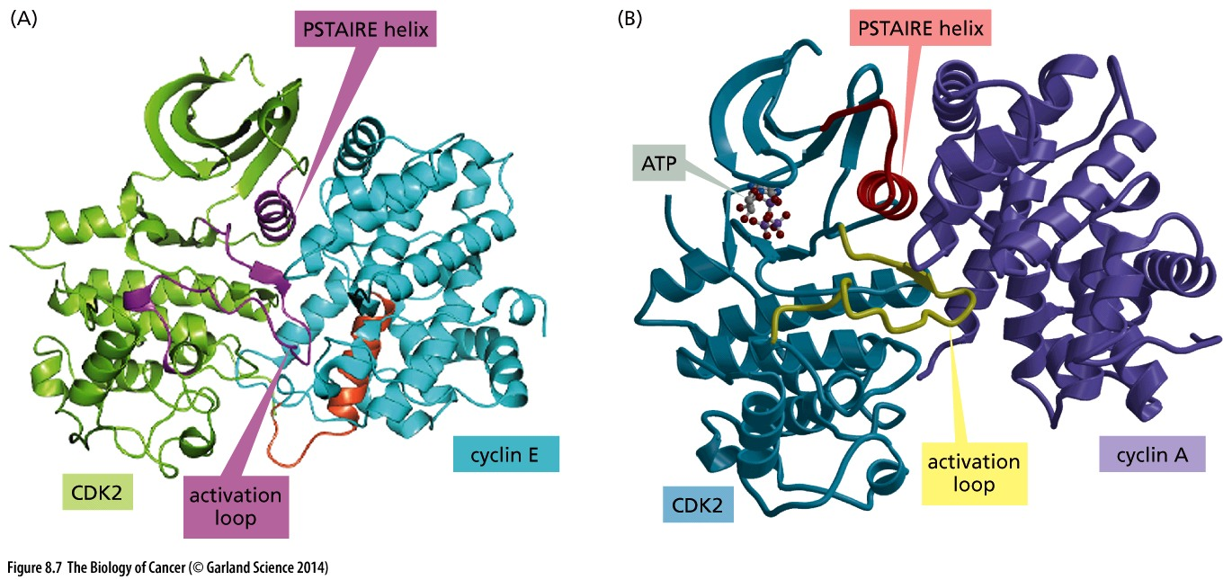
Cyclin-CDK: the engine of the Cell Cycle Clock
X-ray crystallographic analysis
The cyclins associated with the CDKs activate the catalytic activity of their CDK partners (Cyclin A/CDK2 increases the catalytic cativity of CDK2 of 400,000 fold).
PSTAIRE α-helix is present in all CDKs and is essential for binding of cyclins (EGVPSTAIREISLLKE).
Association of cyclins promotes a rotation, generating new interactions that are part of the active ATP-binding site.
Binding with cyclins induces accessible threonine for activating phosphorylation by CAK.
The activation loop (T-loop) must be phosphorylated on a threonine residue by a CDK-activating kinase (CAK) in order for the catalytic function of a CDK to become activated.

Slide 17
CDKs contain an evolutionary conserved 16 amino acid sequence called PSTAIRE (EGVPSTAIREISLLKE) which distinguishes them from other protein kinases.
The PSTAIRE motif is involved in the complex formation with cyclins.
As a consequence Thr160 is more accessible to CAK phoshorylation.

