Slide 1
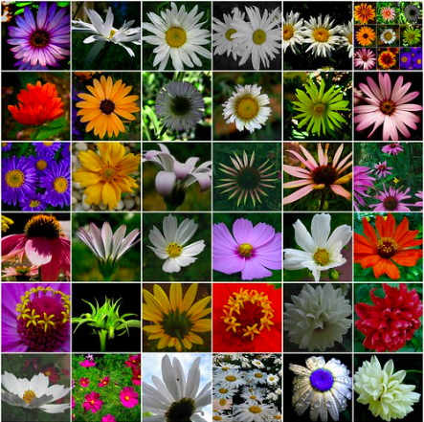
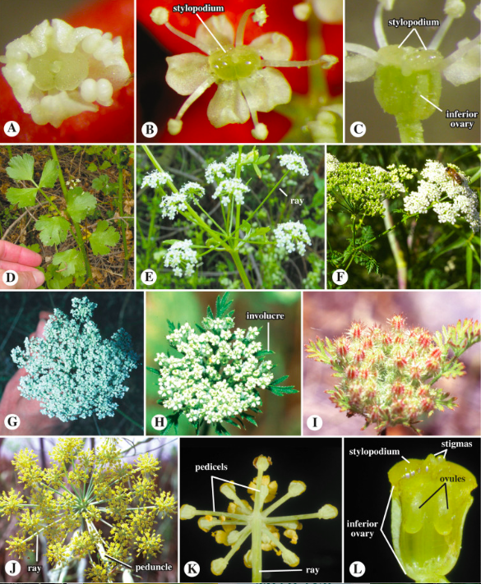
Many unsaturated secondary metabolites also contain triple bonds produced mainly by further dehydrogenations of olefinic systems into molecules derived from fatty acids.
These compounds are widespread in nature, found in many organisms, and particularly in plants belonging to the family of the Compositae / Asteraceae, of the Umbelliferae / Apiaceae (also in fungi Basidiomycetes)
Compositae/Asteraceae
Umbelliferae/Apiaceae

Slide 2
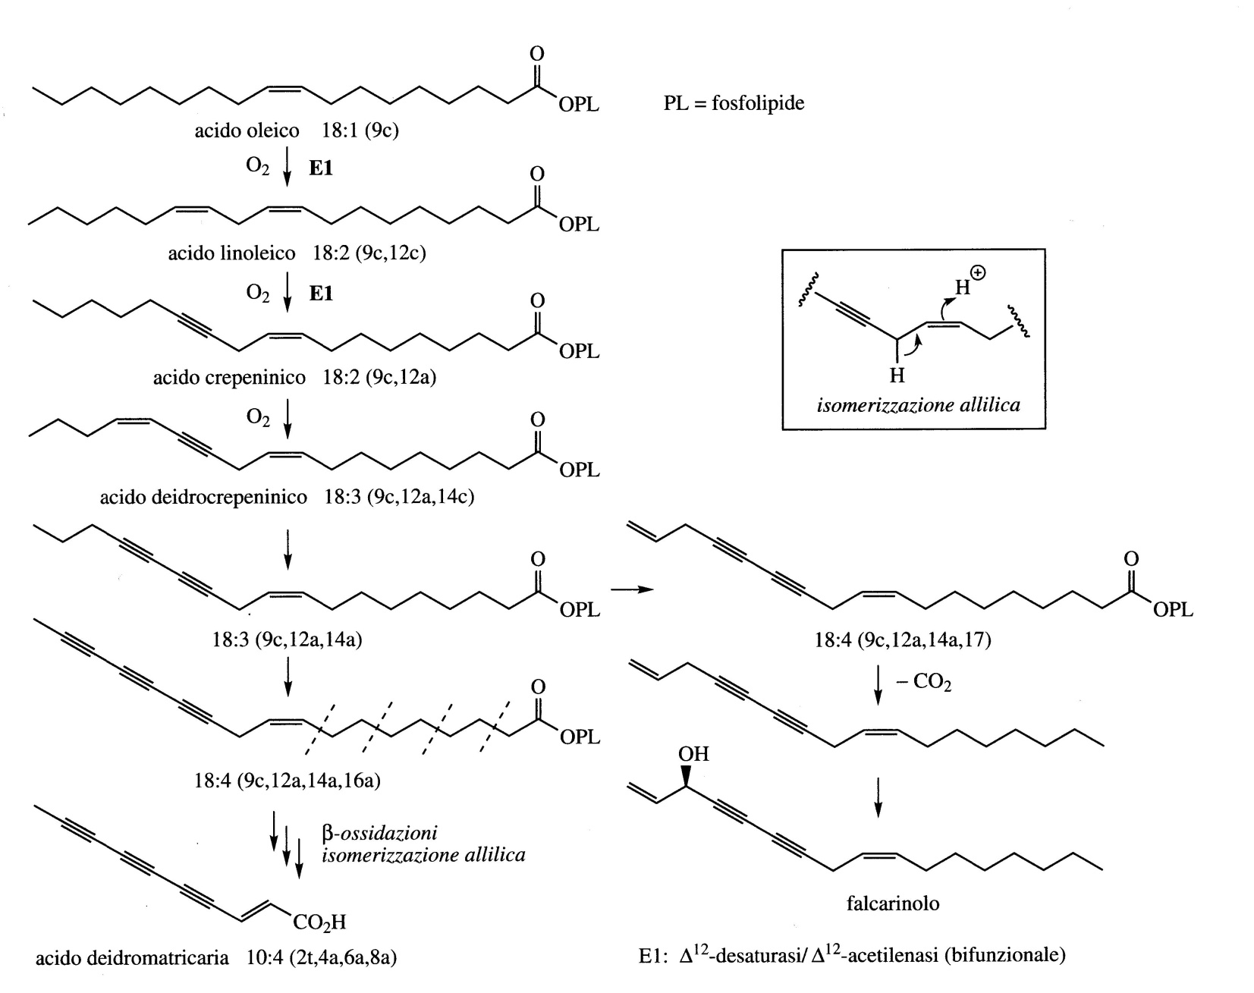
Falcarinol, Ginseng (Panax ginseng) and carrots
Falcarinol synthesis: oleic acid, crepenic and dehydrocrepenic acid are the precursor of falcarinolo.

Slide 3
Falcarinol and CRC
Colorectal cancer (CRC) is a major worldwide health problem and is the third most frequent cause of cancer-related death in developed countries. The growing incidence of CRC is probably associated with a modern lifestyle typified by limited physical activity, alcohol consumption and dietary changes.
In order to reduce the incidence of CRC, effective prevention and treatment strategies need to be identified. Due to the long precancerous stage of this disease, dietary intervention may exert a favorable effect on polyp formation and/or inhibition of the transformation of adenomas to CRC.
Recent findings indicate that long-term consumption of a diet rich in vegetables may prevent the development of CRC. Vegetables contain a wide variety of bioactive secondary metabolites some of which have shown bioactivities that may contribute to their CRC protective effects.

Slide 4
Strong evidence suggests the existence of an association between the development of CRC and the expression of cyclooxygenase (COX) enzyme complex that catalyzes the conversion of arachidonic acid released from membrane phospholipids to prostaglandins. Prostaglandins sustain homeostatic functions and mediate pathogenic mechanisms, including the inflammatory response.
COX-1 is a constitutively expressed enzyme in most mammalian tissues and it is involved in normal physiological functions.
COX-2 levels are normally low but are rapidly induced as an early response to growth factors, cytokines and tumor promoters associated with inflammation, cell survival, abnormal proliferation, angiogenesis, invasion, and metastasis.
The existence of an association between CRC and COX-2 overexpression has been established. COX-2 expression but not COX-1 has been detected in 50% of colorectal adenomas and in up to 85% of colorectal carcinomas, and it is correlated with poor prognosis.

Slide 5
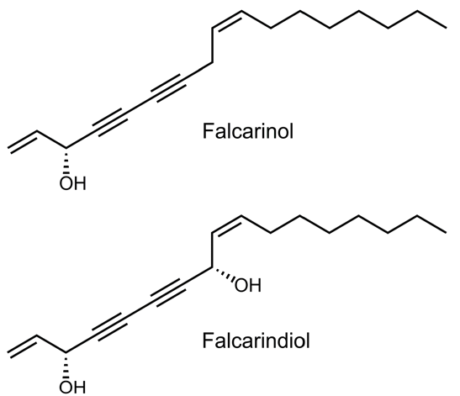
For the prevention of CRC by dietary measures, apiaceous vegetables such as carrots, celery, celeriac, fennel, parsley, and parsnip are highly interesting due to their content of the bioactive polyacetylenic oxylipins falcarinol (FaOH) and falcarindiol (FaDOH).
FaOH and FaDOH have shown many interesting bioactivities, including anti-inflammatory, anti-platelet-aggregatory, anti-diabetic, and cytotoxic activity as well as an anti-neoplastic effect.
FaOH inhibits the growth of the human epithelial colorectal adenocarcinoma cell line Caco-2 in vitro, leads to cell cycle arrest and apoptosis of cancer cells.
The synergistic anti-proliferative effect of FaOH and FaDOH also exists in vivo as recently demonstrated in a cancer primed rat model for CRC where a diet containing 7 μg FaOH and 7 μg FaDOH g−1 feed was shown to significantly inhibit neoplastic transformations in the colon epithelium .
A probable mechanism: do to their alkylating properties FaOH and FaDOH can lead to the inhibition of pro-inflammatory markers, enzymes, and inflammatory transcription factors via covalent alkylation.
https://doi.org/10.3390/nu11092223

Slide 6
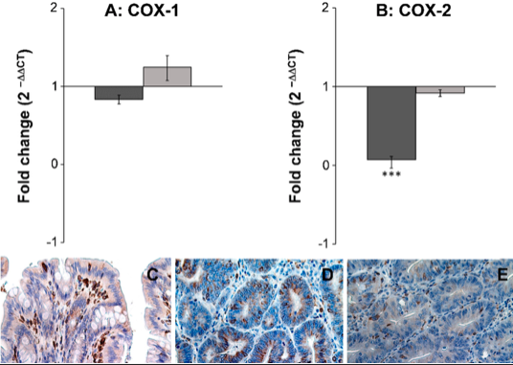
FaOH and FaDOH downregulates expression of COX-2 in neoplastic tissue in colorectal cancer primed rats
FaOH and FaDOH downregulates the expression of 5 different inflammatory and cancer biomarkers:
COX-2, TNFα, IL-6, NF-κβ and PPARγ2,
The amounts of FaOH and FaDOH used in this rat study correspond to a daily human intake of 250–300 g carrots and indicates that apiaceous vegetables could have a preventive effect against CRC.
https://doi.org/10.3390/nu11092223

Slide 7
2019
Danish population of 57,053 individuals with a long follow-up.
Intake of raw carrots at a baseline of 2–4 carrots or more each week (>32 g/day) is associated with a 17% decrease in risk of CRC with a mean follow-up of >18 years, compared to individuals with no intake of raw carrots.
The results of this prospective cohort study clearly support the results from studies in cancer-primed rats for CRC and hence a CRC-preventive effect of carrots.

Slide 8
Amides of fatty acids
The amides of polyunsatured fatty acids have a biological role as signaling molecules in humans (and also in other mammals)
In the roots of Echinacea purpurea, Echinacea angustifolia, Echinacea pallida (Compositae / Asteraceae), there are a series ( at least 12) of alkylamides of polyunsaturated acids with isobutylamine (immunostimulating activity).
Oleammide, amide of oleic acid
Oleamide induces sleep
Oleammide

Slide 9
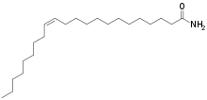
Amides of fatty acids
Erucamide: amide of erucic acid
Erucamide stimulates the growth of blood vessels (angiogenic agent)
Erucammide

Slide 10
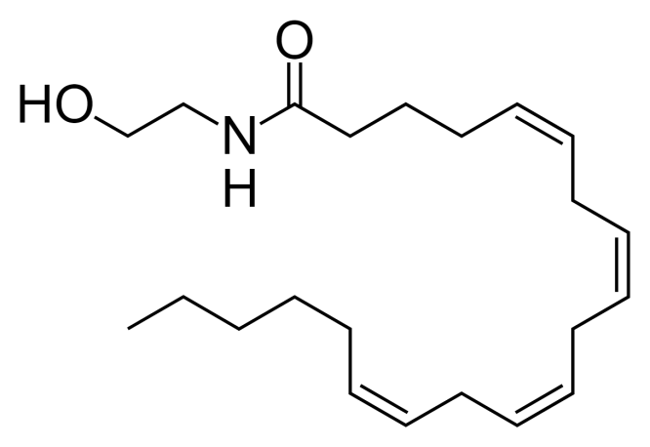
Amides of fatty acids
Anandamide, amide of arachidonic acid
Anandamide or arachidonoylethanolamine (AEA) binds to cannabinoid receptors
Anandamide

Slide 11
Uncommon fatty acids
Ricinoleic acid: oxidation of oleic acid of oil
of castor (preparation of creams)
Acid undecenoic: thermal degradationof ricinoleic acid (fungistatic).

Slide 12
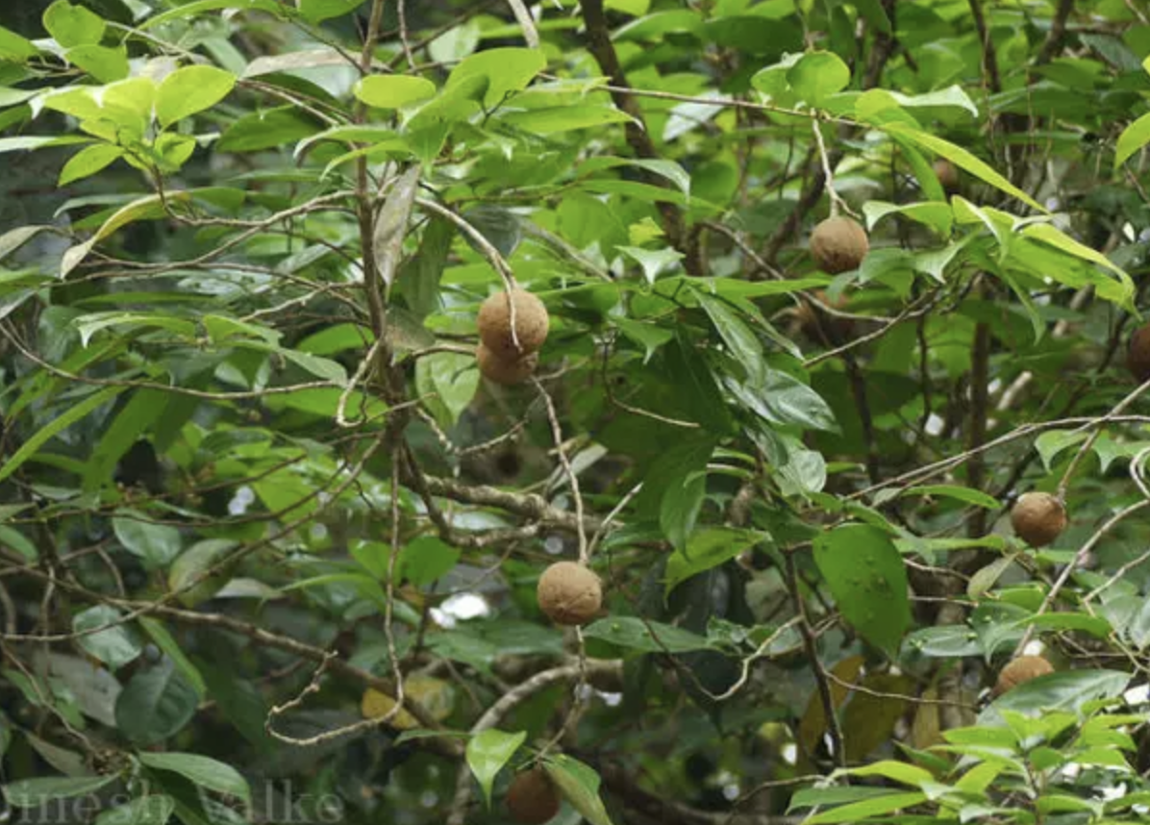
Uncommon fatty acids
The hydnocarpic acid and chaulmoogric acid are found in the oil extracted from the seeds of Hydnocarpus wightiana (Flacourtiaceae)
They have long been the only remedy for leprosy (now their salts and esters are used).
Hydnocarpic acid and chaulmoogric acid: antibacterial action, in particular towards mycobacteria.
Hydnocarpus wightiana

Slide 13
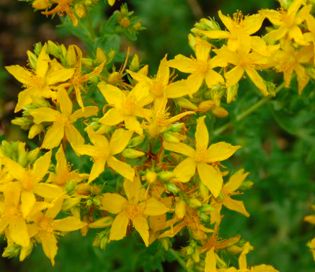
Hyperforin
The dried ends of the inflorescences of St. John's Wort (Hypericum perforatum, Guttiferae / Hypericacee) have been used for many years as a herbal remedy, taking advantage of the antiseptic and healing properties of their vegetable oil extract.
St. John's Wort is sold as an antidepressant with similar efficacy to antidepressants but with fewer side effects than Prozac.
The main contribution to this activity seems to be due to the presence of hyperforin in the oily extract. The polyketide nature of hyperforin is almost entirely obscured by the isoprenoid fragments that are added in the biosynthetic pathway.
Hypericum perforatum

Slide 14
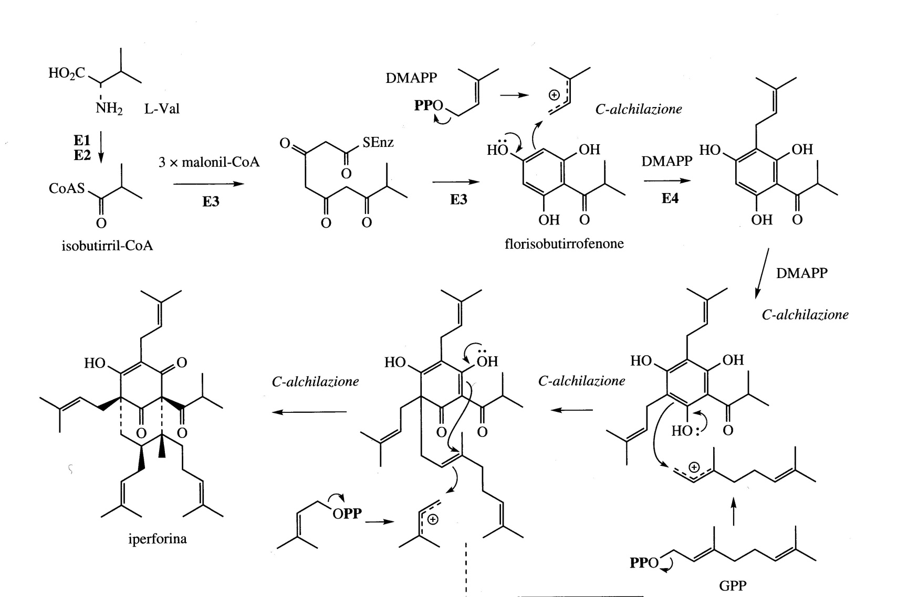
Biosynthesis of hyperforin

