Slide 1
LE CICLINE DI FASE G1
ALMENO UNA CICLINA DI FASE G1 E’ RICHIESTA PER GARANTIRE LA VITALITA’ CELLULARE
Cln1,2 hanno 75% di omologia, 25% con Cln3.
La trascrizione di CLN1, 2, dipendente dal fattore trascrizionale SBF (Swi4/Swi6), oscilla durante il ciclo con un picco massimo a START
La trascrizione di CLN3 ha un andamento quasi costante con un modesto picco in late M/early G1
Cln2: 1801 +/- 531 mol/cell (https://www.yeastgenome.org/locus/S000006177#protein, SGD)
Cln1: 796 +/- 477 mol/cell (https://www.yeastgenome.org/locus/S000004812#protein, SGD)
Cln3: 873 mol/cell (https://www.yeastgenome.org/locus/S000000038#protein, SGD)
L’attività chinasica in vitro del complesso Cln2/Cdc28 sul substrato istone H1 è superiore rispetto a quella del complesso Cln3/Cdc28, coerentemente con i diversi livelli delle cicline Cln2 e Cln3
Nei mutanti cln3Δ la massa cellulare critica per START aumenta rispetto ai mutanti cln1Δ e cln2Δ (dove i cambiamenti sono di modesta entità)
cln1Δ cln2Δ cln3Δ letale

Slide 2
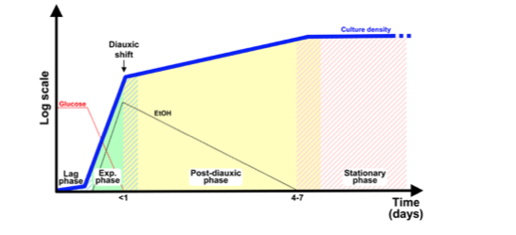
Manipolando i livelli di espressione del gene che codifica la proteina Cln3 si determina un’alterazione della durata della fase G1:
cln3Δ → G1 estesa ed aumento della massa cellulare
Overespressione di CLN3 → G1 ridotta e diminuzione massa cellulare
I livelli di Cln3 sono regolati in funzione delle condizioni nutrizionali:
Crescita esponenziale terreno ricco (alta velocità di crescita) → alti livelli di Cln3
Crescita che segue lo shift diauxico (fase ossidativa-bassa velocità di crescita) → bassi livelli di Cln3
cln3Δ non è letale perché esiste la ciclina Bck2 che induce la trascrizione di CLN1 e CLN2, vicardiando la funzione di Cln3
cln1Δcln2Δ non è letale perché Cln3 induce la trascrizione di geni che codificano per altre cicline (PCL1 e PCL2) che vicariano la funzione di Cln1 e Cln2
cln1Δcln2Δ cln3Δ è letale perché in questo mutante la trascrizione di tutte le cicline è compromessa
cln3Δ bck2Δ è letale perché la trascrizione delle cicline di fase G1 è completamente compromessa
Growth phases of S. cerevisiae cultivated in rich medium supplemented with glucose. When quiescent, stationary phase cells are inoculated in fresh medium, they exhibit an initial lag phase of variable length. During the subsequent exponential phase cells proliferate rapidly by fermenting glucose to ethanol. When glucose becomes limiting, cells transiently arrest growth to adjust their metabolism from fermentative to the respiratory mode (diauxic shift): after the switch to respiration, cells restart growing at a reduced rate by slowly consuming the ethanol accumulated in the medium. When ethanol is also exhausted, cells cease dividing and enter into a quiescent state known as stationary phase

Slide 3
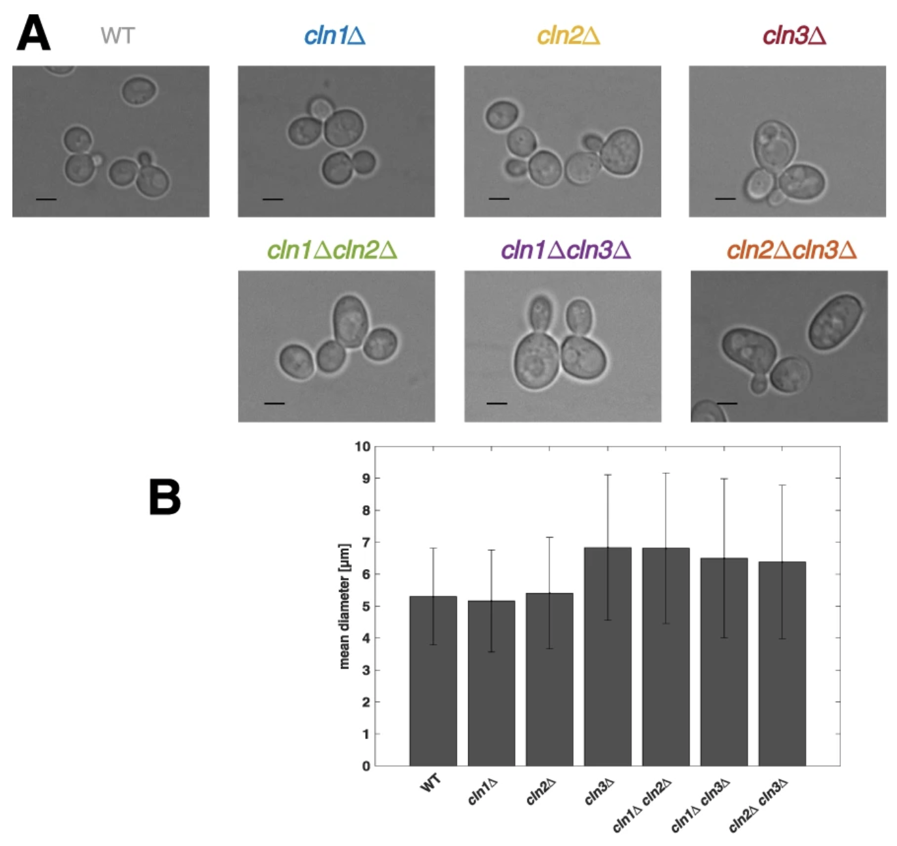

Slide 4
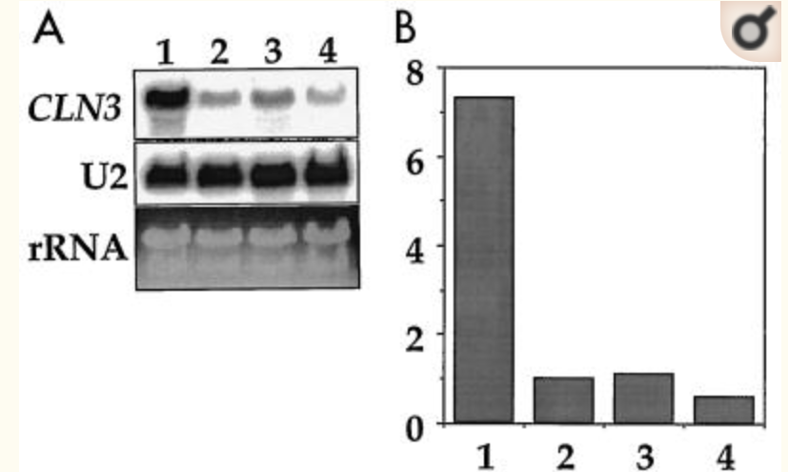
Carbon source regulation of CLN3 mRNA levels
Growth phases of S. cerevisiae cultivated in rich medium supplemented with glucose. When quiescent, stationary phase cells are inoculated in fresh medium, they exhibit an initial lag phase of variable length. During the subsequent exponential phase cells proliferate rapidly by fermenting glucose to ethanol. When glucose becomes limiting, cells transiently arrest growth to adjust their metabolism from fermentative to the respiratory mode (diauxic shift): after the switch to respiration, cells restart growing at a reduced rate by slowly consuming the ethanol accumulated in the medium. When ethanol is also exhausted, cells cease dividing and enter into a quiescent state known as stationary phase
J Bacteriol. 1998 Jan; 180(2): 225–230.
I livelli di mRNA di CLN3 sono più alti in cellule in crescita esponenziale in glucosio rispetto a cellule in crescita post-diauxica ed in fase stazionaria.

Slide 5
CLN3 mRNA levels are decreased in cells growing on non-fermentable carbon sources
J Bacteriol. 1998 Jan; 180(2): 225–230.
I livelli di mRNA di CLN3 sono più alti in terreno con fonte di carbonio fermentabile rispetto a fonte non fermentabile.

Slide 6
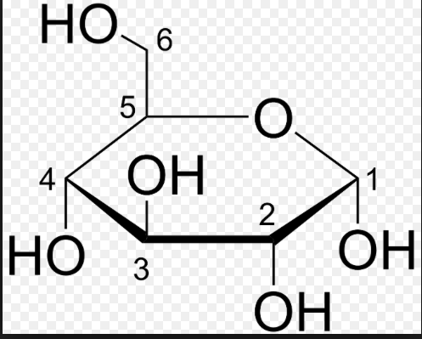
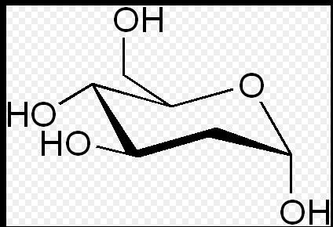
2-Deoxy-D-glucose is a glucose molecule which has the 2-hydroxyl group replaced by hydrogen, so that it cannot undergo further glycolysis
J Bacteriol. 1998 Jan; 180(2): 225–230.
I livelli di mRNA di CLN3 sono regolati dal metabolismo del glucosio (glicolisi) e non direttamente dal glucosio

Slide 7
URA3
(reporter gene)
CLN3 promoter
Analisi di delezione di porzioni del promotore di CLN3 per identificare elementi coinvolti nella regolazione ad opera del glucosio.
La regolazione dell’ mRNA di CLN3 avviene mediante un set di sequenze ripetute AAGAAAAA che si trova nel promotore.

Slide 8
Glucosio
Azf1
Promoter (AAGAAAAA)
CLN3
Mol Cell Biol. 2002 Mar; 22(5): 1607–1614.
Trascrizione
La sequenza presente nel promotore di CLN3 è riconosciuta dal fattore trascrizionale Azf1 che contiene un motivo zinc-finger, regolatore positivo della trascrizione di CLN3 in glucosio.

Slide 9
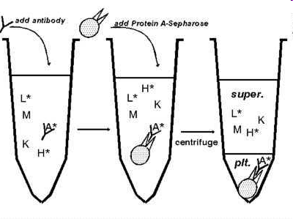
Immunoprecipitazione
M IP1 IP2
In vivo analysis of protein X by immuno-precipitation
Elution of Sic1
P
SDS-PAGE

Slide 10
c-Myc protein is a transcription factor, encoded by the c-Myc gene on human chromosome 8q24. A synthetic peptide corresponding to residues 410-419 of the human p62 c-myc protein conjugated to KLH is used as immunogen.
c-Myc-tag provides a method of localizing gene products in a variety of cell types, to study the topology of proteins and protein complexes and of identifying associated proteins. This product is suitable for detecting the expression level of c-Myc fusion proteins or c-Myc by various immunoassays.
FLAG-tag, or FLAG octapeptide, is a polypeptide protein tag that can be added to a protein using recombinant DNA technology. It can be used for affinity chromatography, then used to separate recombinant, overexpressed protein from wild-type protein expressed by the host organism. It can also be used in the isolation of protein complexes with multiple subunits.A FLAG-tag can be used in many different assays that require recognition by an antibody. If there is no antibody against the studied protein, adding a FLAG-tag to this protein allows one to follow the protein with an antibody against the FLAG sequence. Examples are cellular localization studies by immunofluorescence or detection by SDS PAGE protein electrophoresis.The peptide sequence of the FLAG-tag is: N-DYKDDDDK-C (1012 Da).
HA-protein Monoclonal antibody is produced by immunizing animals with a synthetic peptide containing the influenza hemagglutinin epitope YPYDVPDYA.

Slide 11
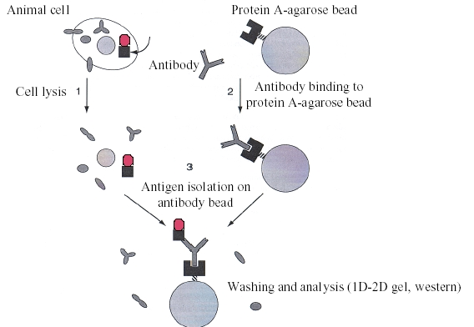
Co-immunoprecipitazione

Slide 12
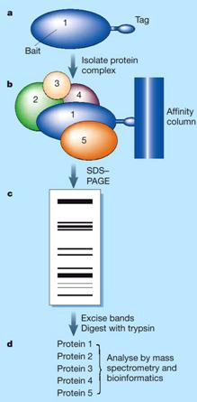
Affinity co-purification
(pull down)

Slide 13
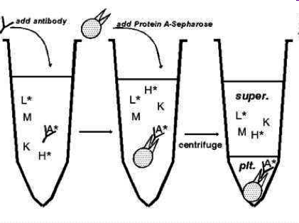
In vitro Kinase assay (H1 Histone)
The tube is centrifuged, bringing all the kinase-coated beads to the bottom of the tube. This experimental technique is called immunoprecipitation. The rest of the cell lysate is discarded.
The bead pellet is incubated with a target substrate (i.e. H1 histone) as well as radiolabeled γ ³²P-ATP: the kinase will transfer the radioactive phosphate from ATP onto the substrate.
After the incubation (30 min 30°C), a sample is taken and, after denaturation with SDS-sample buffer, run on an SDS-PAGE gel.
The gel is then dried and examined by autoradiography. Any radioactive samples on the gel can be detected. If the substrate is phosphorylated by the kinase, it will show up on the autoradiogram.
Or without labelling but specific antisiera generated by immunizing rabbits with specific synthetic phosphopeptide are required.
Ip Kinase complex + ATP ³²P + H1- Histone
? Cln2/Cdc28 and Cln3/Cdc28 kinase activity

Slide 14
Jove Content
An Introduction to Saccharomyces cerevisiae:
https://www.jove.com/v/5081/an-introduction-to-saccharomyces-cerevisiae

Slide 15
Jove Content
Co-Immunoprecipitation and Pull-Down Assays :
https://www.jove.com/v/5695/co-immunoprecipitation-and-pull-down-assays

Slide 16
Jove Content
Identification of Cyclin- dependent Kinase 1 Specific Phosphorylation Sites by an In Vitro Kinase Assay:
https://www.jove.com/v/57674/identification-cyclin-dependent-kinase-1-specific-phosphorylation

