Slide 1
Cannabis sativa L.
Cannabis is a genus of plants in the family Cannabaceae.
There are three recognized species of Cannabis (e.g., Cannabis sativa, Cannabis indica and Cannabis ruderalis) and more than 700 strains.
Cannabis has more than 400 bioactive components, which majorly include cannabinoids (or phytocannabinoids), polyphenols, flavonoids, terpenes, terpenoids, fatty acids, oils and waxes.

Slide 2
The leaves and female flowers of Cannabis plants are of significant interest because of the presence of secondary metabolites:
cannabinoids, flavonoids, terpenoids, alkaloids, lignans, anthocyanins and quinones.
The female flower is the largest reservoir of cannabinoids, usually stored in the glandular trichome spiked on the leafy surface of the flower. The male flower present in the hermaphrodite is responsible for the fertilization process by pollination, from which the female flower grows to seed.
The seed, commonly known as hemp seed, is a potent plant source of PUFA.

Slide 3
Hempseed fatty acids profile
(% of oil)
Nutrients 2020, 12(7), 1935; https://doi.org/10.3390/nu12071935

Slide 4
Hempseed oil contained up to 90% unsaturated fatty acids, of which from 70% to over 80% is composed by PUFAs.
The major monounsaturated fatty acid (MUFA) was Oleic Acid (18:1, OA).
Among PUFAs, Linoleic Acid (18:2, LA, ω-6 ) was the most representative FA in hempseed oil of all analysed genotypes, accounting for more than half of the total FA.
The second prominent PUFAs was α-linolenic acid (18:3, ALA, ω-3).
Hempseed oil represents an especially rich source of Essential Fatty Acids (EFAs).

Slide 5
In addition to the absolute concentration of PUFAs in the diet, ω-6/ ω-3 ratio represents an important index to ensure the maintenance of an optimal state of health, and to prevent the onset of chronic-degenerative diseases characterized by a chronic inflammation status, like cardiovascular and neurodegenerative diseases, as well as cancer.
Despite the existence of different lines of thought about the healthiest ω-6/ ω-3 ratio, according to the European Food and Safety Authority (EFSA), the ideal ω-6/ ω-3 ratio has been established as 3:1 to 5:1 (traditional Japanese and Mediterranean diets, low incidence of coronary disease).
The levels of Linoleic Acid (LA, ω-6) and α-linolenic acid (ALA, ω-3) found in the fat component of hempseeds make them a food matrix with the ideal, low ω-6/ ω-3 ratio ranging precisely from 3:1 to 5:1, which is useful for reducing the ω-6/ ω-3 ratio in diets, especially of industrialized countries, where there is an unhealthy average ω-6/ ω-3 ratio of about 10:1.

Slide 6
Hempseed fatty acids profile
(% of oil)
Nutrients 2020, 12(7), 1935; https://doi.org/10.3390/nu12071935

Slide 7
The manifold applications of plant
Nutrients 2020, 12(7), 1935; https://doi.org/10.3390/nu12071935

Slide 8
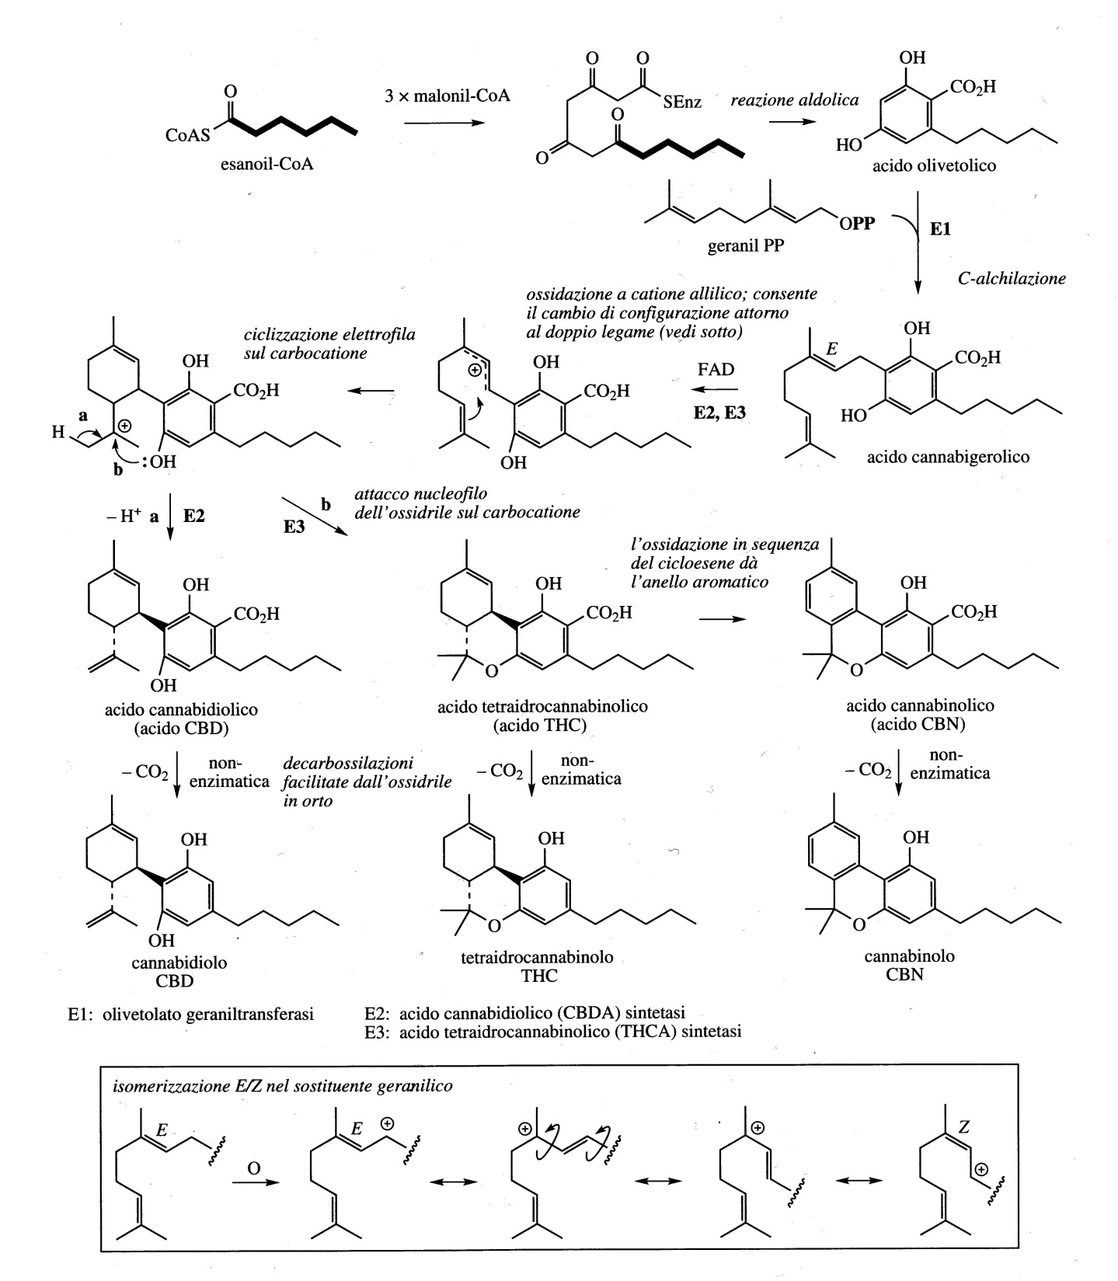
The cannabinoid synthetic pathway
In the formation of cannabinoids, a group of phenolic terpenes isolated from Cannabis sativa, the starter unit: C6 unit of hexanoil-CoA
The main psychoactive component is the tetrahydrocannabinol (THC), while the other structurally related compounds such as cannabinol (CBN) or cannabidiol (CBD) are non-psyhcotropic phytocannabidoids.

Slide 9
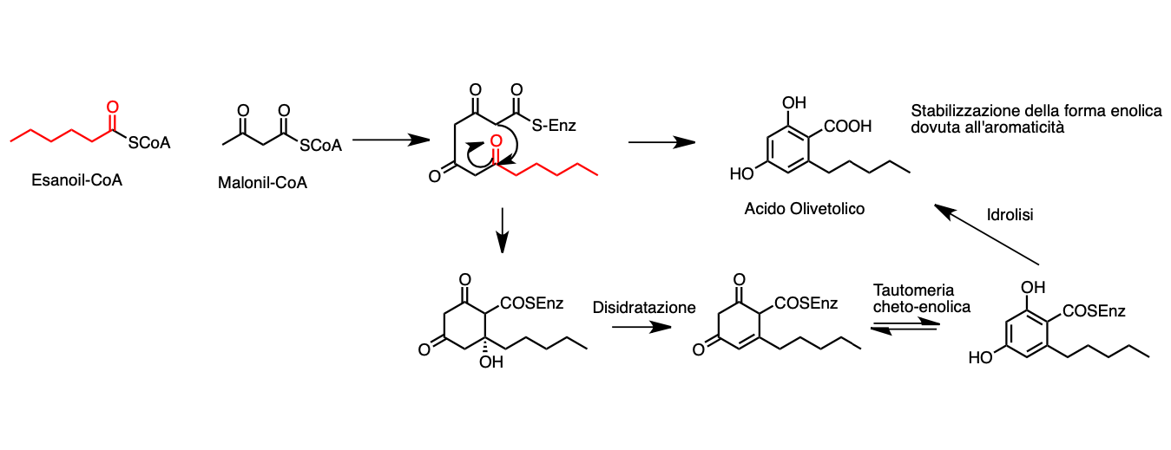

Slide 10
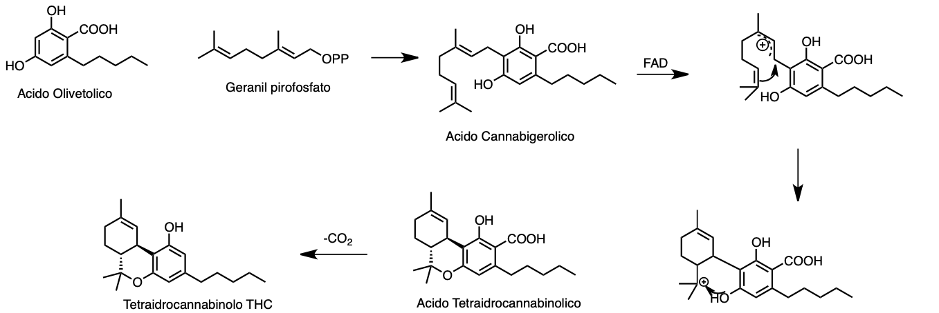

Slide 11
The cannabinoid synthetic pathway
Olivetolic acid is originated in the cytosolic polyketide pathway through an aldol condensation of hexanoyl-CoA with three molecules of malonyl-CoA, that is catalysed by the polyketide synthase (PKS) enzyme in the presence of olivetolic acid cyclase (OAC).
Nutrients 2020, 12(7), 1935; https://doi.org/10.3390/nu12071935

Slide 12
The cannabinoid synthetic pathway
Cannabigerolic acid (CBGA) is the common precursor of all main cannabinoids.
It is synthethesized through an alkylation of the phenolic moiety of olivetolic acid with the terpenoid component of geranyl pyrophosphate (GPP).
The reaction is catalysed by a geranylpyrophosphate:olivetolate geranyl-transferase (GOT).
Nutrients 2020, 12(7), 1935; https://doi.org/10.3390/nu12071935

Slide 13
The cannabinoid synthetic pathway
The GPP is synthesized by the plastidial methylerythritol
phosphate (MEP) pathway.
In the cytosol, CBGA is converted into the acidic form of the three main
cannabinoids, tetrahydrocannabinol acid (THCA) that in the acidic form has no psychoactive activity,
cannabidiolic acid (CBDA) and cannabichromenic acid (CBCA).
Nutrients 2020, 12(7), 1935; https://doi.org/10.3390/nu12071935

Slide 14
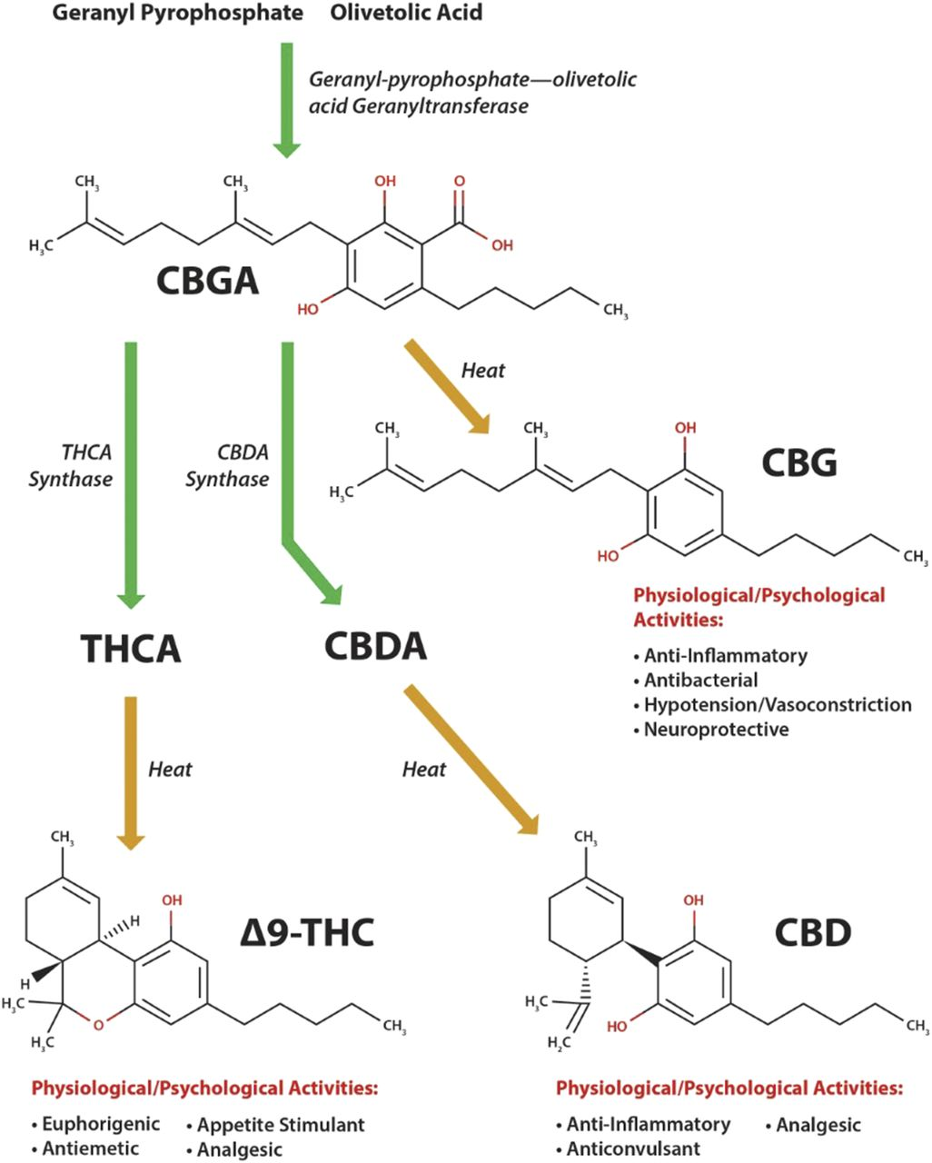
Cannabinoid synthesis begins with the precursor molecules olivetolic acid and geranyl-pyrophosphate, which combine to form cannabigerolic acid (CBGA)
CBGA serves as the precursor to most other cannabinoids and is converted to Δ9-tetrahydrocannabinolic acid (Δ9-THCA), cannabidiolic acid (CBDA), and cannabichromenic acid.
All enzymatically produced cannabinoids (including CBG) are produced as their acidic form and are then decarboxylated by heat to create the “active” form.

Slide 15
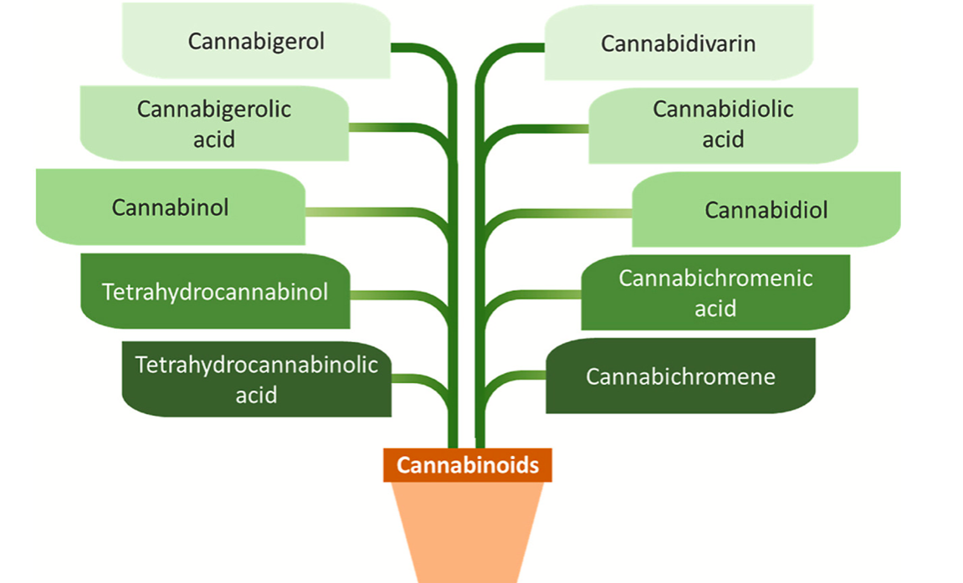
Δ9-tetrahydrocannabinol (THC) has psychoactive activity.
Usually, drug-type Cannabis contain a higher content of THC, whereas hemp (fiber-type) contains lower levels of THC.
The highly lipophilic nature of THC makes it rapidly soluble in the blood.
Besides these phytocannabinoids, there is an endocannabinoid (eCB) system in the human body, which secretes the molecules (endocannabinoids) to activate the cannabinoid receptors namely CB1 and CB2.
https://doi.org/10.1016/j.chemosphere.2021.133012

Slide 16
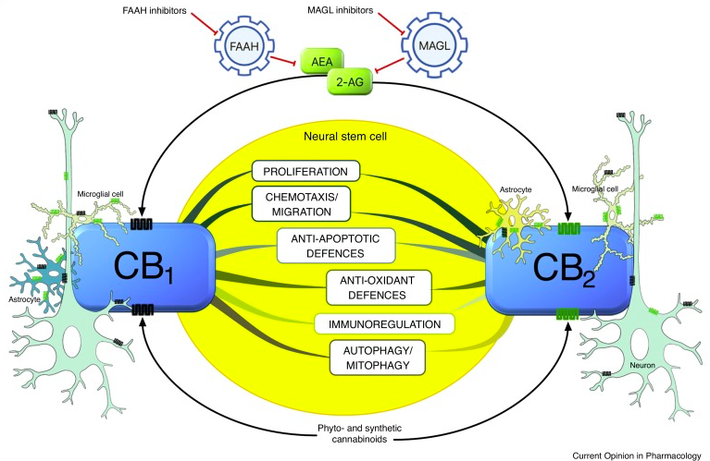
The endocannabinoid system (eCB)
In NSCs, CB₁ and CB₂ receptors display an extremely intricate signaling activity through which they modulate a variety of cellular processes:
survival
proliferation
differentiation
migration
maturation of NSCs
https://doi.org/10.1016/j.coph.2019.11.002

Slide 17
The ECS (endocannabinoid system) of the central nervous system plays several regulatory functions including cognition, appetite stimulation, analgesia, blood pressure, pain relief.
The endogenous cannabinoids are presumed to mediate neuronal plasticity via regulation of potentiation, inhibition, and disinhibition of synaptic output, ultimately modulating synaptic functions.
Although the exact molecular mechanism is not elucidated, further research will aid our understanding of complex processes involved, including cognitive functions, learning, and memory.

Slide 18
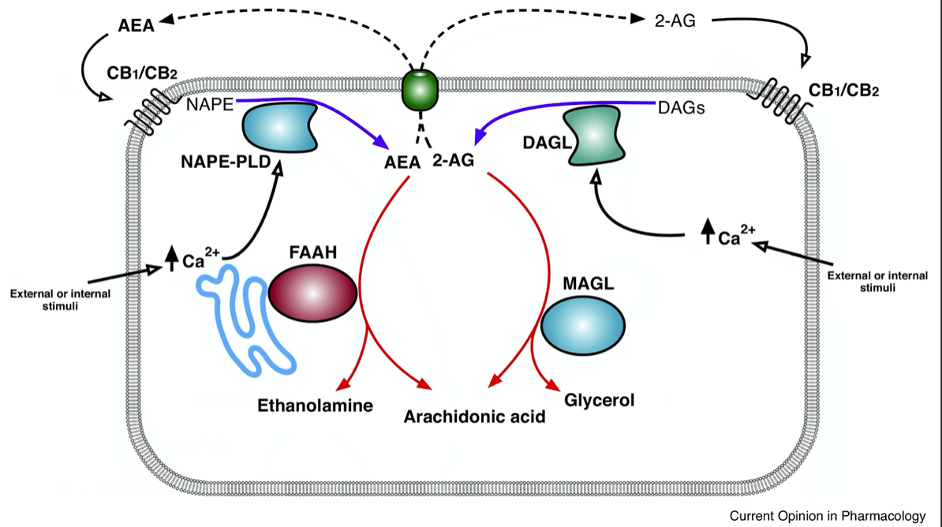
The eCB system
The eCB is a complex lipid network consisting of cannabinoid receptors (CBRs), endogenous ligands, and the enzymes involved in endocannabinoid degradation and synthesis.
Chemicals derived from fatty acid amides and diacylglycerols, endocannabinoids (eCBs) are synthesized endogenously in mammals and are produced on demand in response to increased intracellular calcium levels ([Ca2+]i).
The main eCBs are:
arachidonoylethanolamide, also known as anandamide (AEA)
2-arachidonoyl-glycerol (2-AG)
https://doi.org/10.1016/j.coph.2019.11.002

Slide 19
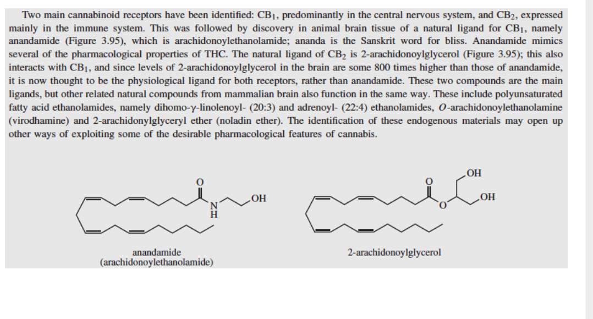

Slide 20
The eCB system
CB₁and CB₂ , cannabinoid receptors, are two G protein-coupled receptors (GPCRs)
two main biosynthetic enzymes:
Nacylphosphatidylethanolamine-specific phopsholipase D (NAPE-PLD) for AEA and diacylglycerol lipase (DAGL) for 2-AG
two main degradative enzymes, fatty acid amide hydrolase (FAAH) for AEA and monoacylglycerol lipase (MAGL) for 2-AG
https://doi.org/10.1016/j.coph.2019.11.002

Slide 21
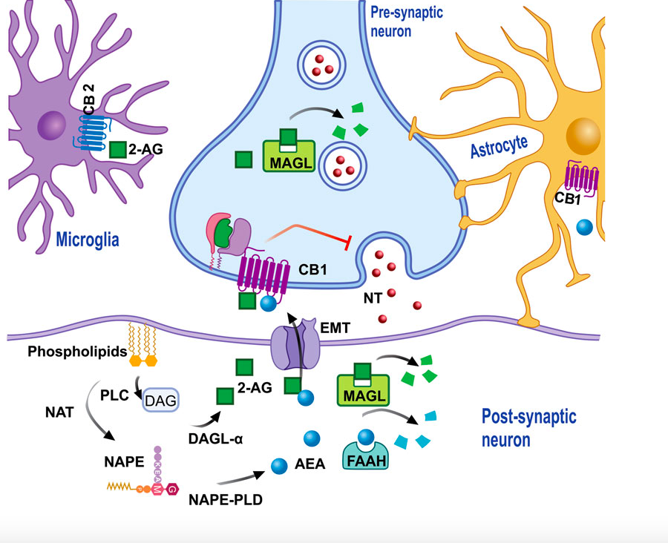
The eCB system controls cell choice between survival and death, immune response, neuronal maturation, neurotransmission, energy homeostasis and reproduction.
Widely distributed throughout the body and highly expressed within the central nervous system.
Unlike classical neurotrasmitters, within neurons AEA and 2-AG are formed ‘on demand’ from membrane precursors, rather than being stored in synaptic vescicles.
The mechanisms by which cells release and take up these bioactive lipids, have not been fully understood yet, but it is likely to involve putative eCB membrane transporters, intracellular carriers and/or passive diffusion.
The eCB system

Slide 22
The retrograde signaling
The ECS is evidenced to follow a retrograde signalling:
the endocannabinoids are released from the post- synaptic end and receptors are localised to pre-synapses.
The endocannabinoid release can be regulated by calcium influx or calcium-independent pathways. 2-AG and AEA are synthesised in post-synapse and, being lipid messengers, are easily diffused through the membrane into the synaptic cleft towards the pre-synapse in a mechanism which is yet to be elucidated.
They activate CB1R in pre-synapse to block signalling neurotransmitter release through suppression of Ca2+ in- flux via inhibiting voltage-gated Ca2+ channels or by inhibiting cAMP/PKA pathway which inhibits adenylyl cyclase. Anandamides, on the other hand, diffuse into the synaptic cleft and activate CB1R, or other non-CBRs such as transient receptor potential cation channel subfamily V member 1 (TRPV1) as a full agonist.
Anandamides are also synthesised in pre-synapse yet it is not clear whether they are responsible for anterograde signalling process.

Slide 23
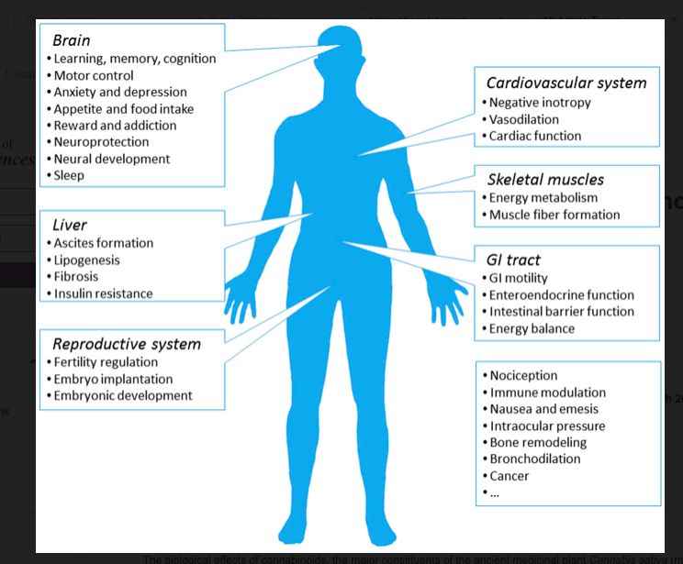
Localization and function of CB1 receptor
CB1 receptors are particularly enriched in the nervous system but are also present in diverse organs, including the liver, adipose tissue, and skin.
In neurons, CB1 receptors are particularly enriched on synaptic terminals, reflecting their major role in modulating synaptic transmission. In addition, functional CB1 receptors are expressed by some astrocytes
CB2 receptors are primarily expressed in imune cells where they exert various immunosuppressive actions

Slide 24
CB1 is also responsible for the psychotropic effect of Δ⁹-tetrahydrocannabinol.
CB1 receptor is the most abundant GPCR in the central
nervous system, and is highly expressed in brain areas
associated with emotionality, cognition and memory like
brain cortex, limbic system, substantia nigra and
hippocampus

Slide 25
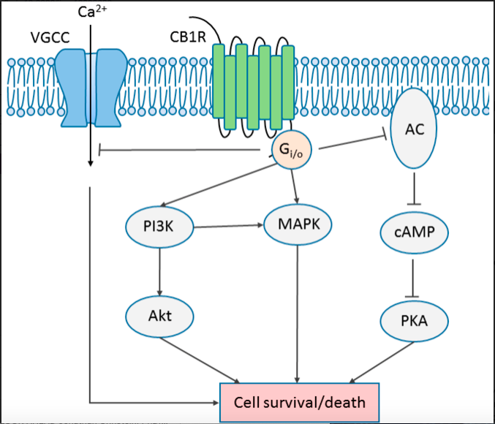
Both cannabinoid receptors are coupled to heterotrimeric G_{i/o} proteins through which they modulate multiple signal transduction pathways, including
inhibition of adenylyl cyclaseand cyclic AMP-protein kinase A (PKA);
activation of extracellular signal-regulated kinase 1 (ERK1) and ERK2;
activation of p38 MAPK and JUN N-terminal kinases (JNKs);
activation of phosphatidylinositol 3-kinase-Akt-mTOR (PI3K/Akt/mTOR);
Regulation of neurons membrane potential by modulating the opening of specific Ca²⁺ and K⁺ ion channels

Slide 26
Adult neurogenesis: an important player in brain homeostasis that could be involved in brain plasticity and repair in adulthood.
Regulatory mechanisms that can promote the process of generating new functional neurons in the adult brain, may lead to strategies for preventive and/or therapeutic approaches against cognitive decline, as well as against age-related brain disorders.
A considerable body of evidence now supports the intriguing possibility that the eCB system is involved in the regulation of proliferation, survival and migration of NSCs and their progeny in the adult brain.
A number of recent studies on the relevance of eCB signaling both in health and in the context of different neuropathological conditions accompanied by impaired neurogenesis are emerging.
They include stroke, epilepsy, alcohol intoxication, Alzheimer’s disease and Parkinson’s disease.
The precise role played by distinct components of the eCB system in NSC biology will contribute to improve our understanding of adult neurogenesis and could provide the basis for new therapeutic applications of eCB-based drugs.

Slide 27
The eCB system
https://doi.org/10.1016/j.coph.2019.11.002

Slide 28
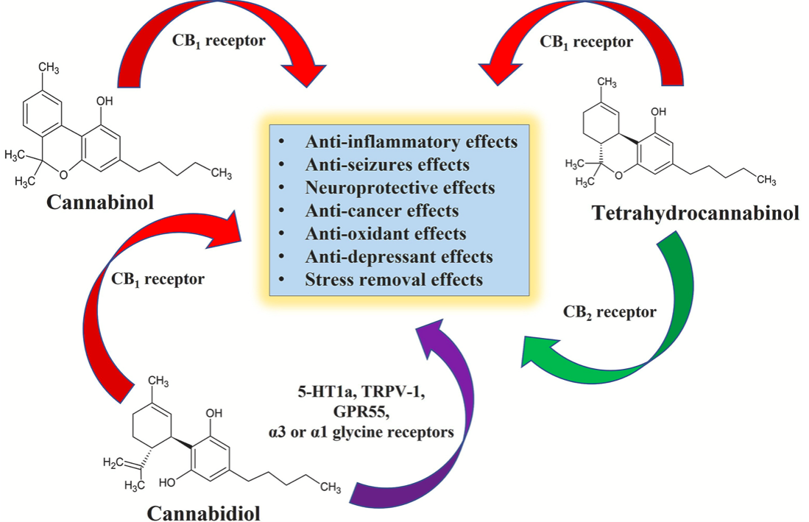
Therapeutic uses of Cannabis

Slide 29
Therapeutic uses of Cannabis

Slide 30
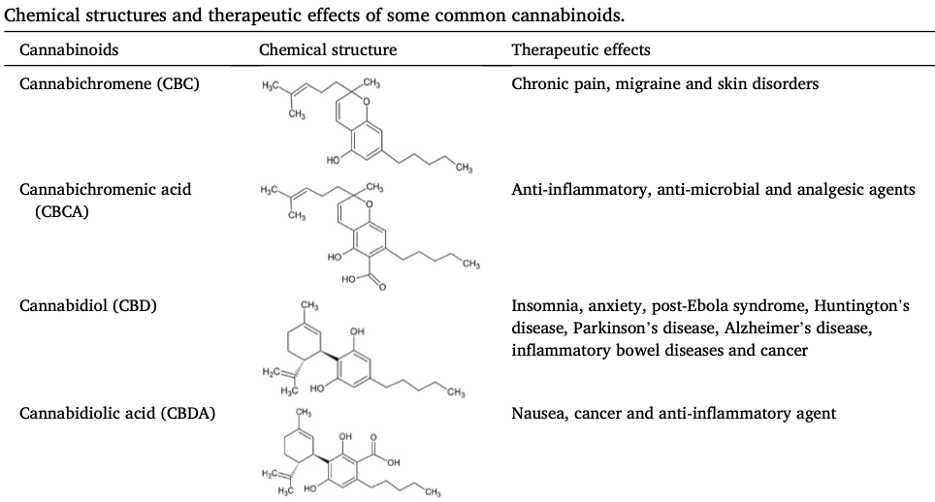
https://doi.org/10.1016/j.chemosphere.2021.133012

Slide 31
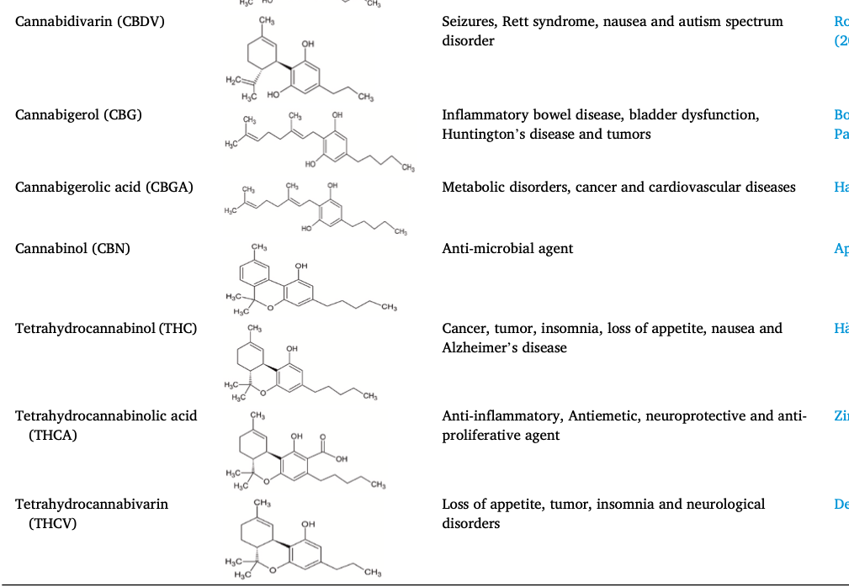
https://doi.org/10.1016/j.chemosphere.2021.133012

Slide 33
Paper discussion

