Slide 1
Shikimic acid : Aromatic AA and Phenylpropanoids

Slide 2
Solar energy
CO₂
CELLULOSE
C3-C4 photosynthesis with Calvin Cycle
SUGARS
GLUCOSINOLATES
Carbohydrates
GLYCOLYSIS
MALONYL-CoA
LIPIDS, PHOSPHOLIPIDS, FATS, WAXES
PENTOSE PHOSPHATE P.
ERYTROSE 4-PHOSPHATE
PHOSPHOENOLPYRUVATE
ACETYL-CoA
MEVALONIC ACID P.
SHIKIMIC ACID P.
TCA
DOXP/MEP
PATHWAY
TERPENOID
PATHWAY
IPP
AROMTIC AA
ALIPHATIC AA
MO-SESQUI-DI-TRI-TETRA-POLY
TERPENES
NITROGEN-CONTAINING SECONDARY PRODUCTS (e.g. ALKALOIDS)
ANTHOCYANINS
FLAVONOIDS
LIGNIN
TANNINS
QUINONES
PHENYLPROPANOID P.
PHENOLIC COMPOUNDS

Slide 3
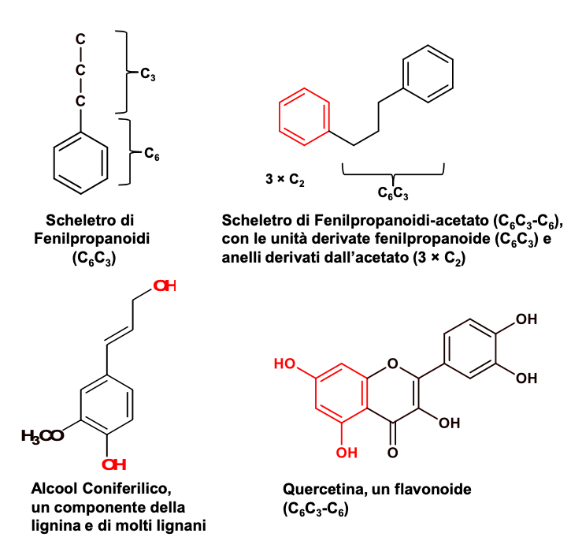
Phenylpropanoids and derivatives are compounds containing a C₆C₃ -moiety derived from the amino acid
L-phenilalanine
Structure of
phenylpropanoids
(C₆C₃)
Phenylpropanoid containing an aromatic ring (C₆)
(C₆C₃-C₆)
Quercetin,
a flavonoid
C₆C₃-C₆
Coniferyl alcohol forms lignin and lignans

Slide 4

Gallotannins
Shikimic acid
PHENYLPROPANOIDS
Quinones
Phosphoenolpyruvate
+
Erytrose 4-phosphate
Corismic acid
L-Tyrosine
trans-Cinnamic acid
L-Phenylalanine
Phenylpropenols
Coumarin
Lignans
Lignins
Benzoic acids
4-Cumaric acid
(4-Hydroxy-cinnamic acid)
Aromatic polyketides
Flavonoids (Anthocyanins,
Catechins, Tannins)
Stilbens
Chalcons
Flavonolignans
Isoflavonoids
Coumarins
Phenylpropens

Slide 5
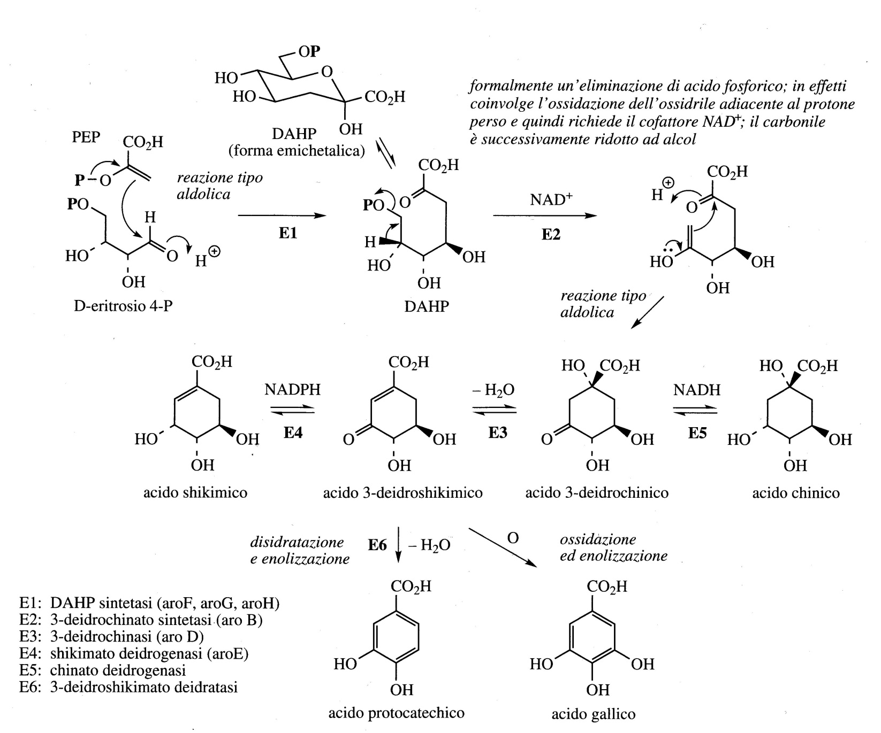
Biosynthesis of Shikimic acid : Aromatic AA and Phenylpropanoids
DAHP Acido 3-deossi-D-arabino-eptulosonico-7-fosfato

Slide 6
Gallotannins
Shikimic acid
PHENYLPROPANOIDS
Quinones
Phosphoenolpyruvate
+
Erytrose 4-phosphate
Corismic acid
L-Tyrosine
trans-Cinnamic acid
L-Phenylalanine
Phenylpropenols
Coumarin
Lignans
Lignins
Benzoic acids
4-Cumaric acid
(4-Hydroxy-cinnamic acid)
Aromatic polyketides
Flavonoids (Anthocyanins,
Catechins, Tannins)
Stilbens
Chalcons
Flavonolignans
Isoflavonoids
Coumarins
Phenylpropens

Slide 7
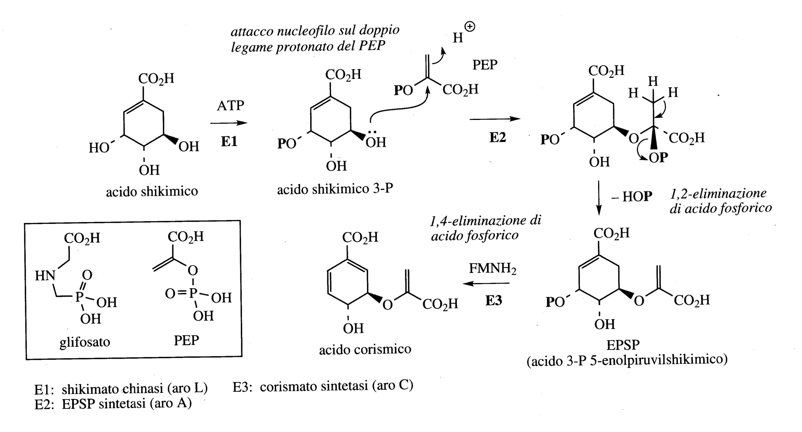
Synthesis of Corismic acid

Slide 8
Gallotannins
Shikimic acid
PHENYLPROPANOIDS
Quinones
Phosphoenolpyruvate
+
Erytrose 4-phosphate
Corismic acid
L-Tyrosine
trans-Cinnamic acid
L-Phenylalanine
Phenylpropenols
Coumarin
Lignans
Lignins
Benzoic acids
4-Cumaric acid
(4-Hydroxy-cinnamic acid)
Aromatic polyketides
Flavonoids (Anthocyanins,
Catechins, Tannins)
Stilbens
Chalcons
Flavonolignans
Isoflavonoids
Coumarins
Phenylpropens

Slide 9
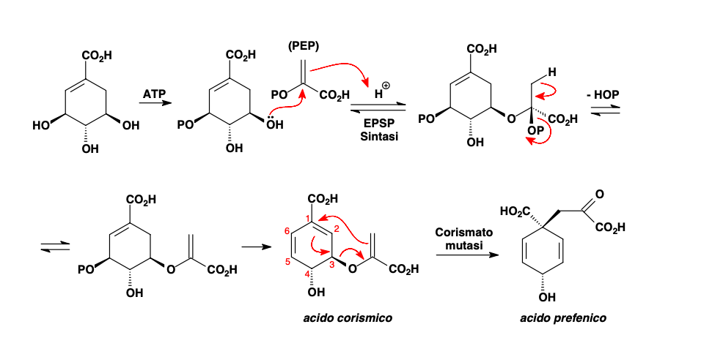
Synthesis of prefenic acid from shikimic acid

Slide 10
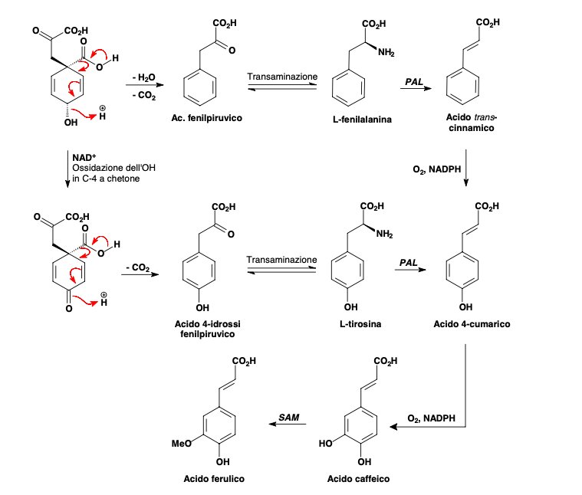
Synthesis of 4-Cumaric acid
and derivatives from prefenic acid
4-coumaric acid (4-Hydroxy-cinnamic acid) (and derivatives among which ferulic acid and caffeic acid) is esterified with CoA and is the starter unit in the synthesis of polychetides.
PAL: phenylalanine/tyrosine ammonia lyases (PAL, TAL)

Slide 11
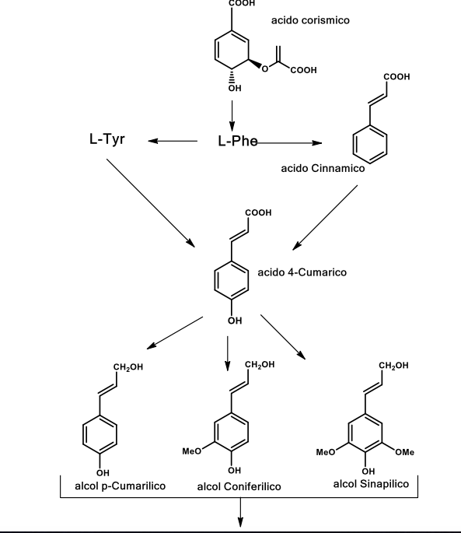
Mammalian cells
Phenylpropenols
LIGNANS and LIGNINS

Slide 12
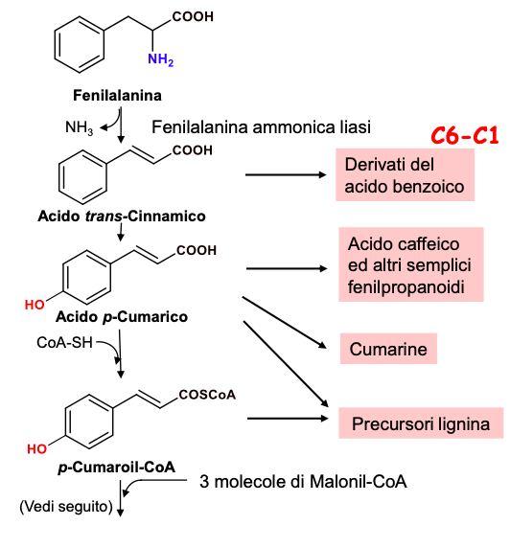
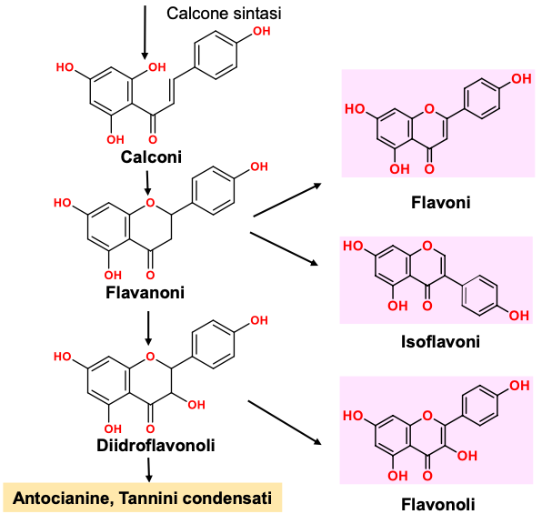
1
2
PAL

Slide 13
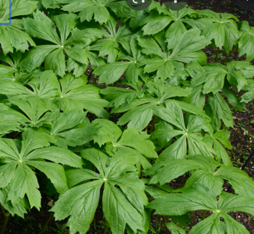
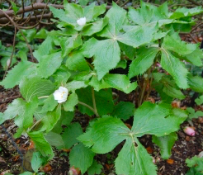
Lignans: dimers of phenylpropene alcohols
coniferyl alcohol
Podophyllotoxin, obtained from plants
of the genus Podophyllum (family Berberidaceae), a mitotic toxin whose derivatives have been used as chemotherapeutic agents.
Podophyllum peltatum
Podophyllum hexandrum

Slide 14
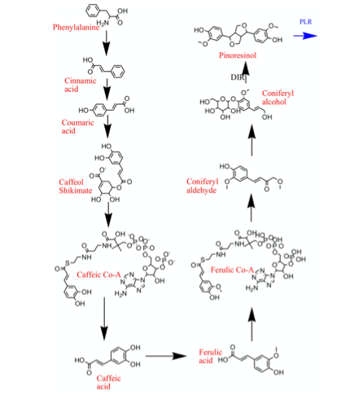
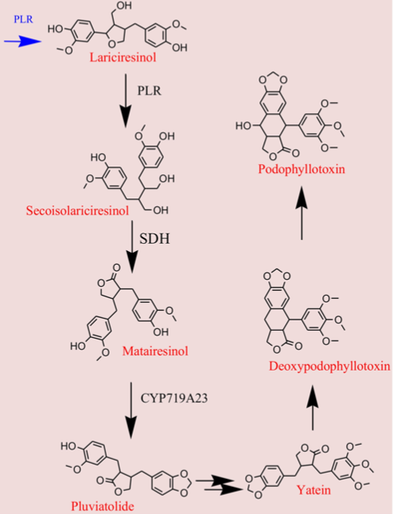
Biomolecules 2021, 11, 603. https://doi.org/10.3390/biom11040603

Slide 15
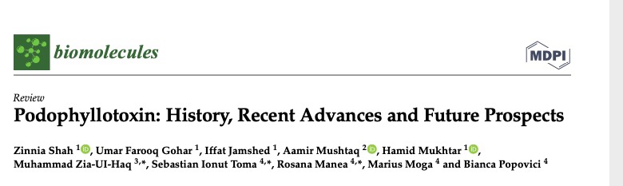
Biomolecules 2021, 11, 603. https://doi.org/10.3390/biom11040603
Podophyllotoxin (C22H22O8) is a selective cyclolignan whose structure was first elucidated in 1930s.
Podophyllotoxin is known to prevent cell growth through inhibiting the polymerization of tubulin and thus subdue the configuration of mitotic spindles. The therapeutic use of these drugs is however hindered by myelosuppression, development of drug-resistance and their cytotoxic activity towards normal body cells.
Extensive structural modifications of podophyllotoxin have culminated to eventually discover clinically viable anticancer drugs. The synthesis of new potent podophyllotoxin-derivatives is a continuing ( see review ). These have thence opened a window for virtual designing of unlimited podophyllotoxin-derivatives geared at improving clinical efficacy.

Slide 16
Lignina
Lignin
The random radical copolymerization of the three precursors (phenylpropenols) catalyzed by the peroxidase enzyme, leads to the formation of a polymer with a disordered, three-dimensional, branched structure, insoluble in water and in the most common solvents: lignin.

Slide 17
Lignin polymers are complex structures with a molecular weight of 10,000 Dalton.
This component of the wood allows to perform many functions essential to the life of plants. For example, it has a very important function in the internal transport of water, nutrients and metabolites.
It provides stiffness to the cell walls and allows the connection between the different cells of the wood, creating a material that is very resistant to shocks, compressions and bending. Lignified tissues resist very well to attacks by microorganisms, not allowing the penetration of destructive enzymes into the cell wall.

Slide 18
Phenylpropens

Slide 19
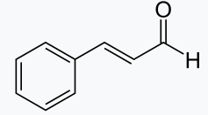
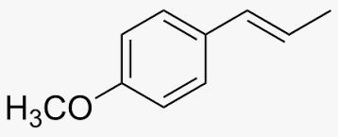
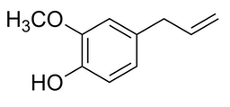
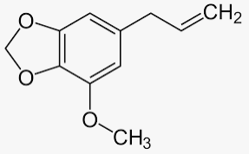
Phenylpropens
Cinnamaldehyde
Eugenol
Anethol
Cinnamaldehyde is used as a flavoring
Eugenol is used as a flavoring and it was also used in the past as a dental anesthetic
Myristicin is a mild hallucinogen
Anethol is found in seed oils of the anise
Myristicin

Slide 20
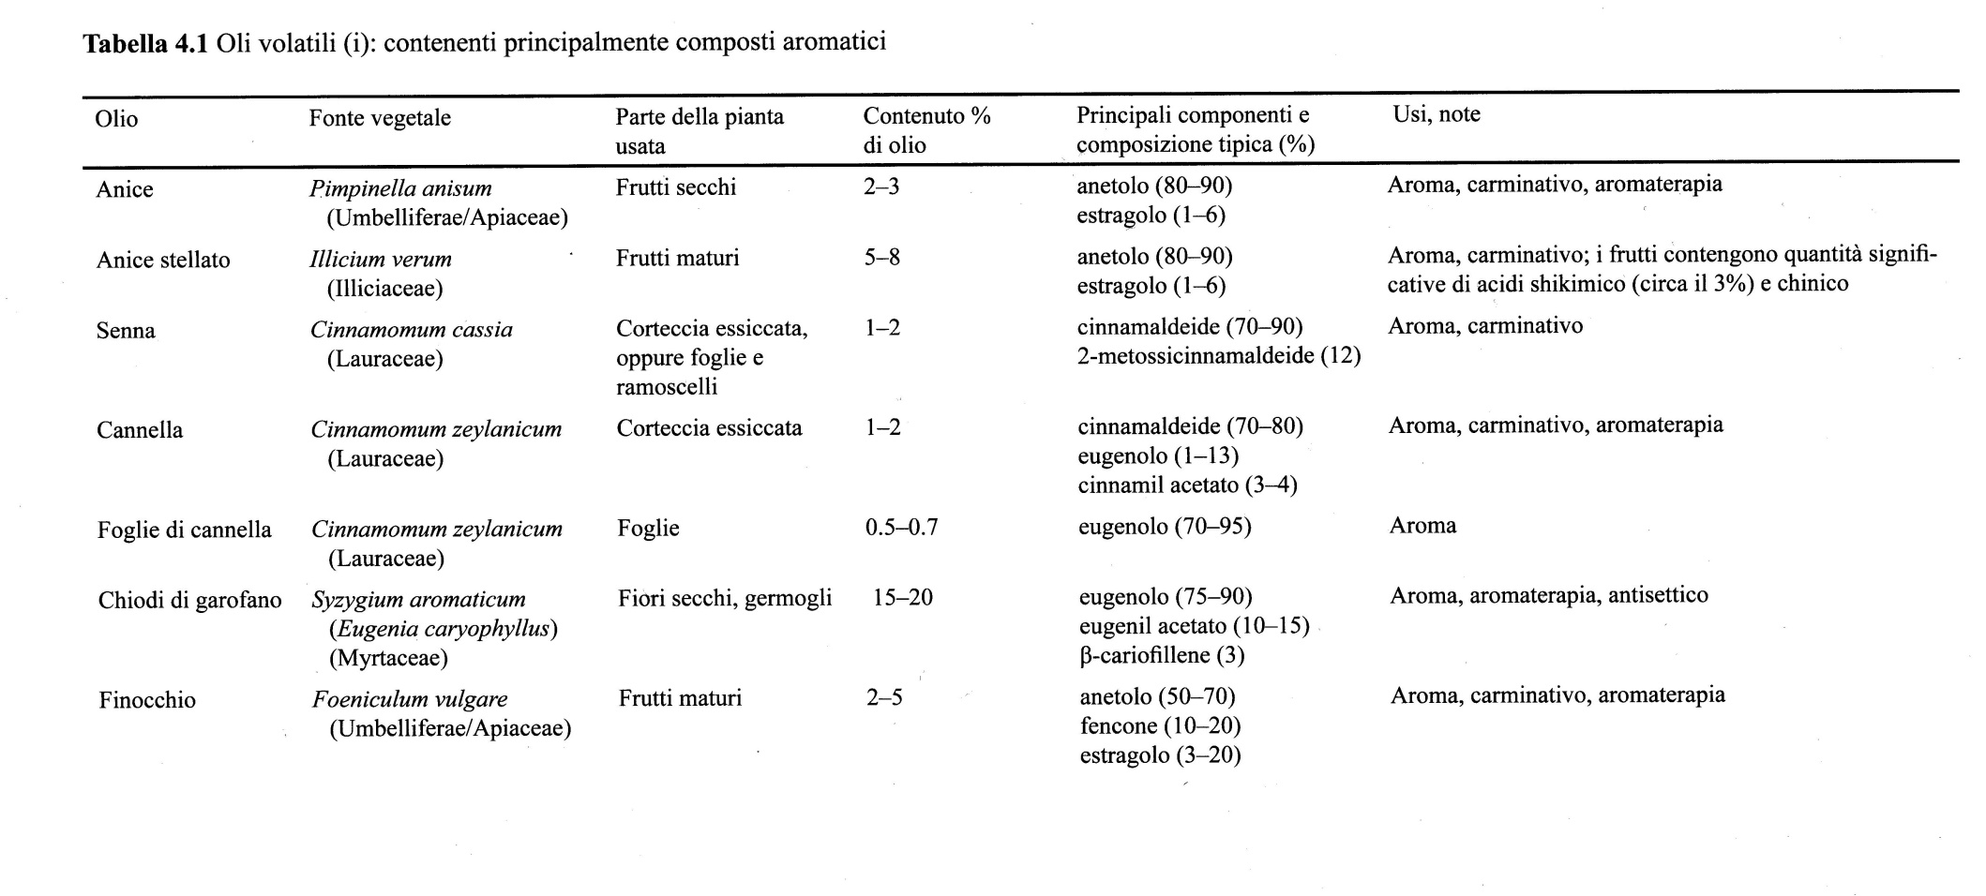
Oils with phenylpropens

Slide 21
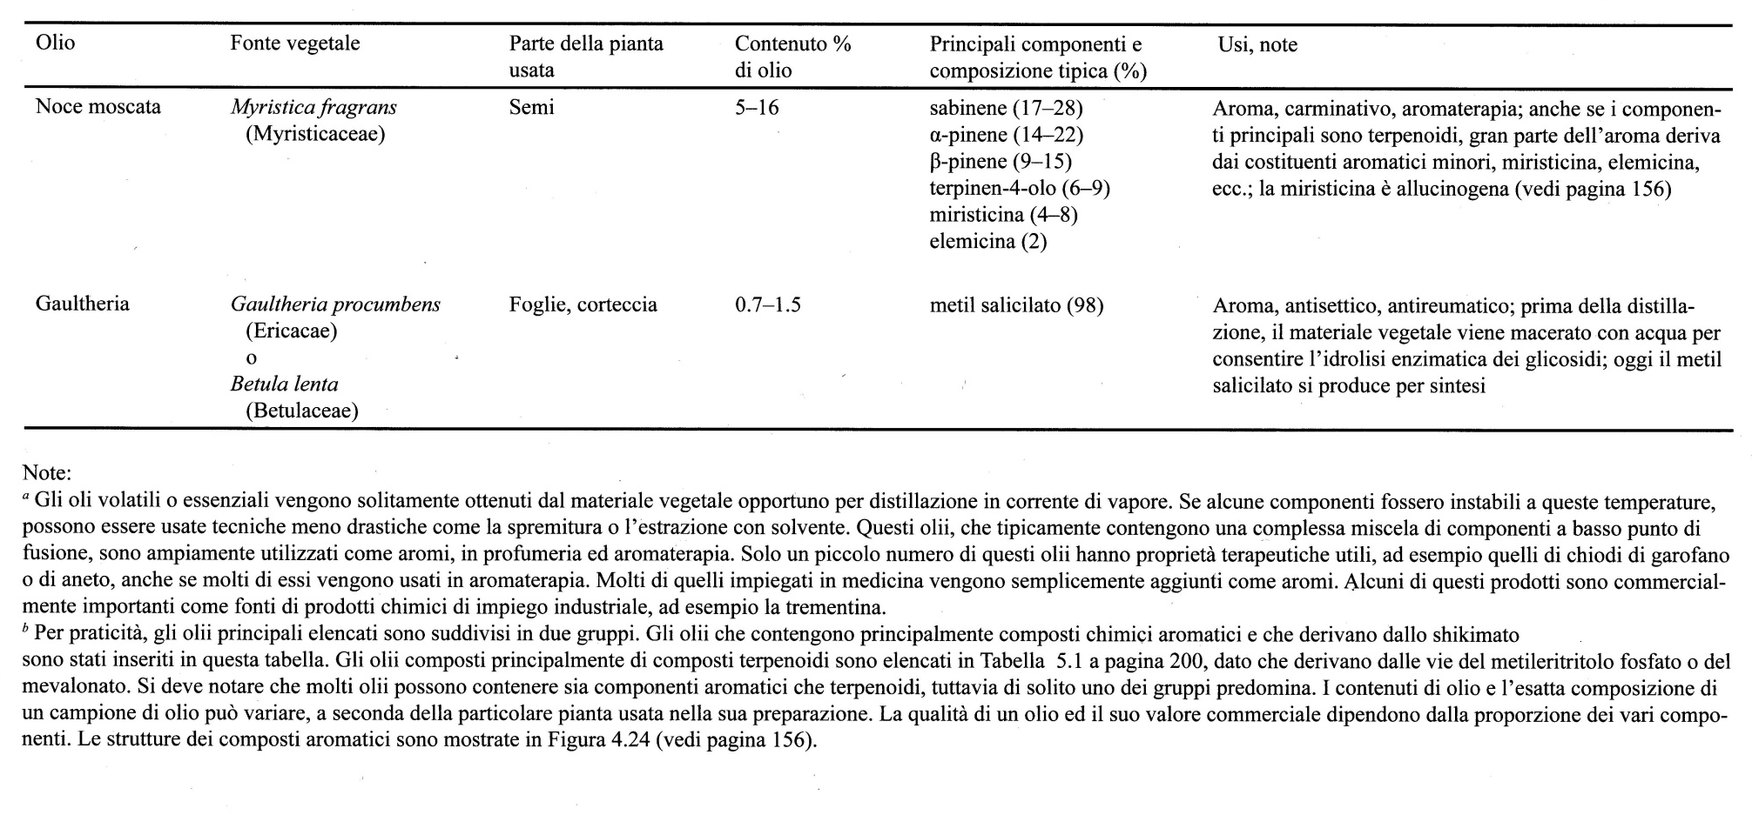

Slide 22
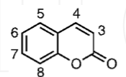
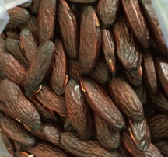
Coumarin
Dipteryx odorata
Dicoumarol and Warfarin (Coumadin) are anticoagulants.
Dicoumarol is an antithrombotic
The name coumarin comes from a French term for the Tonka bean, coumarou, seeds of Dipteryx odorata (Fabaceae/Leguminosae), one of the sources from which coumarin was first isolated as a natural product in 1820.
Recent studies and review manuscripts regarding the coumarin scaffold describe the huge variety of biological activities: anti-inflammatory, anti-coagulant, anti-oxidant functions and neuroprotective activities.
Several derivatives display also antibacterial, antifungal, antiviral, anticancer and anti-hypertensive activities.

Slide 23
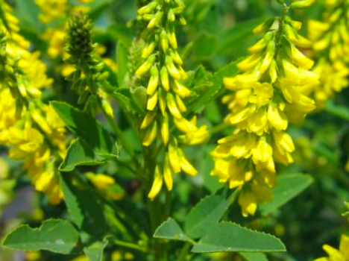
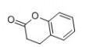
The main source of coumarin in human diet is the cinnamon.
Cinnamon comes from the dried bark of Cinnamomum verum and C. cassia/C. aromaticum
Melilotus officinalis
Dihydrocoumarin (DHC), which is found in Melilotus officinalis (Fabaceae) (sweet clover) or synthetized, is commonly added as flavoring agent to food and cosmetics.
This compound was studied by Olaharski et al. (2005), on different assays to evaluate it as an “epi-bioactive” agent and resulted that DHC inhibited the deacetylase activities of yeast SIRT2p and human SIRT1. DHC exposure in the human TK6 lymphoblastoid cell line also caused concentration-dependent increases in p53 acetylation, cytotoxicity and apoptosis.
Authors also stated that these findings on DHC could be potentially worrisome, since SIRT1 inhibition may lead to epigenetic alterations, as well as possible stem cell depletion and early tissue senescence, a phenotype associated with senescence and aging.
However, on the possibility of deleterious human exposition to epigenetic toxicants that inhibit SIRT deacetylases, this effect can be desirable in cancer treatment mediated chemopreventive potential epigenetic mechanism.
DHC

