Slide 1
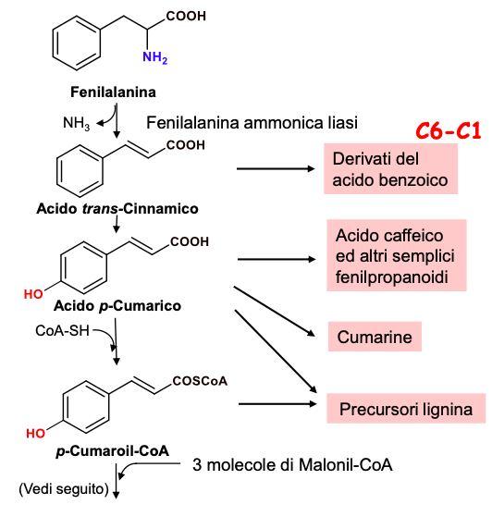
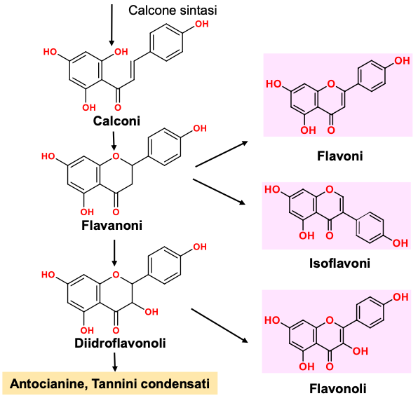
1
2
PAL

Slide 2
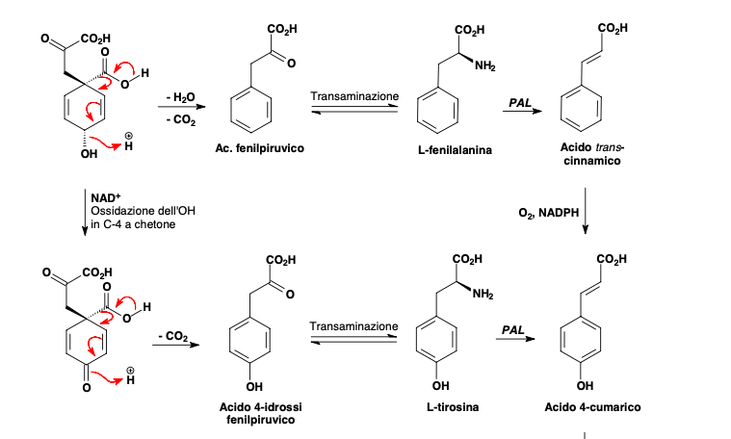
Synthesis of 4-Cumaric acid
from prefenic acid
4-coumaric acid (4-Hydroxy-cinnamic acid) is esterified with CoA and is the starter unit in the synthesis of aromatic polyketides.
PAL: phenylalanine/tyrosine ammonia lyases (PAL, TAL)

Slide 3

Gallotannins
Shikimic acid
PHENYLPROPANOIDS
Quinones
Phosphoenolpyruvate
+
Erytrose 4-phosphate
Corismic acid
L-Tyrosine
trans-Cinnamic acid
L-Phenylalanine
Phenylpropenols
Coumarin
Lignans
Lignins
Benzoic acids
4-Cumaric acid
(4-Hydroxy-cinnamic acid)
Aromatic polyketides
Flavonoids (Anthocyanins,
Catechins, Tannins)
Stilbens
Chalcons
Flavonolignans
Isoflavonoids
Coumarins
Phenylpropens

Slide 4
Aromatic polyketides
In the synthesis of aromatic polyketides, both shikimic acid and acetate pathways are involved
Coumaroil-CoA
Piperonyl is involved in the biosynthesis of alkaloid piperine.
Piperonyl-CoA
Coumaroil-CoA
Flvavouring of raspberry

Slide 5
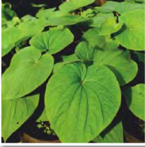
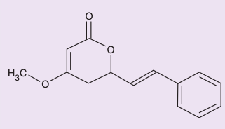
Aromatic polyketides
Kava-kava or kava-kava (or Yaqona or Sakau or Kawa Kawa) is an ancient drink, based on a herb (Piper methyticum), used in Melanesia and in Polynesia.
The active ingredient is called kavaina and is found concentrated in the roots. The dried roots are pounded until they are reduced to a powder and used to make an exciting drink.
In the synthesis, Coumaroil-CoA is condensed (Claisen reaction) with two molecules of malonil-CoA and intra-molecular cyclization.
kavaina

Slide 6
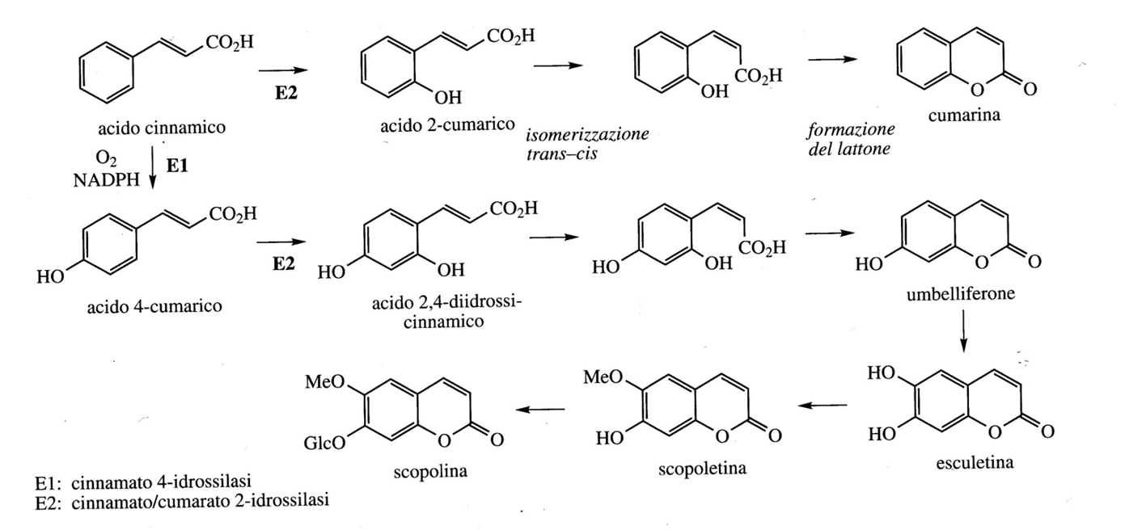
Coumarins
Coumarins are lactone (cyclic ester) derivatives of cinnamic acid. For coumarins, unlike most of the hydroxylations that occur in position 4 with respect to the side chain of cinnamic acids, it occurs in position 2 (ortho). Cinnamic acids then undergo trans / cis isomerization of the double bond
Cinnamic acid and 4-Coumaric acid give rise to coumarins Coumarin and Umbelliferone, respectively. From this derive Esculetina and Scopoletina. Coumarins are usually found in Umbelliferae and Rutaceae both in free form and as glycosides.

Slide 7
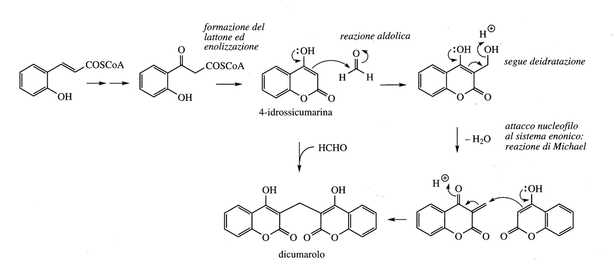
Coumarin is found in Meliloto (Leguminosae / Fabaceae) which, if fermented, in the presence of formaldehyde, derived from bacterial fermentation, produces Dicumarol which has anticoagulant properties and is a rodenticide
2-hydroxy-cinnamic acid-CoA

Slide 8
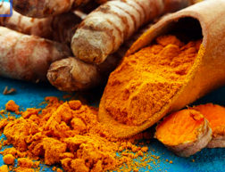
Turmeric
Turmeric, also known as Indian saffron, is a perennial herb. It belongs to the Zingiberaceae family
The most widespread turmeric is curcuma longa.
The main component of turmeric is Curcumin (anti-inflammatory, anti-oxidant, anti-ulcer and anti-tumor properties).

Slide 9
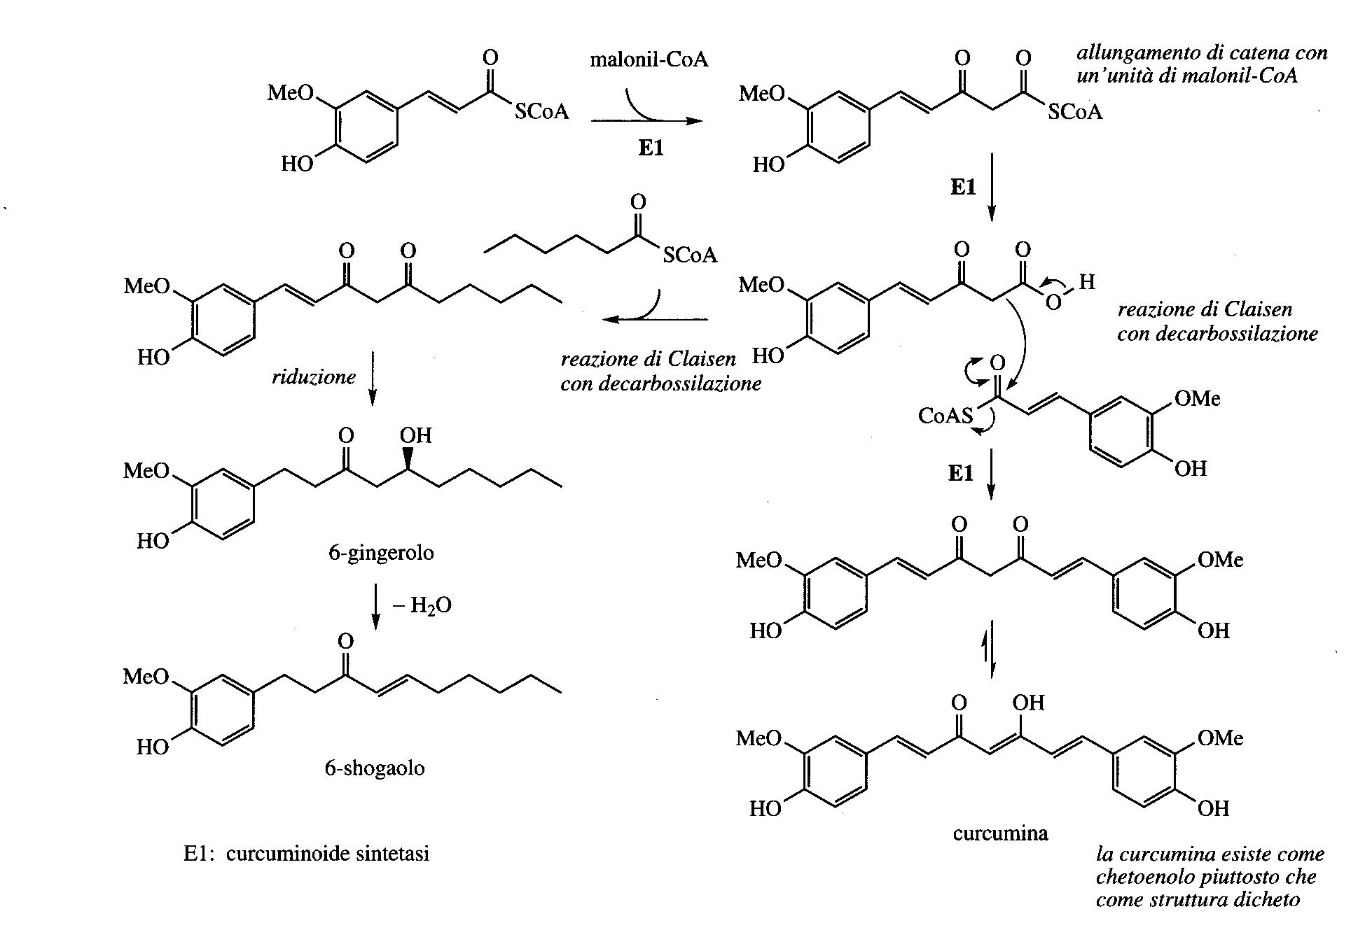

Slide 10
Flavonoids and Stilbenes
Flavonoids and Stilbenes are produced by a Coumaroil-CoA starter unit elongated with three chains of Malonil-CoA

Slide 11
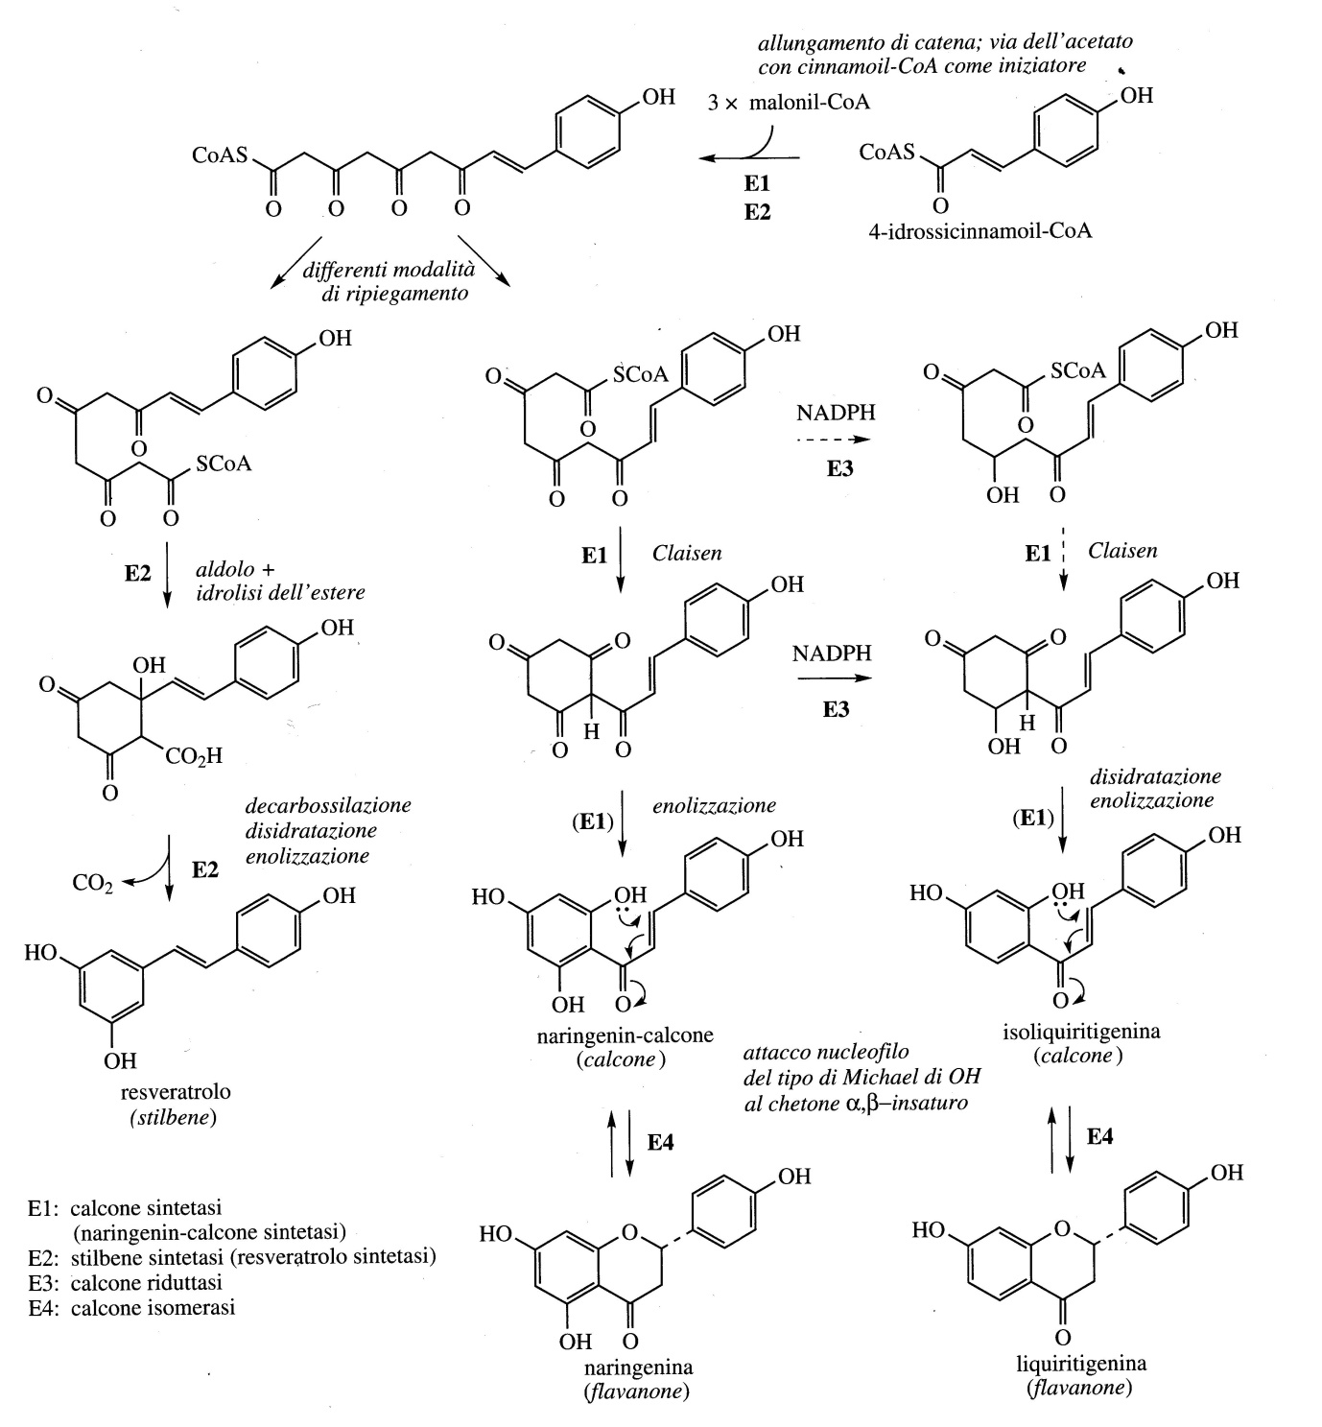
Flavonoids and Stilbenes
Flavonoids and Stilbenes are produced by a 4-hydroxy-Cinnamoyl-CoA starter unit with three chain extensions of Malonyl-CoA

Slide 12
Naringenin is the first flavonoid that is formed and which, in turn, is an intermediate starting point for the biosynthesis of many other flavonoids

Slide 13
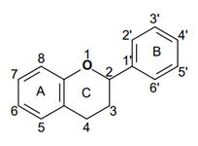
Flavonoids
Flavonoids are a group of pigments contained in plants with a broad spectrum of biological activities.
The basic phenolic-type structure is a a flavanic nucleus containing 15 carbon atoms (C6-C3-C6) arranged in 3 rings, indicated by the letters A, C and C where the bridge with 3 carbon atoms it is commonly cyclized with oxygen.
Glucose is the most common sugar residue (also galactose, rhamnose and xylose).
Among the different classes of flavonoids, those of greatest interest are flavones, flavanones, flavonols, flavanonols, flavan-3-olis, anthocyanidins and isoflavones.
These compounds are largely responsible for the colors of plants, flowers and fruits, in particular the bright shades of blue, scarlet and orange.
In addition to the various types of vegetables and fruits (in particular in citrus fruits, apples and grapes), flavonoid they are also found in seeds, nuts, cereals, spices, herbs (rosemary, thyme and parsley), in legumes, onions and various medicinal plants; plus several drinks like wine (especially red wine), black and green tea, contain appreciable quantities of flavonoids.

Slide 14
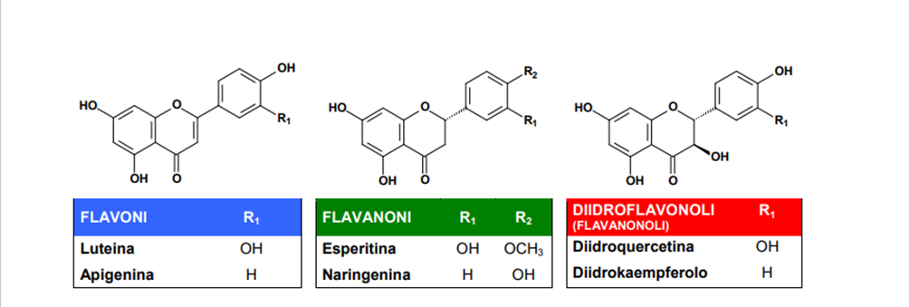
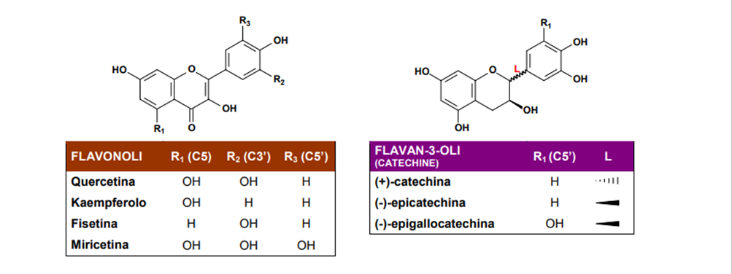
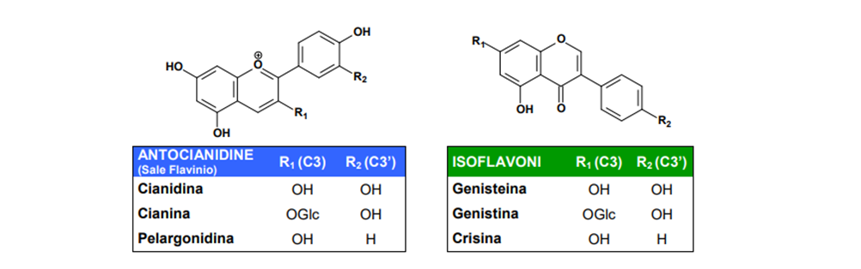

Slide 15
Biological activities of Flavonoids
Flavonoids are important components in the human diet as well, although they are considered gods non-nutrient, the daily amount taken is quite high (50-800 mg) and depends on the consumption of vegetables and fruit and specific beverages such as wine, tea and beer. For this reason, recently, rutin (quercetin + rutinose) obtained from buckwheat and from rue, and hesperidin (hesperetin + rutinose), obtained from citrus peel, were included in dietary adjuvants such as vitamin P, and indicated for the treatment of capillary fragility.
Some important properties of flavonoids:
Ability to impart colors: flavonols and chalcones give yellow, the anthocyanidins give red, blue and violet colors. Even colorless substances such as flavones, by strongly absorbing UV light, are perceptible to insects and can act like visual cues for pollinating insects;
Astringent property: the catechins form oligomers (small polymers) called tannins condensates that contribute to the astringent taste of some foods and drinks (these substances they also have commercial importance in the tanning of hides), also together with others flavonoids represent a defensive system against harmful insects;
Function of catalysts in photosynthesis and / or as regulators of iron channels through the protein phosphorylation;
Antioxidant actions in plant cells through electron transport systems. Was proved that the flavonoids of red wine (quercetin, kaempferol and anthocinidins) and tea (catechins and its esters with gallic acid) have proven effective antioxidants against free radicals.

Slide 16
Examples of free radicals are reactive oxygen species such as superoxide anion (O2·), peroxide (ROO·), alkoxide (RO·) and hydroxyl (HO·) radicals, and nitric oxide (NO) .
Reactive oxygen species can cause considerable damage by attacking cell membrane lipids, tissue proteins and enzymes, carbohydrates and DNA inducing oxidative processes which cause damage to biological membranes, modifications in enzymatic activity and even more damage serious to DNA.
Antioxidant activity of flavonoids
The mechanisms underlying the antioxidant activity include:
Suppression of the reactive oxygen species formed, through the inhibition of enzymes or the chelation of elements involved in the production of free radicals; in particular, inhibition of the enzymes responsible for the production of superoxide anion, such as xanthine oxidase and influence on the activity of numerous enzymes involved in the generation of reactive oxygen species such as cyclooxygenase, lipoxygenase, microsomal monooxygenase , glutathione S-tranferase, NADH oxidase.
Elimination of reactive oxygen species
"Up-regulation" or protection of the antioxidant defenses of the human body.

Slide 17
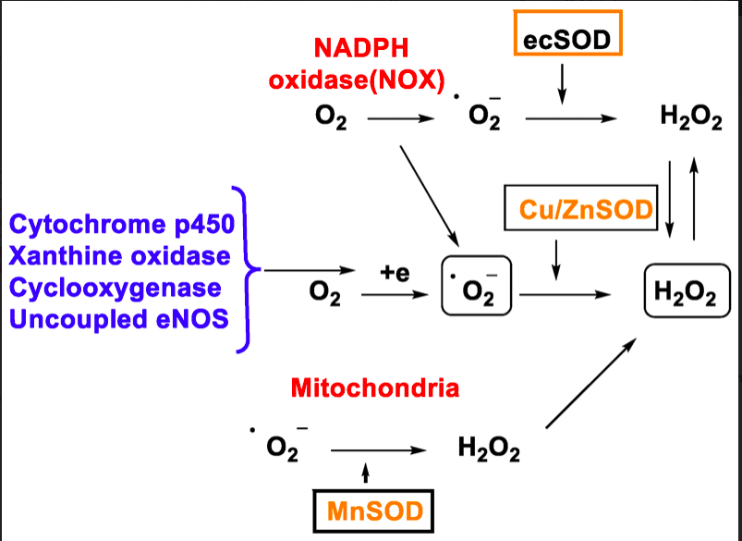
Some flavonoids are able to effectively chelate the metals involved in metabolism of oxygen, such as iron and copper, which reduce hydrogen peroxide by generating the hydroxyl radical (HO·) (1) and oxidize LDL (low density lipoprotein) (2)

Slide 19
The antioxidant activity depends on the functional groups and is greater when the B ring consists of a catechol, as it is a better electron-donor group than a simple phenol.
Furthermore, a double bond in position ∆ 2,3 conjugated with an “oxo” group in C-4 is necessary, which is responsible for the delocalization of the electrons.
The presence of an OH group on C-3 in the heterocyclic ring increases the radical-scavenging activity.
The radical-scavenging activity does not increase with an additional OH and / or Methoxy group in position 5 and 7.

Slide 20
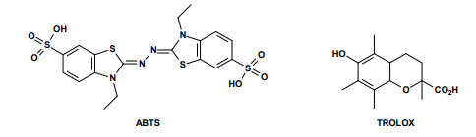
To establish the relationship between antioxidant activity (radical-scavenging) and the structure of the different flavonoids, a procedure was developed that allowed the construction of a radical-scavenging skill scale of flavonoids and related phenolic acids.
The assay is based on the ability of an antioxidant to eliminate at pH 7.4 a radical cation preformed by the 2,2'-azinobis- (3-ethylbenzothiazolin-6-sulfonic) acid (ABTS).
This ability is compared with the 6-hydroxy-2,5,7,8-tetramethylcroman-2-carboxylic acid known by the term TROLOX, a water-soluble vitamin E analogue.
The TEAC, or the “TROLOX equivalent antioxidant capacity” is defined as the concentration of TROLOX having the same radical-scavenging capacity as an antioxidant under study in a concentration of 1mM. The data obtained clearly prove that the radical-scavenging ability depends on the structure of flavonoids.

