Slide 1
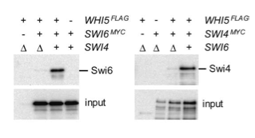
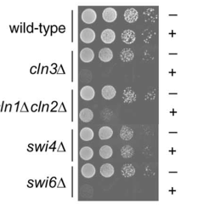
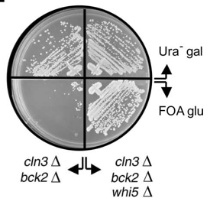
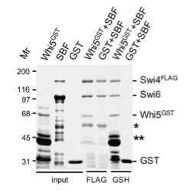
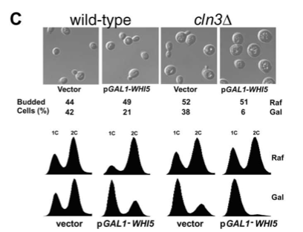
Whi5, an inhibitor of G1/S trancription in yeast
whi5Δ = 30% smaller than wild type (normal rate, resistant to mating pheromone)
Whi5 as a dose-dependent inhibitor of Start
Whi5 interacts with SBF

Slide 2
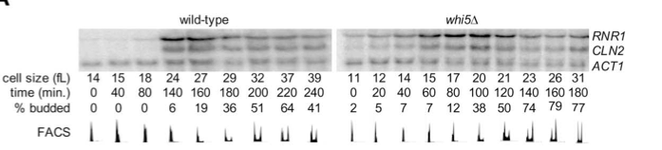
Whi5 regulates SBF-dependent genes
Whi5 affects onset of G1/S transition

Slide 3
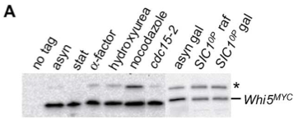
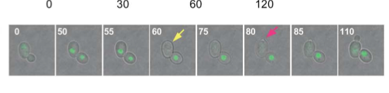
Whi5 nuclear localization
Whi5 is not cell cycle regulated
Whi5 is in the nucleus of cells arrested in G1 by pheromone or in nutrient depleted cells (lack of Cdk activity)
Whi5 is exported from the mother cell nucleus 20’ before bud emergence
(as in d. cells).

Slide 4
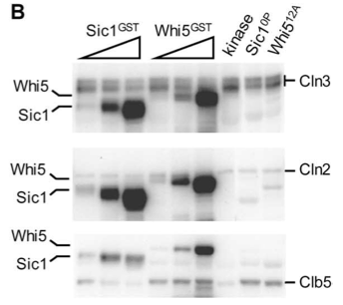
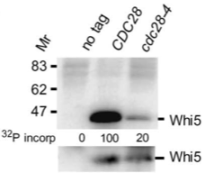
Whi5 is phosphorylated by Cln-CdK complexes
To determine if Whi5 is physically associated with Cdc28 activity, Whi5FLAG immune-complexes isolated from wild-type and cdc28-4ts strains was incubated with [32P]-γ-ATP and resolved the reaction products by SDS-PAGE.

Slide 5
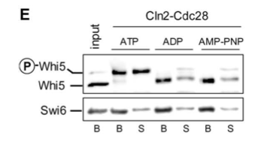
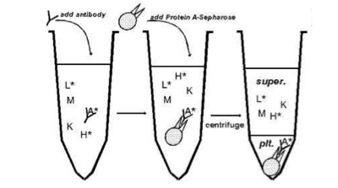
CDK kinase activity is able to modulate the composition of recombinant Whi5-SBF complexes
1) Soluble Whi5-GST produced in bacteria was pre-bound to insect cell-produced Swi4FLAG-Swi6 complex on anti-FLAG resin and incubated with Cln2-Cdc28 in the presence of ATP or ADP
2) After washing, proteins in the bound (B) and supernatant (S) fractions were identified by immunoblot
3) Phosphorylation caused approximately 50% of the SBF bound Whi5 to be released.

Slide 6
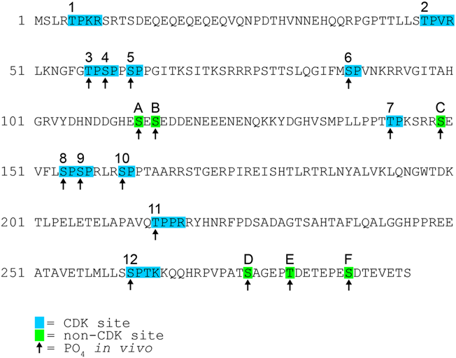
The inhibitor Whi5
Wagner et al., Plos One 2009
Whi5 is phosphorylated on 16 sites in vivo, 12 of which are CDK target sites
CDK sites 8,9,10 and 12 are both necessary and sufficient for viability in combination with Swi6-4Ala
De Bruin et al., Cell 2004

Slide 7
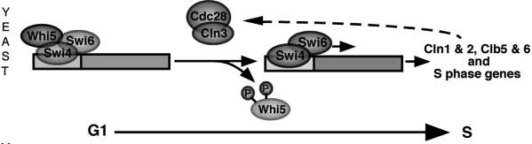
SBF and MBF
Swi4
Swi6
Mbp1
Swi6
SBF
MBF
CLN1, CLN2 promoters: SCB element (CACGAAA, Swi4/Swi6 Cell cycle Box)
CLB5, CLB6 promoters: MCB element (ACGCGTNA, Mbp1/Swi6 Cell cycle Box)

Slide 8
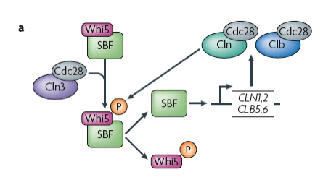
Transcriptional regulation of cyclins
The transcription repressor Whi5 inhibits the activity of the SBF transcription factor.
Phosphorylation of Whi5 by Cln3–Cdc28 induces the nuclear export of Whi5 and activates SBF which induce the transcription of the genes that encode Cln1, Cln2.

Slide 9
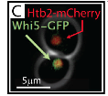
Traversal of Start is driven by CDK activity, which can be measured in live cells via the CDK-dependent nuclear export of the transcriptional inhibitor Whi5.
Start corresponds precisely to the abrupt activation of the G1 cyclin-positive feedback loop, which occurs when about 50% of a cell’s Whi5 has left the nucleus.
Recent studies using single-cell time-lapse imaging of cycling normal human fibroblasts concluded that the mammalian restriction point occurs 4–6 hours before significantly detectable Rb phosphorylation.

Slide 10
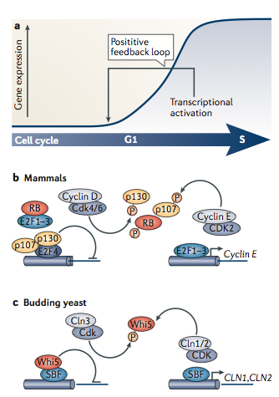
A positive feedback switch ensures commitment
The genes encoding the G1 cyclins CLN1 and CLN2 in yeast and cyclin E in mammals are some of the first G1–S genes to be transcribed.
Through positive feedback, G1 cyclins increase their own transcription to produce a rapid increase in cyclin–CDK activity
In addition to defining the point at which cells commit, the rapid increase in CDK activity driven by this positive feedback results in the timely and coherent activation of the entire G1–S
Then a positive feedback switch ensures cell cycle commitment.
Bertoli et al 2013

Slide 11
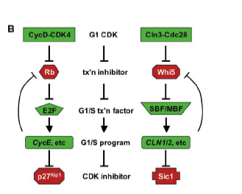
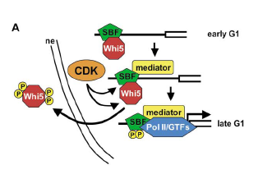
Whi5 Action and Regulation

Slide 12
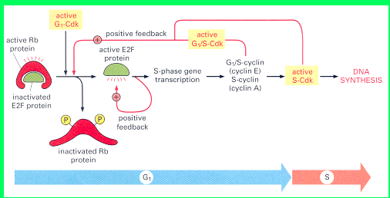
Retinoblastoma (Rb) Tumor Suppressor Gene
Retinoblastoma is an eye cancer, the most common in children, and develops from retinal cells.
During the early stages of eye development, the precursors of retinal cells, called retinoblasts, begin to multiply and generate the cells that will make up the mature retina
If retinoblasts continue to multiply out of control and without maturing, they give rise to a retinoblastoma.

