Slide 1
The antioxidant activity depends on the functional groups and is greater when the B ring consists of a catechol, as it is a better electron-donor group than a simple phenol.
Furthermore, a double bond in position ∆ 2,3 conjugated with an “oxo” group in C-4 is necessary, which is responsible for the delocalization of the electrons.
The presence of an OH group on C-3 in the heterocyclic ring increases the radical-scavenging activity.
The radical-scavenging activity does not increase with an additional OH and / or Methoxy group in position 5 and 7.

Slide 2
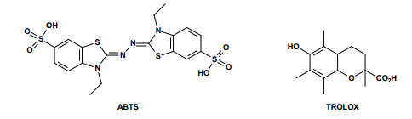
To establish the relationship between antioxidant activity (radical-scavenging) and the structure of the different flavonoids, a procedure was developed that allowed the construction of a radical-scavenging skill scale of flavonoids and related phenolic acids.
The assay is based on the ability of an antioxidant to eliminate at pH 7.4 a radical cation preformed by the 2,2'-azinobis- (3-ethylbenzothiazolin-6-sulfonic) acid (ABTS).
This ability is compared with the 6-hydroxy-2,5,7,8-tetramethylcroman-2-carboxylic acid known by the term TROLOX, a water-soluble vitamin E analogue.
The TEAC, or the “TROLOX equivalent antioxidant capacity” is defined as the concentration of TROLOX having the same radical-scavenging capacity as an antioxidant under study in a concentration of 1mM. The data obtained clearly prove that the radical-scavenging ability depends on the structure of flavonoids.

Slide 3
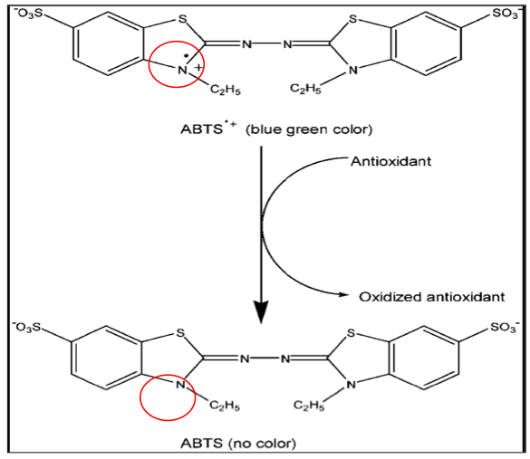
TEAC : TROLOX EQUIVALENT ANTIOXIDANT CAPACITY
THE REDUCING ACTIVITY OF ANTIOXIDANTS IS DETERMINED ON THE BASIS OF THEIR ABILITY TO REDUCE THE COLORED RADICAL CATION ABTS^{•+} WITH CONSEQUENT LOSS OF COLOR.
THE ANTIOXIDANT ACTIVITY IS DETERMINED BY MEASURING THE DECREASE ABSORBANCE (OD 734 nm) AFTER A FIXED TIME OF INCUBATION OF THE RADICAL CATION SOLUTION WITH THE SAMPLE TO BE TESTED.
Doi:
dx.doi.org/10.17504/protocols.io.42xgyfn

Slide 4
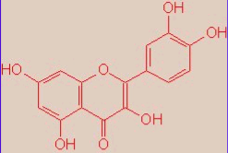
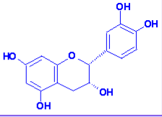
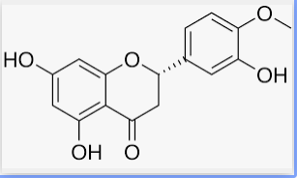
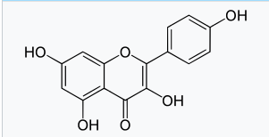
QUERCETIN (flavonol)
Trolox equivalent antioxidant capacity : 4.7
EPICATECHIN (flavan-3-ol, catechin)
Trolox equivalent antioxidant capacity : 2.4
HESPERETIN (flavanon)
Trolox equivalent antioxidant capacity : 0.9
KAEMPFEROL (flavonol)
Trolox equivalent antioxidant capacity : 1.3

Slide 5
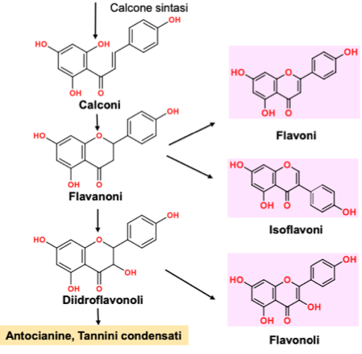
Chalcones are precursors of a large class of flavonoids

Slide 6
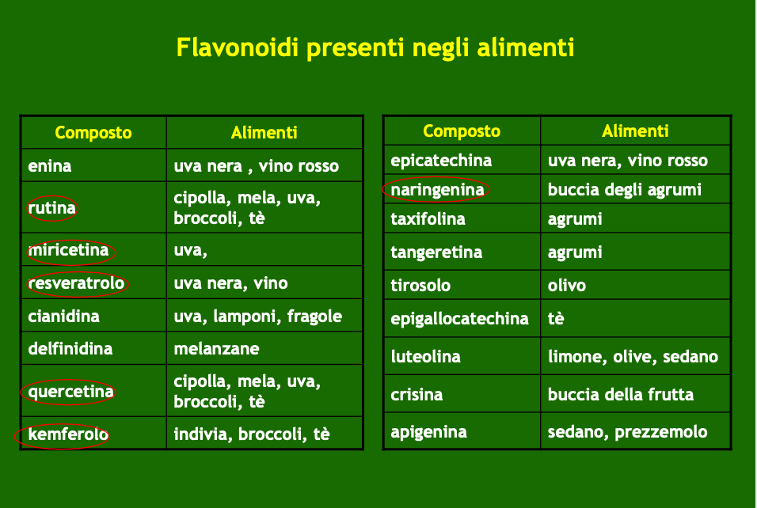
Flavonoids are anti-oxidants and protect against cardiovascular and neurodegenerative diseases.
The flavonoids of red wine (quercetin, kaempferol and antocyanidins) and green tea (catechins and catechin esters with gallic acid) are effective oxidants

Slide 7
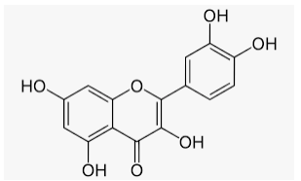
QUERCETIN (flavonol)
PROPERTIES: antioxidant, anti-inflammatory, antiviral, immunomodulatory, anticancer and gastroprotective. It can have antiallergic activity and in the prevention of secondary complications of diabetes.

Slide 8
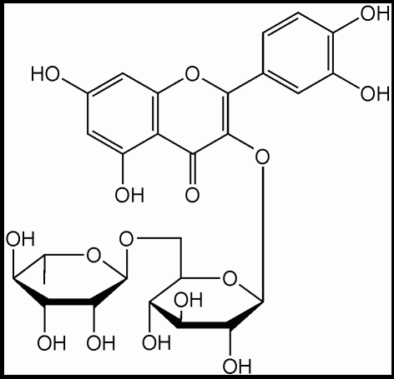
RUTIN
It is a glycosidic flavonoid of the FLAVONOL class composed of quercetin and the disaccharide rutinose. It is found in various plants such as BUCKWHEAT (Fagopyrum esculentum), whose flour is used for various purposes, in BLACK TEA and APPLES (peel). It is the flavonoid most represented in tomatoes.
PROPERTIES
anti-inflammatory, antioxidant, anticarcinogenic, antithrombotic and vasoprotective.
Absorption appears to occur mainly in the colon without the glucoside half detached by the enzymes of the intestinal bacterial flora to form quercetin which is transported to the liver via portal circulation

Slide 9
Flavonoids and Stilbenes
Flavonoids and Stilbenes are produced by a Coumaroil-CoA starter unit elongated with three chains of Malonil-CoA

Slide 10
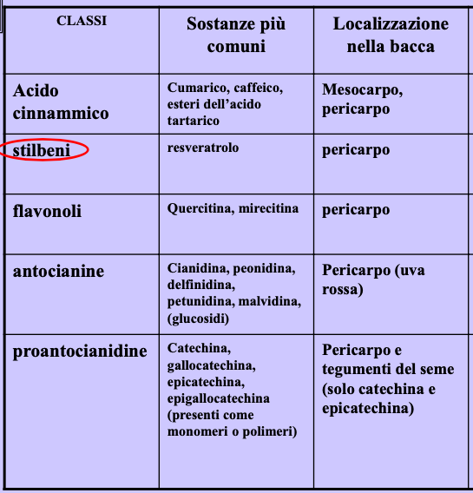
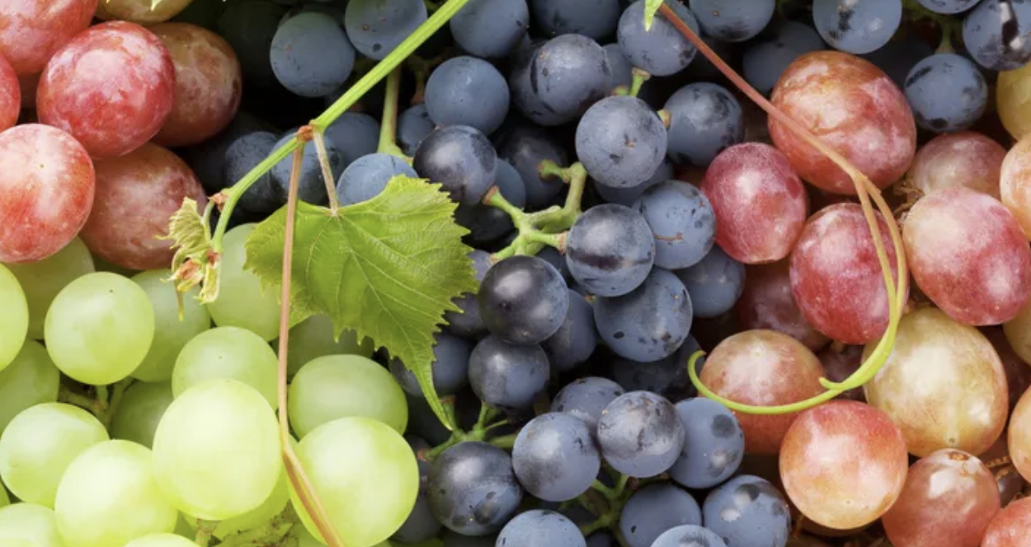
Vitis vinifera
RESVERATROL: 8.5 μg/g

Slide 11
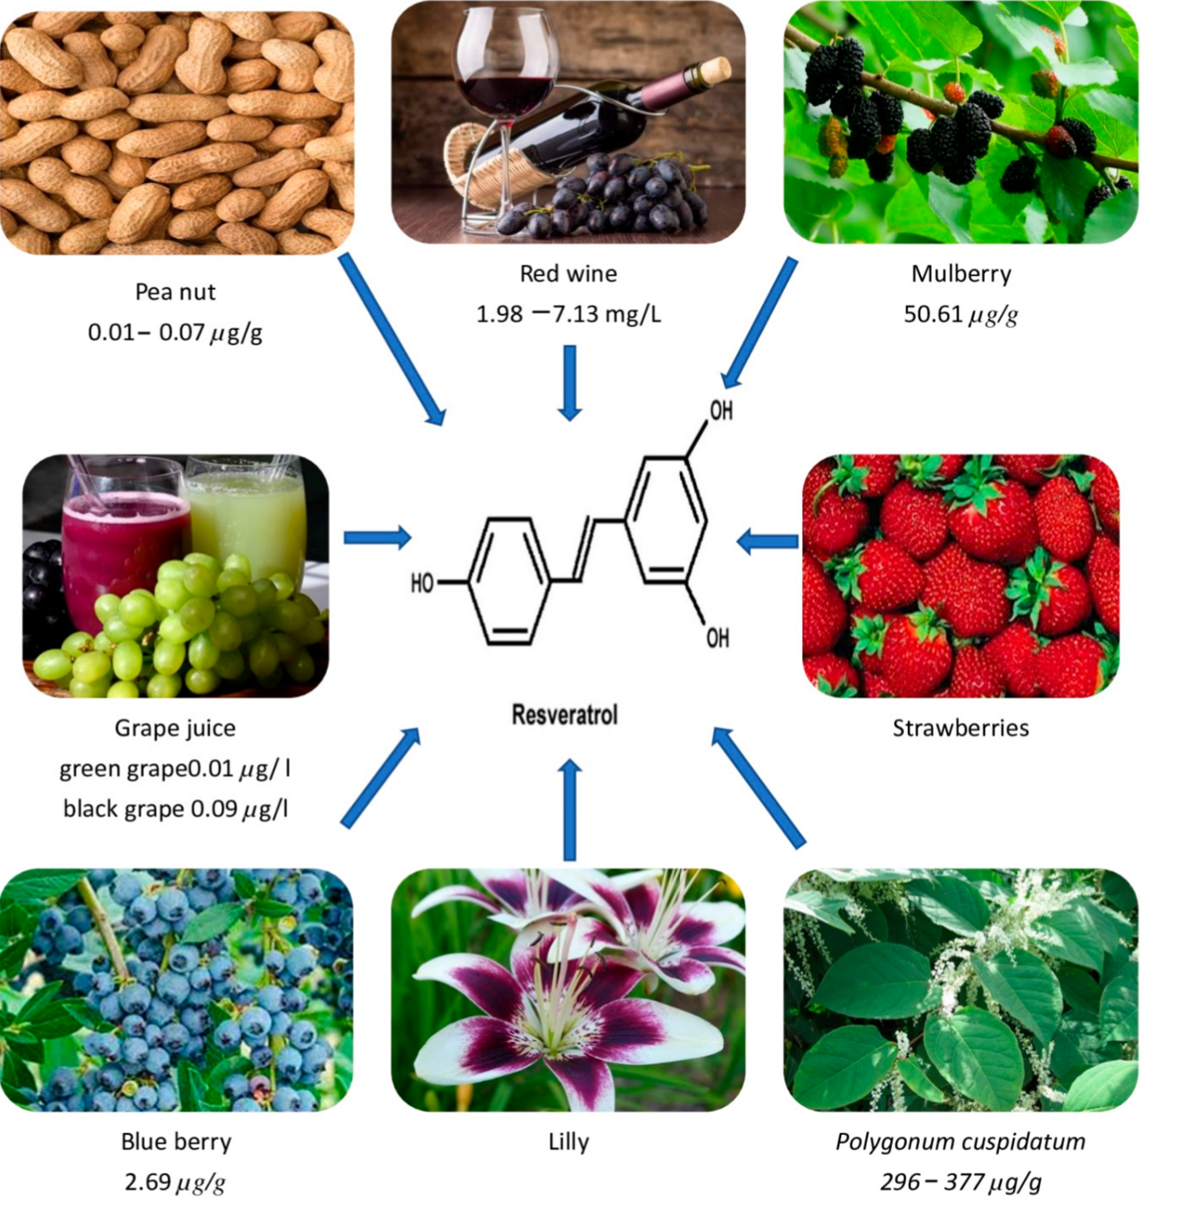
Resveratrol
Resveratrol is a natural phenolic compound (stilbene) and has been found in many foods, such as grapes, peanuts, blueberries, and red wine.
Resveratrol has shown many bioactivities, such as antioxidant, anti-inflammatory, immunomodulatory, hypotensive, and hypolipidemic actions, as well as activities in the prevention of cardiovascular and neurodegenerative diseases, and obesity.
Many studies highlighted its importance in aging treatment through suppressing oxidative stress, inhibiting inflammatory response, improving mitochondrial function and autophagy.
Pharmaceuticals 2022, 15, 957. https://doi.org/10.3390/ph15080957

Slide 12
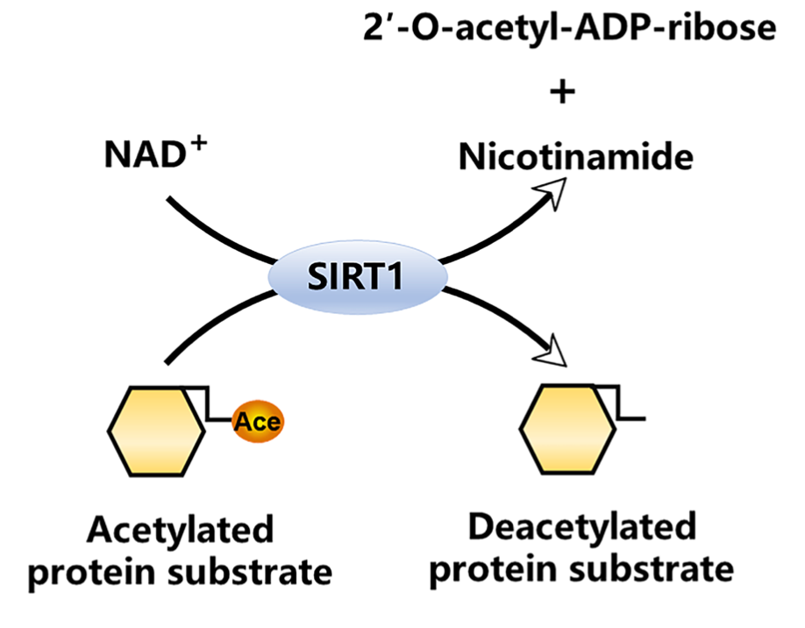
The silent information regulator sirtuin 1 (SIRT1) and resveratrol
Sirtuin-1 (Sirt-1) is a NAD⁺ -dependent deacetylase
SIRT1 was the first SIRT to be discovered in mammals (Sir2 in yeast)
SIRT1 can be activated by caloric restriction and resveratrol (also by depletion of its negative regulators (among which nicotinamide)
SIRT1-mediated deacetylation profoundly impacts multiple biological processes, including cellular senescence, apoptosis, sugar and lipid metabolism, oxidative stress, and inflammation. Thus, even minor changes in SIRT1 expression and function can significantly impact cellular responses.
SIRT1 is well known for its antioxidant and anti- inflammatory properties
SIRT1 plays a role in promoting longevity. As such, SIRT1-targeted anti- inflammatory therapies are attracting increasing attention for their clinical applications in treating inflammatory diseases.
Several signaling pathways provoked by immune cell activation are tightly associated with SIRT1 function.
Front. Immunol. 13:831168. doi: 10.3389/fimmu.2022.831168

Slide 13
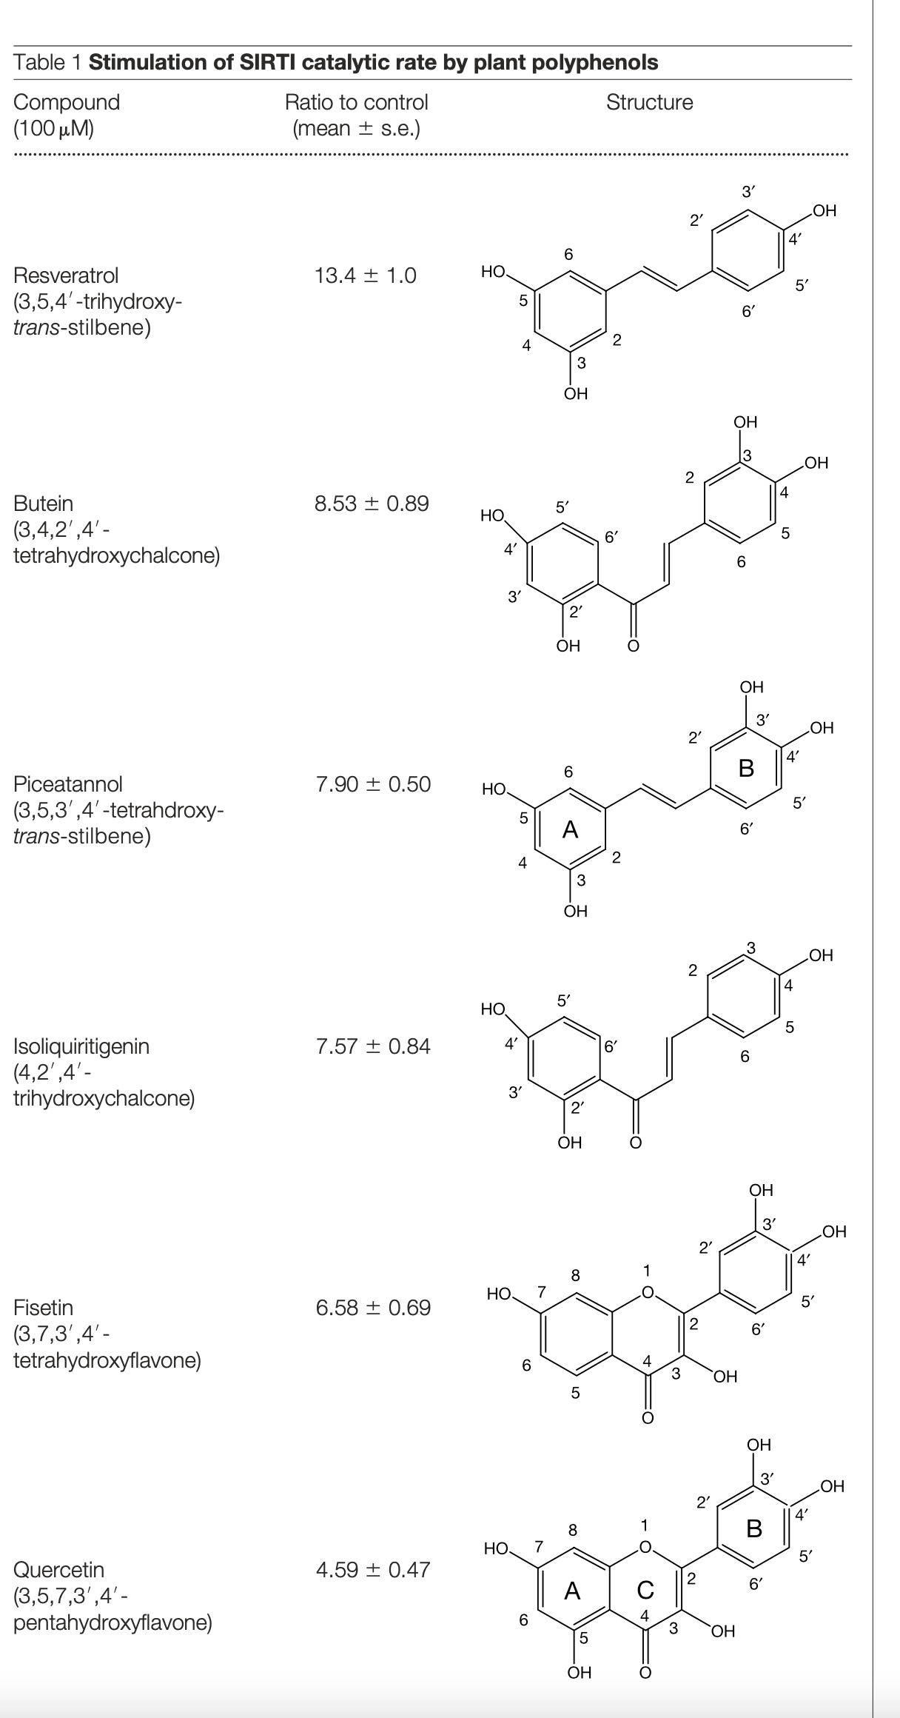
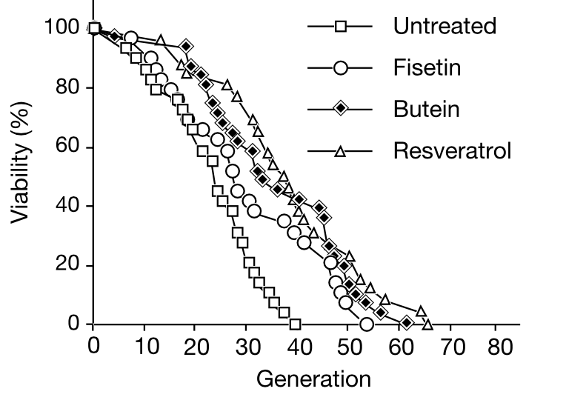
Resveratrol increses lifespan and stimulates SIRT1 catalytic activity
Assay:
Purified recombinant SIRT1 Sir2 proteins: 1.0 mg of SIRT1 and 1.5 mg of Sir2 were used per deacetylation assay
25 mM p53-382 acetylated peptide substrate and 25 mM NAD⁺
Resveratrol increases average lifespan by 70% and also maximum lifespan (yeast cells)
Konrad T. Howitz et al 2003

Slide 14
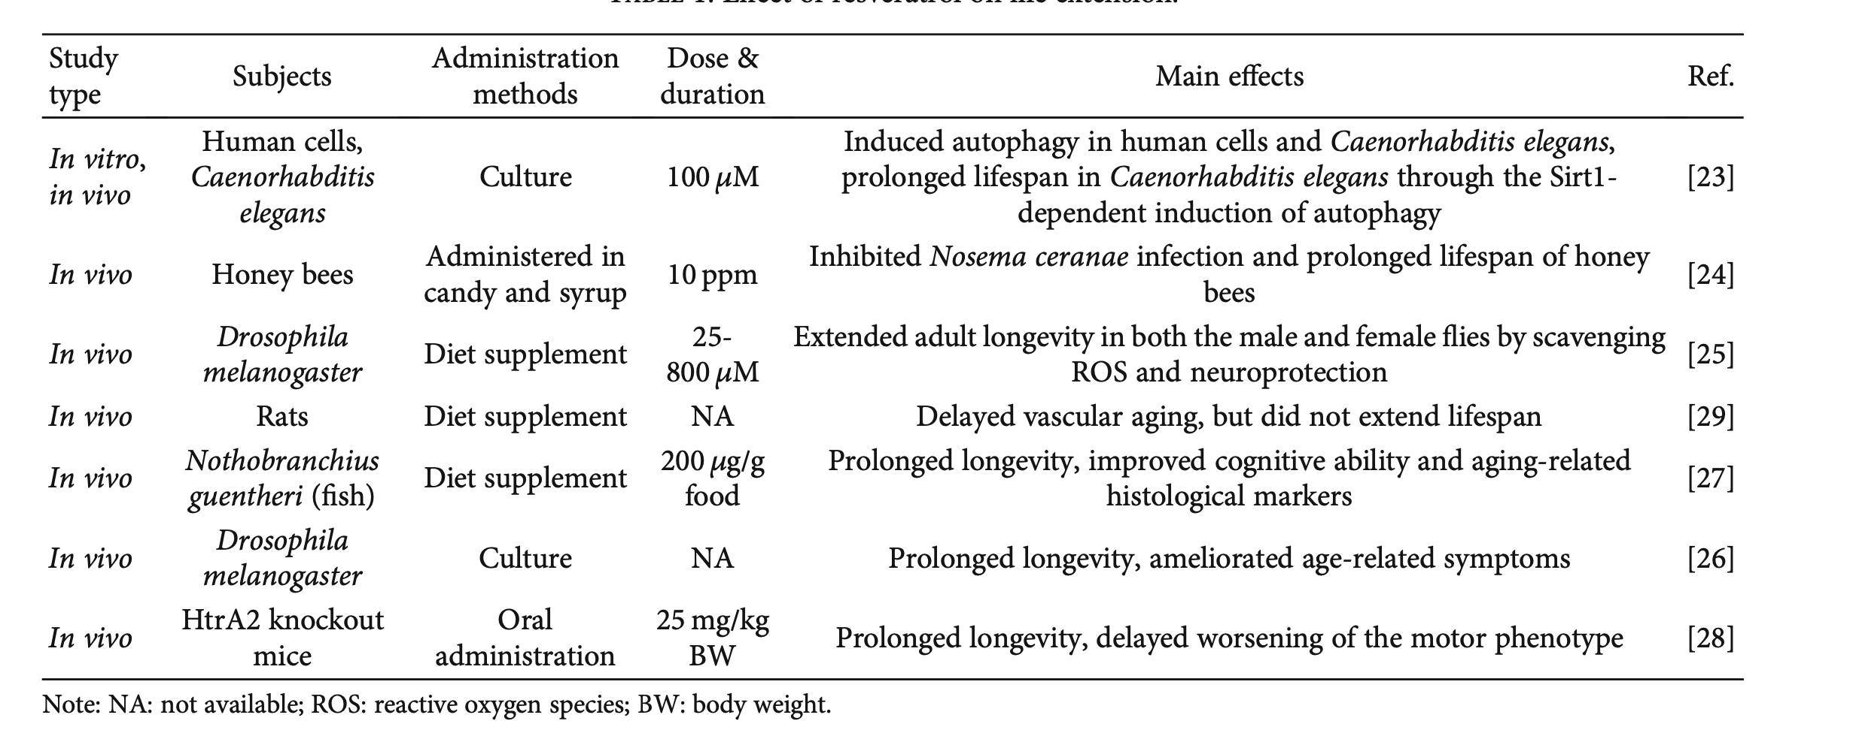
Effect of resveratrol on life extension
https://doi.org/10.1155/2021/9932218

Slide 15
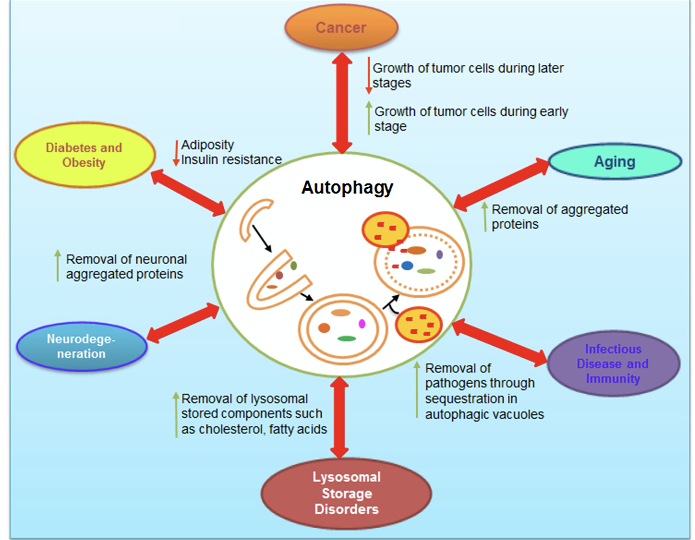
Autophagy is a conserved catabolic pathway that delivers cytoplasmic components, such as damaged organelles or long-lived proteins, to lysosomes for bulk degradation.
Autophagy involves the formation of an isolation membrane (phagophore) that progressively enwraps portions of the cytoplasm until a double-membraned vesicle (autophago- some) is formed.
Autophagosomes mature fuse with lysosomes (generating autophagolysosomes) and their luminal content are degraded by lysosomal hydrolases and generated substrates are exported into the cytosol for metabolic recycling.
Autophagy is mostly a cytoprotective mechanism that allow cells to mobilize their energy reserves and to recycle damaged organelles in conditions of lacking nutrients.
Autophagic dysfunction has been associated with a large number of neurodegenerative diseases. One of the hallmarks of many neurodegenerative diseases is the accumulation of aggregated proteins that escape the degradative process resulting in neuronal cell death

Slide 16
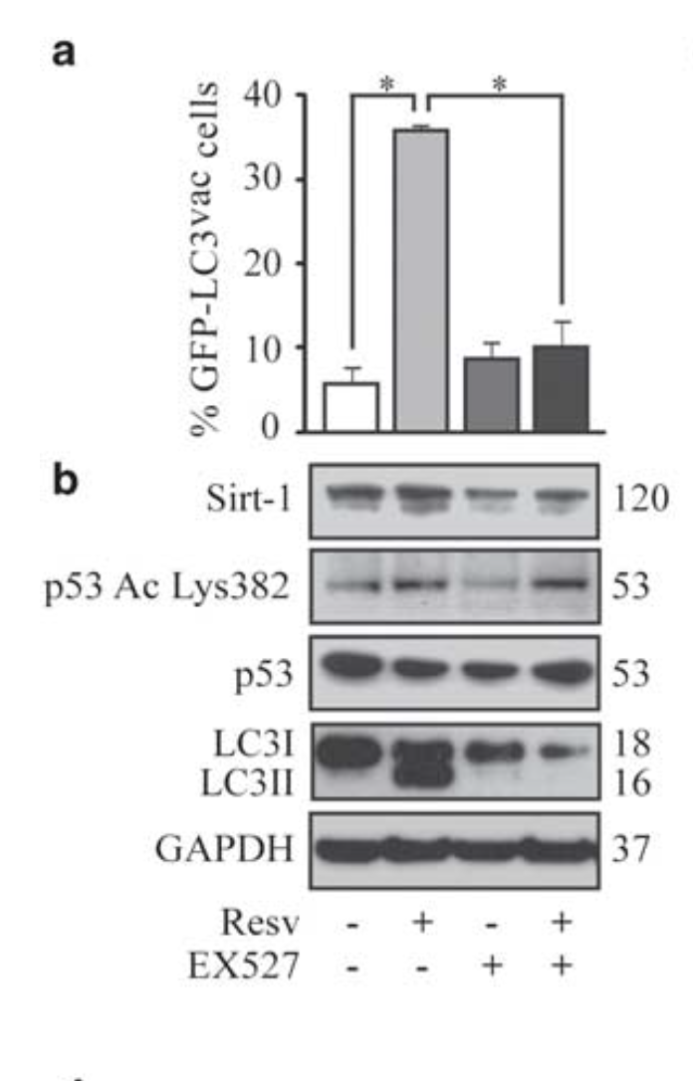
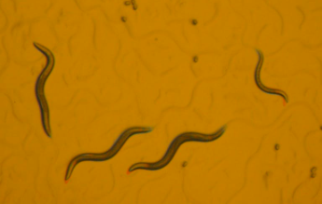
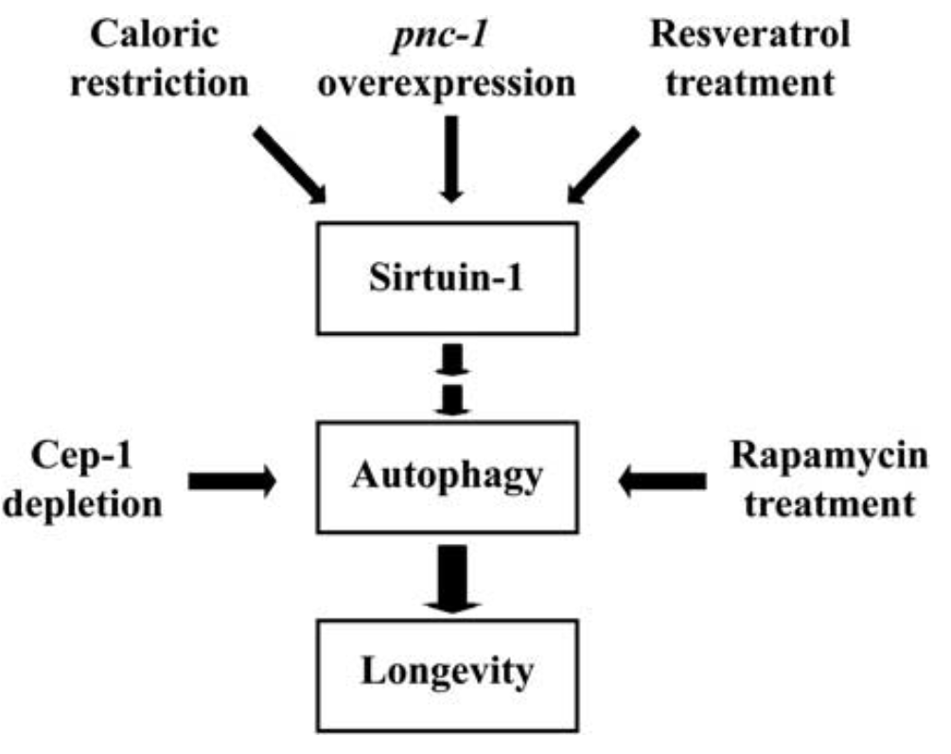
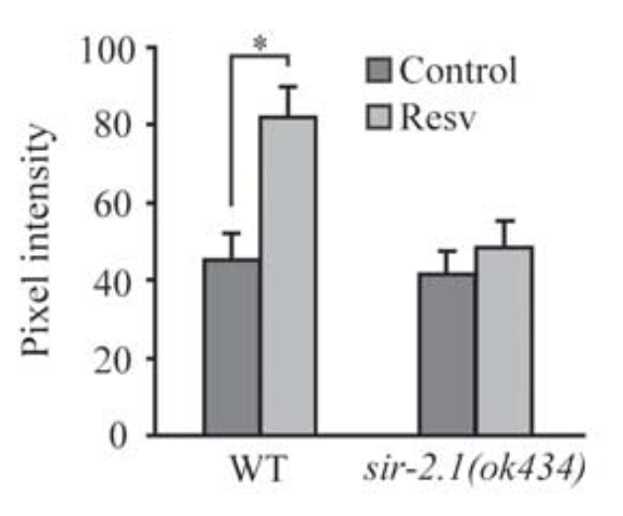
Resveratrol stimulates autophagy
In vivo (C. elegans)
In vitro (HCT116, cell culture)
Cell Death and Disease (2010) 1, e10; doi:10.1038/cddis.2009.8

Slide 17
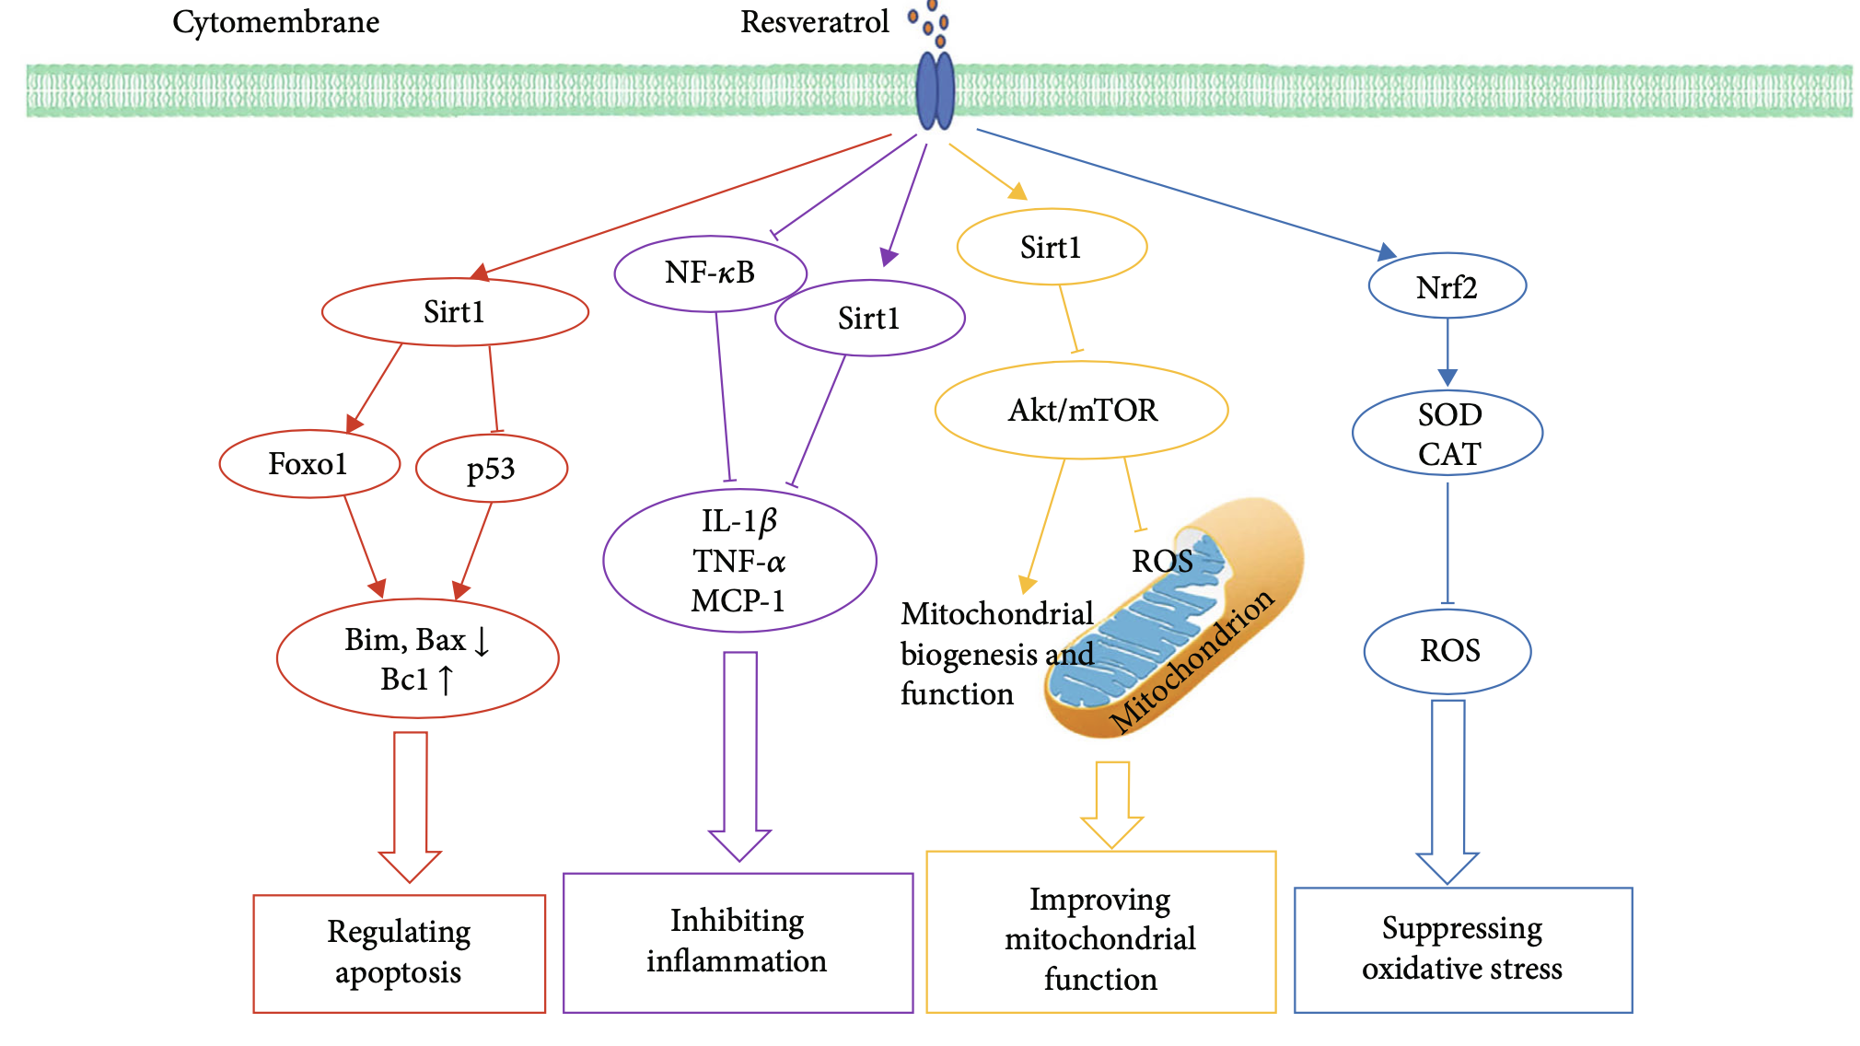
Resveratrol stimulates the activity of nuclear factor erythroid-2 related factor 2 (Nrf2) and promote the activities of antioxidant enzymes, like superoxide dismutase (SOD) and catalase (CAT) to inhibit the production of reactive oxygen species (ROS), thus suppressing oxidative stress.
Resveratrol activates antiaging factor sirtuin1 (Sirt1) and downregulate the Akt/mTOR pathway to inhibit ROS in mitochondria and increase mitochondrial biogenesis and function, which could improve mitochondrial function.
Resveratrol promotes the activities of Sirt1 to decrease the levels of inflammatory markers, like interleukin-1β (IL-1β), tumor necrosis factor-α (TNF-α), and monocyte chemoattractant protein-1 (MCP-1) to inhibit inflammation.
Resveratrol upregulates Sirt1, subsequently promote forkhead box protein O1 (Foxo1), and inhibit p53, thereby modulating the levels of apoptotic proteins Bim and Bax and antiapoptotic protein Bcl, which could regulate apoptosis.
https://doi.org/10.1155/2021/9932218

Slide 18
Another natural stilbene of medicinal interest is Combretastatin isolated from the bark of a South African plant, Combretum Caffrum (Solanaceae).
Compared to Resveratrol (trans) it shows a double bond with cis geometry.
ZybrestatTM, fosbretabulin (USAN), Combretastatin A4 phosphate (CA4P), is a novel vascular disrupting agent (VDA), which induces acute reductions in tumor blood flow. Evidence for vascular disrupting activity was first obtained in rodent cancer models and has subsequently been established to occur in solid tumors in humans.
Combretastatin A4 phosphate (CA4P) is the water-soluble prodrug of Combretastatin A4 (CA4).
CA4 is a potent inhibitor of tubulin assembly, it prevents tubulin depolymerization by binding to the Colchicine site.
Its ability to selectively compromise the vascular network in tumors has advanced this agent into the clinical trials for cancer chemotherapy.

Slide 19
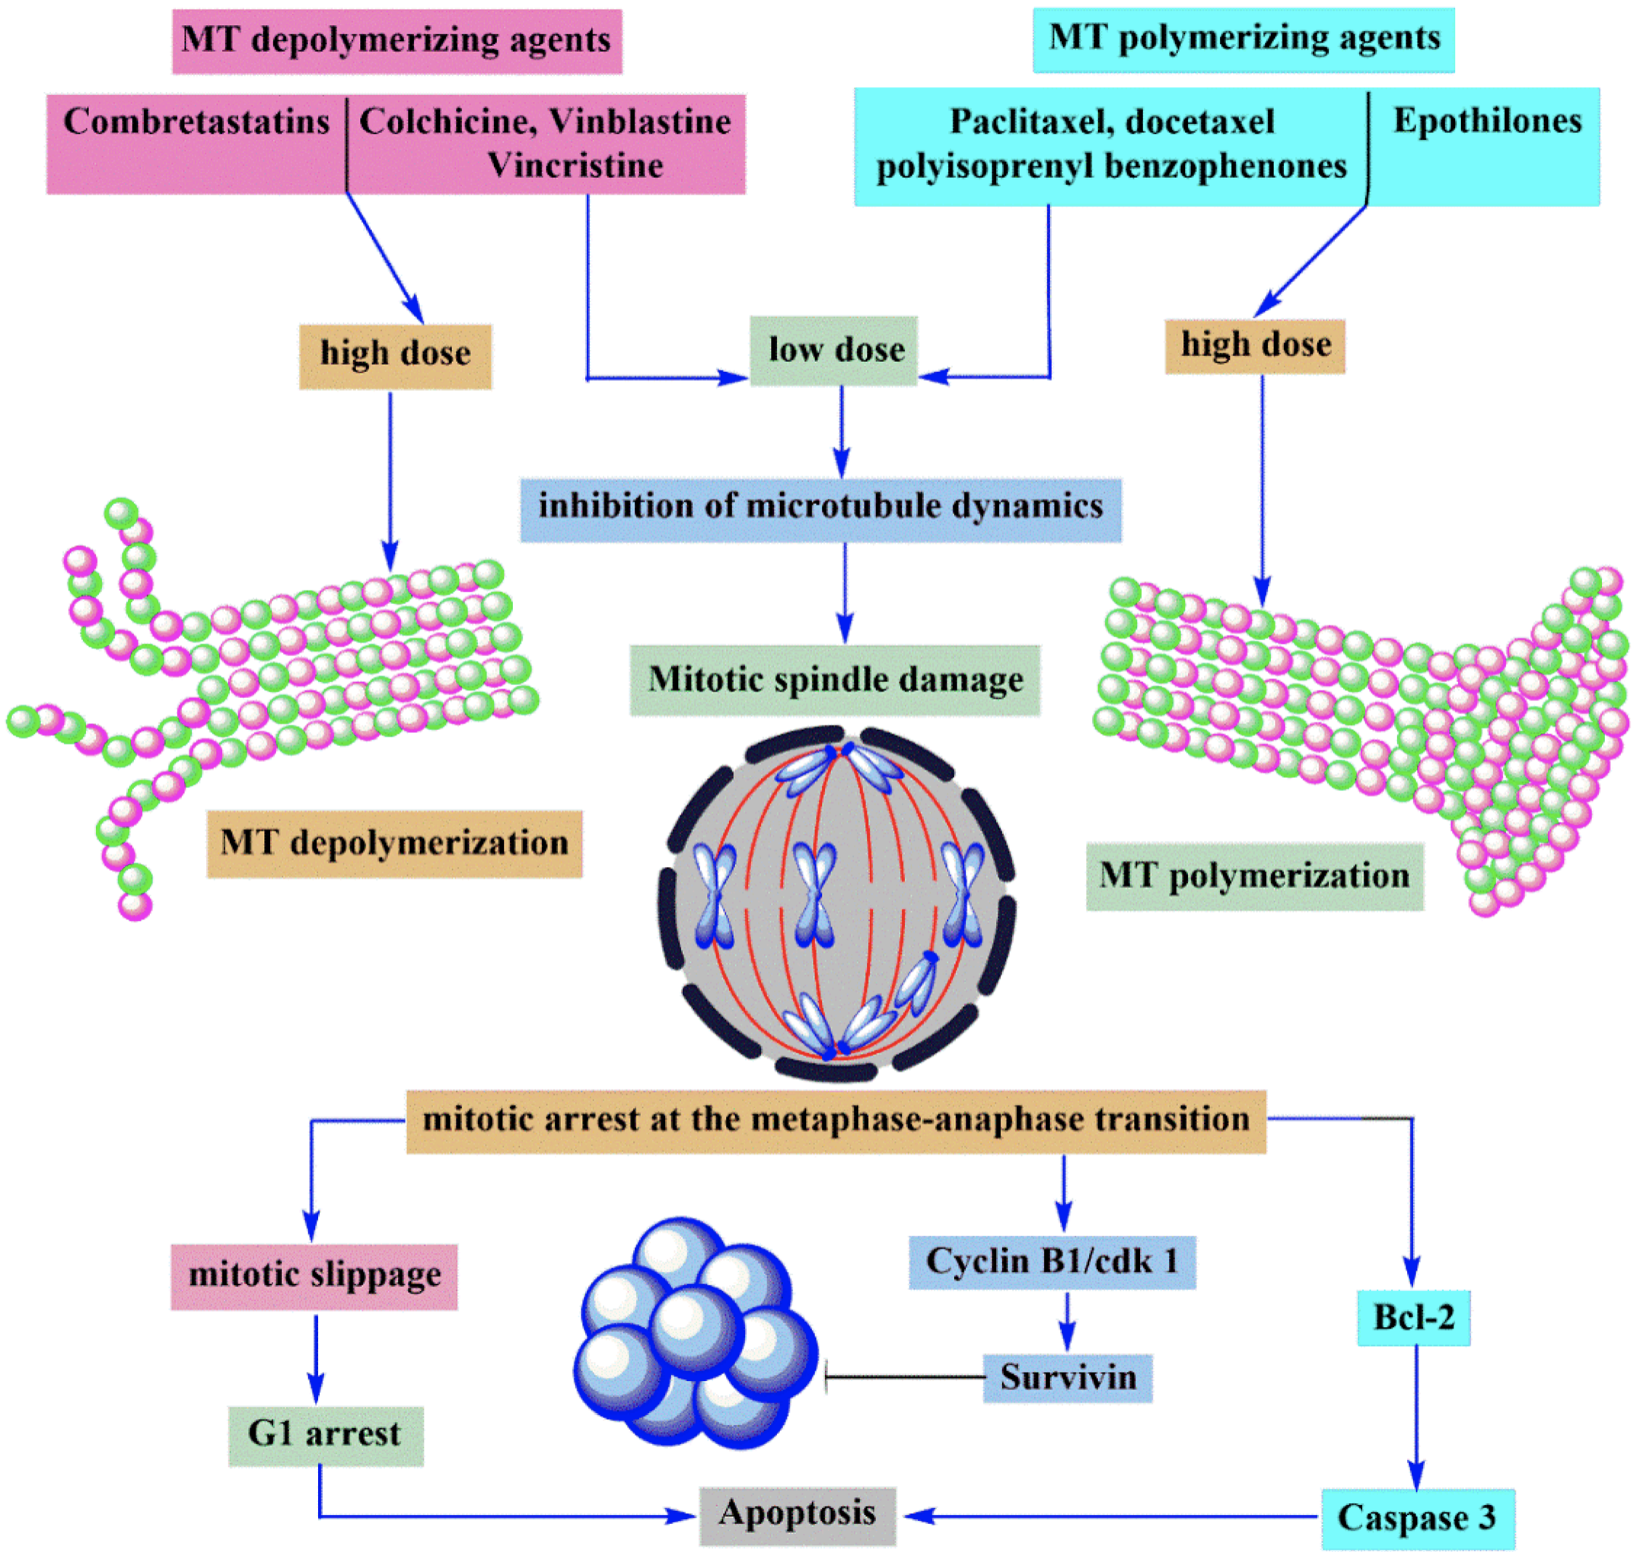
Molecules 2020, 25, 2560; doi:10.3390/molecules25112560

Slide 20
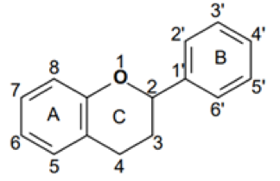
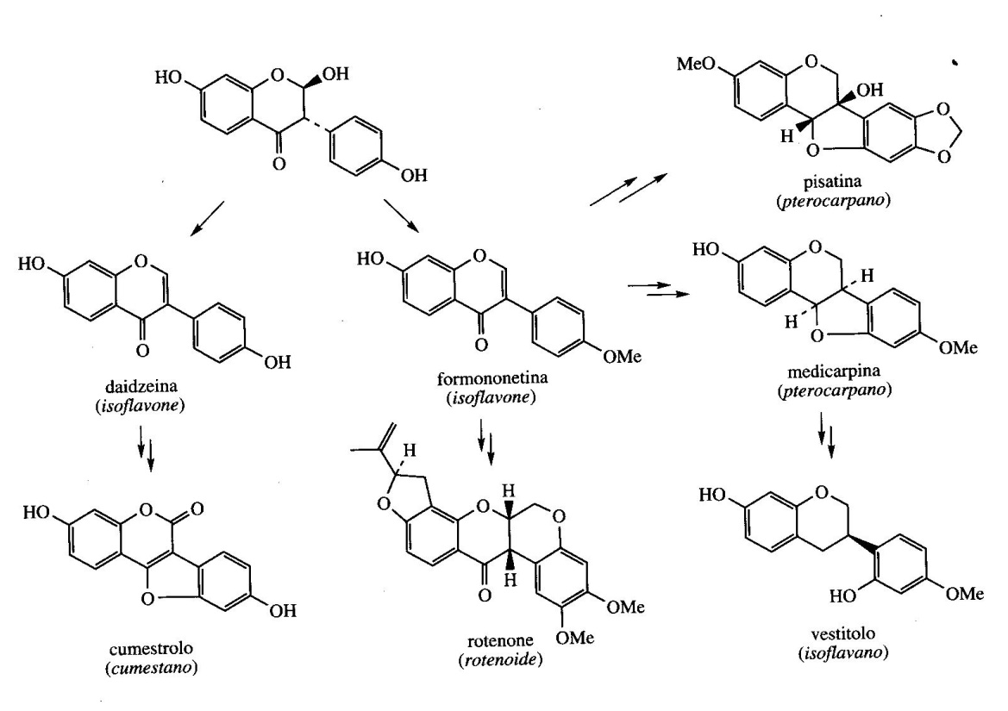
Isoflavonoids
Isoflavonoids possess a rearranged flavonoid skeleton (ring B in C3 in the place of C2)
A variety of structural modifications of this skeleton lead to a large class of compounds that includes isoflavones, isoflavanones and rotenone

Slide 21
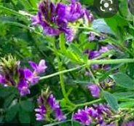
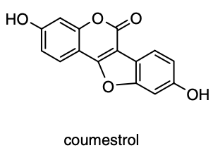
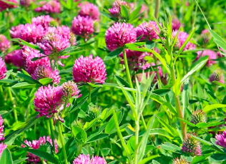
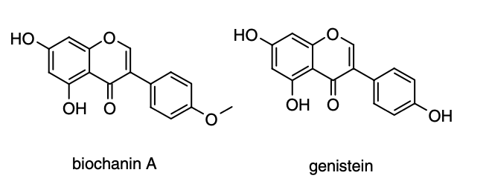
The isoflavonoid compounds are common constituents of the legume family Fabaceae (formerly called Leguminosae family). These compounds displayed estrogenic, insecticidal, and antifungal activity. Some are potent fish poisons.
Medicarpin, Pisatin (pea) and Vestitol (alfalfa) are defensive antifungals for plants. Cumestrol and Daidzeina (clover and alfalfa) have sufficient estrogenic activity to influence the reproduction of grazing animals. They are also called Phytoestrogens. These planar molecules undoubtedly mimic the shape and polarity of the steroid hormone estradiol.
Isoflavones biochanin A from red clover (Trifolium pratense), genistein from soybean (Glycine max), and coumestrol from alfalfa (Medicago sativa) are phytoestrogens, in addition to exhibiting antifungal activity.
Medicago sativa
Trifolium pratense

Slide 22
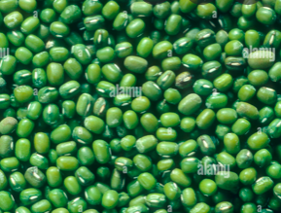
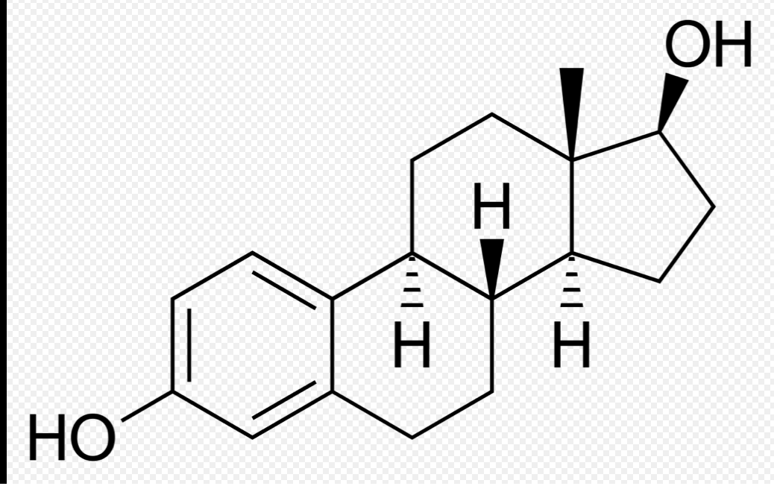
Genistein is the main phytoestrogen in soybean (Glycine max).
soybean (Glycine max)
estradiol
Phytoestrogens are non-steroidal compounds of plant origin with estrogenic properties. Among these, the Isoflavonoids are of particular importance. These molecules mimic the shape and polarity of the steroid hormone estradiol and can bind to an estrogen receptor even if their activity is much lower than estradiol.
In soybean seeds 40% of sterols are in free form, the remainder is in the form of glycoside or ester of fatty acids.
The seeds are used for their high protein content, for an edible oil (fatty acids: oleic 35- 40%, linoleic , 35- 50%, palmitic 7-14%, stearic 1-5%, alfa-linolenic 4-11% ) and also for lactose-free milk.
Foods rich in isoflavonoids help prevent heart attacks and cardiovascular diseases , protect against osteoporosis, and the risk ofAlzheimer’s disease.

Slide 23
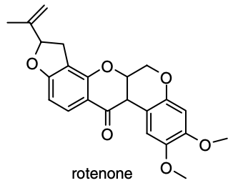
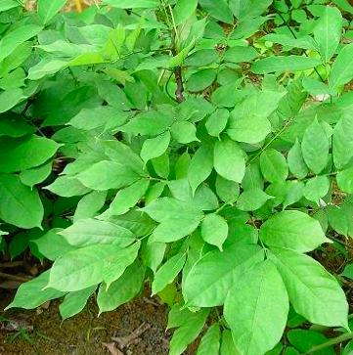
Rotenone
The isoflavanone rotenone is the principal insecticidal constituent of the piscicidal plants Derris elliptica ( roots) and Lonchocarpus nicou. It is a powerful inhibitor of mitochondrial electron transport.
Rotenone blocks complex I of the respiratory chain in the mitochondria. It inhibits the oxidation of NADH to NAD⁺ and thus respiration from oxidizable substrates such as glutamate, pyruvate and malate cannot occur.
Derris elliptica

