Slide 1
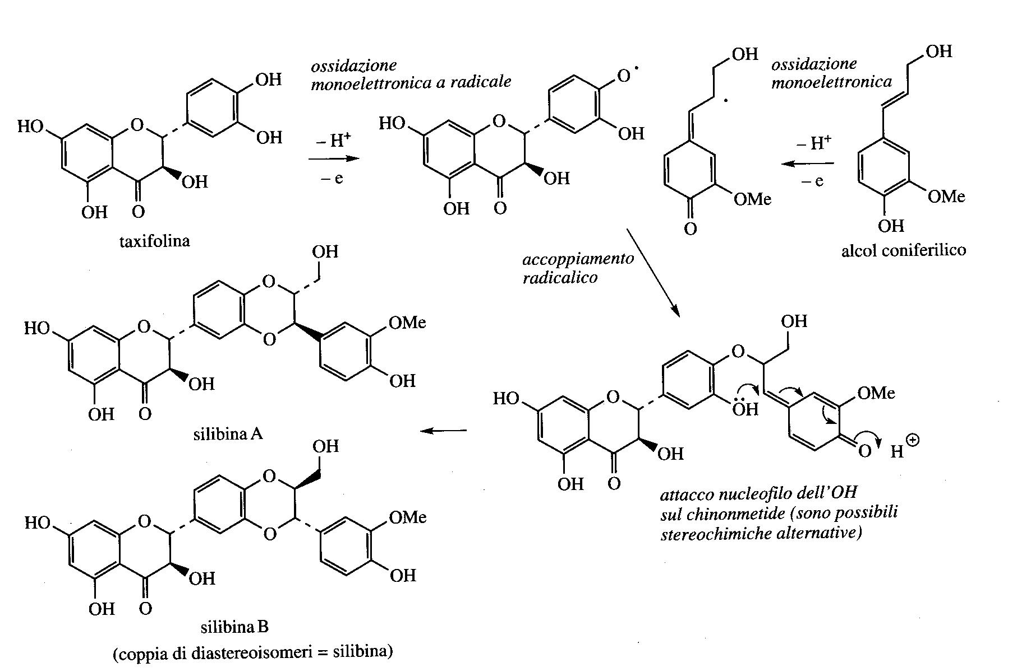
Flavonolignans
Flavonoids +lignans
Taxifolin = dihydroquercetin
(Phenylpropenol)

Slide 2
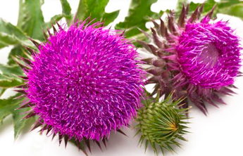
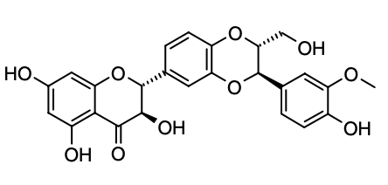

Silybin, one of the silymarins, a mixture of various flavanone derivatives (flavonolignans), is present in the fruit of the milk thistle (Silybum marianum).
Similarly, silymarin (a mixture of silybin, silycristin and silydianin) is the active antihepatotoxic complex used for the treatment of liver damage.
Relieves various liver disorders among which hepatitis and cirrhosis. Silymarin can regenerate damaged liver tissue and protect this organ from various toxins (fungi, alcohol, solvents, drugs).
It increases the rate of synthesis of rRNA.
Silybum marianum

Slide 3
Quinones
The quinones are phenolic compounds that typically form strongly colored pigments covering the entire visible spectrum. Typically, however, they are found in the internal regions of the plant and, thus, do not impart a color to the exterior of the plant.
Quinones play an important role in the respiration of plants, they act as electron carriers that function by converting between hydroquinones and quinones, thus acting as redox couples.
Ubiquinone (coenzyme Q) specifically serves as an electron carrier on the inner mitochondrial membrane by transferring electrons in order to complete a proton pump in the respiratory chain. This makes the quinones important components of most plant respiratory and photosynthetic electron transfer processes.

Slide 4
Quinones
Quinones can be formed from phenolic systems generated either by the Shikimato and acetate pathways.
Catechols and hydroquinones are generated.
Catechols give rise to ortho-quinones and hydroquinones to para-quinones.

Slide 5
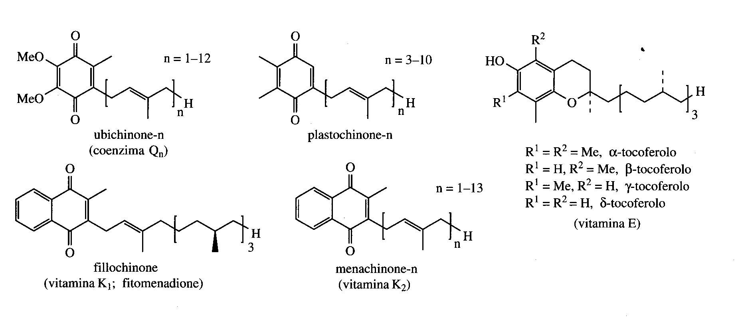
In nature there are series of quinone derivatives and related structures containing a terpenoid fragment and a portion derived from Shikimato.
Several of them show foundamental biochemical functions in electron transport systems for respiration and photosynthesis.

Slide 6
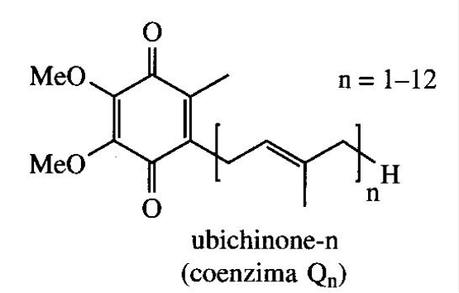
Ubiquinones
Ubiquinones (Coenzyme Q) are present in almost all organisms and function as electron carriers for the electron transport chain in mitochondria.
The length of the terpenoid chain is variable (n = 1-12) and depends on the species.
Most organisms synthesize more than one compound, with those in which n = 7-10 predominate.
The redox agent in humans is Q₁₀

Slide 7
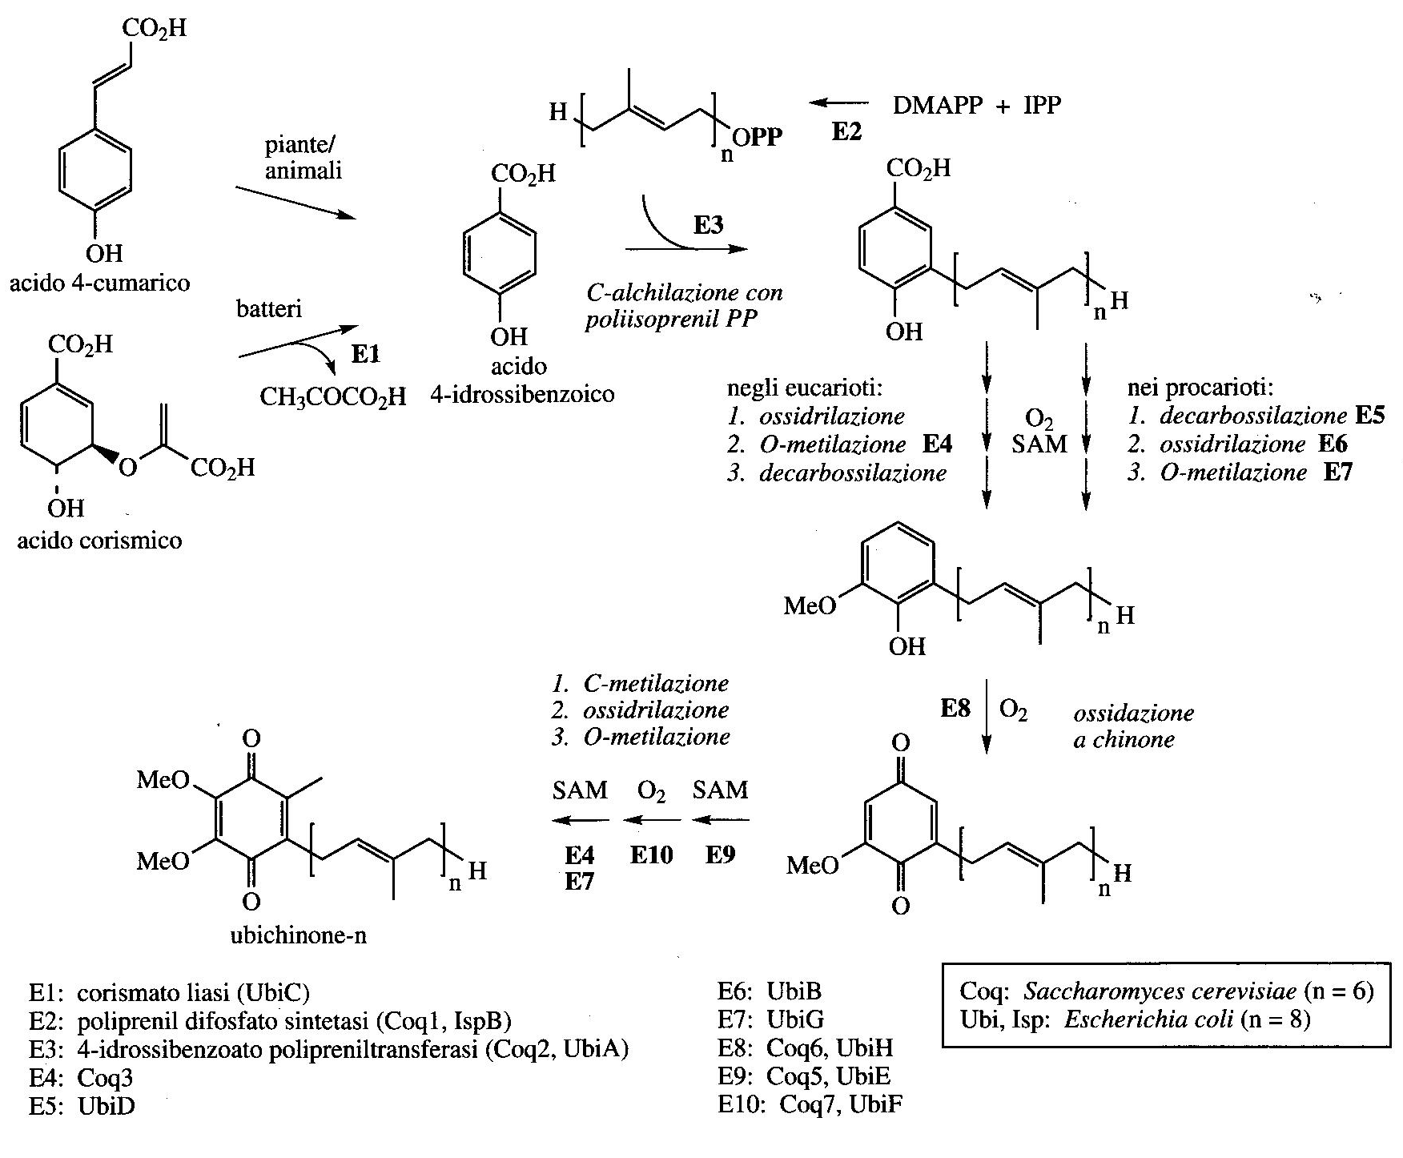
Ubiquinones derive from 4-hydroxy benzoic acid obtained in plants from Phe or Tyr through 4-hydroxy cinnamic acid (4-coumaric acid).
The integration of coenzyme Q is effective in respiratory chain defects and to slow down the symptoms of the disease Parkinson's

Slide 8
Plastoquinones
beta-tocoferolo
gamma-tocoferolo
alfa-tocoferolo
Plastoquinones are structurally similar to ubiquinones but are produced from hydroxy-phenylpyruvic acid
Plastoquinones participate in the electron transport chain in photosysntesis

Slide 9
Tocopherols are members of the group of vitamins E, are not actually quinones but are structurally related to plastoquinones.
Vitamin E refers to a group of fat-soluble vitamins, tocopherols, which are widely distributed in plants, with good levels in the seeds of cereals such as wheat, barley and rye. Wheat germ oil is a particularly rich source of this.
Vitamin E deficiency is practically unknown and most of its dietary intake comes from oils and margarine, although much of it can be lost during industrial processing and cooking.
It has useful antioxidant properties and probably impedes the destruction through radical reactions of vitamin A and unsaturated fatty acids in biological membranes.
It is believed to delay aging and to be cardioprotective.

Slide 10
Its antioxidant effect originates from the reaction with the peroxide radical which generates, through a monoelectronic phenolic oxidation, a stabilized radical by resonance which does not propagate the radical reaction but on the contrary captures further peroxide radicals.
The tocopheryl peroxide is hydrolized to tocopherylquinone.

Slide 11
Phylloquinones and Menaquinones
They derive from chorismic acid through its isochorismic acid isomer
Phylloquinones (vitamin K₁) and Menaquinones (vitamin K₂) are naphthoquinone derivatives derived from Shikimate.
Their are present in plants and algae (vitamin K₁) or bacteria and fungi (vitamin K₂).
The most common phylloquinone structure has a diterpenoid side chain (C₂₀) while the range of menaquinones is wide, with 1-13 isoprene units.
In the diet, vitamin K₁ is present in vegetables while a significant amount of K₂ is produced by the microbiota.
Deficient in vitamin K is evident after prolonged use of antibiotics or in cases where the absorption of the intestine is reduced.
Vitamin K participates in the blood coagulation processes and its deficiency leads to hemorrhage

Slide 12
Tannins
Tannins are water-soluble oligomers, rich in phenolic groups, capable of binding or precipitating proteins.
The tannins, common to vascular plants, exist primarily within woody tissues but can also be found in leaves, flowers, or seeds.
Plant tissues that are high in tannin content have a highly bitter taste and are avoided by most feeders.
Tannins are the main polyphenolic secondary metabolites distributed widely in the range of 5–10% of dry plant material in vascular plants. They are found mainly in the bark, stems, seeds, roots, buds, and leaves.
Tannins are either galloyl esters, or they are oligomeric and polymeric proanthocyanidins.
They protect trees from fungi, pathogens, insects, and herbivorous animals.

Slide 13
Tannins
Hydolyzable Tannins
Condensed Tannins
Complex Tannins
Gallotannins
Ellagitannins

Slide 14
Hydrolysable tannins are those, which upon hydrolysis by acids like HCl or H₂SO₄, yield gallic acid or ellagic acid.
Condensed tannins are resistant to hydrolysis by acids.
Complex tannins are mixtures of both, hydrolysable and condensed tannins.
According to modern studies, structural characteristics leads to categorise tannins into four major groups i.e. gallotannins, ellagitannins, complex tannins and condensed tannins.

Slide 15
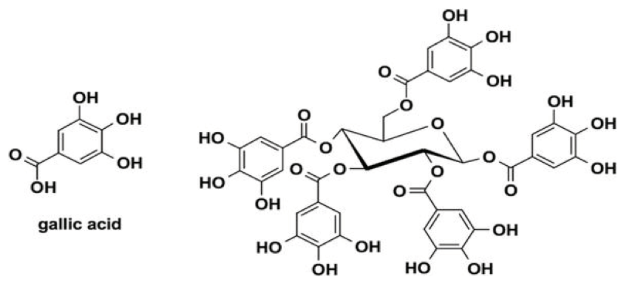
Hydrolyzable tannins are esters of a sugar (usually glucose) with one or more trihydroxybenzenecarboxylic acids (gallic acid). These materials give insoluble precipitates with albumin, starch, or gelatin. This reaction with proteins is used industrially to convert animal skins into leather (tanning).

Slide 16
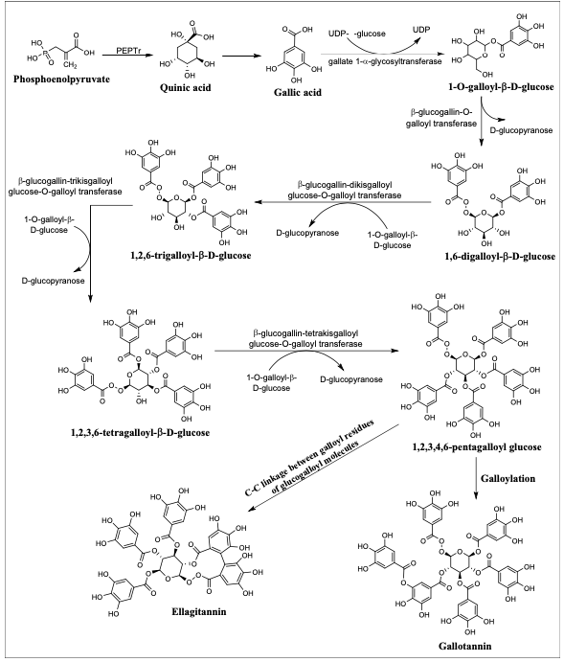
Biosynthetic pathway of gallotannin and ellagitannin
The starting material or the precursor is quinic acid.
Quinic acid comes from the one of the most important intermediate in glycolysis in plant phosphoenolpyruvate.
The biosynthesis of hydrolysable tannins comprises via the key intermediate formation of 1,2,3,4,6-pentagalloyl glucose.
After the intermediate 1,2,3,4,6-pentagalloyl glucose formation, the galloylation of pentagalloyl glucose continues and ester linkage between two galloyl moieties forms gallotannins.
After the formation of intermediate 1,2,3,4,6-pentagalloyl glucose, oxidation takes place by the action of different oxido-reductase enzymes, leading to C–C linkage formation between suitably orientated galloyl residues of glucogalloyl molecules and it results in hexahydroxydiphenoyl (HHDP) units formation which is the core moiety of ellagitannins.

Slide 17
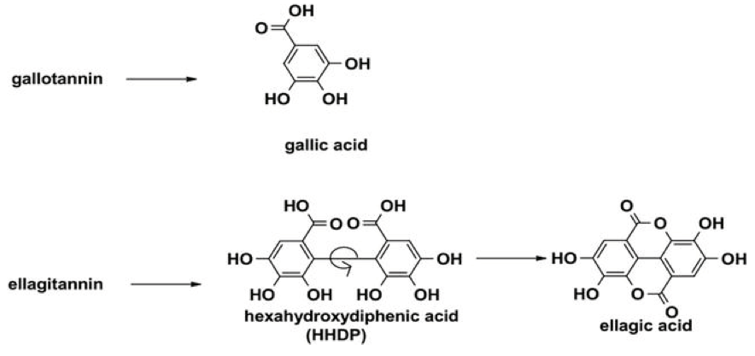
Gallotannins are converted to the related ellagitannins by the oxidative coupling of galloyl groups.
The simple ellagitannins are esters of hexahydroxydiphenic acid (HHDP).
The hydrolyzable tannins contain glucose or other polyhydric alcohols esterified with gallic acid (gallotannins) or hexahydroxydiphenic acid (ellagitannins).

Slide 18
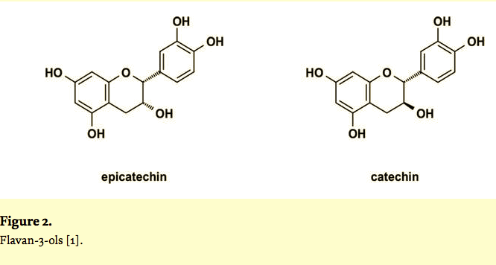
Condensed tannins have a wide range of molecular weight from 500 to over 20,000.
Condensed tannins are polymeric flavonoids, and most of them are based on the flavan-3-ols epicatechin and catechin.
Condensed tannins are formed biosynthetically by the condensation of flavanols to form polymeric networks.

Slide 19
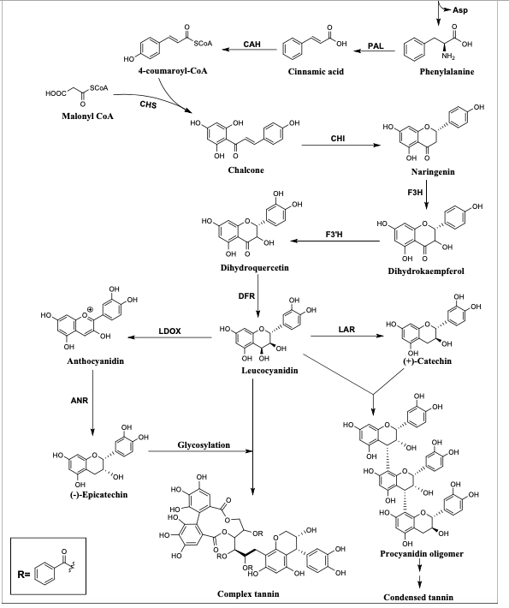
Naringenin chalcone isomerizes under the enzymatic condition produced by chalcone isomerase (CHI) to form naringenin, which is a flavanone.
Naringenin then forms a dihydroflavonol called dihydrokaempferol via the attachment of a hydroxyl group in 3 position by flavanone 3-hydroxylase (F3H).
Another hydroxyl group insertion occurs in dihydrokaempferol and gives dihydroquercetin by flavonoid 3′-hydroxylase (F3′H).
Further reduction takes place by dihydroflavonol reductase (DFR) which results in the formation of leucocyanidin.
Leucocyanidin deoxygenase (LDOX) to produce cyanidin or anthocyanidin, which gives (–)-epicatechin by the reduction of ring double bond.
Leucoanthocyanidin 4-reductase (LAR), gives (+)-catechin.
Procyanidin polymer finally gives condensed tannin by different C–C linkage formation. Epicatechin units can go through glycosylation to produce complex tannins.

Slide 20
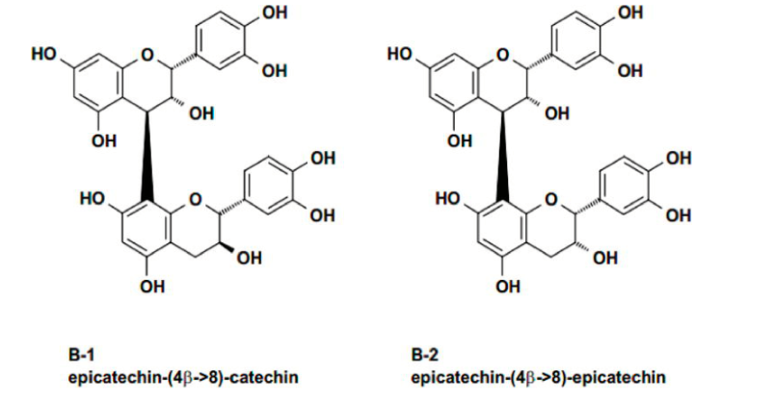
The best categorized condensed tannins are linked by C8 of the terminal unit and C4 of the extender. The four common modes of coupling are called B-1, B-2, B-3, and B-4.

Slide 21
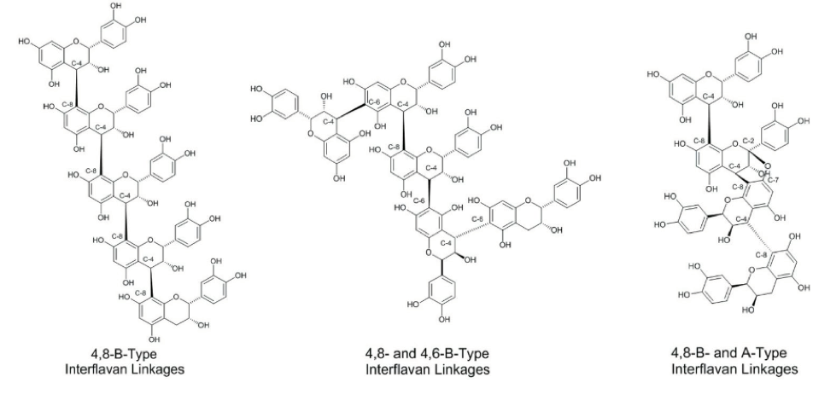

Slide 22
The tannins present in higher plants are phenolic molecules with a high molecular weight capable of forming complexes with both sugars and proteins. Precisely this ability of tannins to bind proteins has been exploited since ancient times by man for the tanning of leather.
Tannins contribute to the bitter taste of some foods such as tea, coffee and wine to which they give astringent characteristics.
As their molecular weight increases, so does their degree of insolubility and their ability to precipitate proteins and their astringency on the palate.
Tannins have antioxidant, radical scavenging, antimicrobial, antiviral , and anti-nutrient effects.
Tannins are capable of binding to proteins with hydrogen bonds between their phenolic groups and the peptide bonds of proteins, forming complexes resistant to the action of proteases of the digestive tract.

Slide 23
Anthocyanins
The anthocyanins are the common red and rare blue pigments of flower petals and can make up as much as 30% of the dry weight of some flowers.
The red pigment of beet (Beta vulgaris) is anthocyanin.
The anthocyanins exist typically as glycosides which derive from anthocyanidines bound with several molucules of sugars.
Food | Anthocyanins mg/ 100 g of food
Aubergine | 750
Orange | 200
Blue raspberry | 115
Raspberry | 10-60
Cherry | 350-400
Currant | 80-420
Red grapefruit | 30-750
Black grapes | 888
Red wine | 24-35
Elderberry | 200-1000

