Slide 1
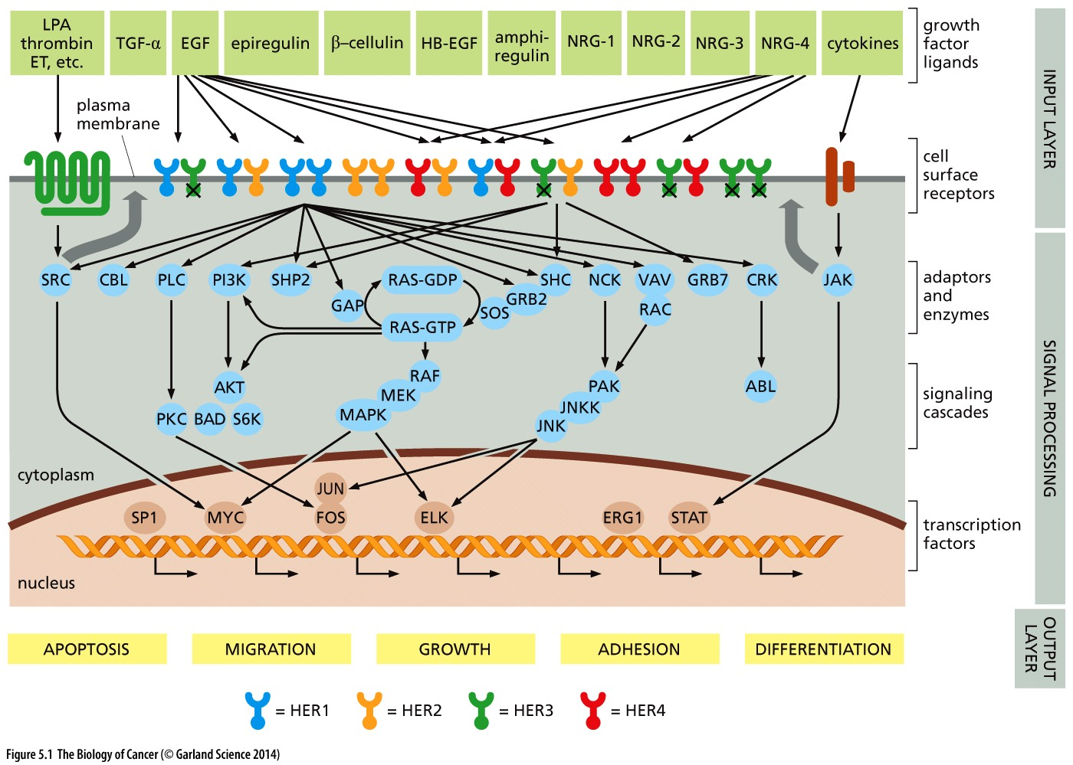
Growth factors and maintenance of tissue architecture
In multicellular organisms, precise control of the cell cycle during development and growth is critical for determining the size and shape of each tissue.
Normal cells receive growth-stimulatory signals from their surroundings.
These signals are processed and integrated by complex circuits within the cell, which decide whether cell growth and division are appropriate or not.
Human EGF receptor (HER) signaling network

Slide 2
These signaling processes are part of the larger problem of cell-to-cell communication. Indeed, the evolution of the first multicellular animals (metazoa) 600 to 700 million years ago depended on the development of biochemical mechamisms that allow cells to receive and process signals from their neighbors within tissues.
Without intercellular communication, the behavior of individual cells could not be coordinated and the formation of tissues and multicellular organisms was inconceivable.
Some cells emit signals and others must be able to receive them and respond in specific ways.
In very large part, the signals passed between cells are carried by proteins. Then, signal emission requires the ability to release proteins into the extracellular space.
After these signaling proteins are released into the extracellular space, the recipient cells must be able to sense the presence of these proteins in their surroundings.
The deregulation of this signaling is central to the formation of neoplastic cells.

Slide 3
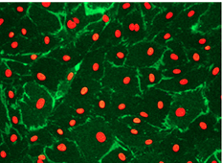
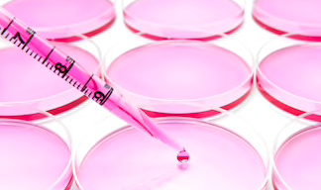
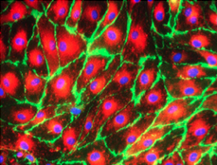
All these functions depend upon cooperation among large groups of cells. This explains why cells in a linving tissue are costantly talking to one another.
Decision about growth versus no-growth must be made for the welfare of the entire tissue and whole organism.
All the decisions made by an individual cell about its proliferation must represent a consensus decision shared with the cells that reside in its neighborhood.
Medium
AA
Vitamins
Salts
Glucose
+
Serum with GFs

Slide 4
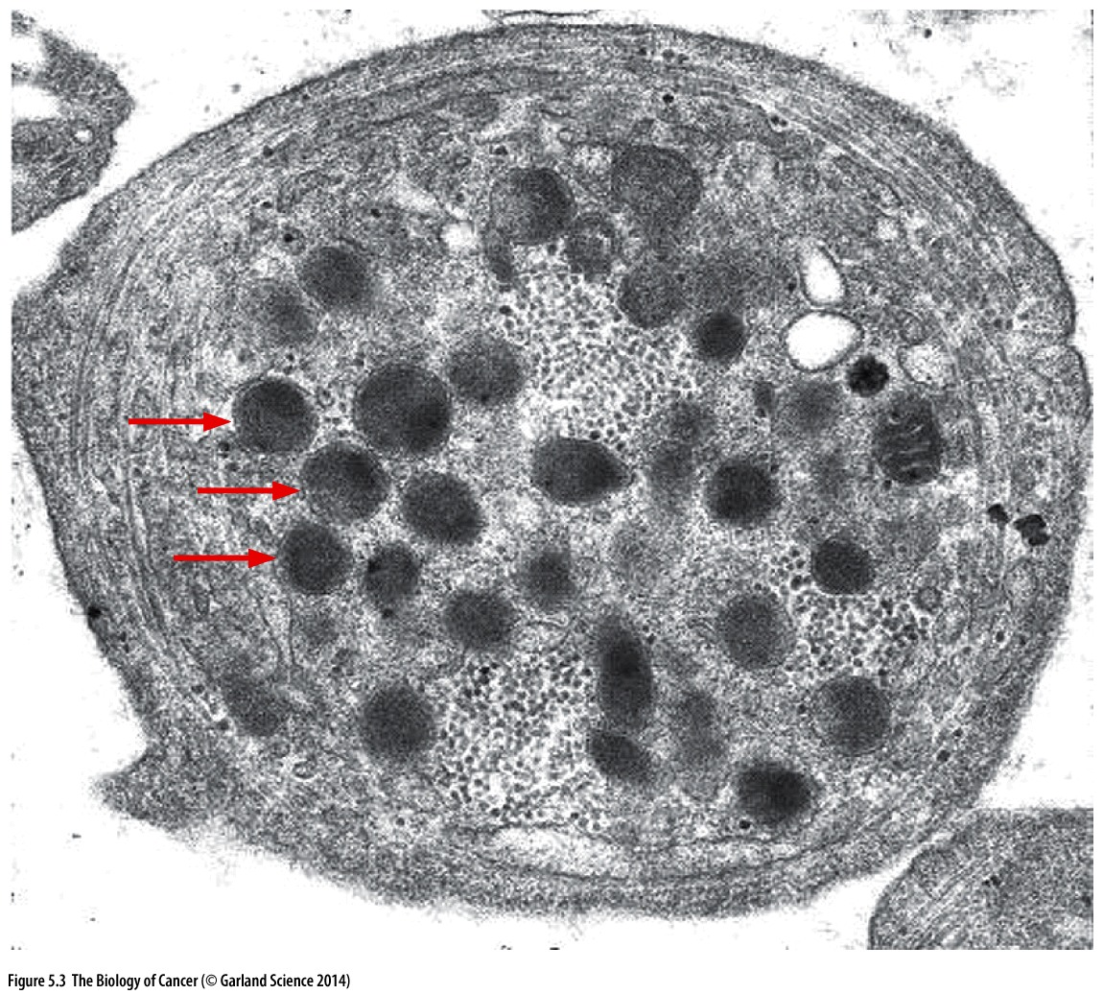
Growth factors (GFs), small proteins, released by some cells, convey many of the signals that tie the cells within a tissue together into a single community, all member of which are in continuous communication with their neighbors.
Plateled-derived growth factor (PDGF) is a potent stimulator of fibroblasts, which form much of the connective tissue including the cell layers beneath the epithelia.
GFs like PDGF are often termed mitogens to indicate their ability to induce cells to proliferate.
Specifically, PDGF attracts fibroblast into a wound site and then stimulates their proliferation.
Platelets carry a number of secretory vescicles termed α-granules, containing PDGF.
When platelets become activated during clot formation, these vescicles fuse with plasma membrane, releasing stored growth factors into the extracellular space.

Slide 5
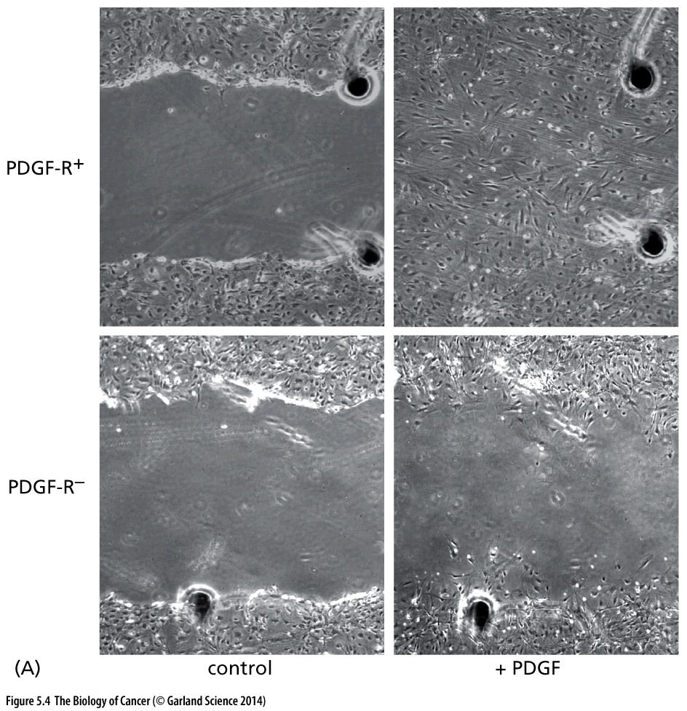
Without stimulation by PDGF, cultured fiblobasts will remain viable but they will not growth and devide

Slide 6
Mammalian Restriction Point is analogous to START in Yeast cells
Cultured cells require growth factor (mitogens) to stimulate cell proliferation. Binding of these growth factor to specific receptor proteins that spam the plasma membrane initiates a cascade of intracellular molecular event, referred to as signal transduction that influence transcription and cell-cycle control
Mammalian cells cultured in the absence of growth factors are arrested in the G0 period of the cell cycle. If growth factor are added to the culture medium, these quiescent cells pass through the restriction point 14-16 hours later, enter the S phase 6-8 hours after that and traverse the remainder of the cell cycle
Like START in yeast cells the restriction point is the point in the cell cycle at which mammalian cells become committed to enter S phase and completing the cell cycle. If mammalian cells are moved from a medium containing growth factors before the restriction point they do not enter S phase. After they have passed the restriction point, they are committed to enter S phase and progress through the entire cell cycle ( 24h)

Slide 7
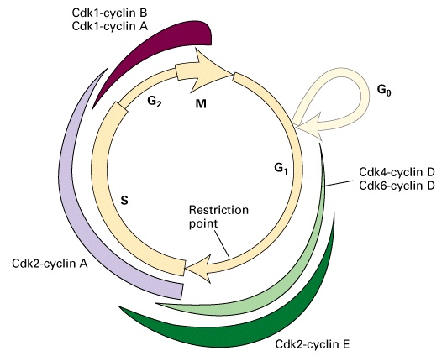
Mammalian cell cycle
M 1 h
G₂ 3-5 h
G₁ 12-15 h
S 6-8 h
To replicate
6.4 x10⁹ bp
S. cerevisiae 1.5 x10⁷ bp
Linfociti attivati e cellule embrionali possono avere un ciclo di 5 ore

Slide 8
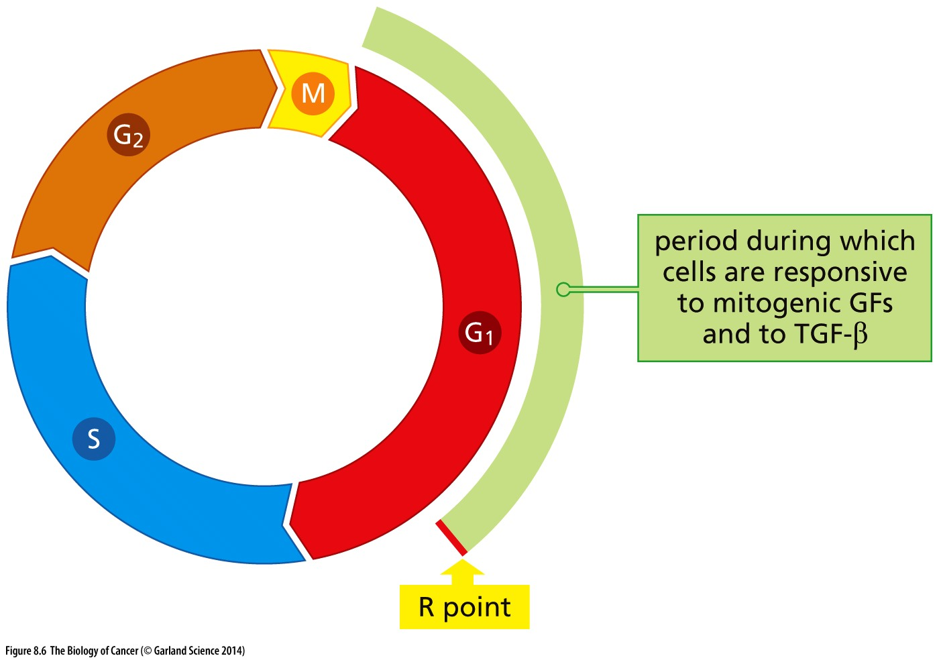
Responsiveness to extracellular signals during the cell cycle
Extracellular mitogens and anti-mitogenic factors are able to impose their effects before RESTRICTION POINT

Slide 9
Restriction point or START
Point at which cell is irreversibly committed to traversing the cell cycle
Mammals: restriction point
Yeast: START
Cell cycle proceeds without influence from environment (only stopped by damage)
Late in G₁

Slide 10
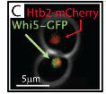
Traversal of Start is driven by CDK activity, which can be measured in live cells via the CDK-dependent nuclear export of the transcriptional inhibitor Whi5.
Start corresponds precisely to the abrupt activation of the G1 cyclin-positive feedback loop, which occurs when about 50% of a cell’s Whi5 has left the nucleus.
Recent studies using single-cell time-lapse imaging of cycling normal human fibroblasts concluded that the mammalian restriction point occurs 4–6 hours before significantly detectable Rb phosphorylation.

Slide 11
CYCLINS and CDKs
CYCLINS
G1 phase: D-type and E-type
- S phase: E-type and A-type
- M phase: A-type and B-type
CDKs
-G1 phase: Cdk2, Cdk4, Cdk6
-S phase: Cdk2
-M phase: Cdk1

Slide 12
Identita’ con
Ciclina A2
Identita’ nel
Cyclin box

Slide 13
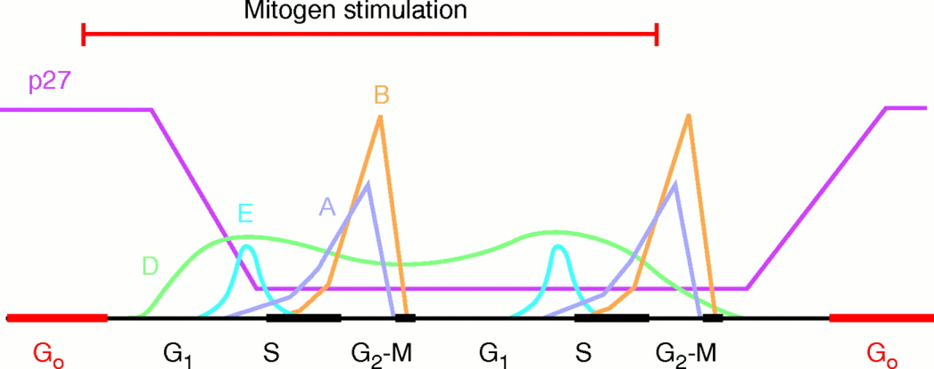
Cyclins
Regulatory subunits of Cdk (cyclin-dependent kinase) complexes (heterodimeric protein kinases)
Turn on kinase activity (phosphorylation)
Levels vary cyclically during cell cycle
Degraded by proteolysis at specific points in the cell cycle

Slide 14
Control of cyclin D1 levels
Macrophages starved and then exposed to the mitogen CSF-1 (colony-stimulating factor-1).
Cyclin D1 mRNA at subsequent times were determined by Northern blotting.
The levels of D-type cyclins fluctuate together with the level of extracellular mitogens, D-type cyclins continuously inform the cell cyle clock of current conditions in the environment around the cell.
After D-type cyclins are synthetized in the cytoplasm and migrate into the nucleus, they assemble with CDK4 and CDK6.

