Slide 1
Curcumin: the active substance of turmeric and its effects on health
Turmeric (Curcuma longa L.) is a perennial herbaceous herb with yellow flowers, belonging to the Zingiberaceae family.
It grows in the tropics and subtropics of Asia, especially in India, China, Indonesia, Jamaica, Peru, and Pakistan.
The plant's primary roots under the earth are shaped like eggs and pears, and the lateral roots are shaped like tubers (rhizomes) where there are the yellow pigments.
The pigment curcumin is the main derivative of turmeric and is a bioactive, hydrophobic and polyphenolic compound
J Sci Food Agric 2021; 101: 5747–5762

Slide 2
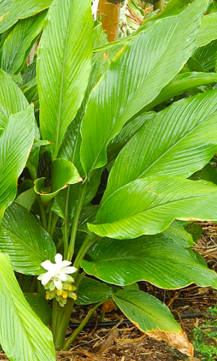
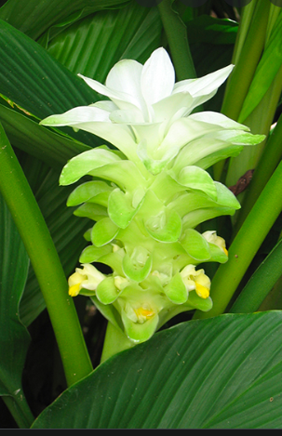
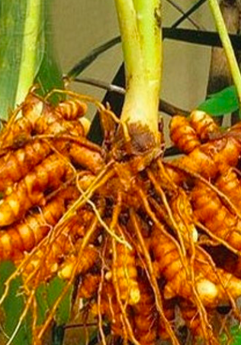

Slide 3
Old scriptures described turmeric as an essential plant. Turmeric is described as ‘Indian saffron’.
It is also prevalent in ancient Indian medicine, Ayurveda. Indeed, the use of turmeric as paint, a condiment, and medicine has spread to many countries. Turmeric is also used as a flavoring agent with digestive properties.
Around 40 Curcuma species are native to India, suggesting their Indian origin and approximately 70–110 species have been recorded in tropical Asia, and also in China and Australia.
Curcumin was first isolated from turmeric in 1815 and was its structure identified as diferuloylmethane (curcumin) in 1910.
The curcumin preparations currently available contain approximately 77% diferuloylmethane (curcumin).
Curcumin is responsible for the main biological activity of turmeric.

Slide 4
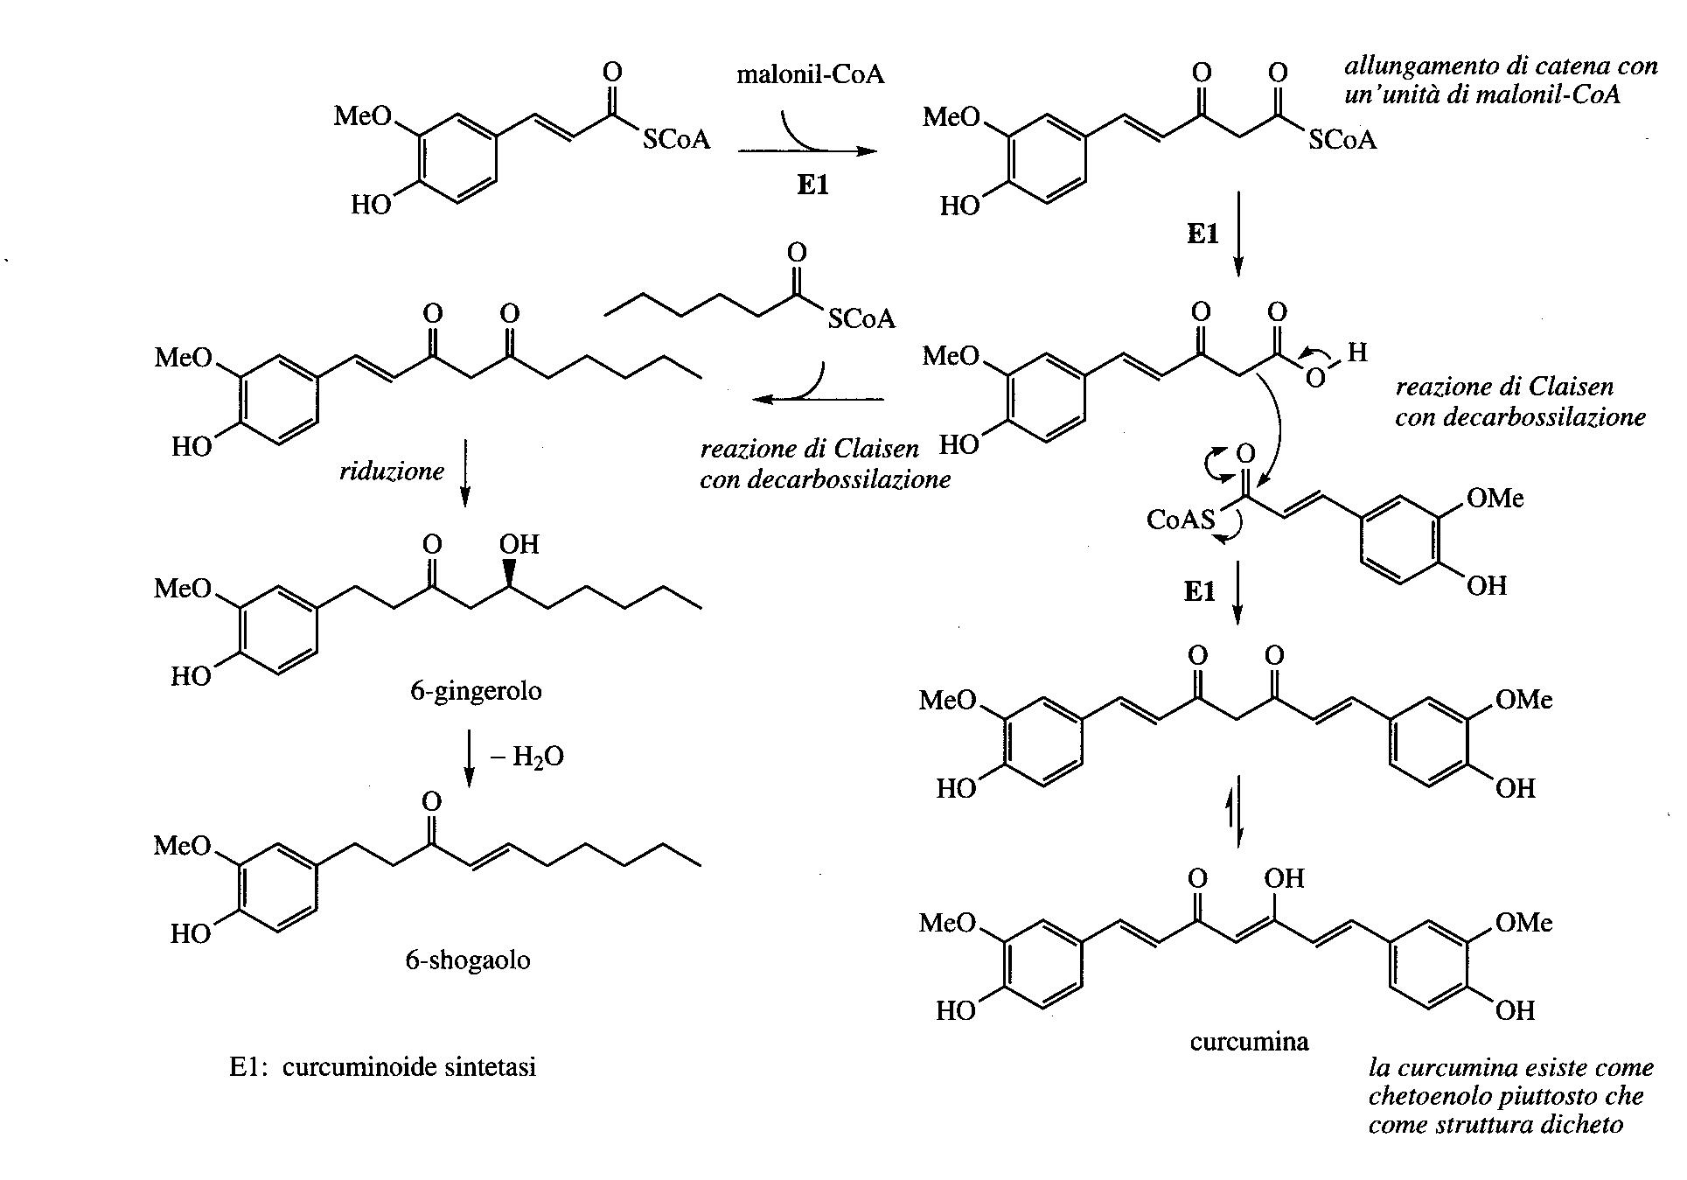

Slide 5
The melting point of curcumin is 183 °C; its molecular weight is 368.38 Da
Its poor bioavailability is one of the greatest issues in curcumin ingestion, mainly because of poor absorption, fast metabolism and rapid removal even with the benefits provided by its anti-inflammatory and antioxidant mechanisms.
Piperine, a known bioavailability enhancer, is the major effective component for black pepper and increases curcumin bioavailability
Other techniques considered to increase curcumin's natural action include the use of adjuvants, nanoparticles, liposomes, micelles, and phospholipid complexes.

Slide 6
Curcumin capsules, tablets, power drinks, soaps, and cosmetics are some of the several types of products available.
Curcuminoids are classified by the United States Food and Drug Administration as ‘generally recognized as safe’ products, and clinical trials have shown strong tolerability and safe profiles at doses ranging from 4000 to 8000 mg.

Slide 7
Intracellular antioxidant curcumin pathway
Its antioxidant activity is controlled by different enzymes, such as catalase, superoxide dismutase, and glutathione peroxide.
It exhibits ten times more antioxidant activity than vitamin E.
Curcumin triggers glutathione S-transferase and inhibits free radical generation, thereby acting as a free radical scavenger.
Its chemical composition also accounts for its anti-oxidant activities.
J Sci Food Agric 2021; 101: 5747–5762

Slide 8
Intracellular antioxidant curcumin pathway
Curcuminoids have the highest ability in macrophage activation to clean superoxide radicals (hydrogen peroxide and nitric oxide), minimize iron complex and prevent lipid peroxidation.
Curcumin is a favorable bioactive molecule among many natural anticancer agents. Studies have shown that curcumin effectively induces apoptosis and prevents metastasis, invasion and angiogenesis.
J Sci Food Agric 2021; 101: 5747–5762

Slide 9
Biological properties of curcumin
J Sci Food Agric 2021; 101: 5747–5762

Slide 10
Curcumin and antibacterial activity
Curcumin has a wide spectrum of activity against bacteria,viruses and fungi
It inhibits the growth of Streptococcus mutans, Actinomyces viscosus, Lactobacillus casei, Porphyromonas gingivalis, Prevotella intermedia, and Enterococcus faecalis, (with minimum inhibitory concentration (MIC) values of 333.33, 167.67, 125, 125, and 208.33 mg L⁻¹ , respectvely). It ia active also on Listeria monocytogenes and Salmonella typhimurium.
Moreover, curcumin was 32-fold more powerful than fluconazole (antifungal agent) in the reticence of the growth of Paracoccidioides brasiliensis,which is the pathogen that triggers one of the most prevalent systemic mycoses in Latin America , paracoccidioidomycosis.

Slide 11
Curcumin and antibacterial activity
Curcumin has been shown to act as an efflux pump inhibitor in multidrug-resistant P. aeruginosa
Gene expression associated with the extracellular metabolism of polysaccharides and carbohydrates, as well as adherence, decrease after curcumin treatment (E. coli and B. subtilis).
Nanocurcumin has also been deemed an alternative to enhance curcumin’s bioavailability. Curcumin nanoparticles (2-40nm) exhibit a strong antimicrobial activity against S. aureus, E. coli as well as P. aeruginosa.

Slide 12
Curcumin and neuroprotective activity
Curcumin exhibits a variety of beneficial effects and appears to have a significant potential in the treatment of multiple diseases that are a result of oxidative stress.
These protective effects of curcumin are attributed mainly to its antioxidant properties and should be further exploited to develop novel drugs.
Dietary supplementation with curcumin may be beneficial in neurodegenerative diseases such as Alzheimer's disease.
In a focal cerebral ischemia model of rats, curcumin offered significant neuroprotection through inhibition of lipid peroxidation, increase in endogenous antioxidant defense enzymes.

Slide 13
Curcumin and neuroprotective activity
Animal model of AD showed that low-dose curcumin significantly suppresses inflammatory cytokine IL-1 and astrocytic marker glial fibrillary acidic protein and reduces oxidative damage, with a consistent decrease of insoluble amyloids.
Curcumin can minimize oxidative damage and mitochondrial dysfunction and inhibits neuronal apoptosis and microglial activation

Slide 14
Hypocholesterolemic function of curcumin
Turmeric decreases cholesterol and triglyceride levels, reduces lipoprotein LDL susceptibility to lipid peroxidation and inhibits platelet aggregation.
These effects are noted even with a low turmeric dose. The LDL susceptibility to lipid peroxidation in addition to low plasma cholesterol and triglyceride levels was demonstrated to decrease in a study of atherosclerotic rabbits given low-dose turmeric extract (1.6–3.2 mg kg−1 body weight per day).
The effect of turmeric extract on cholesterol levels can be attributed to decreased intestinal cholesterol intake and an increased cholesterol conversion to bile cids in the liver.

Slide 15
Anti-cancer effects of curcumin
Curcumin has been beneficial in many models as regulator of uncontrolled angiogenesis. It minimizes the overexpression of genes associated with angiogenesis. It inhibits metalloproteinases and reduces tumor tissue angiogenesis. These effects of curcumin analogs were shown to be due to decrease expression of angiogenesis-associated genes, vascular endothelial growth factor (VEGF) and MMP9.
The molecular basis of anticarcinogenic and chemopreventive effects of curcumin is attributed to its effect on several targets including transcription factors, growth regulators, adhesion molecules, apoptotic genes, angiogenesis regulators and cellular signaling molecules.

Slide 16
Curcumin has been shown to down regulate the production of pro-inflammatory cytokines tumor necrosis factor-α (TNF-α), IL-1β and inhibit the activation of transcription factors nuclear factor-κB (NF-κB) and activator protein-1 (AP-1)
Suppression of AP-1 was due to a direct interaction of curcumin with AP-1 binding to its DNA binding motif and also due to inhibition of c-Jun and c-fos, components of AP-1 .

Slide 17
Curcumin has been widely used in cancer treatment due to its ability to trigger cell death and suppress metastasis.
Based on pre-clinical studies, curcumin administration is beneficial in the treatment of urological cancers and future clinical applications might be considered upon solving problems related to the poor bioavailability of the compound. To improve the bioavailability of curcumin and increase its therapeutic index in urological cancer suppression, nanostructures have been developed to favor targeted delivery.

Slide 18
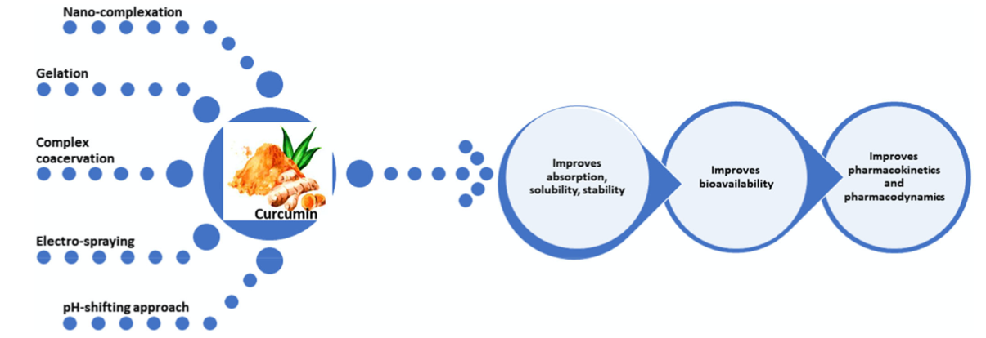
Common methods for curcumin encapsulation
Despite various biological attributes and bioactivity, curcumin has limited applications in food products because of its extremely low bioavailability, caused by poor chemical stability, low water solubility and rapid metabolism.
Encapsulation was suggested as a promising method to improve curcumin's aqueous solubility and stability.
J Sci Food Agric 2021; 101: 5747–5762

Slide 19
Common methods for curcumin encapsulation
Curcumin’s nanocomplex with biopolymers (e.g., proteins) provides a way to encapsulate it.
Curcumin's aqueous solubility increased 812-fold through soy protein nanocomplexing.
Moreover, the complexation improved the stability and antioxidant activity of curcumin.
Ovalbumin nanocomplexation also increased curcumin solubility 370 times compared with free curcumin
J Sci Food Agric 2021; 101: 5747–5762

Slide 20
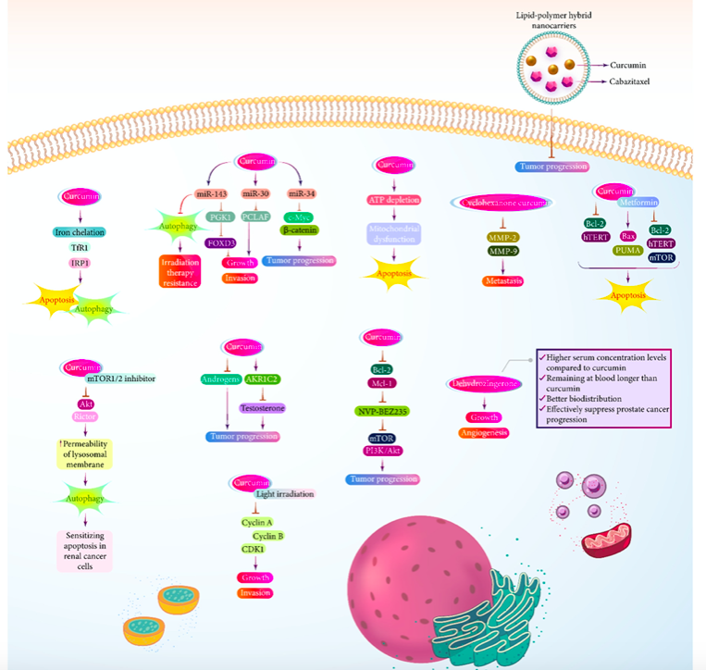
Curcumin in prostate cancer treatment
In vitro model of cancer cell lines
Curcumin limits prostate cancer metastasis by downregulating MMPs and by inhibiting angiogenesis.
Curcumin decreases the expression of Bcl-2 to induce apoptosis
Curcumin can affect autophagy.
https://doi.org/10.1016/j.lfs.2022.120984

Slide 21
Curcumin’s nanocomplex
Nanostructures have been used for the delivery of curcumin in prostate cancer therapy .
Curcumin-loaded nanostructures have been used to suppress the progression of docetaxel-resistant prostate tumor cells.
The lipid-based nanoparticles had curcumin encapsulated and they had a particle size of 150 nm or less.
Their loading efficiency was 7.5 % and entrapment efficiency was 90 %.
These curcumin-loaded nanoparticles demonstrated superior cytotoxicity against prostate tumor cells and they effectively inhibited cancer progression.
https://doi.org/10.1016/j.lfs.2022.120984

Slide 22
Curcumin’s nanocomplex
In another study, curcumin- and cabazitaxel-co-loaded lipid-polymer hybrid nanostructures have been developed.
These had particle size of 121.3 nm and effectively accumulated at the tumor.
Based on these investigations, the potential of curcumin in prostate cancer suppression has been validated in several in vitro studies.
Future studies should evaluate the role of curcumin in the treatment of prostate cancer patients.
https://doi.org/10.1016/j.lfs.2022.120984

