Slide 1
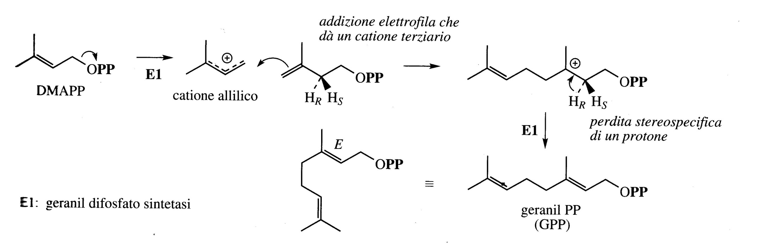
Monoterpenes (C₁₀)
Carbocation formation of the DMAPP and cation delocalization
IPP acts as a nucleophile and DMAPP as an electrophile
DMAPP
The union catalyzed by enzymes between MAPP and IPP leads to the formation of Geranyl Pyrophosphate (GPP) used to synthetize other monoterpenes.

Slide 2
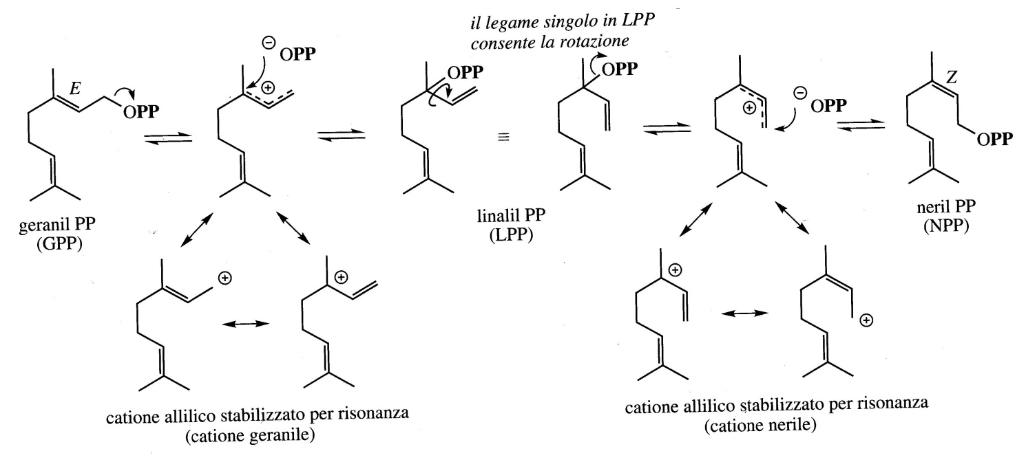
From the GPP the geranyl carbocation can be generated or, an isomerization of the double bond, as seen in the figure. These compounds can originate a series of linear monoterpenes that make up the volatile oils used in the production of aromas and perfumes.

Slide 3
Most of the substances that possess an aroma refer to terpene structures, in particular to monoterpenes and secondarily to sesquiterpenes.
The increase in molecular weight leads to a decrease in the aromatic capacities and their intensity, while influencing their durability, as they are less volatile.

Slide 4
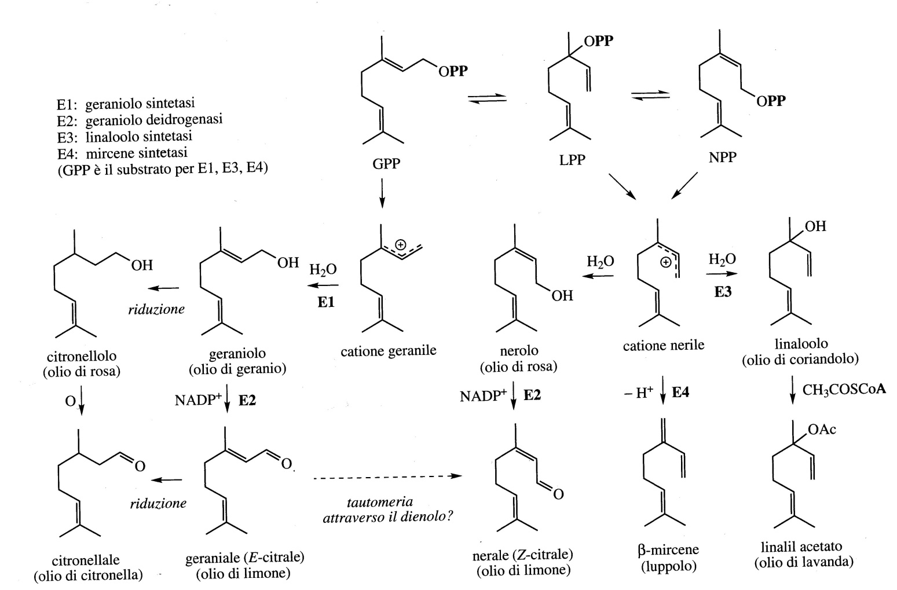
Acyclic monoterpenes
These compounds can originate a series of linear monoterpenes that make up the volatile oils used in the production of aromas and perfumes.

Slide 5
Myrcene is present in more than 200 different perfumes and fragrances and are particularly abundant in the essential oils of many species belonging to the Labiatae and Compositae family.
Myrcene is found in the dried peel of orange and juniper berries.
Linalool, geraniol, nerol and citronellol are the oxygenated derivatives of the series of monoterpenes that are found most frequently in nature.
Linalool is found in the peel of ripe fruits of bergamot, cardamon, coriander, fresh orange blossom, lavender (flowers) and thyme (flowers).

Slide 6
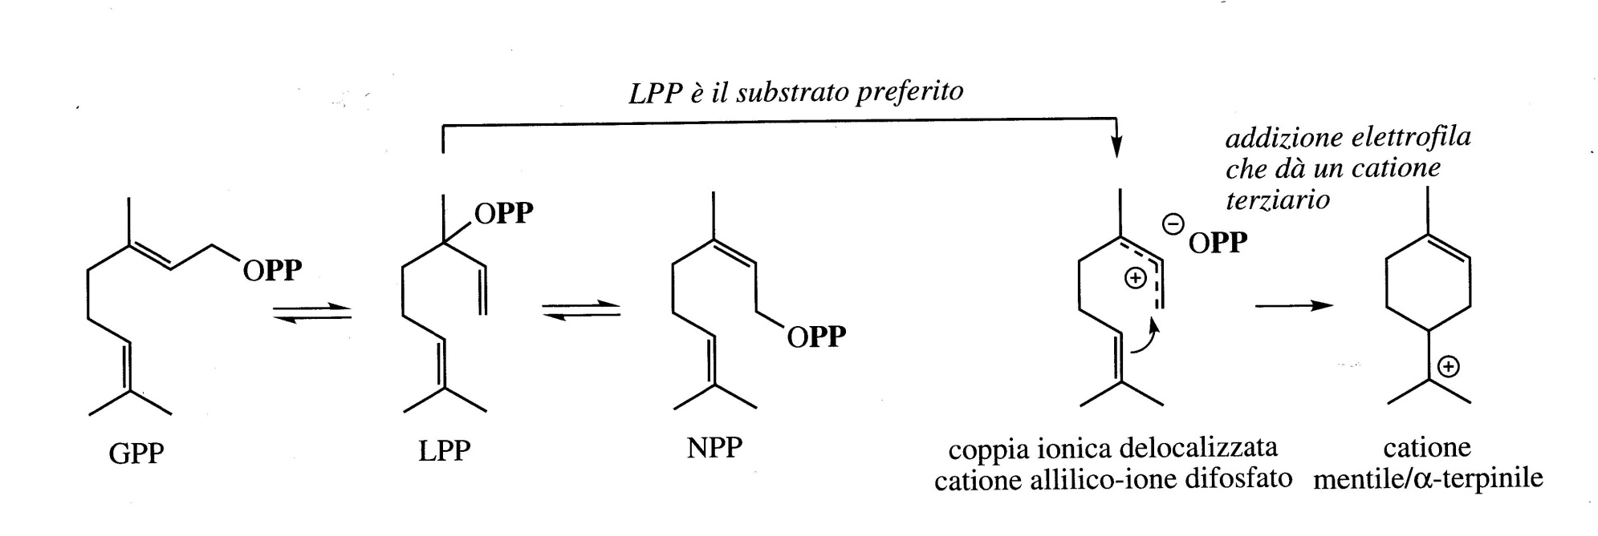
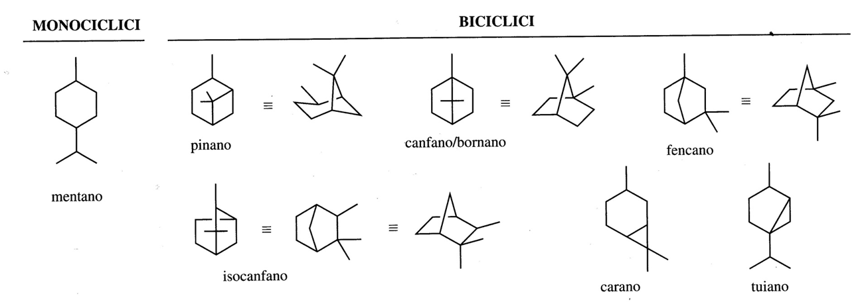
Monoterpenes, in nature, can cyclize and produce monocyclic and bicyclic compounds through enzymatic catalysis (terpene cyclase)

Slide 7
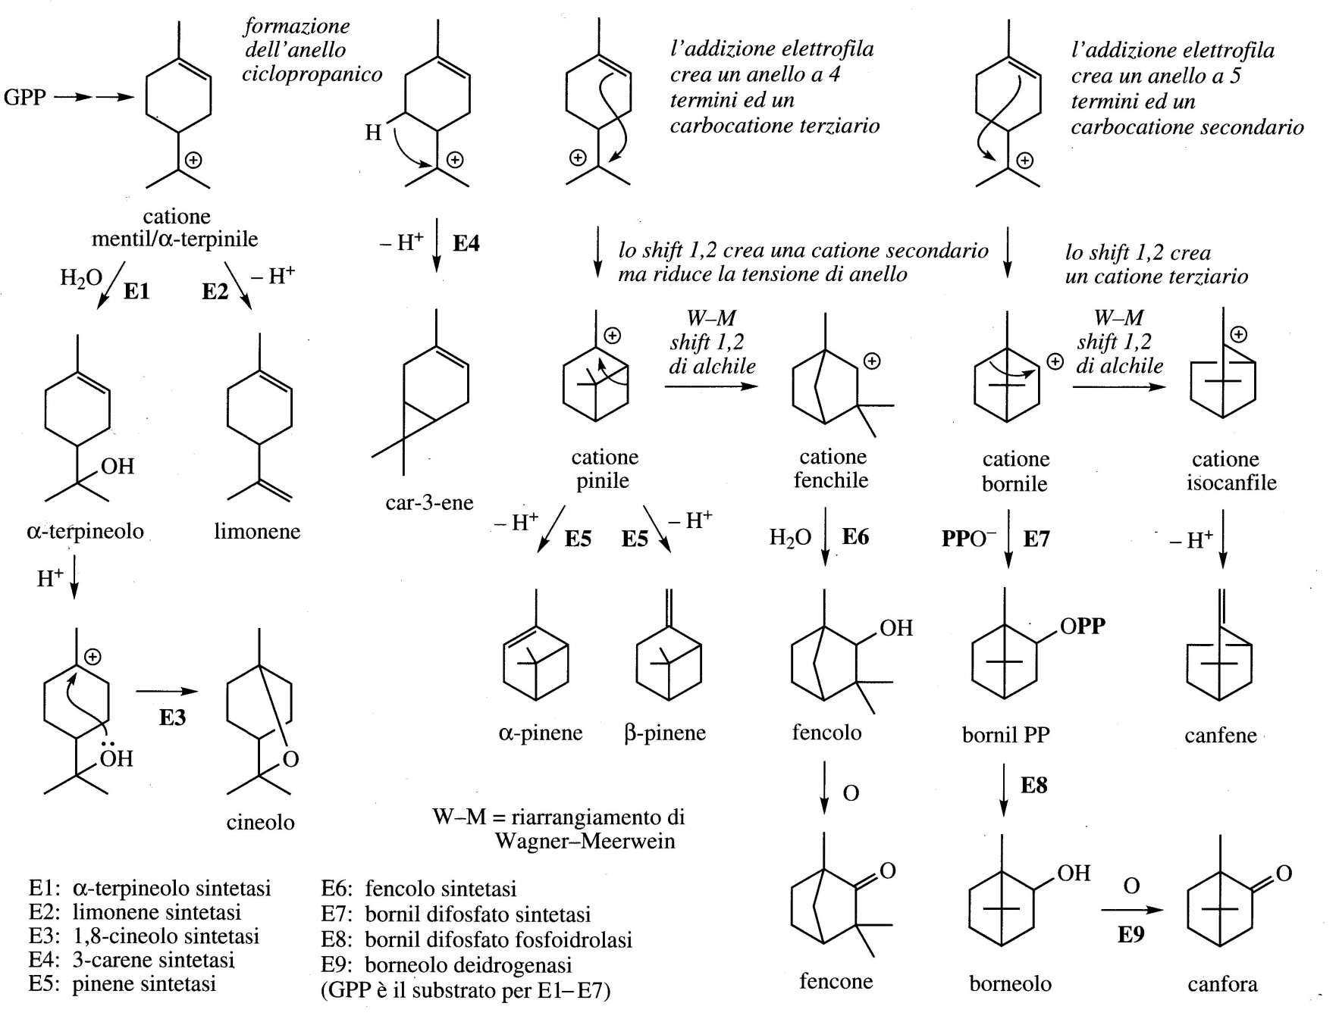
Monocyclic and bicyclic monoterpenes
Carbocations can act with water, lose a proton, cyclize and transpose.

Slide 8
The most representative of the monocyclic monoterpenes is undoubtedly limonene which is present as a component of many aromas.
(+)-limonene is present in the essential oils of many species of Citrus, and in some cases reaches a concentration of 90%.
Its enantiomer (-) is more common in Menta and Pinus species.
Limonene is found in orange, bergamot, cumin, orange blossom, juniper, lemon and sage.

Slide 9
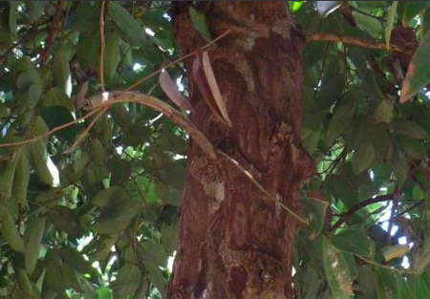
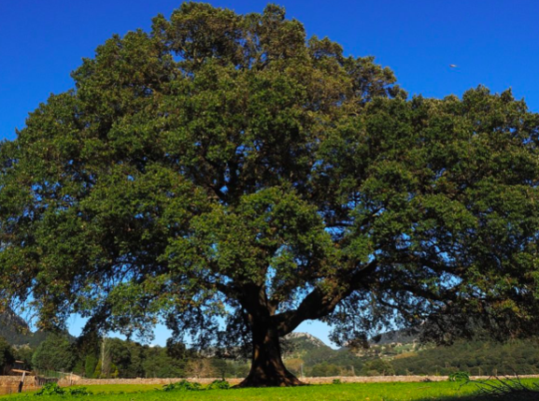
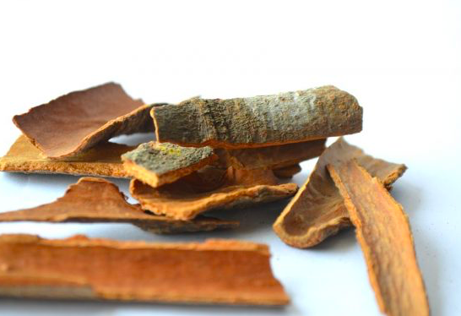
Camphor is a product originally obtained from the distillation of the bark and wood of the camphor (Cinnamomum camphora), an evergreen tree from East Asia.
Camphor is found also in Salvia (Salvia officinalis) in basil, coriander, marjoram, rosemary.

Slide 10
Camphor stimulates nerve endings, exerting a pain-relieving effect and reducing itching.
It also appears to be effective against fungi that can cause foot fungus. It is proposed in products designed for topical use.
The US Food and Drug Administration (FDA) has approved its application on the skin, as a pain reliever and to relieve itching and irritation.
However, it does not appear that EFSA (the European Food Safety Authority) has approved any claim that justifies this proposed use, indeed, the intake of camphor can be dangerous.
it is advisable to avoid the use of products concentrated over 11%, which could trigger more serious irritations.

Slide 11
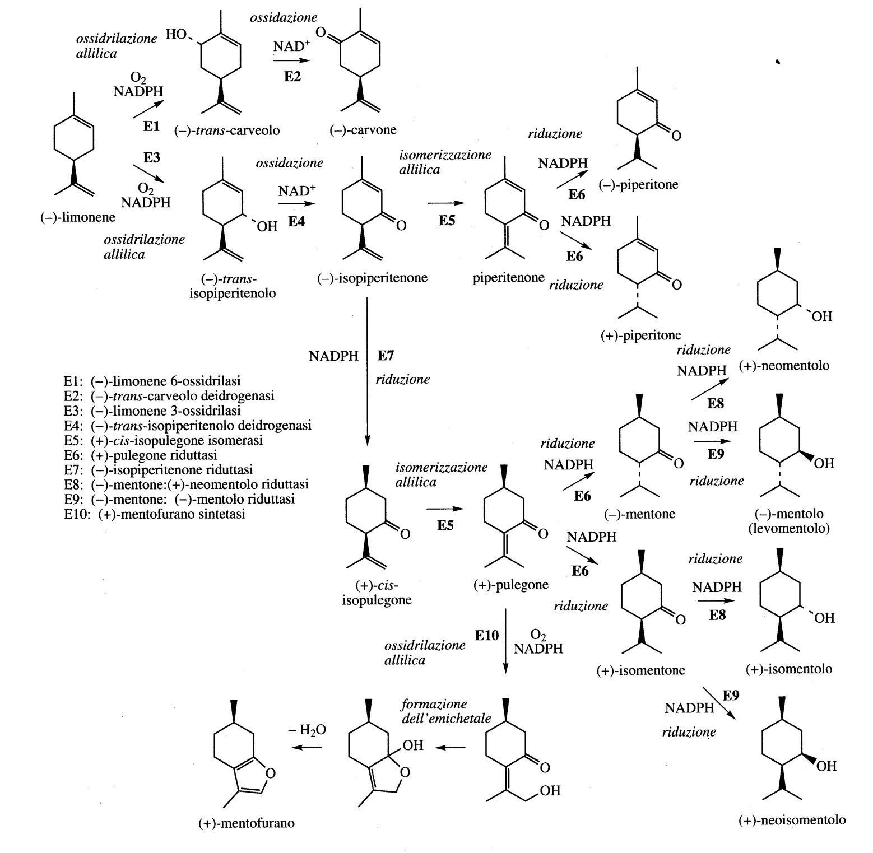
Peppermint (Mentha piperita; Labiatae / Lamiaceae) mainly produces (-) Menthol with small amounts of the following stereoisomers: (+)Neomenthol,
(+) Isomentol and
(+) Neoisomentol.
The oils extracted from the Mentha species also contain ketones and among these the Pulegone which can give rise to the Mentofuran. The latter are hepatotoxic and excessive amounts of Mentofuran in Peppermint oils are harmful.

Slide 12
Irregular monopertenes
Some monoterpenes structures do not agree with the regular head-tail coupling mechanism. These molecules are called irregular monoterpenes and appear to be contained only in plants of the Compositae/Asteraceae family.
GPP and nerilPP don't seem to be involved.
The following figure shows the formation of a cyclopropane ring
electrophile
nucleophile

Slide 13
The most important compounds are chrysanthemic acid and pyretric acid.
They present as esters in pyrethrum flowers (Chrysanthemum cinerariaefolium) are called
Pyrethrins.
Pyrethrins have insecticidal activity and are found in Pyrethrum flowers and are obtained by extraction.
They are used in household sprays and directly on the crop as they have a rapid action on the nervous system of insects.
The extract contains Pyrethrin I (35%), Pyrethrin II (32%), Cinerin I (10%), Cinerin II (14%), Jasmolin I (5%), Jasmolin II (4%), with Pyretrolone alcohols , Cinerolone, Jasmolone.
Pyrethrin II causes the numbing effect.

Slide 14
Synthetic analogues have been produced with longer life times and higher toxicity towards insects (even 1000 times higher than the natural product), and maintain a low mammalian toxicity.
Permethrin and Phenothrin are used against head lice

Slide 15
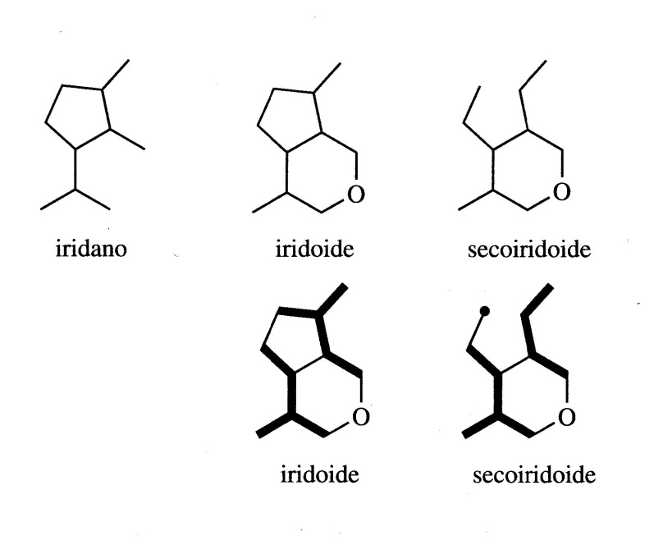
IRIDOIDS
Iridoids are monoterpenes that contain a fused cyclopentane ring with a six-membered oxygenated ring. The iridoid system derives from geraniol with a type of folding different from that of monoterpenoids.
A large number of iridoids occurs naturally as glycosides such as Loganine which is a key intermediate in the biosynthesis of indole terpenoid and tetrahydroquinoline alkaloids.

Slide 16
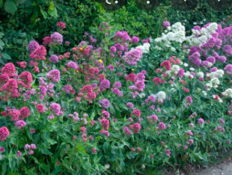
Valeriana officinalis
They are obtained from the roots of Valeriana officinalis, a perennial herb distributed throughout Europe.
It is used as tranquilizers to relieve nervous tension, anxiety, insomnia. During World War I was used in the treatment of traumatic psychosis. It possesses mild sedative and anxiolytic properties.
The main active ingredient is Valtrate (epoxy-iridoid)

Slide 17
Valeriana officinalis
Many researchers believe that the sedative effects of Valerian are not due to the Valtrate which is unstable and insoluble in water but that part of the activity derives from compounds sesquiterpene such as Valerenic acid and Valeranone.
In the aqueous extracts were found also GABA and glutamine which are believed to contribute to the sedative activity.

Slide 18
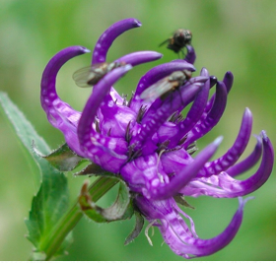
Devil's Claw
Harpagophytum procumbens (Pedaliaceae) has as its common name the Devil's Claw for the shape of its fruits that form curved and sharp hooks.
It is a weed with long roots and grows in sub-Saharan Africa (South Africa, Namibia, Botswana).
Using the secondary roots, which contain much higher levels of iridoids than the primary tubers, are packaged preparations known as anti-inflammatory and antirheumatic agents for arthritis and similar diseases.

Slide 19
The main constituents of Devil's Claw root are a group of decarboxilated iridoid glycosides (about 3%) among which the main ones are Harpagoside and Procumbide, while Harpagide and 8- (4-cumaroil) harpagide are minority components.

