Slide 1
Rb as a guardian of the restriction-point gate
During cell cycle the initial hypophosphorylation of Rb is necessary but not sufficient for functional inactivation of Rb at restriction point (R)
Cyclin E levels increase dramatically at the R point
Cyclin E associates with its CDK2 partner and the complex cyclin E/CDK2 drives Rb phosphorylation, leaving Rb in its hyperphosphorylated inactive state
Rb molecules which are not phosphorylated by cyclin D/CDK4/6 complexes are not good substrates for cyclin E/CDK2 complexes
The phosphorylation and functional inactivation of the other pocket proteins (p107 and p130) are also under the control of cyclin D-CDK4/6 and cyclin E/CDK2 complexes
If mitogens are withdrawn from the cell at any time before R point, D1 levels collapse
In the absence of cyclin D1, Rb is dephosphorylated by still-unidentified phosphatase and then it is no longer a good substrate for cyclin E/CDK2 complexes
THE NEED FOR STRONG AND CONTINUOUS MITOGENIC SIGNALING THROUGH THE EARLY AND MID-G1 PHASE UP TO R POINT

Slide 2
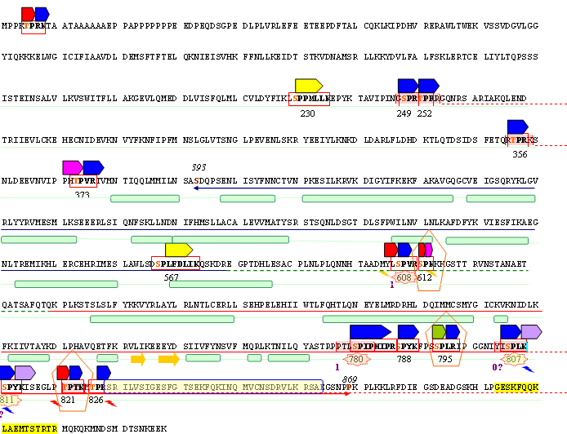
pRb has 16 S/TP consensus sites for Cyclin/Cdk complexes

Slide 3
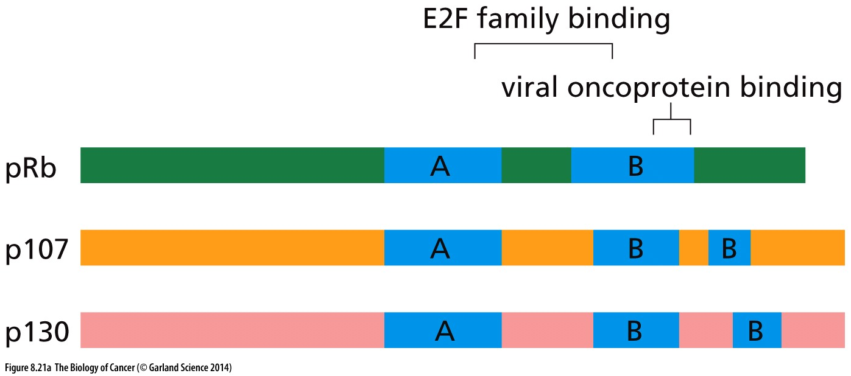
Pocket proteins

Slide 4
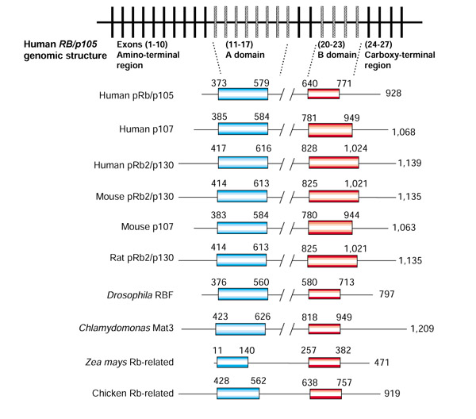
The three pocket proteins (pRB, p107 and p130) consist of an amino-terminal domain, a pocket region composed of two conserved domains (A and B, residues 373-771 in human pRb) separated by a spacer region, and a carboxy-terminal domain.
The pocket domain is responsible for interaction of the protein with transcription factors, cyclins, and cyclin-dependent kinases (CDKs), and for its functional activity

Slide 5
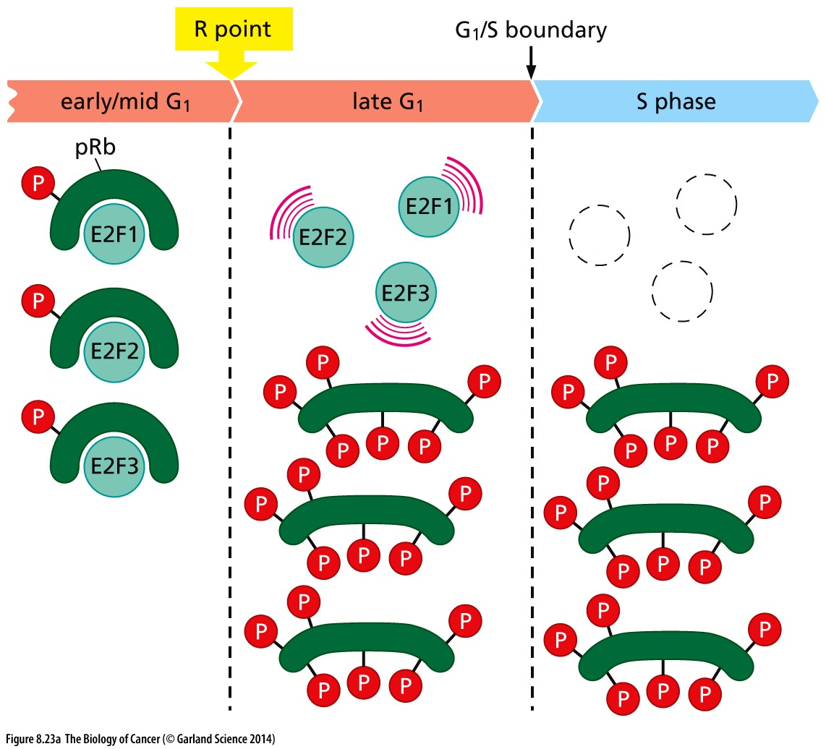

Slide 6
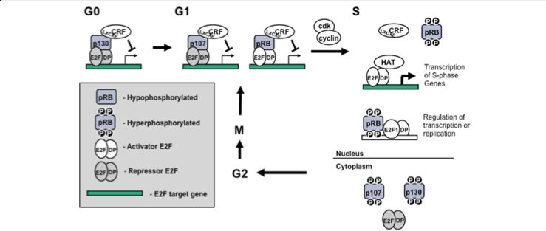
The role of pocket proteins is an advancing cell cycle

Slide 7
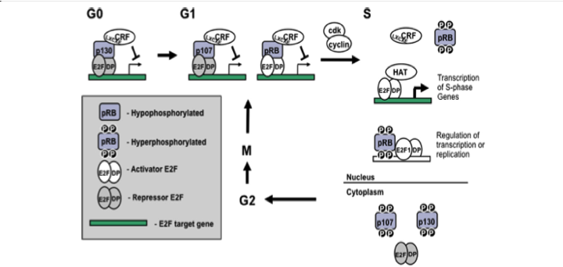
Initial phosphorylation of pRb by cyclin D–CDK4/6 complexes leads to partial activation of E2F, which allows the transcription of cyclin E gene by E2F family members. Cyclin E then interacts with CDK2, forming an active complex cyclin E–CDK2 that further phosphorylates pRb, resulting in full activation of E2F.
This provides a positive feedback loop mechanism, whereby phosphorylation of pRb by cyclin E–CDK2 induces further transcription of the cyclin E gene.

Slide 8
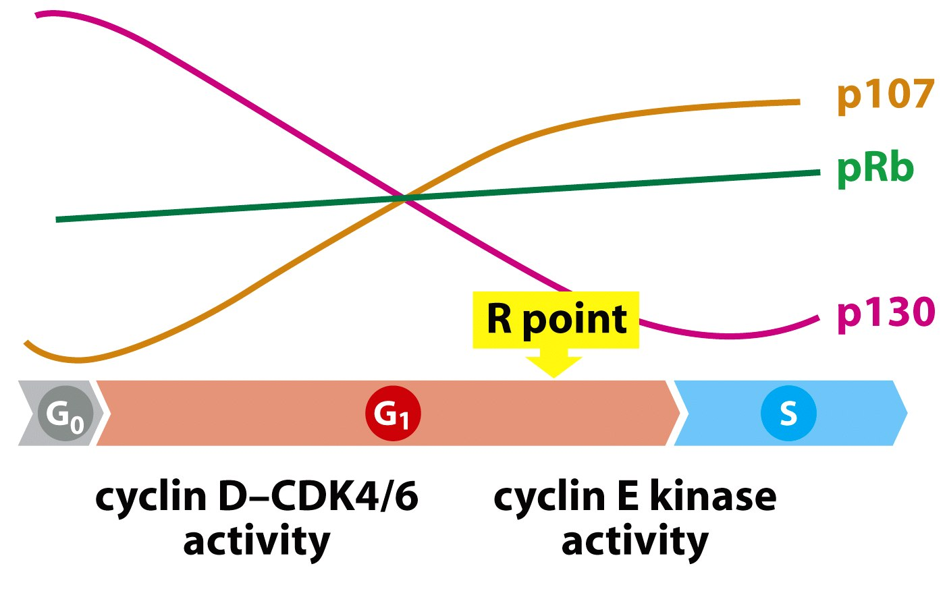
Restriction point and pRB phosphorylation
p130 is specialized to suppress
cell proliferation while cells are in Go
p107 is active in late G1 and S phase
pRb is positioned to control the transition at the R point from mitogen-dependent to mitogen-independent growth
The point of no return for cell cycle entry has often been termed the Restriction Point.
Release of E2F from pRB control by phosphorylation coincides specifically with the point in which cells are obligated to complete the rest of the cell cycle.

Slide 9
Transcriptionally active E2F induces the expression of numerous genes important for cell cycle progression, DNA polymerase α and enzymes involved in nucleotide biosynthesis such as DHFR (dihydrofolate reductase) and thymidylate synthase.
The synthesis of cyclin E, which occurs during late G1, is also regulated by the E2F family of transcription factors.
Interaction with E2Fs is a common feature of RB family proteins that plays a key role in their ability to control proliferation.

Slide 10
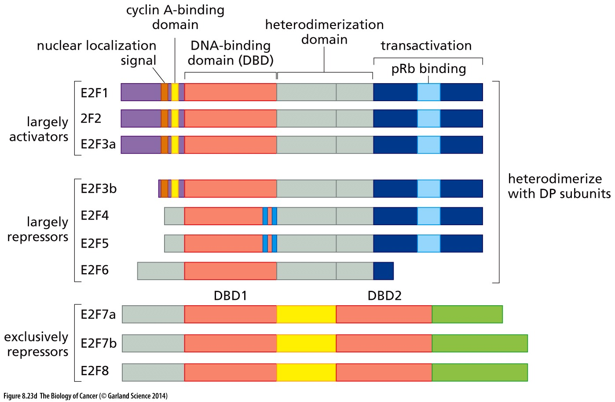
E2F transcription factors
A class of proteins composed by eight members –E2F1 through E2F8
The first six of these E2F proteins need to heterodimerize with the DP family partners that are capable of binding to DNA
The other two E2F7 and E2F8 have two DNA-binding domain (DBDs) allowing each to bind DNA without DP partners

Slide 11
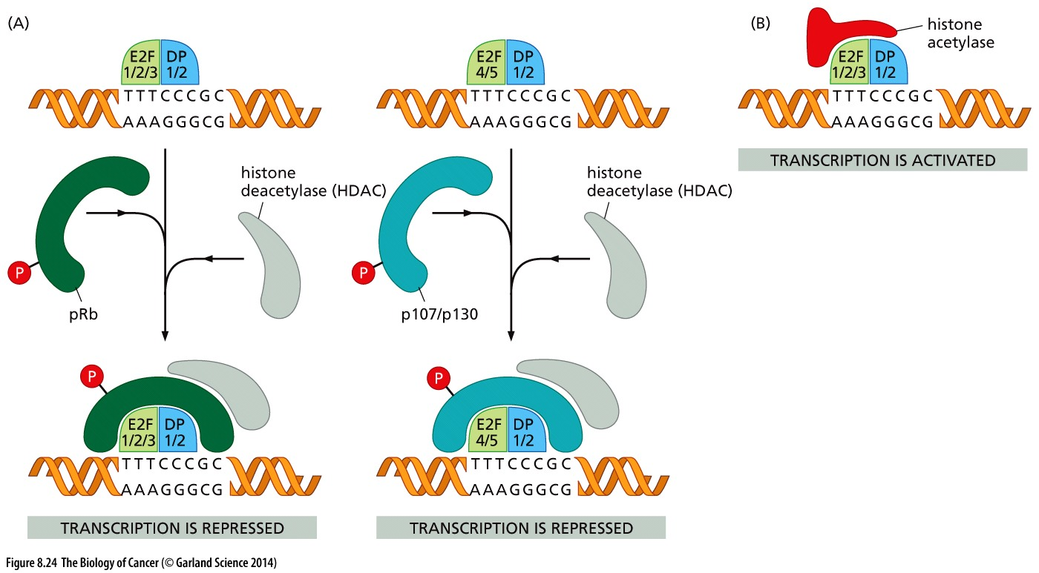
Modification of chromatin by pocket proteins
Hypophosphorylated Rb discourages transcription by attracting histone deacetylase (HDAC) enzyme to Rb-E2F complexes that are bound to gene promoters
These enzymes prevent transcription by removing acetyl groups from histones causing the latter to shift into a configuration that is incompatible with the progression of RNA polymerase through the chromatin

Slide 12
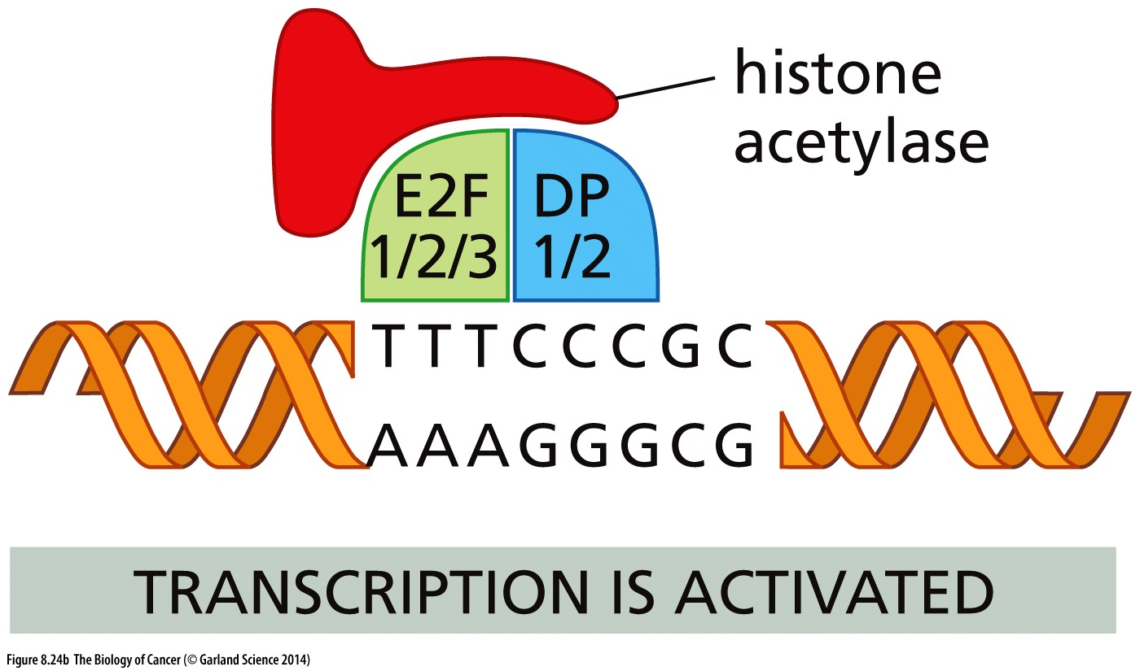
When the E2Fs are not complexed with pRb (or p130 and p107) they attract histones acetylases which place chromatin in an active configuration for transcription

Slide 13
The E2F target genes
Cell cycle regulators: cyclins A, cyclinE,
Components of replication machinery such as the proliferating cell nuclear antigen and DNA polymerase α, as well as enzymes involved in nucleotide biosynthesis such as dihydrofolate reductase and thymidylate synthase
The ability of pocket proteins to interact with E2Fs is dependent on them being maintained in an under phosphorylated state. The phosphorylation status of pocket proteins is often determined by their migration in SDS-PAGE, the slowest migrating forms are extensively modified and don’t interact with E2Fs and this is described as ‘hyperphosphorylated’. Alternatively, the fastest migrating forms are modified at very few positions and readily bind to E2F transcription factors, a state often referred to as ‘hypophosphorylated’. It is imperative for cells to maintain cyclin dependent kinase activity at low levels until the end of G1.
The first kinase complexes to become active in G1 are cyclin D/ cdk4 and cyclin D/ cdk6 and they begin to phosphorylate pRB family proteins. As cells approach the end of G1, partial phosphorylation of the pocket proteins allows some transcription by activator E2Fs that begins to stimulate production of cyclin E, and in turn creates more cyclin E/cdk2 kinase activity.

Slide 14
In addition to E2F targets, pocket proteins also influence the expression of ribosomal genes and tRNA in G0.
Both pRB and p130 are capable of repressing the transcription of rRNA genes by RNA polymerase I.
G0 hypophosphorylated pRB (but not p107 and p130) binds to and represses TFIIIB, suppressing transcription by RNA polymerase III and reducing tRNA levels.
G0 has characteristically low levels of both rRNA and tRNA, which could be explained by pocket protein repression of RNA polymerase I and/or III.
The increase in rRNA and tRNA levels as the cell enters into the G1 phase has been proposed to involve phosphorylation of the pocket proteins to relieve this transcriptional repression

Slide 15
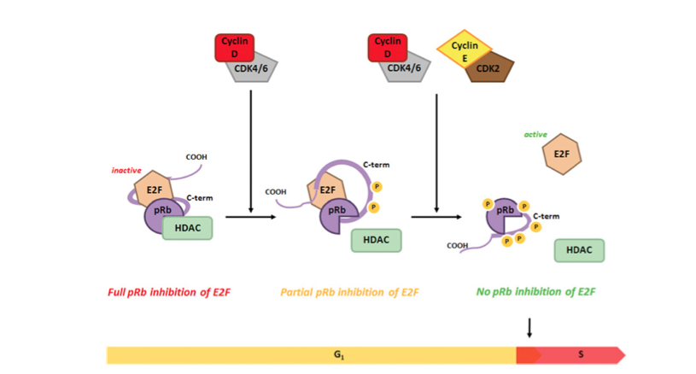
Cumulative phosphorylation of pRb by cyclin D-Cdk4/6 and cyclin E-Cdk2
Early in the G1 phase of the cell cycle, cyclin D/ Cdk4 and cyclinD/Cdk6 phosphorylate pRB, prior to cdk2 activation.
Late in G1, cyclin E/ Cdk2 further phosphorylates pRB, completely disrupting its ability to bind E2F complexes. The sequential phosphorylation of pRB by Ckd4/6 complexes followed by Cdk2 complexes is necessary because Cdk4/6 alone is unable to completely phosphorylate pRB whereas Cdk2 cannot use unphosphorylated pRB as a substrate.
Once free of regulation from pRB, activator E2Fs associate with histone acetyl transferase enzymes such as p300 (HAT) which mediates acetylation of histone H3 and H4, allowing for transcription of E2F target genes to ensure sufficient supplies of nucleotides and other factors necessary for completing S phase of the cell cycle.

