Slide 1
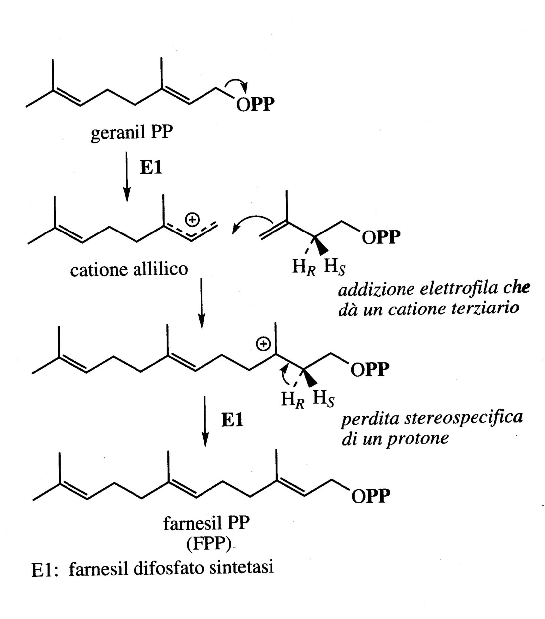
Sesquiterpenes
Sesquiterpenes consist of three C₅ units and are generally synthesized following the mevalonate route rather than starting from the MEP.
The addition of one unit of IPP to GPP with GPP synthetase catalysis leads to the formation of the precursor of the sesquiterpenes, farnesyl diphosphate. FPP can then give rise to a series of both linear and cyclic sesquiterpenes
(mono, bi and tricycles)

Slide 2
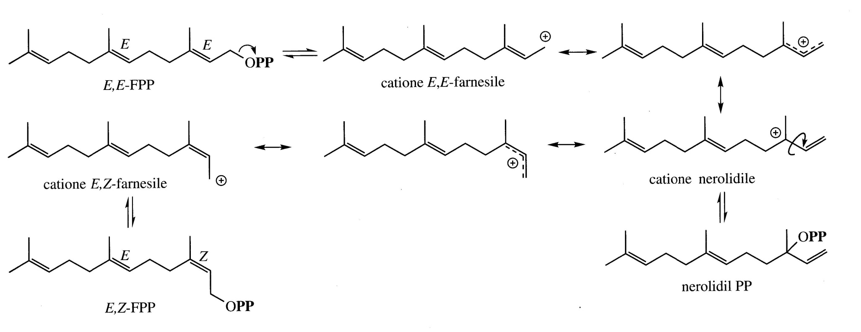
In many systems the most frequent precursor is NerolidylPP which has the OPP unit bonded to a tertiary carbon

Slide 3
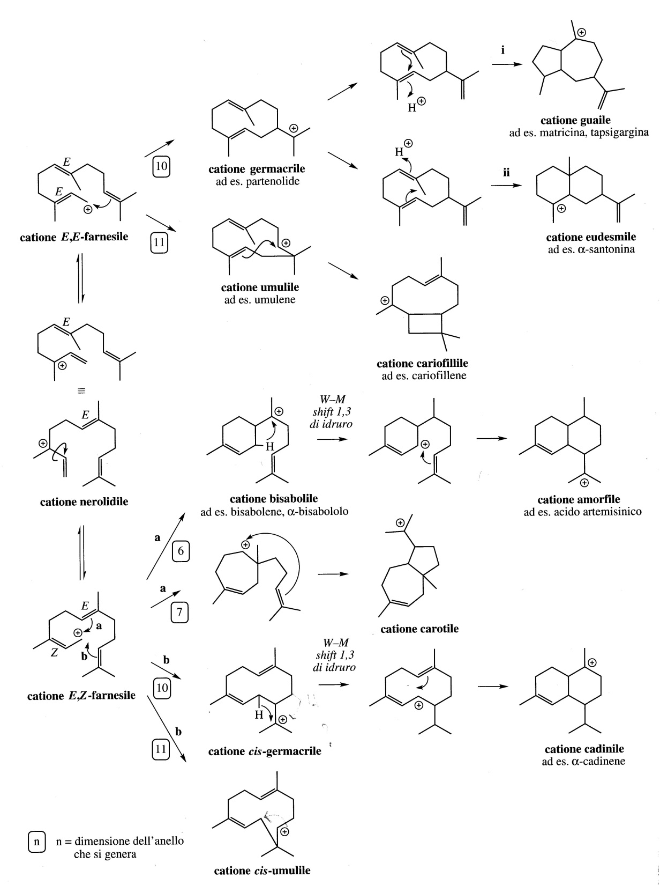
As with monoterpenes, the synthesis of the structure of the skeletons of sesquiterpenes start with the formation of carbocations.

Slide 4
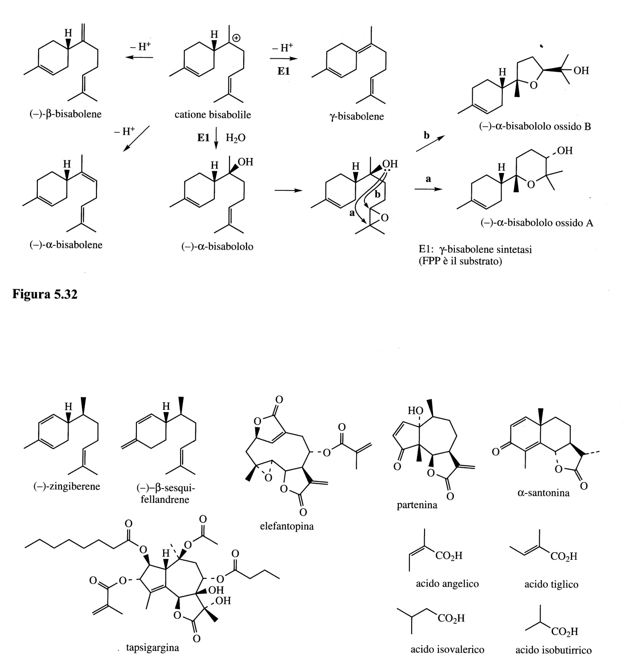
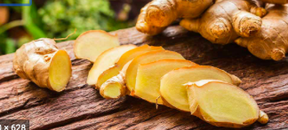
The γ-bisabolene, the zingiberene and β-sesquifellandrene contribute to the aroma of Ginger (Zingiber officinale, Zingiberaceae).
L’α-Bisabolol is one of the main components of the flowers of Matricaria chamomilla, Compositae/Asteracea).
α−Bisabolol oxides A and B are also present in the extracts of these flowers.

Slide 5
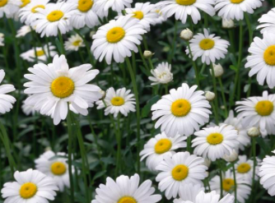
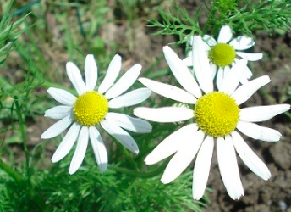
Chamomile and Matricaria. Two types of chamomile are used as medicinal herbs, Roman Chamomile (Chamaemelum nobile; Compositae / Asteraceae) and German Chamomile (Matricaria chamomilla; Compositae / Asteraceae).
German chamomile, more commercially important, is often called Matricaria, the flower heads are dried for medicinal use.
Essential oils obtained by steam distillation are also used for the preparation of creams and ointments for the treatment of skin inflammation and as anti-bacterial and anti-fungal agents.
Chamaemelum nobile
Matricaria chamomilla

Slide 6
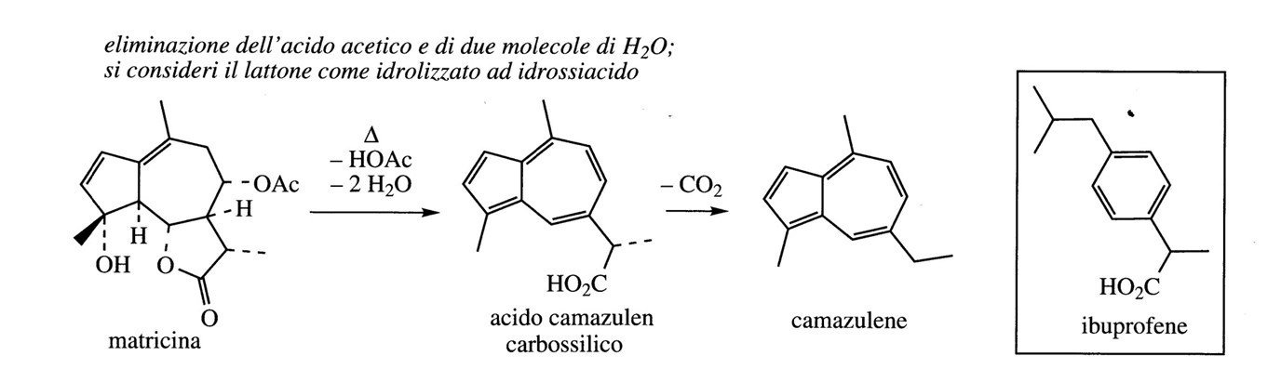
Matricaria flowers provide an essential oil that contains sesquiterpenes which are α-bisabolol (10-25%), α-bisabolol oxides A and B (10-25%) and chamazulene (0-15%).
Chamazulene is a thermal decomposition product of matricine.
Although α-bisabolol has an anti-inflammatory and antibacterial activity, the greatest anti-inflammatory property is chamazulene-dependent.

Slide 7
The main responsible for the anti-inflammatory activity in matricaria preparations is Chamazulene: it blocks the cyclooxygenase enzyme COX-2, (inhibition of the pro-inflammatory prostaglandins).
Matricine itself exerts an anti-inflammatory action and it has been proposed that it is metabolized in the body by forming the chamazulene-carboxylic acid, a natural analogue of the synthetic analgesic ibuprofen.

Slide 8
Roman chamomile, in the form of an aqueous infusion, aids digestion and is a component of mouthwashes, shampoos and many pharmaceutical preparations.
Roman chamomile has mild anti-inflammatory activities.
The essential oil contains more than 75% of aliphatic esters of tiglic, isovaleric and isobutyric acid (see slide n. 39), metabolic products of leucine, isoleucine and valine together with small amounts of monoterpenes and sesquiterpenes.

Slide 9
As with monoterpenes, the synthesis of the structure of the skeletons of sesquiterpenes start with the formation of carbocations.

Slide 10
Germacranes
The Germacril cation is a precursor of the sesquiterpenes of the class of Germacrane of which Costunolide is the bitter principle of the roots of chicory (Cichorium intybus; Compositae / Asteraceae).
The anti-migraine agent present in feverfew (Tanacetum parthenium; Compositae/Asteraceae) is Parthenolide, a derivative of Costunolide.

Slide 11
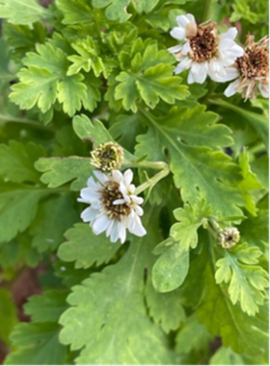
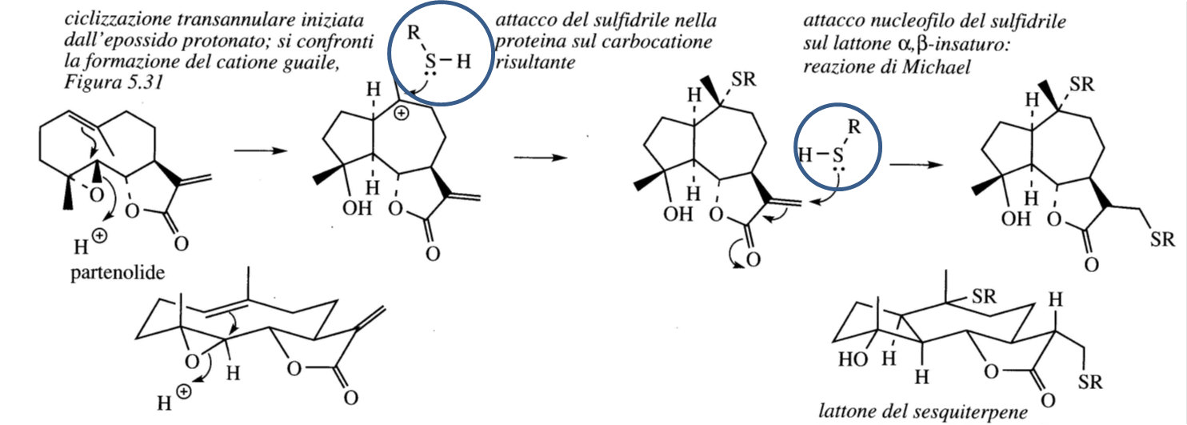
Feverfew is a traditionally used remedy for the treatment of arthritis, migraines, toothache and menstrual disorders.
It is a perennial herb belonging to the Compositae / Asteraceae family and has been classified as Tanacetum parthenium.
The herb inhibits platelet aggregation, the release of histamine from mast cells and the production of prostaglandins, thromboxanes, and leukotrienes. Parthenolide is present at 1% in dry leaves, feverfew can be taken as a fresh leaf, or dried and formulated in capsules.
The component α−β unsaturated lactone function explains the activity of these compounds as they behave as Michael acceptors towards the sulfur of the cysteine ​​residues of the proteins (alkylation of protein thiolic groups).
Tanacetum parthenium

Slide 12
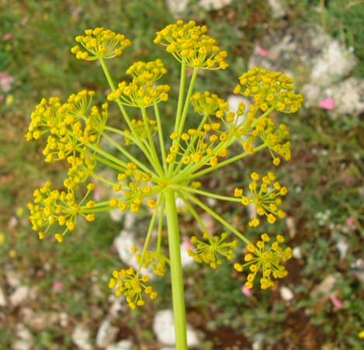
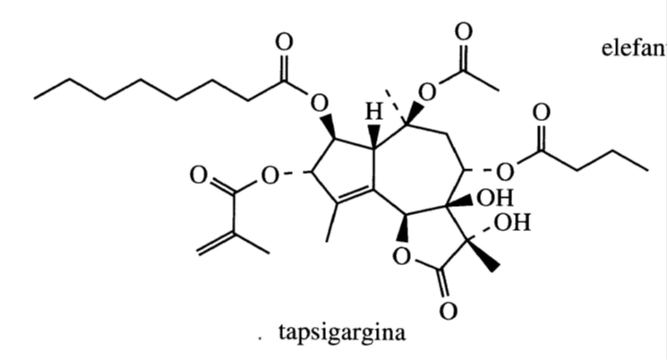
Thapsigargin is found in the seeds and roots of the Mediterranean plant Thapsia garganica (Compositae / Asteraceae) (highly oxygenated and esterified structure with different acid groups).

Slide 13
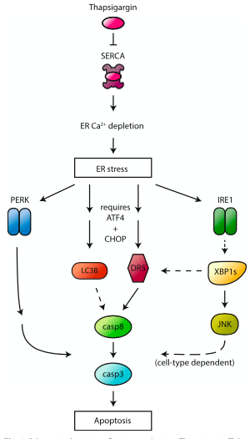
Thapsigargin (Tg) is of considerable pharmacological interest in calcium-mediated signaling pathways.
Thapsigargin (Tg) binds to and blocks SERCA (the ER Ca²⁺ pump), thus causing ER Ca²⁺ depletion and ER stress.
The imbalance of intracellular calcium determines the apoptosis of the cells.
A thapsigargin-based drug has been tested for prostate cancer
https://doi.org/10.1186/s12964-019-0499-z

Slide 14
Artemisin
Artemisinin is an important antimalarial component in Artemisia annua (Compositae / Asteraceae), a Chinese herbal medicine.

Slide 15
Amorph-4,11-diene is an intermediate in the biosynthetic pathway leading to Artemisinin.
The reduction to diihydroartemisinic acid is followed by the transformation into Artemisinin by means of a sequence of reactions that are not considered enzymatic but induced by a photochemical oxidation mediated by oxygen under conditions present in the plant.

Slide 16
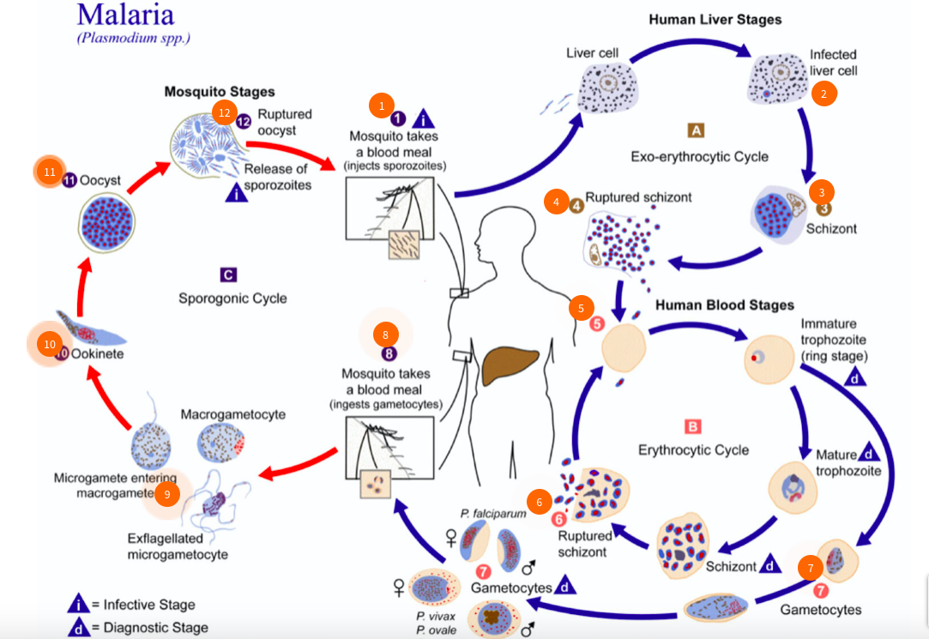
Malaria is responsible for 2-3 million deaths per year worldwide.
Traditional anti-malarial drugs such as chloroquine are proving less effective in treating the disease due to the development of drug-resistant strains of P. falciparum.
Artemisin is currently effective against these strains
P. falciparum has two hosts: a female Anopheles mosquito inoculates the human host during a blood meal.
Following an initial phase of hepatic replication, the parasites undergo asexual multiplication in the erythrocytes. Blood stage parasites are responsible for the clinical manifestations of the disease.
Male and female gametocytes are ingested by an Anopheles mosquito during a blood meal.
The multiplication of parasites in the mosquito is called the sporogonic cycle, inside the stomach of the mosquito, then sporozoites reach the salivary glands of the mosquito.
The inoculation of the sporozoites in a new human host perpetuates the life cycle of malaria

Slide 17
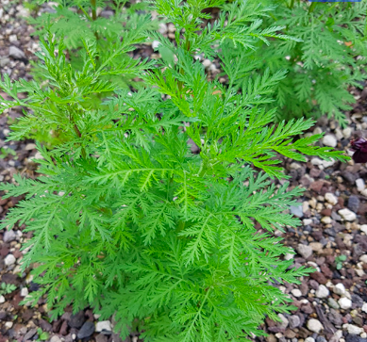
Artemisinin
Artemisia annua
Artemisin is a sesquiterpene lactone having an unusual peroxidic bond that is indispensable for its activity
Artemisia annua (Compositae/Asteraceae) is known as qinghao in traditional Chinese medicine where it has been used for centuries in the treatment of fevers and malaria.
The plant, sometimes called annual or sweet wormwood, is widespread in Europe, North and South America and China.
The plant contains Artemisinin (qinghaosu in Chinese) and this product has been identified as being the active ingredient responsible for the antimalarial activity.
Artemisin has no appreciable toxicity and is currently active against drug-resistant strains of malaria.
Artemisinin acts by hitting a single enzyme, a Ca ⁺⁺ - ATPase causing the dead of the parasite. The evidence for this hypothesis derives from the observation that parasites, with a mutation of the enzyme, are insensitive to Artemisinin.

Slide 18
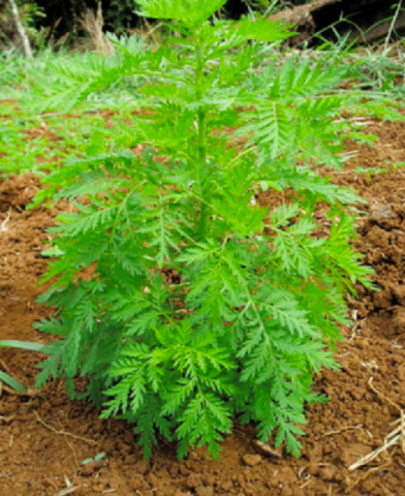
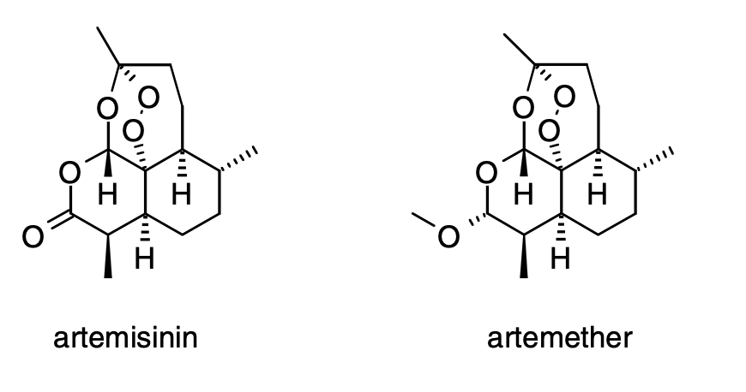
Artemisinin: a Sesquiterpene Derived from Quinhao (Artemisia annua)
In China, in 168 BC, the Qinghao plant (Artemisia annua) was described in the medical treatise, 52 Remedies, found in the Mawangdui Tomb. In the United States, this plant is known as sweet annie or sweet wormwood. In 340 AD, the antifever properties of Qinghao were first described by Ge Hong of the East Yin Dynasty.
The active ingredient of Qinghao was isolated by Chinese scientists in 1972 . Known as artemisinin in the West, it is today a potent and effective antimalarial drug, especially in combination with other medicines. It is presently marketed as a close derivative known as artemether and is marketed in several countries as Artenam®. This derivative resuls in greater stability, better pharmacokinetic properties, and increased potency relative to artemisinin.
Drugs of this peroxide class are gaining in importance as parasites are becoming resistant to current treatments such as mefloquine.

Slide 19
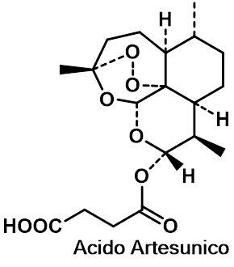
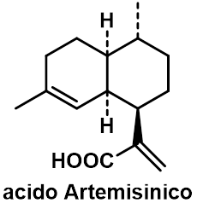
Artemisina
Acido Artelinico
The most abundant sesquiterpenes in the plant are Artemisinic acid (0.2%).
The Artemisinic acid content can be chemically converted to Artemisinin with an easy and straightforward process.
Artemisinin can be used for the synthesis of a variety of analogues including the water-soluble sodium salts of Artesunic and Artelinic acid.
These compounds exhibit increased activity compared to Artemisinin and also reduce the chances of recurrence of the infection.

Slide 20
The Artemisia annua genes encoding specific enzymes involved in the synthesis of Artemisinic acid were expressed in S. cerevisiae. The genes codify for amorphdiene synthetase enzyme and the cytochrome P450-dependent monooxygenase which carries out the oxidation from amorphdiene to artemisinic acid.
Several genes linked to the MVA-FPP transformation were overexpressed to provide a sufficient amount of FPP precursor to yeast; overexpression of the gene for HMGCoA reductase had the most significant effect.
To prevent FPP conversion into steroid biosynthesis, the gene encoding squalene synthetase has been suppressed. The net effect was a high production of artemisinic acid up to 100 mg/liter in the culture medium.
This process has been commercialized for the production of artemisinic acid for the semi-synthesis of antimalarial drugs.

Slide 21
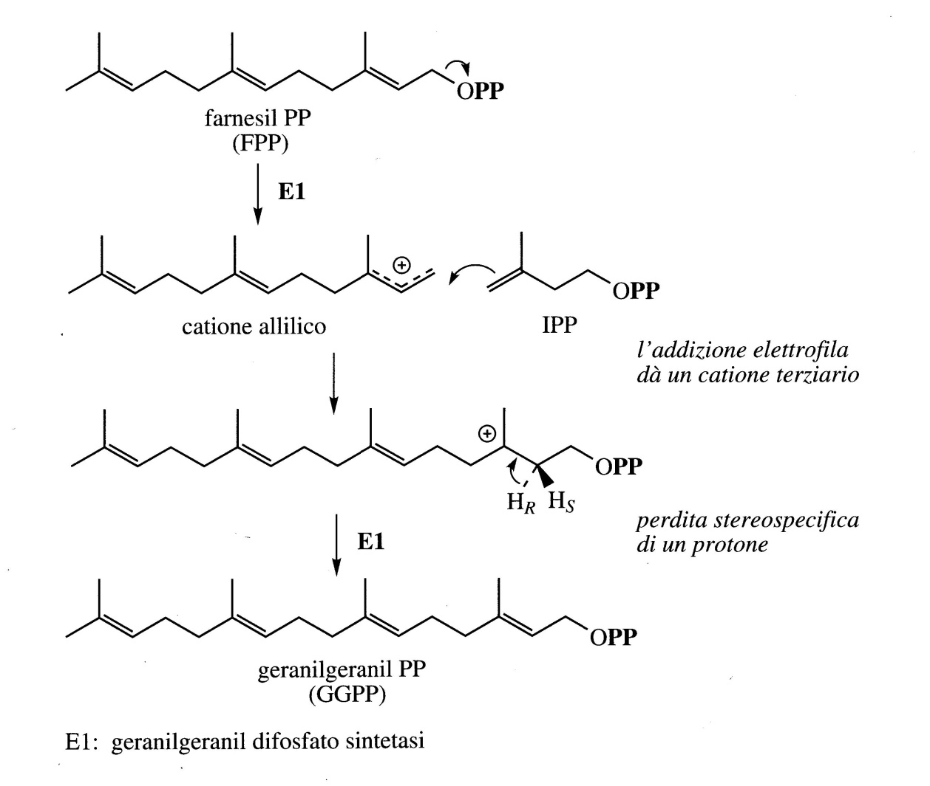
Diterpenes
Diterpenes derive from geranylgeranyl di-phosphate (GGPP).
IPP and FPP react to generate GGPP

Slide 22
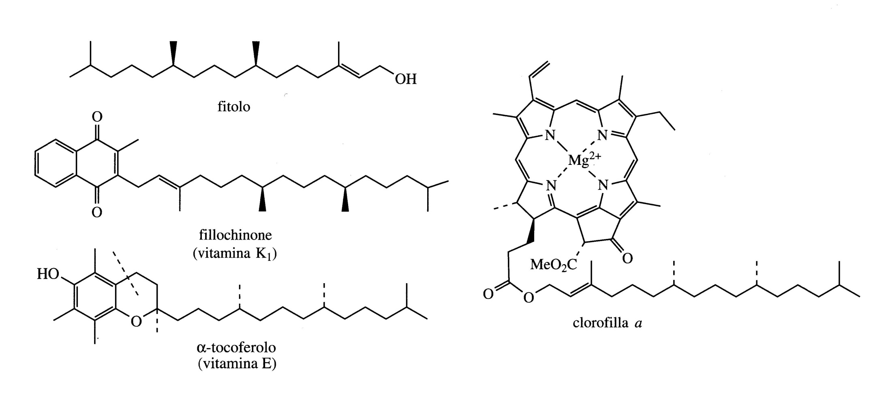
One of the most important and also the simplest diterpenes is Phytol which is a reduced form of geranylgeraniol.
Phytol forms the lipophilic side chain of chlorophylls such as for example in Chlorophyll a.
The structure of Phytol is formed when the diterpene molecule has already been attached to the heme group.
After the ester formation reaction, the double bonds are reduced.

Slide 23
The Phytol substituent is found in Vitamin K1 (Phylloquinone) and in the group of vitamins E (Tocopherols).

Slide 24
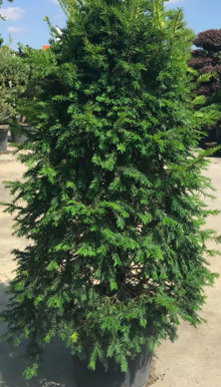
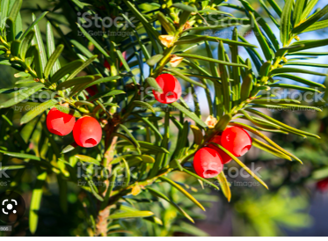
GGPP is the starter for the synthesis of a number of diterpenoids (through the carbocation mechanism).
One of the most interesting reaction is the formation of the toxic compound taxin which has been isolated from the tree Taxus baccata (the common yew).
The toxic taxin is a mixture of at least 11 compounds, all of them with the skeleton of taxadiene.

Slide 25
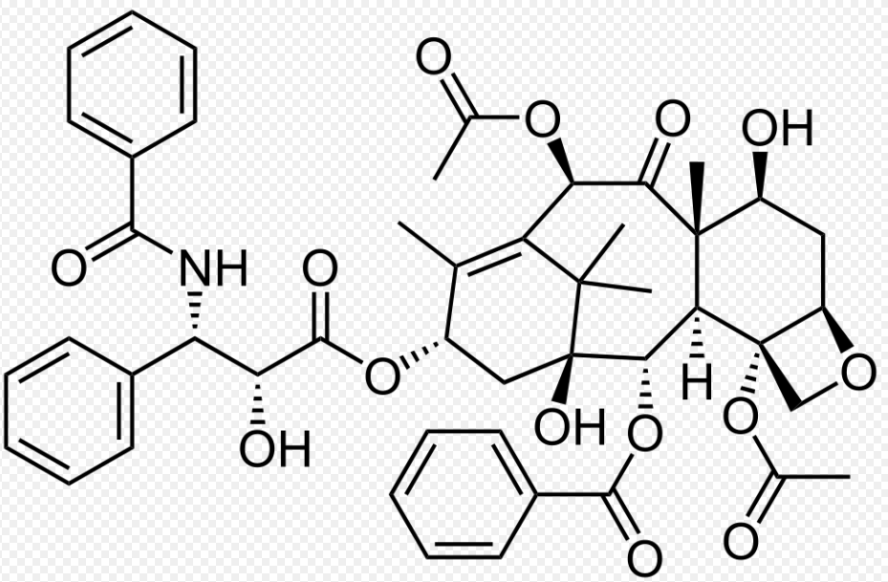
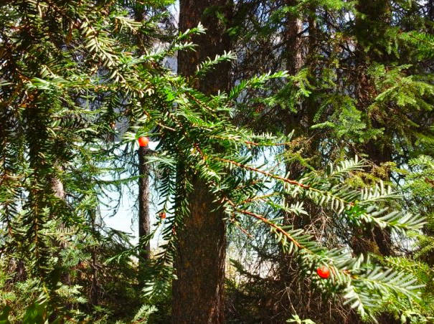
The side chains that contain aromantic rings derive from Shikimate via phenylalanine.
The nitrogen atom derives from a β-fenylalanine, which is a rearranged version of the amino acid L-Phe.
Taxol
The name Taxol was given to a diterpene ester with anti-cancer properties isolated for the first time in 1971 from a Taxus brevifoglia.

Slide 26
Taxol® (Paclitaxel)
Beginning in 1958, the U.S. National Cancer Institute in collaboration with the U.S. Department of Agriculture conducted a massive collection (>35,000 samples) of plants for anticancer activity. Four years later, of the thousands of samples collected, one included about 15 lb of the needles and bark of the pacific yew (Taxus brevifolia).
By 1971, it was determined that an individual component of the yew has remarkable anticancer activity. However, obtaining sufficient amounts of the substance, temporarily known as compound 17, remained elusive.
Interest in this material greatly increased in 1979, when it was found that the anticancer activity was not only potent, but, more importantly, was proceeded by a unique mechanism of action involving tubulin stabilization.
Phase I (safety in humans) clinical trials began in 1983, and Phase II (efficacy) trials began in 1985.
Finally, the first of several FDA approvals for various uses for Taxol® was announced in 1992.
Today, it is one of the world’s most widely used cancer treatments.
The chemical structure of Taxol®, an alkaloid with a diterpenoid core.

Slide 27
Synthesis of Taxol
1

Slide 28
2

Slide 29
The name Taxol continued to be used and was then registered as a trademark even when the compound was put in the market as a drug.
Taxol was later named as paclitaxel.
In literature, both names are currently used to identify the compound even if the original taxol is used more often.
Taxol is extracted from the bark of the Pacific yew Taxus brevifoglia (Taxaceae).
It is a slow-growing shrub that is found in the forests of Canada (Noth-West) and USA.
1 g of taxol: the bark of 3 100-years-old trees
250 kg: the demand in USA per year
The supply of only vegetable sources is extremely poor.
Taxol is now obtained by alternative methods

Slide 30
Almost 400 taxans (diterpenes) are isolated from various taxus species.
These taxans are structurally related to the toxic components also found in the common yew (T. baccata).
The semi-synthesis of taxol starting from Baccatina III and from 10-deacetyl-baccatina III is an alternative to satisfy the clinical demand for taxol.
10-deacetyl-baccatin III is easily extracted from the leaves and twigs of the T. baccata and is generally present in the short-leaved Taxus even if in variable quantities.
Given the complexity of the semi-synthesis, other alternative routes have been considered.
Cell cultures (by fermentation) produce 20 mg L⁻¹ ( low yield).
Taxomyces adreanae which live on the bark of T. brevifolia, and Pestalotiopsis microspora which live on the bark of the Himalaya yew have been also used. Nevertheless the yield is too low.

