Slide 1
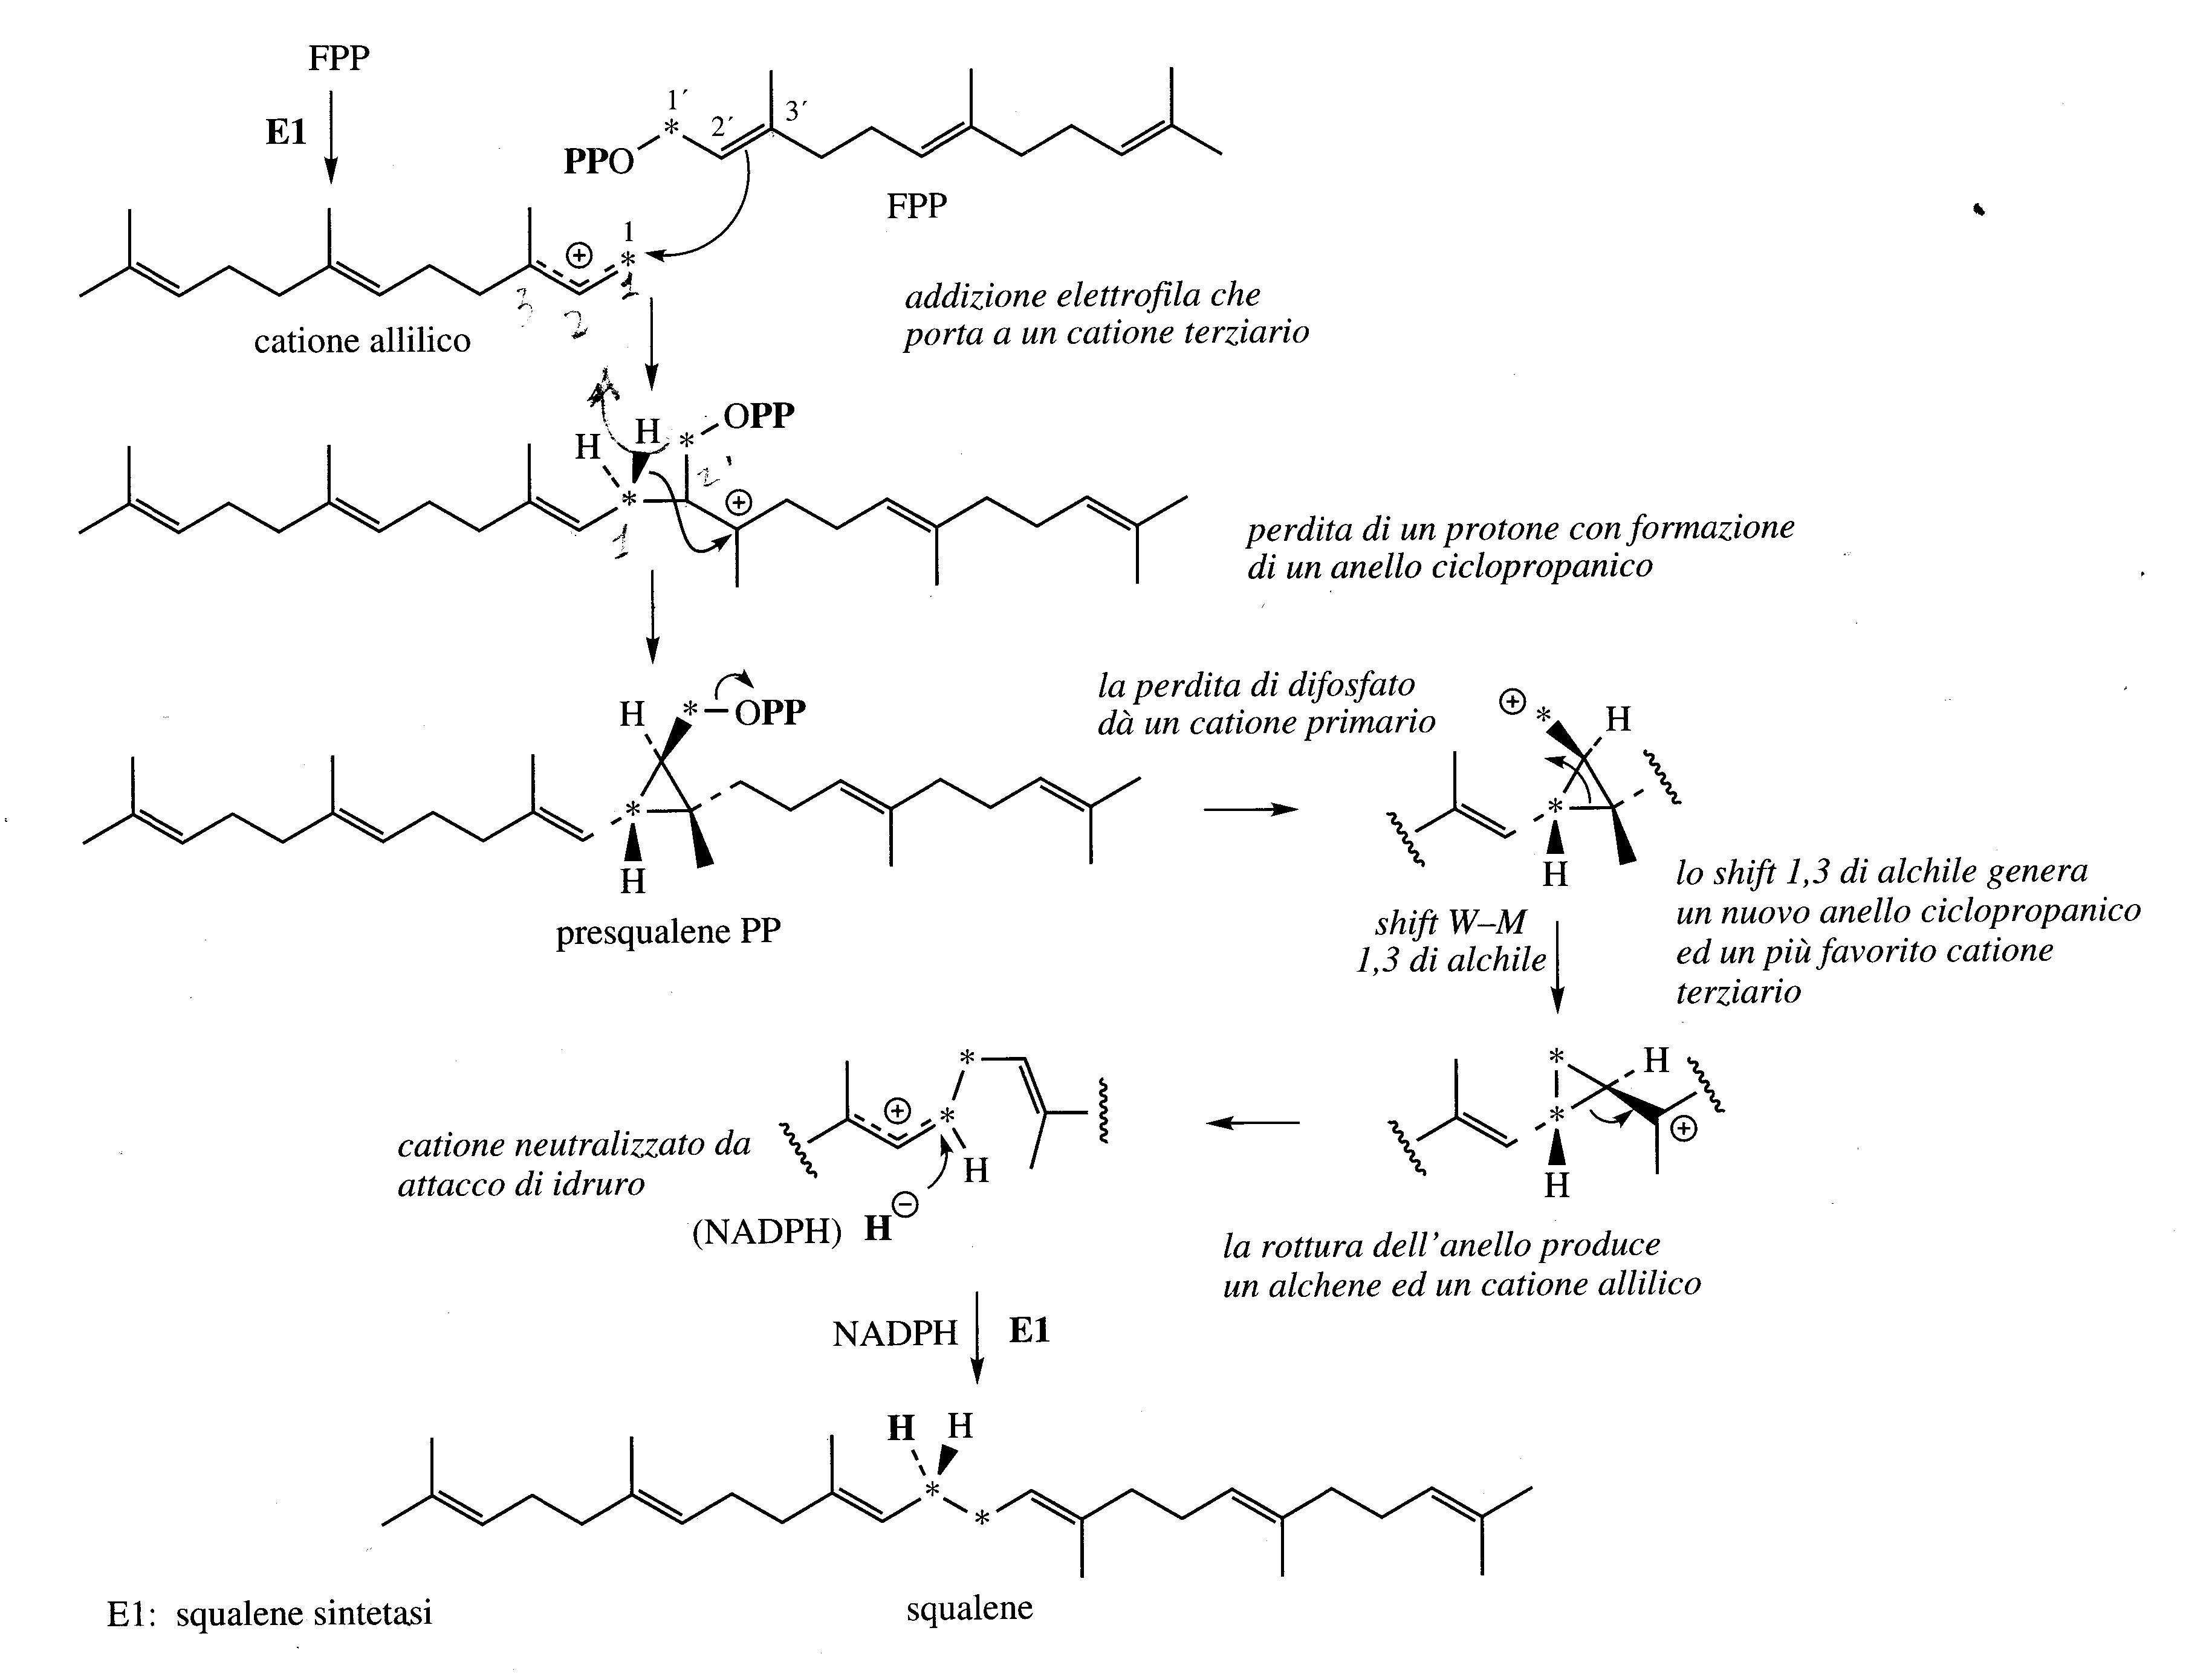
2’
1
3’
1’
1’
1
2’
1
2’
3’
3’
1’
2’
1’
2’
1
1
3’
3’
2’
3’
1
1’

Slide 2
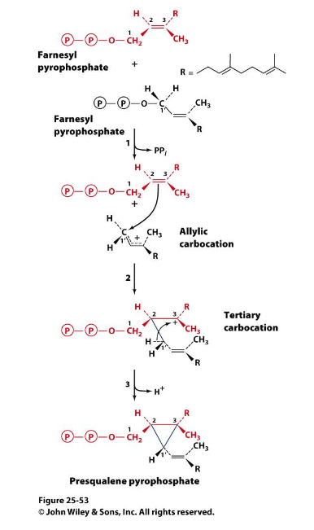
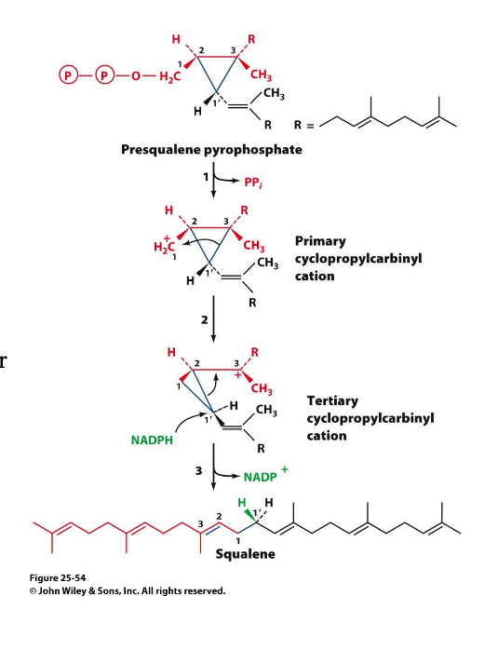

Slide 3
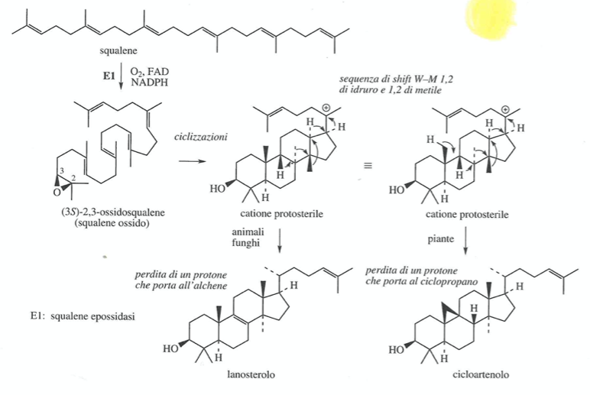
The cyclization of squalene occurs through the intermediate 2-3 oxido-squalene (squalene epoxidase with O₂ and NADPH as co-factors).
The protosterile cation is the intermediate cation.
In plants from the protosterile cation derives cycloartenol which is the precursor of plant steroids.

Slide 4
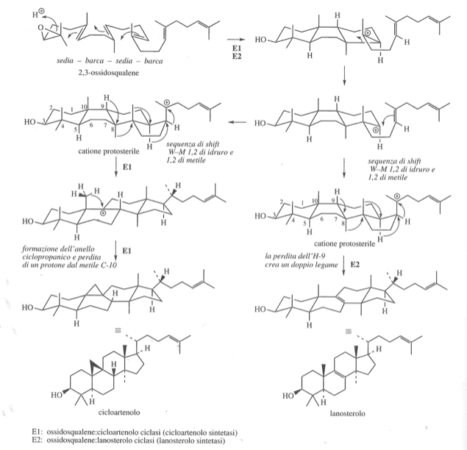

Slide 5
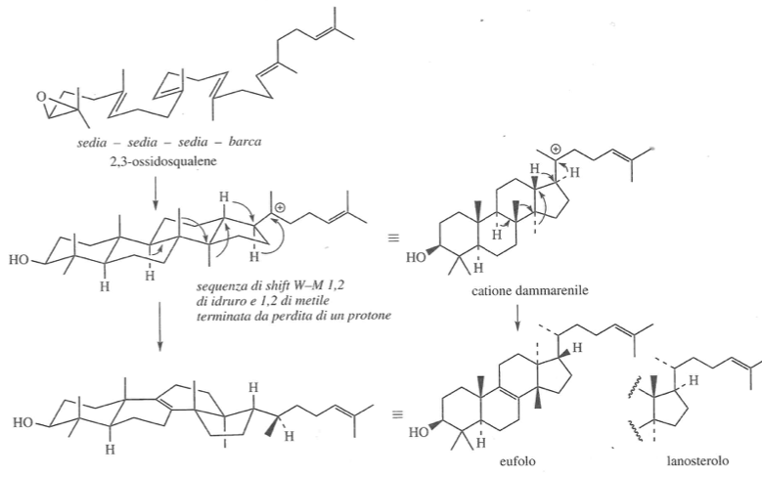

Slide 6
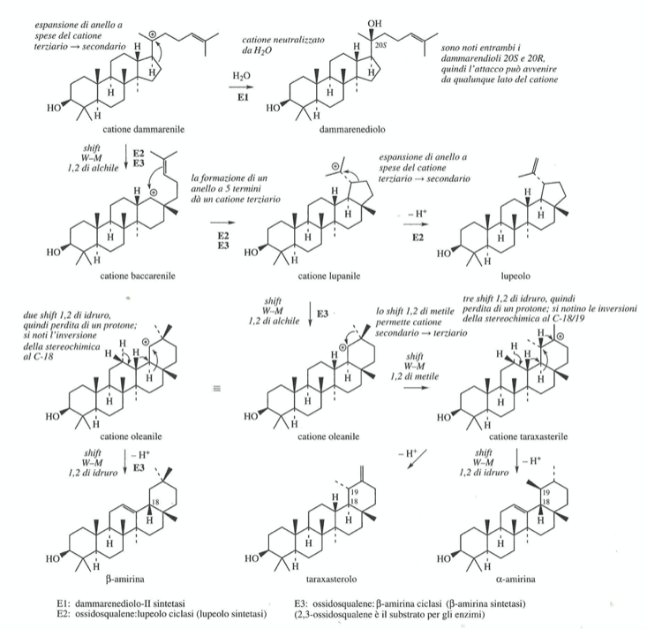
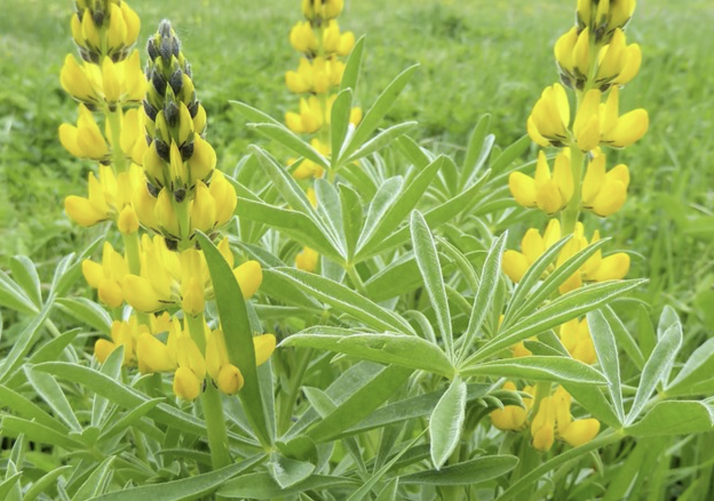
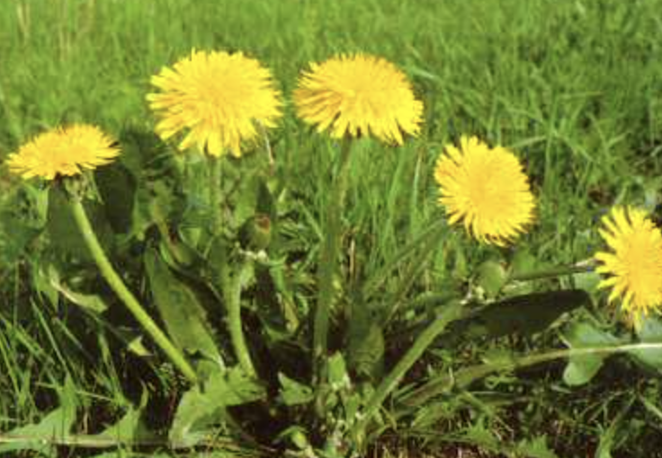
Lupeol in Lupus luteus Leguminosae
Taraxasterol in Taraxacum officinam officinale Composite/Asteraceae

Slide 7
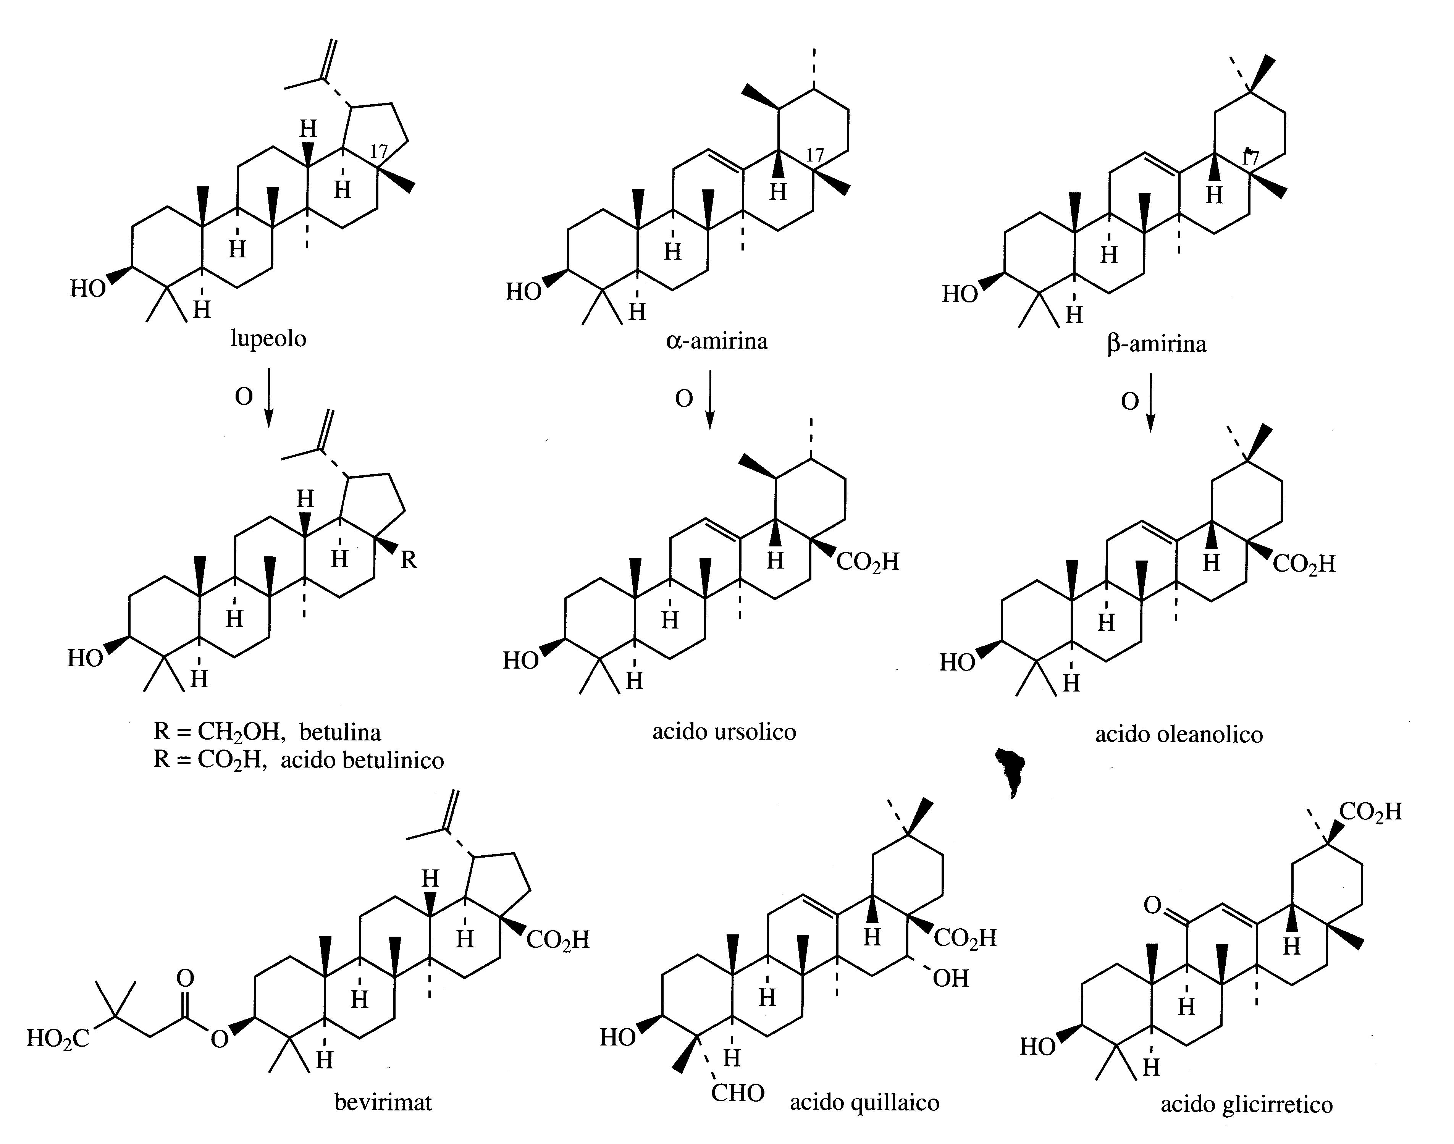
A further very frequent modification of these triterpenoids leads to triterpenoic acids.
For example, betulinic acid is an oxidized version of lupeol.
Betulinic acid derivatives have attracted much interest as possible anti-HIV drugs.
The most promising compound in clinical trials is the semi-synthetic product bevirimat.

Slide 8
Triterpenoid saponins
The pentacyclic triterpenoid skeletons represented by lupeol, α-amyrin and β-amyrin are frequently found in the structures of triterpenoid saponins.
Saponins are glycosides which, even at low concentrations, induce the formation of foam in aqueous solution due to their surfactant properties.
The name derives from the fact that the materials obtained from plants that contained saponins were originally used for washing laundry, such as soapwort (Saponaria officinalis and Quillaja saponaria).
The bioactive components of ginseng (Panax ginseng, Arariaceae) are a group of saponins based on the dammaran skeleton and are called ginsenosides

Slide 9
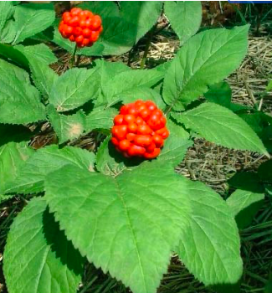
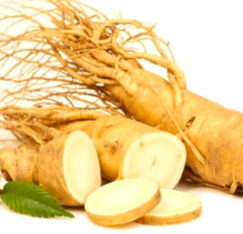
Panax ginseng
Ginseng is a Chinese plant ( also in Korea and Russia). The root is dried and used peeled as a food supplement.
Ginseng is considered an adaptogen as it helps the body to adapt to stress with an immunostimulating effect.
More than 30 different ginsenosides are known and the sugars are found bonded to the hydroxyl groups at C3, C6 and C20.

