Slide 1
Phytosterols
From the biosynthetic point of view phytosterols of plants and algae derive from cycloartenol.
The most common sterols in plants, fungi and algae are characterized by the presence of a side chain generally linked to C-24, which carryies one or two extra carbons C-24¹ and C-24².

Slide 2
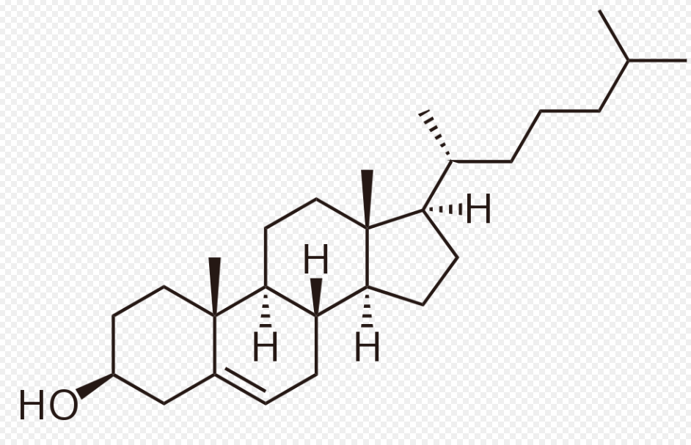
The most common sterols in plants are campesterol and sitosterol which are the 24-methyl and 24-ethyl analogue of cholesterol, respectively
Cholesterol

Slide 3
Stigmasterol
The presence of an unsaturation in the side chain (∆²²) is a typical feature of many plant-derived sterols (e.g. stigmasterol), but not of those found in mammals.
PLANTS: campesterol, sitosterol
ALGAE: fucosterol
MUSHROOMS: ergosterol

Slide 5
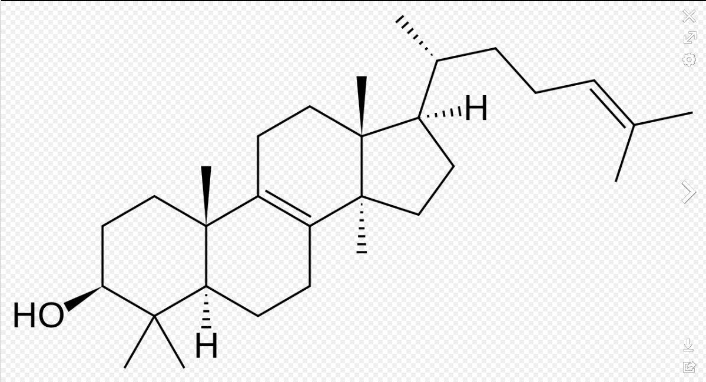
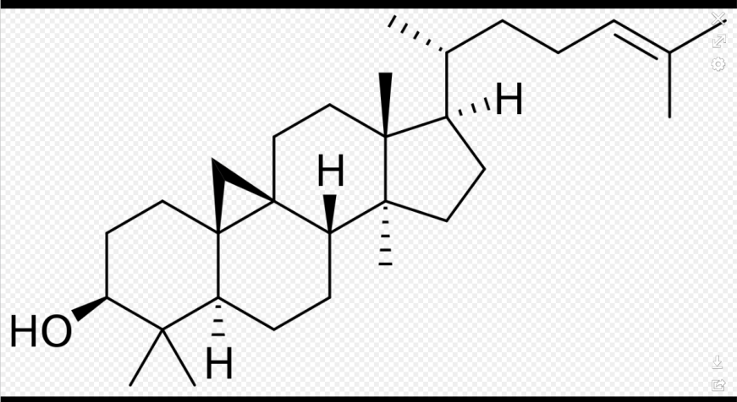
Biosynthesis of phytosterols
The introduction of extra methyl or ethyl groups into the side chain is obtained by alkylation by S-adenosylmethionine as single carbon units.
The presence of the double bond ∆²⁴ is foundamental in the initial phase.
This unsaturation is present in lanosterol and in cycloartenol.

Slide 6
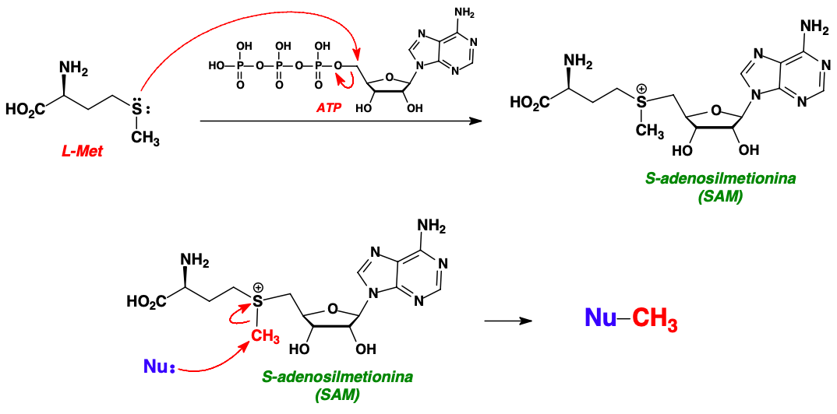
SAM is formed by the interaction of the amino acid methionine with an ATP molecule.
The triphosphate group acts as a leaving group and the the sulfur of methionine (nucleophile) binds to adenosine residue thus becoming positive.
The positive charge on the sulfur induces a strong electron-attractor effect giving electrophilic characteristics to the methyl bound to it, making it more susceptible to attack by a nucleophile.

Slide 8
The first alkylation cycle involves cycloartenol, while the second one involves gramsisterol.
The double bond trans-Δ²² is introduced only after the complete alkylation at C-24.

Slide 9
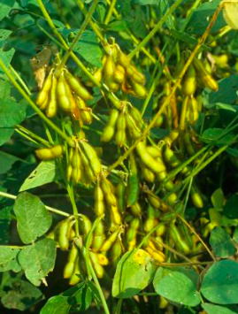
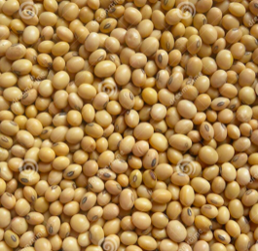
Soy beans (Glycine max, Leguminosae/Fabaceae) contain 0.2% sterols, in addition to the high protein percentage.
Sterols include stigmasterol (20%), sitosterol (50%) and campesterol (20%)
Sitosterol and stigmasterol are used for the partial synthesis of steroid drugs.
Soy is intensively cultivated as a food plant.
The seeds are high in protein (37% of dry weight).

