Slide 1
Cardiac glycosides
Many of the plants used for a long time as fast-acting poisons (such as Strophanthus) or as cardiac drugs (such as Digitalis) have been shown to contain cardiotonic or cardiac glycosides.
These glycosides have the ability to normalize the functionality of a weakened heart, increasing its efficiency.
However, it must be taken into account that their dosage must be adequately controlled, since the therapeutic dose is very close to the toxic dose.
The cardioactive effects of Digitalis were discovered by studying the results of its application in the treatment of dropsy.
Digitalis relieves the dropsy disorders indirectly through an action on the heart, in fact by increasing the blood flow it compensates for the renal deficiency and therefore allows the elimination of excess fluids.

Slide 2
In plants, cardiac glycosides are found in angiosperms in both dicotyledons and monocotyledons.
Cardiac glycosides increase the force of contraction of the heart both by increasing cardiac output and by increasing the pause times between contractions.
The primary effect on the heart consists in the inhibition of the ion transport activity of ATPase-dependent Na⁺/K⁺ in the cardiac muscle cell membranes, in particular by inhibiting the Na⁺ pump and thus increasing the intracellular concentration of Na⁺.
Alteration the Na⁺ gradient across the membrane reduces the energy of Ca²⁺ transport out of the cell leading to an increase in the intracellular Ca²⁺ concentration and provides a positive ionotropic effect and increased heart contraction.
The improvement in blood circulation also tends to improve renal function, producing an increase in diuresis and a consequent reduction in edema, often associated with heart failure.

Slide 3
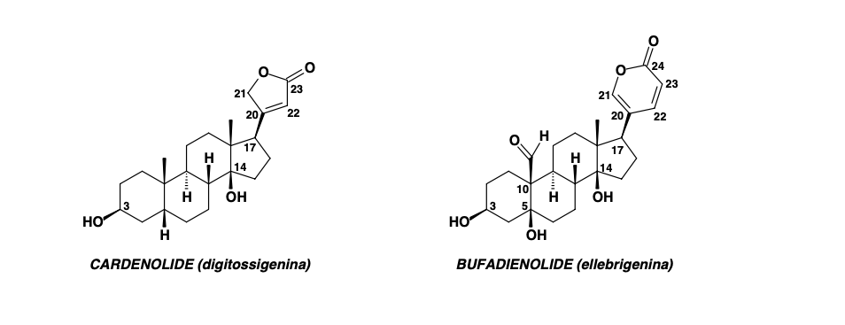
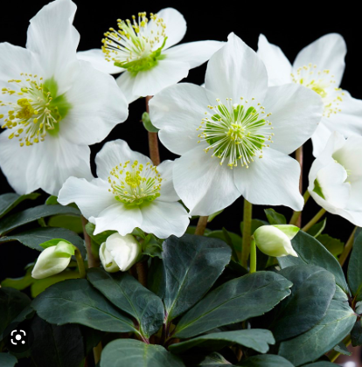
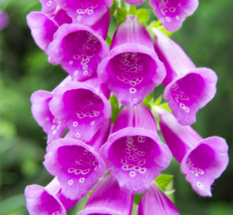
The therapeutic action of cardiac glycosides depends on the structure of the aglycone and the type and number of sugar units bound.
Aglycones have two types of structures:
CARDENOLIDS: compounds with 23 carbon atoms, eg. digitoxigenin (Digitalis purpurea).
BUFADIENOLIDES: compounds with 24 carbon atoms, eg. hellebrigenin (Helleborus niger).
Digitalis purpurea
Helleborus niger

Slide 4
The most widespread cardiac glycosides are cardenolides, and the plants of the Apocynaceae (Strophantus), Liliaceae (Convallaria), Scrophulariaceae (Digitalis) families are a source of various medicinal products.
Bufadienolides are rarer and have been found in some species of the Liliaceae (Urginea) and Ranunculaceae (Helleborus) families, as well as on the skin of the toad of the genus Bufo (from which this class of compounds was first isolated and from which the general name was taken).
Queen butterflies and their larvae accumulate in their body a certain variety of cardenolides which they take through the diet based on plants such as the common gentian (Asclepias syriaca , Asclepiadaceae). This feature makes them unattractive to most predators such as birds.

Slide 5
For the activity, the stereochemistry of these compounds is very important:
cis junction both between the A / B and C / D rings;
β orientation of the hydroxyls in position C-3 and C-14;
lactone function α, β-unsaturated localized in position C-17 (β);
in position 3 a glycosidic group must be bound, whose function is to increase the solubility of these compounds in water and therefore the ability to bind to the heart muscle (up to 4 monosaccharide units).

Slide 6
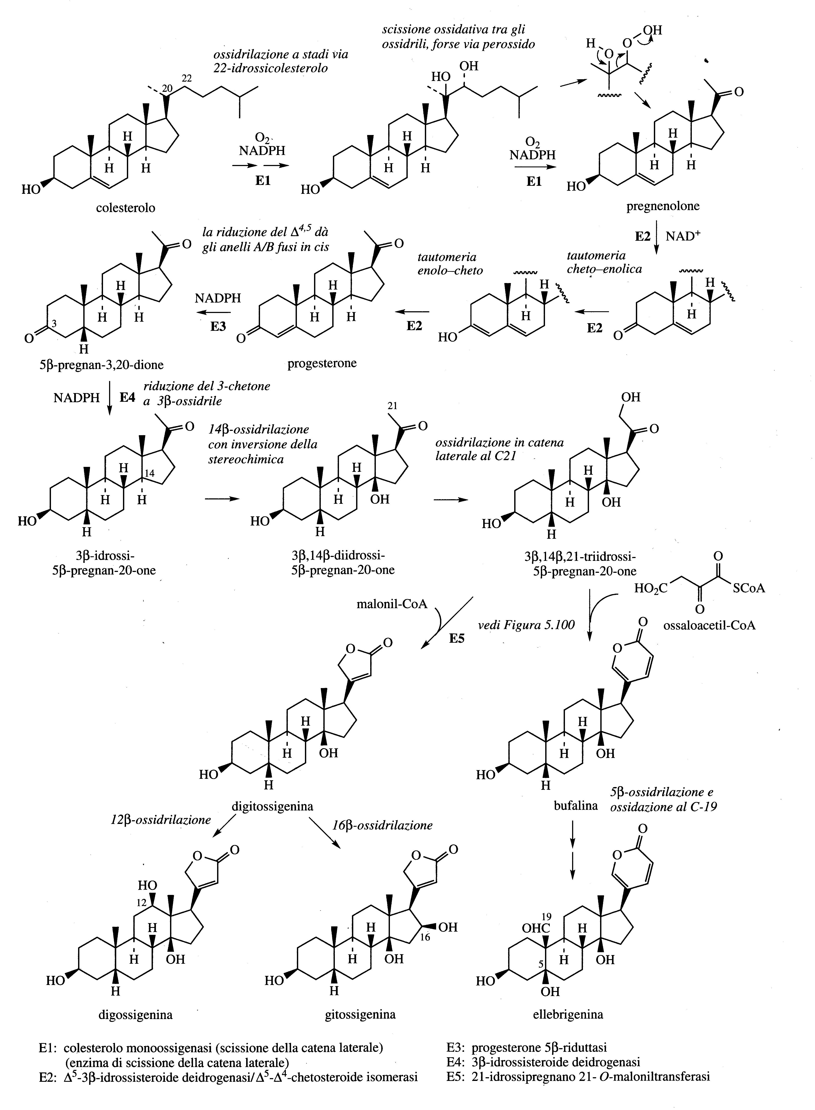

Slide 7
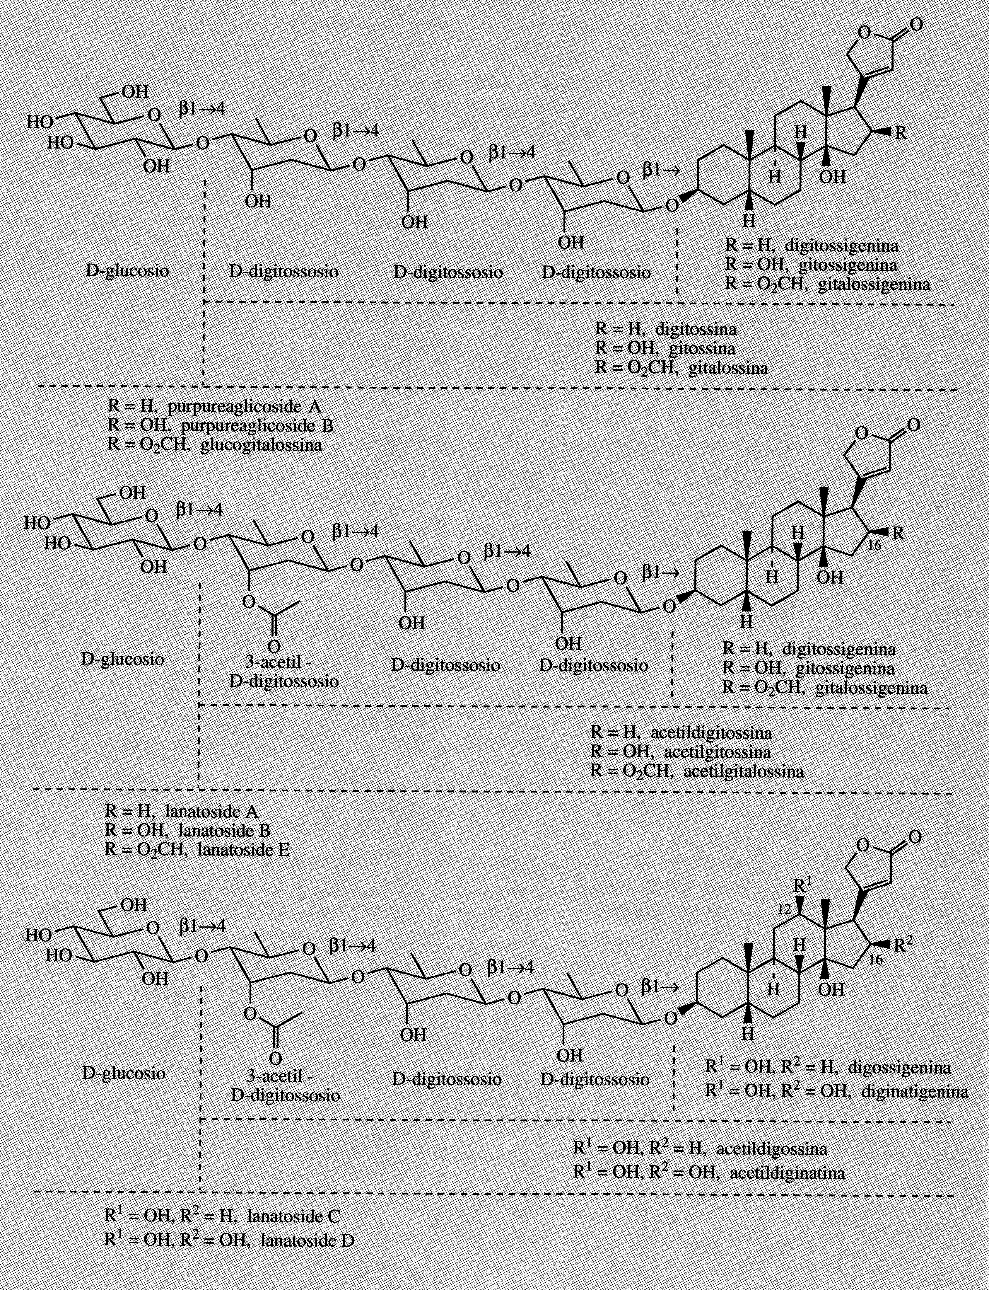

Slide 8
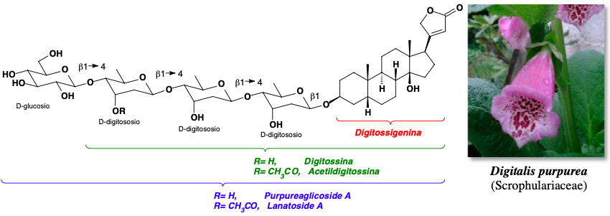
D. purpurea is a biennial plant common in Europe and North America.
For the pharmacological production, the leaves of the first year are harvested and they are promptly and rapidly dried at temperatures no higher than 60 °C, to make inactive the enzymatic hydrolysis processes of the cardioactive glycosides.
The content of cardioactive glycosides in the leaves of D. purpurea ranges from 0.15 to 0.4% and consists of a mixture of about 30 different structures, the main components of which refer to aglycones such as digitoxigenin.

Slide 9
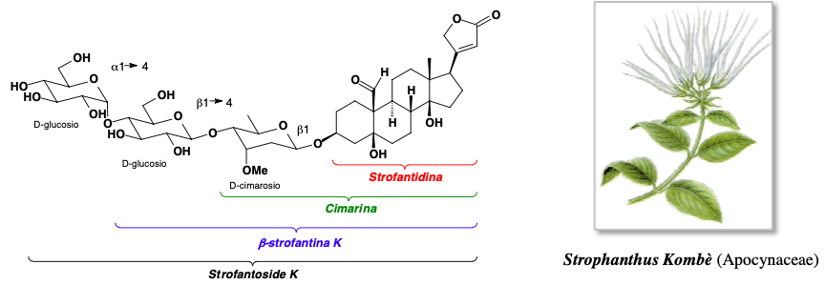
African plant.
Strophanthus kombe has historically been used by African tribes to poison arrowheads.
The seeds contain 5-10% cardenolides, a mixture known as K-strofantin.

