Slide 1
Tetraterpenes
Tetraterpenes are formed from only one group of organic compounds, the Carotenoids. They are involved in photosynthesis.
They are present also but also in non-photosynthetic plants and in fungi and bacteria.
Phytene is the tetraterpenic skeleton and its formation requires the coupling of two molecules of Geranylgeranyl diphosphate (GGPP) with a similar mechanism used for the synthesis of squalene and triterpenes.

Slide 2
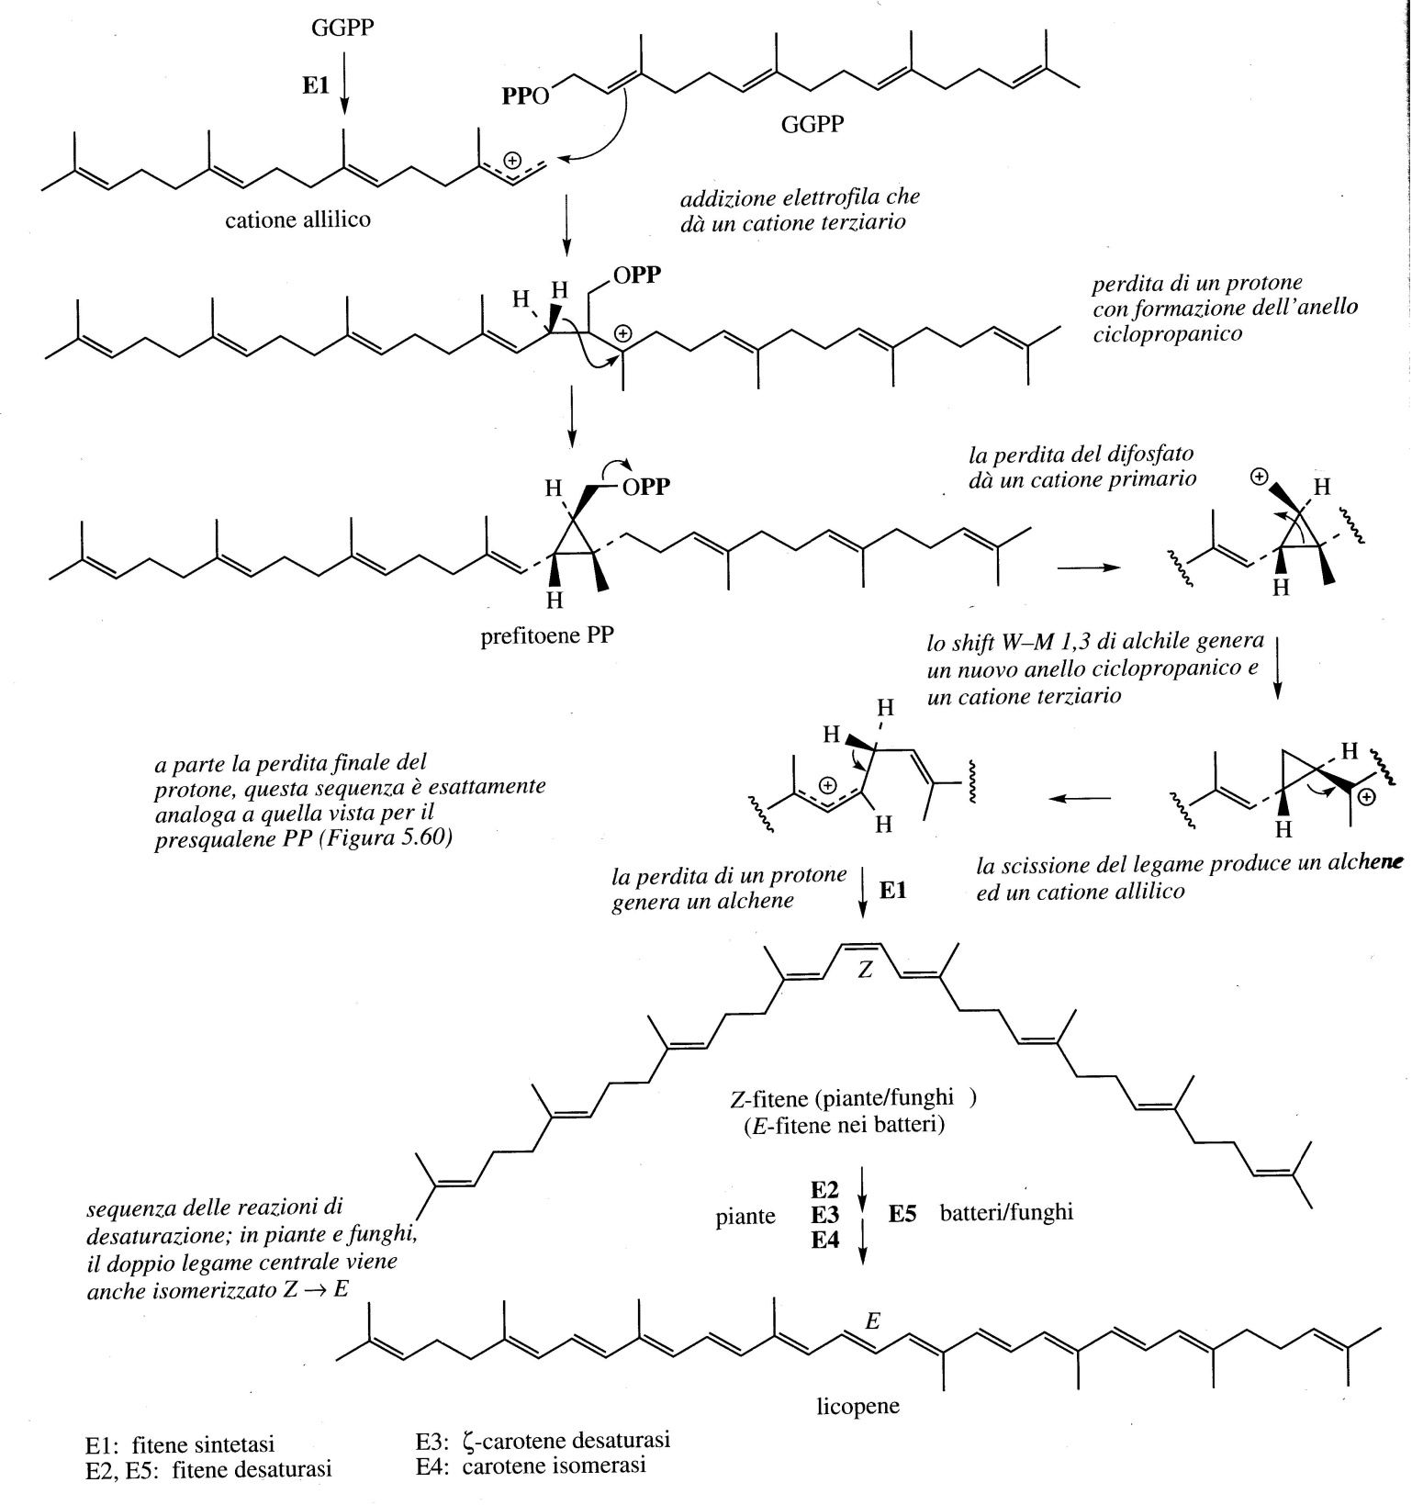
In the biosynthesis the loss of a proton with the formation of a double bond in the center of the molecule.
In plants and fungi this double bond has a Z (cis) configuration, while in bacteria it is E (trans).
This conjugated triene system prevents the cyclization seen with squalene.
Subsequently, the conjugation is extended by providing the Lycopene which is all in configuration E (trans)

Slide 3
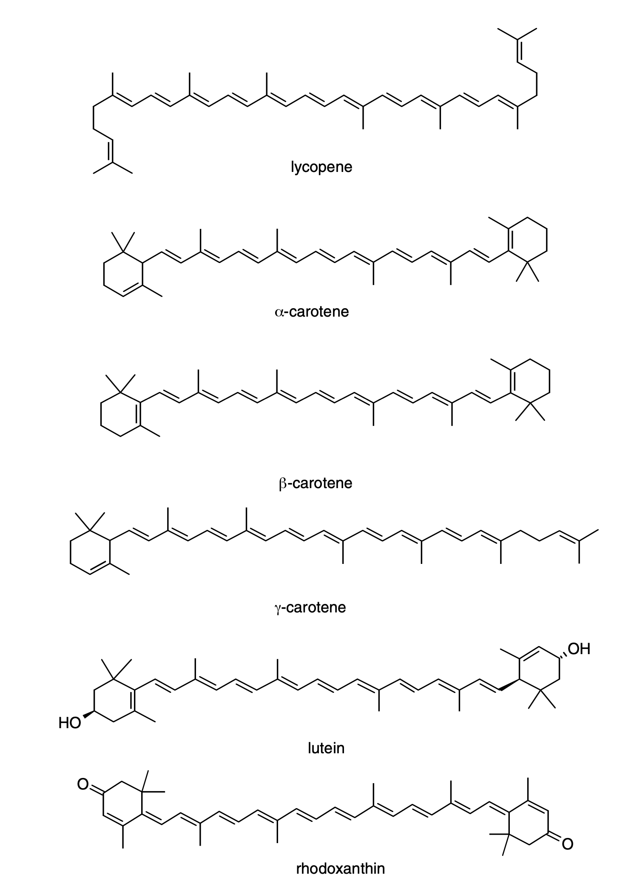
The carotenoids are generally derived from lycopene. Cyclization at one end gives γ-carotene and at both ends provides β-carotene. This pigment was first isolated in 1831.
It is virtually universal in the leaves of higher plants.
They are also responsible for colors varying from yellow to red in both flowers and fruits. This coloration attracts pollinators (flowers) and serves as a source of food for animal herbivores (fruits), thus aiding in seed dispersal.

Slide 4
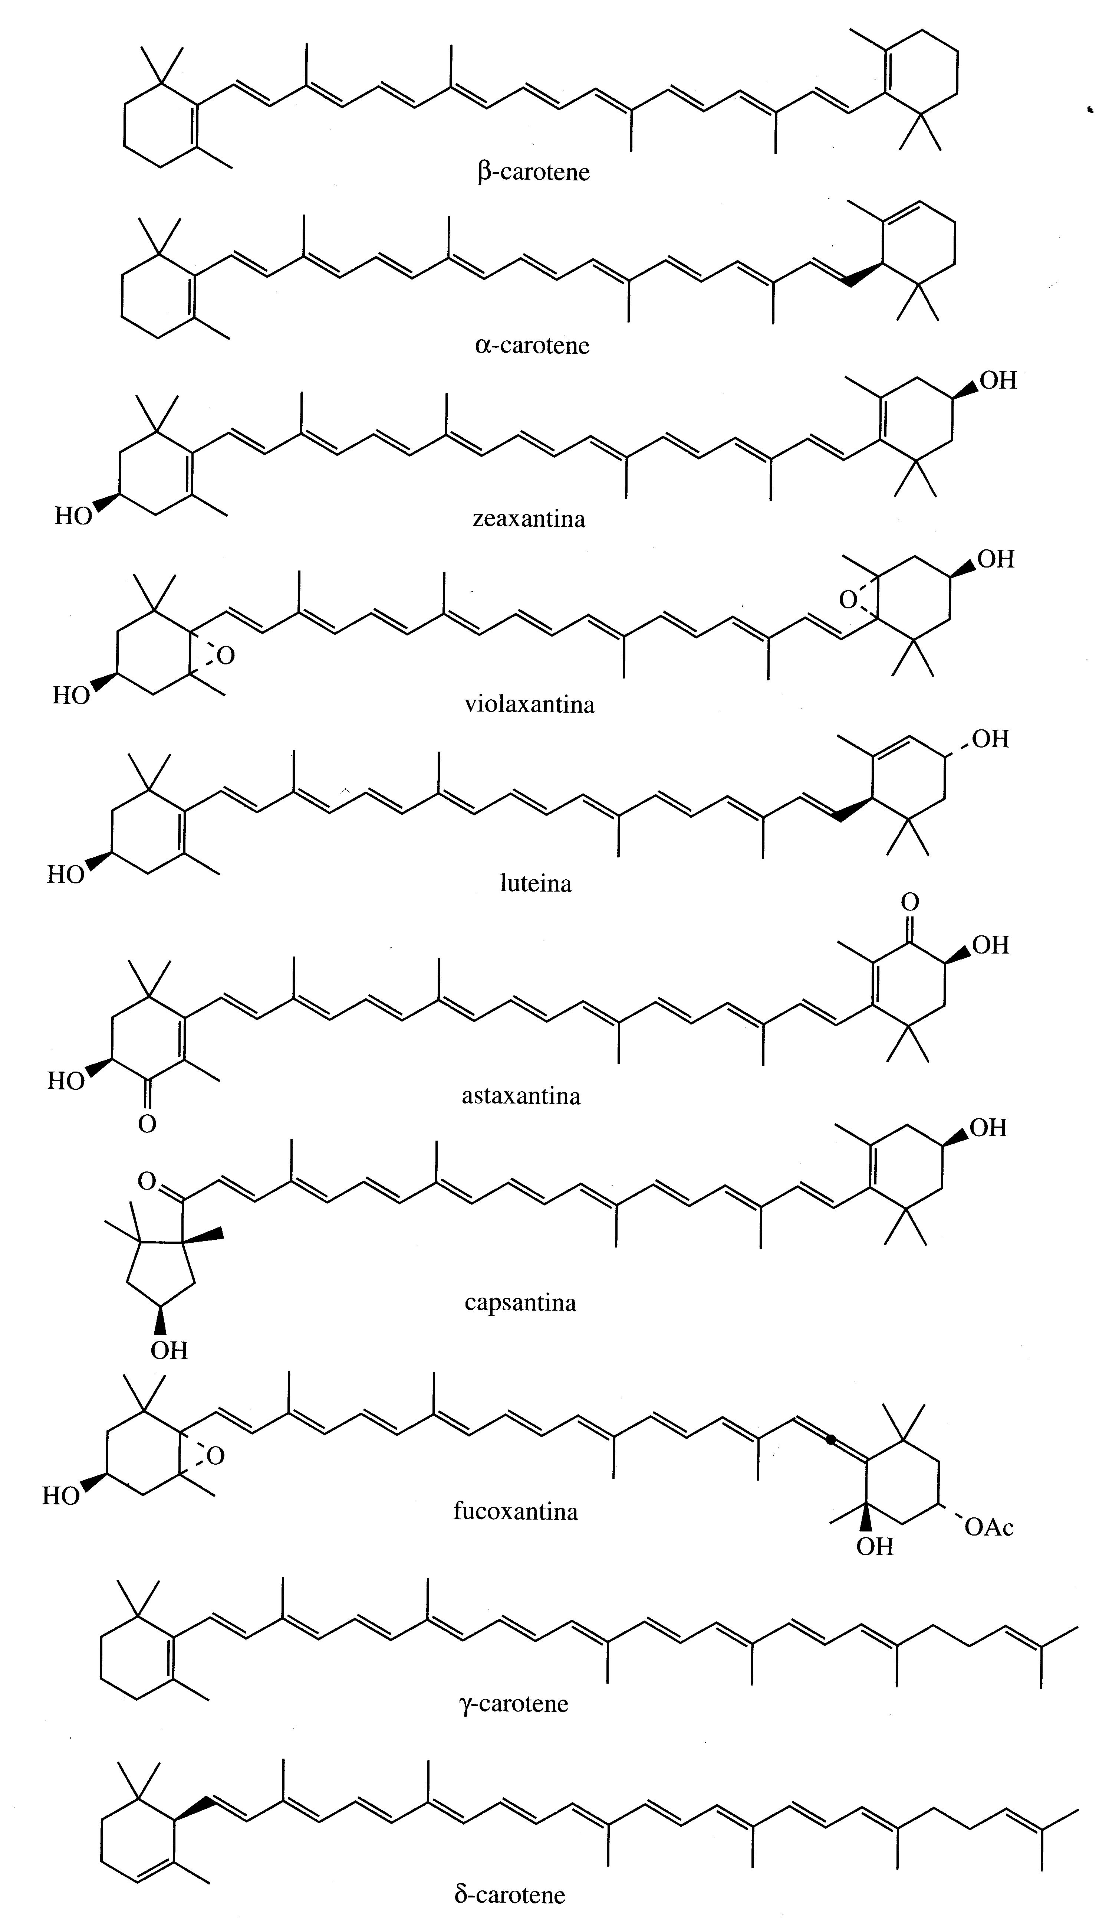
The extended π-electron system gives color to carotenoids (yellow, orange and red).
Lycopene is the pigment of ripe tomatoes (Lycopersycon esculent; Solanaceae).
The orange color of carrots is due to β-carotene (which is widely used as a colorant in foods, beverages, sweets and medicines).
Carotenoids show cyclization at one (δ and γ carotene) or both ends, with the same (β-carotene, zeaxanthin, violaxanthin, astaxanthin) or different (α-carotene, lutein, capsanthin, fucoxanthin) cycles.

Slide 5
Astaxanthin gives the red color to crustaceans and fish such as salmon. They do not synthesize carotenoids and astaxanthin is produced by the modification of vegetable carotenoids (β-carotene) obtained from the diet.
Carotenoids are involved in photosynthesis as accessory pigments for capturing light.
They also protect plants from photo-oxidative damage neutralizing toxic oxygen species generated by light-absorbing pigments, such as the chlorophylls.

Slide 6
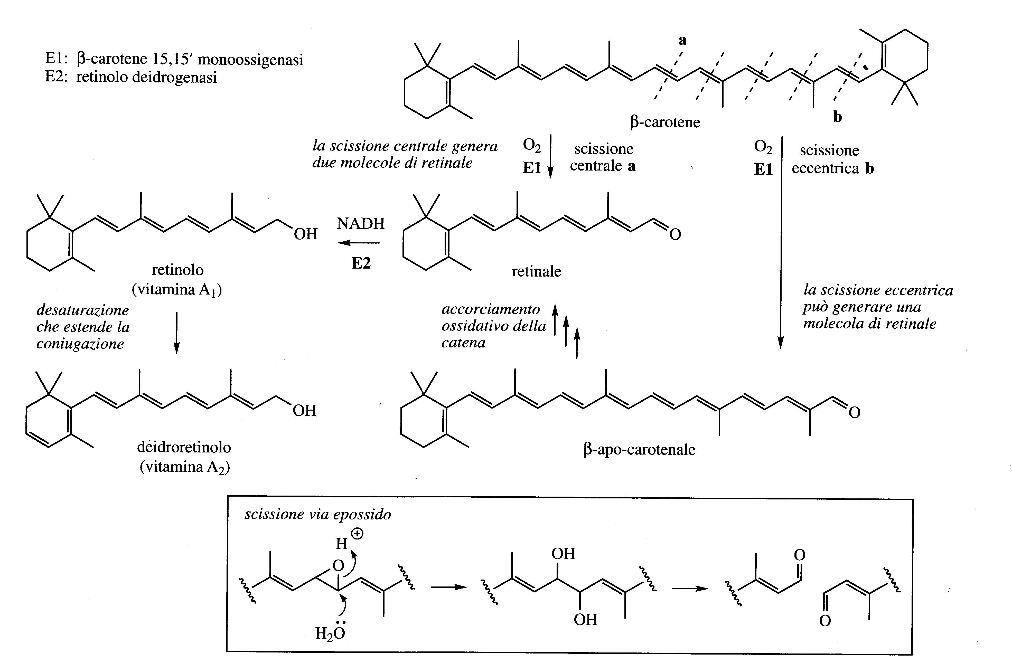
The group of vitaminin A is an important family of metabolites of carotenoids.
Vitamin A₁ (retinol) has a diterpenoid structure and in mammals derives from the oxidative metabolism of β-carotene, taken with the diet.
The division into retinal takes place in the intestinal mucosa by a monooxygenase and then converted into vitamin A₁.

Slide 7
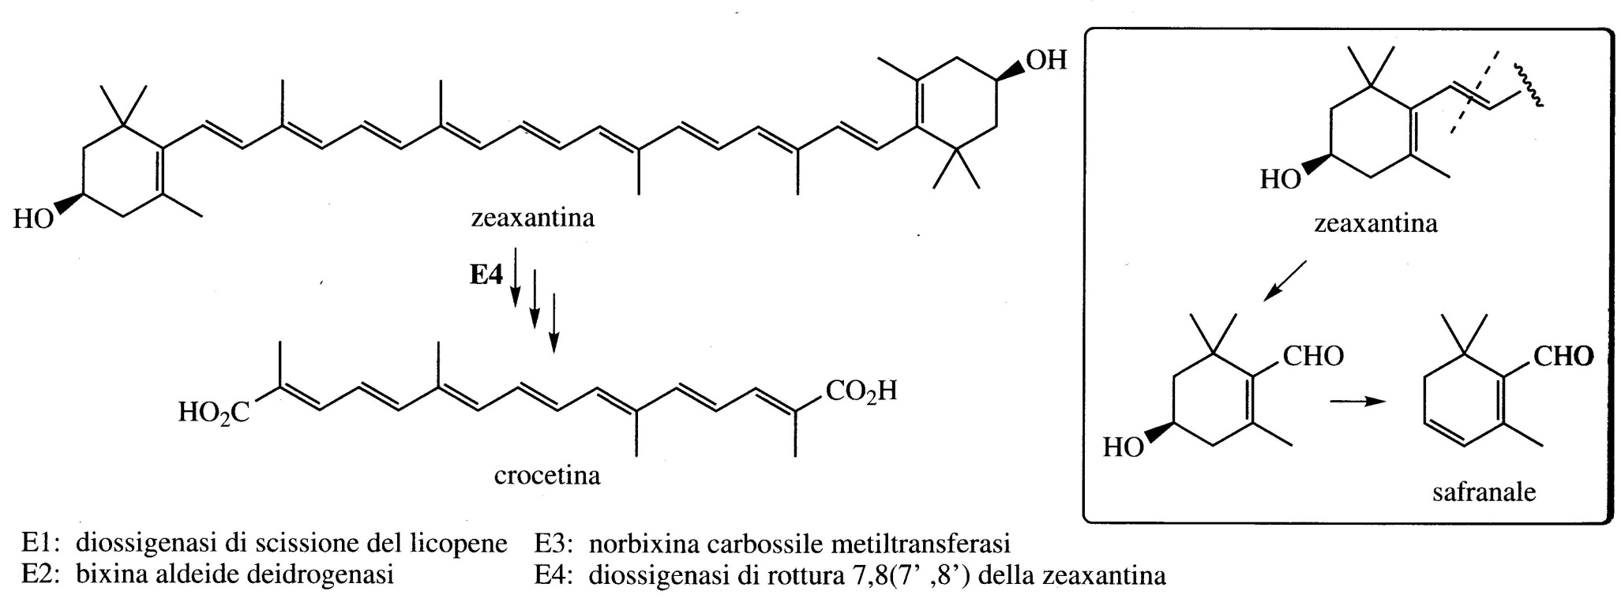
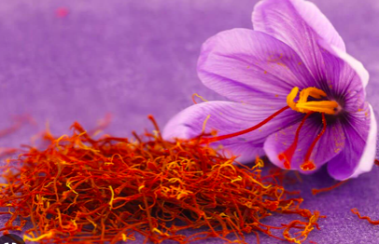
Crocetin is produced from the cyclic carotenoid zeaxanthin, it is the main pigment in the stigmas of Crocus sativus (Iridaceae) which contain saffron.
The monoterpenoid safranal also contributes to the aroma and taste of saffron and is synthesized from the remainder of the carotenoid cyclic structure.

