Slide 1
Nutrient sensing
Nutrient
Metabolism
Gene
Expression
Cell Growth and Proliferation

Slide 2
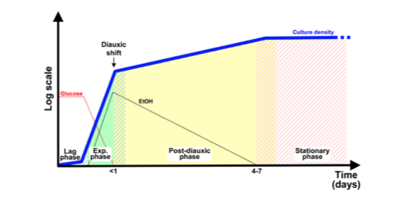
GLUCOSE SENSING
Growth phases of S. cerevisiae cultivated in rich medium supplemented with glucose.
When quiescent, stationary phase cells are inoculated in fresh medium, they exhibit an initial lag phase of variable length. During the subsequent exponential phase cells proliferate rapidly by fermenting glucose to ethanol. When glucose becomes limiting, cells transiently arrest growth to adjust their metabolism from fermentative to the respiratory mode (diauxic shift): after the switch to respiration, cells restart growing at a reduced rate by slowly consuming the ethanol accumulated in the medium. When ethanol is also exhausted, cells cease dividing and enter into a quiescent state known as stationary phase that becomes deeper and deeper as cells spend more time in this state.
Solid colors indicate steady states, diagonal stripes transient states.

Slide 3
A nutrient is sensed by the signalling network:
externally, via a receptor protein in the plasma membrane which after binding of the nutrient adopts a new conformation that activates a downstream signalling cascade
internally, after uptake of the nutrient, followed by its metabolism, thereby causing a change in its intracellular concentration which, in turn, modulates downstream signalling
Yeast cells preferably ferment glucose and other rapidly fermentable sugars to ethanol and acetate, although respiration would be energetically more favourable (Crabtree effect).
Competitive advantage:
1) the ethanol produced during fermentation inhibits growth of other micro-organisms;
2) when glucose becomes limiting yeast will enter the diauxic shift during which metabolism shifts from fermentation to respiration to allow usage of ethanol and acetate
(Smerts et al 2010)

Slide 4
Yeast cells obtain energy through fermentation of sugars (glucose, fructose, sucrose, galactose etc) or through oxidation of a variety of fermentation products, such as ethanol and glycerol
The rapid depletion of the sugar and the accumulation of large amounts of ethanol produced during fermentation (which is toxic for most competing microorganisms) enable yeast cells to successfully compete for survival
Since yeast readily ferment glucose, both to extract energy rapidly and to generate precursors for all anabolic processes, the availability of glucose presents an opportunity for increased mass accumulation, which is realized by increased ribosome production
More than 40% of the genes in yeast alter their expression by more than twofold within minutes following addition of glucose to cells growing on glycerol:
increased expression of genes involved in ribosome biogenesis
repression of genes required for oxidative phosphorylation
repression of genes required for metabolism of sugars other than glucose

Slide 5
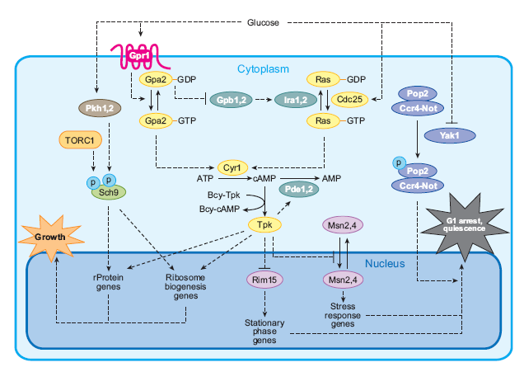
Ras and Gpr1/Gpa2 pathways
L’aggiunta di glucosio a cellule in fase stazionaria o in crescita su terreni non fermentabili induce l’attivazione di due vie di trasduzione del segnale: una mediata da Ras/GTPasi monomerica e la seconda dal complesso Gpr1/Gpa2. Entrambe portano all’attivazione della chinasi PKA
Zaman et al, 2008

Slide 6
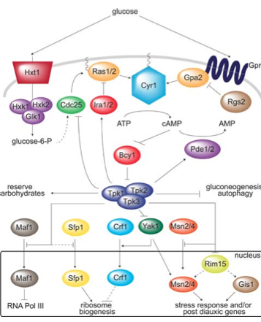
Glucose Induction Signal: the GPCR System
The GPCR (G-protein coupled receptor) module composed by the Gpr1 receptor and its cognate G protein Gpa2 defines a glucose-sensing system that works in parallel with Ras to activate PKA.
GPR1 encodes a seven-transmembrane G protein–coupled receptor that physically interacts with Gpa2, a small GTP-binding protein homologous to the mammalian Gα subunit of the heterotrimeric G proteins. Binding of glucose to Gpr1 directs the formation of the GTP-bound, active form of Gpa2, which then stimulates adenylate cyclase to increase cAMP production.
Gpa2 is required for the recruitment of Ras-GTP at the plasma membrane.
Activation of cAMP/PKA pathway.

Slide 7
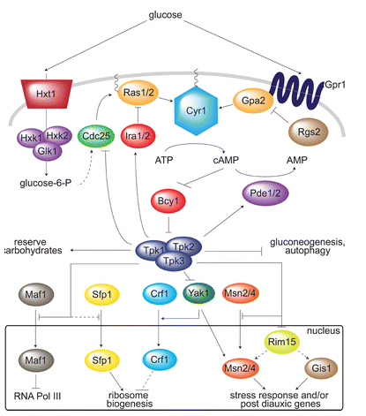
The cAMP/PKA pathaway
cAMP-PKA plays a major role in the control of metabolism, stress resistance and proliferation. In response to a sudden availability of rapidly fermentable sugars, the pathway induces the synthesis of cAMP to activate PKA. The cAMP/protein kinase A pathway, regulates many aspects of cellular physiology, including growth, proliferation, metabolism, stress resistance, aging, morphogenesis and development according to nutrients availability
Glycolysis: Upregulation
Gluconeogenesis: downregulation
Stimulation of cell growth and cell cycle progression
Downregulation of stress resistance

