Slide 1
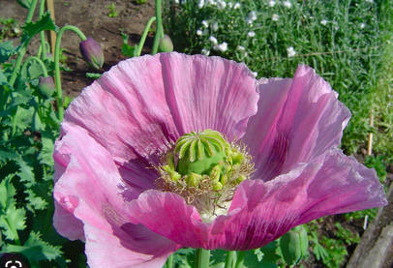
Alkaloids
More than 27,000 alkaloids have been characterized, of which 21,000 of vegetable origin.
Alkaloids are low molecular weight organic containing nitrogenous bases.
These molecules contain one or more nitrogen atoms in the form of primary, secondary or tertiary amines.
Alkaloids containing quaternary ammonium salts are also known, as well as amide groups.

Slide 2
Alkaloids
The akaloids are classified according to the substructure that contains the nitrogen (pyrrolidine, pyrrolizidine, piperidinic, quinoline, isoquinoline, indole, etc.).
The nitrogen atom always comes from an amino acid which is conserved in the final structure except the carboxyl functional group which is almost always lost upon decarboxylation.
Alkaloid structures contain also sub-units deriving from the metabolism of acetate, shikimate or methylerythritol-phosphate (MEP).

Slide 3
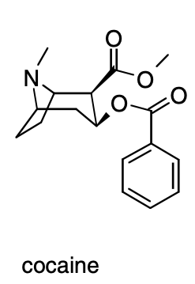
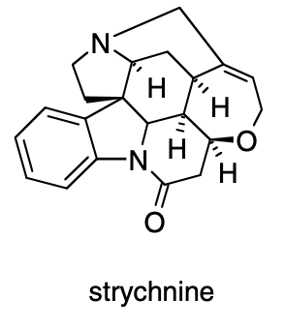
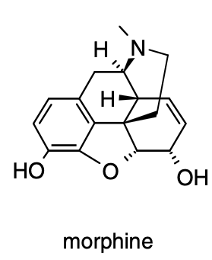
Many alkaloids have a bitter taste, and a large number of them exhibit potent physiological effects on mammals.
For example, morphine shows narcotic effects; reserpine is an antihypertensive agent; atropine is a smooth muscle relaxant; cocaine is a local anesthetic and a potent central nervous system stimulant; and strychnine is a nerve stimulant.

Slide 4
Alkaloids in plants serve as chemoprotective anti-herbivory agents or as growth regulators, such as the well-known plant hormone, indole-3-acetic acid, IAA (an indole derivative synthesized from tryptophan).
People have been using alkaloids in the form of plant extracts for poisons, narcotics, stimulants, and medicines for several thousand years (folk or traditional medicine).
Common examples include caffeine, quinine, and nicotine. More potent examples include cocaine, morphine, and strychnine.
Much of the structure-based natural products research that began around 150 years ago was focused on the alkaloids, or “vegetable alkalis,” as they were known.

Slide 5
Isolation techniques developed primarily by British and German chemists enabled the isolation of analytically pure samples that had pronounced biological effects, but the chemical structures were unknown.
The alkaloids have highly varied and often complex three-dimensional chemical structures.
The structure of cocaine was determined in 1898, quinine in 1944, and morphine was synthesized in 1956.
Because of this chemical complexity, the alkaloids are often obtained from the plant source rather than produced synthetically.

Slide 6
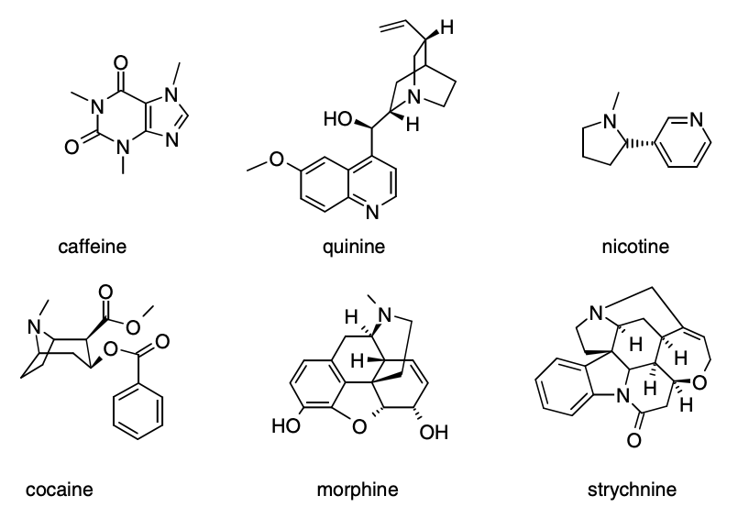

Slide 7
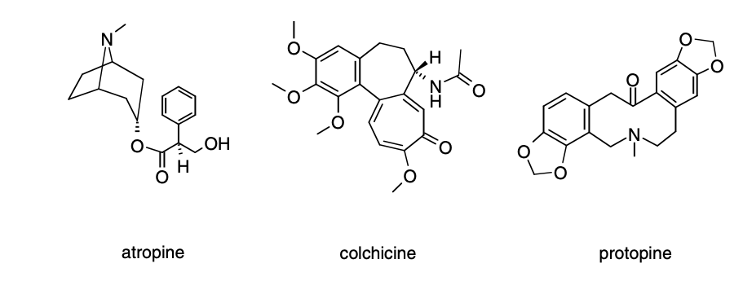

Slide 8
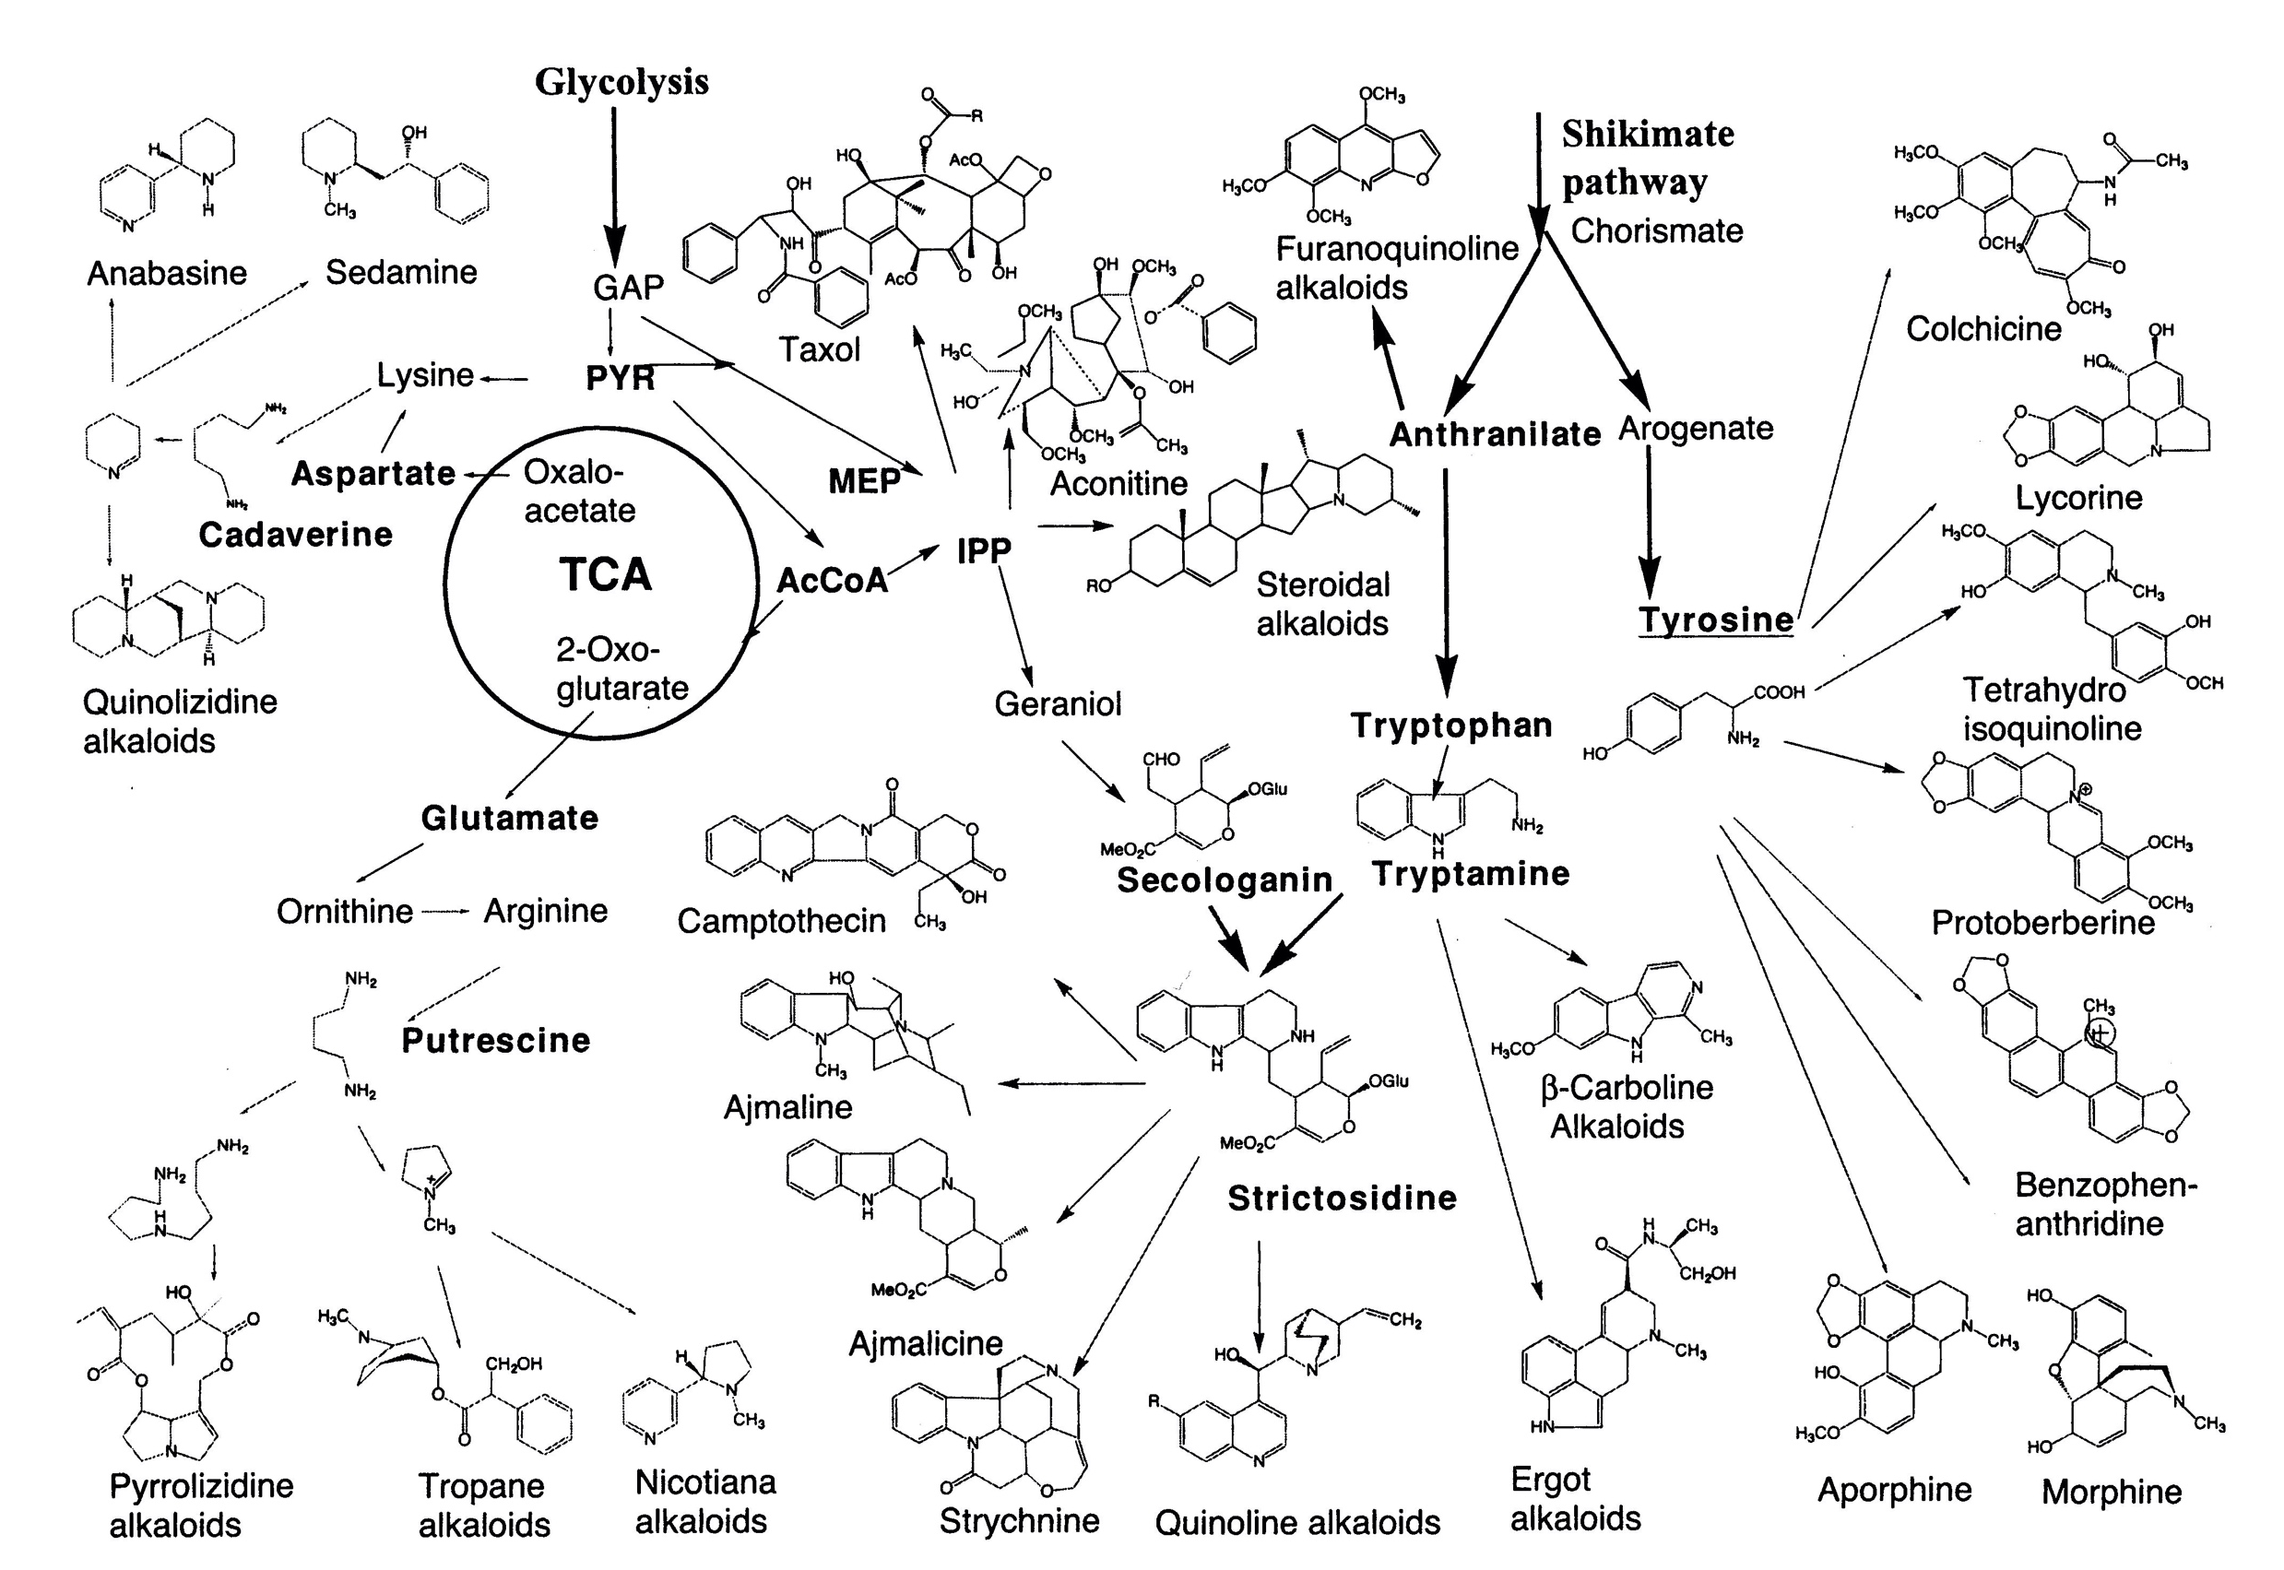
Overview of biosynthetic pathway of major groups of alkaloids
Pyrrolidine
alkaloids

Slide 9
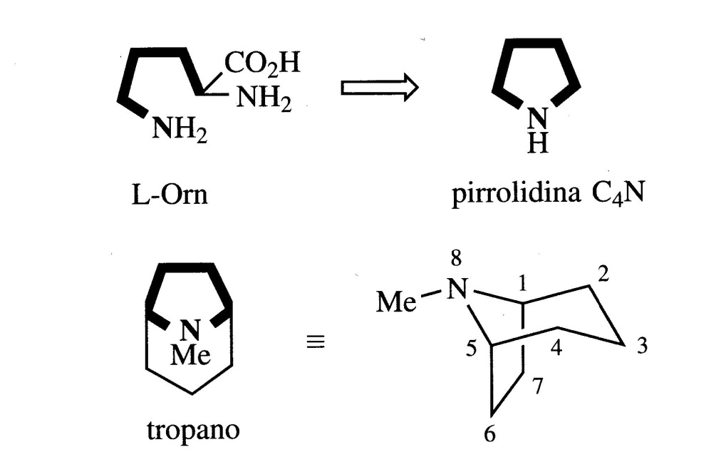
Ornithine-derived Alkaloids
L-Ornithine is a non-protein amino acid produced from L-Arginine.
In plants it is produced from glutamic acid.
Ornithine contains two amino groups, one in the α position and the other in the δ position.
The molecule, without the carboxyl group, constitutes the skeleton of the alkaloids of this class.
Ornithine provides a basic C₄N-type unit in the form of a pyrrolidine or tropane cycle

Slide 10
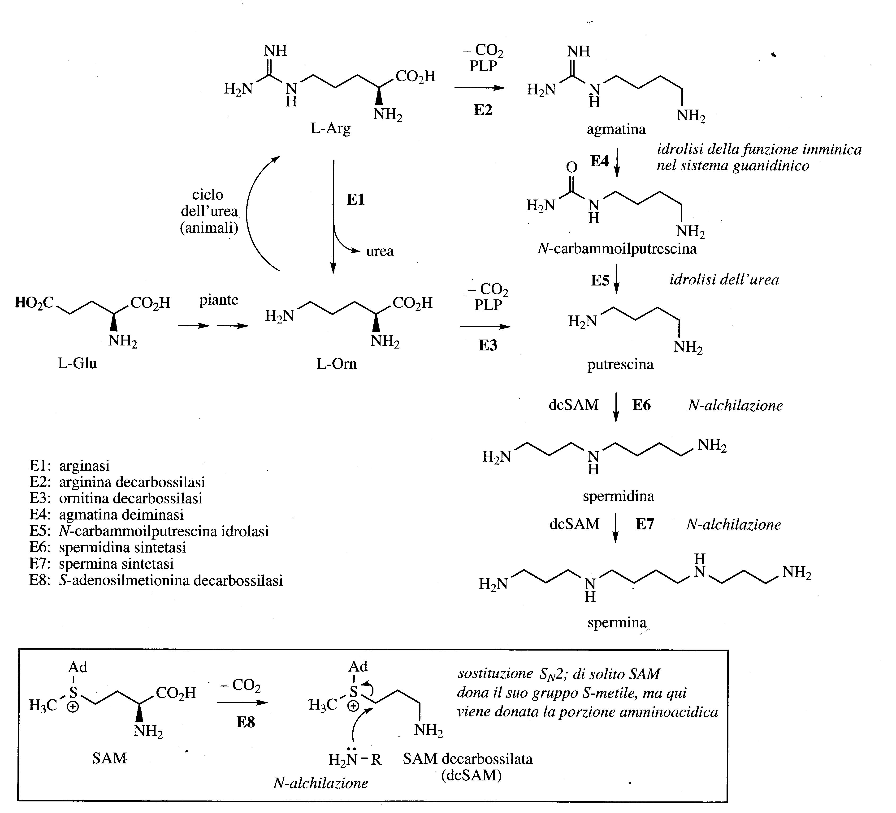

Slide 11
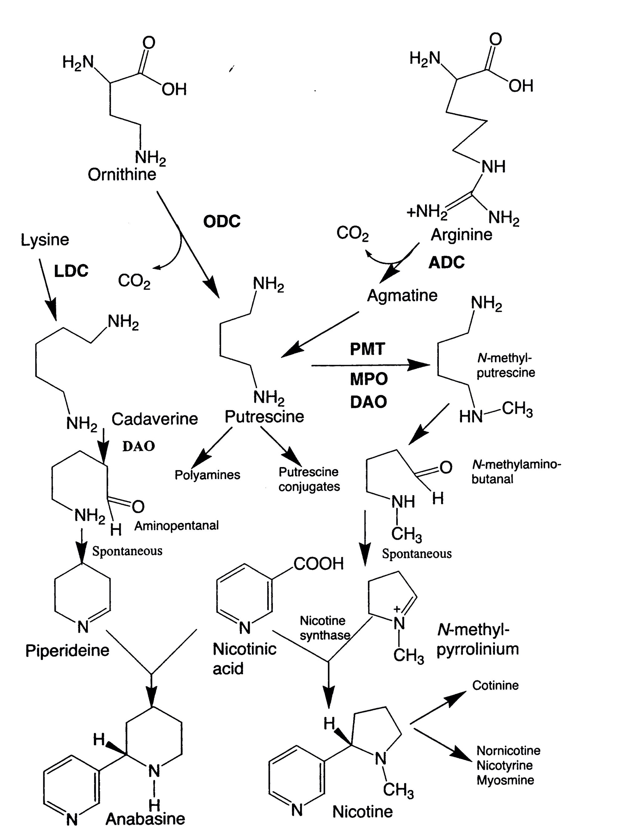
Putrescine is produced by the decarboxylation of either ornithine or arginine, as a result of the activities of either ornithine (ODC) or arginine decarboxylase (ADC).
Putrescine is used in the biosynthesis of the polyamines, spermine and spermidine.
The conversion of putrescine to N-methylputrescine is the first step for the synthesis of alkaloids containning pirrolidine and tropane cycle.
N-methyl-pyrrolium is formed spontaneously after the oxidative deamination of N-methylputrescine to N-methylamino-butanal.
N-methyl-pyrrolium is condensed with an intermediate derived by the decarboxylation of nicotinic acid.
The enzymes involved are:
(i) N-methyltransferase (PMT);
(ii) N-methylputrescine oxidase (MPO);
(iii) nicotine synthase.

Slide 12
Pyrrolidine and Tropane alkaloids
The pyrrolidine cycle is initially formed as a Δ1-pyrroline cation.
Putrescine is methylated to N-methylputrescine which by an oxidative deamination gives the aldehyde. Then, the intramolecular imine is formed which is Δ1-pyrroline cation.
N-methylamino-butanal

Slide 13
Putrescine is produced by the decarboxylation of either ornithine or arginine, as a result of the activities of either ornithine (ODC) or arginine decarboxylase (ADC).
Putrescine is used in the biosynthesis of the polyamines, spermine and spermidine.
The conversion of putrescine to N-methylputrescine is the first step for the synthesis of alkaloids containning pirrolidine and tropane cycle.
N-methyl-pyrrolium is formed spontaneously after the oxidative deamination of N-methylputrescine to N-methylamino-butanal.
N-methyl-pyrrolium is condensed with an intermediate derived by the decarboxylation of nicotinic acid.
The enzymes involved are:
(i) N-methyltransferase (PMT);
(ii) N-methylputrescine oxidase (MPO);
(iii) nicotine synthase.

Slide 14
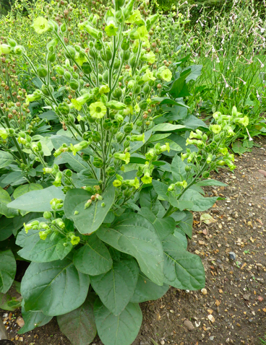
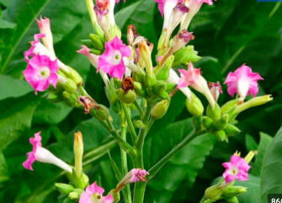
Nicotiana Alkaloids
Nicotiana rustica and N. tabaccum root cultures principally contain nicotine, which is made from putrescine and nicotinic acid.
Nicotiana rustica
Nicotiana tabaccum

Slide 15
Nicotiana alkaloids serves as chemical defence compounds.
They are synthetized in the roots and are transported to the other plant organs, such as aerial parts, via the xylem.
These alkaloids accumulate in vacuoles.
The correlation between nicotine accumulation and its defensive role in N. sylvestris has been demonstrated (defence against herbivory).
Tobacco plants subjected to leaf damage showed a fourfold increase in the alkaloid content of their undamaged leaves.
This resulted from increased alkaloid synthesis and, as a consequence, a tenfold increase in alkaloids in the xylem.

Slide 16
Pure nicotine is a colorless liquid which darkens in the air, acquiring the smell of tobacco.
It is a potent neural poison and was included in the formulation of various insecticides.
At low concentrations it is a stimulating substance and is one of the main factors linked to the pleasure and habit of smoking tobacco (in the sense that it creates addiction).
In addition to the tobacco plant, nicotine is also present in smaller quantities also in tomatoes, potatoes, aubergines and peppers.

Slide 17
Polyamines are found in all living species and are regulators of cell growth, differentiation and death
The simplest is Putrescine (1,4-diaminobutane) which was first isolated from Vibrio cholerae, its name derives from the rotting animal flesh.
The other ones are Spermidine and Spermine.
In plants, the three polyamines are synthesized from glutamic acid.
The aminopropyl groups are transferred from a decarboxylated SAM (dcSAM) to give putrescine.
The polyamine pathway is a target for chemotherapy and spermidine synthetase is a target for antimalarial drugs.

Slide 18
Pyrrolidine and Tropane alkaloids
The pyrrolidine nucleus is initially formed as a Δ1-pyrroline cation.
Putrescine is methylated to N-methylputrescine which by an oxidative deamination gives the aldehyde. Then, the intramolecular imine is formed which is Δ1-pyrroline cation.

Slide 19
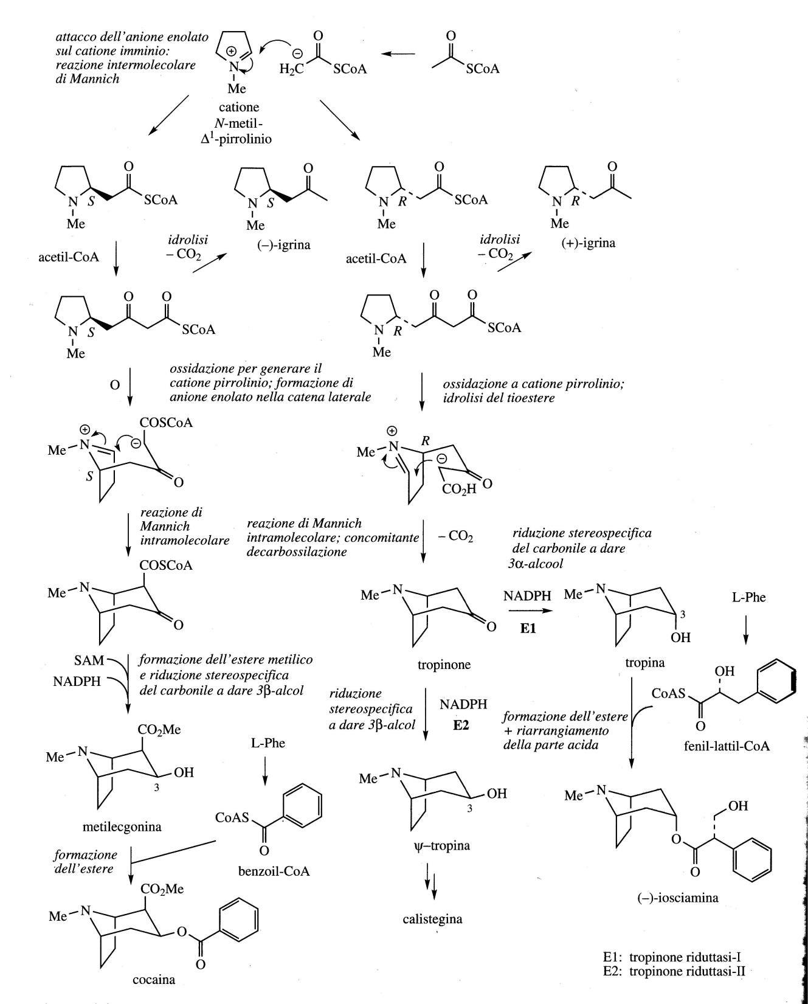
Two carbon atoms are provided by acetyl-CoA which acts as a nucleophile towards the pyrrolinium ion.
Through an oxidation a new pyrrolinium ion is formed and simultaneously the enzyme generates carbanion in α of COSCoA group.
The reaction produces a bi-cyclic compound of the tropane skeleton.
Tropane alkaloids are synthesized in roots and translocated via xilem to aerial part where they accumulate in the vacuole.

Slide 20
The synthesis that leads to the formation of cocaine starting from the S enantiomer of the pyrrolidine compound is reported.
The reduction of the carbonyl group and the formation of the methyl ester produces Methylecgonine which by benzoylation is converted into Cocaine (Erythroxylum coca, Erythroxylaceae ).
The benzoyl group of cocaine derives from phenylalanine.

Slide 21
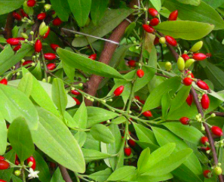
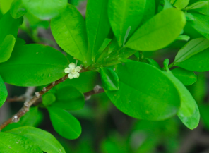
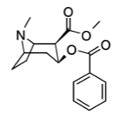
Cocaine is a well-known tropane alkaloid and a potent central nervous system stimulant present in coca leaves (Erythroxolon coca, Colombia, Peru, Ecuador Bolivia).
The active ingredient of coca is the alkaloid cocaine, which is found in fresh leaves in quantities ranging from 0.3 to 1.5% of the total alkaloids present in coca leaves.
Cocaine is used in the medical field as a local anesthetic for topical application (in ophthalmic and otorhinolaryngologist surgery).
Only 1-2% of the coca produced is exported for pharmaceutical production, the rest contributes to fueling the drug market.

Slide 22
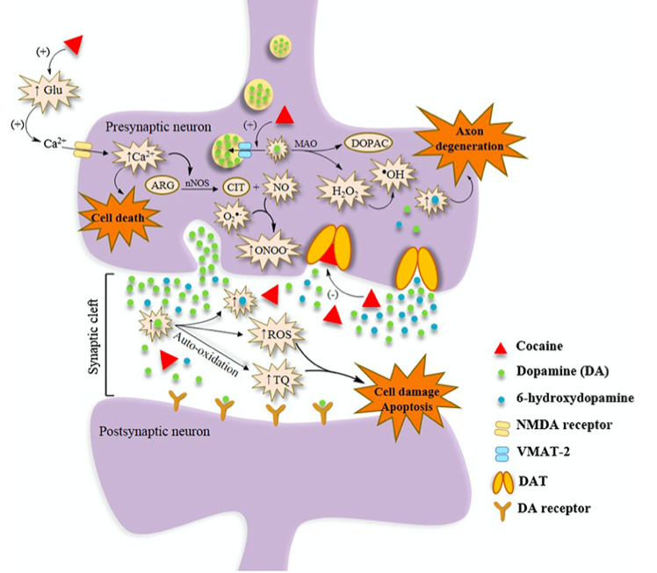
The mechanism by which cocaine causes neurological damage is complex and involves interactions of the drug with several neurotransmitter systems, by the increase of extracellular levels of dopamine and ROS.
Excessive concentrations of DA can be neurotoxic and catecholamines have been shown to cause neuronal death.
DOI 10.1007/s12640-015-9536-x

Slide 23
From R enantiomer of the pyrrolidine derivative Tropine and (-) Hyoscyamine are obtained.

Slide 24
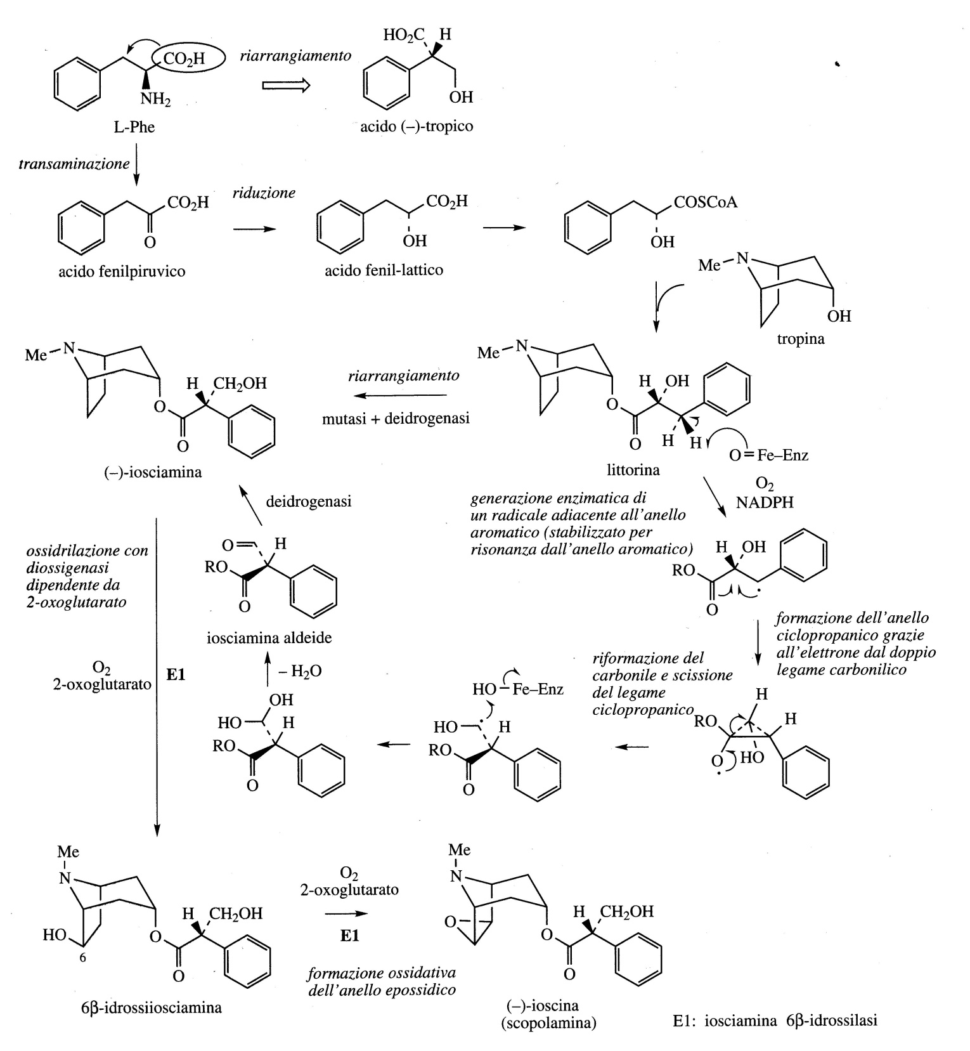
Tropine is esterified with phenyl-lactic acid forming littorina which then undergoes a series of modifications to arrive at (-) Hyoscyamine.
(-) Hyoscine (scopolamine) derives from (-) Hyoscyamine through two successive oxidations.

Slide 25
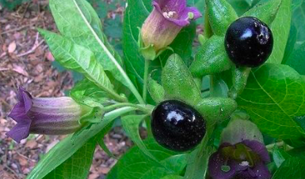
(-) Hyoscyamine and (-) Hyoscine are the most important alkaloids used in medicine.
They are found in Solanaceae: Atropa belladonna, Datura stramonium, Hyoscyamus niger (Giusquiamo); Duboisia myoporoides and Duboisia leichardtii, Mandragora officinarum.
Belladonna: Atropa belladonna. Extremely poisonous plant (the name comes from Atropos who in Greek mythology is the Fate who cuts the thread of life). The alkaloids contained are easily absorbed through the skin and humans, unlike some animals (such as rabbits, sheep, pigs), are extremely sensitive to these toxins.
Contains 0.3-0.6% of alkaloids, mainly (-) Hyoscyamine. From the roots also (-) Hyoscine (scopolamine). It is grown for pharmaceutical purposes in Europe and the United States, it is used as an analgesic to relieve gastrointestinal pain.
Atropa belladonna

Slide 26
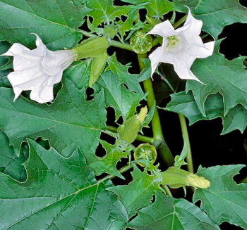
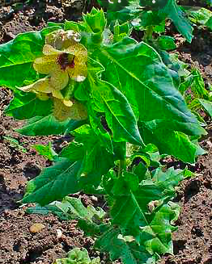
Stramonium: Datura stramonium (Europe and North America). The leaves contain 0.2-0.45% alkaloids, mainly (-) Hyoscyamine and (-) Hyoscine.
Henbane: Hyoscyamus niger (Europe). The alkaloid content is 0.45-0.14%, consisting of (-) Hyoscyamine and (-) Hyoscine in equal quantities. It is grown for pharmaceutical purposes in Europe and the United States.
Hyoscyamus niger
Datura stramonium

Slide 27
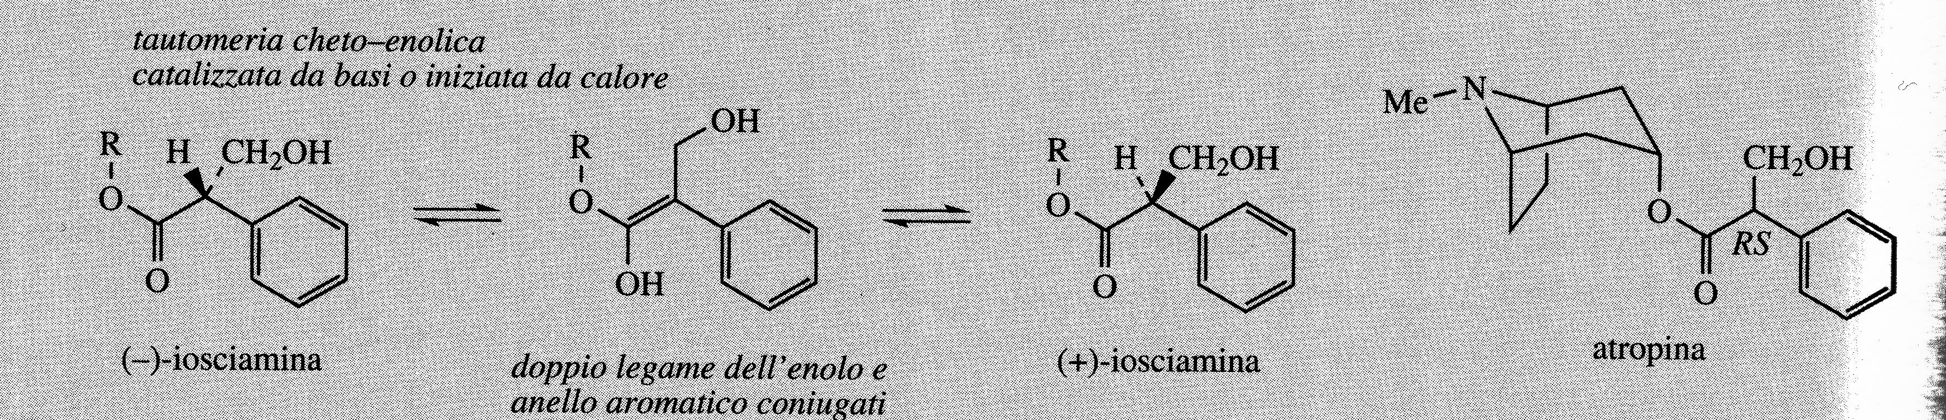
Atropine
Atropine is the racemic form of Hyoscyamine

Slide 28
These tropane alkalidois compete with acetylcholine for the occupation of the muscarinic receptor of the parasympathetic nervous system, thus preventing the passage of nerve impulses and are therefore classified as anticholinergics.
The antagonistic properties of hyoscyamine and hyoscine have a number of useful therapeutic applications including the spasmolytic action of the gastrointestinal tract, the antisecretory effect which can control the production of saliva during surgical operations and the dilating action on the pupil.
Hyoscine has a depressing action on the central nervous system and can be particularly useful as a sedative in the control of pathologies that lead to a partial loss of control over movements.
Most of the plant sources described produce hyoscimine in greater quantities. Since the largest commercial value is given by hyoscine, researchers are developing plant systems with genetic engineering capable of mainly accumulating hyoscine, also using tobacco plant crops and engineered microorganisms.

Slide 29
Scopolamine
Scopolamine has a long history of use.
It exists in various members of Solanaceae, including Hyoscyamus niger and Datura stramonium, among others.
Scopolamine is a potent tropane alkaloid with a structure similar to the neurotransmitter, acetylcholine, and so can act as an anticholinergic.
The complete determination of its chemical structure occurred in 1952.
It was found to be hallucinogenic and it also causes retrograde amnesia.
It is legally prescribed for motion sickness, to ease the trauma of intubation, for preanesthetic sedation, and as an antiarrythmic.

Slide 30
Overview of biosynthetic pathway of major groups of alkaloids
Pyrrolidine
alkaloids

