Slide 1
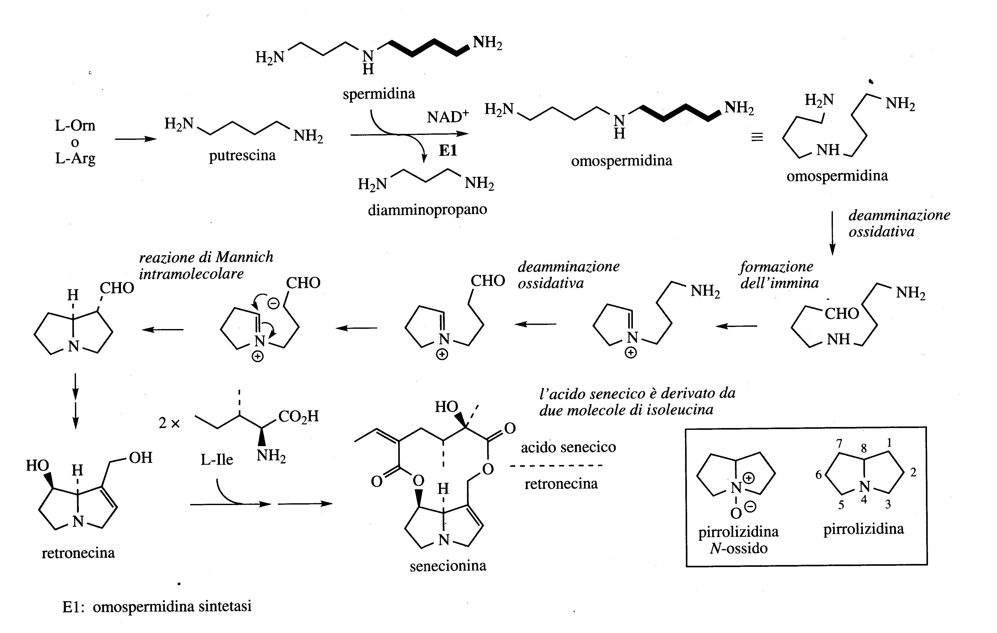
Pyrrolizidine Alkaloids
The bicyclic pyrrolizidine skeleton is constructed from Putrescine.
Although Ornithine could act as a precursor, it is actually incorporated through Arginine because plants that synthesize pyrrolizidine alkaloids appear to lack the decarboxylase enzyme that converts Ornithine into Putrescine.
Putrescine is then converted into the polyamine Homospermidine.
An example of a pyrrolizidine alkaloid is Retronecine.

Slide 2
Pyrrolizidine Alkaloids
Pyrrolizidine alkaloids have a narrow distribution, they are characteristic of some genera of Boraginaceae, Compositae/Asteraceae, some genera of Leguminosae/Fabaceae and Orchideaceae.
Pyrrolizidines rarely occur as free bases but are most often present as esters with rare mono- or bi-carboxylic acids. An example is in Senecionina

Slide 3
Pyrrolizidine alkaloids accumulate in plants in the form of N-oxides, facilitating their transport and eliminating their toxicity (equilibrium between the non toxic N-oxide structure and the pre-toxic one).
In the intestine of herbivores the tertiary amines are reconverted to strong toxic compounds for liver. Several cases of poisoning of livestock happened mainly deriving from the ingestion of Senecio plants which contain these alkaloids.
The toxicity derives from the exit of the ester groups with formation of strong double bonds accepting nucleophiles present in the cell such as nucleic acids and proteins.
The use of herbal medicines with pyrrolizidine alkaloids, for inflammatory, rheumatic and gastrointestinal problems can lead to serious liver damage in case of prolonged use

Slide 4
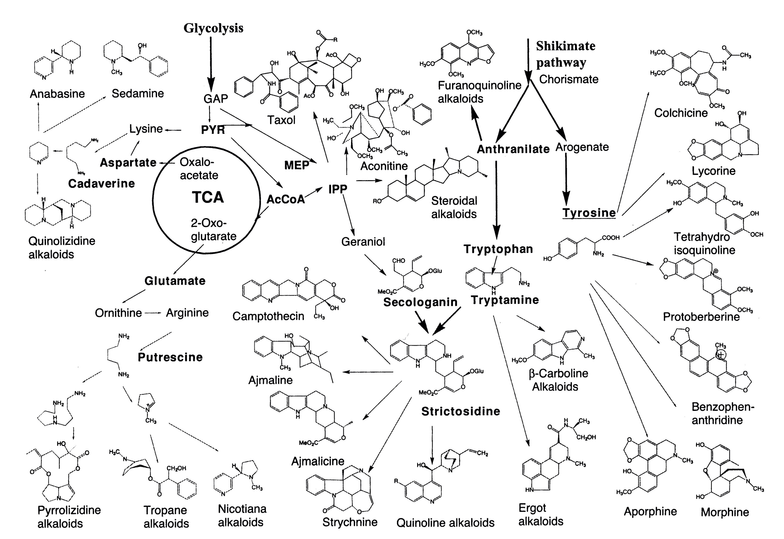
Overview of biosynthetic pathway of major groups of alkaloids

Slide 5
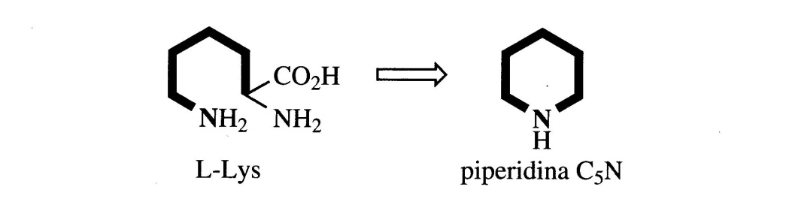
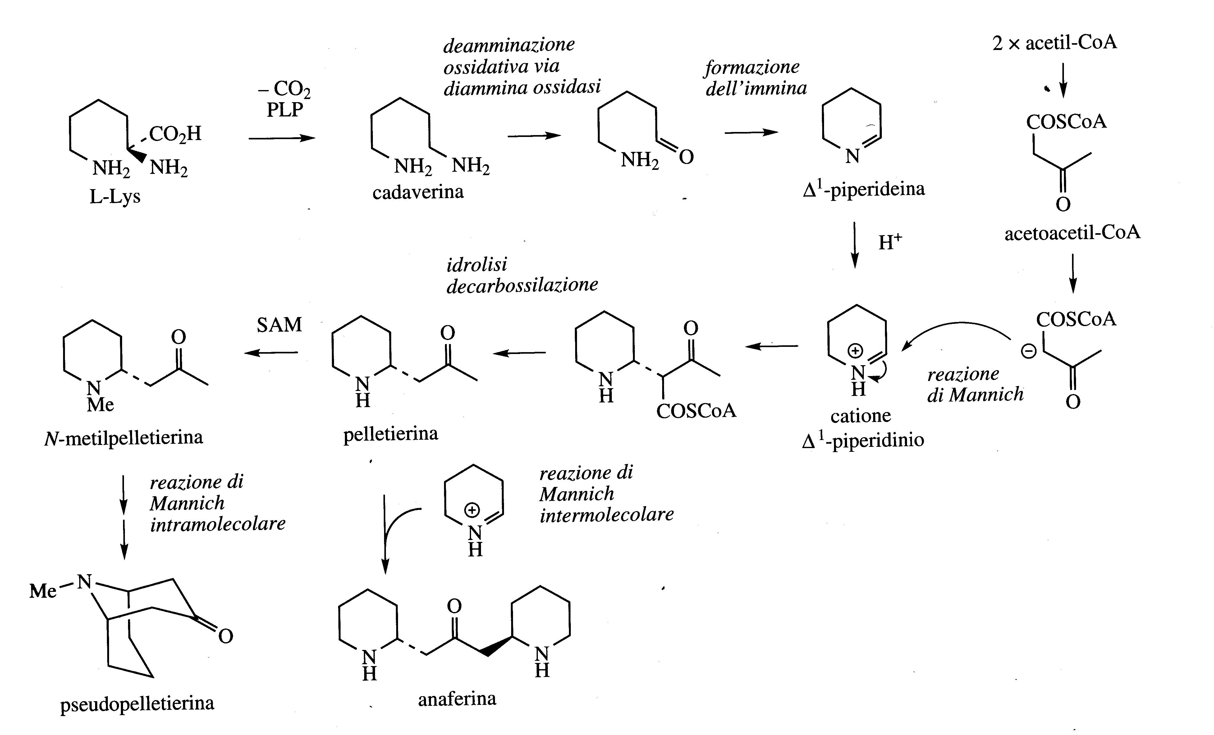
Lysine-derived Alkaloids
Lysine can also act as a precursor to alkaloids.
Similarly to Ornithine, a six-membered ring of the C₅N type will form.
Pelletierine, N-methylpelletierine and pseudo-pelletierine are alkaloids isolated from pomegranate bark (Punica granatum, Punicaceae).
This mixture has tenifugal activity.

Slide 6
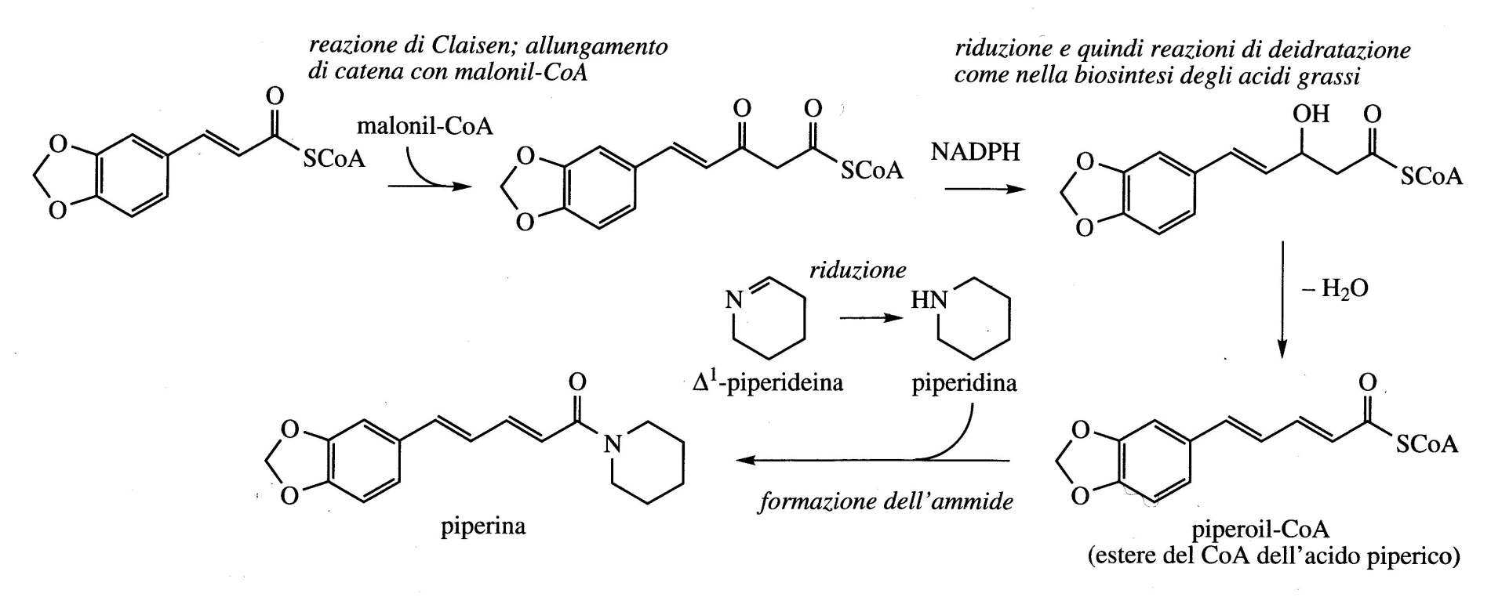
The spicy taste of black pepper fruits (Piper nigrum; Piperaceae) is mainly due to the piperidine alkaloid Piperine.
The name of the piperidine heterocyclic ring derives from the piperine molecule of the pepper plant.
Piperine, which derives from the reduction of piperideine forms a tertiary amide with piperoyl-CoA.
This originates from cinnamoyl-CoA through a series of chain-extension reactions via acetate/malonate.

Slide 7
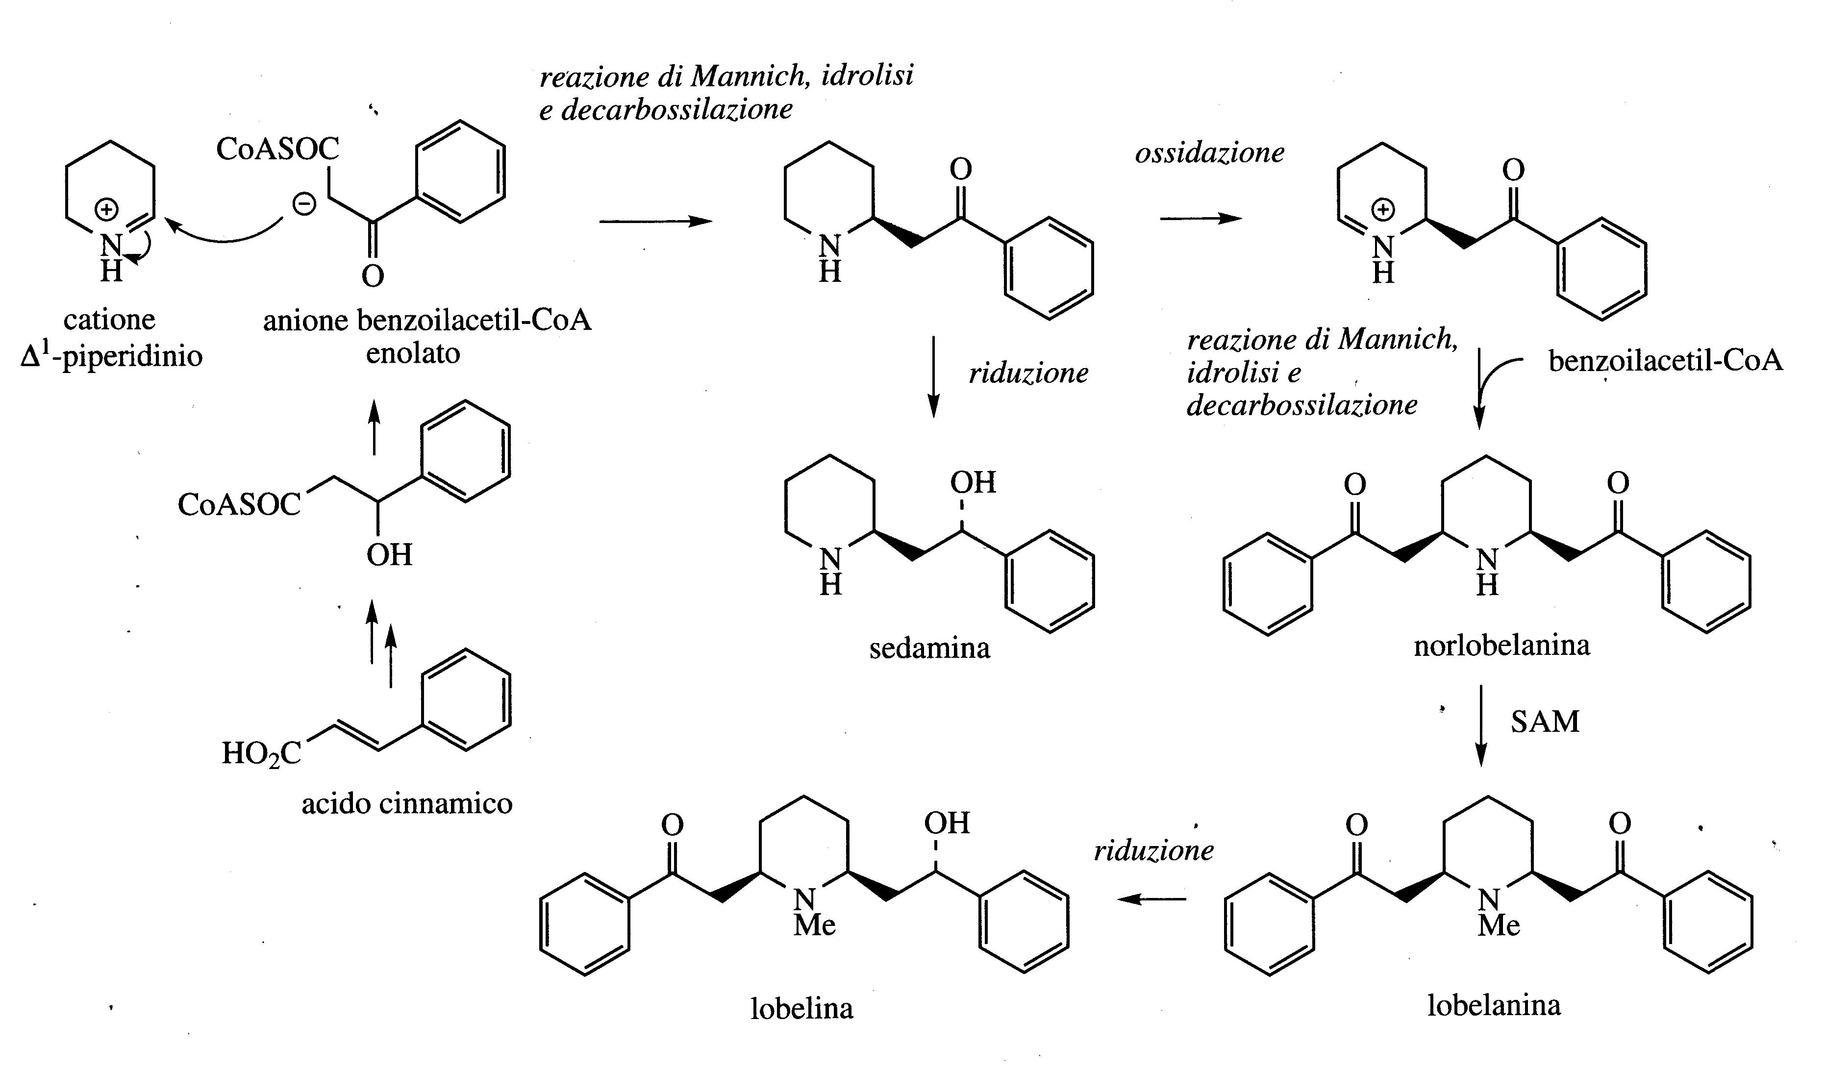
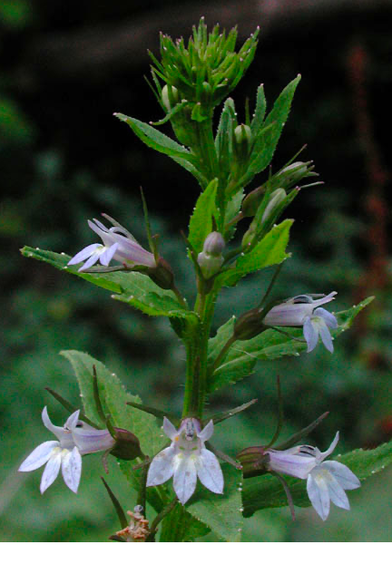
The alkaloids Lobeline and Lobelanine that derive from the plant Lobelia inflata (Crassulaceae) have anti-asthmatic action and contain piperidine rings with side chains that derive from phenylalanine via cinnamic acid.
Lobeline stimulates the nicotinic receptors of the endogenous neurotransmitter acetylcholine similarly to nicotine but with a weaker effect.
For this reason, it is has used as an adjuvant remedy in detoxification from tobacco use (also to treat methamphetamine abuse).
Lobelia inflata

Slide 8
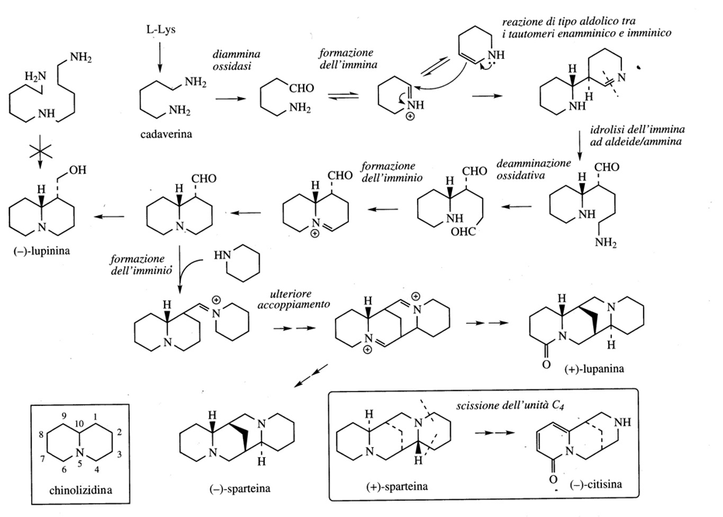
Quinolizidinide Alkaloids
Quinolizidine alkaloids are mainly found in plants of the Leguminosae family.
They are toxic for herbivorous animals.

Slide 9
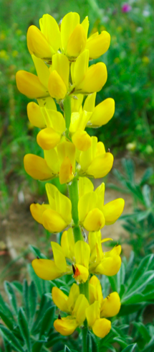
Lupinus luteus
Lupinine (Lupinus luteus) is formed from two molecules of lysine while Lupanine and Sparteine, which is the main alkaloid of broom, are formed by the incorporation of a third molecule of lysine.
The "sweet lupins" have a low alkaloid content compared to the "bitter" varieties and are grown for their protein content.

Slide 10
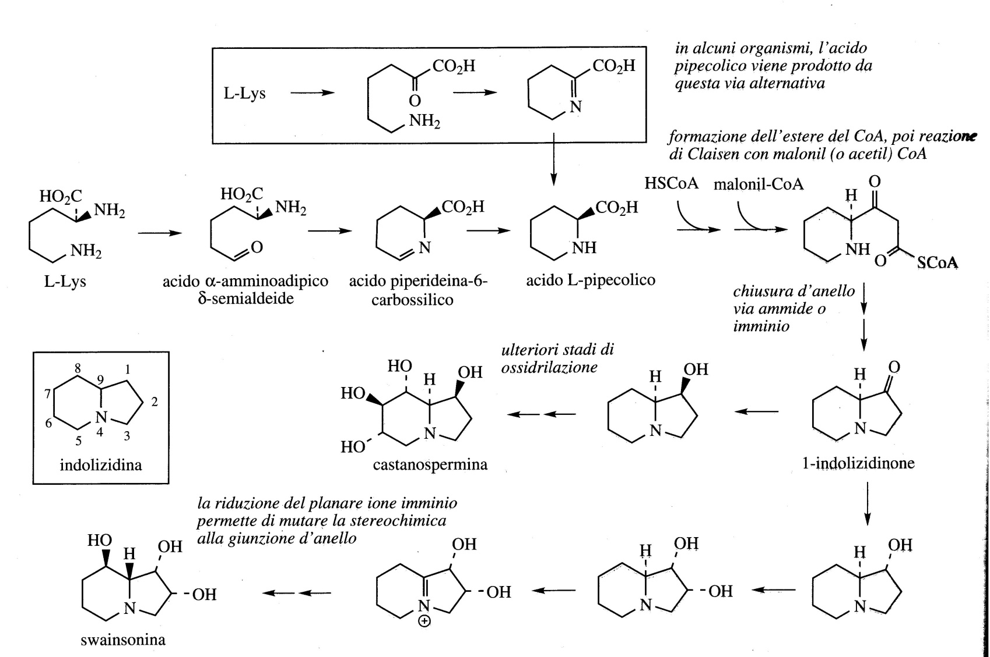
Indolizidine Alkaloids
Indolizidine alkaloids are characterized by five- and six-membered fused rings with a nitrogen atom at one of the joining positions.
Although derived from lysine, their biosynthetic pathway is different from the common alkaloids derived from this amino acid because L-Pipecolic acid is the main intermediate.

Slide 11
Indolizidine Alkaloids
The most important compounds are:
Swainsonine (Swainsona canescens, Leguminosae/Fabaceae) Castanospermine (Castanospermum australe; Leguminosae/Fabaceae).

Slide 12
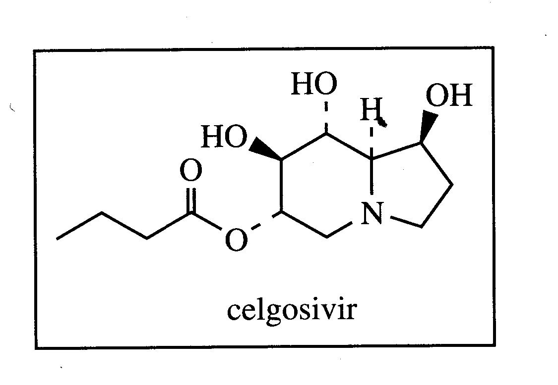
6-O-butanoil-castanospermine
The ester 6-O-butanoil-castanospermine Celgosiviris is an oral prodrug of the natural product castanospermine.
Celgosivir, in preclinical studies for the treatment of hepatitis C virus (HCV) infection.
It inhibits the glycosidase enzymes that plays a critical role in viral maturation by initiating the processing of the N-linked oligosaccharides of viral envelope glycoproteins.
The antiviral mechanism of action against many enveloped viruses, including dengue virus (DENV), HIV, influenza and hepatitis C virus, is believed to be mediated by inducing misfolding of viral N-linked glycoproteins through inhibition of host endoplasmic reticulum-resident α-glucosidases enzymes.
SARS-CoV-2-induced cell death and reduced viral replication and Spike protein levels in a dose-dependent manner in culture with Vero E6 cells.
This leads to reduced secretion and/or infectivity of virions and hence lower viral titres, both in vitro and in vivo.

Slide 13
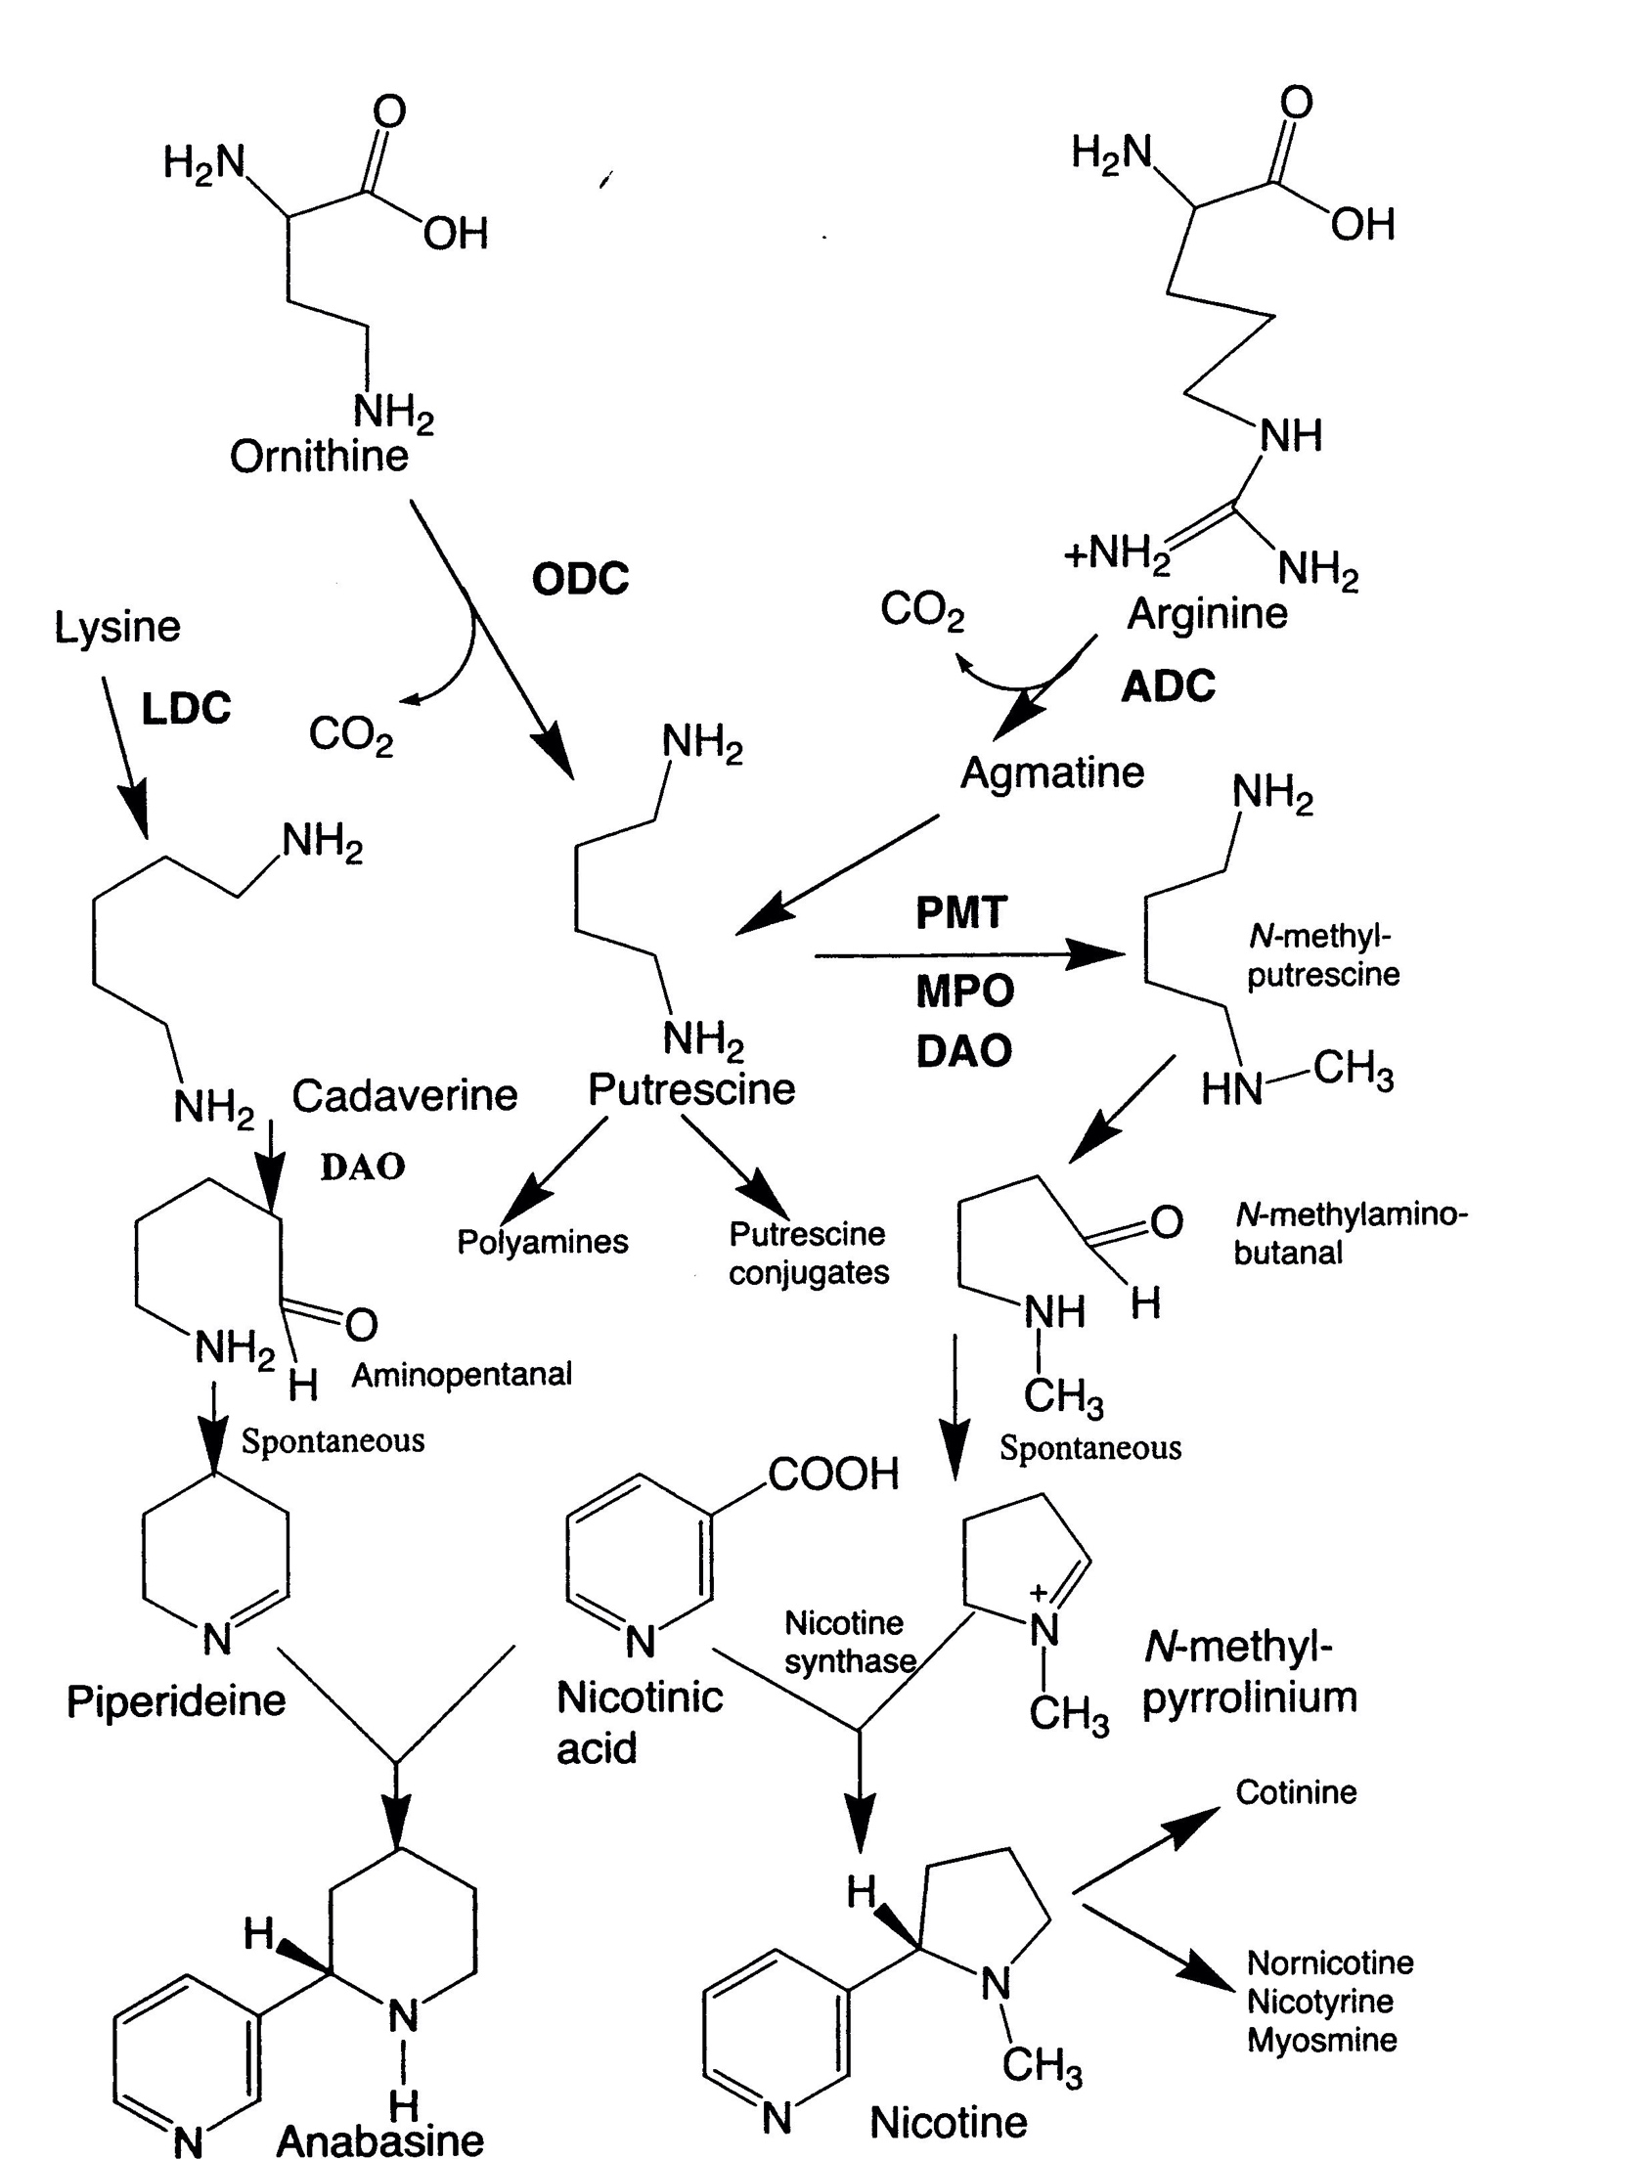
Putrescine is produced by the decarboxylation of either ornithine or arginine, as a result of the activities of either ornithine (ODC) or arginine decarboxylase (ADC).
Putrescine is used in the biosynthesis of the polyamines, spermine and spermidine.
The conversion of putrescine to N-methylputrescine is the first step for the synthesis of alkaloids containning pirrolidine and tropane cycle.
N-methyl-pyrrolium is formed spontaneously after the oxidative deamination of N-methylputrescine to N-methylamino-butanal.
N-methyl-pyrrolium is condensed with an intermediate derived by the decarboxylation of nicotinic acid.
The enzymes involved are:
(i) N-methyltransferase (PMT);
(ii) N-methylputrescine oxidase (MPO);
(iii) nicotine synthase.

Slide 14
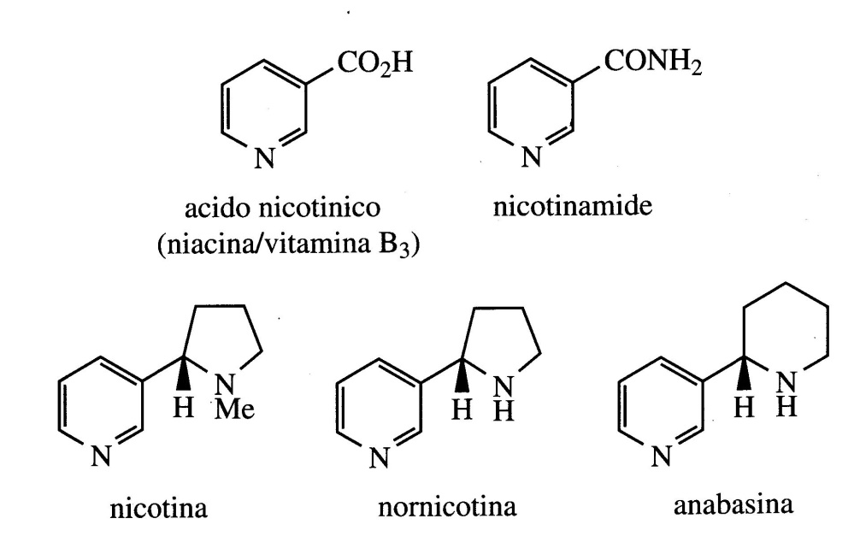
Alkaloids derived from Nicotinic acid
Alkaloids derived from nicotinic acid are pyridine alkaloids.
The most important alkaloids of tobacco (Nicotiana tabacum) are Nicotine and Anabasine.
Anabasine contains a pyridine ring bonded to a piperidine ring (from lysine).
Nicotine contains a pyridine ring bonded to a pyrrolidine ring (from ornithine).
The nicotinic unit originates from Nicotinic acid (vitamine B3).
Nicotinic acid is synthesized from L-Tryptophan in mammals while plants use glyceraldehyde -3-phosphate and L-Aspartic acid as precursors.

Slide 15
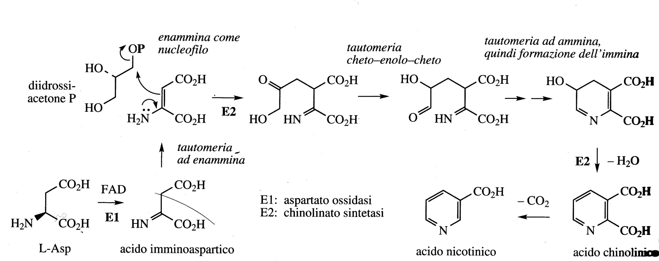

Slide 16
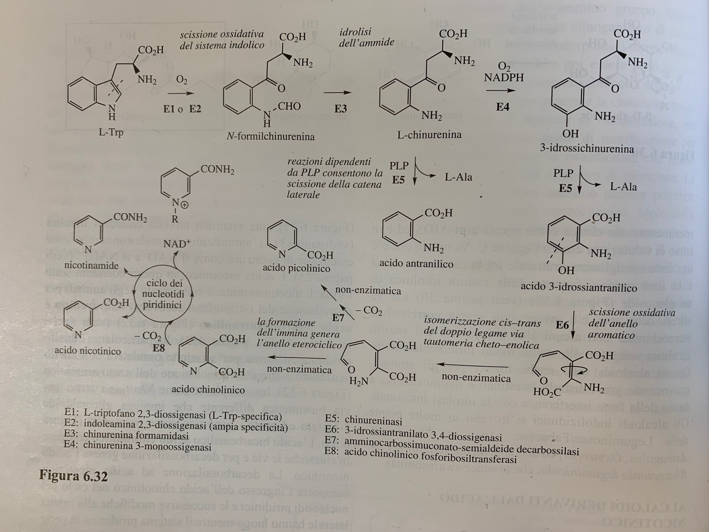

Slide 17
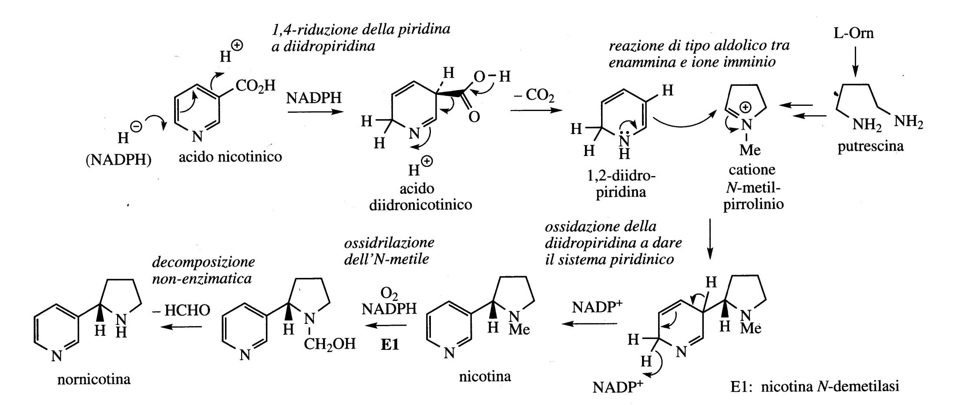
In nicotine biosynthesis, a pyrrolidine ring derived from ornithine, as the N-methyl- pyrrolinium cation is linked to the pyridine ring of nicotinic acid by replacing the carboxyl group.
Anabasin is produced from nicotinic acid and lysine via the piperidinium cation.

Slide 18
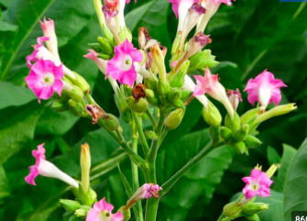
Nicotiana tabaccum
Tobacco is made from dried leaves of Nicotiana tabaccum an annual indigenous plant of tropical America, widely coltivated throughout the world to produce smoking tobacco.
The leaves can contain 0.6-9% of nicotine, which is the main alkaloid (about 93%) together with other small qualities of anabasine, anabatine and nornicotine. In leaves, alkaloids are normally present as salts with malic and citric acids.
Nicotine in small doses may act as a respiratory stimulant, but in large doses it induces respiratory depression.
Despite a large body of evidence linking it to cancer, smoking is highly prevalent and therefore tobacco remains one of the major crops.

Slide 19
Tobacco smoke contains more than 4000 chemical compounds, of which more than 60 are highly canecerogenous, formed by incomplete combustion.
Among these are polycyclic aromatic hydrocarbons such as benzopyrene, nitrosamines, aromatic amines, aldehydes and other volatile compounds.
Smoking tobacco is an addictive habit, unlike other addictive drugs, however tobacco is legal and widely available.
Nicotine is given to smokers who want to quit smoking.
Powdered tobacco leaves have long been used as an insecticide, and nicotine has been used in both agricultural and horticultural purposes. Free base is much more toxic than its salts.
Although its insecticidal activity is very high, other substances that are safer for humans are now preferred.
Nicotine is toxic due to its effect on the nervous system which is represented by its interaction with the nicotinic acetylcholine receptors.
Recent studies also indicate that nicotine can improve the transmission of nerve impulses, which may explain the low incidence of Alzheimer's disease among smokers.
Any health benefits conferred by smoking are vastly outweighed by an increased risk of heart, lung disease as well as cancer.

Slide 20
Overview of biosynthetic pathway of major groups of alkaloids

Slide 21
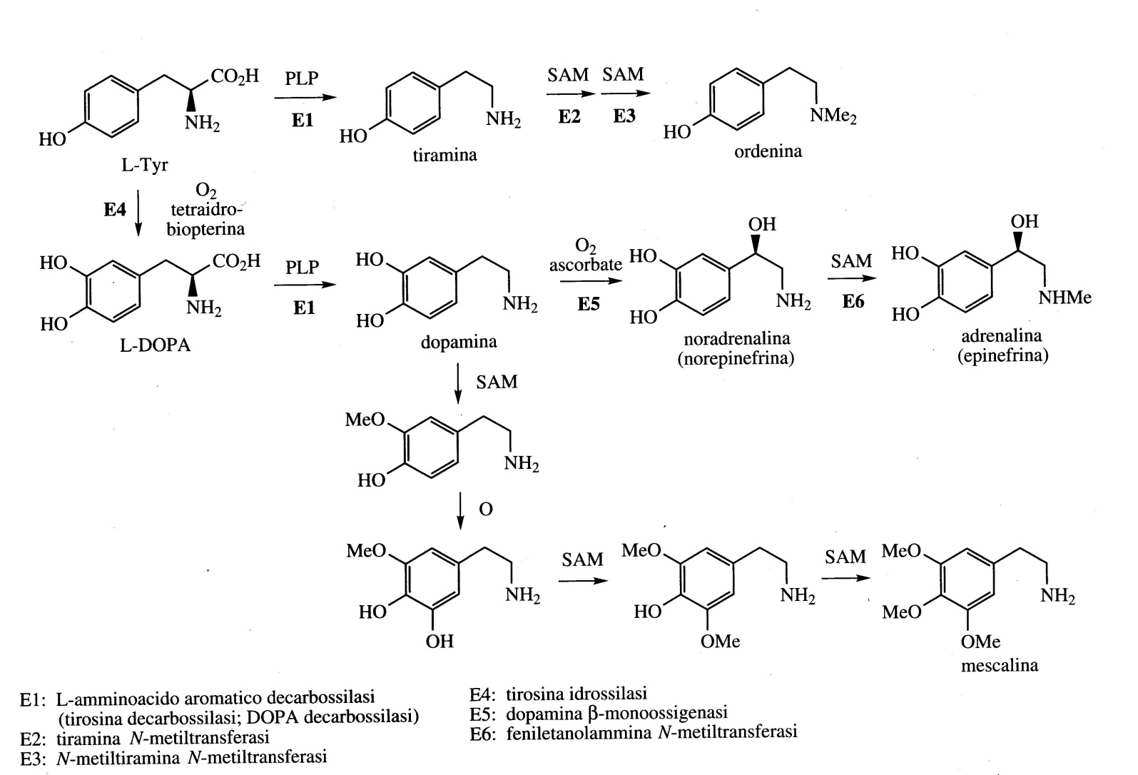
Alkaloids derived fromTyrosine
Phenylethylamines and simple Tetrahydroisoquinoline alkaloids
The PLP-dependent decarboxylation of L-Tyrosine gives the phenylethylamine derivative Tyramine which by double N-methylation gives Hordenine, an alkaloid isolated from barley which has germination inhibitory activity (Hordeum vulgare; Graminaceae/Poaceae).
The molecules with a phenylethylamine structure are formed starting from Dopamine, the decarboxylation product of L-Dopa (L-dihydroxyphenylalanine)

Slide 22
The most important derivatives in mammals are the Catecholamines (Noradrenaline, Adrenaline).
In the Cactus (Lophophora williamsii; Cactaceae), reactions of aromatic hydroxylation and O-methylation lead to the conversion of Dopamine into Mescaline, an alkaloid with psychotropic and hallucinogenic properties

Slide 23
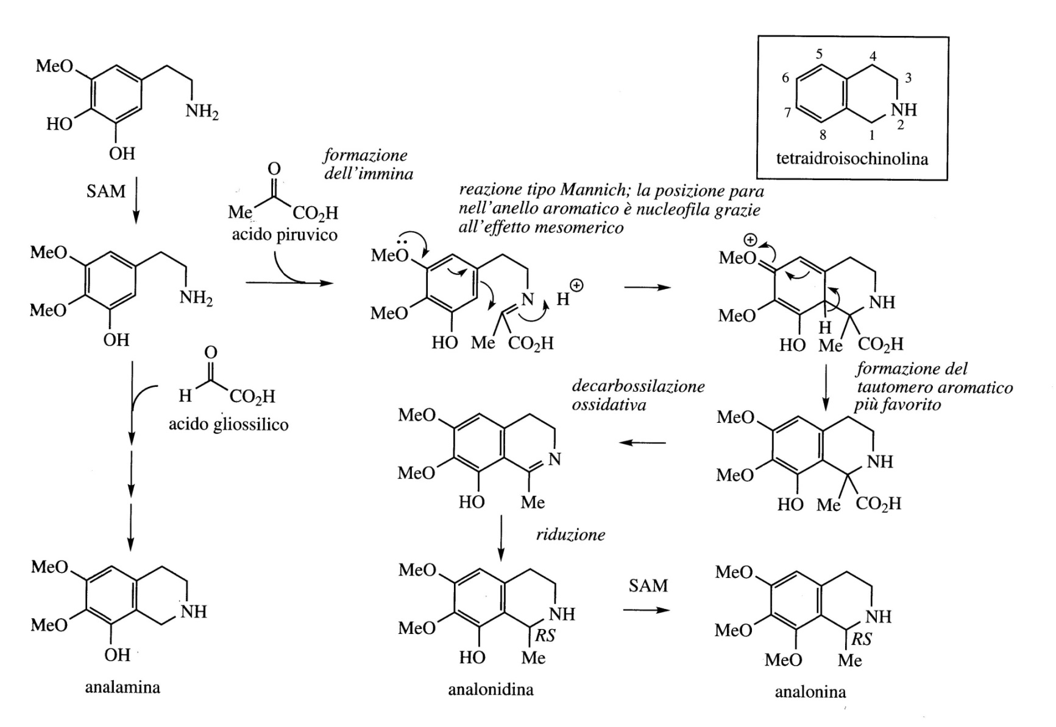
Tetrahydroquinoline alkaloids
Alkaloids isolated from the same natural source and closely related to mescaline are Analamine, Analonine and Analonidine which are classified as tetrahydroisoquinoline alkaloids

Slide 24
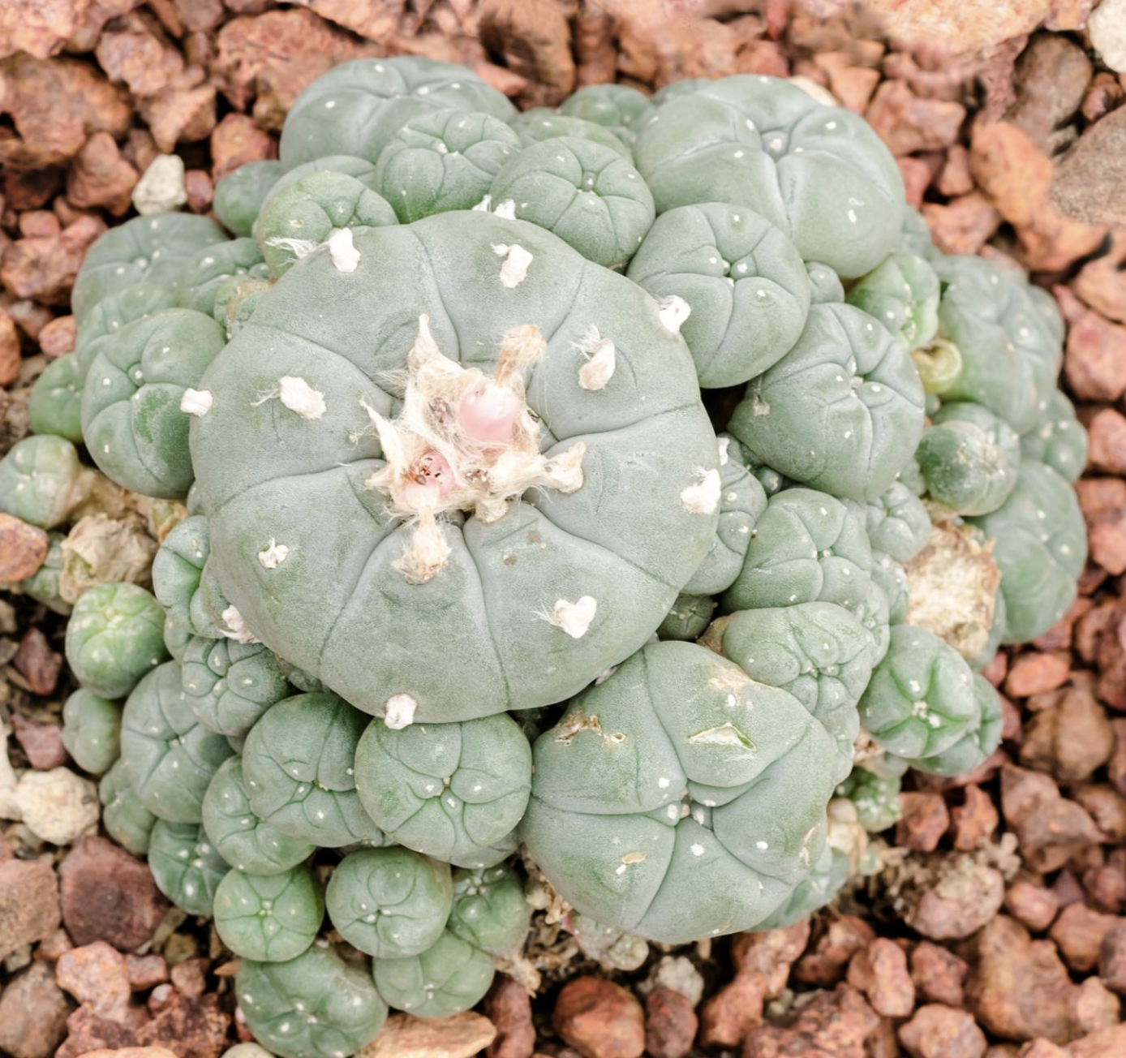
Peyote consists of cut and dried parts of the cactus Lophophora williamsii (Cactaceae).
It is a small cactus native of Mexico and the South Western part of the United States. The plant has been used by the Aztecs and then by the Mexican Indians for many years especially in religious ceremonies, to produce hallucinations and establish contact with the gods.
The so-called «mescal buttons» were ingested giving psychotropic and hallucinogenic effects.
In dried «mescal buttons»there is a total of 8-9% alkaloids, of which the most active is mescaline, a phenylethylamine derivative.
Lophophora williamsii

