Slide 1
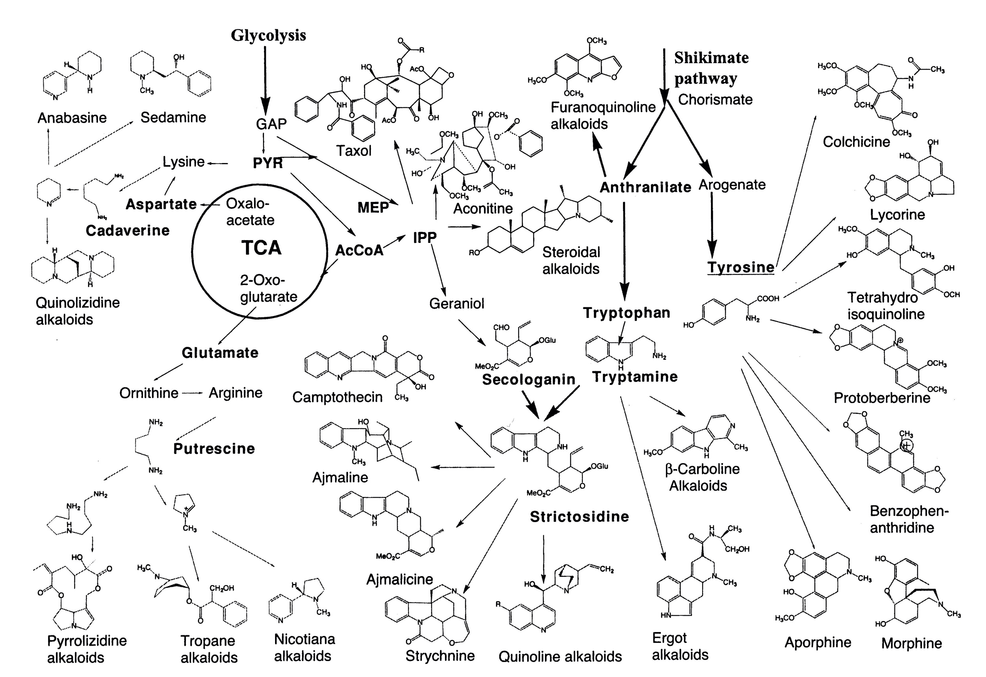
Overview of biosynthetic pathway of major groups of alkaloids

Slide 2
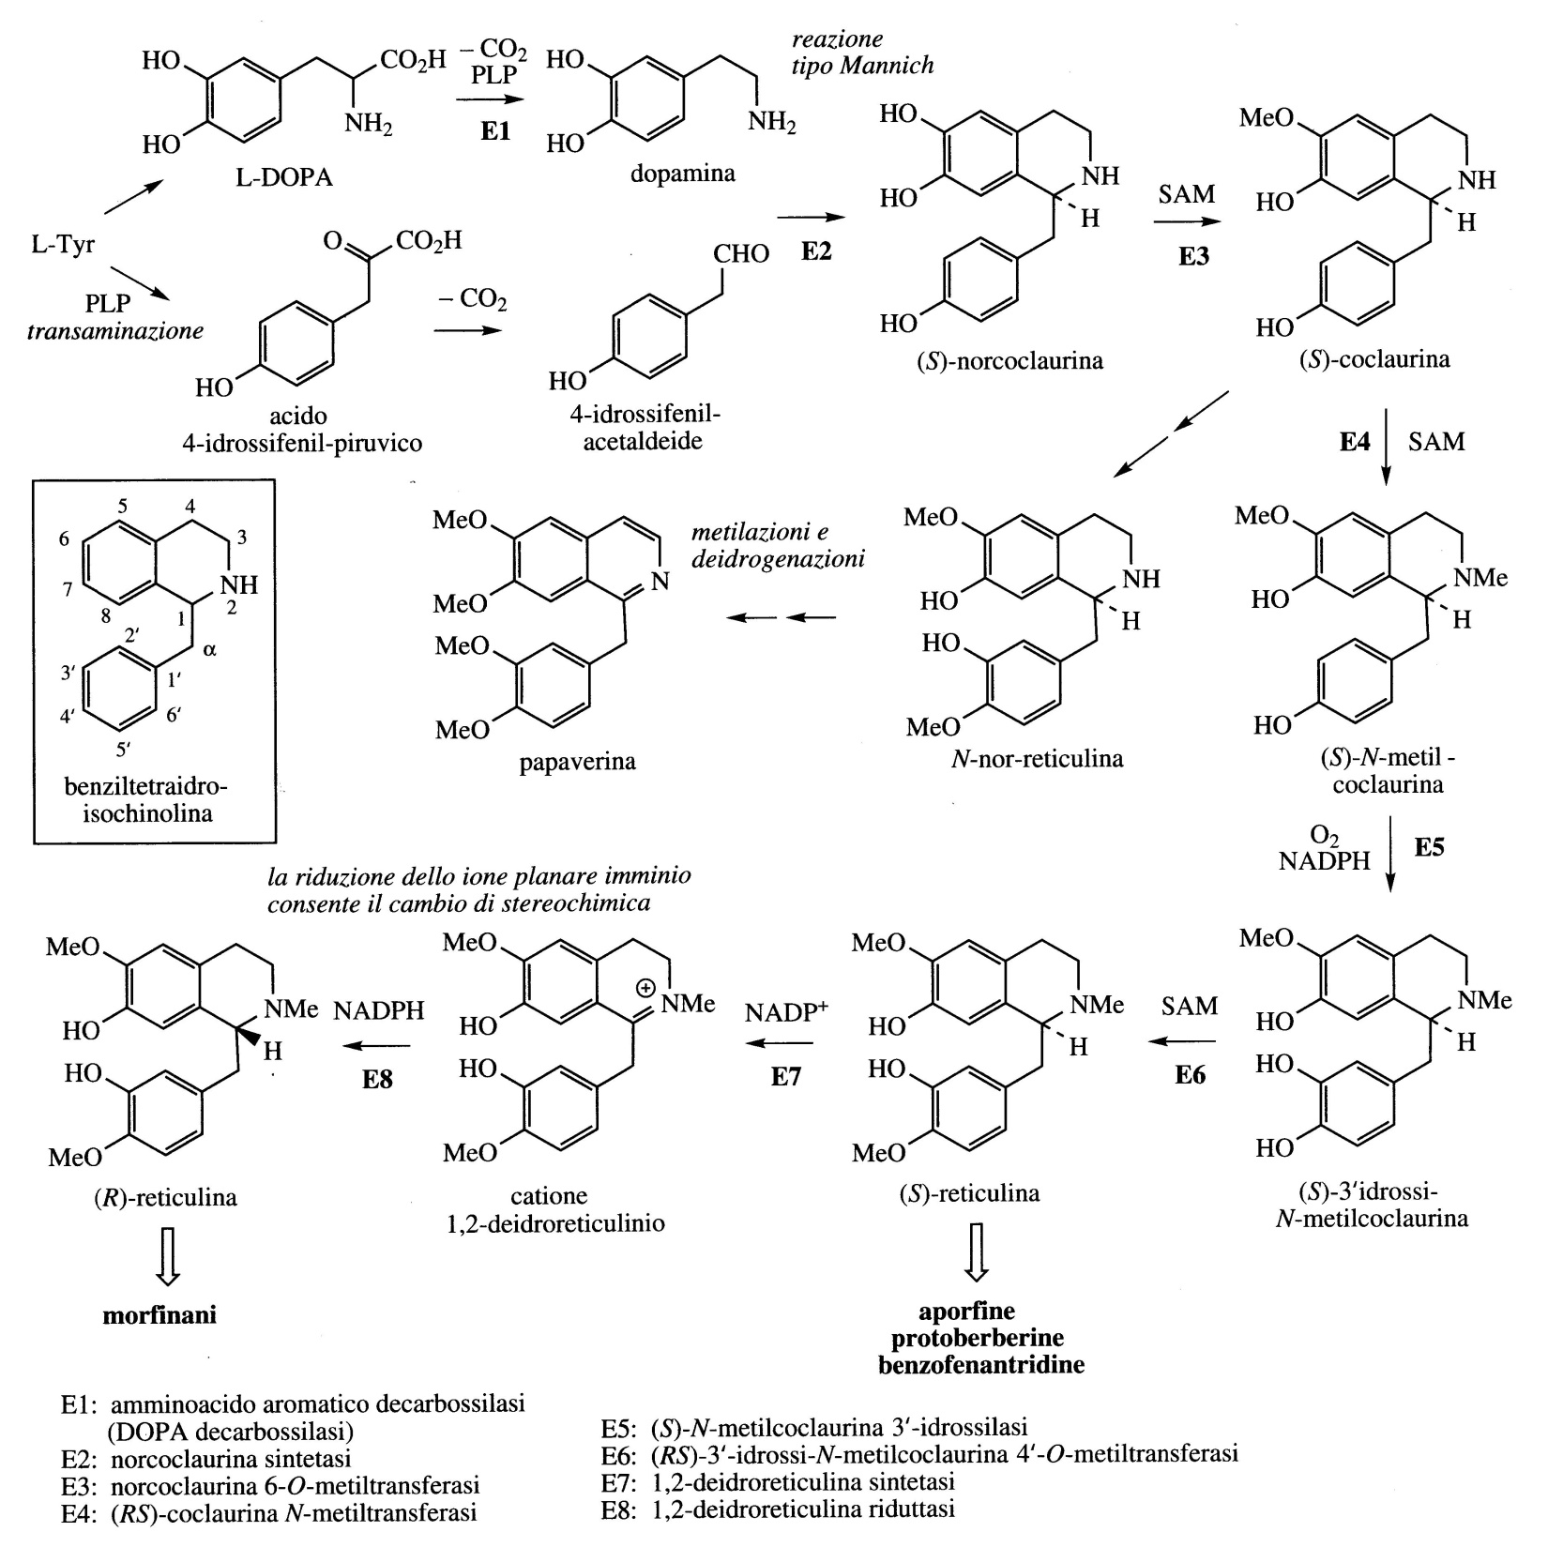
In benzyltetrahydroisoquinoline alkaloids, although two molecules of tyrosine are used in biosynthesis, it is only the phenylethylamine fragment of the tetrahydroisoquinoline system that is formed from L-DOPA (L-dihydroxyphenylalanine), while the other carbons are derived from tyrosine via 4-hydroxyphenylpyruvic acid and 4-hydroxyphenylacetaldehyde.
By successive reactions, S-Reticulin and R-Reticulin are obtained, fundamental intermediates for the synthesis of several alkaloids.
Some alkaloids, such as the opiates Morphine, Codeine and Thebaine are synthetised starting from R-Reticulin and not from its S isomer.

Slide 3
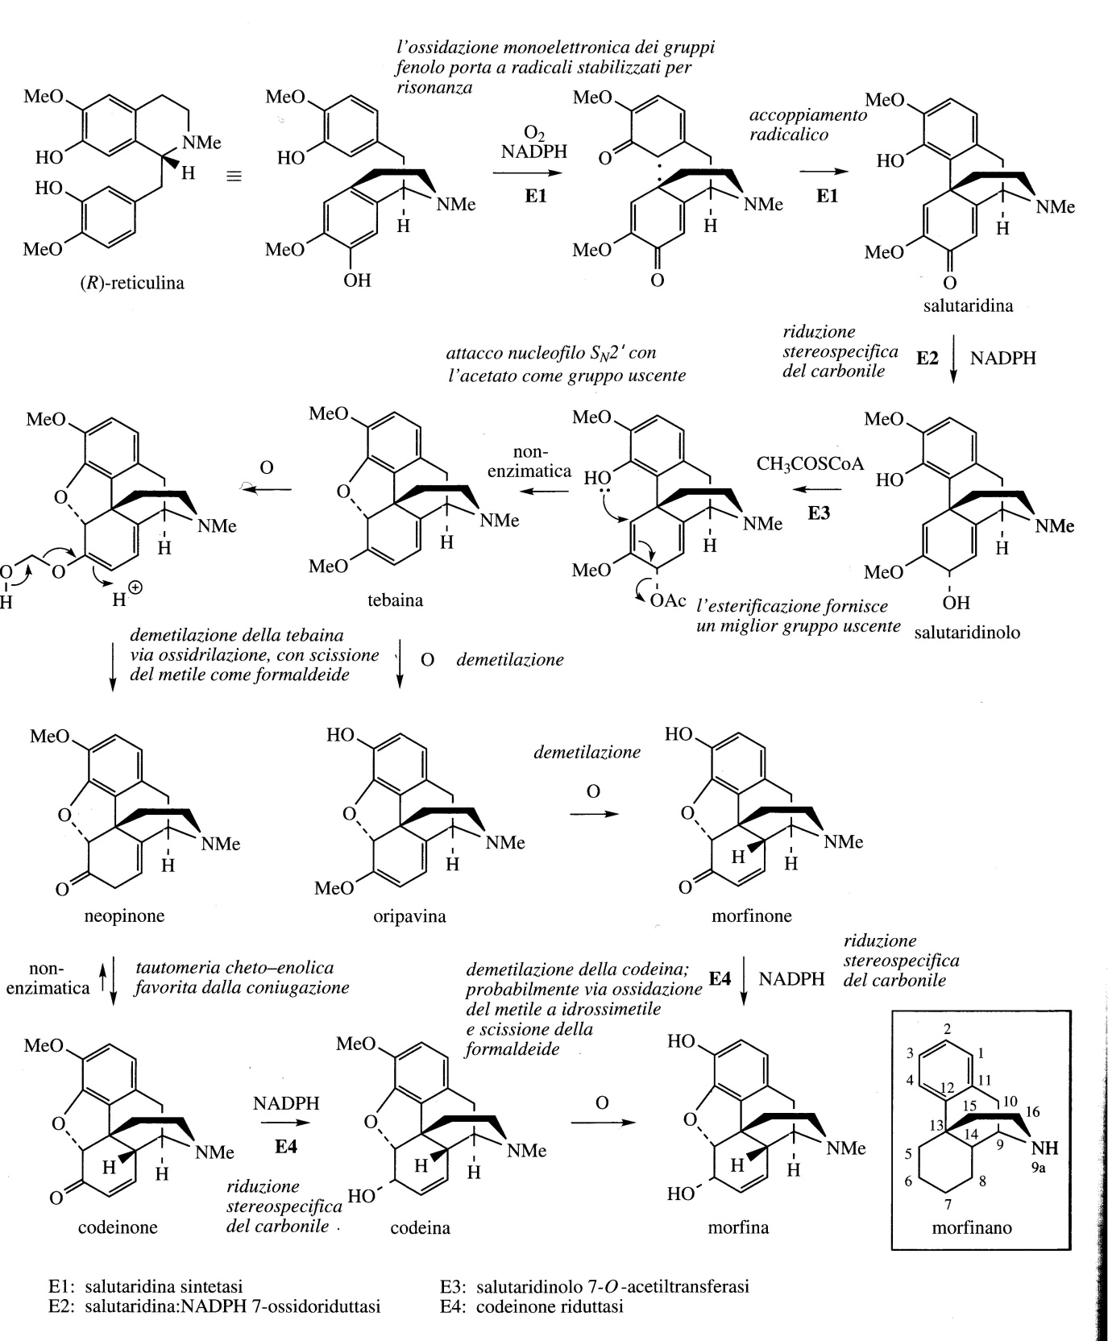
The main alkaloids of opium (Morphine, Codeine, Thebaine) have a benzyltetrahydroquinoline origin and carbon-carbon bonds are formed between the aromatic rings.
R-Reticulin is the precursor of these morphine alkaloids.
The reactions that involve the conversion of thebaine into codeine and from this into morphine modify the oxidation state of the diene ring and two O-methyl groups are removed.

Slide 4
Papaver sominiferum (Papaveraceae)
Opium is the latex obtained by incision of the immature capsules of the opium poppy. The plant is an annual shrub with various colored flowers.
For opium production, the maturing capsules that are just changing color from blue-green to yellow are incised. The rapidly oozing latex initially has a catty consistency and white color but quickly turns brown and forms a paste. This material is raw opium which is put into poppy leaves and dried.
Opium has been known and used for 4,000 years as an analgesic to induce sleep (narcotic) and to treat coughs.
25% of the mass of opium contains alkaloids. Of the 40 identified, the predominant part is given by morphine (4-21%), codeine (0.8-2.5%), thebaine (0.5-2%), papaverine (0.5-2.5%).
Morphine is a powerful narcotic analgesic and remains one of the best analgesics for relieving severe pain.

Slide 5
Codeine is the 3-O-methyl ether of morphine and is one of the most widely used opium alkaloids, it is produced by semi-synthesis from morphine.
It also acts as an analgesic but less potent and is partially demethylated in the liver (producing morphine) which gives it the morphine-like analgesic effects, without typical euphoria and addiction.
Thebaine is the starting point for other drugs.
Papaverine has spasmolytic and vasodilatory activity.
Papaveretum is a mixture of purified opium alkaloids present as acid chlorides and its current formulation contains morphine (85%), codeine (8%), papaverine (7%).
It is used as an analgesic during operations. It can be combined with al hyoscine, an antisecretory tropane alkaloid.

Slide 6
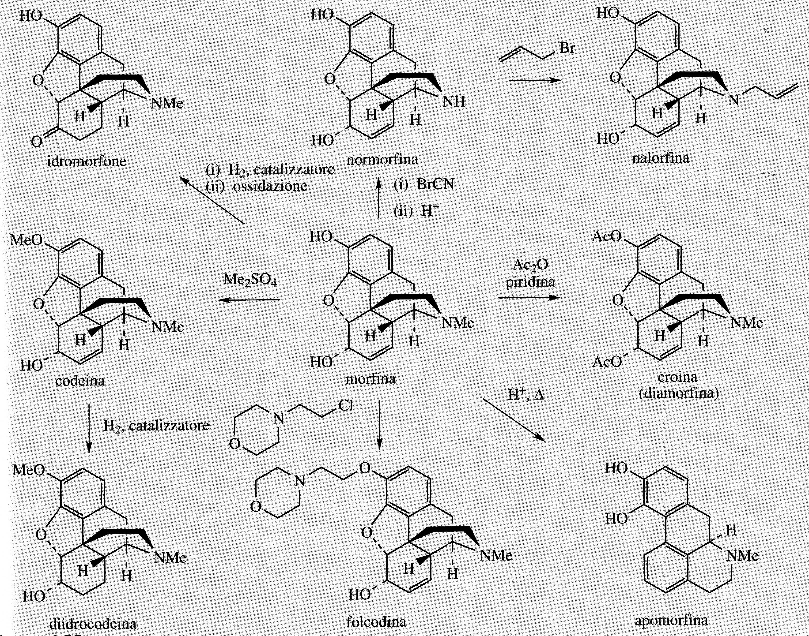
Pharmaceutical research has developed a large series of semi-synthetic or fully synthetic derivatives of morphine, called opioids. They have analgesic and narcotic properties similar to morphine.
Diamorphine or heroin is the diacetyl derivative of morphine

Slide 7
In benzyltetrahydroisoquinoline alkaloids, although two molecules of tyrosine are used in biosynthesis, it is only the phenylethylamine fragment of the tetrahydroisoquinoline system that is formed from L-DOPA (L-dihydroxyphenylalanine), while the other carbons are derived from tyrosine via 4-hydroxyphenylpyruvic acid and 4-hydroxyphenylacetaldehyde.
By successive reactions, S-Reticulin and R-Reticulin are obtained, fundamental intermediates for the synthesis of several alkaloids.
Some alkaloids, such as the opiates Morphine, Codeine and Thebaine are synthesized starting from R-Reticulin and not from its S isomer.

Slide 8
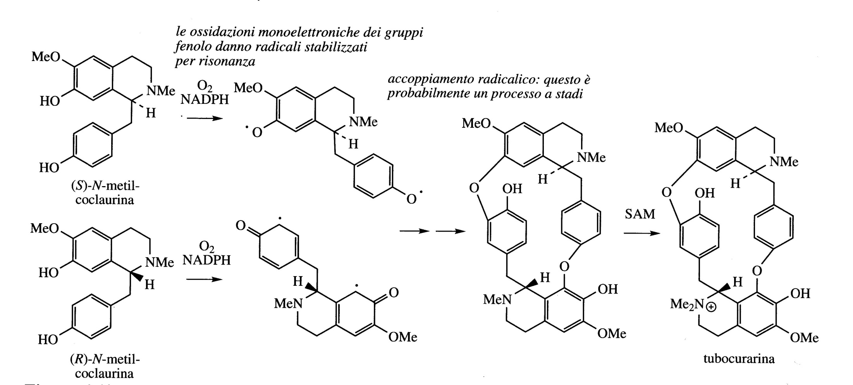
Tubocurarine is the main active component of Curare (Chondrodendrum tomentosus; Menispermaceae), a poison used to dip arrows by the Indians of South America.
It is produced by a coupling between a molecule (R) and one of (S)-N-Methylcoclaurine

Slide 9
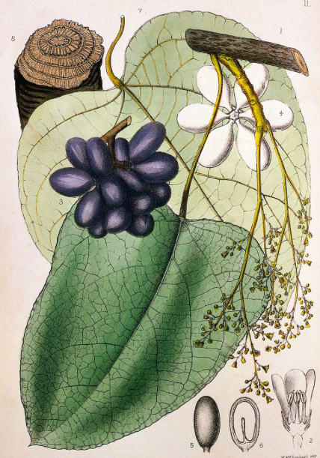
Curare is the poison with which the Indians of South America sprinkled their arrows.
It is a complex mixture that can contain up to 30 different substances.
The current sources of curare is Chondrodendrum tomentosus (Menispermaceae).
Curare causes death following paralysis, with flaccid relaxation of voluntary muscles. This result is achieved following the competition with the nicotinic acetylcholine receptor which causes the blockage of nerve impulses towards the neuromuscular junction.
Death occurs because the respiratory muscles stop working.
Curare has found medical use as a muscle relaxant, especially in surgical operations such as abdominal surgery, tonsillectomy.
The alkaloid content of curare ranges from 4 to 7% and the active component is tubocurarine. Due to the its limited availability, synthetic analogues of tubocurarine have been developed.
Chondrodendrum tomentosus (Menispermaceae)

Slide 10
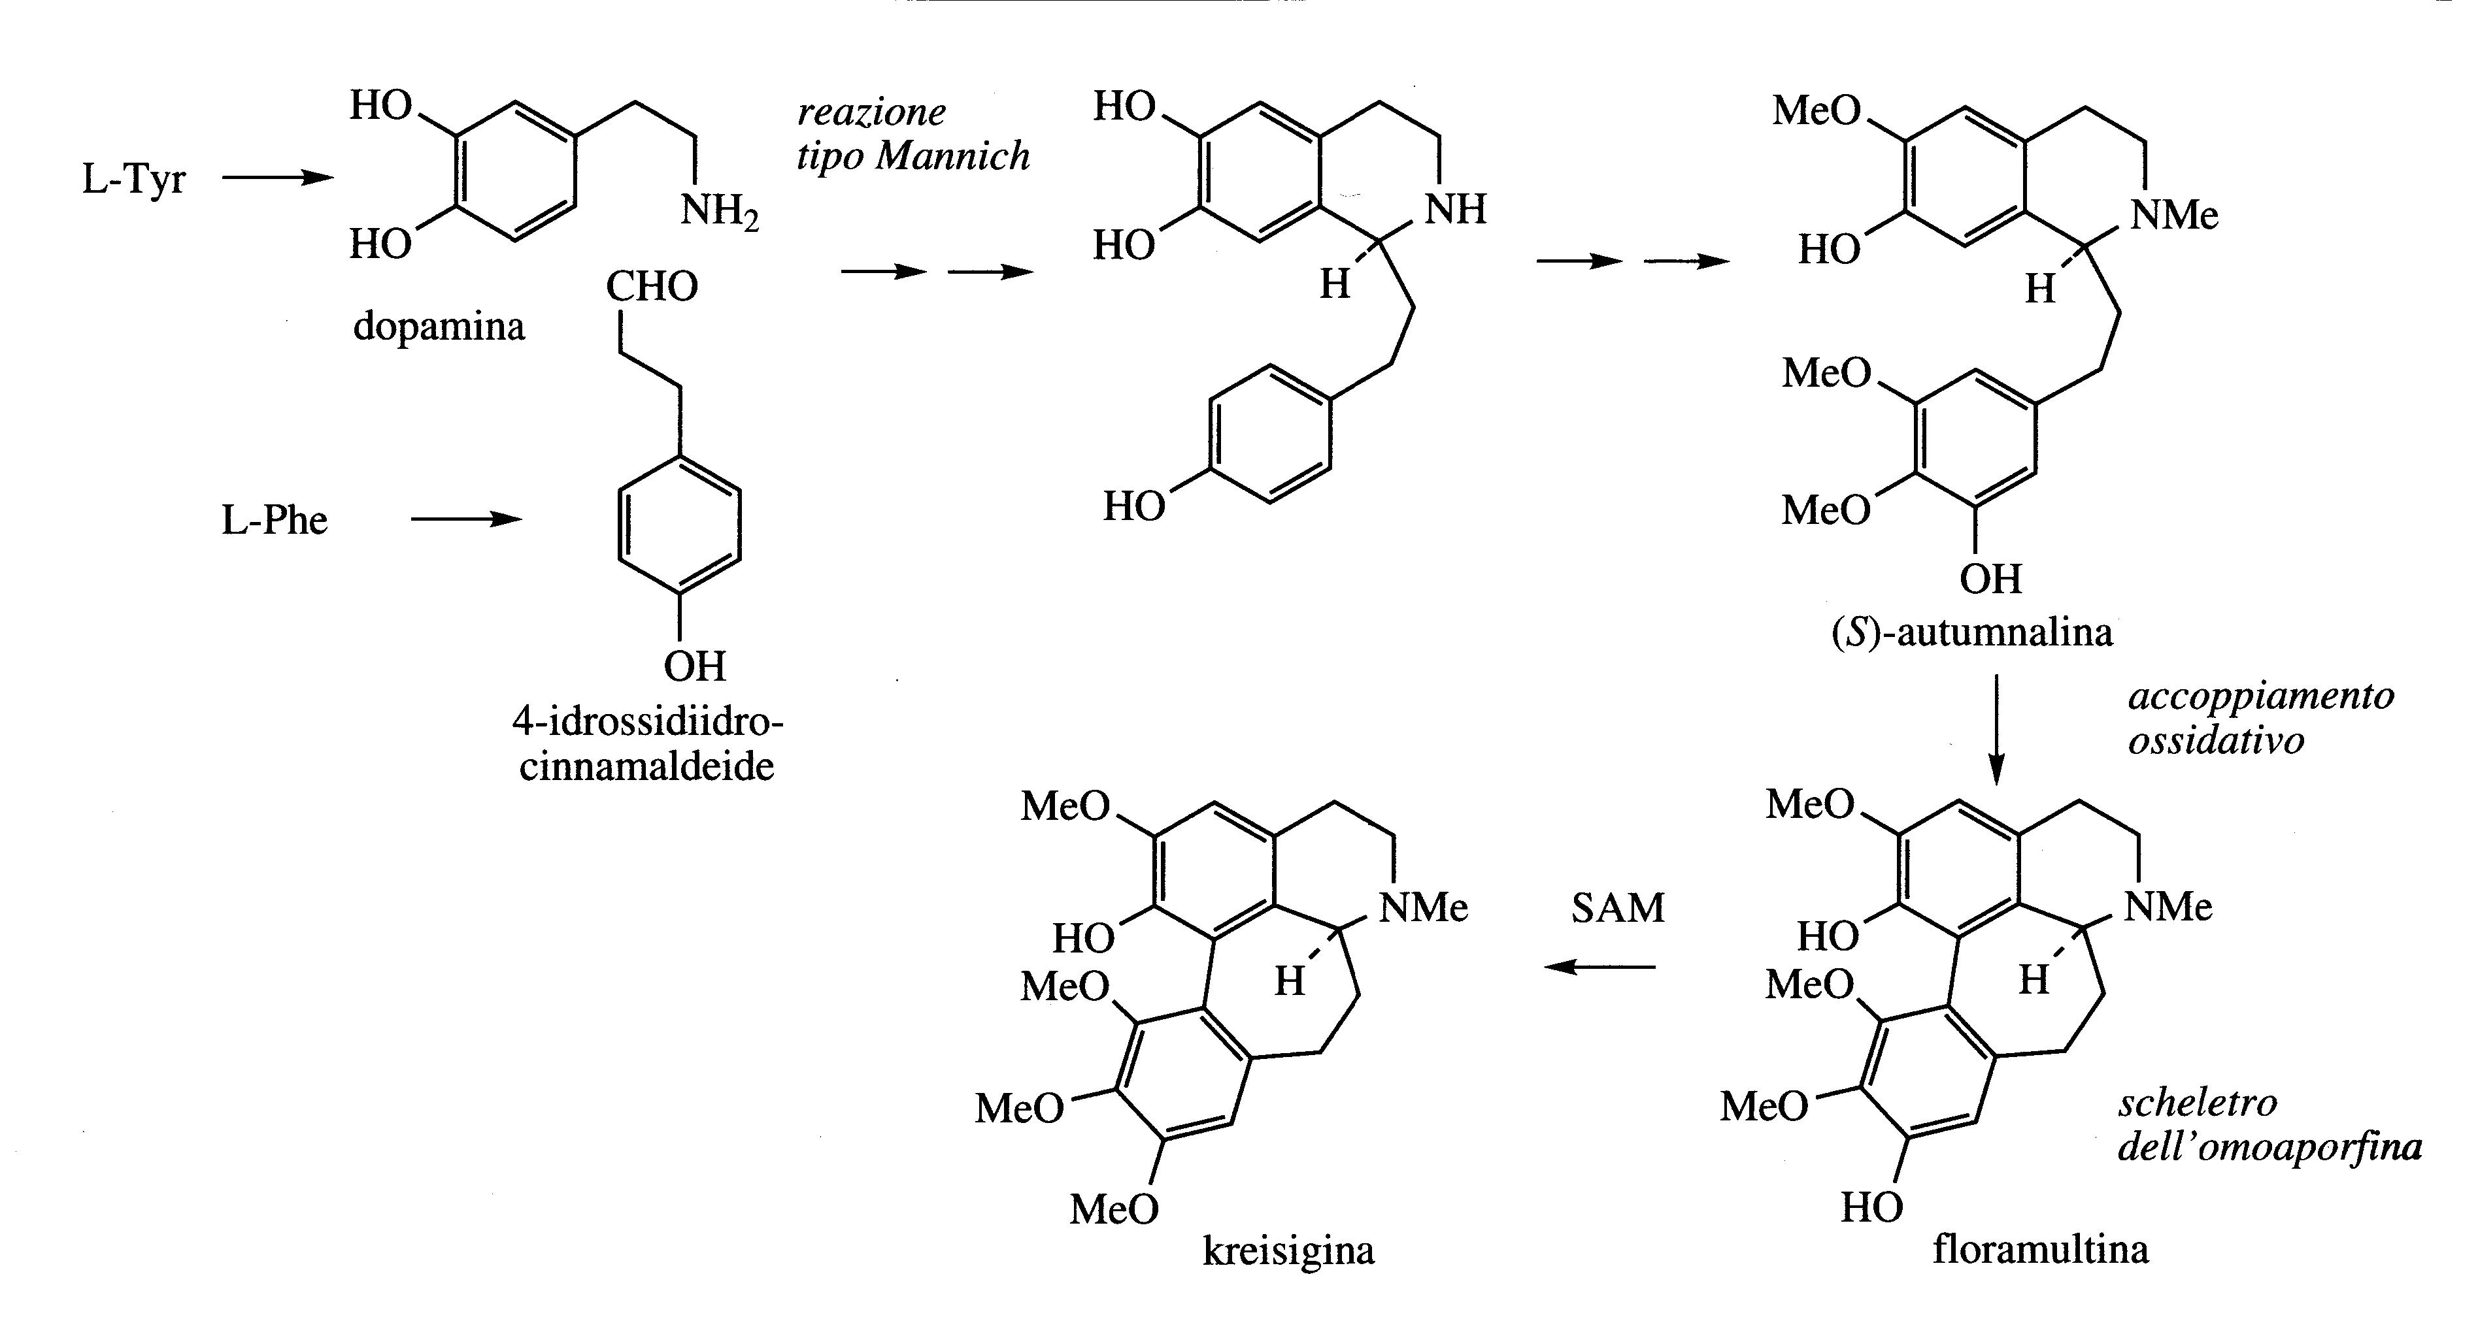
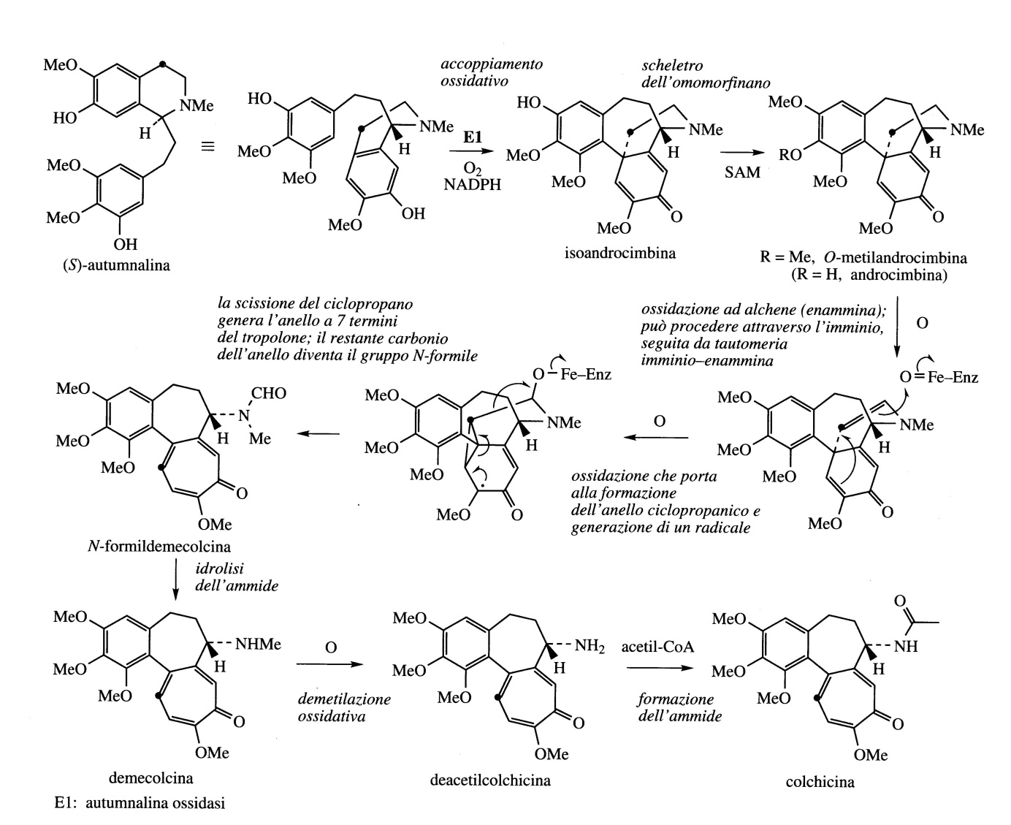
L-Tyr
S-Autumnaline
L-Phe
S- autumnaline is the
precursor of colchicine

Slide 11
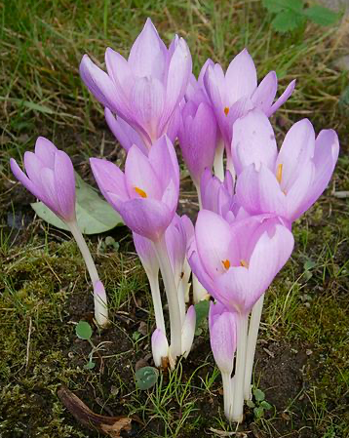
Colchicum seeds and bulbs are obtained from Colchicum autumnale (Liliaceae/Colchicaceae) called autumn crocus or field saffron.
It is native to Europe, widely cultivated as an ornamental garden plant and also for pharmaceutical purposes.
The main alkaloid is Colchicine, present in the seed (0.8%) and bulb (0.5%). Colchicine nitrogen is part of an amide function so it is not basic.
The extracts of Colchicum autumnale are used in the treatment of gout, defects in purine metabolism lead to the overproduction of uric acid which precipitates in crystalline form in the joints. Colchicine is used for acute attacks but its strong toxicity excludes its frequent use.
Colchicine does not interfere with uric acid metabolism and its action is anti-inflammatory only. Other drugs that have a therapeutic effect based on intervention in the uric acid metabolite are inhibitors of the enzyme xanthine oxidase (allopurinol).
Colchicum autumnale

Slide 12
Colchicine and the alkaloids connected to it have stimulated various essays to evaluate their use as anticancer drugs but these molecules were found to be too toxic.
Colchicine binds to Tubulin of the mitotic spindle preventing its polymerization and the assembly of microtubules with a mechanism similar to Podophyllotoxin and Vincristine.
Several non-toxic derivatives are under investigations. Docking modeling studies are also used to generate new molecules which are able to bind at the colchicine site of tubulin.

Slide 13
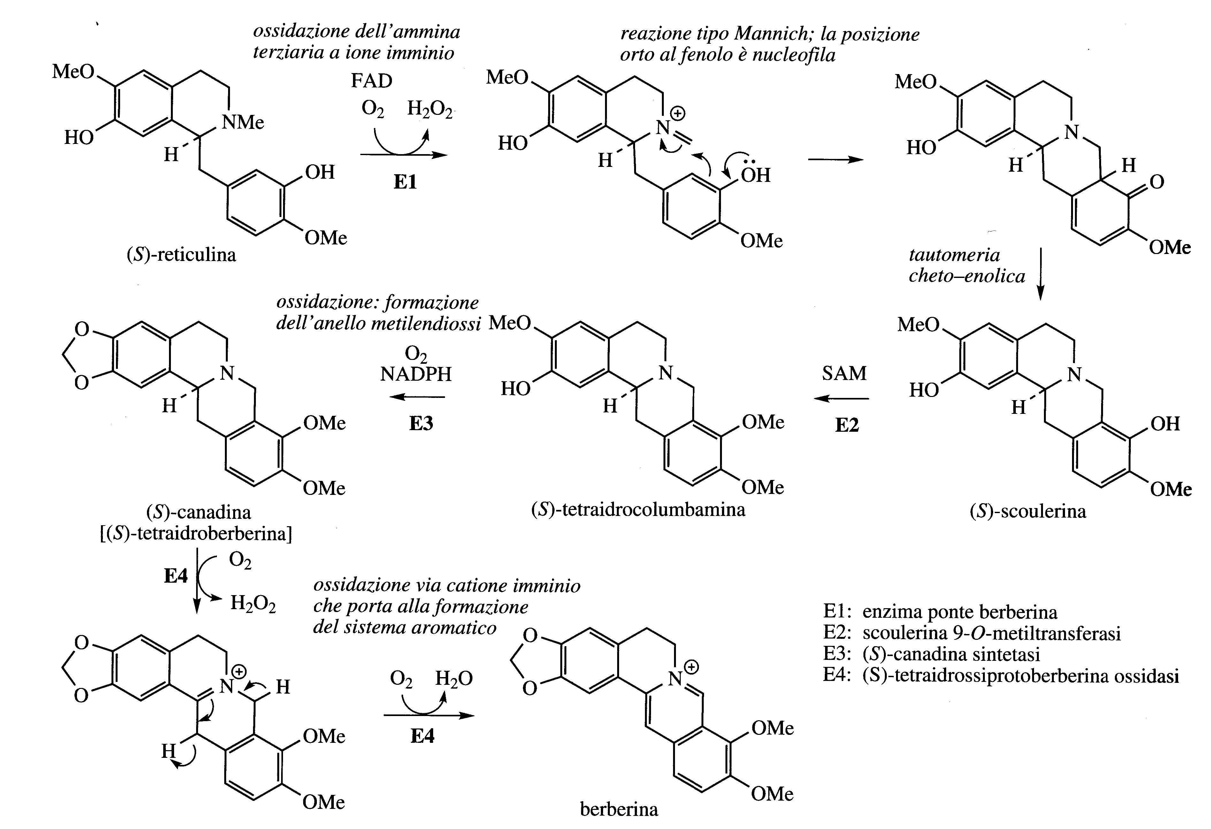
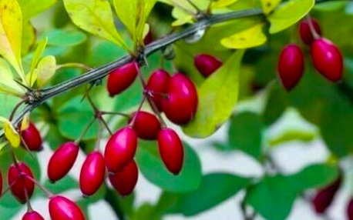
Berberis vulgaris
The alkaloid berberine has been isolated in many plants of the Berberidaceae (e.g. Berberis, Mahonia) Ranunculaceae (Hydrastis) and others.
Berberine has antibacterial and anti-inflammatory, anti-oxidant properties and the plants that contain it have long been used in traditional medicine.

