Slide 1
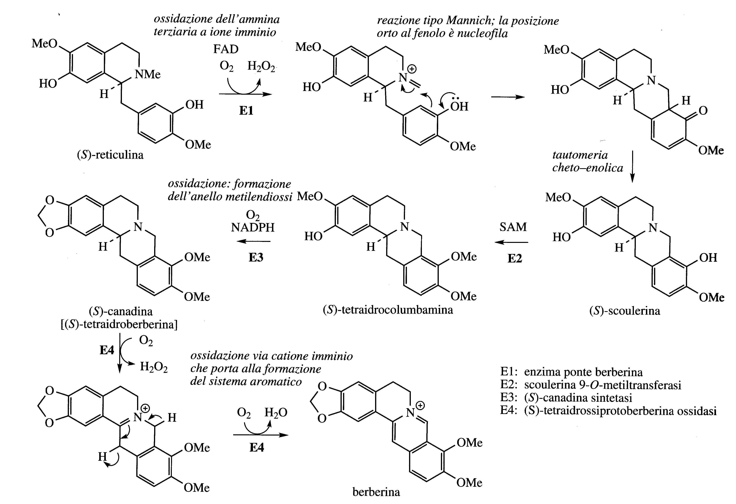
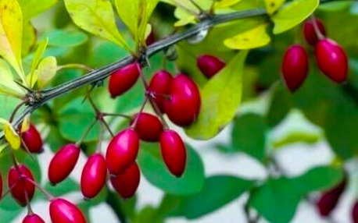
Berberis vulgaris
The alkaloid berberine has been isolated in many plants of the Berberidaceae (e.g. Berberis, Mahonia) Ranunculaceae (Hydrastis) and others.
Berberine has antibacterial and anti-inflammatory, anti-oxidant properties and the plants that contain it have long been used in traditional medicine.

Slide 3
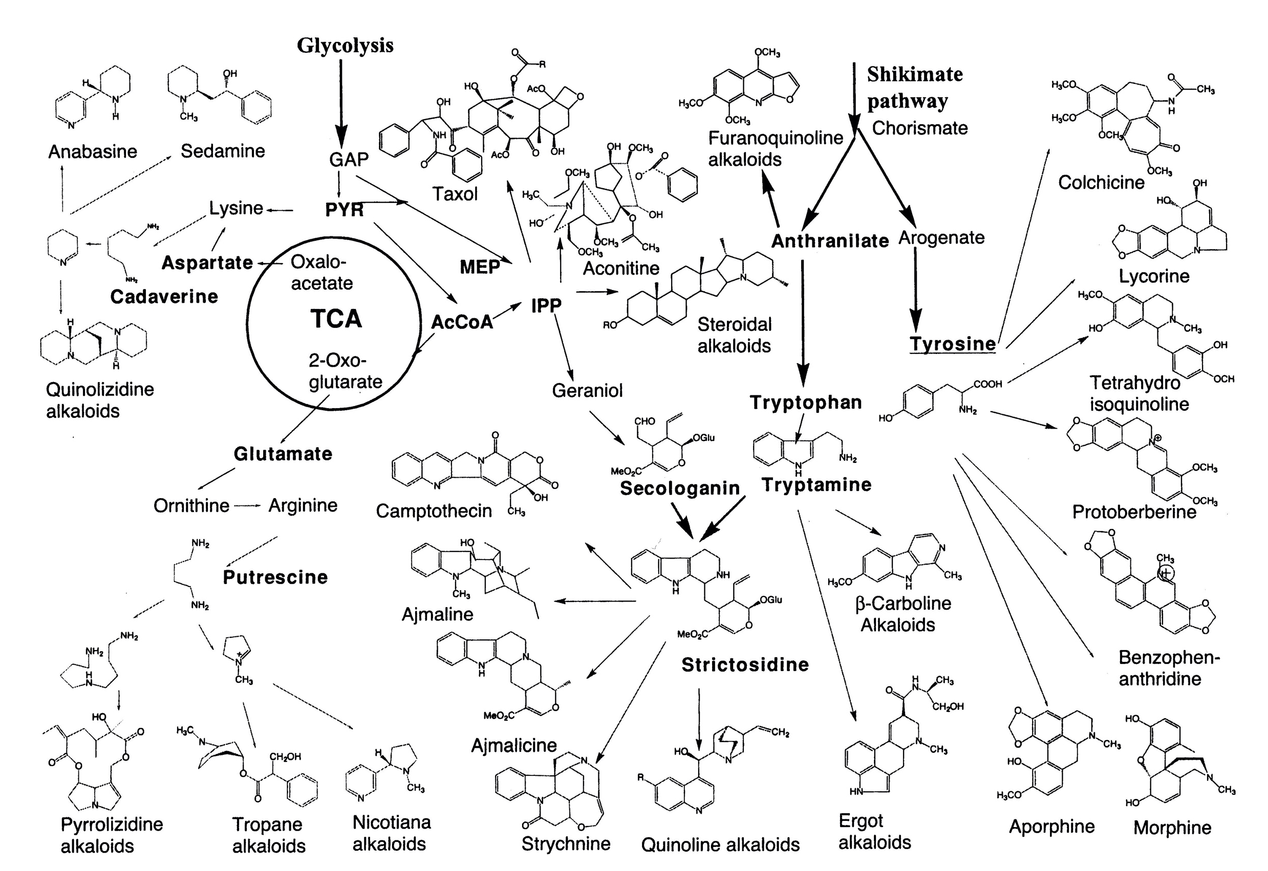
Overview of biosynthetic pathway of major groups of alkaloids

Slide 4
Alkaloids derived from Tryptophan

Slide 7
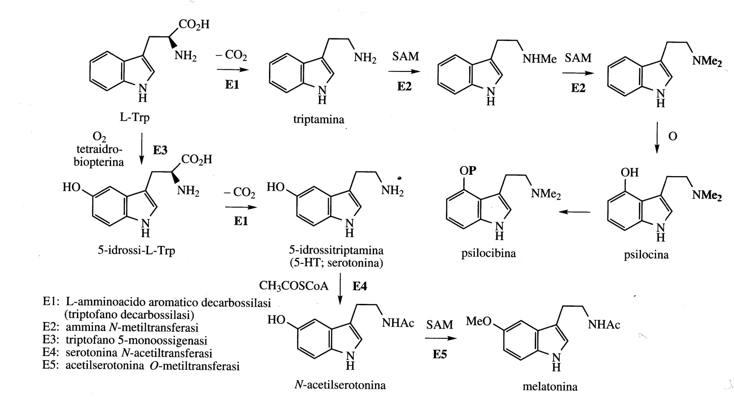
Simple indole alkaloids
Tryptamine and its N-methyl and N,N-dimethyl derivatives are widely distributed in plants, as well as hydroxylated derivatives such as 5-hydroxytryptamine (5-HT, Serotonin).
N-acetylation of Serotonin followed by O-methylation leads to Melatonin, an animal hormone that regulates circadian rhythms. Melatonin is found even in some plants (even if the function is unknown)

Slide 8
Simple indole alkaloids
From Tryptophan are also formed Psilocin and Psilocybin which are responsible for the hallucinogenic properties of the so-called "magic mushrooms”.
The Psylocybe genus includes a group of small mushrooms distributed throughout the world. Expecially the Mexican species have hallucinogenic activity. More than 80 species have shown psychotropic properties.

Slide 9
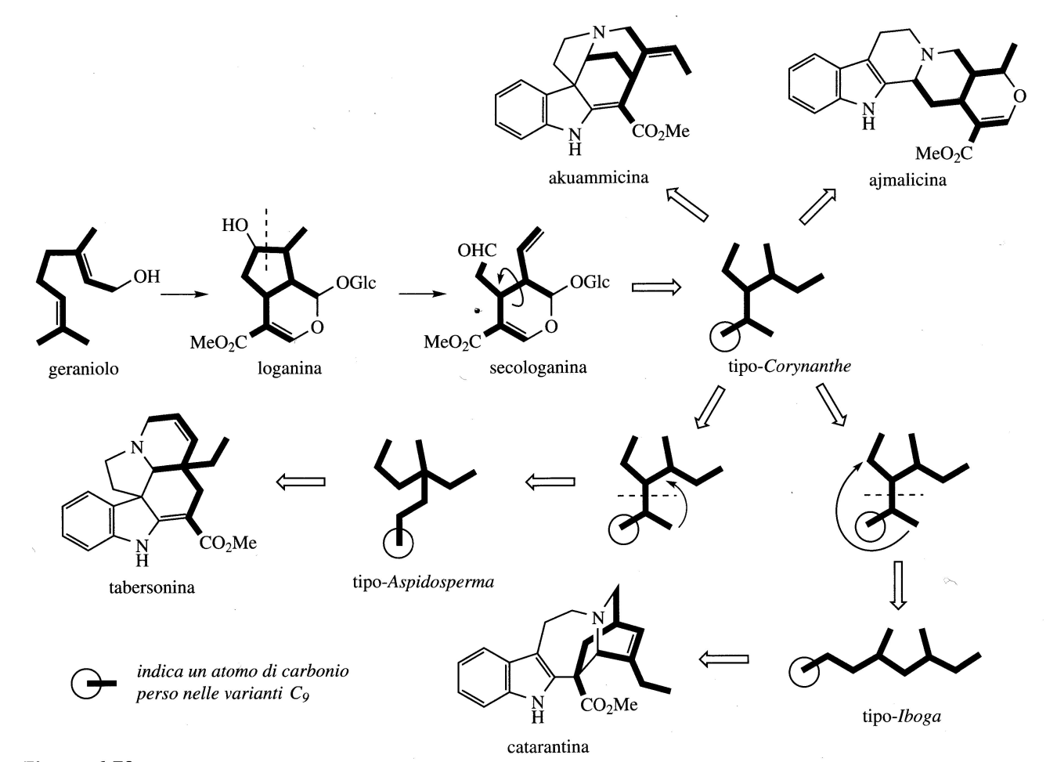
Indole terpenoid alkaloids
More than 3000 indole alkaloids have been isolated which incorporate a terpenoid moiety.
This class of alkaloids is one of the most represented in plants.
In all the structures there is a Tryptamine moiety and a C9 or C10 fragment.
The C9 or C10 fragment is of terpenoid origin and the Secologanin is the derivative which combines with the tryptamine portion of the molecule

Slide 10
Indole terpenoid alkaloids
Three categories:
Coryanthe class, to which Ajmalecina and Akuammicina belong;
Aspidosperma class, to which Tabersonina belongs;
Iboga class to which Catarantina belongs.

Slide 11
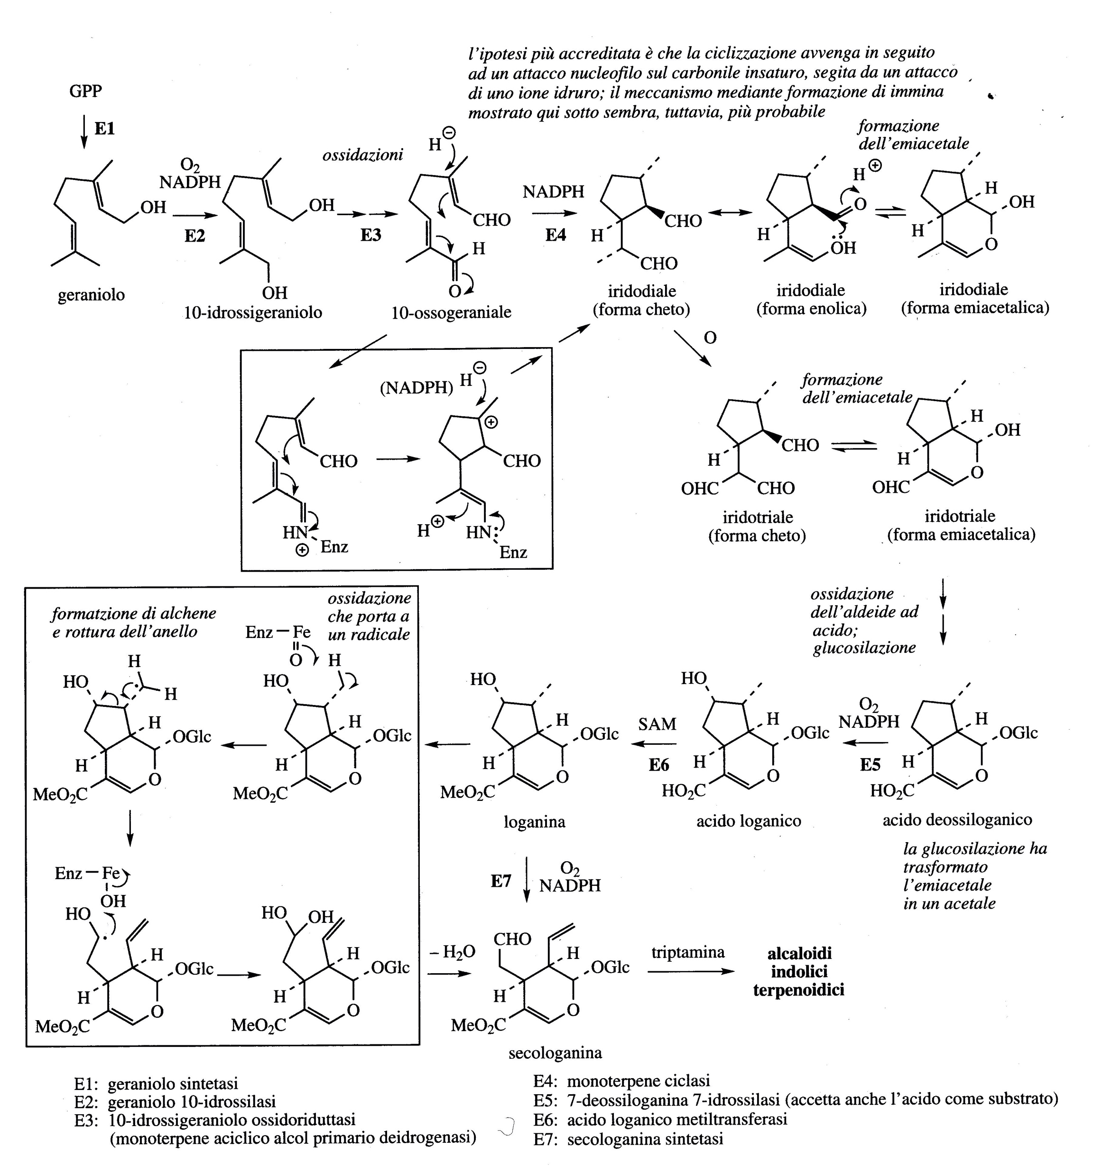

Slide 12
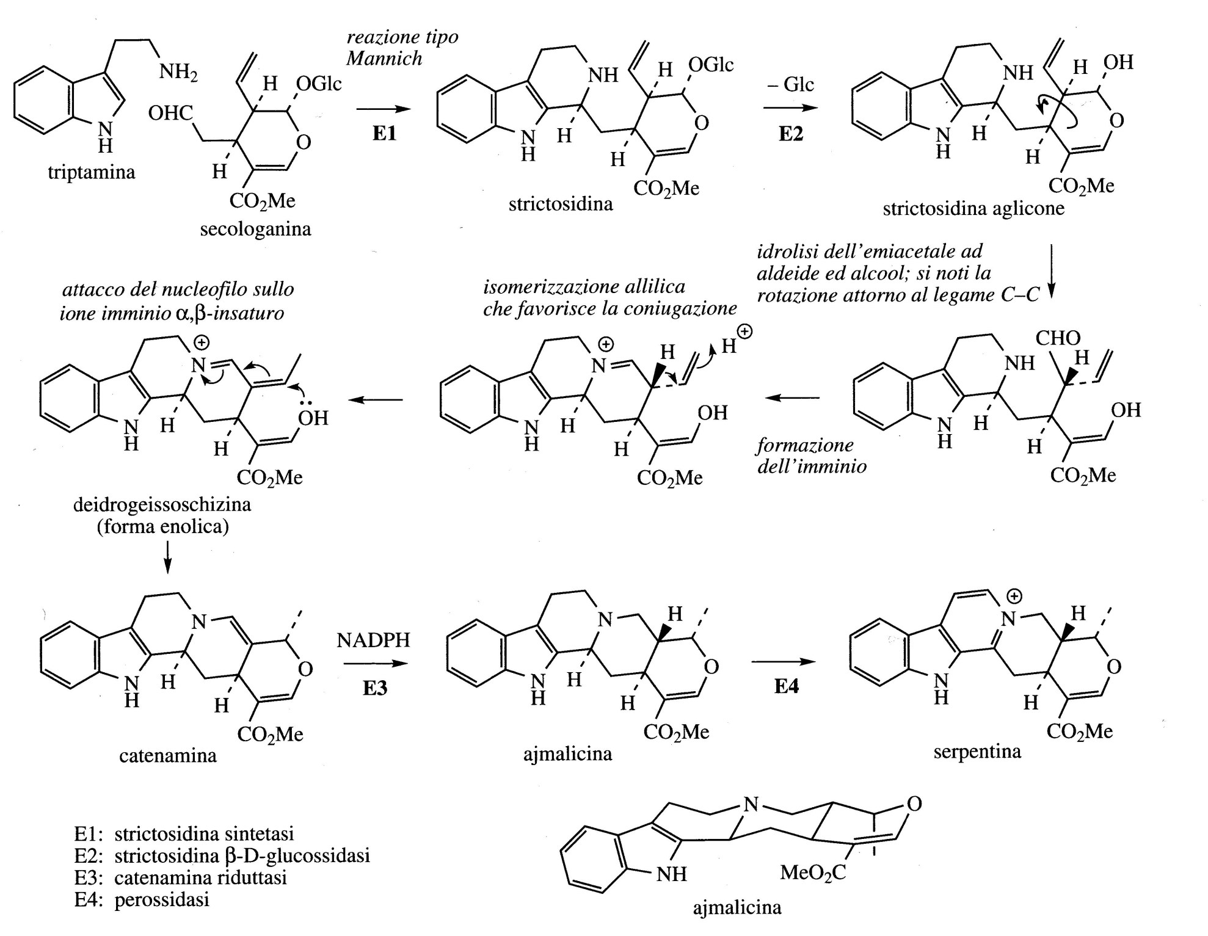

Slide 13
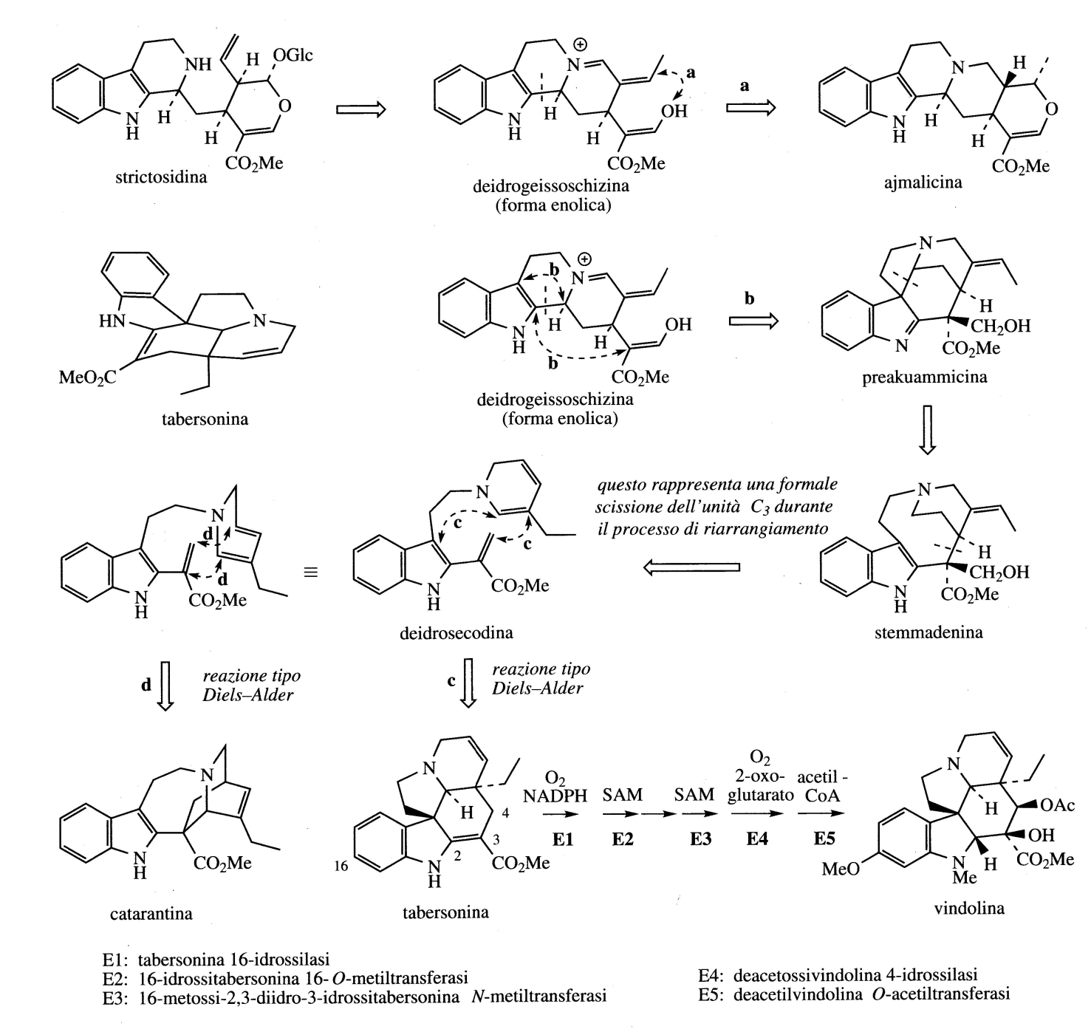
Many of the experimental studies that led to the elucidation of the biosynthesis of indol terpenoid alkaloids were conducted using Madagascar periwinkle (Catharanthus roseus; Apocynaceae).
Three classes of alkaloids are produced:
Ajmalecina (Coryanthe), Catarantina(Iboga) Vindolina (Aspidosperma).

Slide 14
The extensive study of the alkaloids of Catharanthus roseus has been stimulated by the antitumor activity exhibited by a group of bi-indolic alkaloids.
Two of these, Vinblastine and Vincristine are in use as chemotherapeutics and are considered to be among the most active drugs available.
These two molecules derive from the coupling of Catarantina and Vindolina.

Slide 15
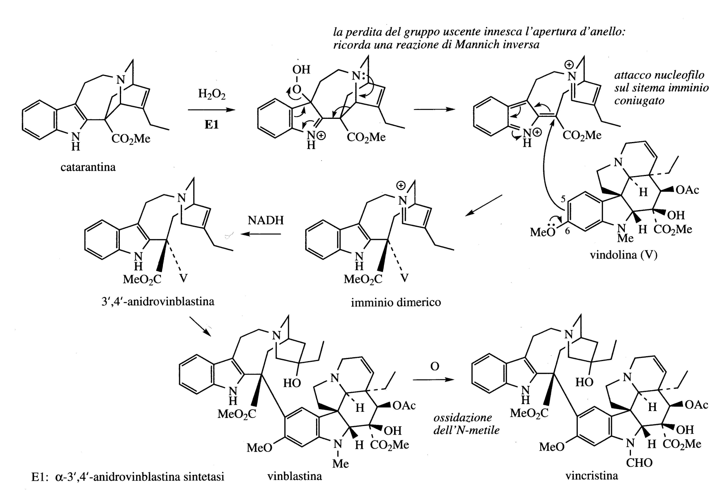

Slide 16
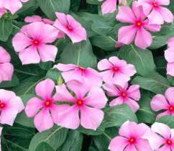
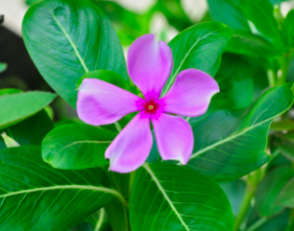
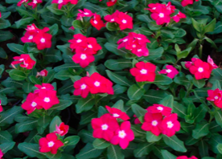
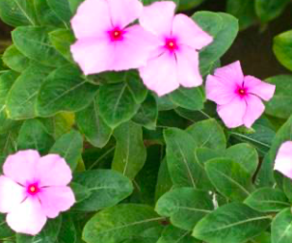
Catharanthus Madagascar periwinkle (Catharanthus roseus)(Vinca rosea) is a small shrub plant native to Madagascar but now used as an ornamental plant.
The plant was used to test its hypoglycaemic properties but the rabbits on which the tests were performed had lethal bacterial infections due to low levels of white blood cells (leukopenia).

Slide 17
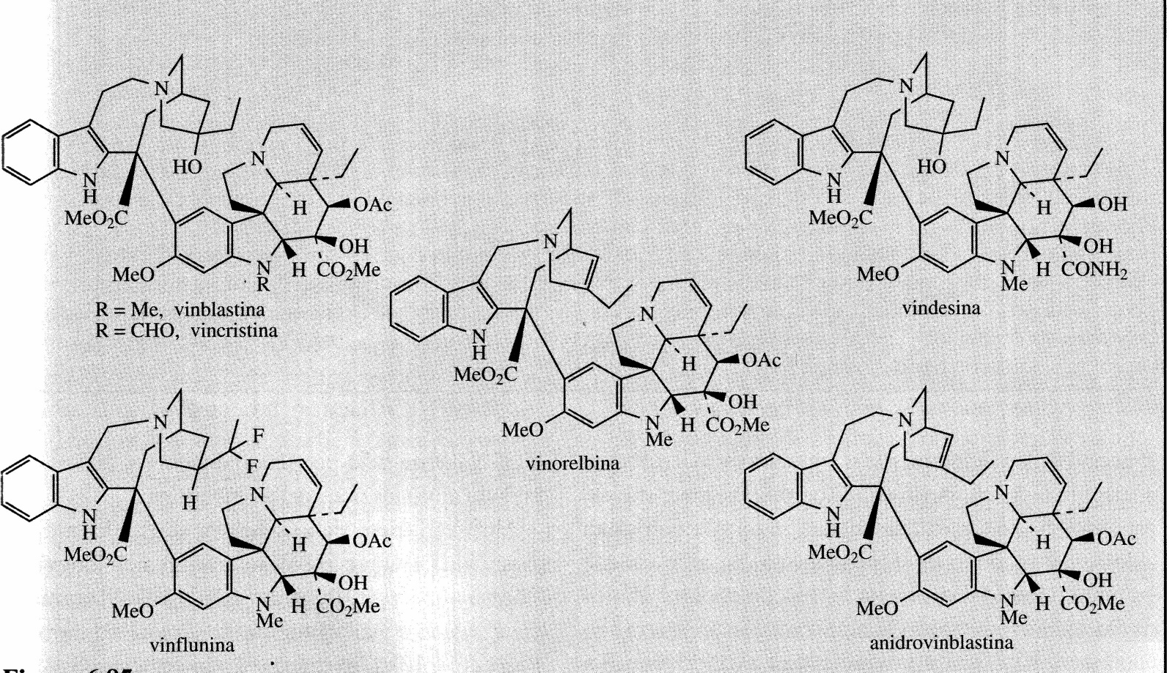
This effect on rabbits suggested the potential use as anticancer agent.
The alkaloids with antitumor activity were dimeric in structure (bi-indol alkaloids), among them Vincaleucoblastine, Leurosine, Leurosidine, Leurocristina. These compounds have become better known as Vinblastine, Vinleurosine, Vinrosidine and Vincristine, respectively. Vinblastine and Vincristine have long been used as chemotherapy and have proven to be extremely effective.
Vinblastine is mainly used in the treatment of Hodgkin's disease.
Vincristine has a higher activity than Vinblastine and is used for the treatment of childhood leukemia, other lymphomas, lung, cervical and breast cancers. Vindesine is a semisynthetic derivative of Vinblastine that has been introduced for the treatment of acute lymphoid leukemia in children.

Slide 18
All of these compounds inhibit cell mitosis by binding to tubulin in the mitotic spindle and preventing microtubule polymerization. This mechanism is the same as for Colchicine and Podophyllotoxin.
One of the main problems with the use of Vincristine and Vinblastine is their scarce presence in the plant: more than 500 kg of plant are needed to obtain 1 g of Vincristine.
They are now produced by semi-synthesis and total synthesis.
With a heterologous approach, genes of Catharanthus roseus encoding Strictosidine synthetase and Strictosidine glucosidase were expressed in yeast cells.
When Secologanin and Tryptamine are administered in the culture medium, the yeast culture produces high levels of Strictosidine which can be converted into Catenamine by Strictosidine glucosidase

Slide 19
Quinoline alkaloids
Some of the most important examples of modified indol terpenoid alkaloids have been isolated from the genus Cinchona (Rubiaceae) which contains the alkaloids quinine, quinidine, cinchonidine and cinchonine, known for their antimalarial properties.

Slide 20
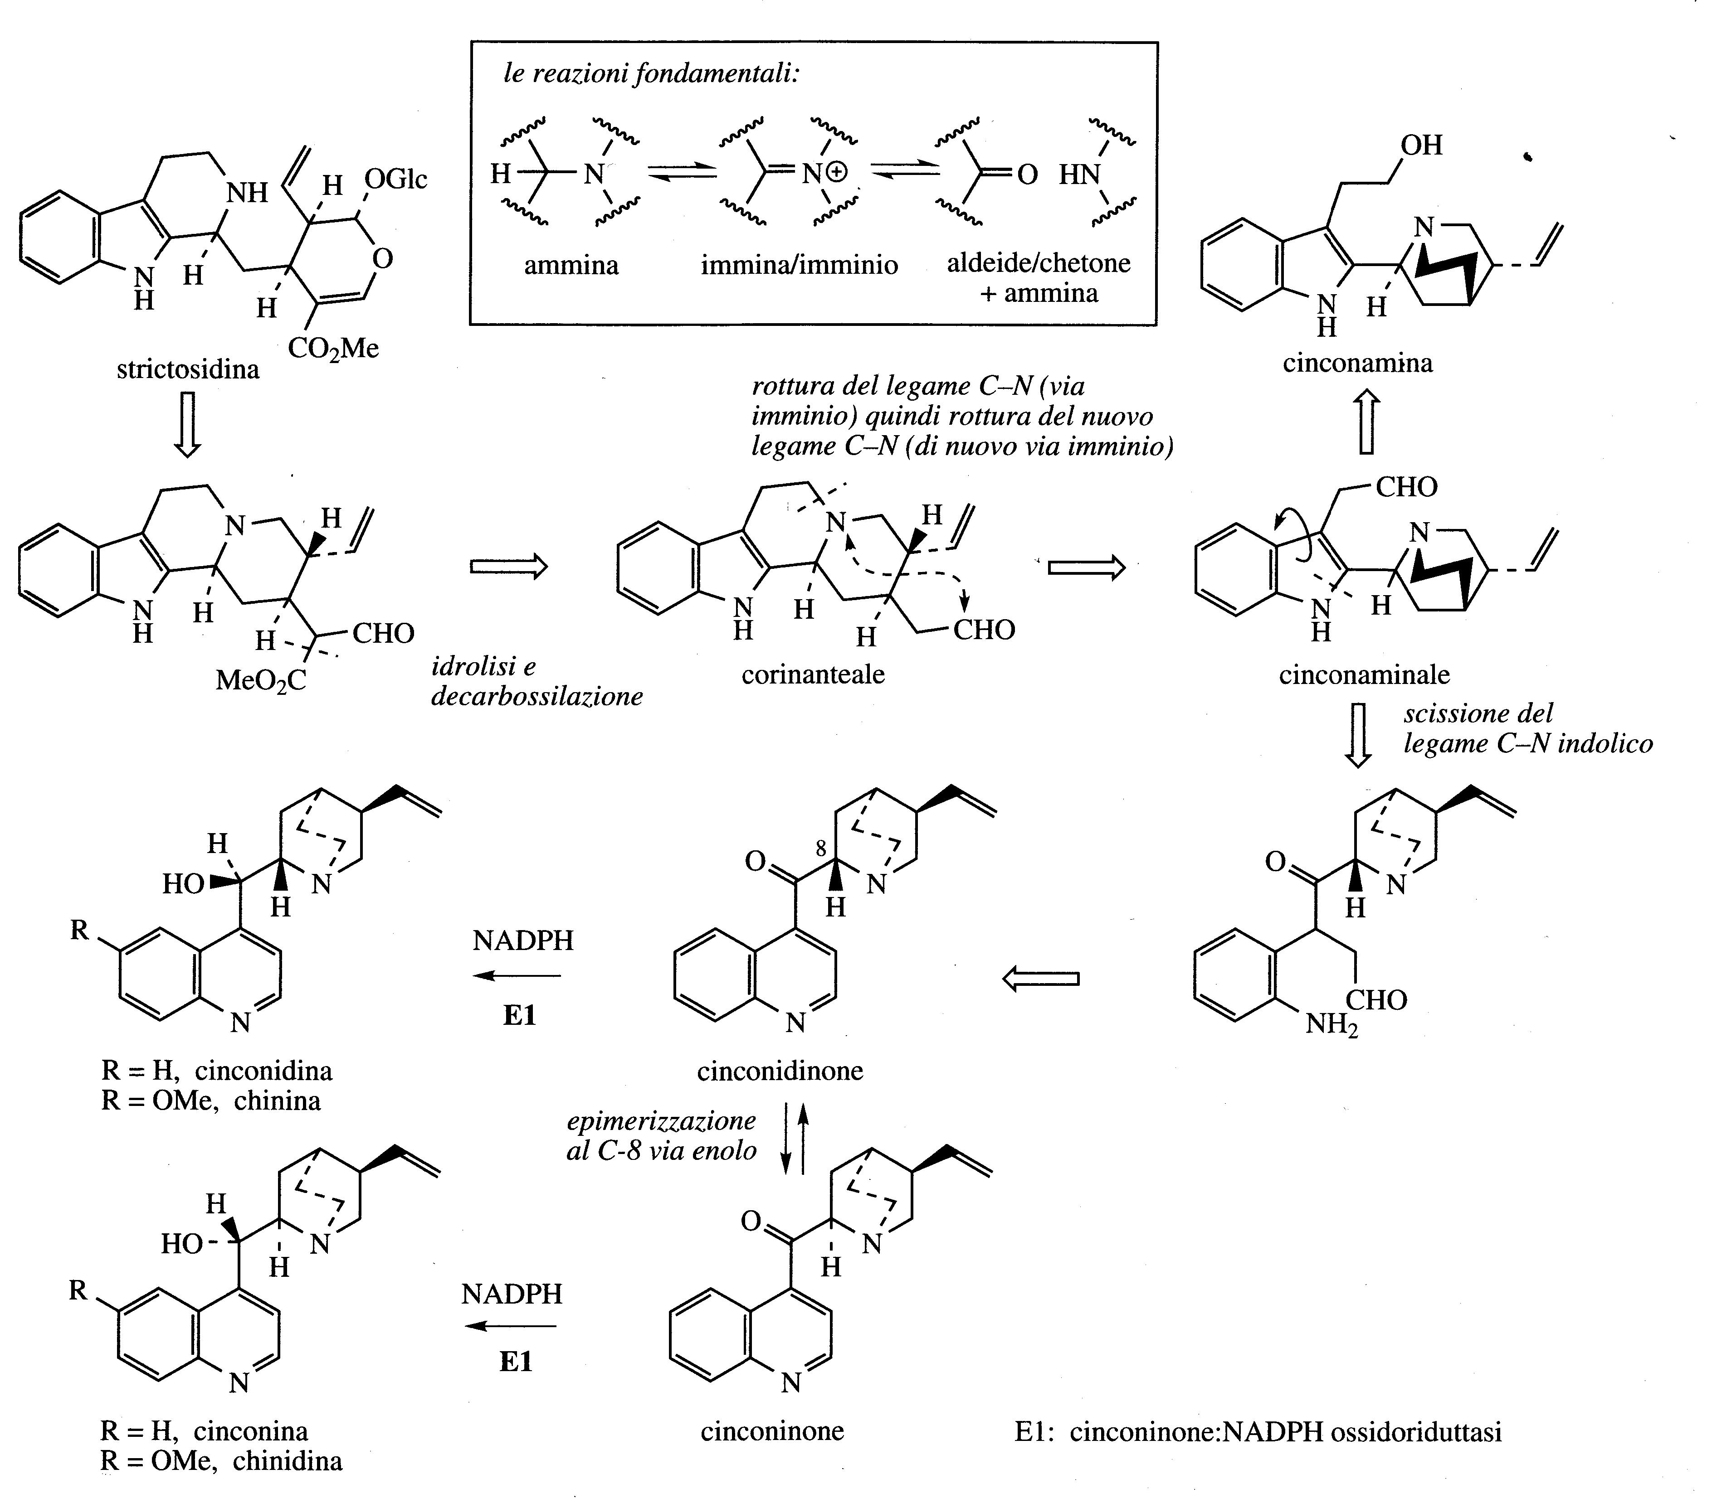

Slide 21
The name cinchona bark refers to the dried bark from the stem and roots of some species of Cinchona (Rubiaceae), large trees native to South America.
Currently plants of this genus are grown in different parts of the world including Bolivia, Guatemala, India, Zaire, Tanzania and Kenya.
About a dozen different species of Cinchona have been used as a commercial source but the great variability in composition and percentage of the alkaloid mixture present in the different species has led to the selection of three main species:
Cinchona succirubra supplies the red bark (5-7% alkaloids)
Cinchona ledgeriana supplies the brown bark (5-14% alkaloids)
Cinchona calisaya supplies the yellow bark (4-7% alkaloids).
Selected hybrids can raise the alkaloid content to 17%.
The bark is taken from 8-12 year old trees after the tree has been completely uprooted.

Slide 22
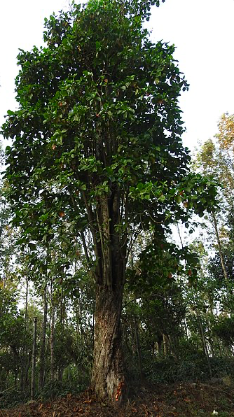
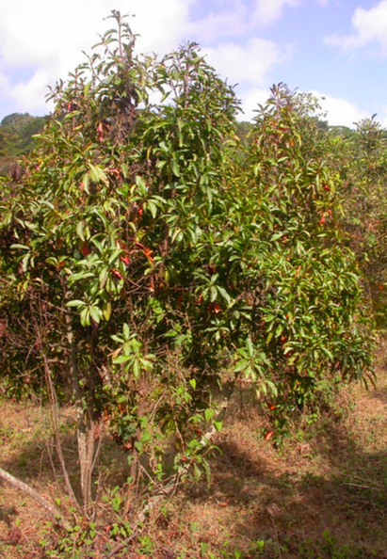
Cinchona succirubra
Cinchona calisaya

Slide 23
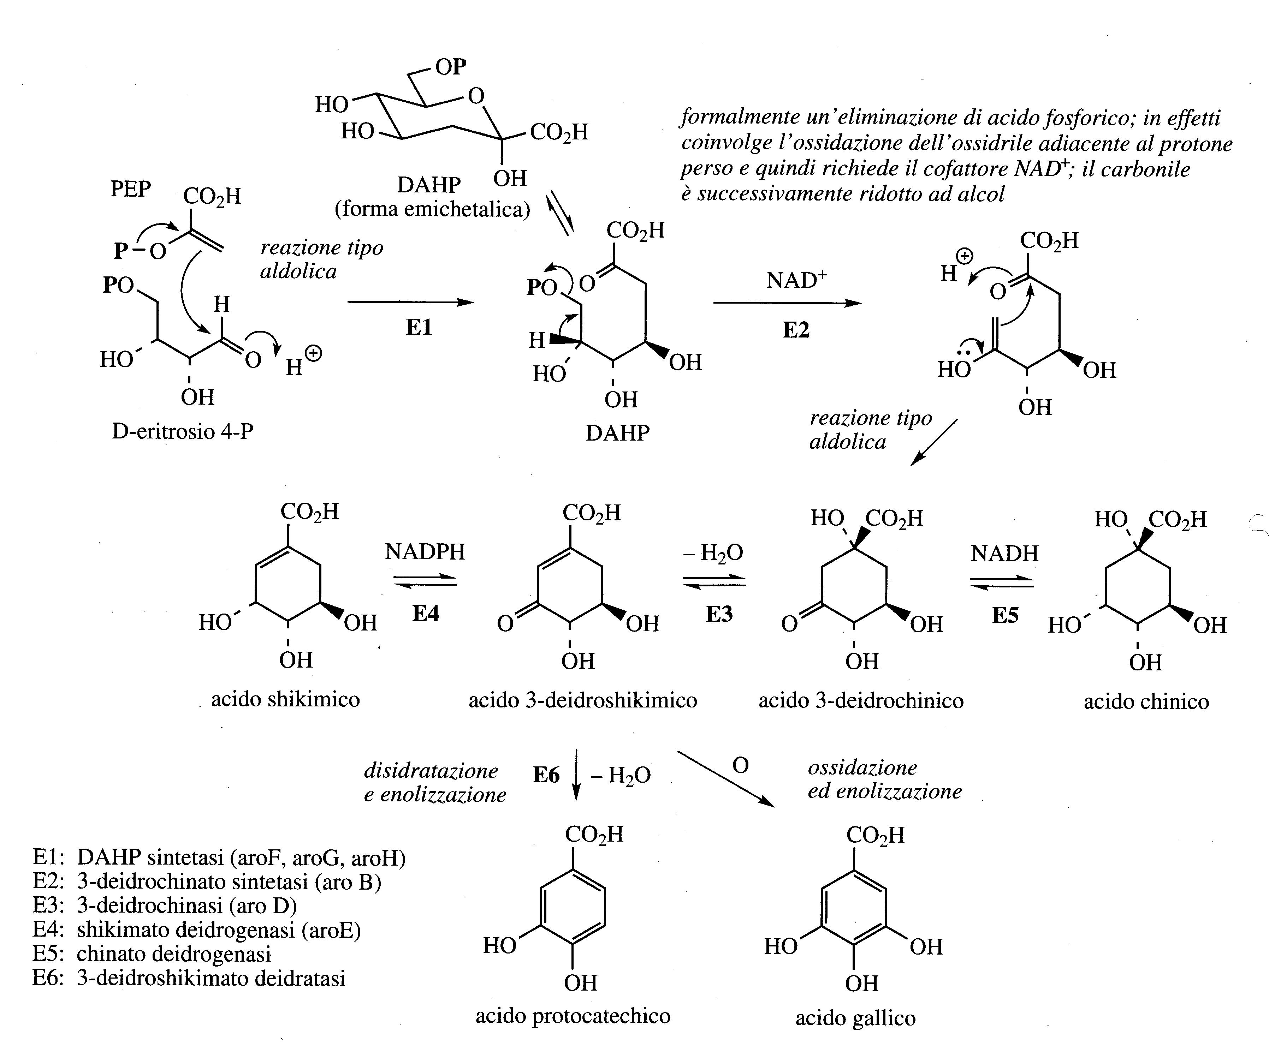
The cinchona bark contains a very large number of alkaloids, only four of them make up 30-60% of the mixture.
They are quinine, quinidine, cinchonidine and cinchonine, quinoline-like structures which constitute two pairs of diastereoisomers.
Quinine is the most abundant component but the proportions vary depending on the species or hybrid. The alkaloids are present in the bark as salts of quinic acid or with a tannic material called cincotannic acid.
During the processing of the bark the cincotannic acid decomposes by enzymatic oxidation to give a red pigment which is much more abundant in the red bark.

Slide 24
Quinine has been used for many years for antimalarial therapy.
The beneficial effects of cinchona bark were first discovered in South America in 1630 and since then it was imported into Europe.
Subsequently, various crops were planted in the German (Java) and English (India) colonies. At the start of World War II nearly all of the supply of cinchona for export to the world came from Java.
During the Second World War when the Japanese occupied Java, the production of synthetic antimalarial drugs to be used as an alternative to quinine had to be studied. Many of these compounds are based on a quinoline backbone.
Of the large series of compounds produced, chloroquine, primaquine and mefloquine have become important antimalarials.
Primaquine is an exception as it has an 8-aminoquinoline structure, while chloroquine and mefloquine retain the 4-substituted quinoline structure of quinine.

Slide 25
Although synthetic antimalarials have nearly replaced quinine, the existence of P. falciparum strains resistant to synthetic drugs is leading to the reintroduction of natural quinine.
Mefloquine is active against strains resistant to chloroquine but if it is ten times more active than quinine it produces serious side effects.
Artemisin and its derivatives are used for the treatment of drug-resistant malaria.

Slide 26
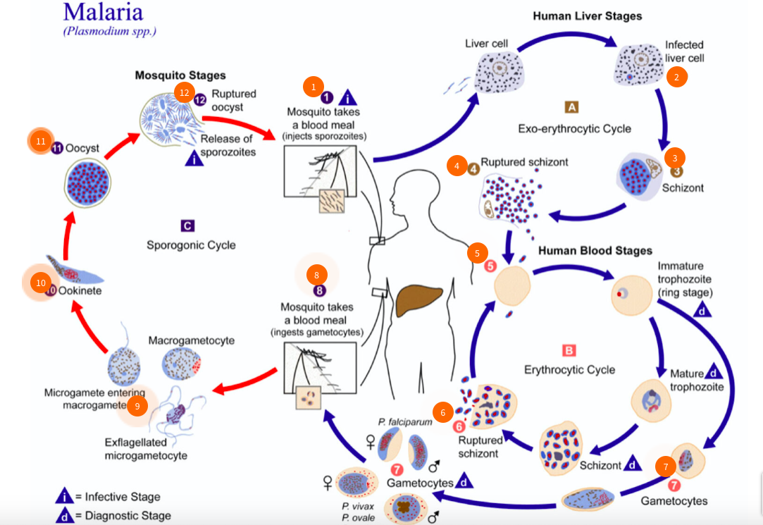
Malaria is responsible for 2-3 million deaths per year worldwide.
Traditional anti-malarial drugs such as chloroquine are proving less effective in treating the disease due to the development of drug-resistant strains of P. falciparum.
Artemisin is currently effective against these strains
P. falciparum has two hosts: a female Anopheles mosquito inoculates the human host during a blood meal.
Following an initial phase of hepatic replication, the parasites undergo asexual multiplication in the erythrocytes. Blood stage parasites are responsible for the clinical manifestations of the disease.
Male and female gametocytes are ingested by an Anopheles mosquito during a blood meal.
The multiplication of parasites in the mosquito is called the sporogonic cycle, inside the stomach of the mosquito, then sporozoites reach the salivary glands of the mosquito.
The inoculation of the sporozoites in a new human host perpetuates the life cycle of malaria

Slide 27
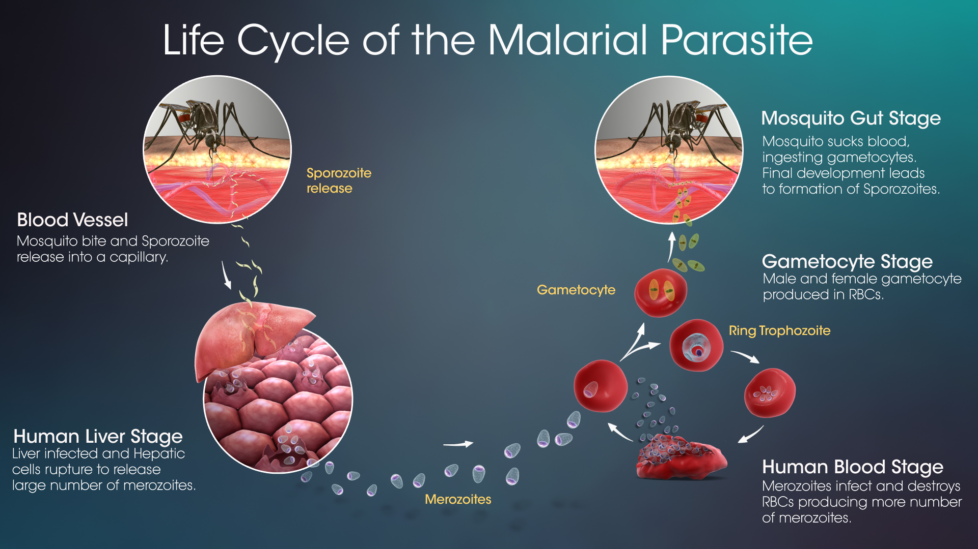
https://www.microbiologiaitalia.it/parassitologia/plasmodium-falciparum/
Plasmodium falciparum is an obligate unicellular parasitic protozoan.
The life cycle can be divided into an asexual or schizogonic cycle which takes place in the human host, where the gametocytes will form, and into a sexual or sporogonic cycle in the insect vector, the Anopheles mosquito, in whose stomach, the gametes mature which they will contribute to the formation of the zygote (oocyst).

Slide 28
https://www.microbiologiaitalia.it/parassitologia/plasmodium-falciparum/
This zygote contains numerous sporozoites which, once released, will reach the salivary glands of the mosquito.
During the next blood meal, which is needed by the mosquito for egg development, the sporozoites will be released into the bloodstream of the next host to start the cycle again.

Slide 29
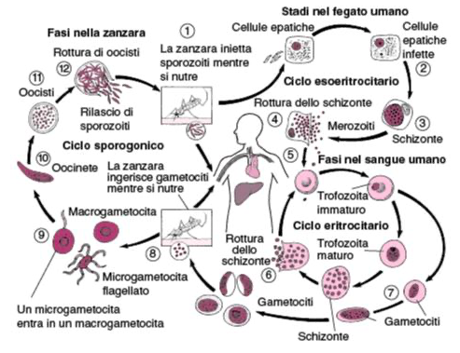
Schizogonic cycle of Plasmodium falciparum
The schizogonic cycle begins with the bite of the vector insect which inoculates the sporozoites into the individual.
However, since the mosquito is an effective vector of malaria it is necessary that the completion of the sporogonic cycle takes place inside it.
The sporozoites enter the hepatocyte where the plasmodium will grow by schizogony (type of asexual reproduction), leading to the formation of schizonts which require a maturation time of between 5-11 days, from which the merozoites will emerge.

Slide 30
Schizogonic cycle of Plasmodium falciparum
Then begins the phase which is called the "erythrocyte phase" because it takes place in the red blood cells.
Merozoites interact with membrane receptors to recognize red blood cells. Here the plasmodium grows through different stages of development, inside the erythrocyte. Moreover, in the schizogonic cycle gametocytes can form which present, in the case of Plasmodium falciparum, a characteristic sickle shape.
The cycle will then end in the female mosquito of the genus Anopheles.

Slide 31
Sporogonic cycle of Plasmodium falciparum
The macrogametocytes formed in the infected individual and sucked by the mosquito lead to the formation of microgametocytes which are formed by exfoliation.
These migrate through the intestinal wall of the insect to form ovoid oocytes on the external surface.
The oocyst produces thousands of long thin sporozoites (~15μm in length), which eventually infect the salivary glands, from there are injected into the vertebrate host.

Slide 32
The malaria parasite uses the host's hemoglobin as a food source. However, the heme group, which is a soluble iron porphyrin released from hemoglobin following proteolytic digestion, is toxic to plasmodium so it is normally converted to the insoluble, non-toxic form (hemozoin) by enzymatic polymerization.
Drugs such as chloroquine can interfere with this polymerization mechanism or avoid the polymerization of the toxic products released by the breakdown of hemoglobin caused by the parasite.

Slide 33
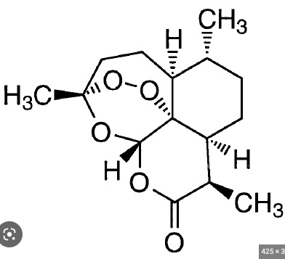
Mechanism of action of artemisin
Fe^{II} at the center of the heme group causes a reductive cleavage on the peroxidic group of artemisin to generate an oxygen radical species.
Oxygen radicals proceed with the production of a carbon radical which can interact with the porphyrin heme alkylating it. Alternatively, specific proteins or other biomolecules may be alkylated causing the death of the malaria parasite.
It has been suggested that artemisinin acts also on a single enzyme which is a Ca²⁺-ATPase since parasites with a mutation on this enzyme are insensitive to artemisin.

