Slide 1
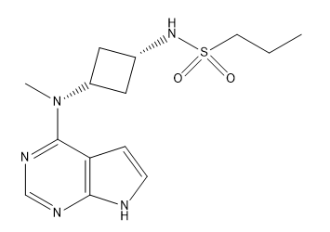
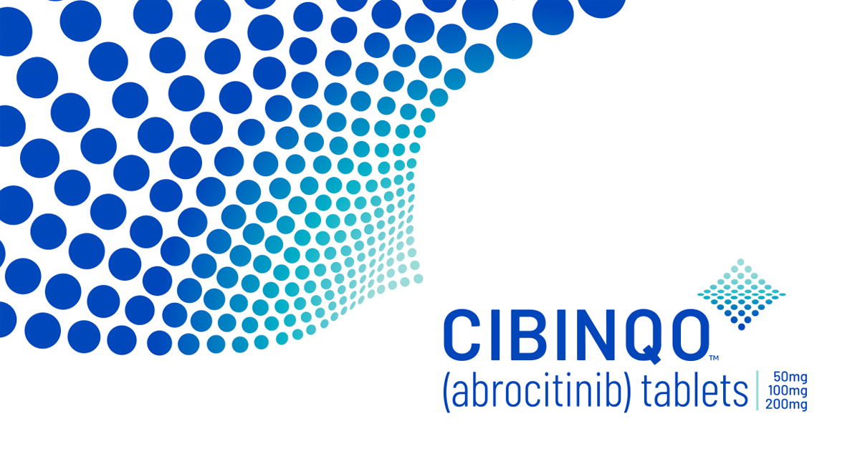
Abrocitinib (Cibinqo ®)
A selective JAK1 inhibitor developed by Pfizer for the treatment of moderate-to-severe Atopic Dermatitis

Slide 2
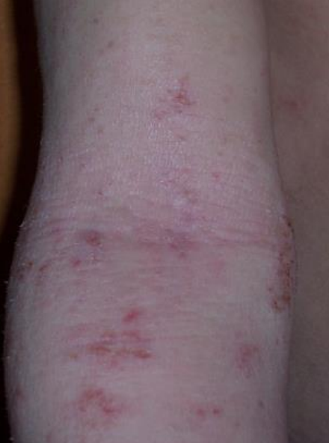
Atopic Dermatitis
Introduction
Epidermal barrier impairment
Skin microbiota dysbiosis
Immunologic disorder
Causes

Slide 3
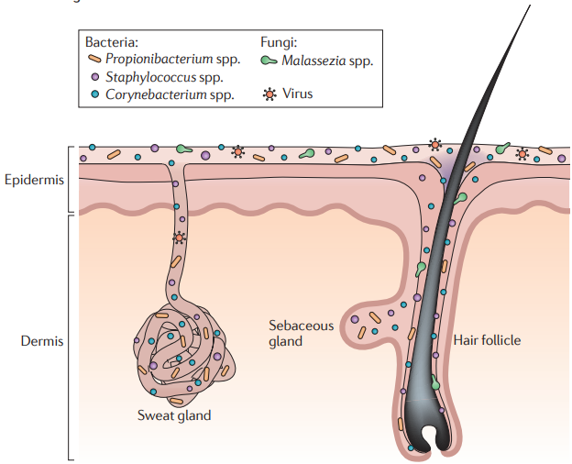
Atopic Dermatitis
Introduction
Epidermal barrier impairment
Skin microbiota dysbiosis
Immunologic disorder
Causes

Slide 4
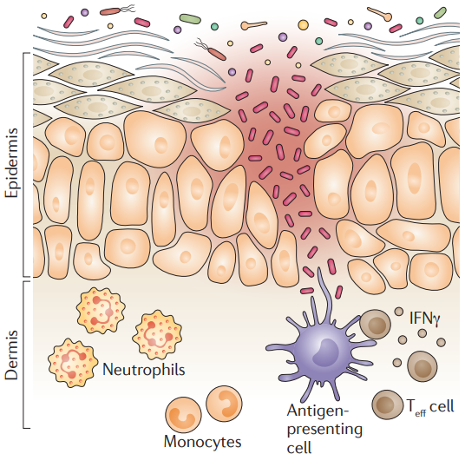
Atopic Dermatitis
Introduction
Epidermal barrier impairment
Skin microbiota dysbiosis
Immunologic disorder
Causes

Slide 5
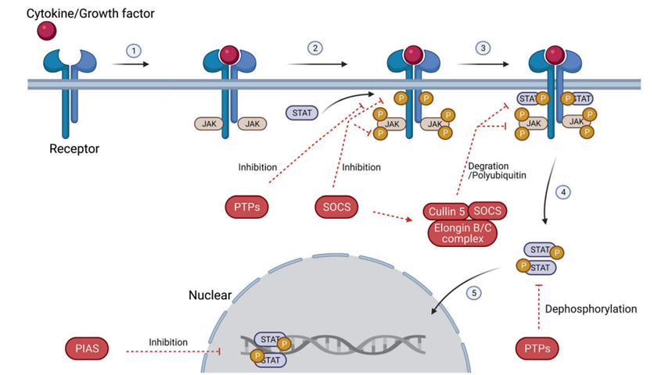
JAK/STAT pathway
Introduction
JAK: Janus Kinase
STAT: Signal Transducer and Activator of Transcription

Slide 6
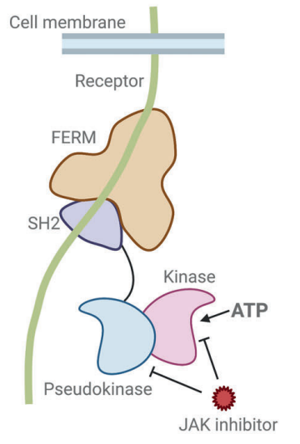
Target: JAK family
Introduction
JAK1: major role in the signaling of proinflammatory cytokines
JAK2: interaction with receptors for hematopoietic growth factors
JAK3: primary role in mediating immune function
TYK2: regulation of antiviral and inflammation response

Slide 7
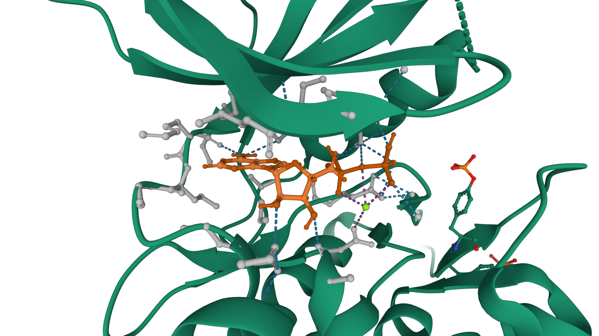
Introduction
JAK1-ADP
Met956
Lys908
Glu957
Asp1021
Leu959
Mg²⁺
H₂O
Glu966
Arg1007

Slide 8
Introduction
JAK1-ADP
Met956
Lys908
Glu957
Asp1021
Leu959
Mg²⁺
H₂O
Glu966
Arg1007

Slide 9
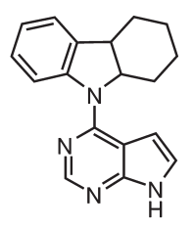
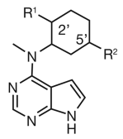
Tofacitinib
First in class
Pfizer compoud library (∼400000 compounds, ca.1996) was screened against the JAK3 catalytic domain
SAR
CP-352,664 (210 nM vs JAK3)
R1=R2=Me
IC50 20 nM
IC50 58 nM
Notes:
2010
PIRROLOPIRIMIDINA

Slide 10
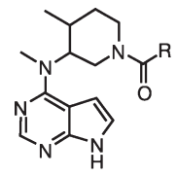
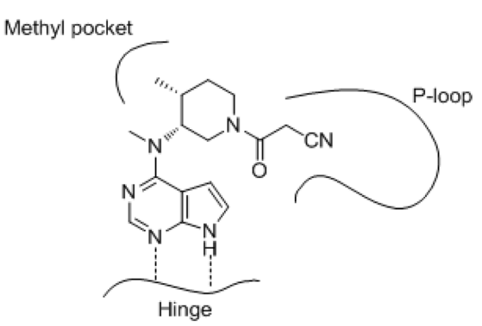
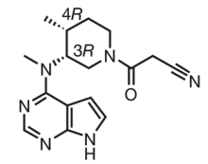
Tofacitinib
First in class
PK issues
polar features to decrease lipophilicity (logP≤2)
Tofacitinib
CP-690550
JAK3 IC50 = 1nM

Slide 11
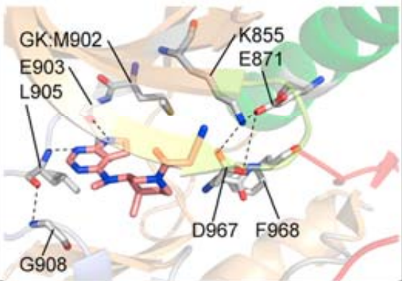
Tofacitinib
First in class
PK issues
polar features to decrease lipophilicity (logP≤2)
Tofacitinib
CP-690550
JAK3 IC50 = 1nM

Slide 12
Tofacitinib: PAN-JAK inhibitor
First in class
Reduction of hemoglobin observed in patients
IC50 (JAK1)=3,2 nM
IC50 (JAK2)=4,1 nM
IC50 (JAK3)=1,6 nM
IC50 (TYK2)=34,0 nM
Interference with Erythropoietin receptor and Thrombopoietin receptor

Slide 13
Tofacitinib: PAN-JAK inhibitor
First in class
Reduction of hemoglobin observed in patients
IC50 (JAK1)=3,2 nM
IC50 (JAK2)=4,1 nM
IC50 (JAK3)=1,6 nM
IC50 (TYK2)=34,0 nM
Interference with Erythropoietin receptor and Thrombopoietin receptor

Slide 14
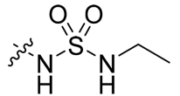
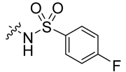
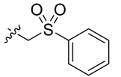
SBDD optimization for Abrocitinib
Abrocitinib
Sulfamides | Sulfones | Sulfonamides and ‘Reverse Sulfonamides’
11
19
9
15
20
23

Slide 15
Abrocitinib
Abrocitinib
Results:
Selectivity generally improved as the side chains grew larger
Sulfamide subset is of lower interest (poorest JAK1 potency)
Sulfonamides achieve the best selectivity for JAK1
Enhanced metabolic stability when log D_{7.4}<2.0
IC50(JAK1)= 29 nM
IC50(JAK2)= 803 nM
IC50(JAK3)= >10,000 nM
IC50(TYK2)= 1250 nM
logD=1.9
PF-04965842

Slide 16
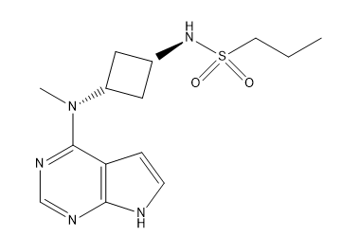
Abrocitinib
Abrocitinib
Results:
Selectivity generally improved as the side chains grew larger
Sulfamide subset is of lower interest (poorest JAK1 potency)
Sulfonamides achieve the best selectivity for JAK1
Enhanced metabolic stability when log D_{7.4}<2.0
IC50(JAK1)= 29 nM
IC50(JAK2)= 803 nM
IC50(JAK3)= >10,000 nM
IC50(TYK2)= 1250 nM
logD=1.9
PF-04965842

Slide 17
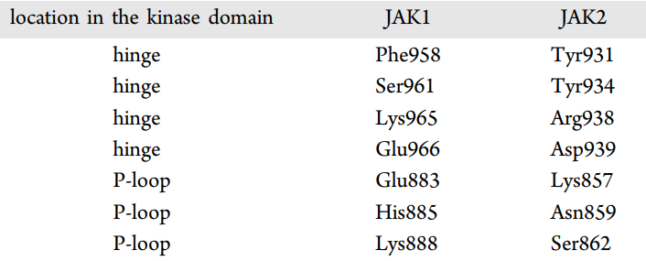
Understanding JAK1/JAK2 selectivity
Abrocitinib
The residue differences (within 5 Å radius from the ligand) are located in the hinge region, phosphate-binding region, (i.e., P-loop) and in the solvent exposed regions toward the periphery of the binding site.

Slide 18
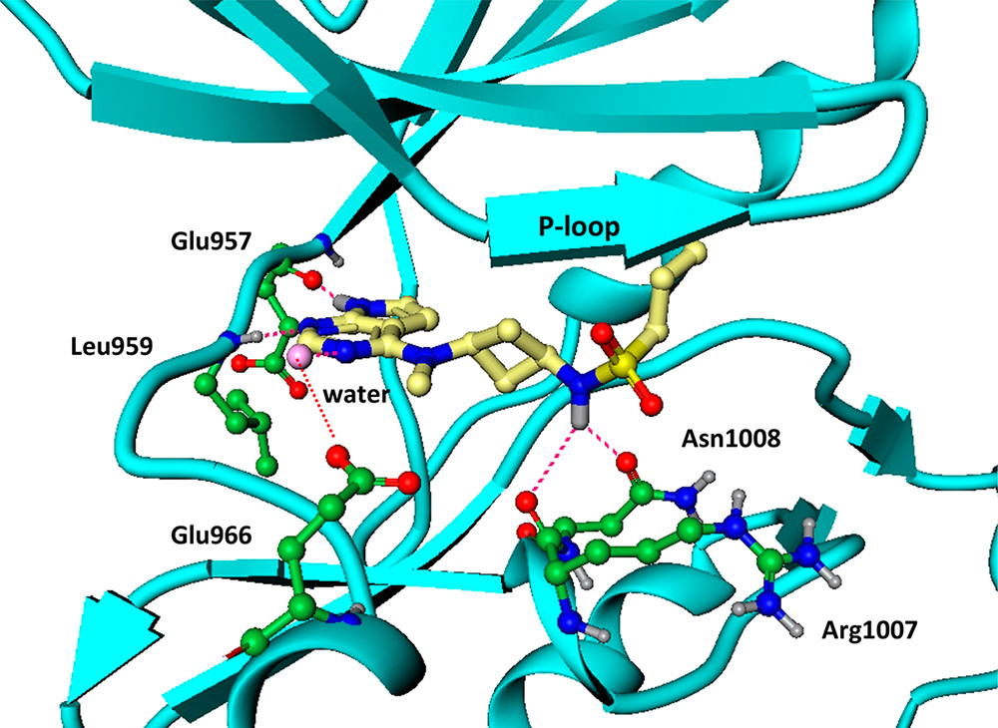
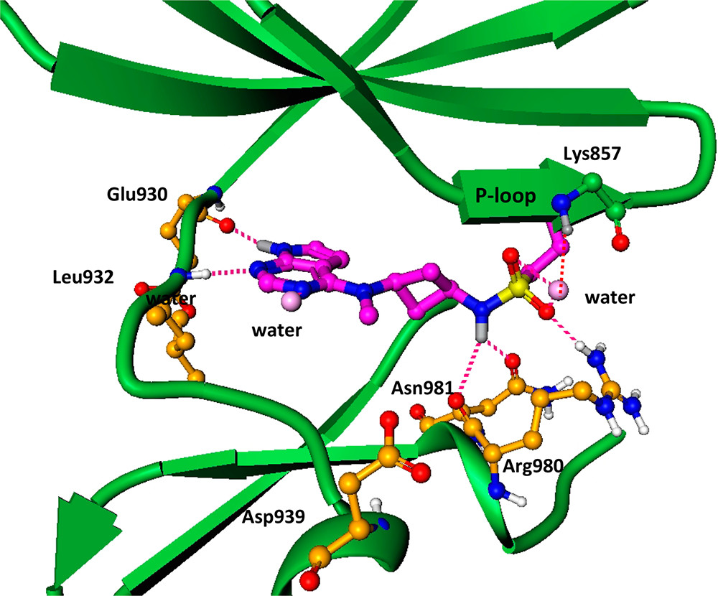
Understanding JAK1/JAK2 selectivity
Abrocitinib
Although the JAK1 kinase domain shares only 53% overall sequence identity with JAK2, most of the residues in the ATP-binding site are conserved between the two enzymes.
JAK1
JAK2

Slide 19
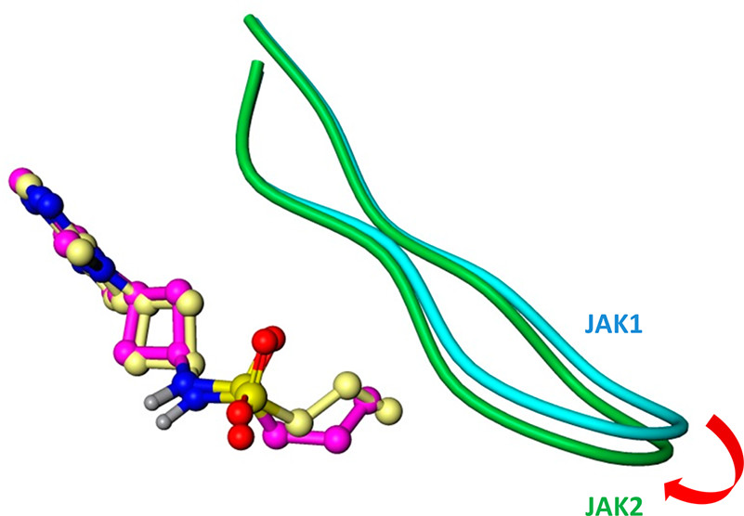
Understanding JAK1/JAK2 selectivity
Abrocitinib
Although the JAK1 kinase domain shares only 53% overall sequence identity with JAK2, most of the residues in the ATP-binding site are conserved between the two enzymes.
JAK1
JAK2

Slide 20
Phase I
Abrocitinib
79 Healthy subjects, adults,
randomized in a 3:1 ratio of Abrocitinib:placebo
Most frequent treatment-emergent adverse events:
- Headache (n=13)
- Diarrhoea (n=11)
- Nausea (n=11)

Slide 21
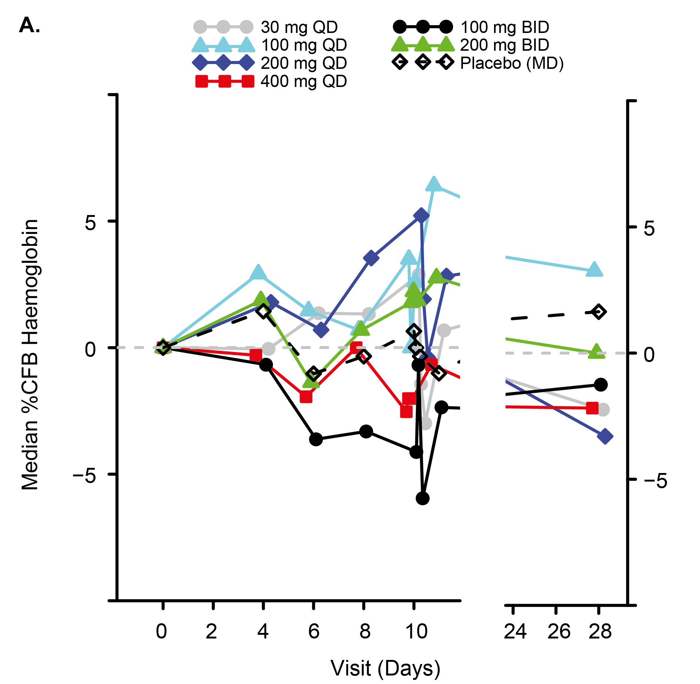
Phase I
Abrocitinib
79 Healthy subjects, adults,
randomized in a 3:1 ratio of Abrocitinib:placebo
Most frequent treatment-emergent adverse events:
- Headache (n=13)
- Diarrhoea (n=11)
- Nausea (n=11)

Slide 22
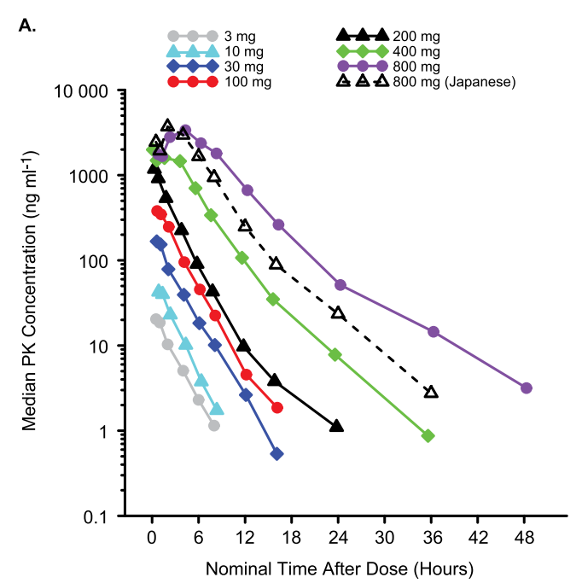
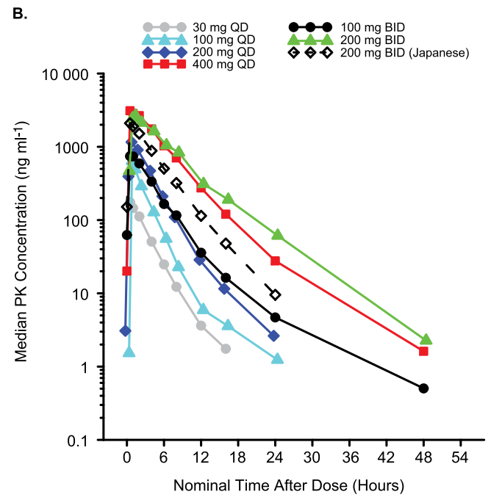
Phase I
Abrocitinib
SAD
MAD

Slide 23
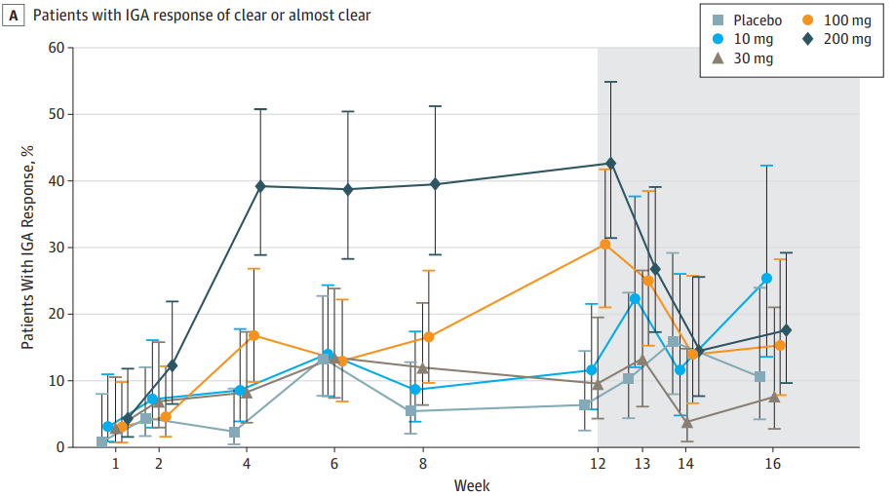
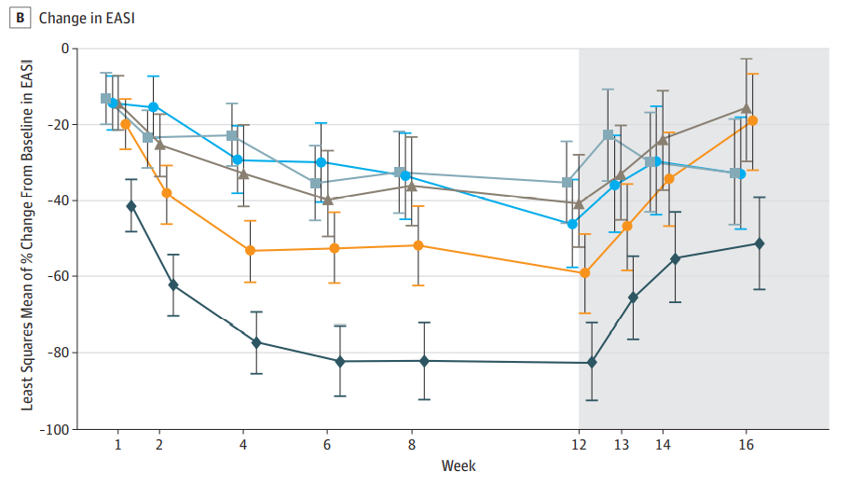
Phase II
Abrocitinib
267 partecipants (adults) randomly assigned 1:1:1:1:1 to receive Abrocitinib (200 mg, 100 mg, 30 mg, or 10 mg) or placebo for 12 weeks

Slide 24
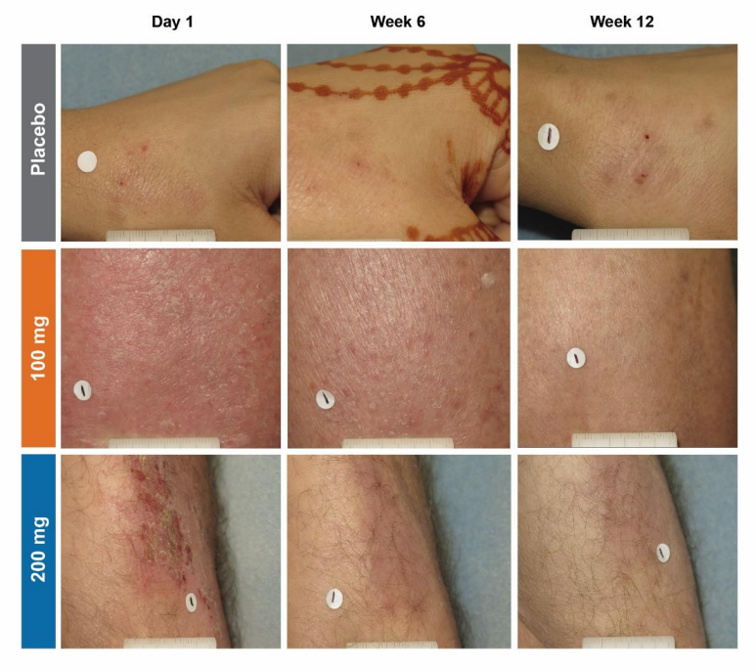
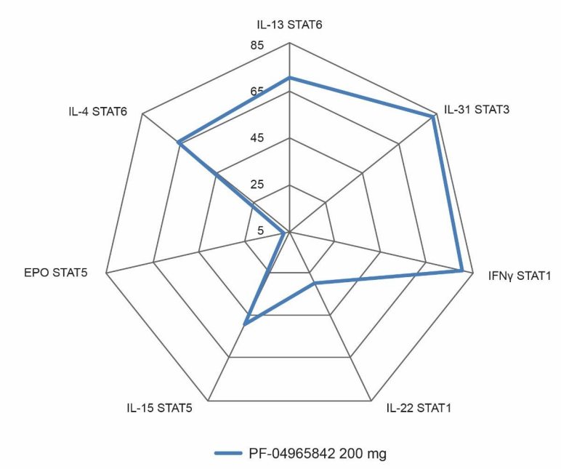
Phase II
Abrocitinib

Slide 25
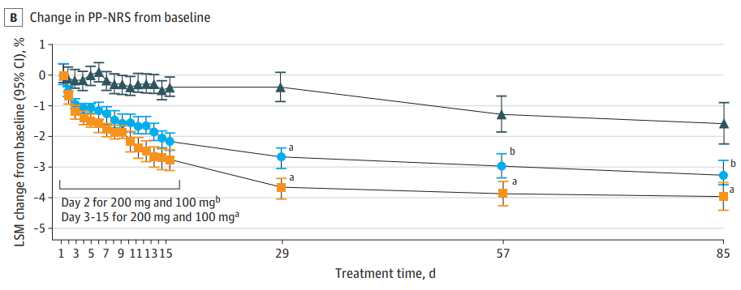
Phase III
Abrocitinib
391 partecipants (adolescents ≥12 and adults) randomly assigned 2:2:1 to receive once-daily Abrocitinib in 200mg or 100mg doses or placebo
Percentage of patients achieving the desired score
 | 100 mg | 200 mg
IGA | 28,4% | 38,1%
EASI | 44,5% | 61,0%
PP-NRS | 45,2% | 55,3%

Slide 26
Toxicity and metabolism
Abrocitinib
No deaths, no serious adverse events → Nonclinical toxicology
CYP450-family mediated metabolism:
M1
M2
M3
M4
Less active
Comparable activity
Notes:
Abrocitinib is well absorbed, with oral absorption of over 91% and absolute oral availability of ≈ 60%

Slide 27
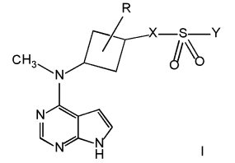
Conclusions
JAK1 inhibitor with 28-fold selectivity over JAK2, >340-fold over JAK3, 43-fold over TYK2 as well as the broader kinome
30-40% of patients treated with Abrocitinib show desired improvement in key-index for Atopic Dermatitis
Focus on the long-term efficacy and safety
Bibliography
Doi:10.3390/microorganisms8111743 https://doi.org/10.1038/s41392-021-00791-1 http://dx.doi.org/doi:10.1016/j.phrs.2015.10.021 Doi: 10.1021/jm1004286 | http://dx.doi.org/10.1021/acs.jmedchem.7b01598 Doi:10.1111/bcp.13612 Doi:10.1001/jamadermatol.2019.2855 Doi:10.1001/jamadermatol.2020.1406

Slide 28
Thanks for your kind attention
Any questions?

